Slide 1


Slide 2

Championship Cups
2238

Slide 3
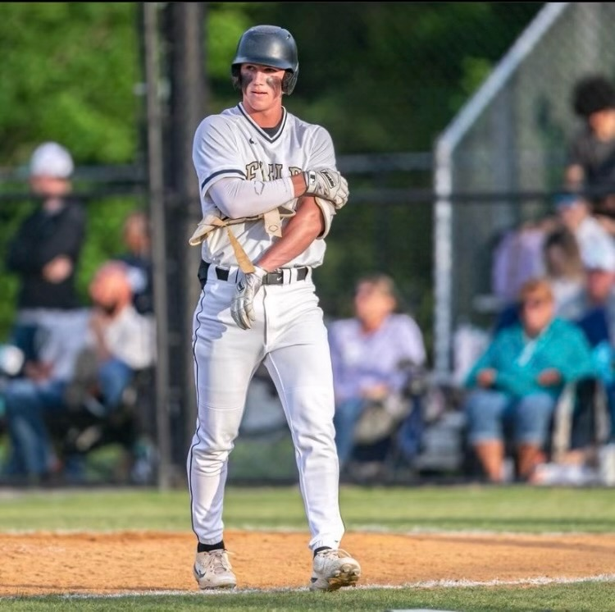
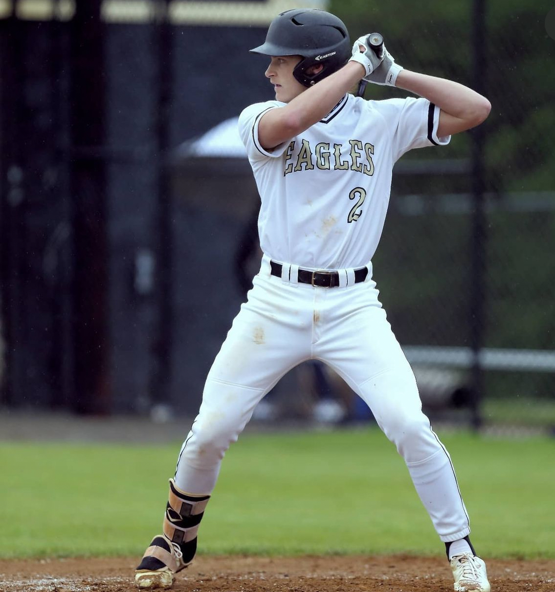
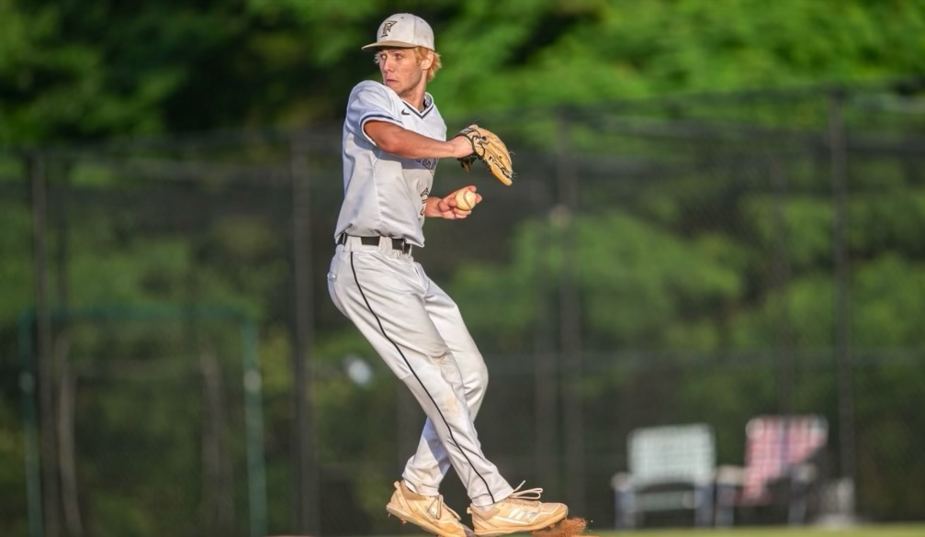
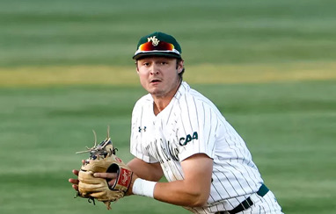
Championship Cups
2238

Slide 4

Championship Cups
2238

Slide 5

Championship Cups
2238

Slide 6

Championship Cups
2238

