Slide 1
Controlled Drug Accountable Officers MASTERY
Jon Hayhurst
Kandarp Thakkar
Wendy McAllister

Slide 2
Objectives for this presentation
Reflect on why we have controls on drugs
Do controls work?
The difference between the Misuse of Drugs Act and the Regulations
The need to have controls for healthcare professionals
Controlled Drug Accountable Officers
Local Intelligence Networks

Slide 3
Why are some drugs controlled?

Slide 4
Why are some drugs controlled?
All medicines can be dangerous, and we need to be careful with all of them

Slide 5
Why are some drugs controlled?
All medicines can be dangerous, and we need to be careful with all of them
Insulin
Caffeine

Slide 6
Why are some drugs controlled?
All medicines can be dangerous, and we need to be careful with all of them
Insulin can be extremely harmful, but it isn’t addictive
Caffeine is addictive but it doesn’t cause much harm

Slide 7
Why are some drugs controlled?
All medicines can be dangerous, and we need to be careful with all of them
Insulin can be extremely harmful, but it isn’t addictive
Caffeine is addictive but it doesn’t cause much harm
Morphine is addictive and harmful

Slide 8
Why are some drugs controlled?
All medicines can be dangerous, and we need to be careful with all of them
Insulin can be extremely harmful, but it isn’t addictive
Caffeine is addictive but it doesn’t cause much harm
Morphine is addictive and harmful
Imagine if cocaine and heroin were legal?

Slide 9
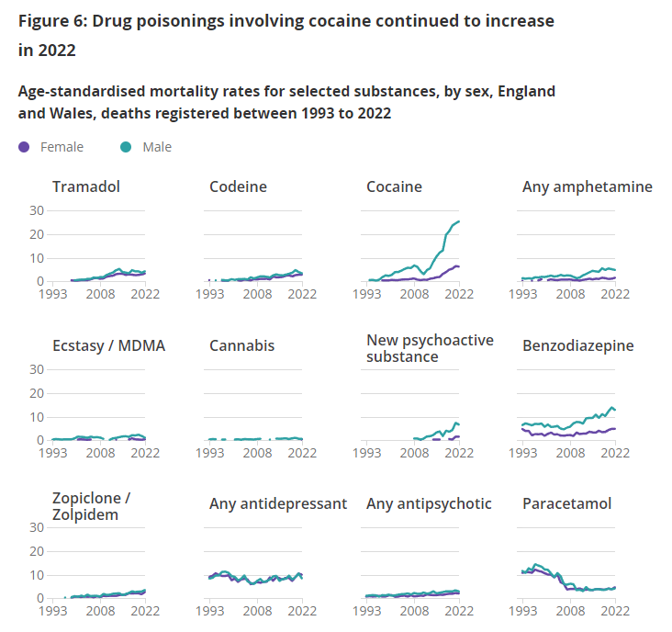
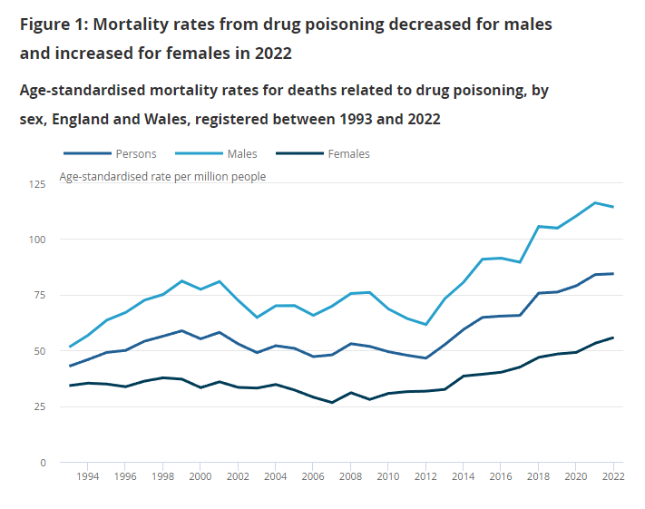
Drug related deaths

Slide 10

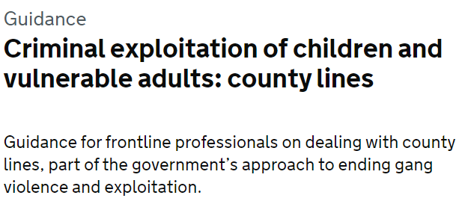

County Lines

Slide 11
Heroin and cocaine are legal
In the UK we still use diamorphine in anaesthesia and end of life care
We use Cocaine in ENT surgery

Slide 12
Heroin and cocaine are legal
In the UK we still use diamorphine in anaesthesia and end of life care
We use Cocaine in ENT surgery
The Misuse of Drugs Act makes all CDs illegal, but…
The Misuse of Drugs Regulations permit their use in very specific circumstances
The Act makes morphine a Class A drug
The Regulations make morphine a schedule 2 CD (or a schedule 5…)

Slide 13
Practical implications of controlling a drug
You can’t make it
You can’t buy it
You can’t possess it
You can’t prescribe it
You can’t administer
You can’t supply it

Slide 14
Practical implications of controlling a drug
You can’t make it
You can’t buy it
You can’t possess it
You can’t prescribe it
You can’t administer
You can’t supply it
Unless the regulations say you can

Slide 15
Practical implications of controlling a drug
You can’t make it
You can’t buy it
You can’t possess it
You can’t prescribe it
You can’t administer
You can’t supply it
If you’re one of the few people who is allowed to do these things, you must comply with additional rules and regulations
Unless the regulations say you can

Slide 16
Practical implications of controlling a drug
You can’t make it
You can’t buy it
You can’t possess it
You can’t supply it
Unless the regulations say you can
If you’re one of the few people who is allowed to do these things you have to comply with additional rules and regulations
Can’t we just trust doctors and others to use them safely?

Slide 17
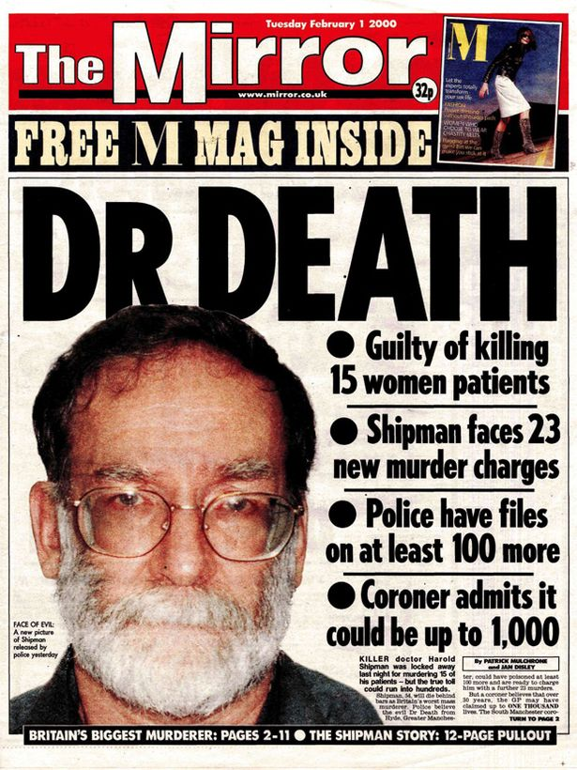

Slide 18
Dr Harold Shipman
Harold Shipman was convicted in January 2000 for the murder of 15 of his patients

Slide 19
Dr Harold Shipman
Harold Shipman was convicted in January 2000 for the murder of 15 of his patients
As a result of his actions, the Shipman Inquiry was set up to protect patients in the future
The inquiry concluded that Shipman might have been deterred from his criminal career or at least he would have been detected sooner

Slide 20
Dr Harold Shipman
Harold Shipman was convicted in January 2000 for the murder of 15 of his patients
As a result of his actions, the Shipman Inquiry was set up to protect patients in the future
The inquiry concluded that Shipman might have been deterred from his criminal career or at least he would have been detected sooner
On one occasion, two of Shipman’s professional colleagues noticed his unusual use of diamorphine but failed to report their concerns. Other colleagues noticed the apparently high rate of deaths among his patients – but their concerns were not taken seriously.
Only when Shipman forged the will of one of his victims was serious action taken to unmask his activities.

Slide 21
The Shipman Inquiry
The Inquiry concluded that he was probably responsible for about 250 deaths in total; the 15 murders, 200 further unlawful killings, 45 suspicions of unlawful killing, plus a further 38 cases where there was insufficient evidence for decision
Most of these murders occurred in the patient’s own home
In the main, he used diamorphine to kill his victims
80% of his victims were women
His youngest victim was a 41 year old man
Whilst most had some ill-health, the patients would not have been expected to die when they did

Slide 22
How did Dr Shipman get away with it?
There was (and still is) a huge amount of trust in doctors
“The doctor knows best”
“This prescription is legal; we must supply the medication”
It used to be relatively easy for doctors to obtain, prescribe, and supply controlled drugs

Slide 23
More laws
The Health Act created the role of the Accountable Officer for Controlled Drugs in 2006
Further regulations set out detailed duties for those Accountable Officers
Specific organizations are required to appoint an Accountable Officer
They are responsible for the safe management and use of CDs
They must be sighted on incidents and concerns
They must investigate these, and act when appropriate

Slide 24
Local Intelligence Networks
Accountable Officers should talk to each other and not work in isolation
The law requires them to do so
These networks cover the whole of the UK
They are getting bigger (not so ‘local’)
They are led by the NHS – but are not just for the NHS
Independent hospitals
Other regulators and the police
Counter fraud staff
Integrated Care Boards and local authorities

Slide 25
The Lead Accountable Officer
The CDAO for all organisations that don’t have their own
Community pharmacies
Medical practices
Dentists
Care homes
Prison healthcare
You still need to know what is going on
Just culture
Reporting of incidents and concerns

Slide 26
Objectives for this presentation
Reflect on why we have controls on drugs
Do controls work?
The difference between the Misuse of Drugs Act and the Regulations
The need to have controls for healthcare professionals
Controlled Drug Accountable Officers
Local Intelligence Networks

Slide 27
Controlled Drug Accountable Officers
Jon Hayhurst, November 2022

Slide 28
The Role of the CDLO, Relevant law and Common Issues
Wendy McAllister

Slide 29
CDLO duties include:
To oversee the implementation of the Health Act 2006
To investigate ANY allegation involving criminality, by ANY healthcare professional concerning Pharmaceutical Controlled Drugs. Misuse Drugs Act 1971 (schedules/class) - Different response all over the country
To undertake ‘Targeted Inspections’ at Pharmacies, Hospitals, Hospices etc
Offer ‘police inputs’ at training days – crime prevention
Direct liaison with healthcare partners/regulators concerning the sharing of information and to raise ANY concerns. Attend LIN meetings

Slide 30
Relevant laws
Health Act 2006 Part 3 Sec 20
A constable or other authorised person may, for the purpose of securing the safe, appropriate & effective management & use of controlled drugs;
Enter any relevant premises (hospital/pharmacy/hospice etc.)
Inspect any precautions taken on the premises for the safe custody of controlled drugs (cabinet/rooms etc.)
Inspect any stocks of controlled drugs on the premises
Require any relevant records kept on the premises to be produced for inspection (CD registers/invoices/requisitions etc.)
Has the power to take copies of relevant records or take possession/retain for as long as necessary

Slide 31
Relevant laws
Health Act 2006 Part 3 Sec 21
It is an offence in connection with the power of the police to enter/inspect to;
Intentionally obstruct
Conceal
Fail to produce relevant records

Slide 32
Relevant laws
Health Act 2006 Part 3 Sec 18
Duty to co-operate between health bodies & organisations (NHSE, Police, CQC, NMC, GPhC etc)
In relation to controlled drugs
In order to protect the safety of patients
Controlled Drugs (supervision of management & use) Regs 2013 Part 3 Sec 14, 15 & 16
Establishing the LIN
Co-operation between responsible bodies
The sharing of information

Slide 33
Relevant laws
Police & Criminal Evidence Act 1984 (PACE) codes of practice
Sec 19 provides the police with the power to seize items where there are reasonable grounds for believing the items were obtained by the commission of an offence, or which is evidence of an offence which is being investigated, and the seizure is necessary to prevent the evidence being concealed, lost, altered or destroyed
The constable must be lawfully on premises
Example – seizing CCTV footage

Slide 34
Common issues
CD register/cabinet/keys
Patients own meds/TTO’s/TTA’s
Stock Items – Schedule 3,4 & 5 (Oramorph/Class A)
CARRY OUT STOCK CHECKS - all schedules
Wastage – sharps bins/WITNESS destruction
Behaviour – Mental Health / Lone worker
Offences: Theft, Possession / Possession with intent to supply a controlled drug
FRAUD – check ALL CD entries/cross reference

Slide 35
Things to consider……
Compulsory drug testing for all staff
CCTV
Change door codes regularly
Introduce a search policy
Check DBS checks are up to date
Too much responsibility given to junior/unregulated staff !
Regular stock/balance checks of ALL CD’s
Regular CD training / re-reading of SOP’s
Swipe card security – deny access/monitor

Slide 36


Slide 37
Developing the Role of the Controlled Drugs Accountable Officer (CDAO)
Kandarp Thakkar
Chief Pharmacist & Clinical Director of Medicines Optimisation
Controlled Drugs Accountable Officer
Associate Lecturer, Peninsula Medical School
Healthcare Conferences UK
18th July 2024
Notes:
Good morning. My name is xxx and I am xxx.
I am delighted to be here today and talk to you about my role as CDAO and experiences I have had.
I want to apologies for sneezes and sniffles; like a lot of people, a little bit under the weather. And if you see a bright red nose, Rudolph hasn’t turned up pre-Christmas – it is only me!

Slide 38
The brief
Current issues
Skills and qualities needed by a CDAO
Ensuring adequate time for the role
How to get assurance on controlled drugs governance, e.g., policies, procedures and audit
Reporting, investigating and closing incidents
Monitoring adherence to the NICE Guideline on the Safer Management of Controlled Drugs
Keeping your organisation informed and ensuring support
The role in practice: challenges and reflections
Notes:
I was actually delighted to see this brief – as this is about practical everyday discharge of the role as opposed to the history, legal jargon etc. Of course, I will cover a little bit of this for context but the majority of this presentation is about some practical tips and my experience. A lot of this is quite interconnected so I won’t necessarily cover all the brief in order but I certainly hope to cover all aspects over the next 25 mins or so. Hopefully some time at the end for burning questions.

Slide 39


Having a Controlled Drug Accountable Officer (CDAO) is a STATUTORY responsibility i.e., required by law.
CQC will require evidence that your organisation is implementing the regulations.
Notes:
I will start with a simple hard, black and white fact – no grey here. The CDAO role for an organisation is not a luxury nice to have – it is a statutory role. And the regulatory body will absolutely be interested in what you have done around the regulations. As a relative veteran of 6 or so inspections over the last few years, including working in an organisation where we have had a 29A notice, CDs feature heavily. I promise you that! There are also several HR type investigations that involve this role.

Slide 40
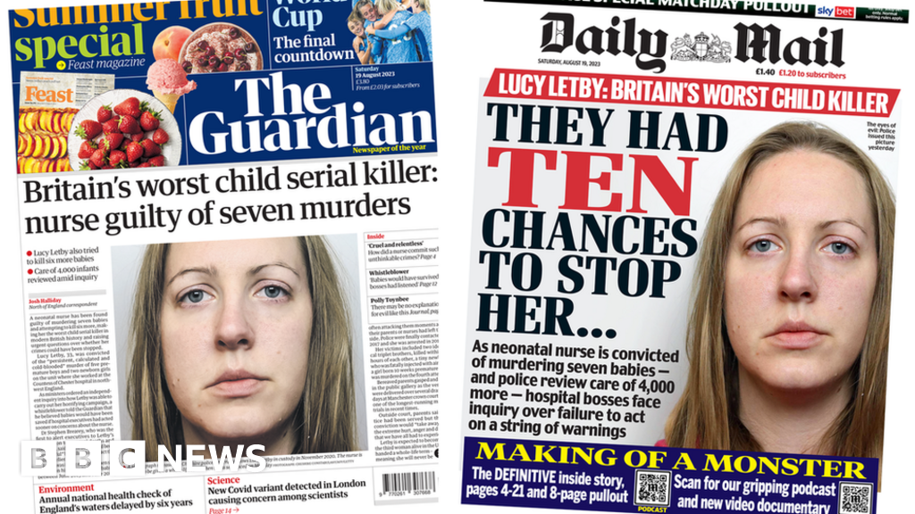
Notes:
Before I start talking about the nitty gritty, I strongly believe that the culture in an organsiation around medication safety and raising concerns is critical to ones role as CDAO. And this is of course, a very current topic!
Concern around speaking up – my big concern is closing the loop and particularly communicating that where possible.

Slide 41

Importance of freedom to speak up
If staff are misusing controlled drugs at work (or from work) then patients are not safe
Caring for patients with an untreated / self-treated addiction
Medication not available to patients or not of the quality it should be
Controlled Drug Accountable Officers mitigate that risk
Robust governance and procedures
Responding to incident reports
Monitoring activities – reconciling supply and usage
We need an open culture in which staff feel safe enough to raise a concern about something that may be a risk to patients
this includes a concern that colleague may be misusing controlled drugs, or using them in an unsafe way
Source: NHSE SW CDAO
Notes:
FTSU Month - October

Slide 42
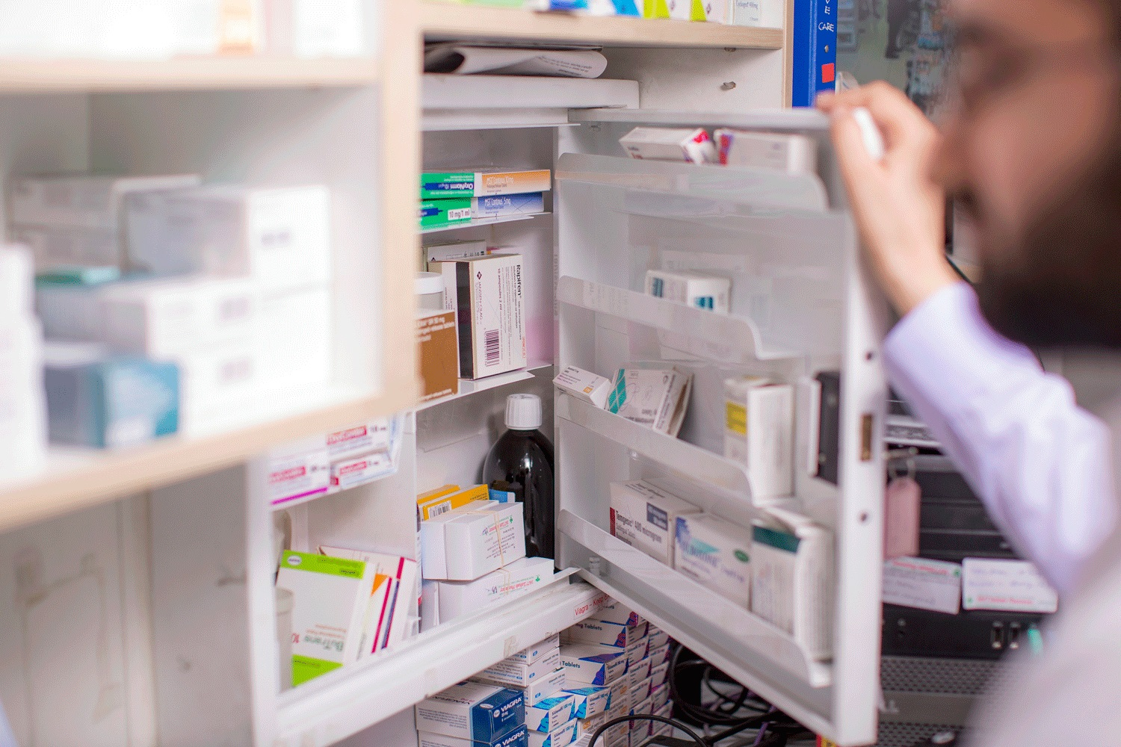
The Law
The Health Act created the role of the Accountable Officer for Controlled Drugs in 2006
The Controlled Drugs (Supervision of Management and Use) Regulations 2013
Regulation 8 – Appointment and support of accountable officers
Designated bodies must appoint an AO
The AO must be a person of sufficient seniority
Must be an officer or employee of the designated body or bodies if acting jointly
Must have little or no contact with CDs within that body
Allows for joint appointments of an AO across designated bodies, subject to conditions
Requires designated bodies to fund and resource AOs adequately
Notes:
This led to some much needed change in law.
Some requirements for a CDAO that I will come back to you about.
And time to do the role which I will also come back to.

Slide 43
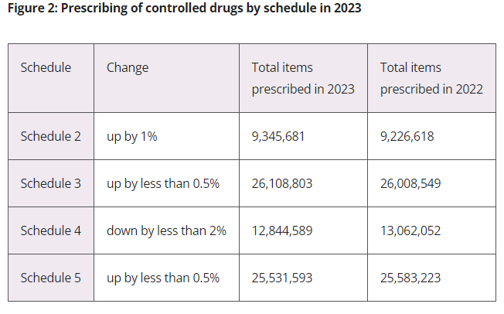
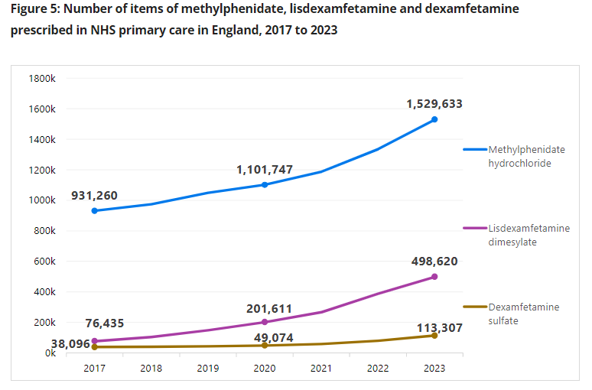
Source: CQC Annual CD Report
Notes:
These charts may come in slightly randomly in the context of this presentation but it is to make a simple point.
We tend to focus on the safety & security of controlled drugs. We tend to focus on those serious incidents where diversion has been suspected or occurred,.
But fundamentally we still have a problem around prescribing of these substances. However, there is some sign of hope – the escribing is starting to flat line.
Continued increases in prescribing volumes of Schedule 2 medicines that are licensed to treat attention deficit hyperactivity disorder (ADHD), such as dexamfetamine, lisdexamfetamine and methylphenidate. This trend is also echoed in NHS hospital prescribing for dispensing in the community, as well as in the private prescribing trends, which may reflect a lack of access to NHS care.
But we have seen a significant drop around some of the dirty drug prescribing – combined analgesics like co-proxomal and dydramol, pethidine etc.
Take home message – the CDAO role is also about opioid stewardship.

Slide 44
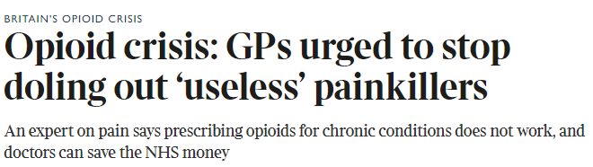
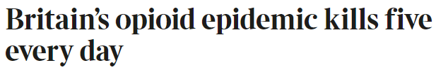
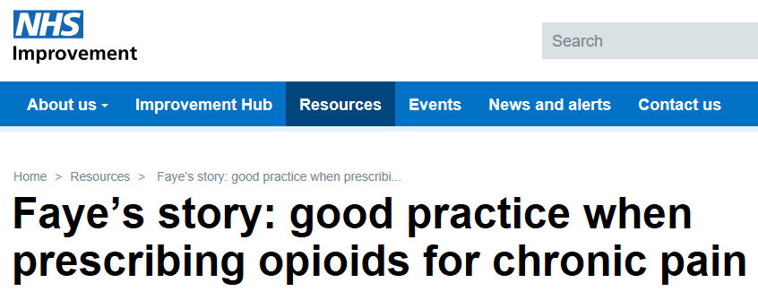
Notes:
And dare I say we are outlier compared to many parts of the world.

Slide 45
CDAO requirements / qualities
The CDAO must be a person of sufficient seniority
Must be an officer or employee of the designated body or bodies if acting jointly
Must have little or no contact with CDs within that body
Communication /stakeholder engagement/ relationships
Investigative skills
Influencing
Situational Leadership
Resilience
Curiosity (appreciate enquiry, PSIRF)
Notes:
So these THREE are effectively from the law. This removes a common misconception that the CDAO has to be a Chief Pharmacist on someone on an a Board – often the nursing or medical Director in a hospital. Actually, many different people hold this role as long as you fit this definition.
I have some reflections about the CDAO role from when I am one now and where I was Chief Pharmacist and someone else was the CDAO…..difficult as Chief Pharmacist and it all comes to role definition, particularly with your colleagues.
The rest of this list is simply my opinion based on experience. I think several soft skills are needed for this role but these are some of my top ones.

Slide 46

Duties of CDAO
Assurance the organisation is following adequate and up to date Standard Operating Procedures (SOPs).
Appropriate arrangements for monitoring and auditing the management and use of controlled drugs.
Systems exist to alert the accountable officer of any complaints or concerns involving the management or use of controlled drugs.
The incident reporting system captures untoward incidents involving the management or use of controlled drugs; appropriate arrangements in place for analysing and responding to these.
Relevant individuals receive appropriate training in relation to controlled drugs.
The recording and assessment of any concerns raised in relation to the management or use of controlled drugs by a relevant individual; determining whether these concerns should be shared with a responsible body.
Protecting patients or members of the public in cases where concerns in relation to the management or use of controlled drugs by a relevant person appear to be well-founded.
Appropriate arrangements for ensuring the proper sharing of information.
The CDAO themselves should not witness destruction.
Notes:
Trained / authorised witnesses do not need to be “healthcare professionals”
A T28 exemption Certificate is required which gives you permission to store or treat up to 1 cubic metre of waste at any one time and store waste for up to 6 months. Lasts for 3 years, free
Enhanced DBS checks for witnesses (update service).

Slide 47
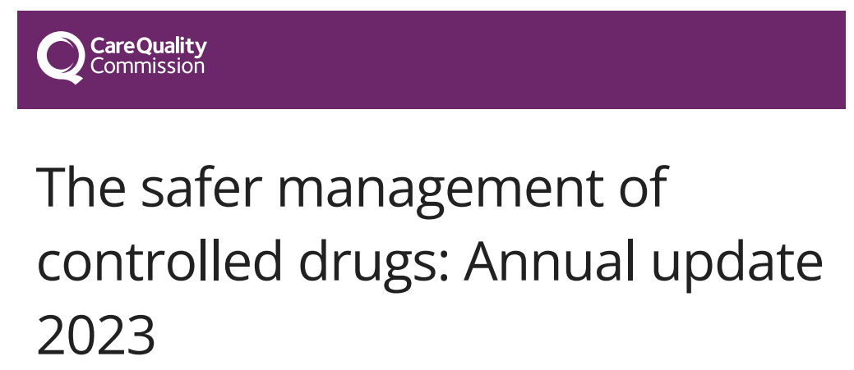

Slide 48

Key learning (1)
Home Office
Legislation Update
Codeine – risks and reclassification
Nitrous Oxide reclassification
Nitazenes
Overseas prescribing of CDs
Designated bodies
Role of CDAO
Board level oversight of CDs
Resourcing of CDLOs
Prescriber Identification Numbers
Notes:
we recommended that providers allow enough time when applying for a licence. Working with the Home Office, we are producing guidance for providers when applying or re-applying for a Home Office licence.
Legislation – December last year was a change in what paramedic Ips, therapeutic radiographers
Codeine – linctus, but also diversion, forged prescriptions etc.
NO - In November 2023, possession of nitrous oxide was made illegal if it is, or is likely to be, “wrongfully inhaled”. It is now a Class C drug under the Misuse of Drugs Act 1971 and a Schedule 5 controlled drug under the Misuse of Drugs Regulations 2001.
Nitazenes – synthetic opioids. An investigation by the Advisory Council on the Misuse of Drugs (ACMD) found that one nitazene, isotonitazene, was responsible for 24 fatalities in the UK in 2021. This particular nitazene is 500 times more potent than morphine. In July 2023, the Office for Health Improvement and Disparities issued a useful alert relating to staff awareness of synthetic opioids, and the treatment of overdose. This alert is important for organisations where staff may encounter people who use drugs and those who provide emergency care for opioid overdose. Availability of naloxone
Oversease - Prescribing of controlled drugs from outside England continues to be an issue that is raised with us. Practitioners who can legally produce a prescription in their European Economic Area (EEA) home country for controlled drugs in Schedules 4 and 5 can also legally prescribe these for someone in England. This is not a reciprocal agreement with the EEA
Role of CDAO – visibility, resource. Board level – not just a Pharmacy responsibility.
PINs - The current system for issuing prescriber identification numbers (PINs) for private prescribing and requisitioning of controlled drugs would benefit from a review. This could potentially help achieve better national oversight of prescribing and manage areas of risk. There is currently no expiry date for PINs and practitioners are only required to provide one main address of work, even when they may also practise in a wide range of settings.

Slide 49
Key learning (2)
Learning from Incidents
Alfentanil medication errors
Morphine sulfate – infant overdose
Remote prescribing of CDs
Storage of prescription stationery
Managing unknown substances in services
Identity badges, cards and uniforms
Delays in submitting private controlled drug prescriptions to NHS Business Services Authority
Notes:
Remote consultations resulting in the prescribing of controlled drugs are becoming more common, both across NHS and private settings. However, we have heard of examples where healthcare professionals are not adhering to safe practices when prescribing remotely, including non-medical prescribers.
Unknown substances - Services need to have a clear policy and process to manage this issue and the risks associated with it, and there must be a robust documented audit trail. Unknown substances must be put into a secure, sealed container. Quantities that indicate personal use only can be destroyed locally as an unknown substance. Services should assess and manage the risk of exposure to unknown substances during the destruction process. Larger quantities, which are indicative of supply (not for personal use), will need to be notified to the police. CDLOs are a good first point of contact for concerns in relation to this. Any trends should also be communicated to the NHS England CDAO so they can share the issue and any learning with the CDLIN.
Identity cards - This underlines the importance of ensuring that ID cards and uniforms are returned, and that access cards are de-activated as quickly as possible when staff change roles or leave employment

Slide 50
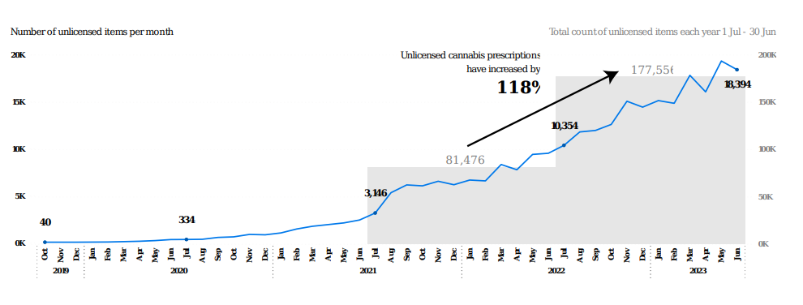
Key learning (3)
Keeping controlled drugs after someone has died
Incorrect use of controlled drugs disposal kits
Electronic controlled drugs registers and medicines storage
Cannabis based products for medicinal use
Notes:
Keeping controlled drugs after death - When a person dies, their medicines may need to be kept for 7 days in case the coroner requires them for an investigation. This may include a supply of controlled drugs, including those of a high strength, and in injectable form.
Kits - sometimes see that controlled drugs disposal kits containing resin are not used properly. This results in a range of controlled drugs being left open to diversion. Examples of incorrect use include: Overfilling the kits, so that the resin does not set.
CBMPs - Cannabis-based products for medicinal use (CBPMs) are Schedule 2 controlled drugs
under the Misuse of Drugs Regulations 2001. They can be prescribed by, or under the
direction of, a doctor who is on the specialist register of the General Medical Council to
treat patients on a case-by-case basis to meet an unmet clinical need.
During 2023, we continued to register clinics in the independent sector that provide
treatment with CBPMs. At the time of publishing, 22 providers that prescribe unlicensed
CBPMs were registered with CQC. Administration of CBPMs in health and social care settings.
ensuring the product has been prescribed how to support patients with ongoing supplies, if required safe storage, records and appropriate authorised access, as with other Schedule 2 controlled drugs
appropriate training for staff if they are required to support with administration the position on vaping, and the possible need to obtain prescribed alternatives where people are not able to vape whether a risk assessment is required

Slide 51

Time to do role / support
Often a ‘tag on’ - resource can vary – mitigations?
Every organisation is different. Who is in the team?
Access to further staff – expert knowledge – those carrying out investigations, audits, writing Standard Operating Procedures, etc.
Appropriate IT and business intelligence support e.g., incident logs reporting
Appropriate security support e.g., CCTV
Training sessions, induction and mandatory, for all relevant staff
Don’t forget the wider network
Care Quality Commission
Police Controlled Drug Liaison Officers (CDLOs)
General Pharmaceutical Council Inspectors
NHS Counter Fraud Authority
Practitioner Performance Advice
Responsible Officers
But, no model of benchmarking for staff

Slide 52
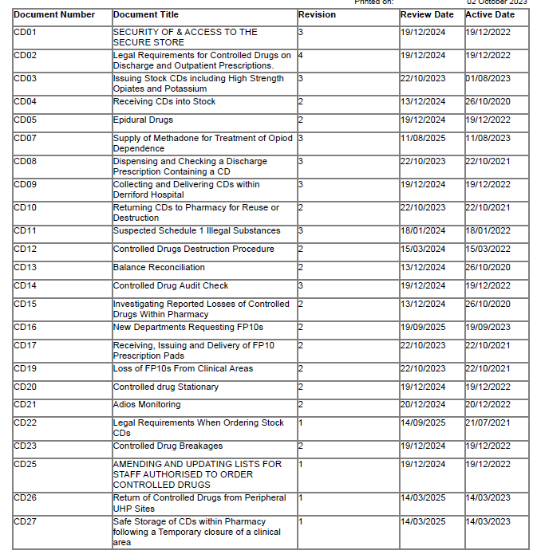

Standard Operating Procedures
Notes:
Do you have up to date SOPs and are they based used as needed?
Q-Pulse – document control, near misses, analysis etc.
This is an output of our CD SOPs – you will see a range of activities are being covered.
Remember, this is also part of your GDP, of you are a WDA license holder and have a CD Home Office License.

Slide 53
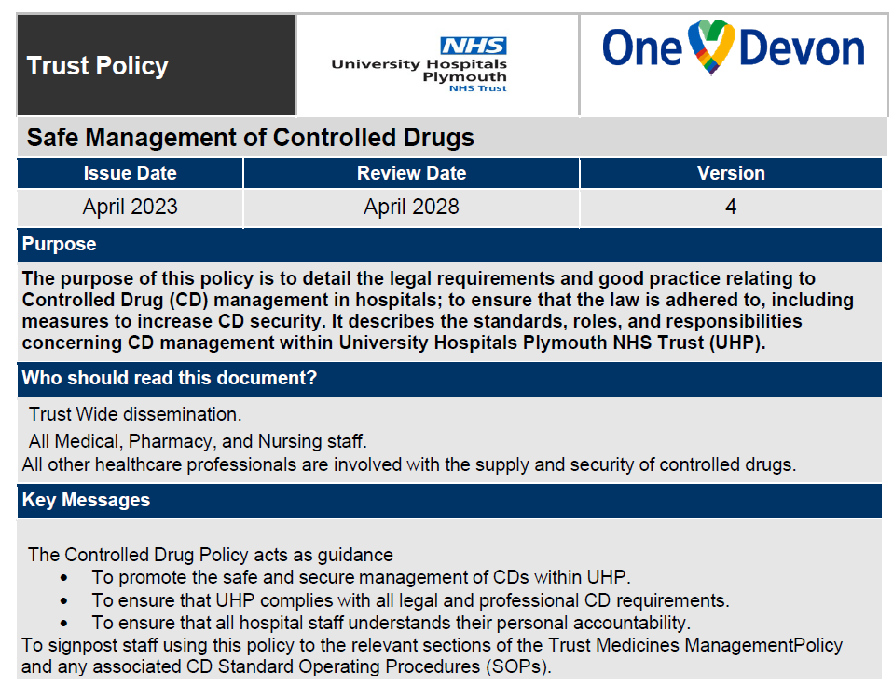
Controlled Drugs Policy
Notes:
An overarching policy document. This is ours.

Slide 54
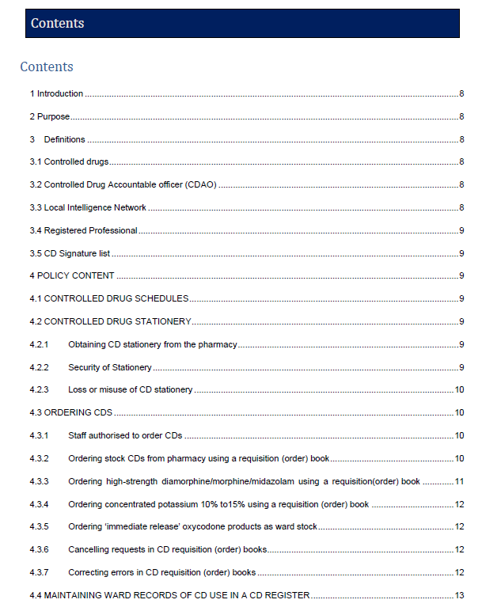
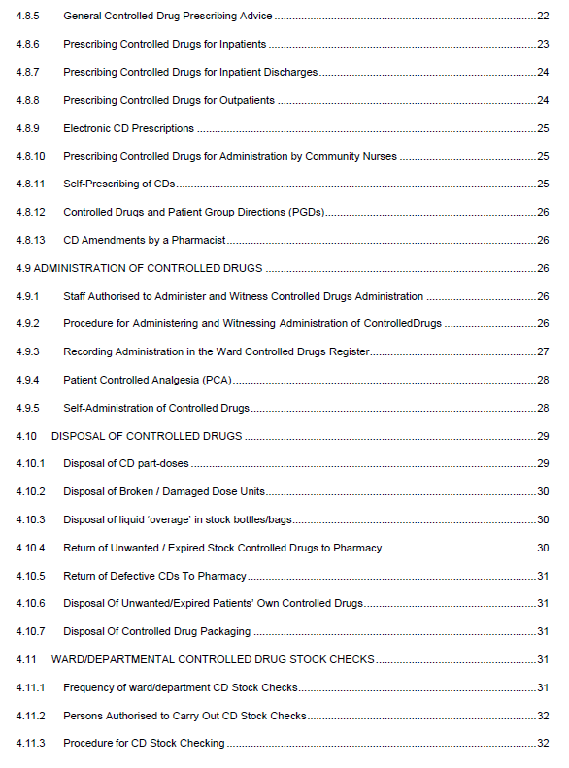
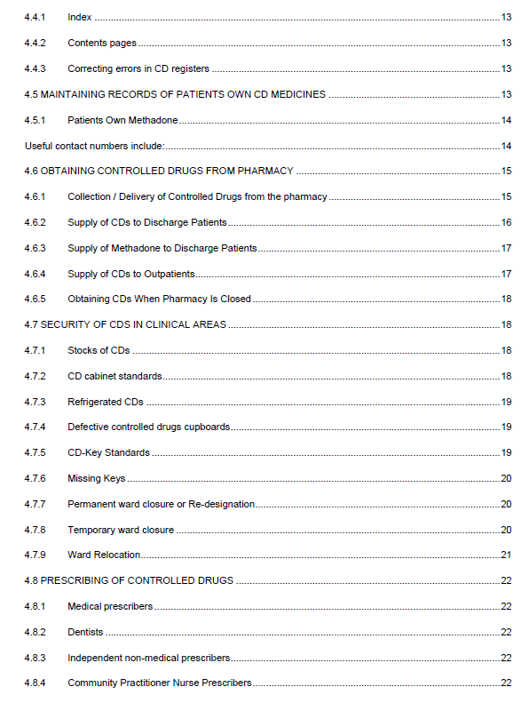
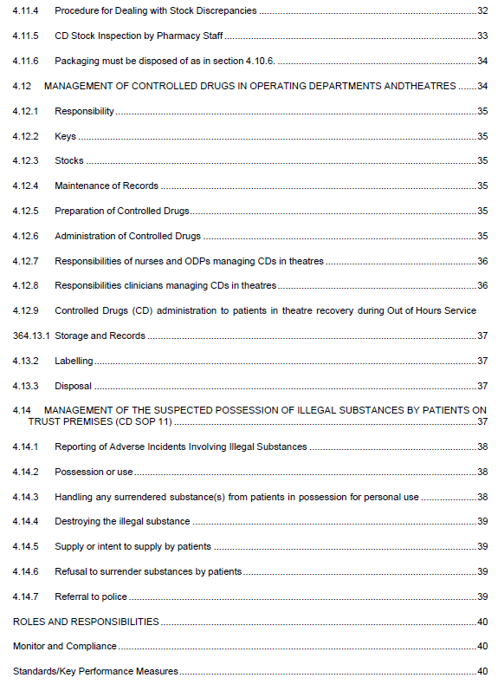
Notes:
I don’t intend you to read every detail. This is simply to demonstrate the range of stuff in a CD policy.

Slide 55
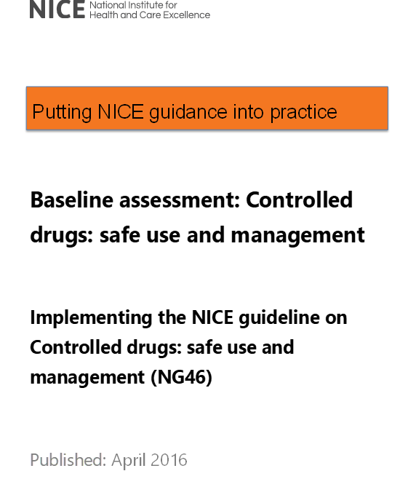
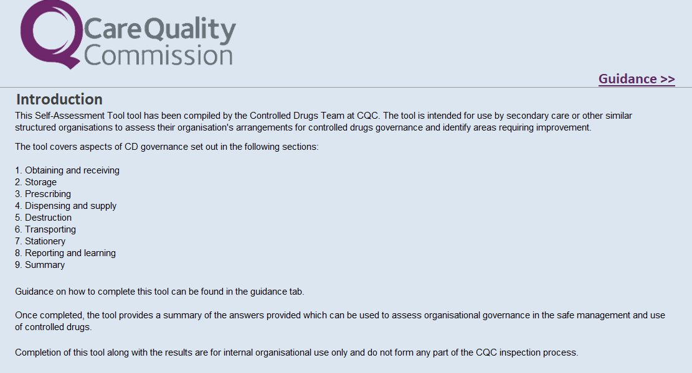
Baseline Assessments
Notes:
How do you find out where you are against the recommendations. Both legal and where considered good practice.
NICE and the CQC.
I tend to use the CQC – ultimately what the regulator will use and it is more recent BUT in reality, both similar principally and useful.

Slide 56
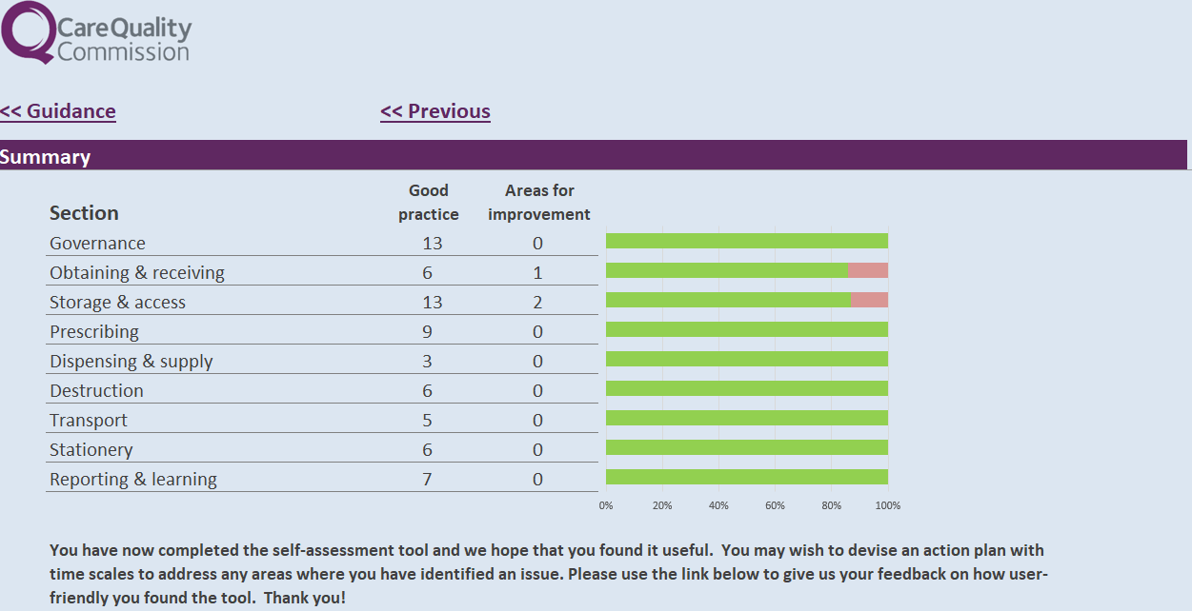
Baseline Assessments
Notes:
That is ours. Proud to share this but that isn’t the point – it is understanding where you are.
More importantly, the so what question.
We are developing an action plan to address the deficiencies and this should absolutely be overseen by the CDAO.
Review list of sample signatures of staff who are authorised to receive controlled drugs.
Complete a risk assessment to determine if other schedule-controlled drugs in Schedules 3, 4 and 5 require storage.
Confirm that risk assessment of the CD cupboard is carried out as part of the dispensary refurbishment.

Slide 57
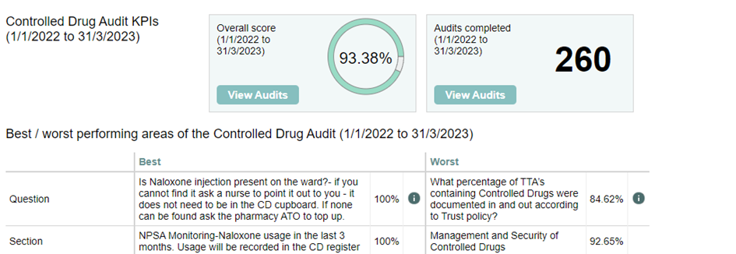

Audits
Notes:
Regular CD audits – we do ours every 3 months and we also align this with CD LIN reporting as best as we can.
We audit circa 60 areas each time – remember not just the obvious areas – but places like theatres, imaging and the ‘hidden’ areas where Pharmacy have less of a presences.
Again, so what?
DATIX reporting? Incidents post audit – we record every single one! It helps creating that right culture we spoke about.
Trends?
Involvement of senior nursing teams?
Escalation
Example of estates and work I am doing now.

Slide 58
Reporting incidents and concerns
Creating the right culture - If you have a concern about controlled drug use, you must report it
No such thing as ‘over’ reporting!
Statistical Process Control & Harm Levels
“I think I’ve got a forged prescription here…”
“Gut feeling something Is not right.”
“Last night there were six boxes of tramadol in the cupboard, but this morning only four.”
“Nurse has been taking end of life medication from the homes of deceased patients, but never returned these to a pharmacy.”
“Something odd with the ADIOS data especially when no one is prescribed the medicine.”
Notes:
SPC – is there a change outside control limits – then think about why?
Also, not about just how many incidents but the level of harm. Personally only worried when harm has increased.
These are the sort of range of stuff people talk to me about – all equally important and taken seriously.

Slide 59
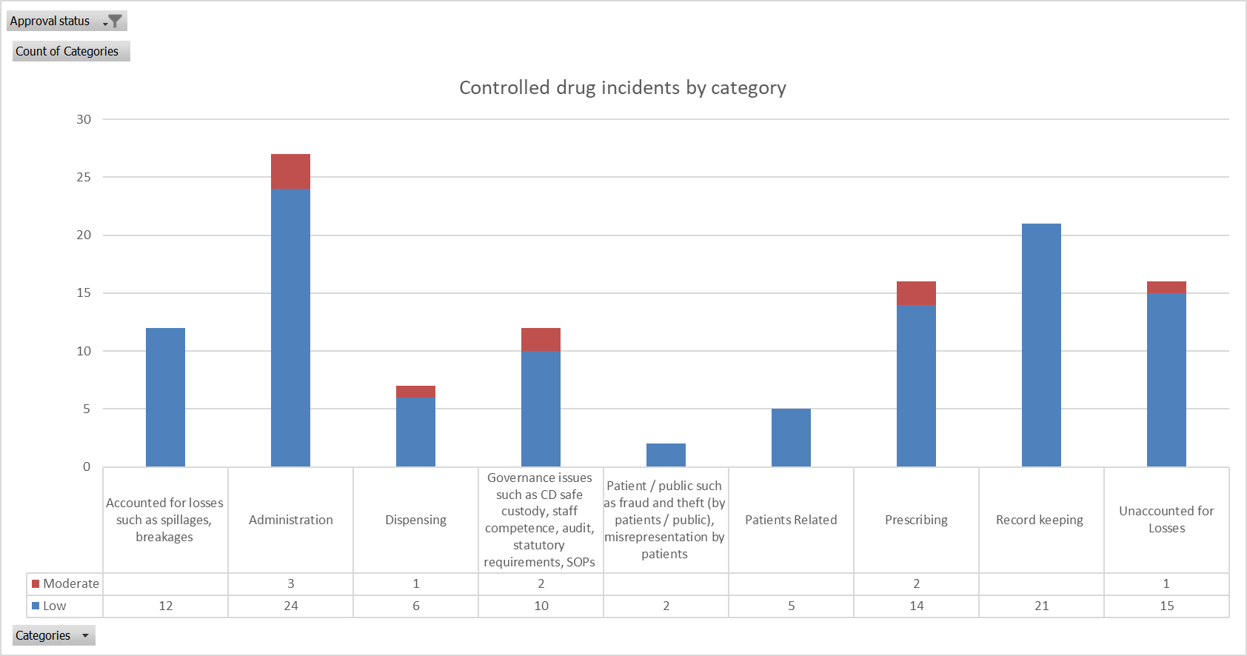
Incident themes
Notes:
This is helped by thematising incidents.
Tells you harm levels and type of incidents.
You can further triangulate this with areas you need to target.
This helps you answer that so what question.

Slide 60
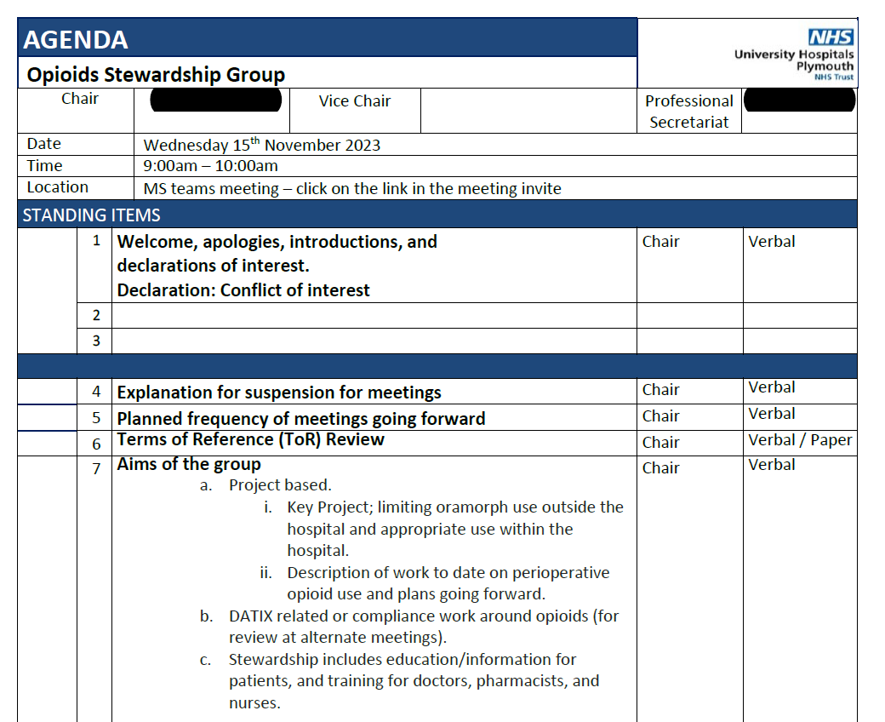
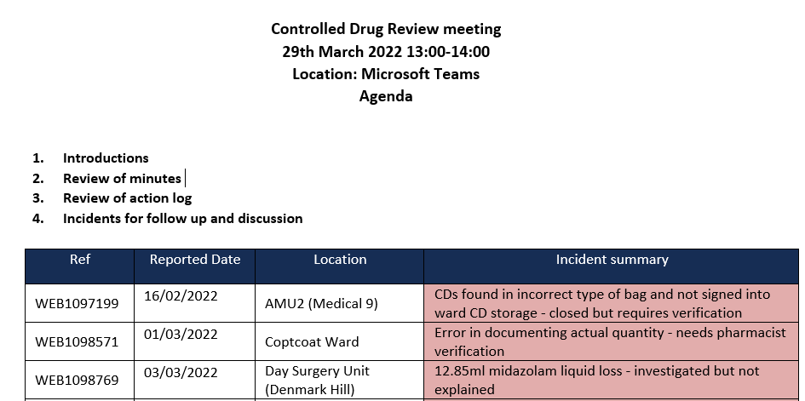
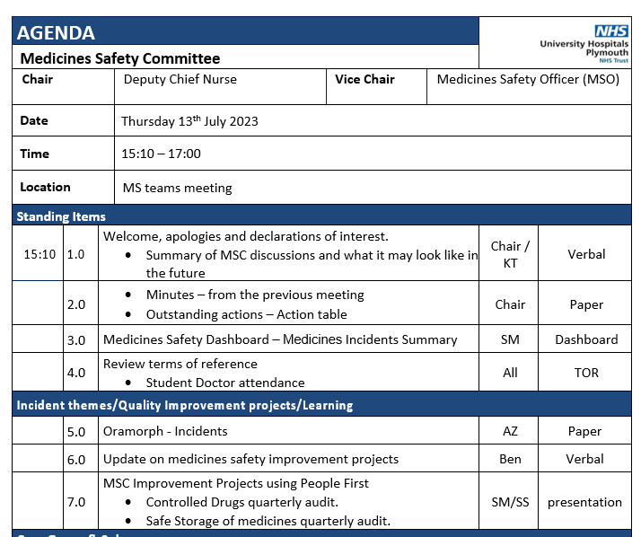
Governance Forums
Notes:
Once you know the issues, the right governance has to be in place to escalate, discuss and put mitigations or improvement projects into place.

Slide 61
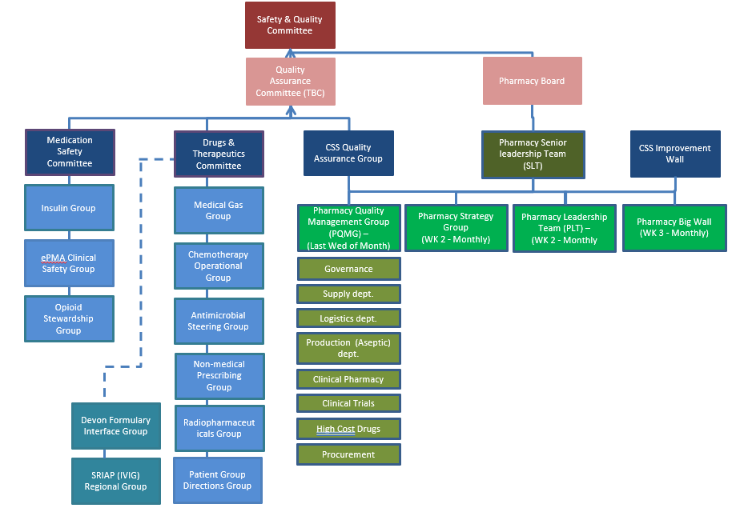

Slide 62
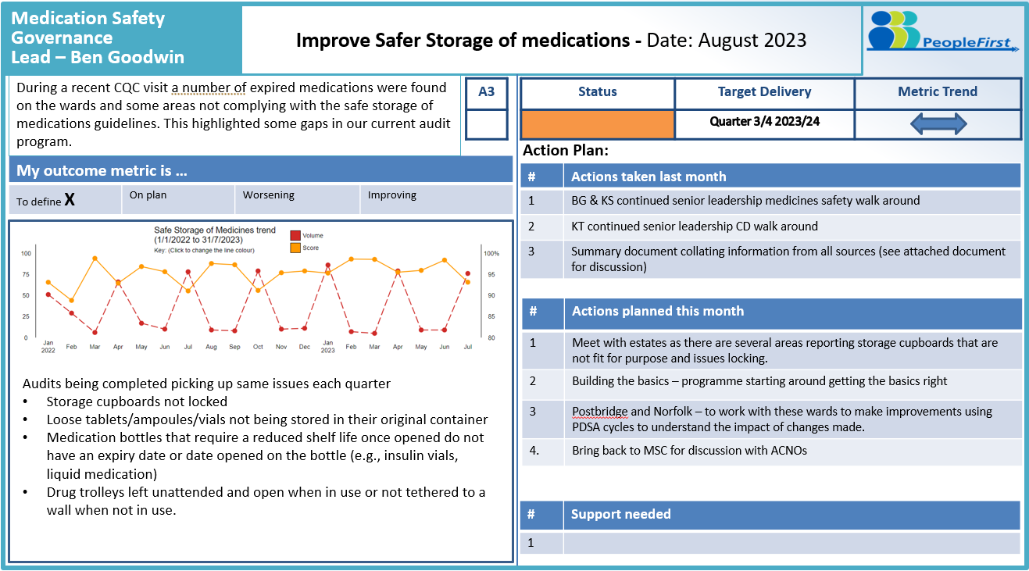
Improvement – People First

Slide 63

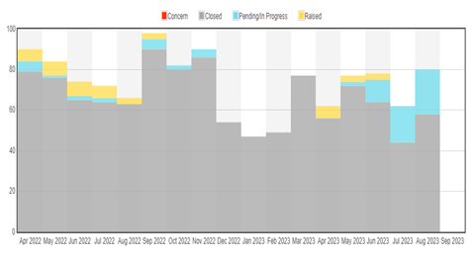
Notes:
Part of the Rx info suite.
Intelligence on unusual patterns of reporting
Recent case on codeine – may have highlighted an individual

Slide 64
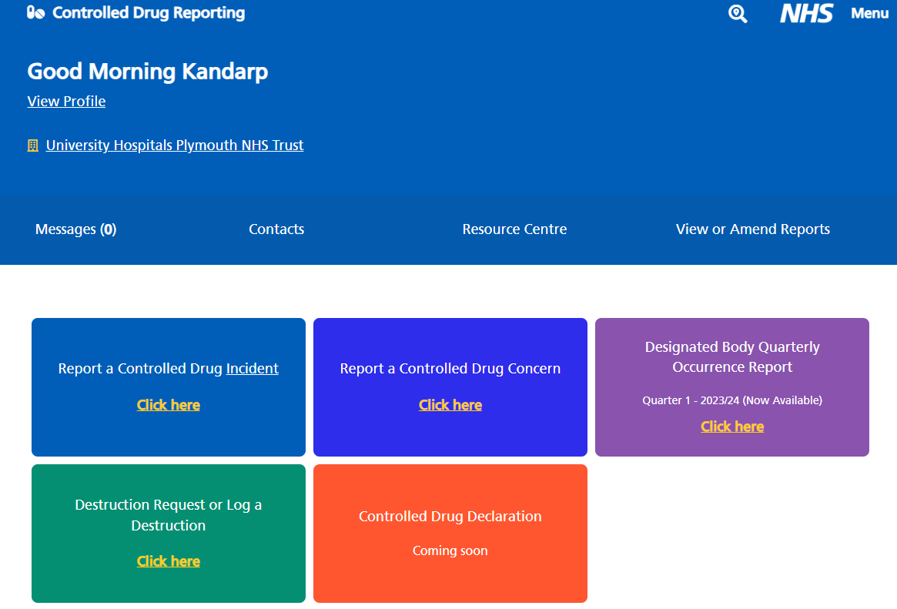
NHS Online Reporting

Slide 65
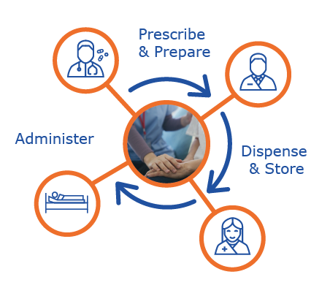
Our Controlled Drugs Automation Journey
Our vision is to have a fully closed loop management system, including for Controlled Drugs.
However, we had several challenges:
No automation (aside from old ROWA)
No fit for purpose software platform
No interfaces between the platforms that do exist
Legislation

Slide 66
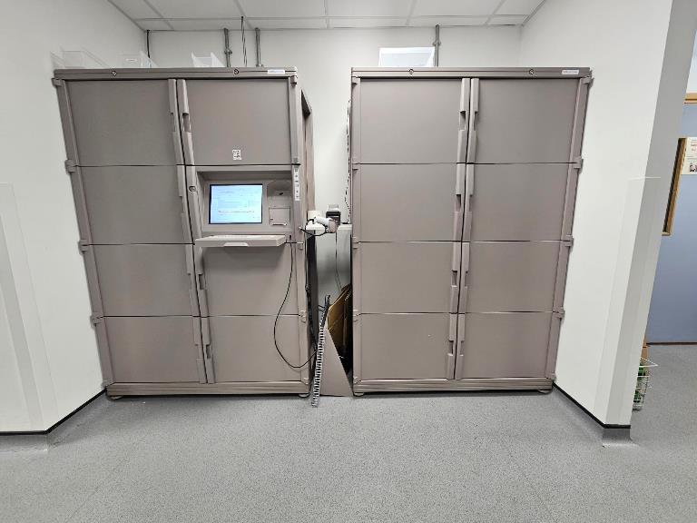
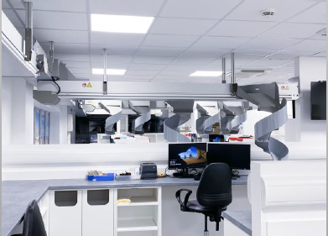
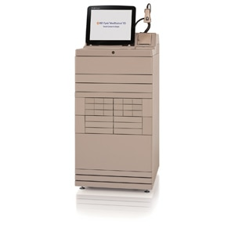
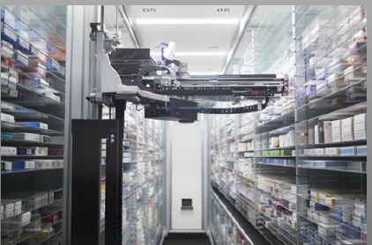
Our Controlled Drugs Automation Journey
The hardware
BD CII Safe™
BD ROWA™
BD Pyxis™

Slide 67
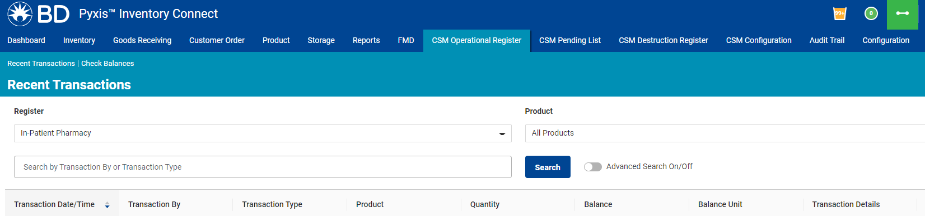
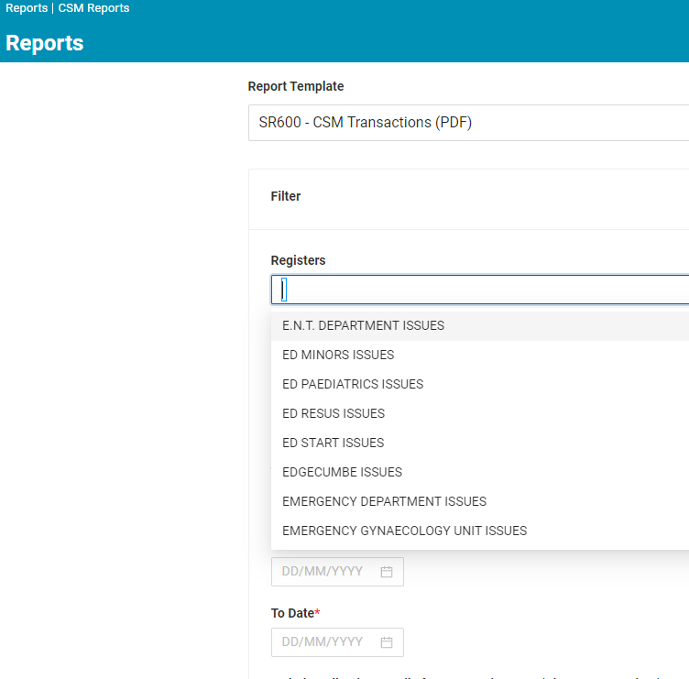
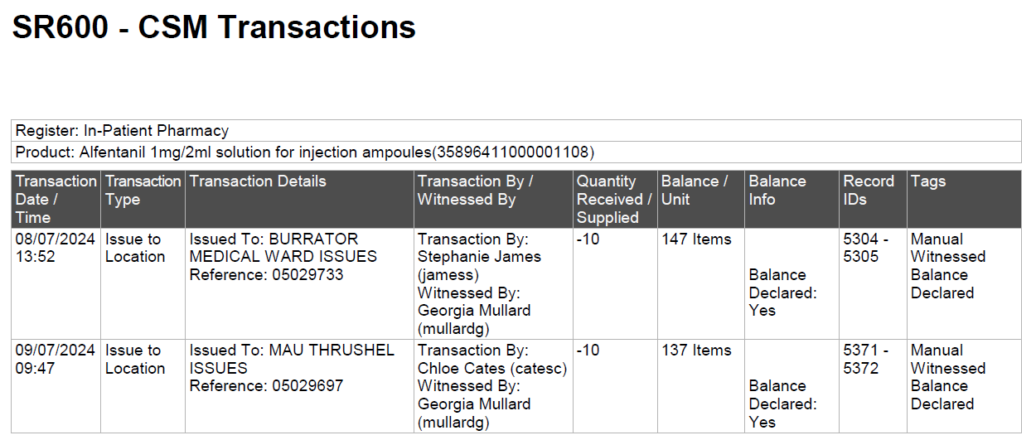
Our Controlled Drugs Automation Journey
The software
BD Inventory Connect™
BD Controlled Substances Manager™

Slide 68
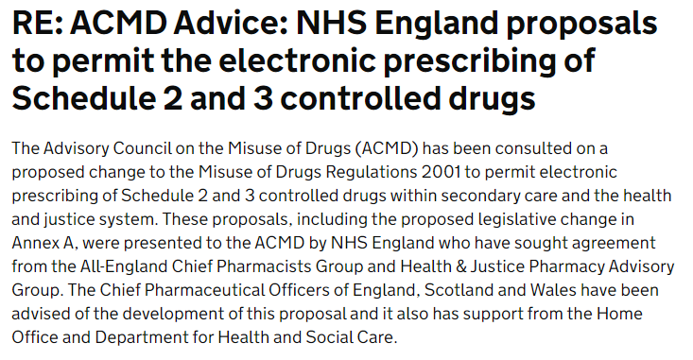
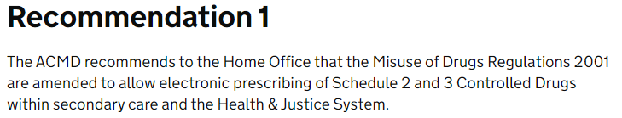
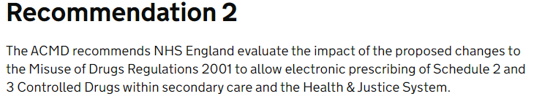
Digital signatures
Notes:
Many of you will know that within primary care, electronic signatures have been acceptable for a few years now.
This is a big operational issue in secondary care and you may remember this was one of the CQC observations.
The great news is that this is about to change!
Most EPMA systems already have the encryption and functionality.

Slide 69

Challenges & Reflections
Never enough time to do the role as you would like to – legal & good governance versus best practice
Prescribing focus
Quality Improvement
Multiprofessional
Using the support network – internal & external; allyships
Innovation – particularly digital

Slide 70
Internal v Criminal investigations. When to call the police.
Wendy McAllister

Slide 71
Internal Investigations
CD’s missing?
When should you report CD incidents to the police ?
Suspect known?
Previous issues?
Suspicious behaviour?
Check drugs charts / PMR
Patient harmed?
Check the CD register

Slide 72



ONLY CALL 999 IF…….
FOR EVERYTHING. ELSE THERE ARE
OPTIONS
HELP KEEP
999
LINES FREE FOR EMERGENCIES
A CRIME IS HAPPENING NOW
SOMEONE IS INJURED
YOU OR SOMEONE ELSE IN DANGER
THE PERSON WHO HAS COMMITED THE OFFENCE IS STILL THERE OR NEARBY
REPORT ONLINE
CALL 101

Slide 73
Internal Investigations
Not socially acquainted
with the suspect
Senior member of staff
Who
should investigate?
Experienced
Someone easily contactable
Someone with time to
conduct the investigation

Slide 74
Internal Investigations
Line/ward manager/HR/OH/CDAO
CQC
HR
NMC/GMC/
GPhC/HCPC
Who
should be informed ?
Agency
Safeguarding team
Colleagues
Police/CDLO
Regional CDAO at NHSE (CD reporting tool)

Slide 75
Internal Investigations
Drug test
Make drug a full sch 2
Retrieve staff pass/swipe
access cards
Suspension
What actions could / should be taken?
FULL CD audit
Escort off
the premises
Change door codes
Search locker
Interview the
suspect/witnesses
Secure the CDR/drugs
charts
Conditions of practice

Slide 76
Internal Investigations
Criminal conviction
Removed from register
NFA
Potential outcomes
OH referral
Written warning
Conditions of
practice remain
Unsolved crime
Dismissal

Slide 77


Slide 78
NURSE A
Senior SN in A&E
Suspected of stealing Tramadol
Tramadol made a Sch2
18 frauds & 37 thefts
POLICE NOT INFORMED
Conditions of practice – nonclinical role
Swipe card not disabled
Colleagues unaware
Police informed 13 months later
Criminal investigation commences
Swipe card analysis
Interviewed at Bromley Police Station
Charged
Convicted
Rehab order
What lessons were learnt ?

Slide 80
Controlled Drug Accountable Officers
Jon Hayhurst, November 2022

Slide 81
Objectives for this presentation
A just culture, reporting incidents, and speaking up
Monitoring prescribing
Lead CDAOs and what they do
Spotting forged prescriptions
About Responsible Officers for Medical Practitioners
When Home Office licenses are required

Slide 82
Patient safety and the importance of freedom to speak up
If staff are misusing controlled drugs at work (or from work) then patients are not safe
Caring for patients with an untreated / self-treated addiction
Medication not available to patients or not of the quality it should be

Slide 83
Patient safety and the importance of freedom to speak up
If staff are misusing controlled drugs at work (or from work) then patients are not safe
Caring for patients with an untreated / self-treated addiction
Medication not available to patients or not of the quality it should be
Controlled Drug Accountable Officers mitigate that risk
Robust governance and procedures
Responding to incident reports
Monitoring activities – reconciling supply and usage

Slide 84
Patient safety and the importance of freedom to speak up
We need an open culture in which staff feel safe enough to raise a concern about something that may be a risk to patients
this includes a concern that colleague may be misusing controlled drugs, or using them in an unsafe way

Slide 85

What is speaking up?
When things go wrong, we need to make sure that lessons are learnt and things are improved.
If we think something might go wrong, it’s important that we all feel able to speak up so that potential harm is prevented.
Even when things are good, but could be even better, we should feel able to say something and should expect that our suggestion is listened to and used as an opportunity for improvement.

Slide 86

What is speaking up?
Speaking up is about all of these things:
Raising a concern
Making a disclosure
Making a complaint
Whistleblowing
Taking out a grievance
Making a qualifying disclosure
Suggesting an improvement

Slide 87
Incidents and concerns
If you have a concern about controlled drug use, you must report it
To your own organisation
To the Controlled Drugs Accountable Officer
To a Medical Practitioner’s Responsible Officer
To the police - on 999, or 101, or online

Slide 88
What kind of incidents and concerns?
“We supplied Zomorph 30mg MR capsules, but the prescription was for Zomorph 10mg MR capsules.”

Slide 89
What kind of incidents and concerns?
“We supplied Zomorph 30mg MR capsules, but the prescription was for Zomorph 10mg MR capsules.”
“The prescription was for pregabalin, but we supplied gabapentin.”

Slide 90
What kind of incidents and concerns?
“We supplied Zomorph 30mg MR capsules, but the prescription was for Zomorph 10mg MR capsules.”
“The prescription was for pregabalin, but we supplied gabapentin.”
“We just gave Darren’s methadone to Kevin by accident. Kevin normally has 30ml, but we gave him the 80ml we dispensed for Darren.”

Slide 91
What kind of incidents and concerns?
“We supplied Zomorph 30mg MR capsules, but the prescription was for Zomorph 10mg MR capsules.”
“The prescription was for pregabalin, but we supplied gabapentin.”
“We just gave Darren’s methadone to Kevin by accident. Kevin normally has 30ml, but we gave him the 80ml we dispensed for Darren.”
“The District Nurse applied a fentanyl patch as prescribed, but a few hours later the carer visited and applied a second one.”

Slide 92
“Will I get into trouble?”
The CDAO wants to help when things go wrong
That includes helping to investigate, reflect on what went wrong, helping to learn, and helping to prevent it from happening again (or reduce the risks of a reoccurrence)
If anything doesn’t sound right, we will ask for further information
If we know something is wrong, we will say so
In the few very exceptional cases where people are deliberately or regularly causing harm, we will take steps to protect patients – and protect the person doing it too.
As a professional you must report concerns

Slide 93
What kind of incidents and concerns?
“Last night there were eight boxes of codeine tablets in the cupboard, but this morning only six.”

Slide 94
What kind of incidents and concerns?
“Last night there were eight boxes of codeine tablets in the cupboard, but this morning only six.”
“Dr Jones calculated the dose of morphine to be given, and it was six times the correct dose.”

Slide 95
What kind of incidents and concerns?
“Last night there were eight boxes of codeine tablets in the cupboard, but this morning only six.”
“Dr Jones calculated the dose of morphine to be given, and it was six times the correct dose.”
“Nurse Smith has been taking end of life medication from the homes of deceased patients, but never returned these to a pharmacy.”

Slide 96
What kind of incidents and concerns?
“Last night there were eight boxes of codeine tablets in the cupboard, but this morning only six.”
“Dr Jones calculated the dose of morphine to be given, and it was six times the correct dose.”
“Nurse Smith has been taking end of life medication from the homes of deceased patients, but never returned these to a pharmacy.”
“I think I’ve got a forged prescription here…”

Slide 97
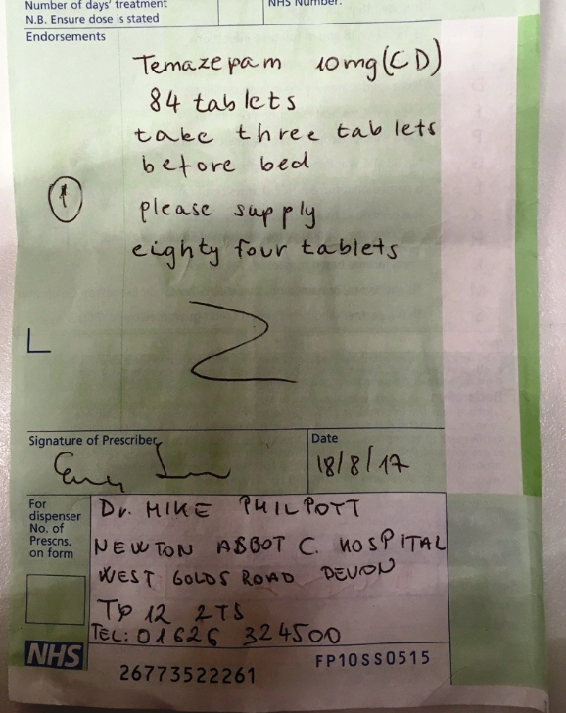
Forged prescriptions

Slide 98
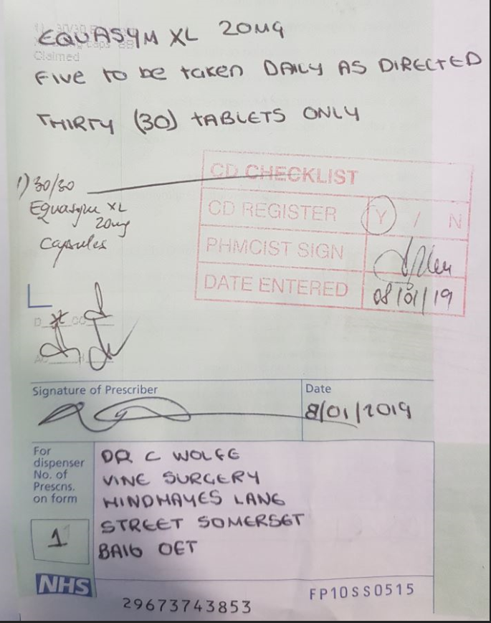
Forged prescriptions

Slide 99
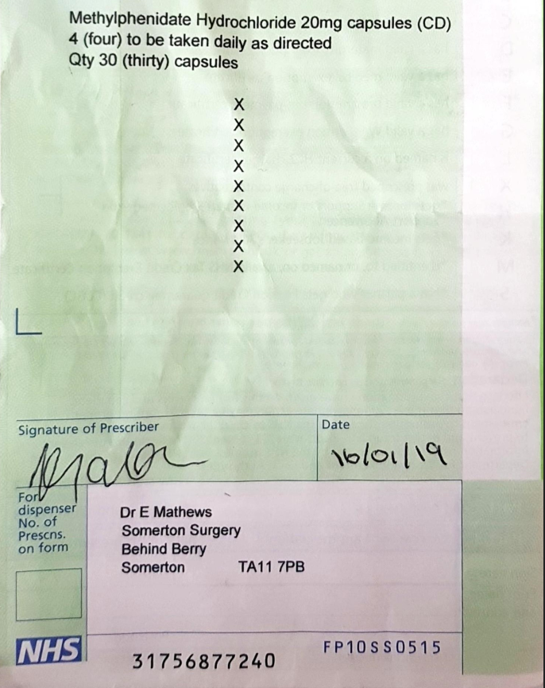
Forged prescriptions

Slide 100
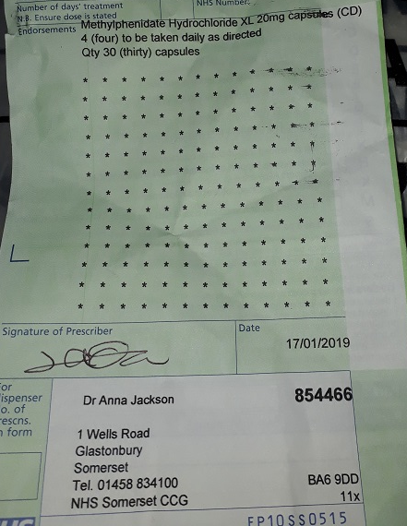
Forged prescriptions

Slide 101
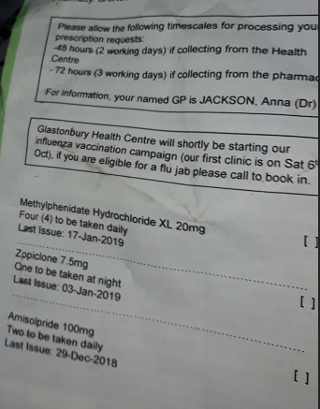
Forged prescriptions

Slide 102
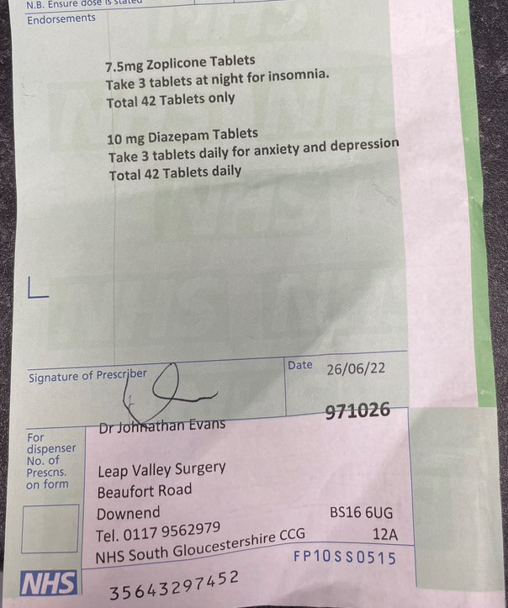
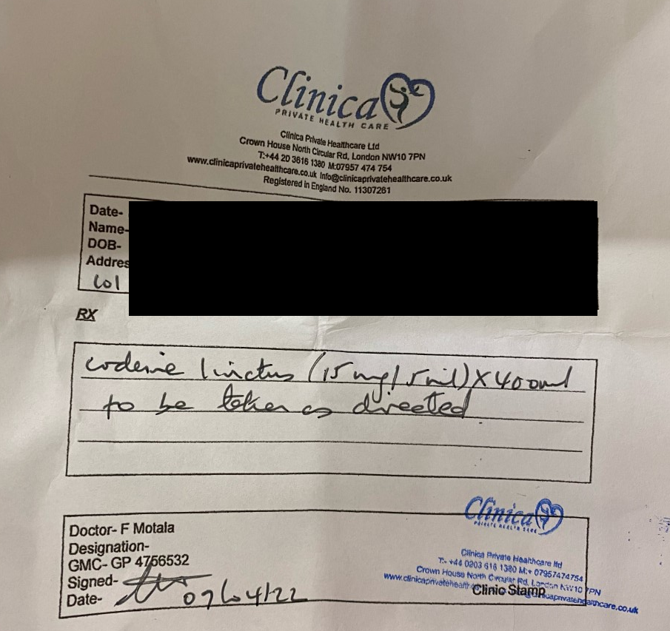
Recent forged prescriptions

Slide 103
Monitoring prescribing
“Dr B prescribes a lot of lisdexamfetamine…”

Slide 104
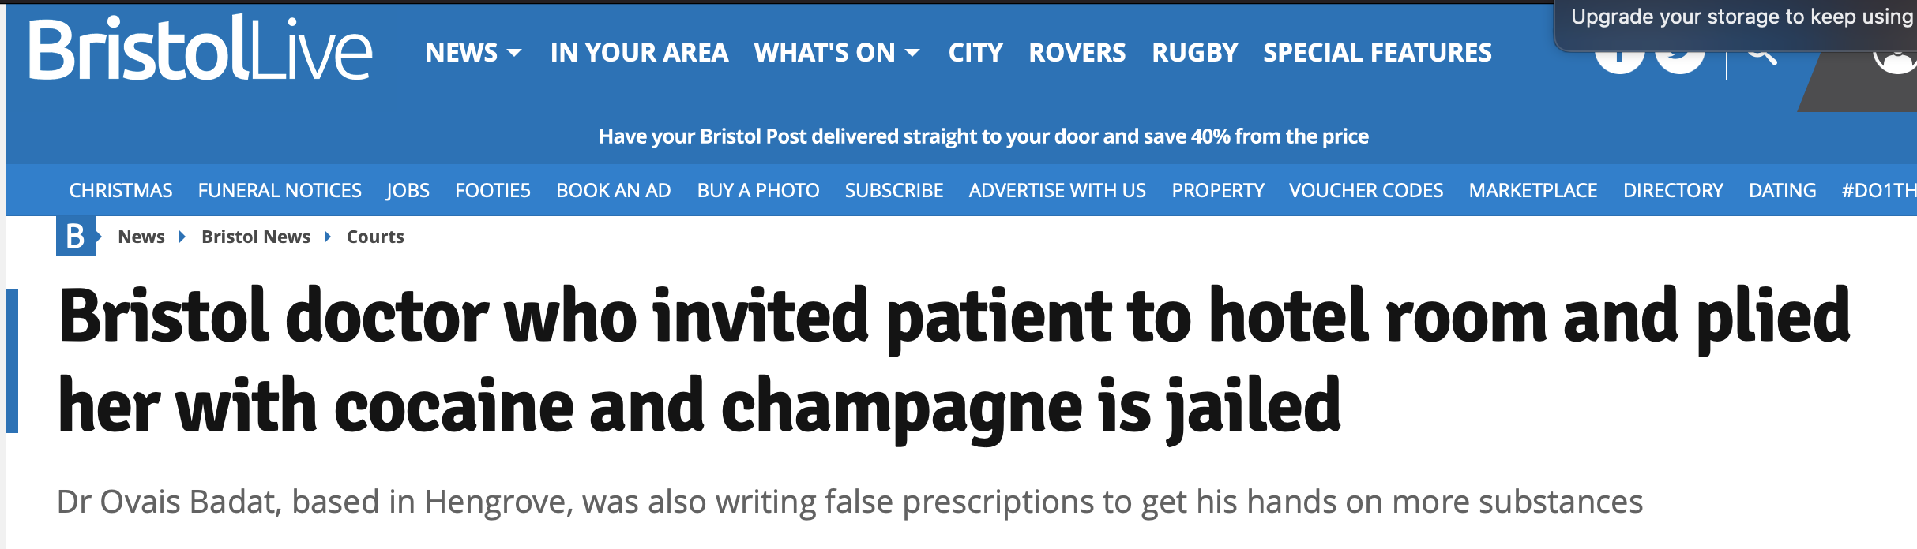
Monitoring prescribing

Slide 105
The Lead Accountable Officer also…
Authorises witnesses to the destruction of schedule 2 controlled drugs
Authorises private prescribing of schedule 2 and 3 controlled drugs
Requests and reviews summaries of incidents and concerns from other Accountable Officers in their network
Requests and reviews assurance on safe management and use of controlled drugs from organizations that do not have their own Accountable Officer

Slide 106
The Lead Accountable Officer also…
Authorises witnesses to the destruction of schedule 2 controlled drugs
Authorises private prescribing of schedule 2 and 3 controlled drugs
Requests and reviews summaries of incidents and concerns from other Accountable Officers in their network
Requests and reviews assurance on safe management and use of controlled drugs from organizations that do not have their own Accountable Officer
Monitors the prescribing of controlled drugs

Slide 107
Responsible Officers
The Responsible Officer Regulations give specified senior doctors (responsible officers) in certain organisations (designated bodies) responsibility to oversee the work of medical practitioners.
Where there are concerns about a doctor’s fitness to practise, the Regulations empower responsible officers to instigate investigation of the doctor’s performance and to ensure that the appropriate action is taken.
Medical practitioners must tell their responsible officer if there is a concern about their fitness to practise.
Responsible officers make recommendations to the GMC on revalidation – most doctors revalidate every five years, and need to show they have an annual whole practice appraisal

Slide 108
Home Office licenses
Some organisations require a license to possess controlled drugs
Controlled drugs that have been prescribed for, and supplied to a patient belong to the patient and no license is required for possession

Slide 109
Home Office licenses
Some organisations require a license to possess controlled drugs
Controlled drugs that have been prescribed for, and supplied to a patient belong to the patient and no license is required for possession
A doctor or dentist can possess controlled drugs
Certain persons in an organisation maintained out of charitable or public funds can possess controlled drugs

Slide 110
Home Office licenses
Some organisations require a license to possess controlled drugs
Controlled drugs that have been prescribed for, and supplied to a patient belong to the patient and no license is required for possession
A doctor or dentist can possess controlled drugs
Certain persons in an organisation maintained out of charitable or public funds can possess controlled drugs
Most other organisations need a license to possess controlled drugs
Organisations that supply stock of controlled drugs (by wholesale) should assume they require a license.

Slide 111
Home Office licenses
So why do some organisations have a CDAO, but no license? Or a license, but no CDAO?
If your organisation provides healthcare services to in-patients (i.e. falls within the definition of a hospital), you need a CDAO.
If your organisation holds stock of controlled drugs (not patients’ own), it usually needs a Home Office license.
Some organisations need neither, and some need both.

Slide 112
Objectives for this presentation
A just culture, reporting incidents, and speaking up
Monitoring prescribing
Lead CDAOs and what they do
Spotting forged prescriptions
About Responsible Officers for Medical Practitioners
When Home Office licenses are required

Slide 113
Controlled Drug Accountable Officers
Jon Hayhurst, November 2022

