Slide 1

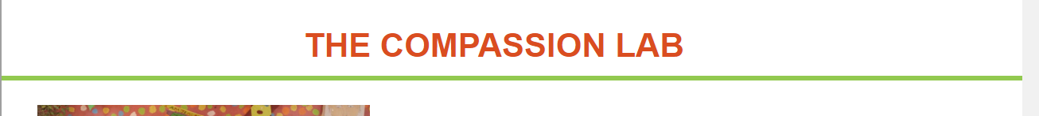
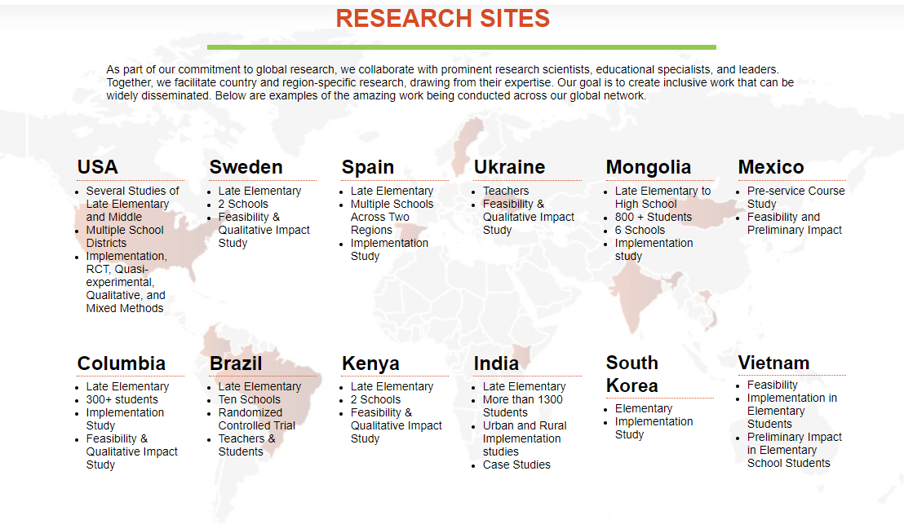
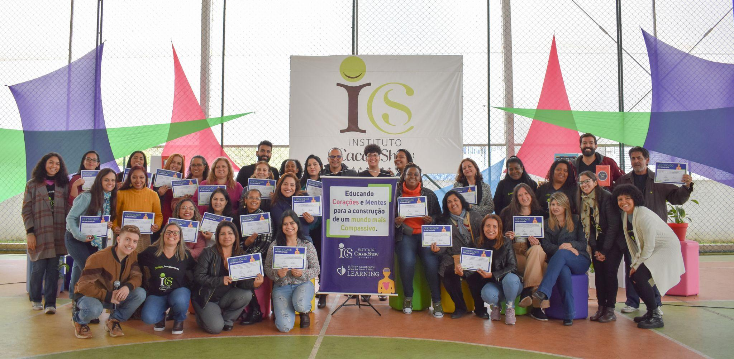
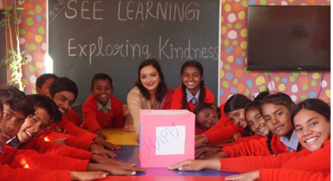
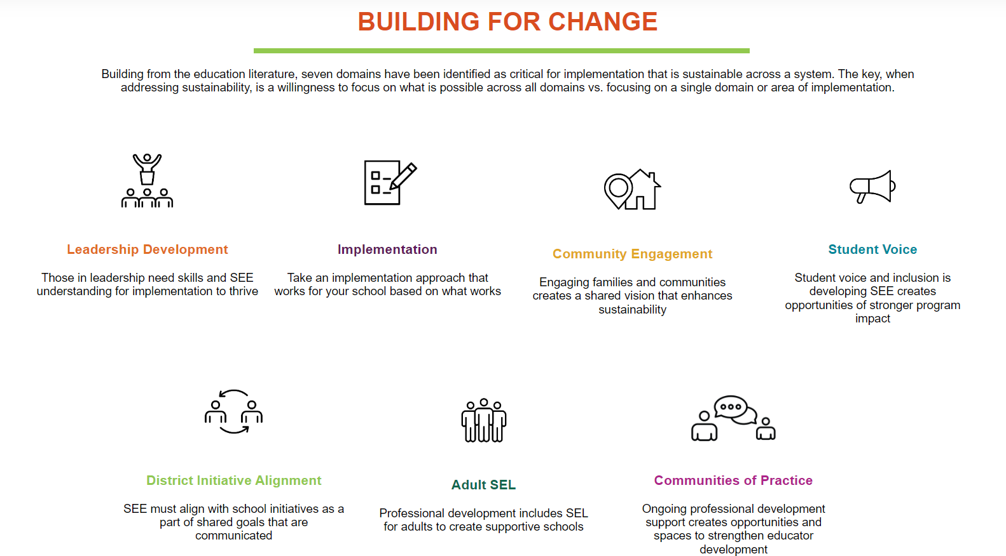


THE COMPASSION LAB
MISSION
Supporting the development of the evidence-based, SEE Learning program and CBCT for Educators by assessing program implementation and examining feasibility, impact, and long-term sustainability at the school, district, city, and national levels.
Developing effective tools and measures to CBCT and SEE Learning
Support global dissemination through impactful manualization
Contribute to compassion-based education studies worldwide through scientific advancements that examine compassion, common humanity, wellbeing, interdependence, and secular ethics.
RESEARCH SITES
We collaborate with global affiliates to conduct collaborative region-specific research. Read below to discover the impactful projects from our worldwide network!
BUILDING FOR CHANGE
To meaningfully impact change, we have:
Identified seven critical domains for whole-school implementation sustainment
Conducted studies on sustainable implementation and its impact on compassionate systems
Begun work on global implementation frameworks, monitoring guides, and whole-school trainings
Leadership Development
Those is leadership need skill and SEE understanding for implementation to thrive.
Implementation
Sustainable practices involves strategies that embed SEL into the educational landscape of the school
Community Engagement
Engaging families and communities creates a shared vision that enhances sustainability.
Student Voice
Empowering students to actively participate in and contribute to the SEL process strengthens the school community and supports SEL sustainability
District Initiative Alignment
SEE must align with school initiatives as a part of shared goals that are communicated.
Adult SEL
Professional development includes SEL for adults to create supportive schools.
Communities of Practice
Ongoing professional development creates opportunities and spaces to strengthen educator development.
https://scholarblogs.emory.edu/compassionlab/

Slide 2
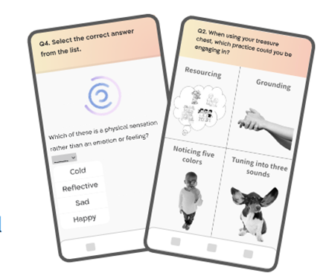
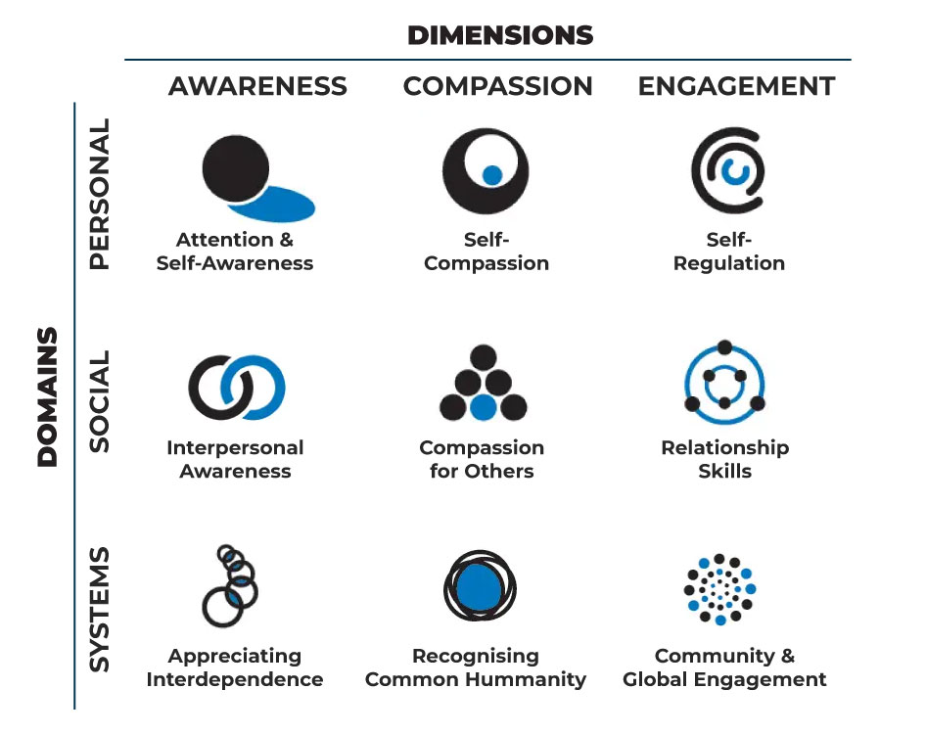
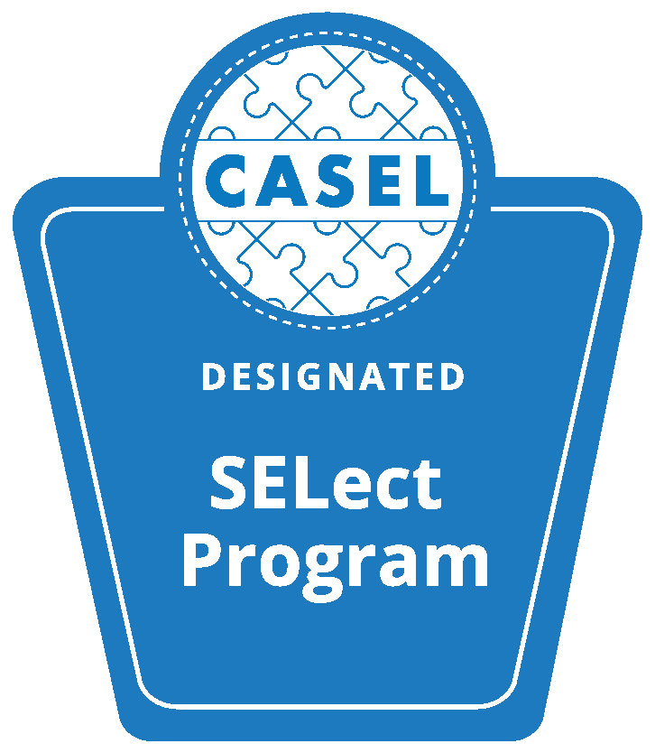
Assessment Development Projects
Digital Assessment: SEE Learning Insight - curriculum-based assessment tool being developed in collaboration with Kayma | Developmentally Appropriate Expectations of Change: We are building age-appropriate rubrics that span the K-12 curriculum. They will help teachers understand expected changes in behavior, communication, relationships, and learning. | Assessment Package for Framework-Based Effectiveness: With affiliates, development of an assessment package for effectiveness studies aimed at assessing domain components, specific to our programs.
Other Key Areas of Development
Global Implementation Framework: Establishing a foundation for a monitoring and evaluation approach that is informed and grounded by practices worldwide to better support implementation.
Whole School/System Trainings and Courses: Utilizing theories for comprehensive school-wide and system-wide implementation to address the sustainability of SEE Learning and SEL programs.
Student Team
Currently, over 38 undergraduates, masters students, and PhD students from Emory and globally have been a part of our student research team.
Key Publications
US: Frazier, T., Roeser, R., Schonert-Reichl, K.A. (2024). Cultivating compassion in educational settings - evaluating the effectiveness of a compassion-based SEL program in elementary school children in the US. PLOS one. In review.
Colombia: Frazier, T., Jaramillo Suarez, A. M., Manzano Hurtado, C., & McNabb, N. (2024). Resilience and Renewal: Exploring the Role of Social, Emotional, and Ethical Learning in Elementary Schools in Colombia. International Journal of Education. In review.
South Korea: Min, H. J., Park, S. H., Lee, S. H., Lee, B. H., Kang, M., Kwon, M. J., & Won, S. (2024). Building Resilience and Social–Emotional Competencies in Elementary School Students through a Short-Term Intervention Program Based on the SEE Learning Curriculum. Behavioral Sciences, 14(6), 458.
Ukraine: Rosenstein, S., Marushchenko, O., Valevska, N., Elkoin, O., Drozhzhina, T., & Frazier, T (2024). The Effects of a School-Based Social-Emotional and Ethical Learning Program on the Well-Being of Ukrainian Classrooms in the Context of War. Conflict and Health. In Review
Brazil: Romano, G., Bazán, P., Sato, J., Cruz, N. V., Pacífico, E., Lacerda, S., Kolchraiber, F. C., Frazier, T., & Kozasa, E. H. (2024). Mental health improvements of a four-week social, emotional and ethical learning training in Brazilian public school teachers. Frontiers in Psychology, Educational Psychology. In review.
Mongolia: Ishkhorloo, L., Lkhamsuren, B., Byambajav, B., & Frazier, T. (2024). Predicting the happiness and life satisfaction of middle school students by family factors. Educational Studies, 24(598), 598.
Global Integration: Frazier, T., & Fosco, S. L. D. (2023). Nurturing positive mental health and wellbeing in educational settings – the PRICES model. Frontiers in Public Health, 11.

