Slide 1
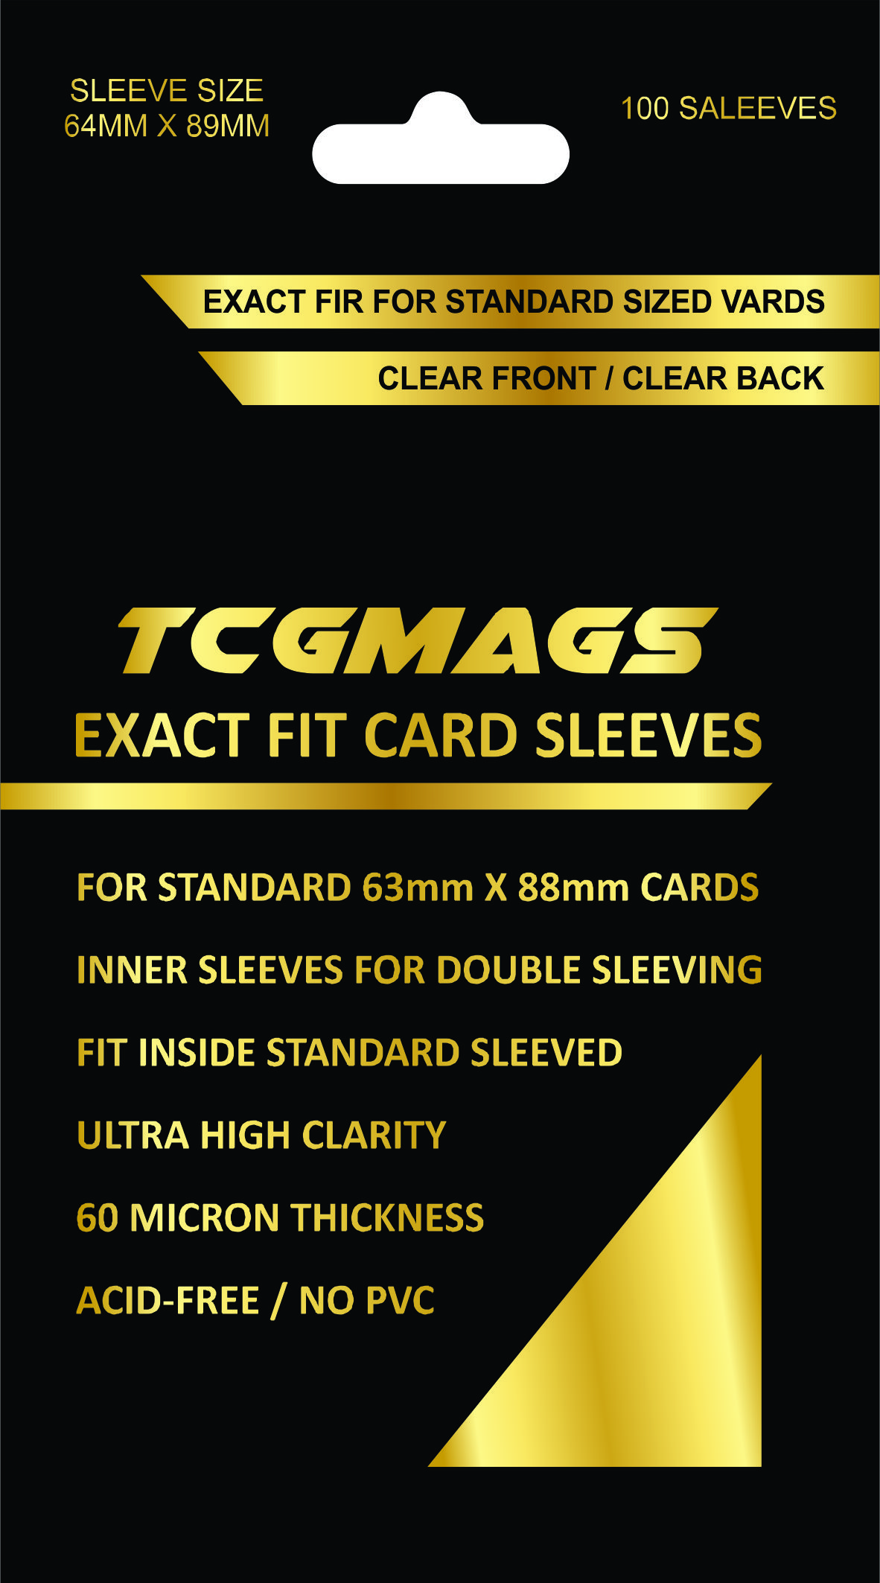
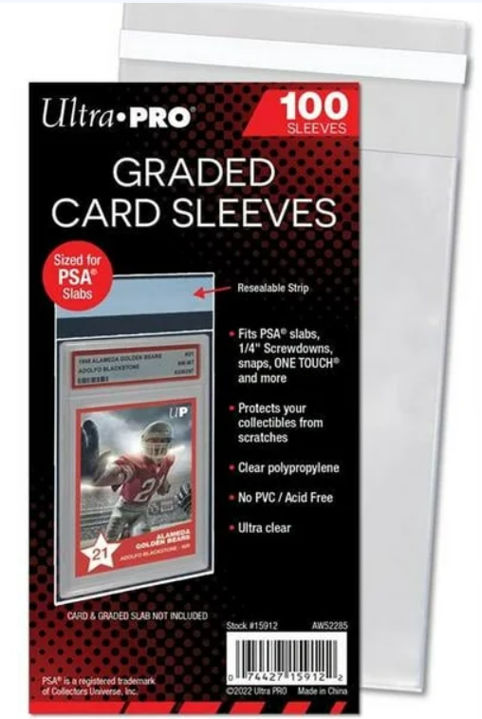
GRADED CARD SLEEVES
Redesign this so it looks more premium.
Similar Product On Market

Slide 2
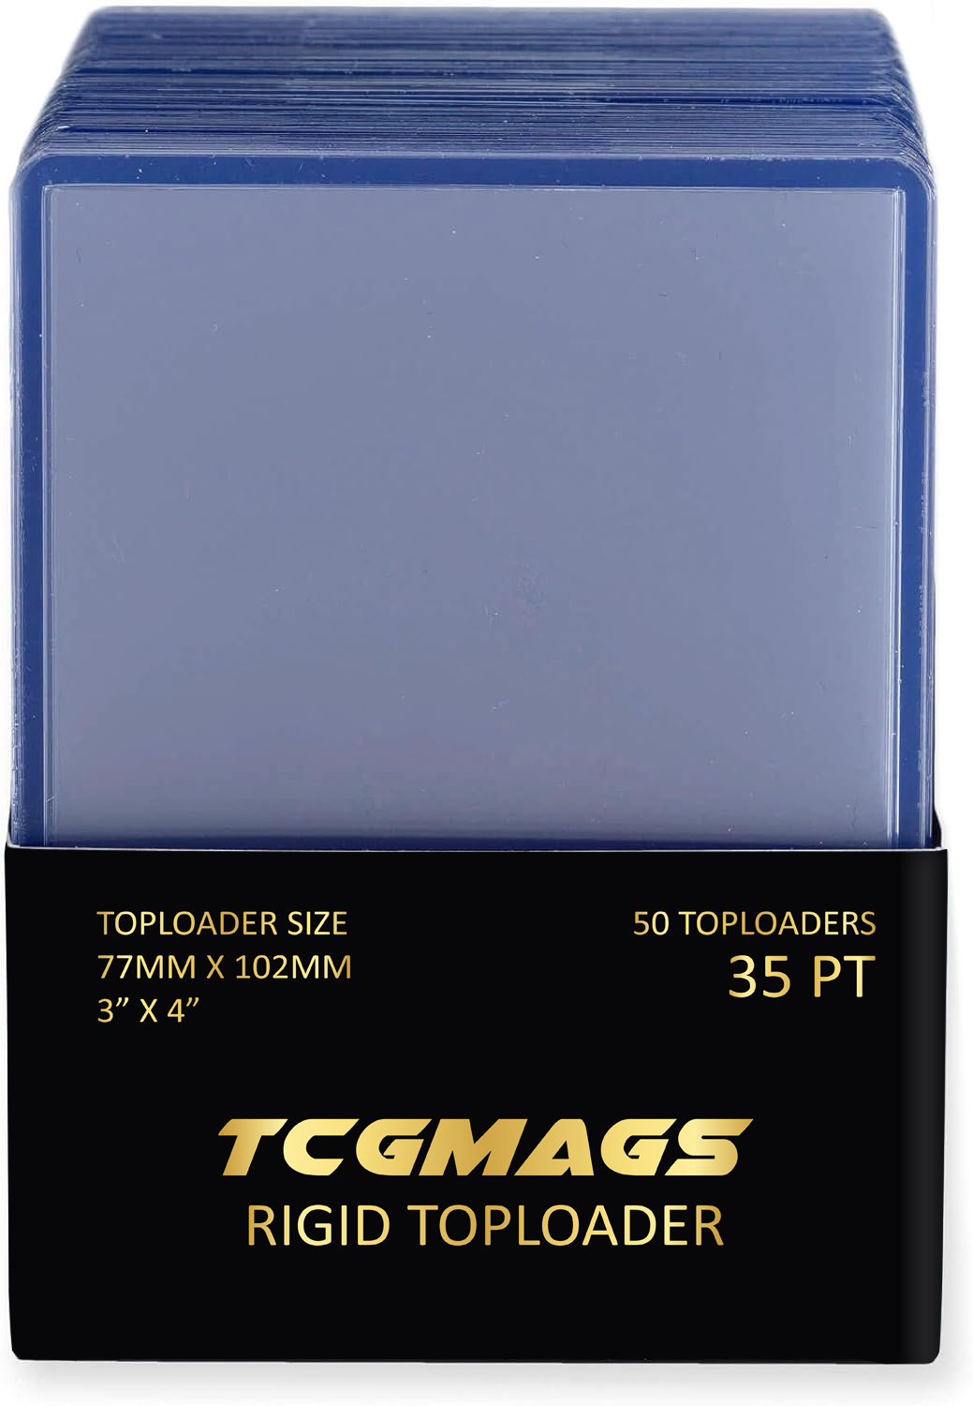
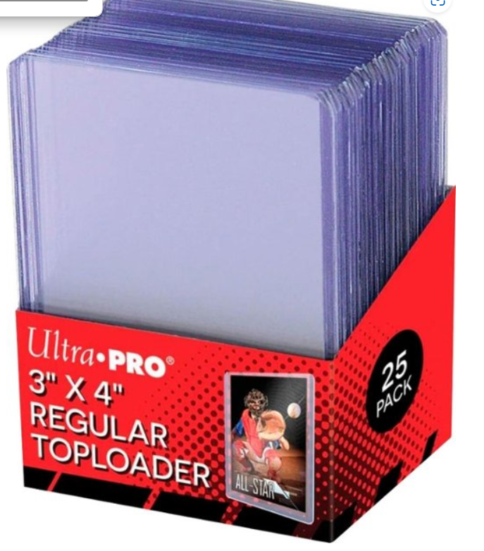
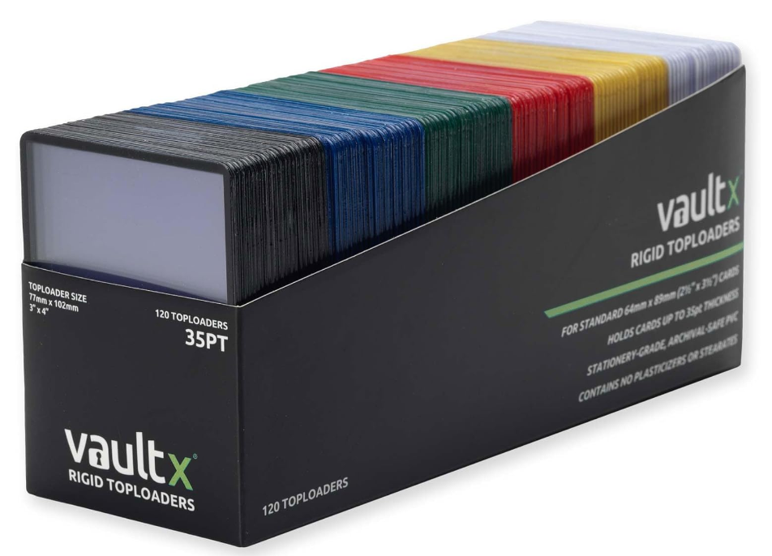
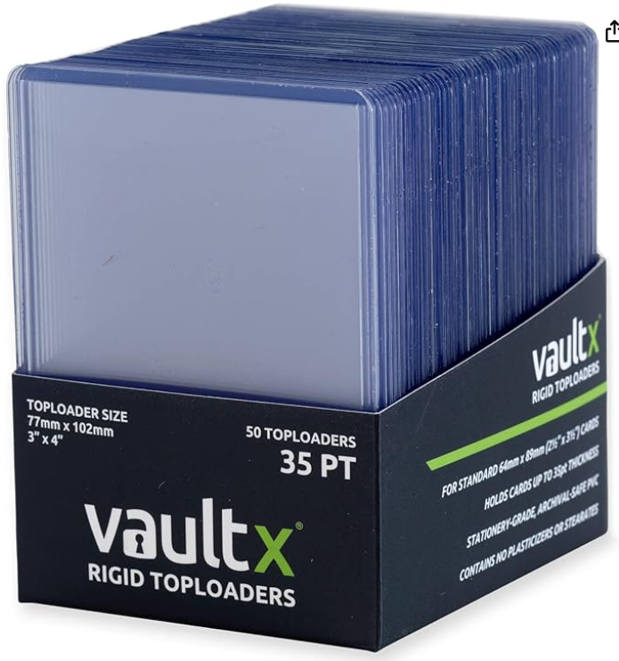
Redesign packaging so it looks more premium, then provide multiple angles of 20 pack image. Then provide it in many colors.
35pt Top Loaders
Redesign this so there is a 120 pack design similar to the one below.
Competing Product

Slide 3
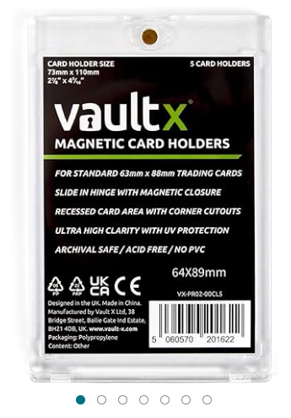
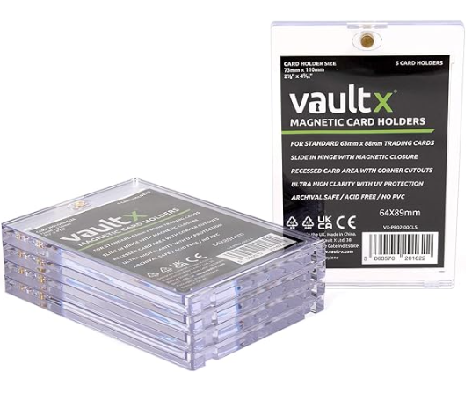
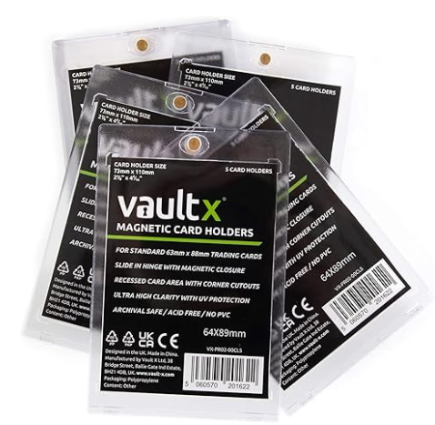
One Touch Case
Take Previous Product Styles and create a style for this one touch case so all products have same branding style.

