Slide 1



UNEP Plastic Pollution Treaty
Scientific Checks & Balances
Some think science can provide definitive, complete and foolproof answers. But given the world’s complexity, different research modalities and replication limits, critical thinking must be embraced to develop policies that work.
The Body of Research on Plastic Is Extensive.
Are All Plastics Toxic?
Are NGO, UNEP or Industry Interpretations Accurate or Inaccurate?
Is Data Transparency Evident For The Science Supporting Policy Considerations?
Problematic Plastics Are Classified Without Criteria
Is Scientific Information On Plastic Pollution Being Used Out Of Context?
Know How To Ask The Right Questions

Slide 2

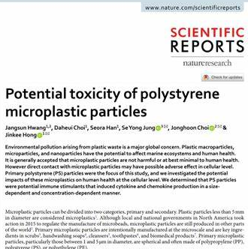
NGO Misuse of Technical Data
The definition of data misuse is using any information in a way it’s not supposed to be used. Terms of proper data use are usually specified in laws, industry standards, policies, and other agreements.
False Claim: “Polystyrene foam contains styrene, which has been linked to cancer, vision and hearing loss, impaired memory and concentration, and nervous system effects.”
Reference: Potential Toxicity of Polystyrene Micropolastics
Research Conclusions: “The study confirmed that PS particles were not toxic to human cells at a dosage of ~500µg/mL and PS particles with diameters of 10-11 µm were not significantly cytotoxic”. Further, “It could be concluded that PS particles are not cytotoxic to HDFs and PBMCs in usual conditions but might cause damage in extreme, high concentrations.”
Potential Toxicity of Polystyrene Microplastic Particles, Yonsei University, South Korea December 1, 2020

Slide 3
Atmospheric Studies In 11 Cities Have Varying Results
Does Microplastic Really Represent A Threat? A Review of Atmospheric Contamination Sources & Potential Impacts (2021)
In 11 studies in specific locations (Europe, Asia, North America) airborne polystyrene particles were found in only three cities. The results represent three different test sample types and all three used varying air concentration calculations. Therefore, the results are incompatible.
Thematic Hypothesis: Atmospheric transport of microplastics is detrimental and is of great concern to the global community.
What’s Inside:
There Are Three (3) Air Sampling Methodologies In This Developing Field of Study
No Standard Method Exists To Prepare Airborne Microplastic Test Samples
Visual Identification Methods Are Ineffective For Smaller Atmospheric Samples
Studies Have Shown a Dominant Number of Airborne Microplastics are Fibers (≤95%).
Bottom Line: There is a need to conduct comprehensive research on sources of atmospheric microplastics to aid in the initiation of effective control mechanisms and policy measures.

Slide 4
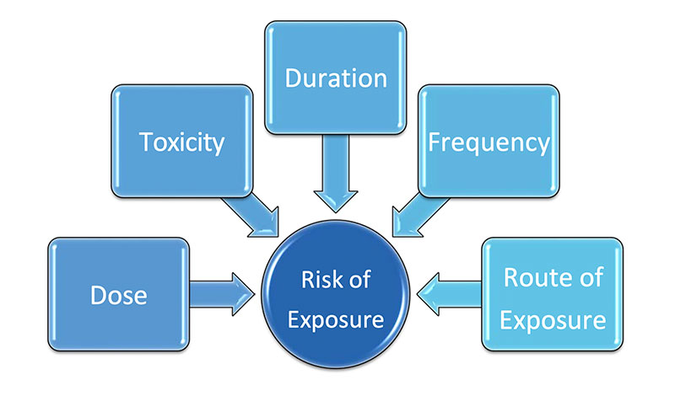
Understanding Risk Versus Exposure
Any substance can be poisonous. Chemicals of concern must be evaluated within typical use parameters to evaluate its potential to present a hazard.
U.S. Integrated Risk Information System (IRIS) cautions that “IRIS values cannot be validly used to accurately predict the incidence of human disease or the type of effects that chemical exposures have on humans. This is due to the numerous uncertainties involved in risk assessment, including those associated with extrapolations from animal data to humans and from high experimental doses to lower environmental exposures.”
Risk Assessment Involves Reasonable Assumptions Under Different Exposure Scenarios To Determine Toxicity Levels
Is It Toxic? Scientific Ratings
Carcinogens
“no significant risk level” (“NSRL”) means that exposure to the amount of chemical in a product would result in no more than one case of cancer out of every 100,000 individuals who were exposed to the chemical over a 70-year time period.
Reproductive Toxins
Maximum allowable dose level (“MADL”) is the level at which a chemical would have no observable effect, even if an individual were exposed to 1,000 times that level

Slide 5
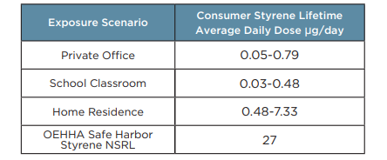
Expanded Polystyrene Does Not Pose A Human Health Threat
Expanded Polystyrene Foam – Residual Styrene Emissions
Styrene NSRL
≤27µg/day IS NOT Harmful
≤7.3µg/day

