Slide 1

GLYCAN-BINDING PROTEINS FOR BIOTECHNOLOGY AND MEDICINE
Barbara Imperiali
Professor of Biology and Professor of Chemistry
Massachusetts Institute of Technology
imper@mit.edu 1-617-253-1838

Slide 2
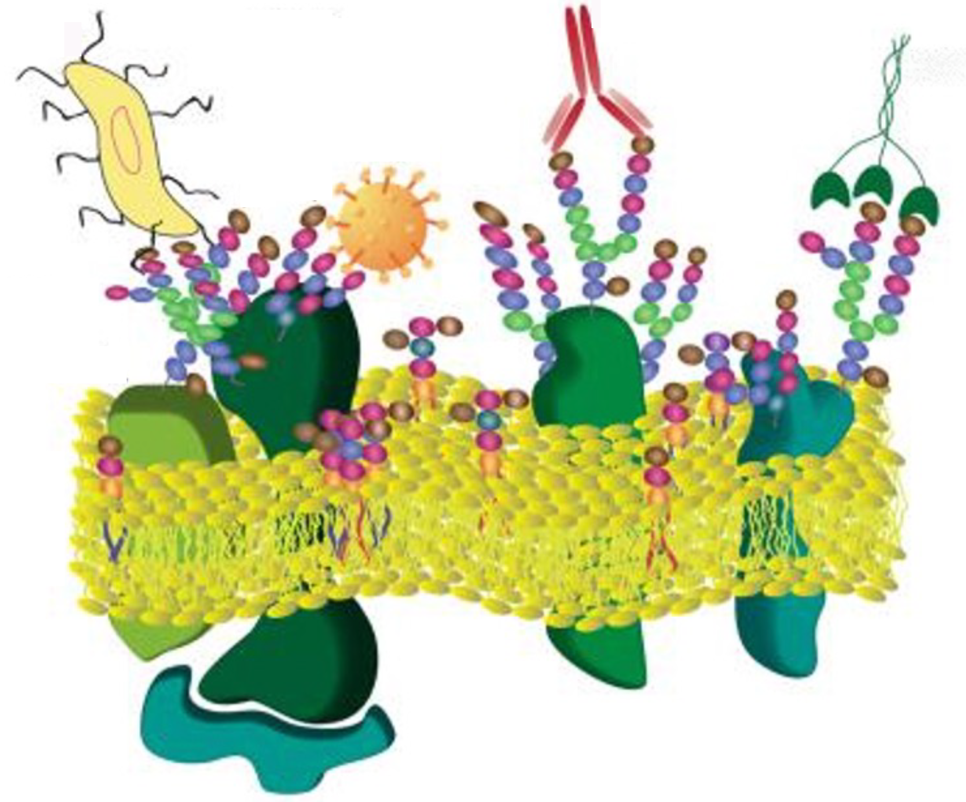
GLYCANS ON THE FRONT LINE OF HUMAN HEALTH
Mammalian cell surfaces and glycan interactions
Glycans implicated in many diseases^{1,2}
Targets for diagnostic (Dx) and therapeutic (Tx) agents³
Current glycan binding approaches: Lectins⁴ and antibodies (mAbs)⁵
Glycobiology R&D thwarted by limitations in production and scope of lectins and glycan-targeted mABs⁶
GOAL: Novel approach to Dx and Tx agents for detection and treatment undruggable targets
bacteria
mAbs
lectins
viruses
membrane
bilayer
glycolipid
glycoprotein
Notes:
Market by 2025: LTN 20 MM, mAbs (all) 250 BN
Questions for reviewer:
Do you agree with our problem statement?
Are you seeing a need / are you currently using these glycan binders (or what do you use).
If not, why? Is glycobiology important to you?
Are current technologies meeting your needs?

Slide 3
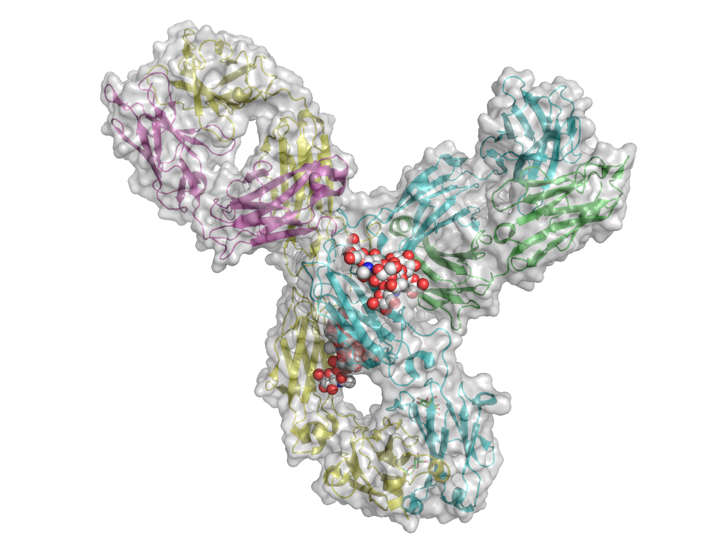
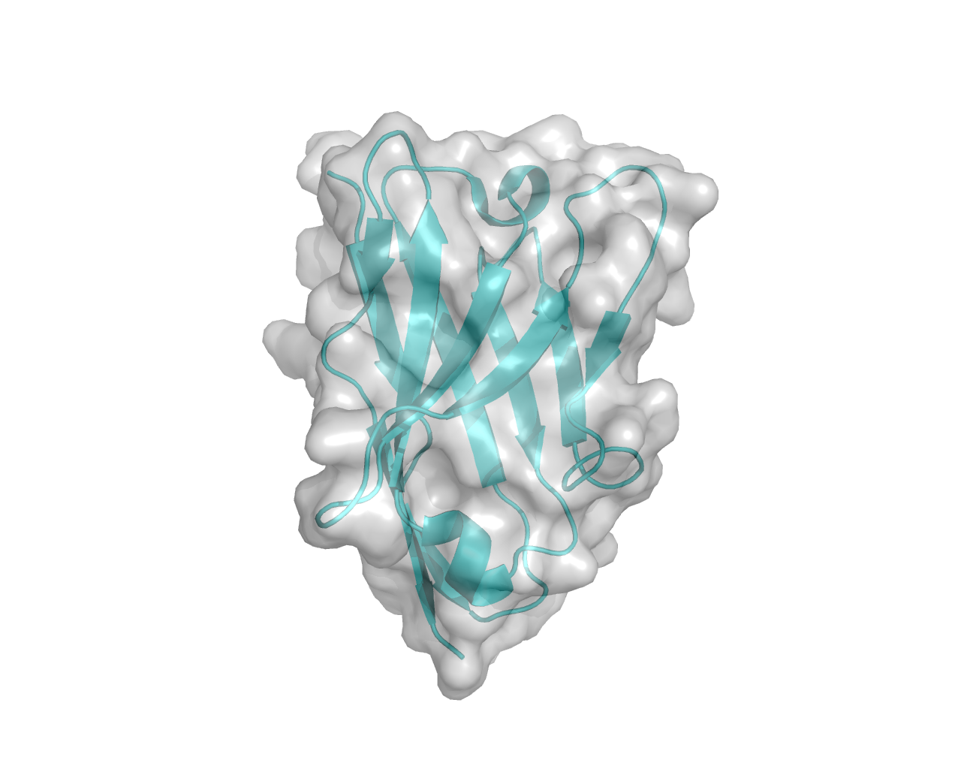
SIZE AND SIMPLICITY
Nanobody
<12 kDa, monomer
User-defined glycan
E. coli expression
YSD selection
Facile engineering
Antibody IgG
~150,000 kDa, tetramer
Human glycans poorly antigenic
Polyclonal Ab in animals
Monoclonal Ab via extensive screening and mAb formation
Expression in mammalian cells
Challenging to engineer

Slide 4
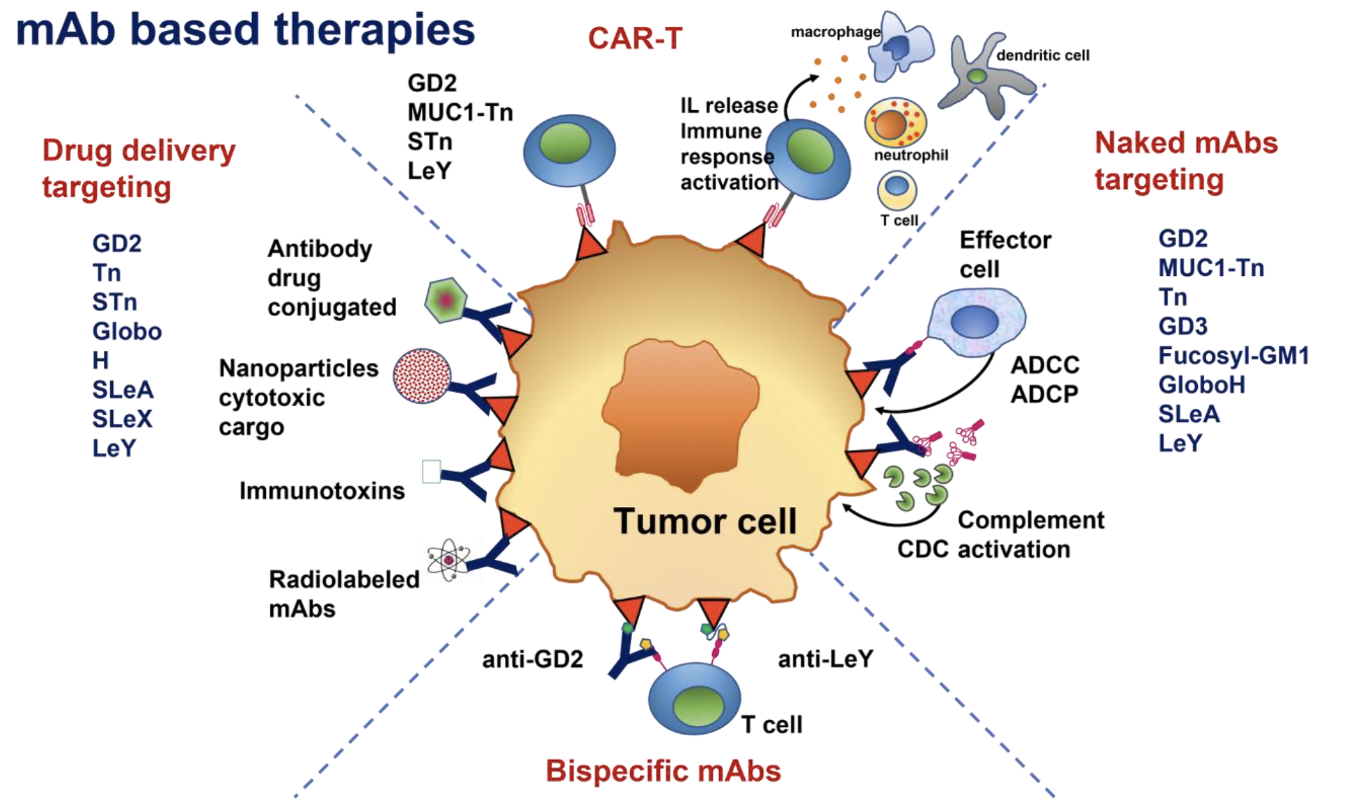
TUMOR ASSOCIATED CARBOHYDRATE ANTIGENS (TACAs)
Altered glycosylation patterns are a characteristic of cancer cells⁸
Specific glycans associated with tumor progression and metastasis
Many TACAs validated but under-served – Huge Dx and Tx opportunities
QUESTION:
Can evolved glycan binding NBs replace glycan-targeted mAbs⁹?
TEST CASE:
TF antigen (Galβ-1,3-GalNAc-αSer)¹⁰
Expression correlates with carcinoma differentiation. Clustered structures involved in invasion.
A Dx marker and target for CAR-T Tx¹¹

