Slide 1

GLYCAN-BINDING NANOBODIES (GB-NBs):
A NEW COMMERCIAL PLATFORM FOR
DIAGNOSTICS AND THERAPEUTICS
Barbara Imperiali
Professor of Biology and Professor of Chemistry
Massachusetts Institute of Technology
imper@mit.edu
Deshpande Mentor: Preston Keller (PhD, MBA)

Slide 2
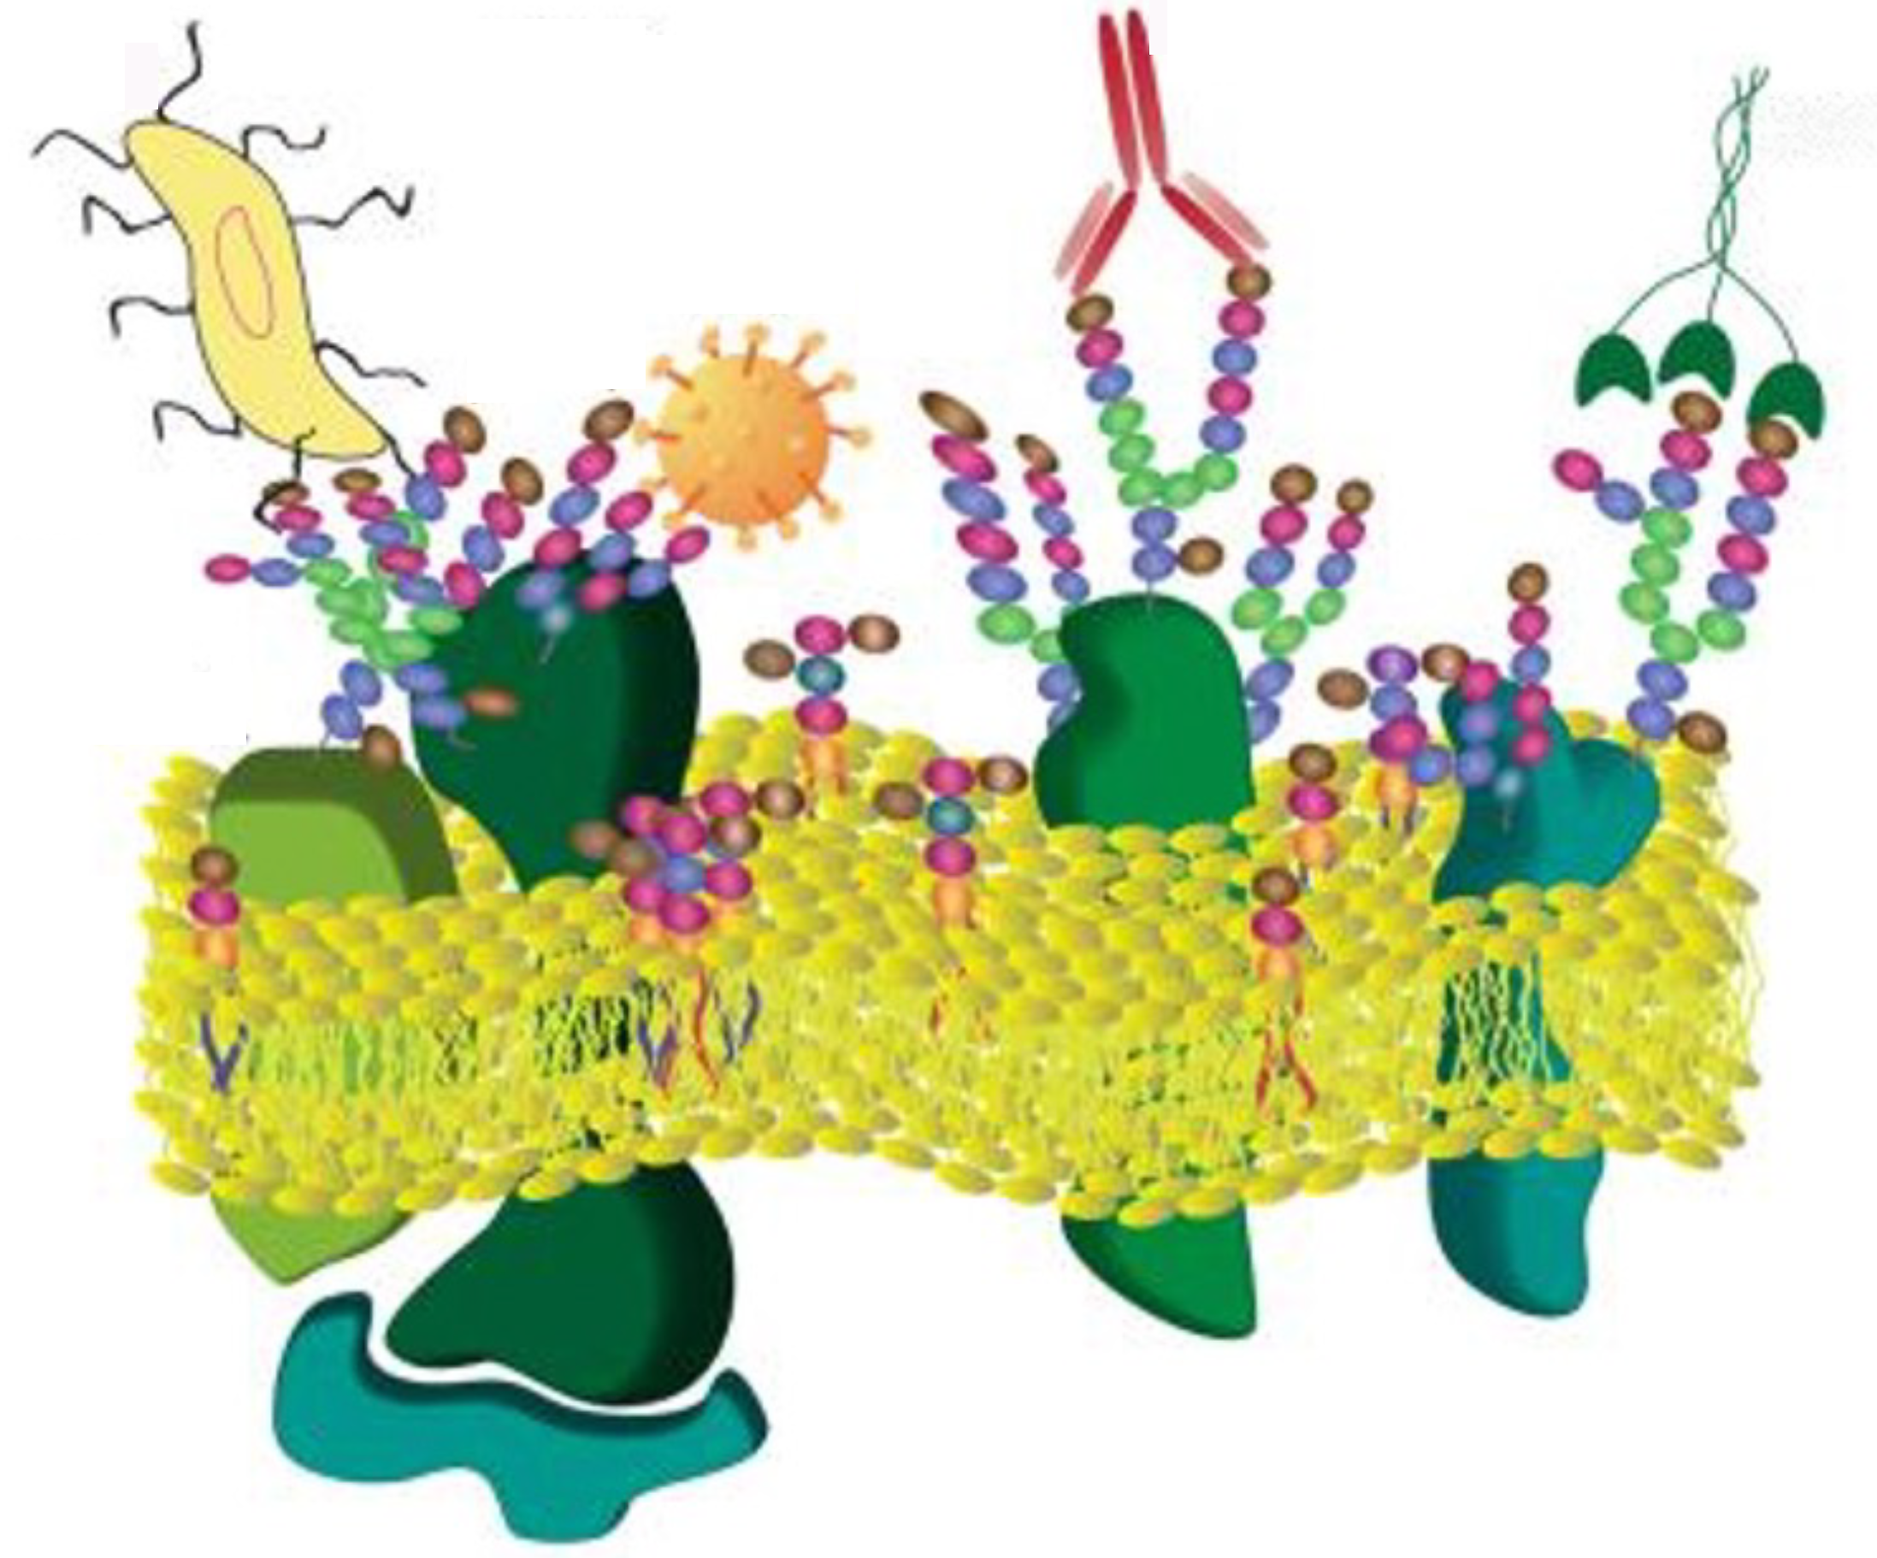
GLYCANS ON THE FRONT LINE OF HUMAN HEALTH
MAMMALIAN CELL SURFACES AND GLYCAN INTERACTIONS
Glycans implicated in many diseases^{1,2}
Targets for diagnostic (Dx) and therapeutic (Tx) agents³
Current glycan binder menu: Lectins⁴ and antibodies (mAbs)⁵
Glycobiology R&D thwarted by limitations in BOTH production and scope of lectins and glycan-targeted mABs⁶
GB-NB TECHNOLOGY: Novel approach to Dx and Tx agents for glycan detection and glycan enabled therapeutics
bacteria
mAbs
lectins
viruses
CELL SURFACE
glycolipid
glycoprotein
Notes:
Glycans – Polymers of sugar molecules form part of a rich “language”. Feature prominently in the surface Landscape of ALL cells – code for communication/interactions – good and bad
Market by 2025: LTN 20 Glycans on mediate
Questions for reviewer:
Do you agree with our problem statement?
Are you seeing a need / are you currently using these glycan binders (or what do you use).
If not, why? Is glycobiology important to you?
Are current technologies meeting your needs?

Slide 3
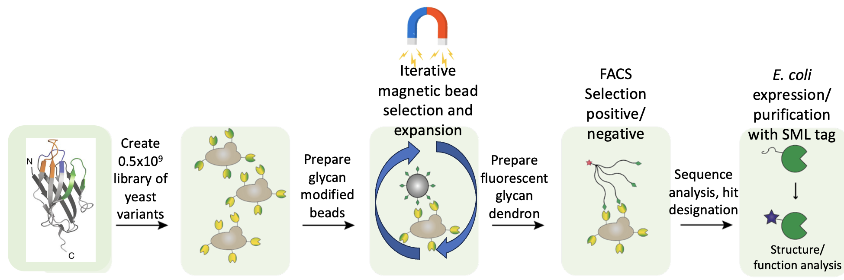
DIRECTED EVOLUTION PLATFORM FOR GLYCAN BINDERS
Established platform technology for nanobody (NBs) binders to “user-defined” glycans at MIT⁷ (new IP)
Yeast surface display and NB selection with multivalent glycan presentation (pool ~10⁸)
Platform addresses limitations in lectin and mAb production (cost and speed) and properties (specificity and scope)
ATTRIBUTES: User-defined glycan, E. coli production, potential for automation, facile engineering for applications - IR tags, PET ¹⁸F, radiolabels, gold nanoparticles……
Notes:
Questions for reviewer:
Do you agree our technology is a solution to the problem?
Are there other applications we haven't considered (ie if you don't agree with the problem, does this technology have other uses?)
What criteria (Kd, cost, data, cost, etc) do you need to see to feel like the solution is compelling?

Slide 4
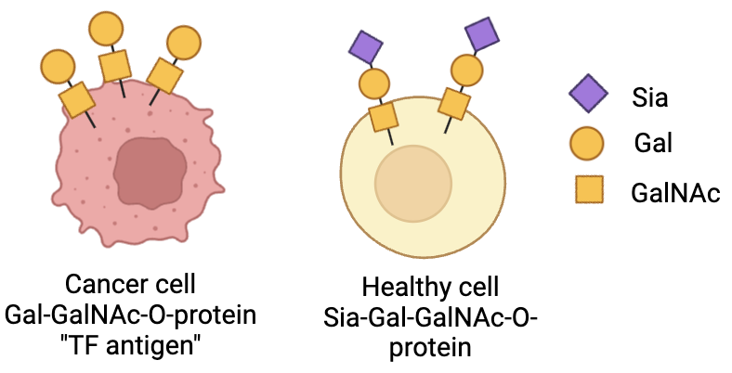
TUMOR ASSOCIATED CARBOHYDRATE ANTIGENS (TACAs)
Altered glycosylation patterns are signature characteristics of cancer cells⁸
Specific TACA glycans are associated with tumor progression and metastasis
Many TACAs validated but, majorly under-addressed – unmet opportunities (Dx/Tx)
A BENCH MARK TARGET FOR PLATFORM ENGINEERING
Thomsen-Friedenreich (TF) antigen
(Galβ-1,3-GalNAc-αSer)^{10.}
Expression correlates with carcinoma differentiation.
Clustered glycan structures involved in invasion.
TF is a Dx marker and target for CAR-T Tx¹¹

Slide 5
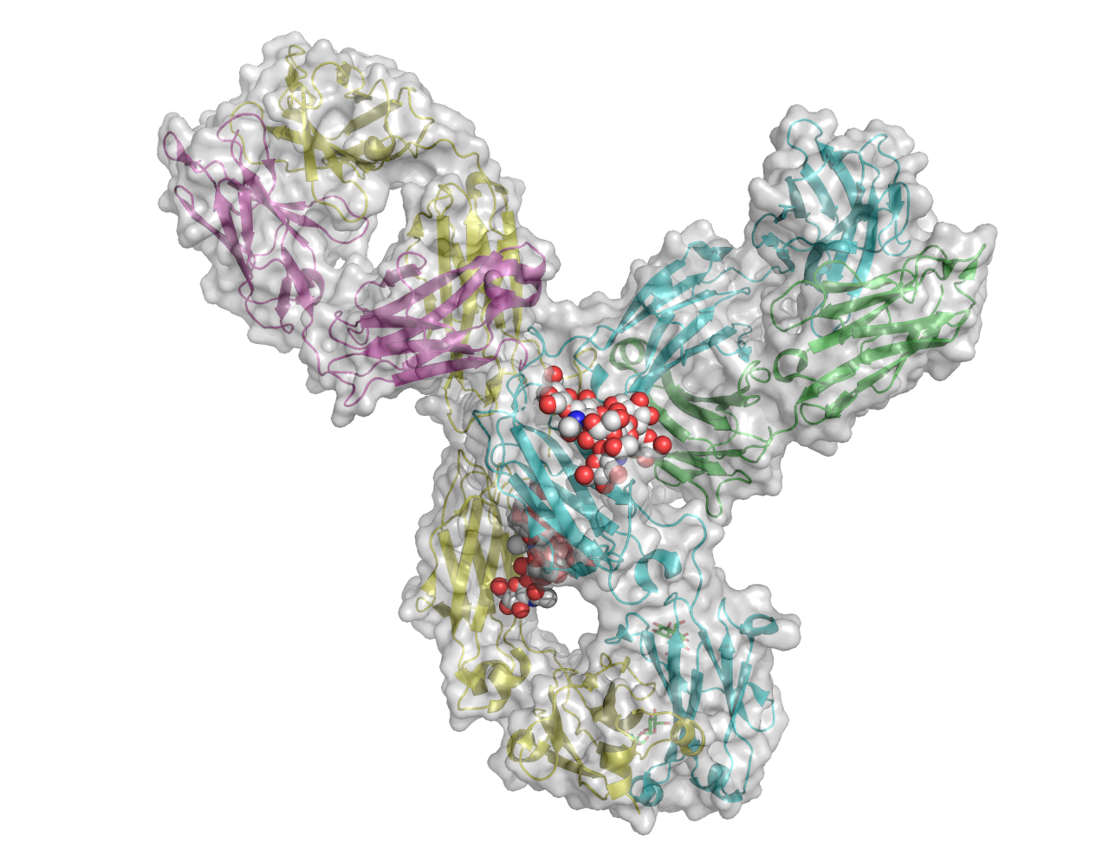
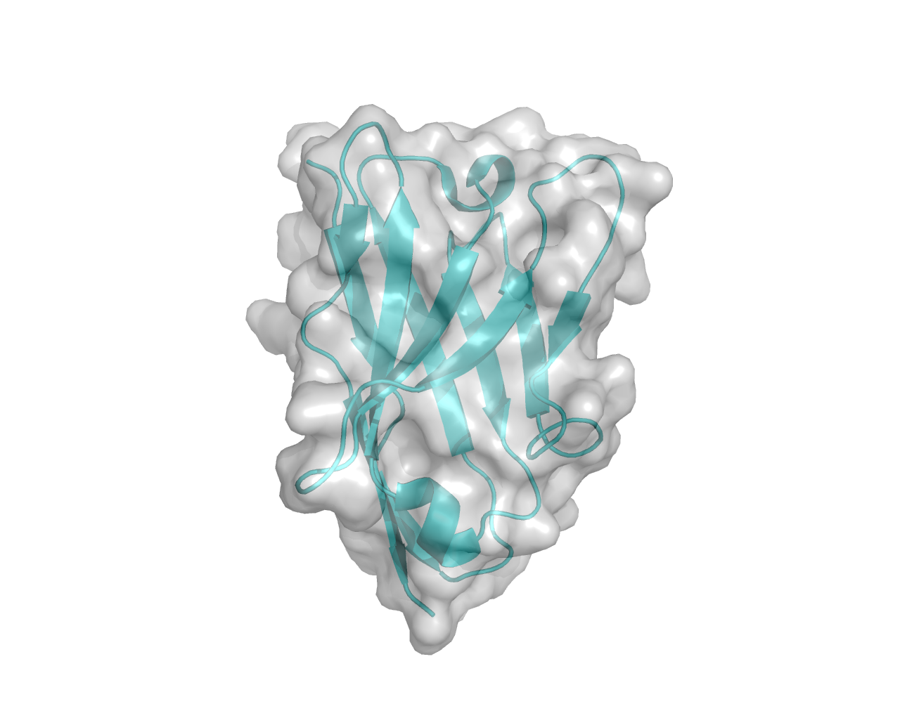
SIZE AND SIMPLICITY
NANOBODY
<12 kDa, monomer
User-defined glycan
E. coli expression
YSD selection
Facile engineering
Represent Fab domain (ADCC not activated)
ANTIBODY IgG
~240 kDa, tetramer
Human glycans poorly antigenic
Polyclonal Ab in animals
Monoclonal Ab via extensive screening and mAb formation
Expression in mammalian cells
Challenging to engineer
Activate ADCC and ADCP

Slide 6
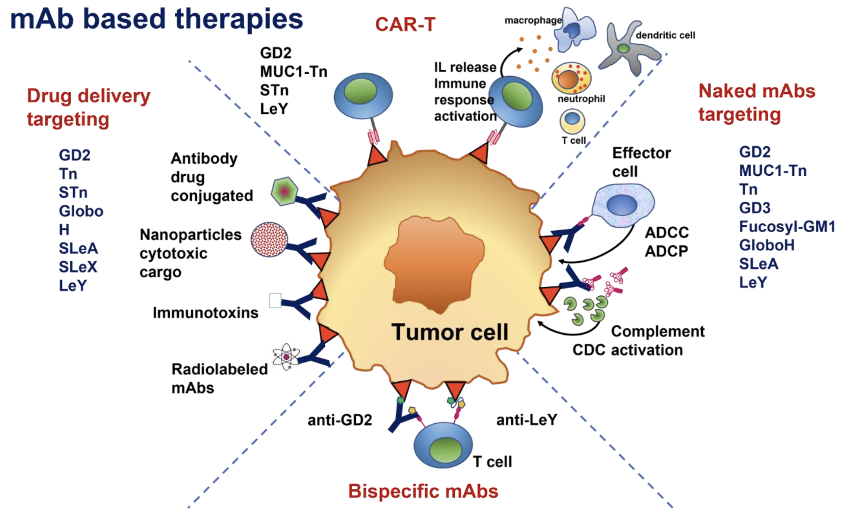
TACA TARGETS FOR mAb Tx STRATEGIES
ADCC and ADCP
Need IgG Fc domain
CAN SELECTED mAb FUNCTIONS BE REPLACED BY GB-NBs?

Slide 7
CONTACT
Barbara Imperiali
Class of 1922 Professor of Biology and Professor of Chemistry
Department of Biology 68-380
Massachusetts Institute of Technology
Cambridge
MA 02139
imper@mit.edu
1-617-253-1838
https://imperialilab.com/

Slide 8
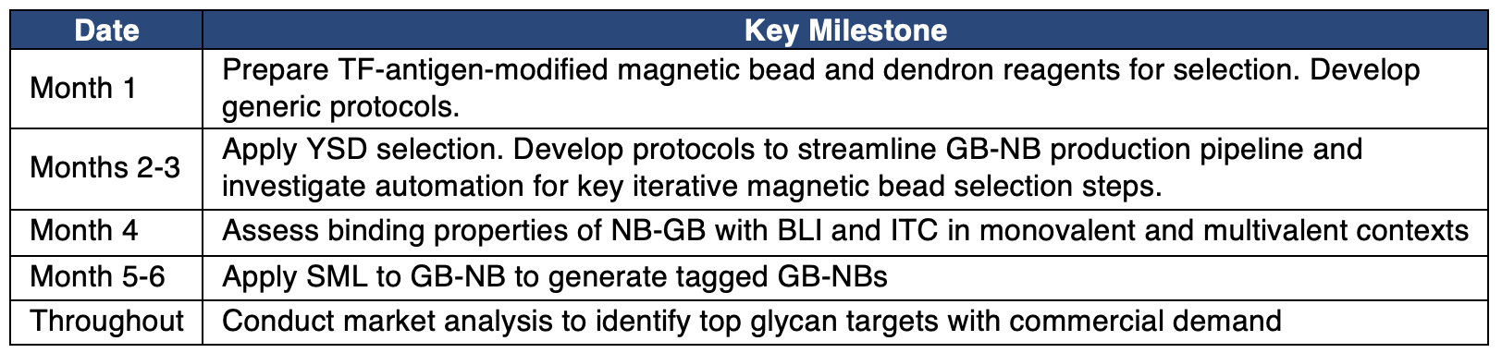

Slide 9
LITERATURE CITED
(1) Reily, C.; Stewart, T. J.; Renfrow, M. B.; Novak, J. Glycosylation in health and disease. Nat Rev Nephrol 2019, 15, 346-366.
(2) Varki, A. Biological roles of glycans. Glycobiology 2017, 27, 3-49.
(3) Guo, Y.; Jia, W.; Yang, J.; Zhan, X. Cancer glycomics offers potential biomarkers and therapeutic targets in the framework of 3P medicine. Front Endocrinol (Lausanne) 2022, 13, 970489.
(4) Bojar, D.; Meche, L.; Meng, G.; Eng, W.; Smith, D. F.; Cummings, R. D.; Mahal, L. K. A Useful Guide to Lectin Binding: Machine-Learning Directed Annotation of 57 Unique Lectin Specificities. ACS Chem Biol 2022, 17, 2993-3012.
(5) Sterner, E.; Flanagan, N.; Gildersleeve, J. C. Perspectives on Anti-Glycan Antibodies Gleaned from Development of a Community Resource Database. ACS Chem Biol 2016, 11, 1773-1783.
(6) Ward, E. M.; Kizer, M. E.; Imperiali, B. Strategies and Tactics for the Development of Selective Glycan-Binding Proteins. ACS Chem Biol 2021, 16, 1795-1813.
(7) Ward, E. M.; Zamora, C. Y.; Schocker, N. S.; Ghosh, S.; Kizer, M. E.; Imperiali, B. Engineered Glycan-Binding Proteins for Recognition of the Thomsen-Friedenreich Antigen and Structurally Related Disaccharides. ACS Chem Biol 2023, 18, 70-80.
(8) Berois, N.; Pittini, A.; Osinaga, E. Targeting Tumor Glycans for Cancer Therapy: Successes, Limitations, and Perspectives. Cancers (Basel) 2022, 14.
(9) Gillmann, K. M.; Temme, J. S.; Marglous, S.; Brown, C. E.; Gildersleeve, J. C. Anti-glycan monoclonal antibodies: Basic research and clinical applications. Curr Opin Chem Biol 2023, 74, 102281.
(10) Springer, G. F. T and Tn, general carcinoma autoantigens. Science 1984, 224, 1198-1206.
(11) Dragon, A. C.; Beermann, L. M.; Umland, M.; Bonifacius, A.; Malinconico, C.; Ruhl, L.; Kehler, P.; Gellert, J.; Weiss, L.; Mayer-Hain, S.; et al. CAR-Ts redirected against the Thomsen-Friedenreich antigen CD176 mediate specific elimination of malignant cells from leukemia and solid tumors. Front Immunol 2023, 14, 1219165.

