Slide 1
Overview
The product is a deck cleaner for boats. Two labels are required, one label for the front side of the container (Slide 2) and one label for the back side of the container (Slide 3).
Container Size
1 Gallon. See Slide 4 for the label dimensions.
Design
Slide Nos. 2-3 are examples of design and content. We are looking for a professional design that has a nautical theme fitting for the product use.
Design Files
We do have the Ebersold Boatworks logo design files. Other boat deck photos are also available if needed.

Slide 2
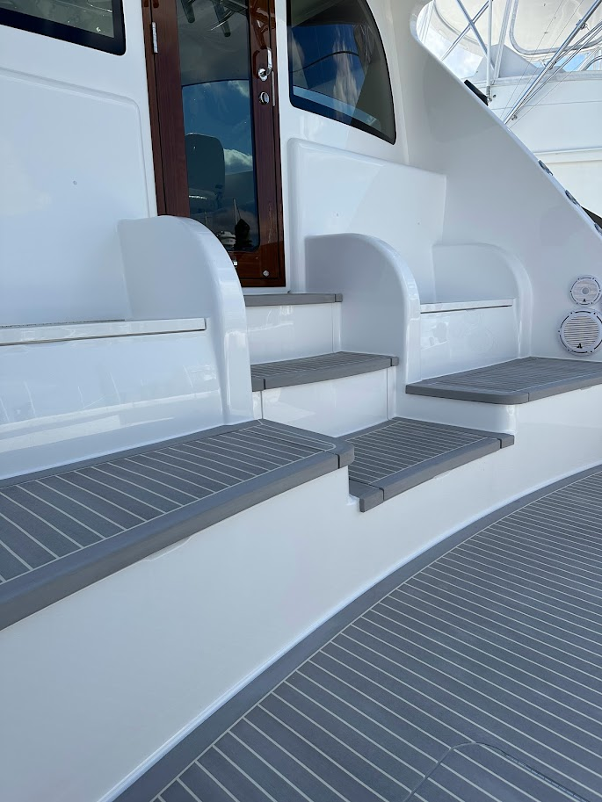



No. 7
Deck Cleaner
Concentrate
No Dyes
No Harsh Acids & Alkalis
Neutral pH 7
Safe For Synthetic Teak Decks
Safe for hard surface finishes.
CAUTION:
AVOID EYE CONTACT
1 GAL (3.78L)

Slide 3



No. 7 Deck Cleaner is a concentrated and environmentally safe biodegradable nontoxic surfactant cleaner. It is safe for synthetic teak decks and other exterior boat and yacht hard surfaces.
DIRECTIONS
Dilute 10:1
32oz Container
Use 2.9 oz of No. 7 Deck Cleaner to 29.1 oz of water.
128oz Container
Use 11.6 oz of No. 7 Deck Cleaner to 116.4 oz of water.
Warm surface temperatures (80º - 120ºF) will enhance cleaning effectiveness. Wet surface area and apply No. 7 Deck Cleaner using a 10:1 dilution ratio. Allow the No. 7 Deck Cleaner to dwell on the surface for a couple of minutes. Adjust dilution as required. Do not add any other chemicals.
SAFETY
Contains no harsh acids or akalis and is considered to be non-hazardous as defined by OSHA 29 CFR 1900.1200. Contains no chemicals to be reportable under EPA SARA Title III Section 313. Scan the code on this package to read the material safety data sheet (MSDS).
CAUTION
Avoid eye contact. May cause eye injury and/or skin irritation of throat, mouth and digestive tract. Ingestion may cause nausea. Keep away from children.
FIRST AID
Eye Contact: Flush eyes with water.
Skin Contact: Flush area with water.
If Swallowed: Call a physician.
STORAGE AND DISPOSAL
Store in a cool place away from heat and flame. Do not store at freezing temperatures. Rinse container thoroughly when empty. Return container for recycling or disposal in a manner consistent with government regulations.
No. 7
Deck Cleaner
Ebersold Boatworks LLC
4477 SE Commerce Avenue
Stuart, FL 34997
1-772-200-3252
www.ebersoldbw.com
Scan for product information.

Slide 4
