Slide 1
Baretto
1931
1931 - For the year that the owner’s grandmother was born
Baretto - Italian “Little Bar”

Slide 2
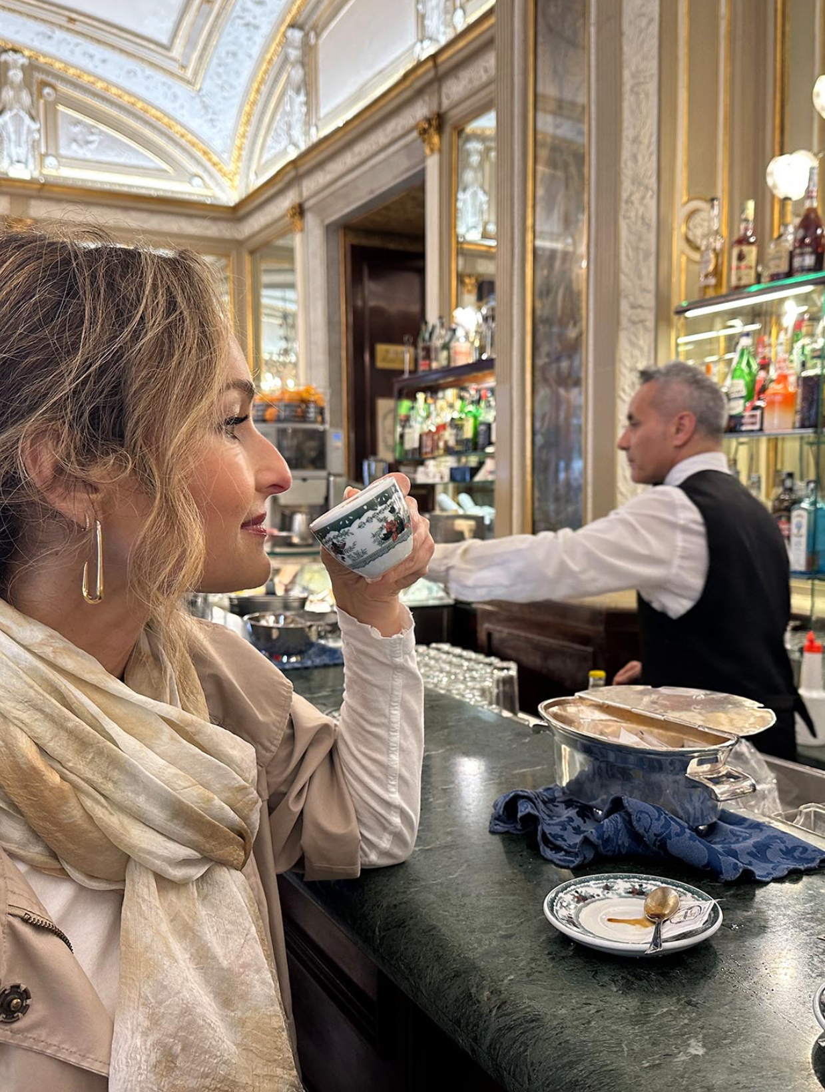
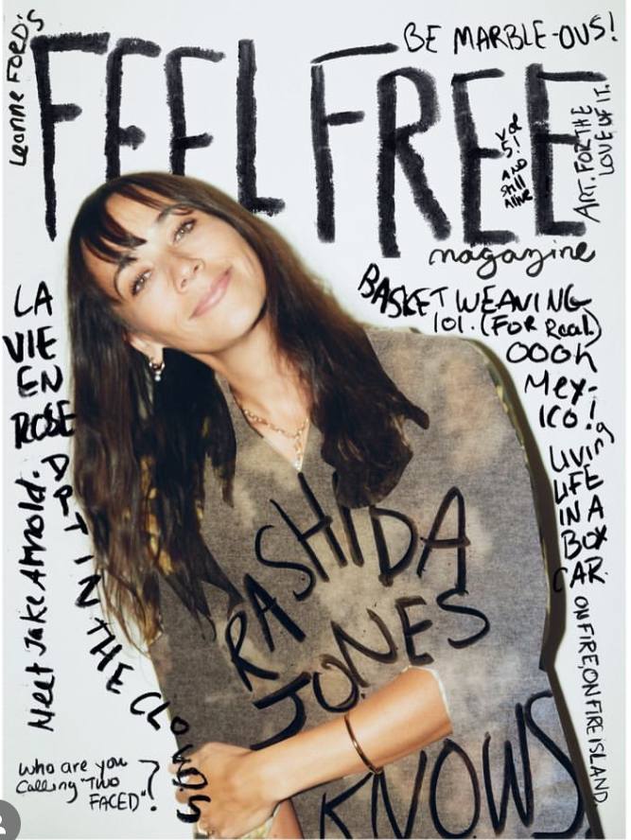
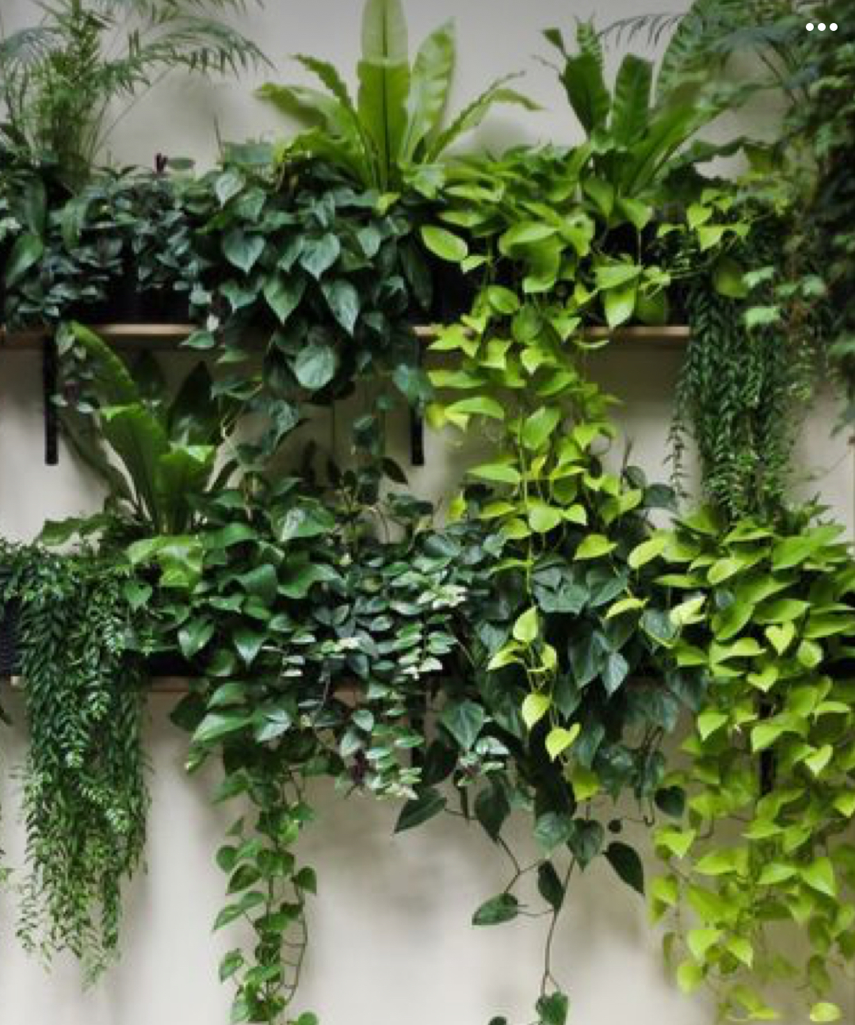
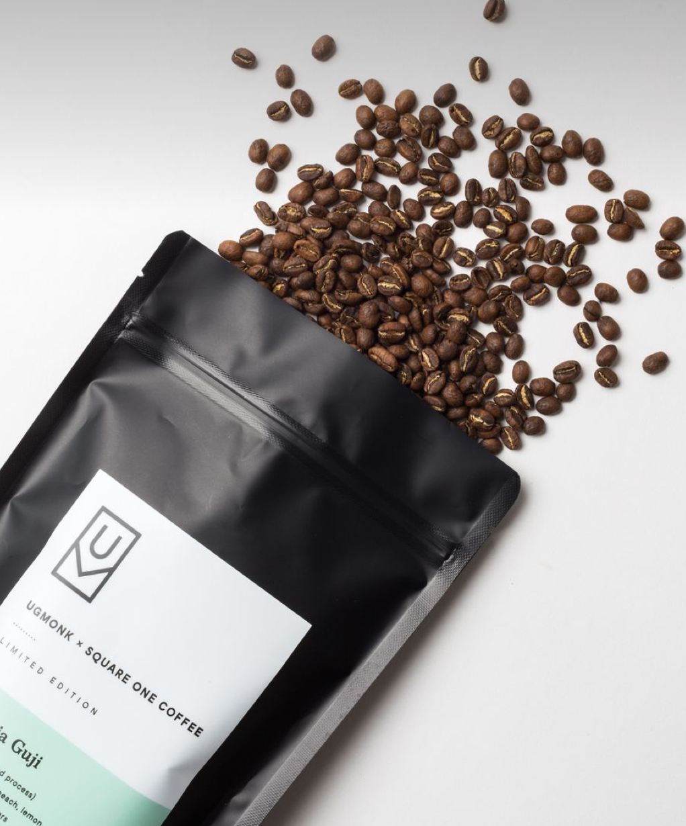
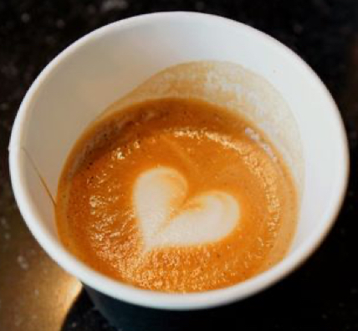
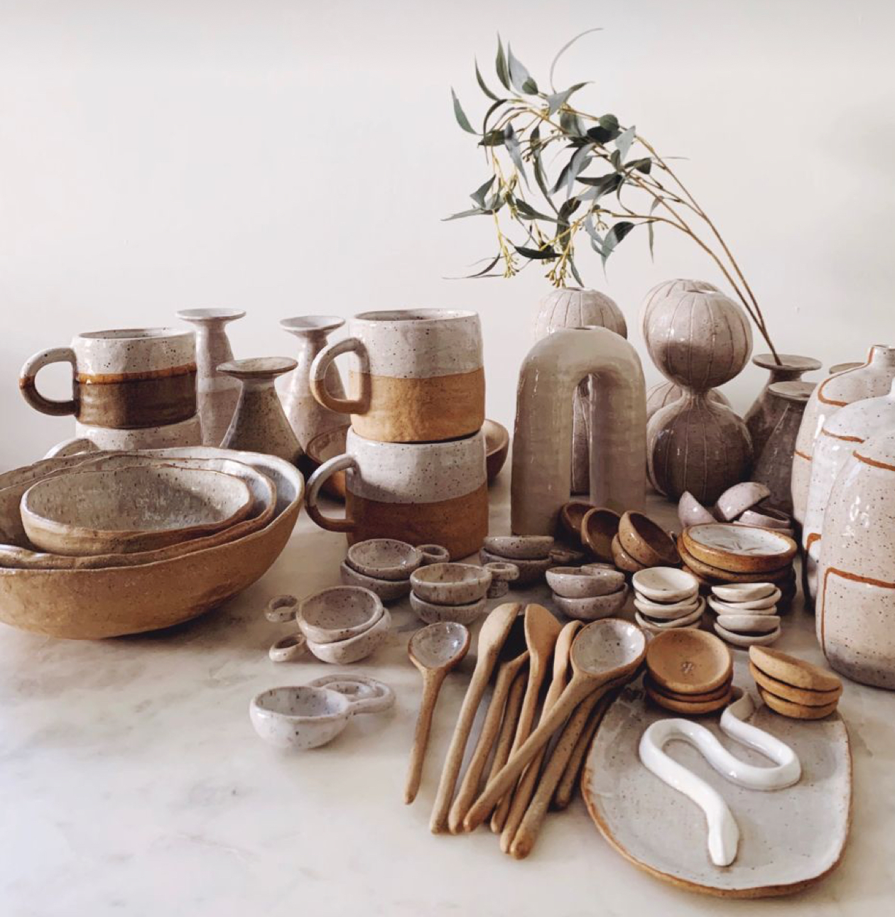

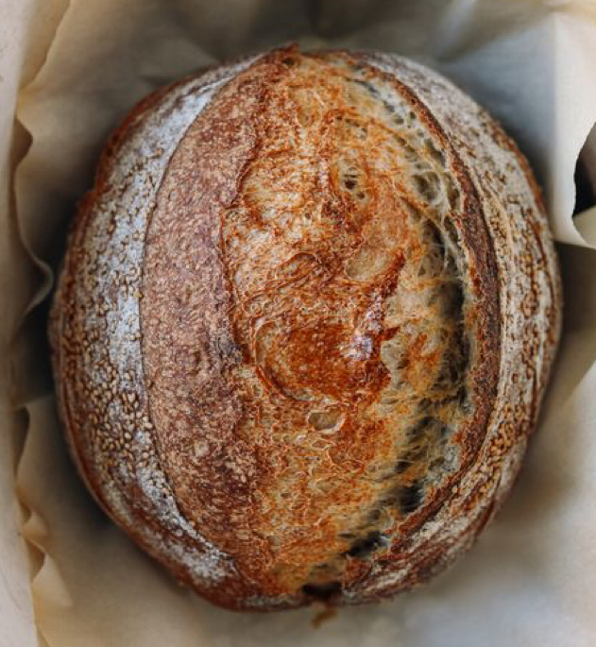
The Concept
Italian espresso bar meets Williams-Sonoma meets DonLo Mercantile
Stop in for your daily cortado and flip through a gorgeous coffee table book of your favorite travel spots or grab a magazine featuring all women artists. You can bring home a bag of locally roasted coffee, some sourdough tools and a how-to book for the person who is learning the craft.
Fine kitchen items for the foodie, great espresso for anyone and everyone, handmade ceramics, specialty limited baked goods and books and magazines for the reader and daydreamer!

Slide 3
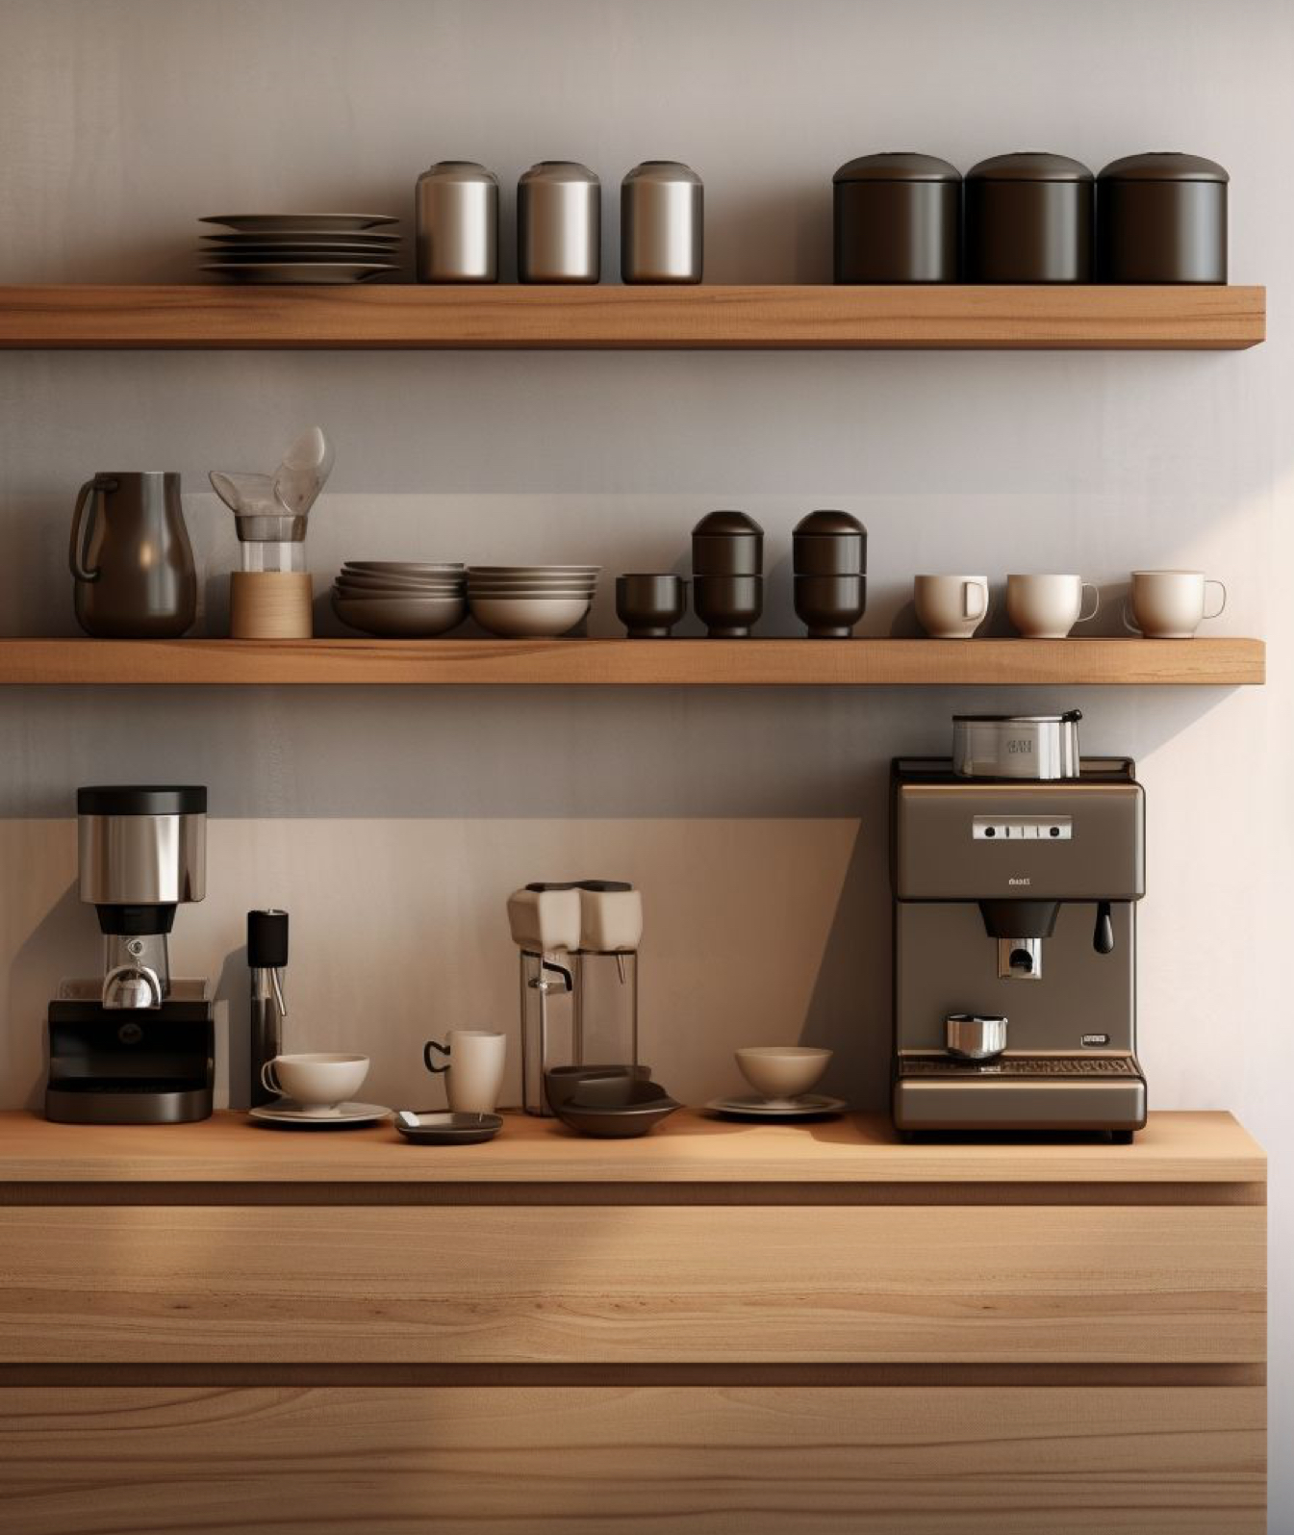

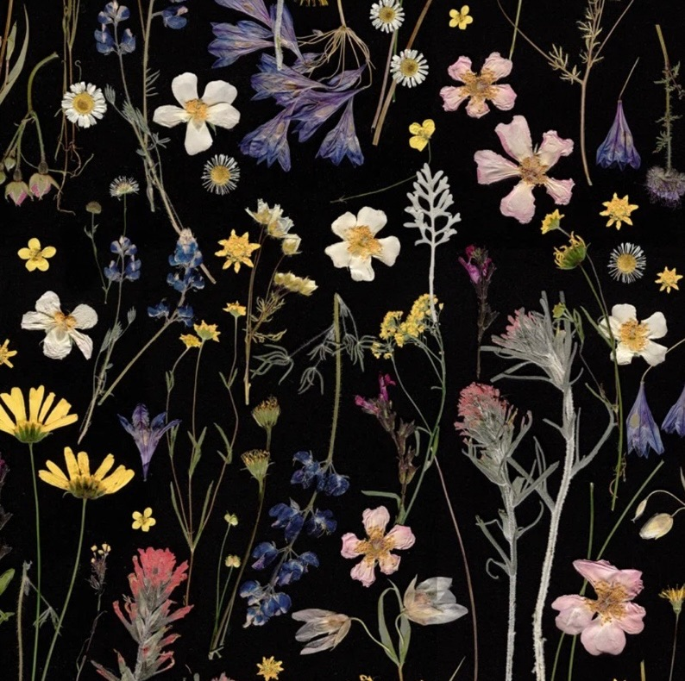
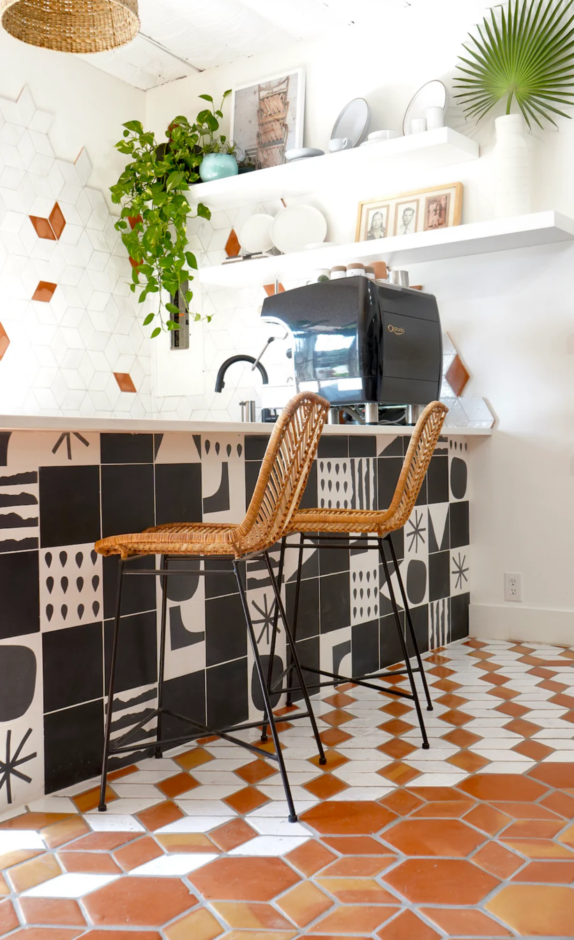
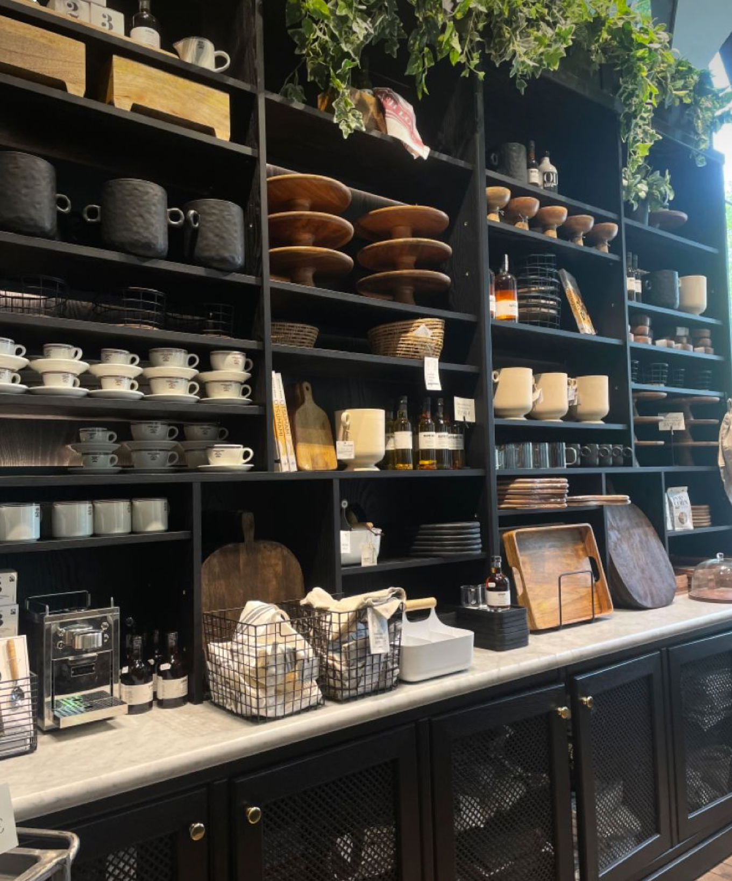
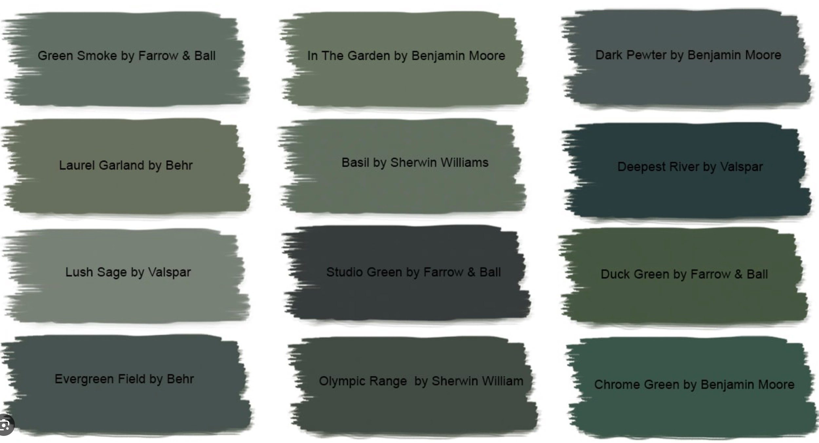
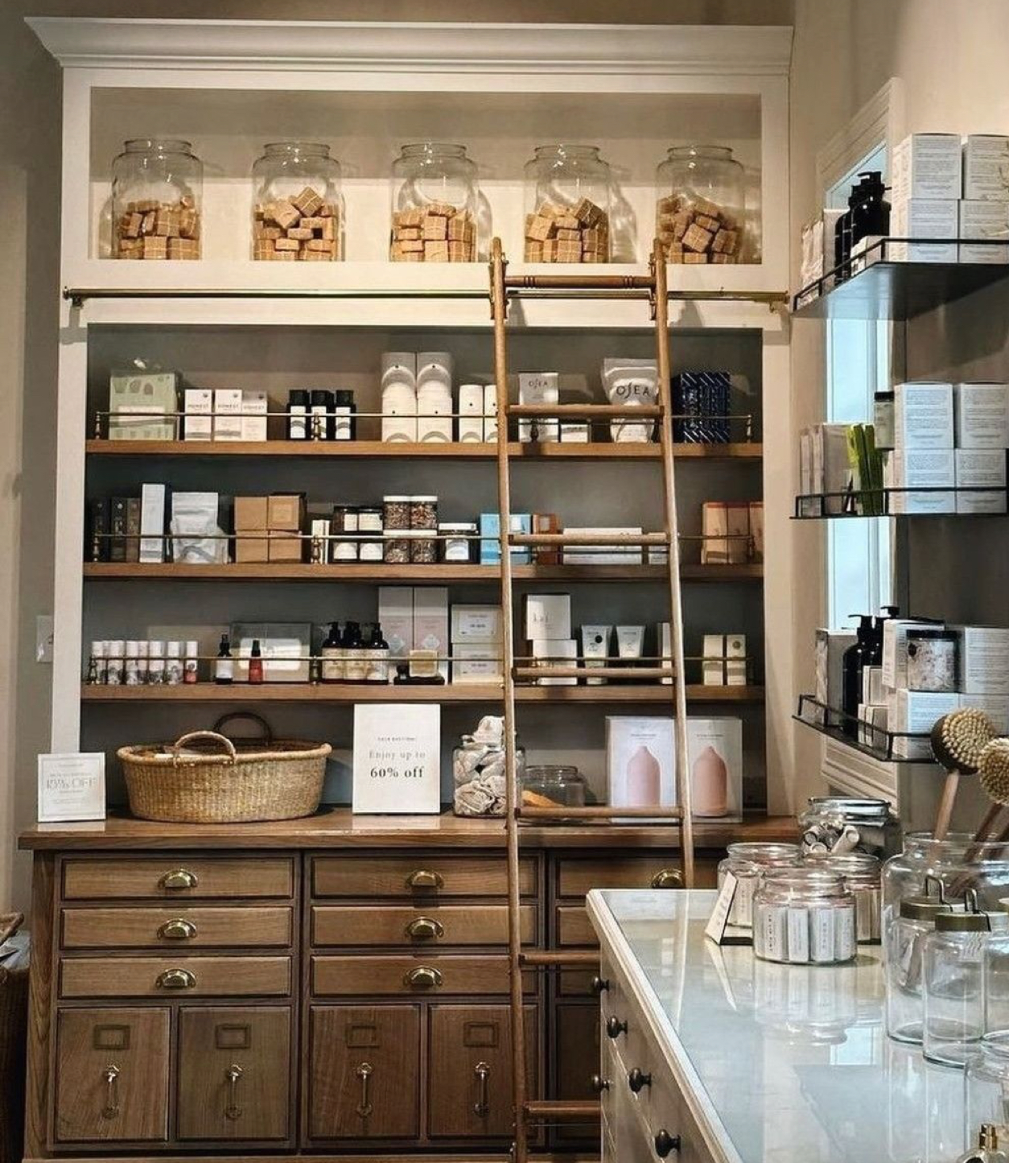
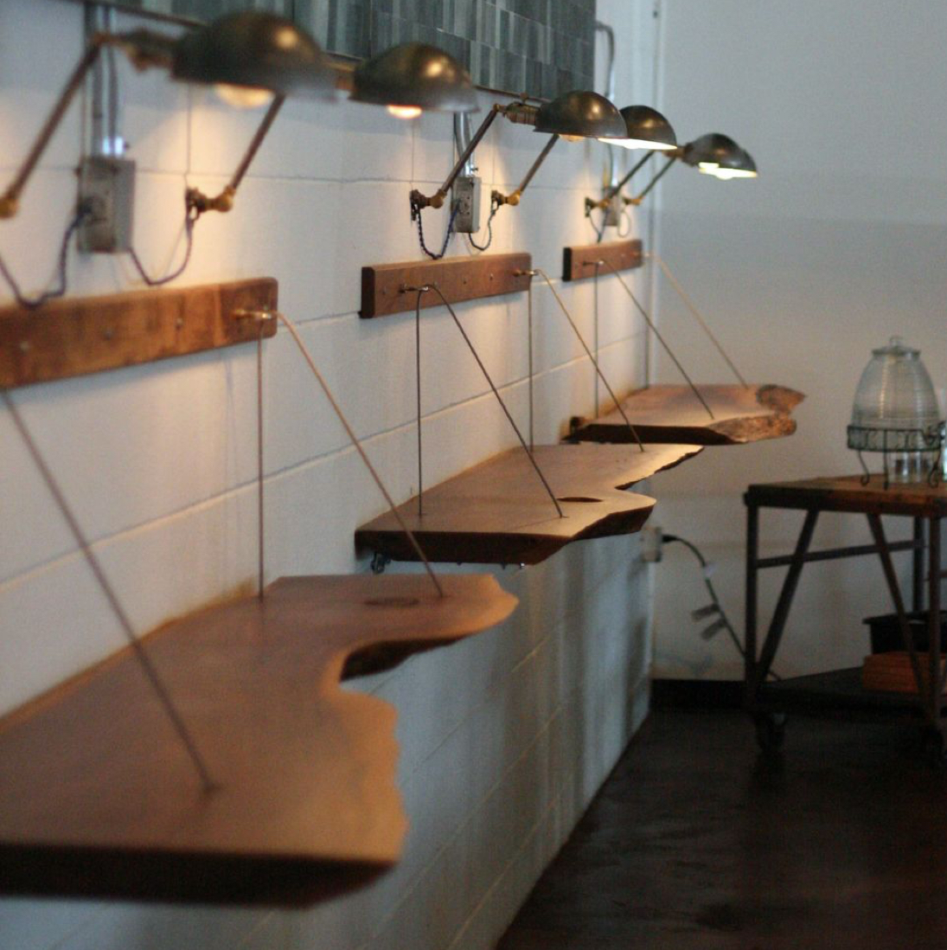
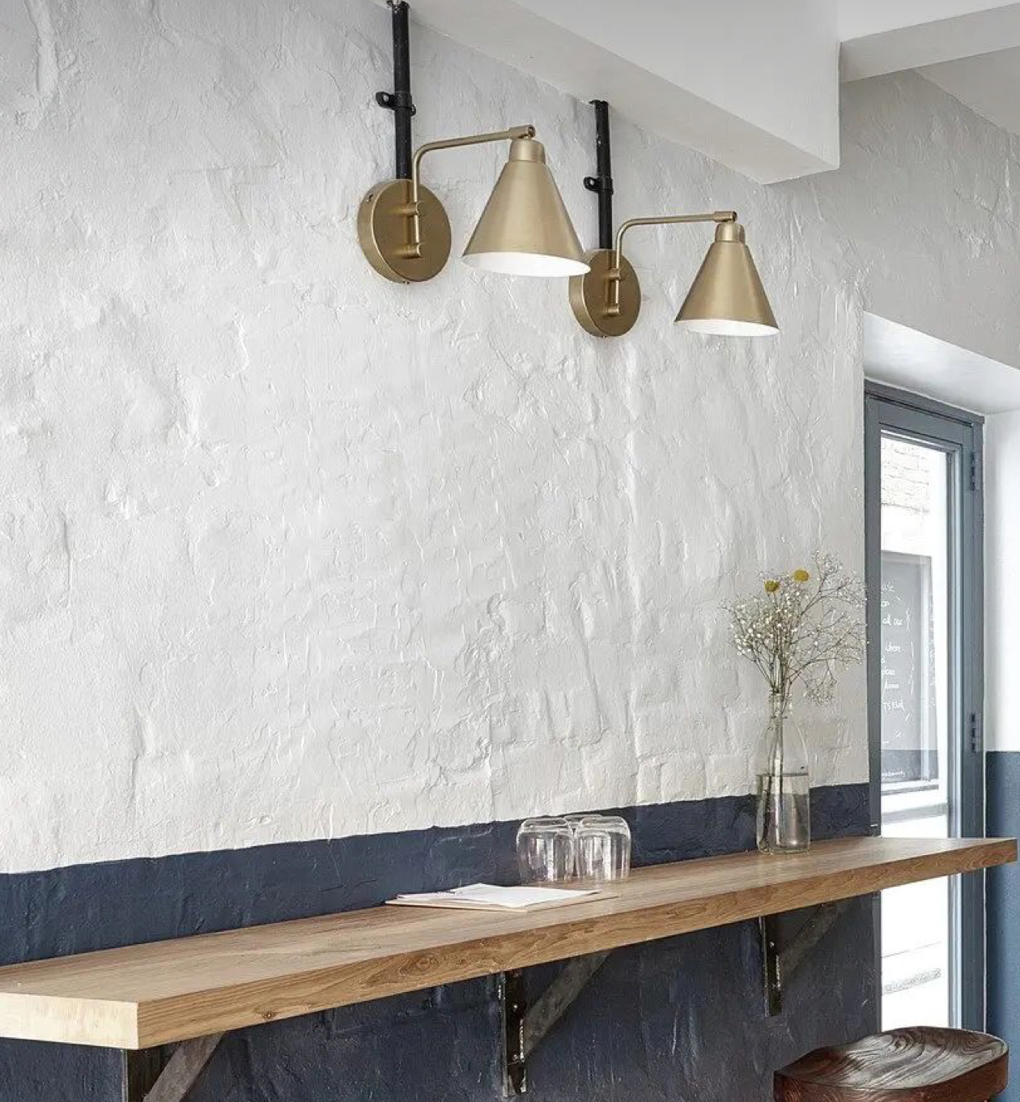
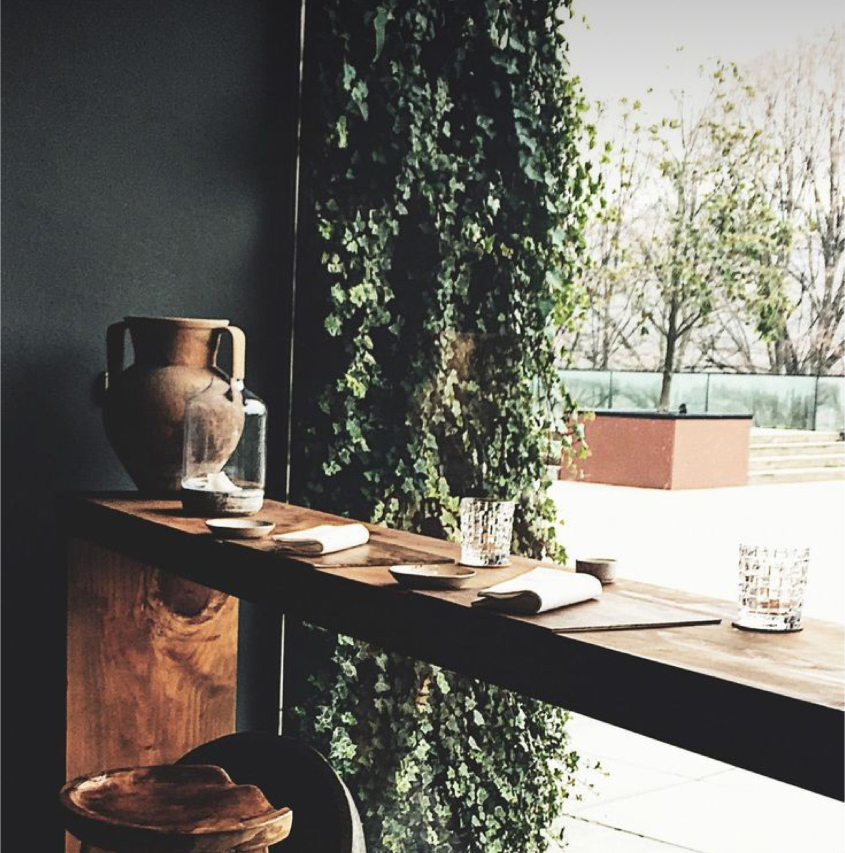
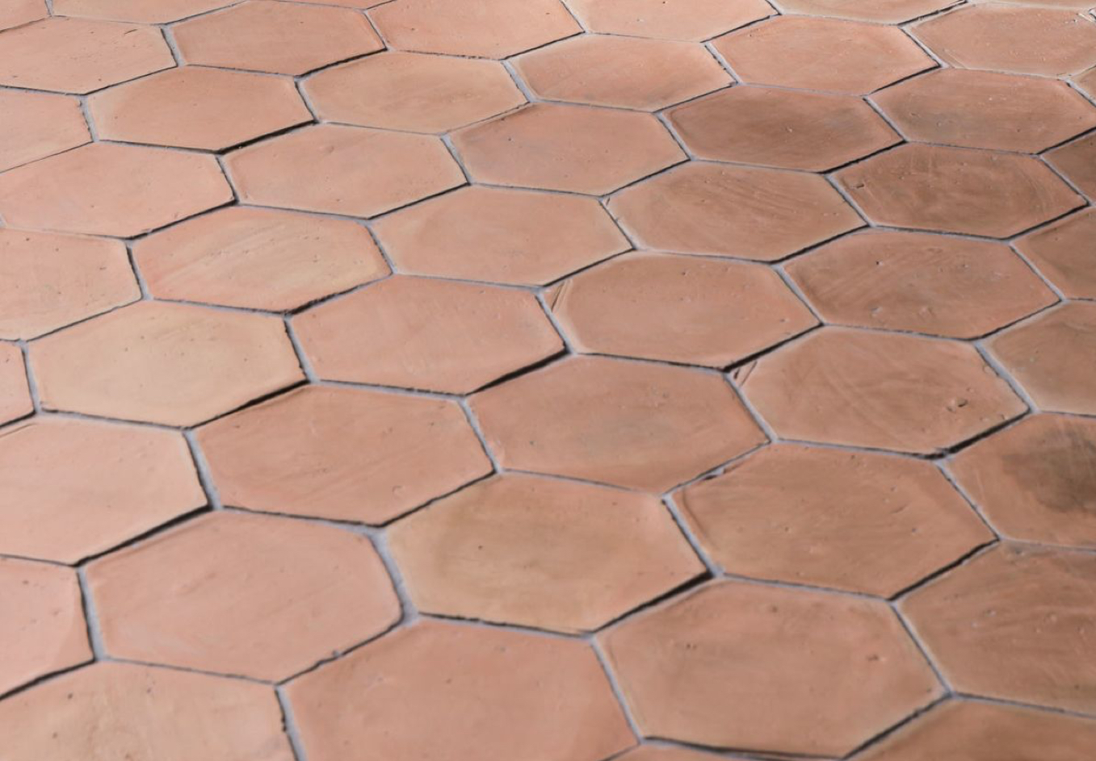
The Look

Slide 4
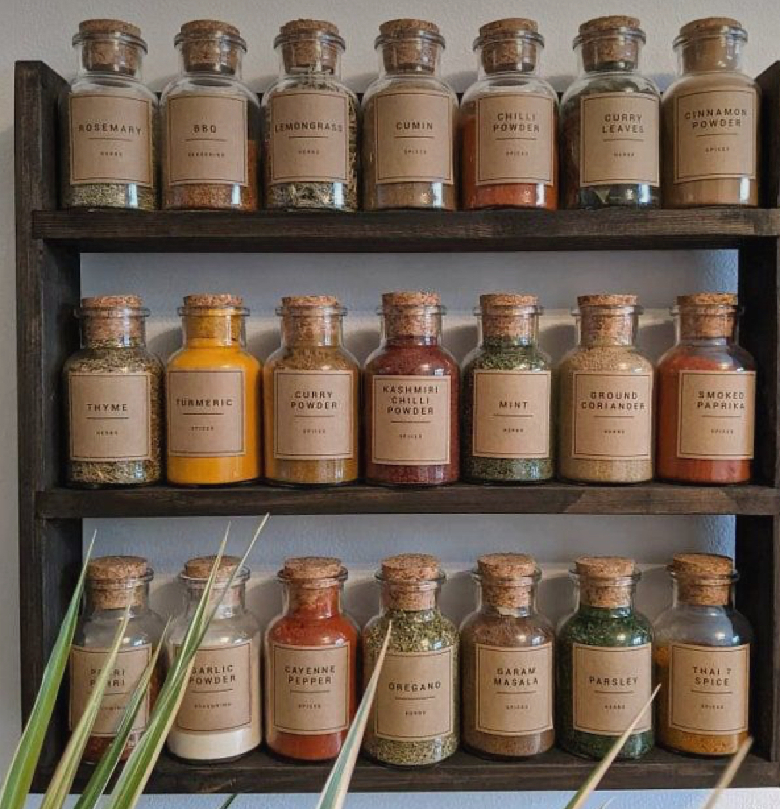
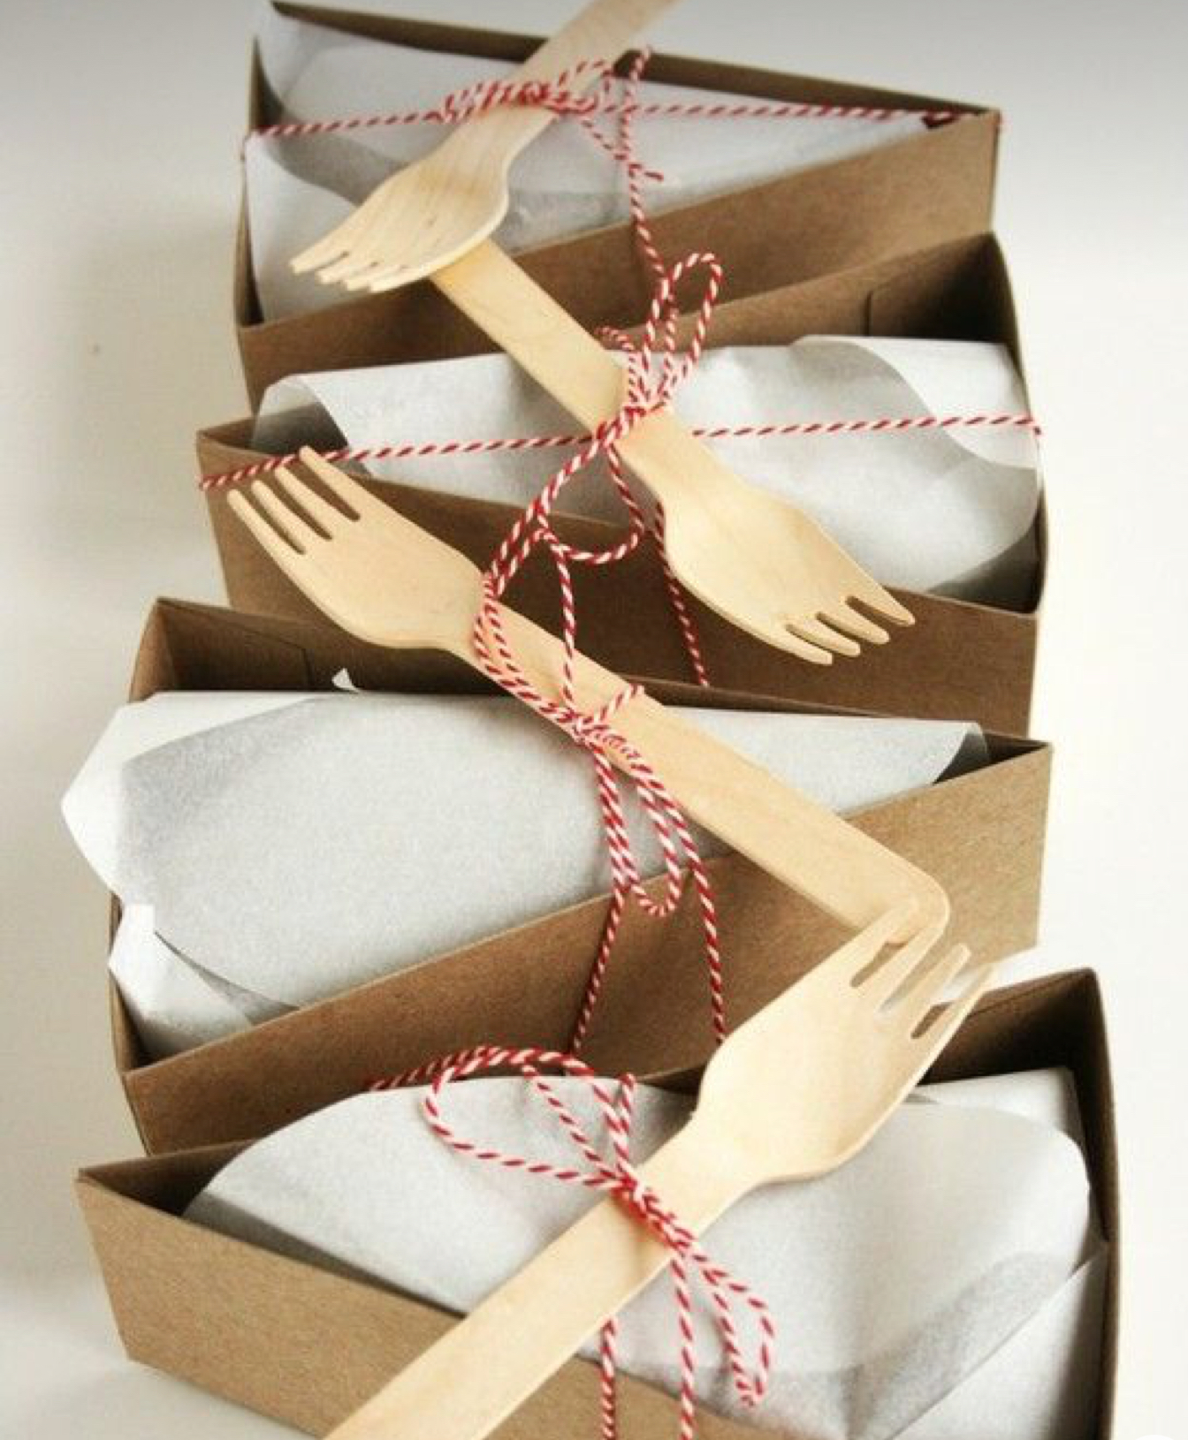

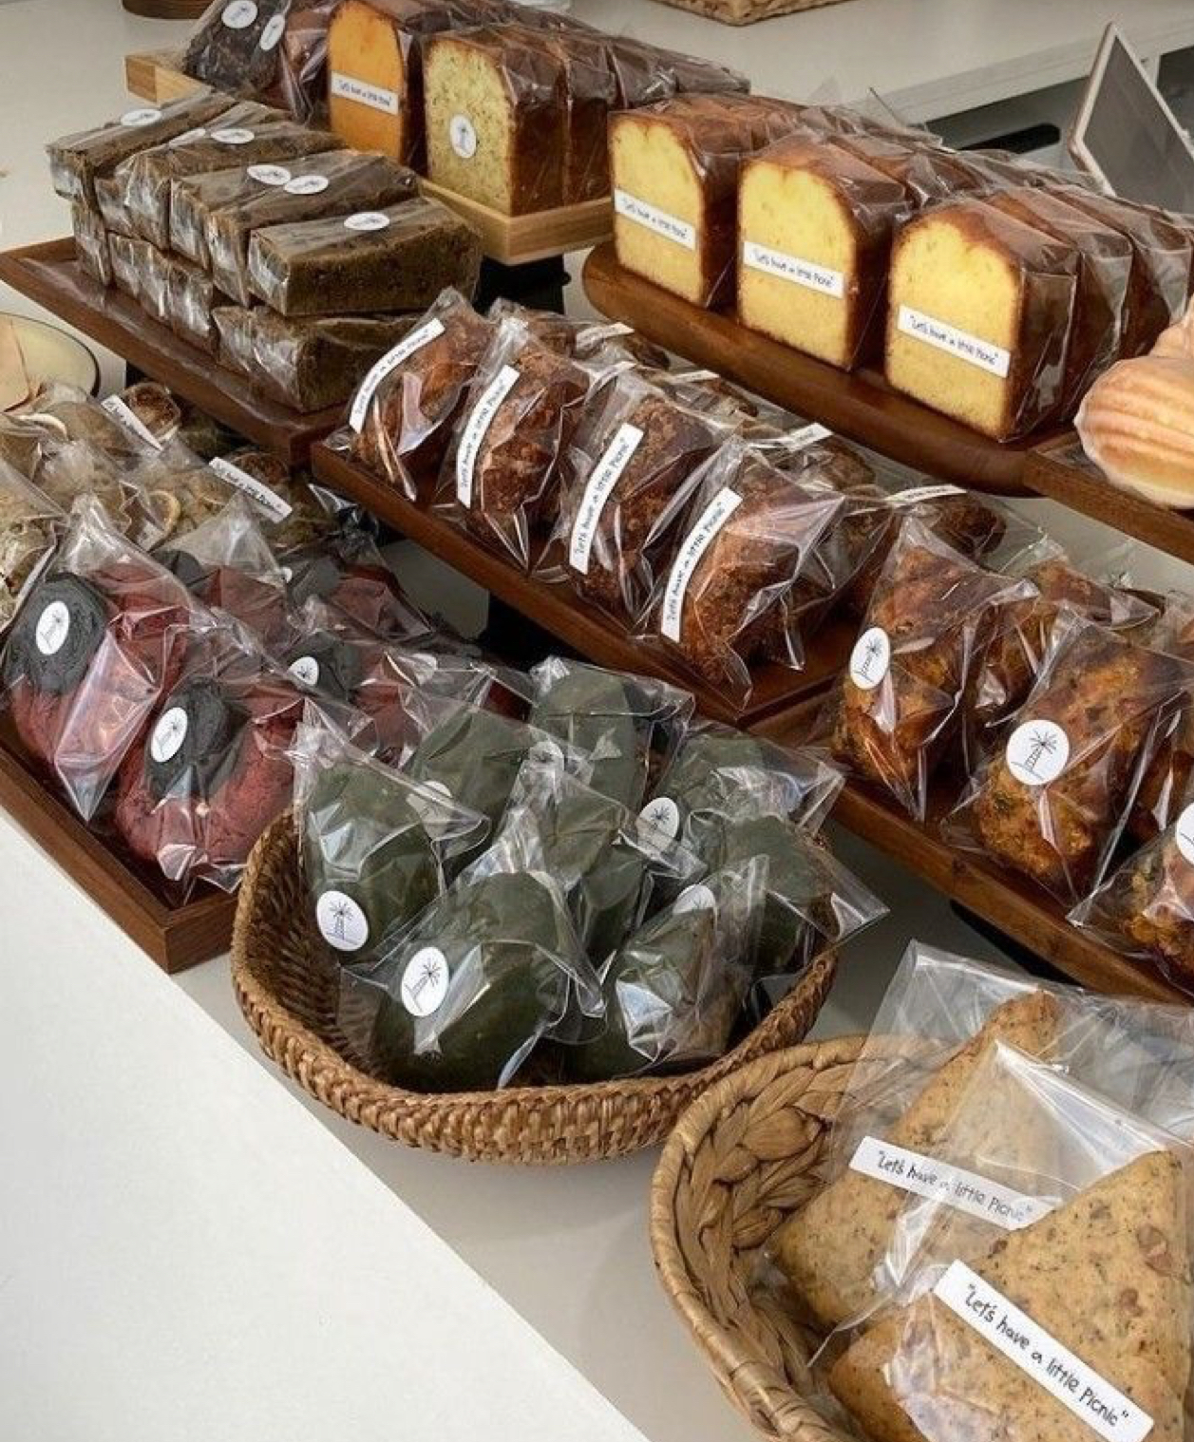
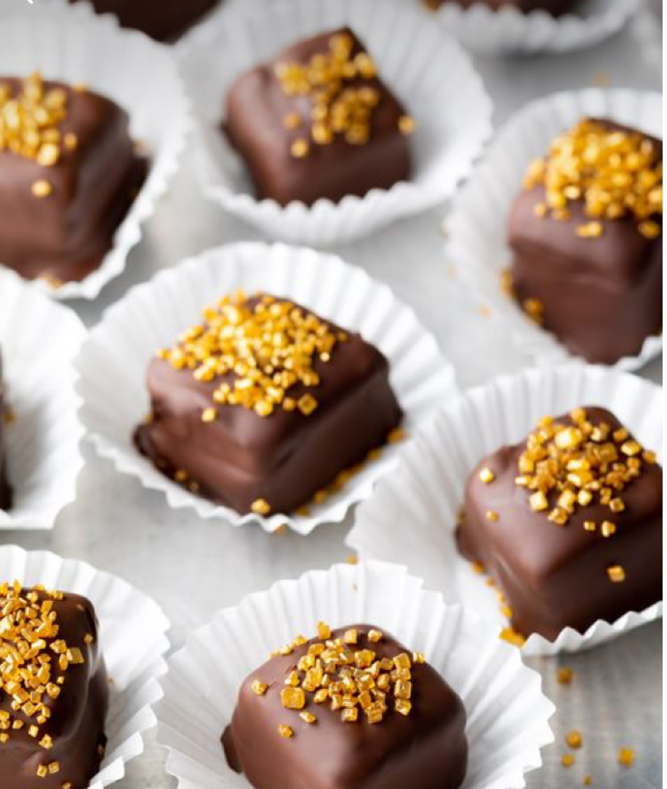
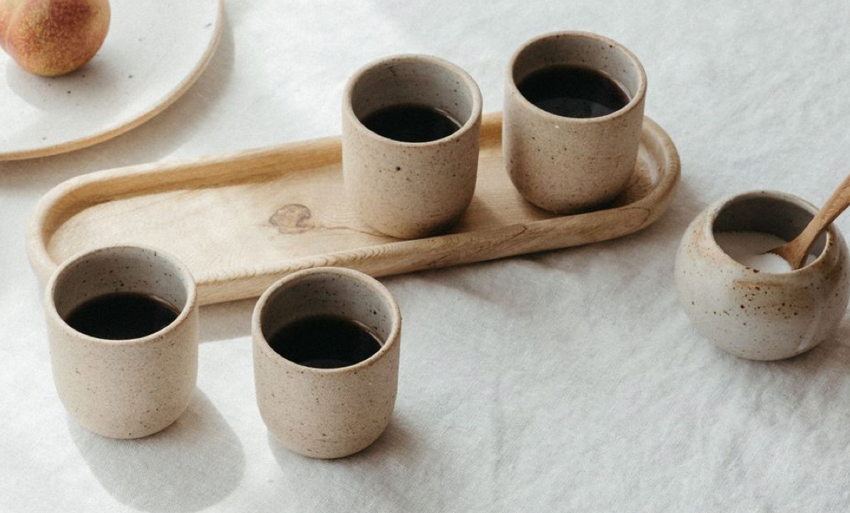
The Goods - Coffee & Food
Espresso drinks
Only pre-packaged baked goods - cake slices, muffins, etc…
Chocolate truffles
COFFEE BEANS
Possibly be a drop off location for sourdough loaves? Local baker?
Might be a good idea to do limited baked good appearances, such as specialty donuts on Sundays
Tapenades and things that go well with sourdough
Specialty seasoning blends (herb salt, blends)

Slide 5
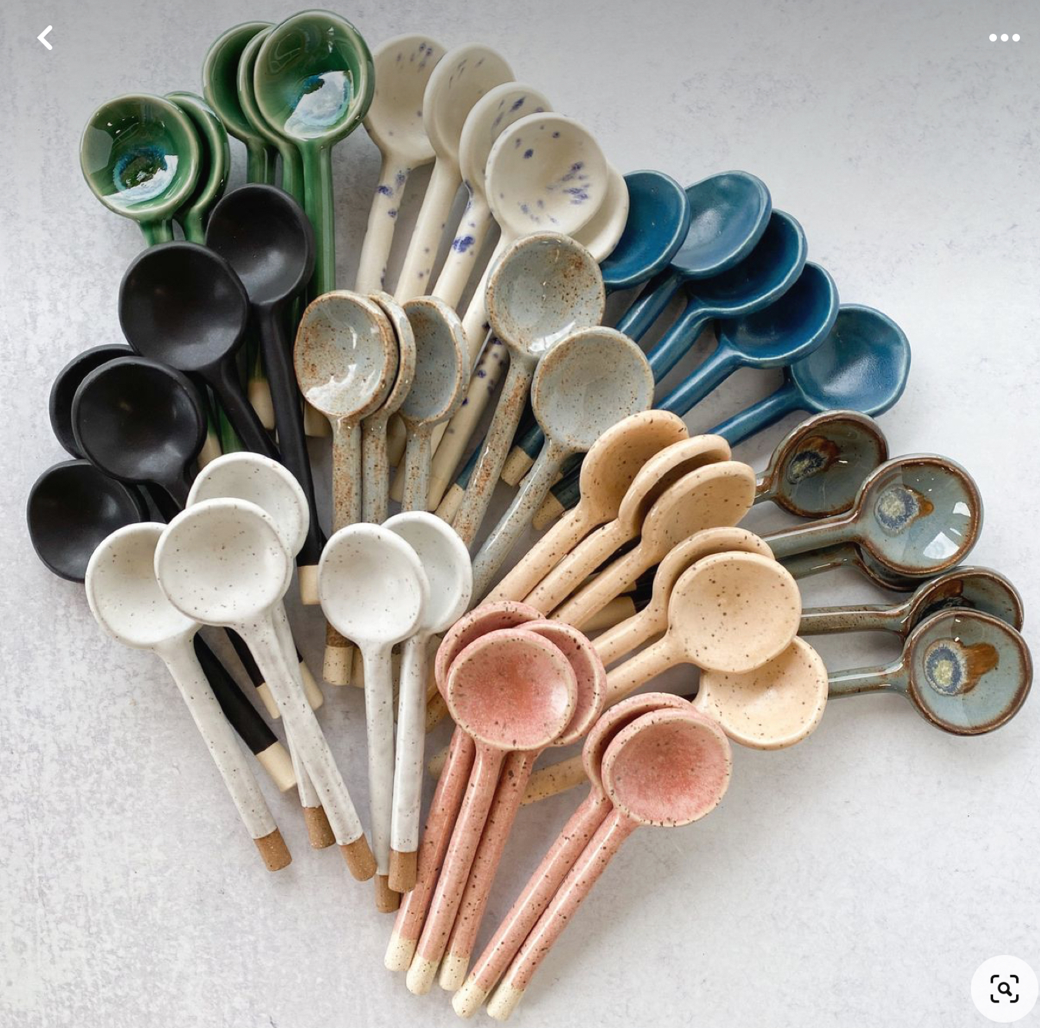
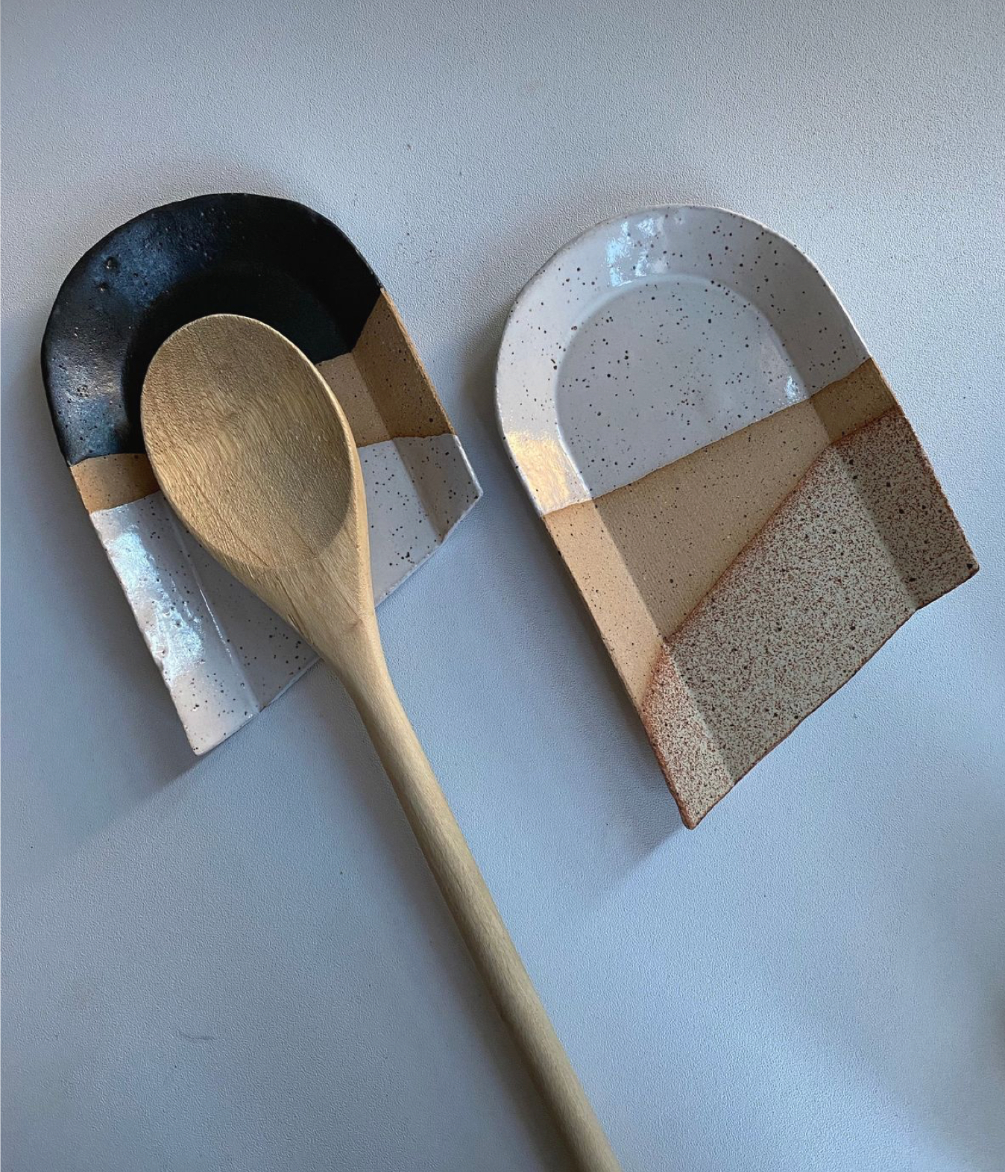
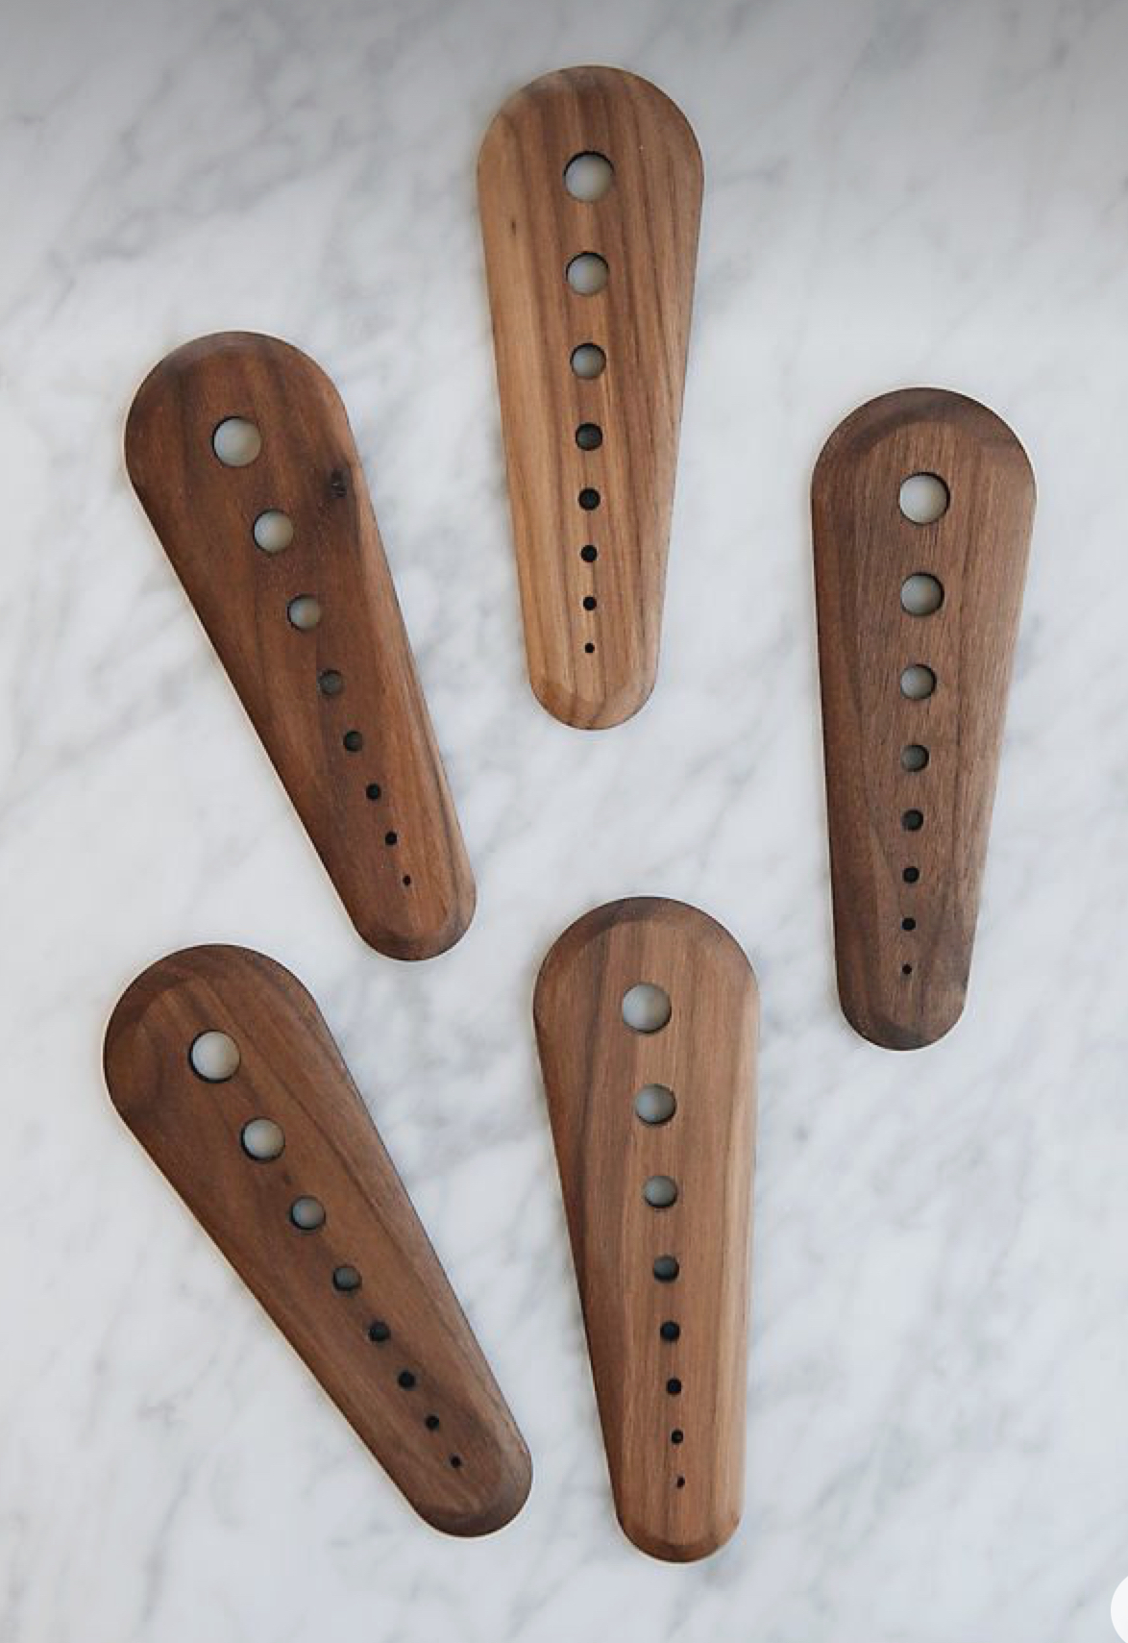
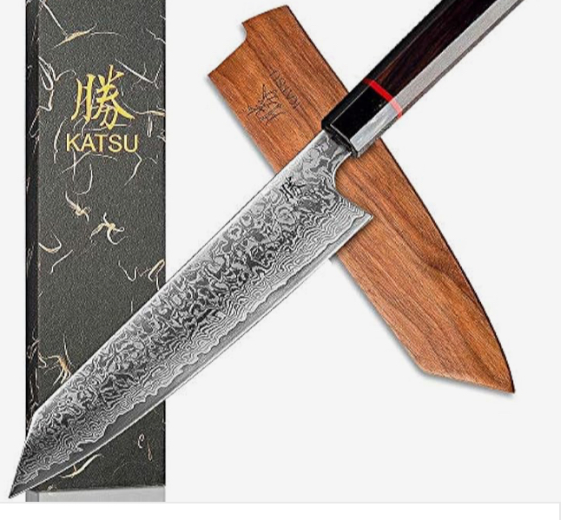
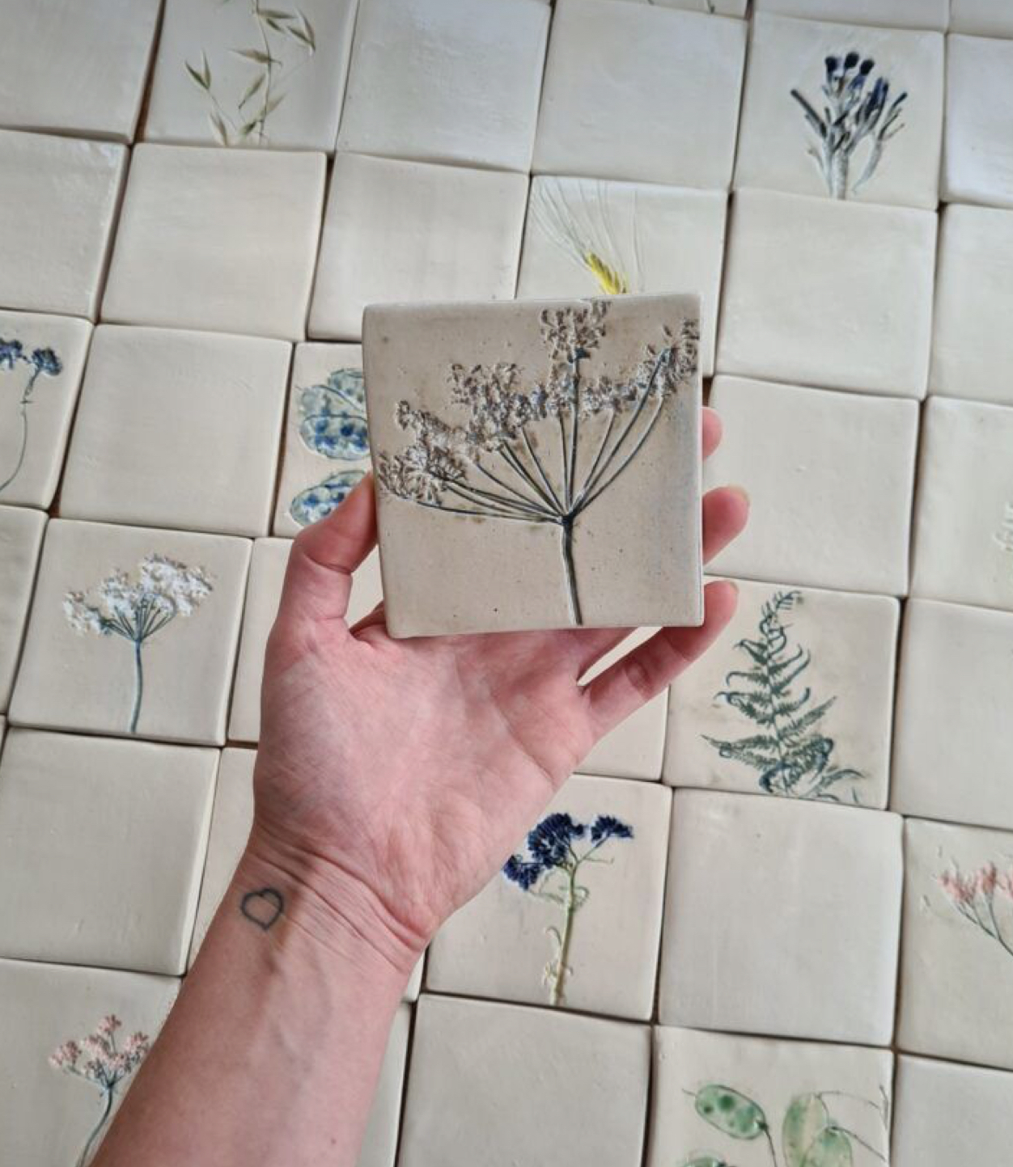
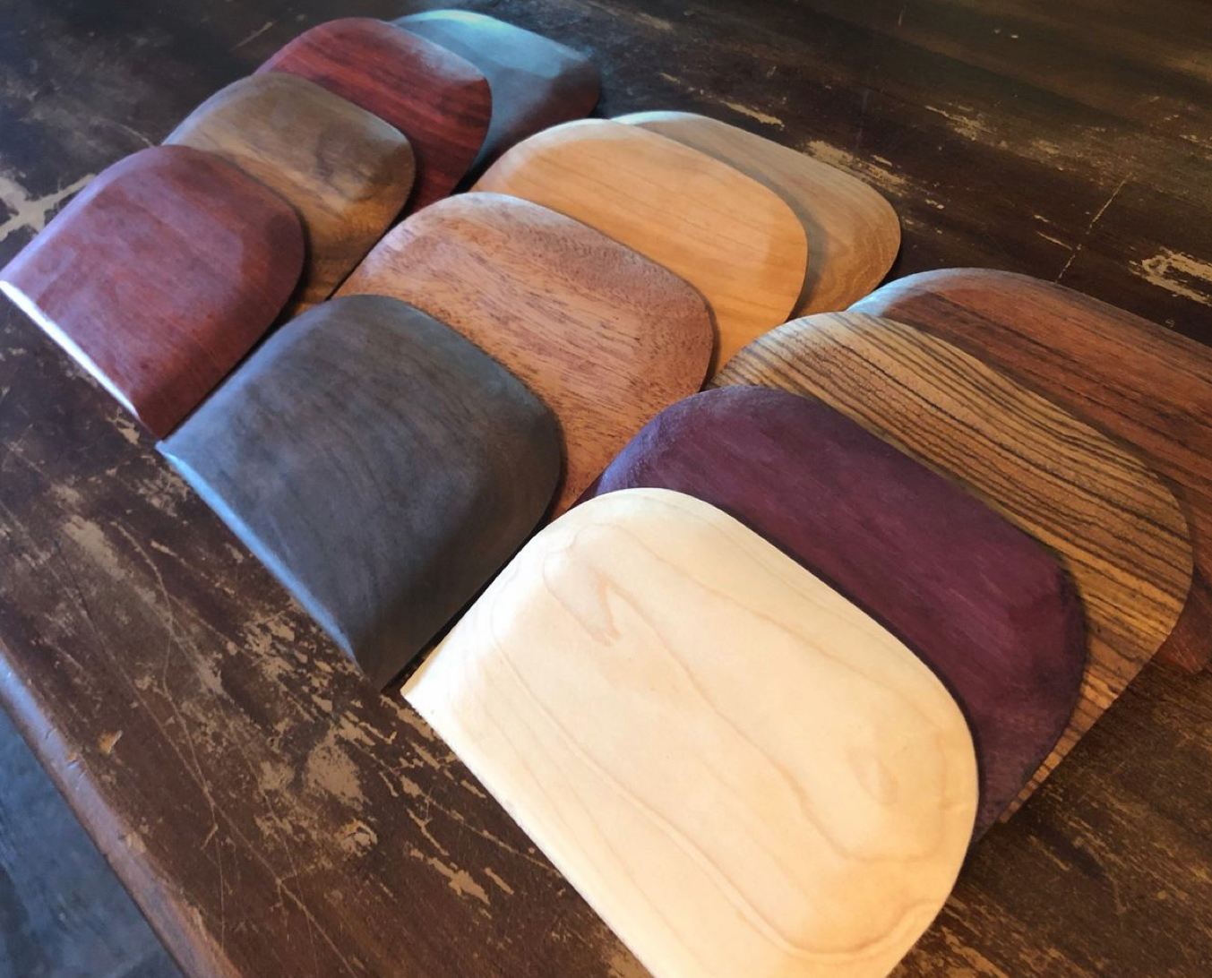
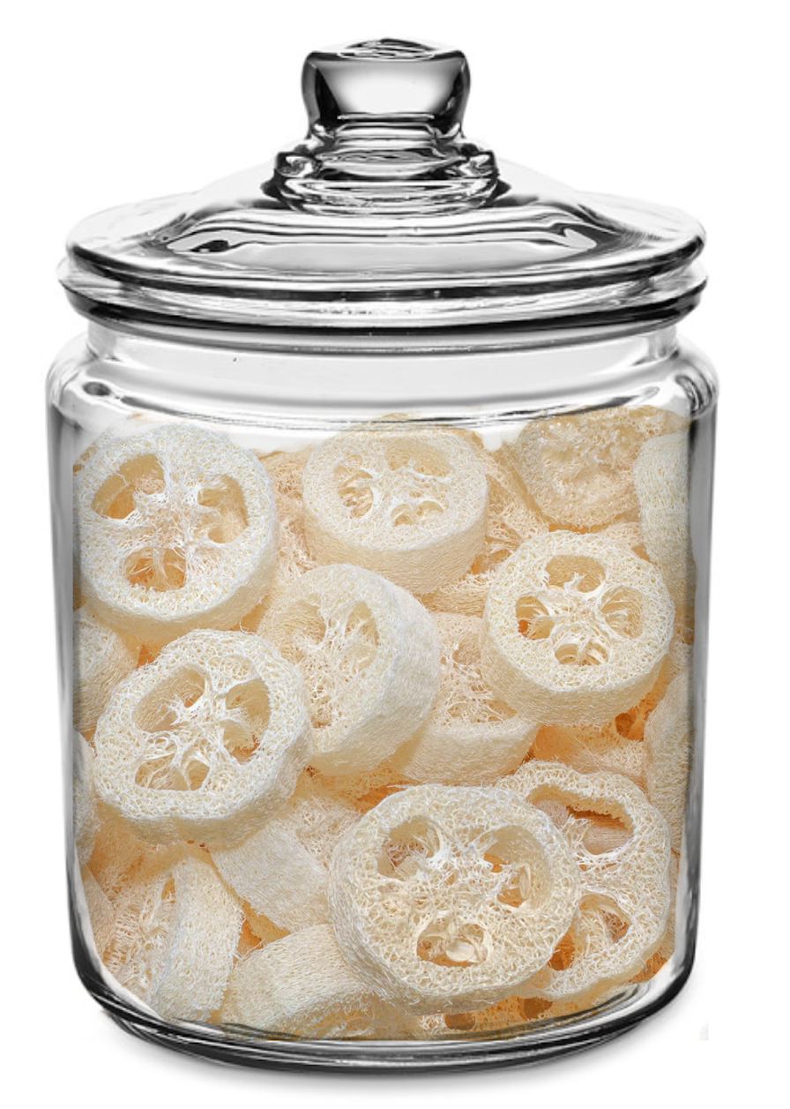
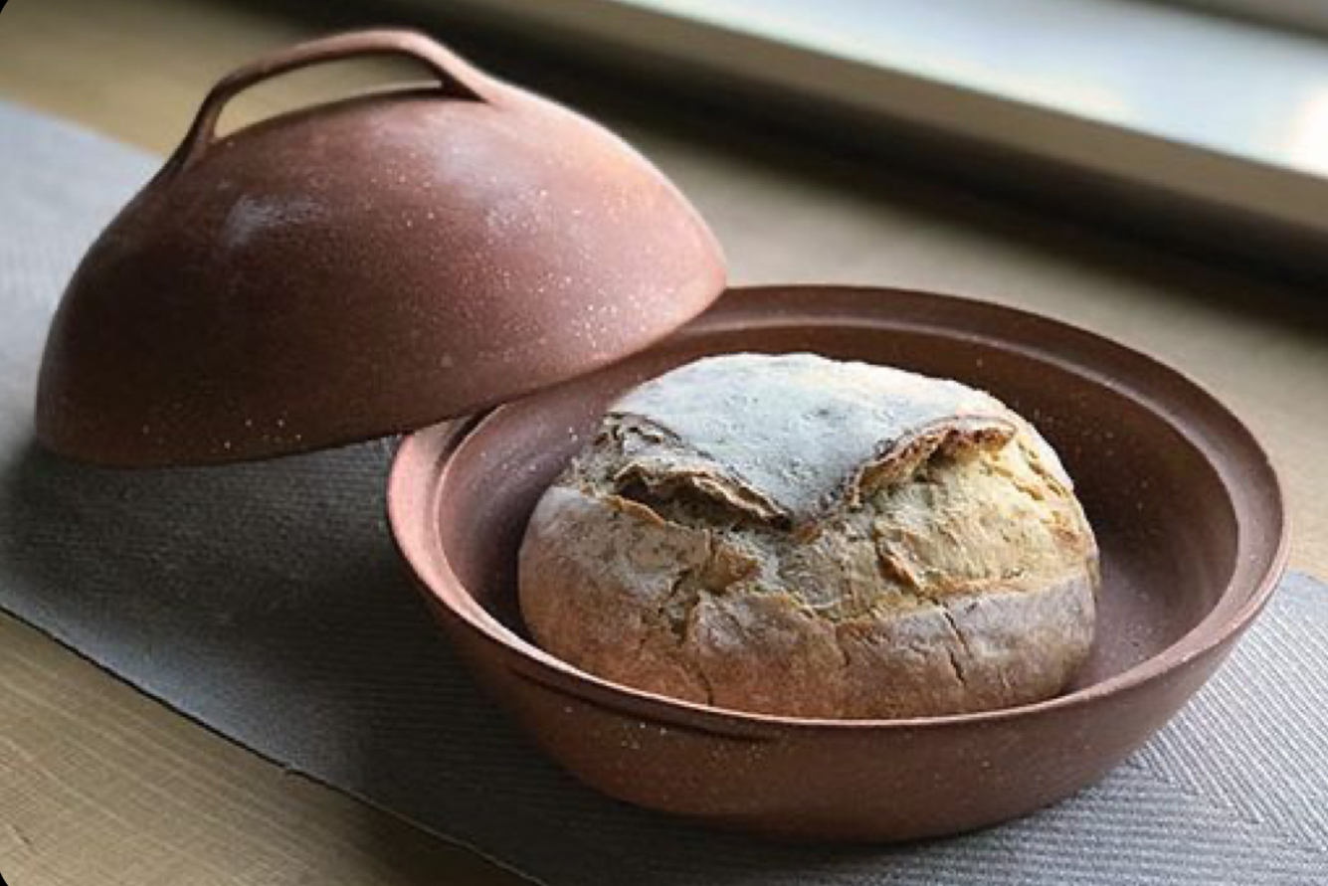
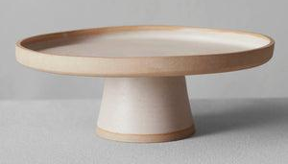
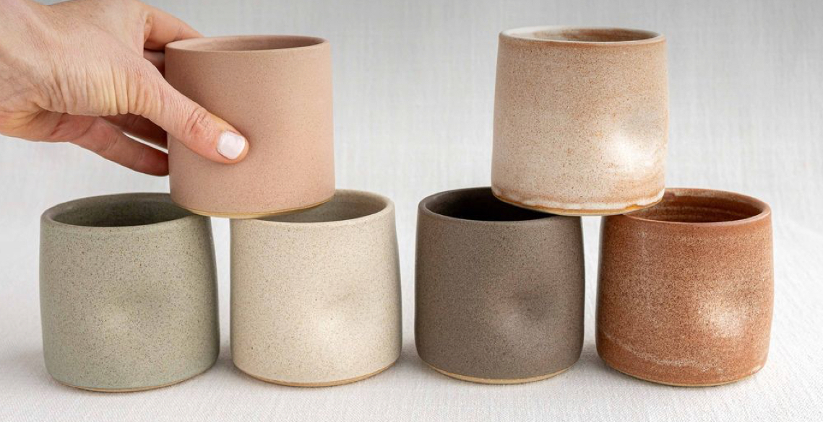
The Goods - Kitchen
Ceramic kitchen items - spoon rests, cake stands, sourdough cloches, roasters, butter dishes, etc….
Wooden items - herb strippers (pictured), kitchen utensils, charcuterie/cutting boards + care items
Knives - High quality kitchen knives
Natural kitchen items - loofah sponges are actually a dried gourd and can be an environmentally friendly scrubbing sponge that will fully compost. Something locals might continually stock up on
Cookbooks
Cloth napkins
Any kind of sourdough supplies that you can’t get anywhere else
Artist made tiles for kitchen

Slide 6
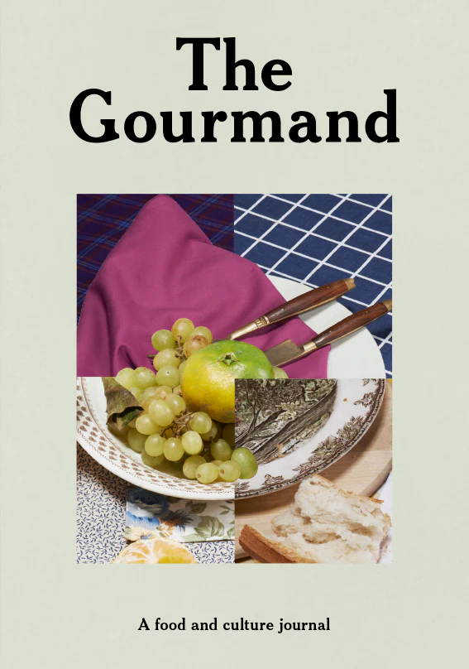
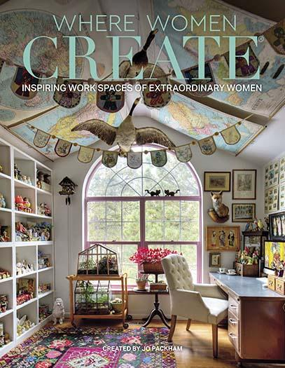
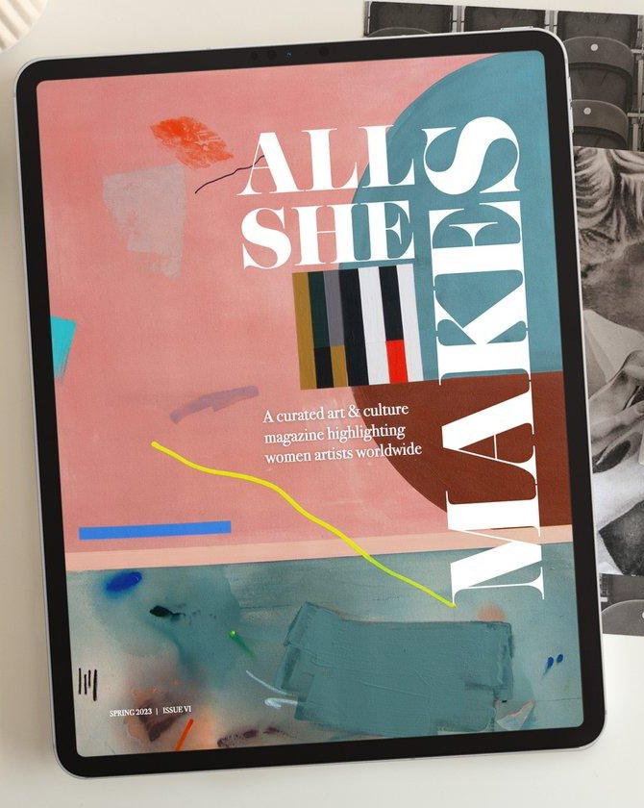
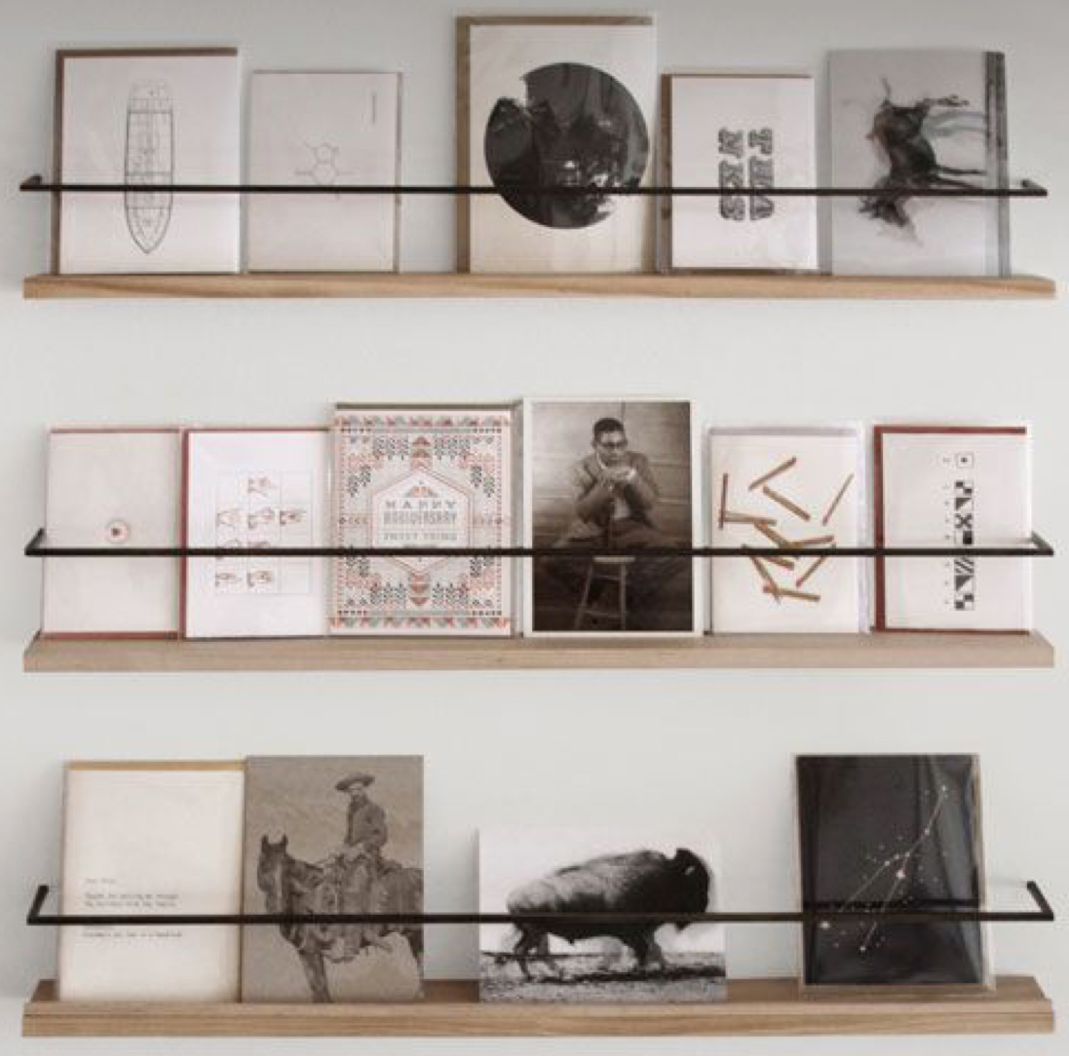
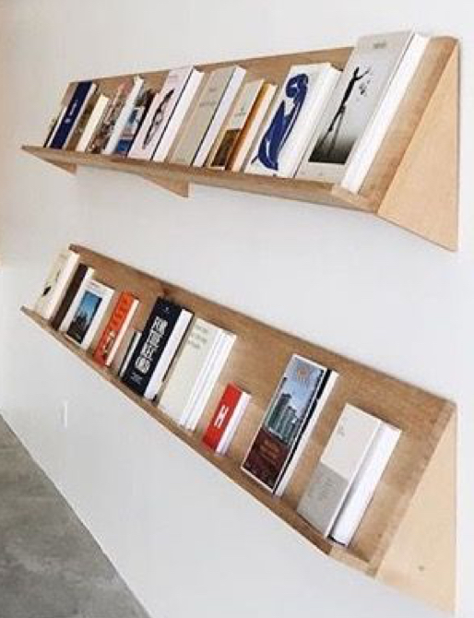
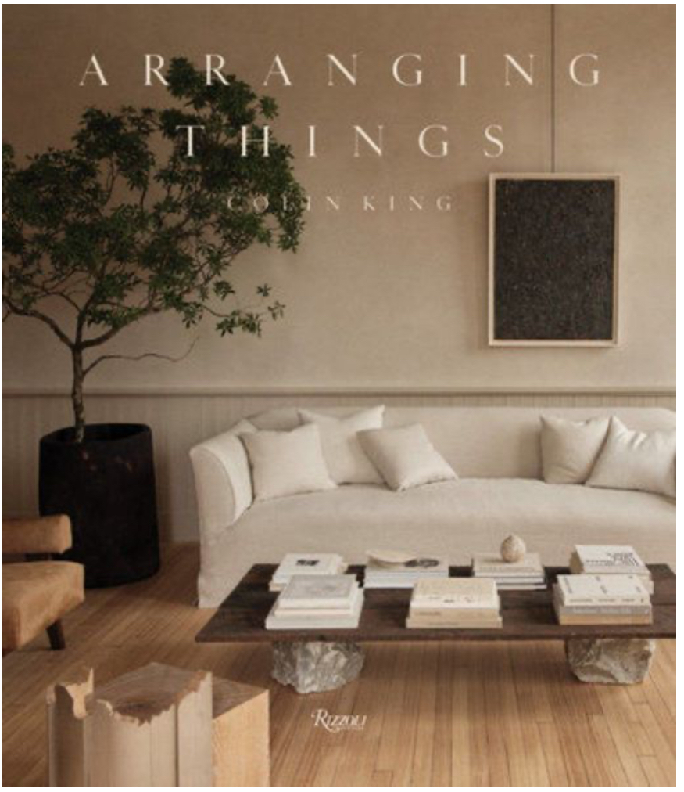
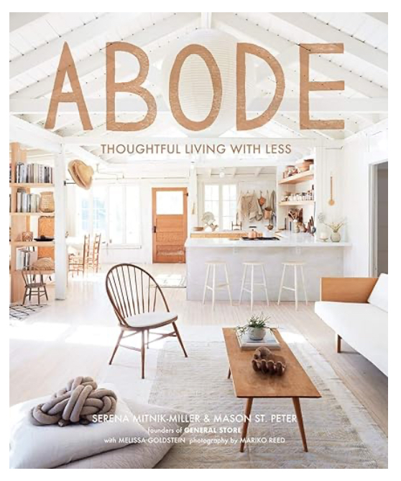
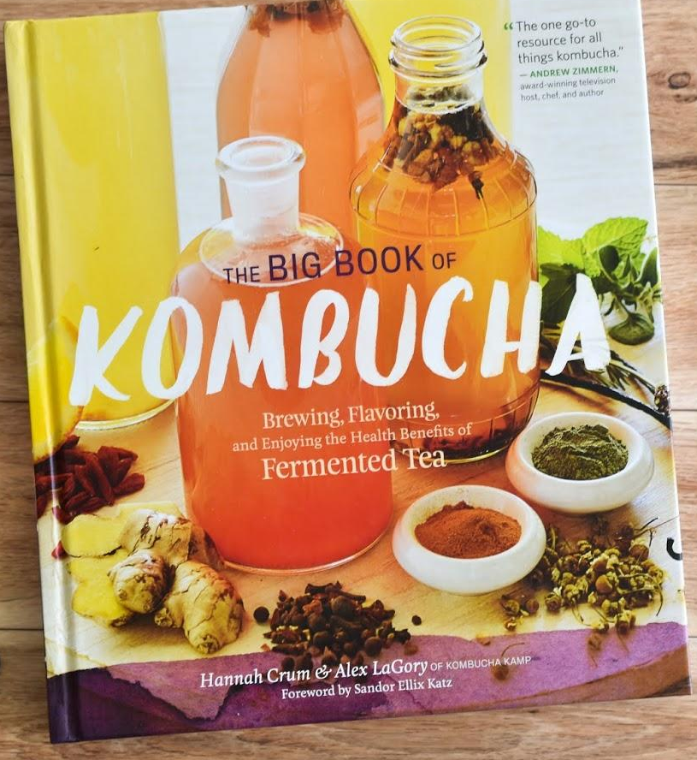
The Goods - Books/Magazines
Magazines/Books could be displayed on wall shelves for people to look through and the back stock of books for purchase could go on the tall shelving
Cookbooks - Einkorn book?, Kombucha book, Ferments, etc…
Coffee Table books - Decor, Art, Travel
Magazines - Feel Free, All She Makes?, Where Women Create?, The Gourmand (british food mag)

Slide 7
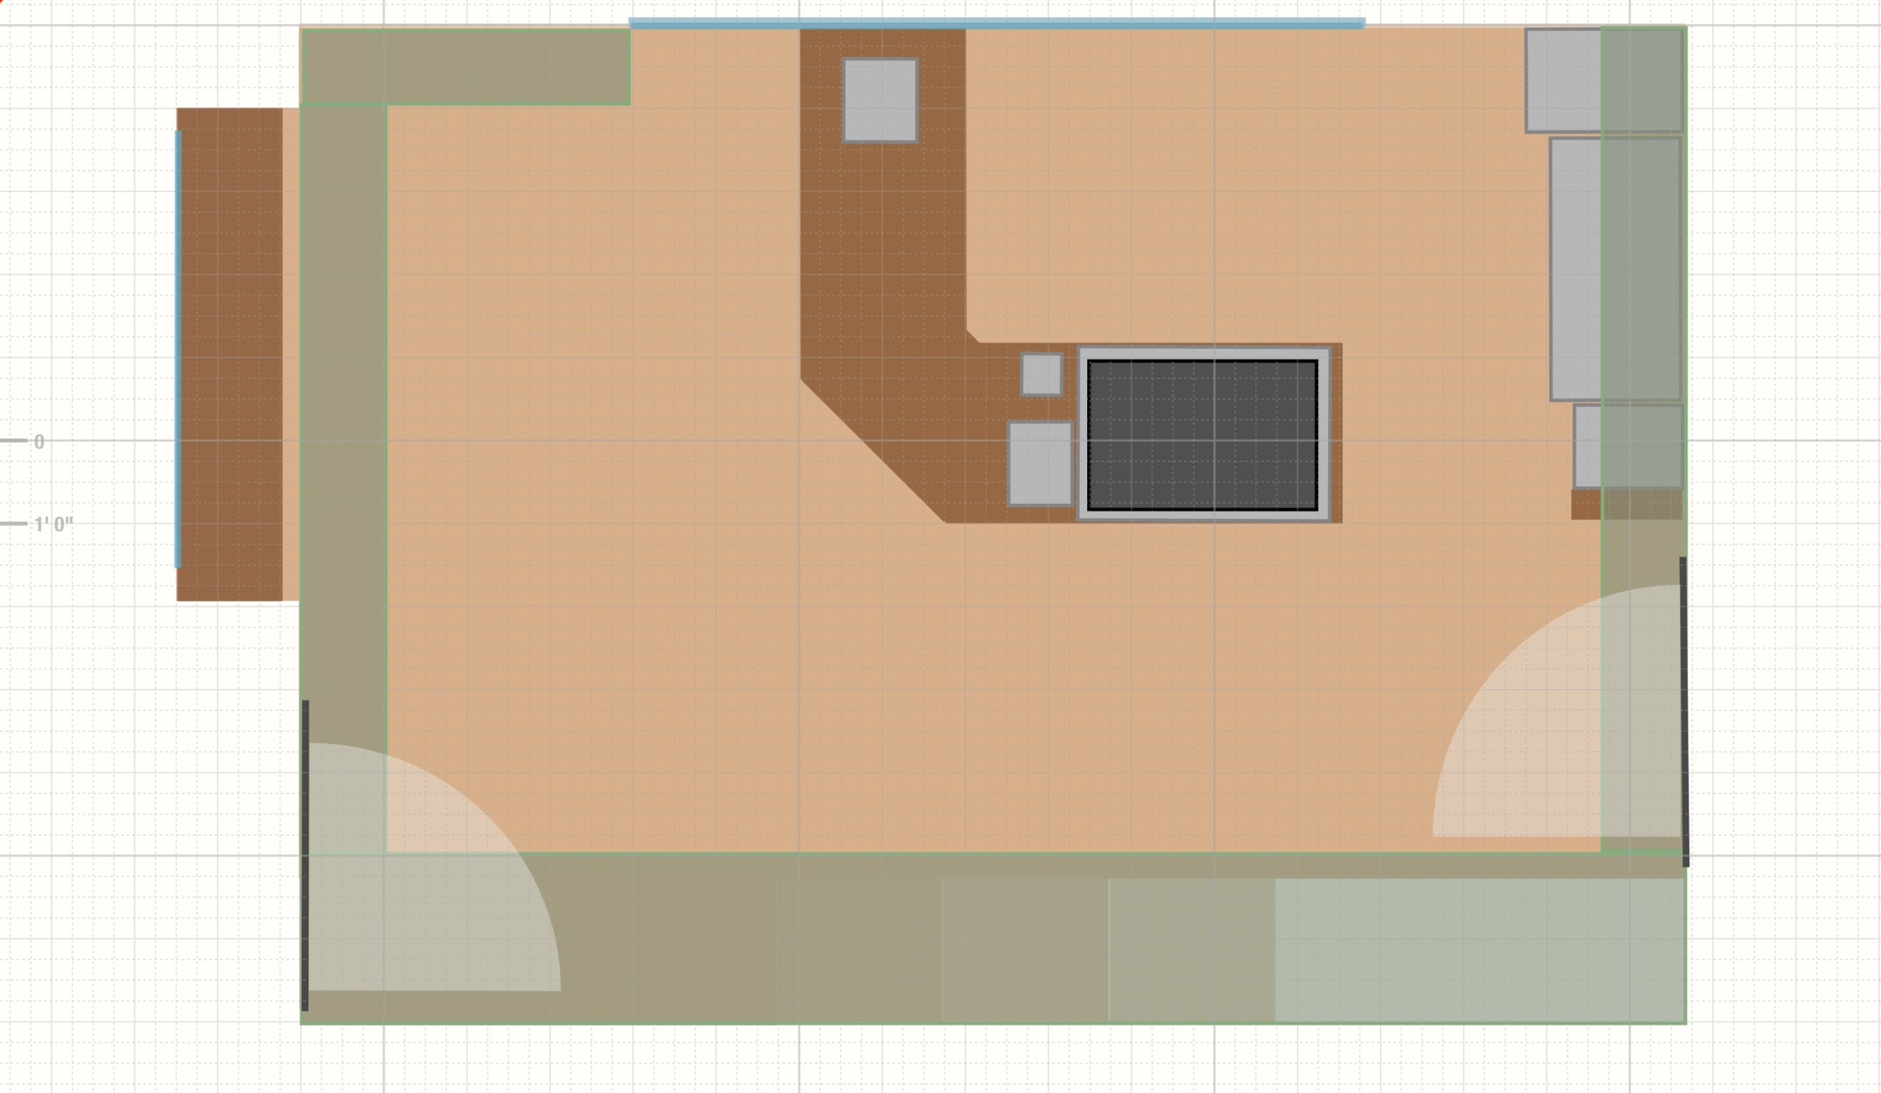
The Layout
POS
Ice maker
3 comp sink
Standing bar
Espresso Machine/Fridge
Hand sink
Main Street Access
Retail Shelving (Green areas)

