Slide 1


LTC ESG
Committee Update
July 2024

Slide 2
Agenda Items
01
Climate-Related Disclosures
06
ISS Scores
02
Strategy Update
07
Appendix
03
ESG-Related Cost-Saving Initiatives
04
Ongoing Initiatives
05
Costs

Slide 3

SEC Climate-Related Rule Disclosures: Unlikely To Take Effect
Ongoing litigation by various groups
In June,, 2024, the “Chevron” doctrine was repealed, potentially limiting regulatory agencies’ authority on major questions of policy absent specific Congressional authorization
Most likely scenario: future climate-related disclosure will be driven by individual company decisions influenced by shareholder requests and proxy advisory recommendations
2024
Climate-Related Rule:
General Pause
(Per SEC Counsel)
California SB253: Not Applicable to LTC
Last year California adopted its own version of climate-related disclosure
The rules have not yet been proposed; Governor Newsom recently proposed postponing the effective date of this law by two years
LTC is below relevant income thresholds; the law does not appear to apply

Slide 4
Strategy Update
We will continue to focus on our core ESG message of delivering value to our operators and shareholders by identifying cost-saving initiatives that enhance our buildings and save our operators money.
We are developing an ESG Playbook to better communicate a variety of options to reduce costs for our operators. The ESG committee will consider timeline and related costs as opportunities arise. See Anthem example in appendix.
We will also continue to be standup corporate citizens by taking actions within our control. Some examples include:
  E: recycling, purchasing carbon offsets, choosing an energy efficient building as new headquarters
  S: care for our employees, create an inclusive environment, support industry organizations
  G: continue with best practices for governance as determined by leadership and advised by SEC counsel

Slide 5
ESG-Related Cost-Saving Investments
Operator | Project | Status | Cost
ALG (Deerwood & Spartanburg) | LED retro / upgrades | 100% Complete | $210k @ 6.25% $276k @ 7.25%
Brookdale (35 of 35 properties) | LED retro/upgrades | 100% Complete | $1.4m @ 6%
HMG (9 of 13 properties) | LED retro/upgrades | 100% Complete | $864k LTC capitalized for free
Encore McHenry | LED retro / upgrades | 100% Complete Too early | $227,000 LTC capitalized for free
Fundamental | LED retro / upgrades | Under Consideration | TBD
Note: Non-ESG capital improvement projects currently have approximately 7% return

Slide 6
LTC ESG Ongoing Initiatives
Action | Detail
Frameworks and Reporting | ISS – maintaining relationship; quarterly consulting calls SASB and UNSDGs – updating GRESB – canceling moving forward
Property Installments / Retrofits (Lighting) | Consider Fundamental
Green Leases | Continue to “green” amended, new and existing leases 18 master leases (increase from 16 last quarter) 100 properties; 52% of the portfolio (increase from 83 last quarter)
Portfolio Climate Risk Assessment | Updated portfolio using ClimateCheck® software to assess climate risk across our portfolio; included in disclosures Ongoing tracking and communicating with operators, especially when in danger of environmental events (ie hurricanes, floods, fires)
Measurabl tracking for electric, gas, water benchmarking and reporting on select portfolios | Contract ends in October Identifying more cost-effective options
ESG Underwriting | Basic ESG questions are now included in underwriting criteria
ESG Report | Target date for release: Sept. 15
Notes:
Have q on hand in case they ask for underwrigin.

Slide 7
Costs
 | 2023 Actuals | 2024 Projections | 2025 Estimate
ESG Consultant to assess cost-saving initiatives | $60,000 | $60,000 | $60,000
ESG Report Design | $44,252 | $35,000 | $20,000
ISS | $16,500 | $17,500 | $18,500
GRESB | $15,200 | $8,640 | $0
Benchmarking Data Collection | $66,103 | $90,170 | $50,000
ClimateCheck Annual Risk Report | $405 | $5,000 | $5,000
Carbon Offsets | $4,500 | $10,000 | tbd
Reputation Analytics | $1,410 | $0 | $0
Miscellaneous | $4,739 | $5,000 | $tbd
Total | $213,109 | $231,310 | $153,500
Actual Spent: 7/19/24
$138,435

Slide 8
ISS Update: Why Did Scores Drop?
LTC | July 2023 | Oct. 2023 | April 2024 | July 2024
Environment | 8 | 9 | 9 | 9
Social | 3 | 5 | 5 | 5
Governance | 3 | 3 | 4 | 4
  The system is somewhat arbitrary. Scores are based on changes relative to the ISS-selected peer group, and data updates. Some data is scored, other data is not.
  Some questions get “retired” and new ones are issued between the time we file our disclosures and update them again (annually), which can negatively impact the score. Some questions are very specific and if a couple of words are off, we don’t receive the points. See an example in the appendix.
  There is also a very detailed report that provides a very detailed overview of our score based on their questions, also in the appendix.
  NOTE: Several items in the social pillar have been challenged. We are awaiting ISS response.

Slide 9
ISS Updates: LTC (1 is Best)
Governance | July 2023 | Oct. 2023 | April 2024 | July 2024
Overall | 3 | 3 | 4 | 4
Board Structure | 4 | 4 | 5 | 5
Compensation | 3 | 3 | 3 | 3
Shareholder Rights | 7 | 7 | 7 | 7
Audit / Risk | 1 | 1 | 3 | 3
Environmental | July 2023 | Oct. 2023 | April 2024 | July 2024
Overall | 8 | 9 | 9 | 9
Risk & Opportunity | 3 | 4 | 5 | 6
Carbon & Climate | 9 | 9 | 8 | 9
Natural Resources | 8 | 8 | 8 | 8
Waste & Toxicity | 5 | 8 | 7 | 7
Social | July 2023 | Oct. 2023 | April 2024 | July 2024
Overall | 3 | 5 | 5 | 5
Human Rights | 3 | 4 | 5 | 5
Labor, Health, & Safety | 1 | 1 | 1 | 1
Stakeholders & Society | 6 | 8 | 8 | 8

Slide 10
ISS Updates: Peers
Environment | July 2023 | Oct. 2023 | April 2024 | July 2024
LTC | 8 | 9 | 9 | 9
CareTrust | 9 | 8 | 7 | 7
NHI | 10 | 10 | 10 | 10
Omega | 7 | 7 | 6 | 6
Sabra | 10 | 10 | 8 | 8
Social | July 2023 | Oct. 2023 | April 2024 | July 2024
LTC | 3 | 5 | 5 | 5
CareTrust | 5 | 5 | 3 | 3
NHI | 10 | 10 | 10 | 10
Omega | 3 | 5 | 4 | 5
Sabra | 10 | 9 | 7 | 7
Notes:
Environment: CareTrust, Omega and Sabra have been more aggressive about collecting and reporting environmental data and stating specific goals, although in most cases, the data is based on estimates. This data helps move the needle albeit very expensive and a very heavy lift. SHOP / RIDEA structures help mandate information requests.

Slide 11
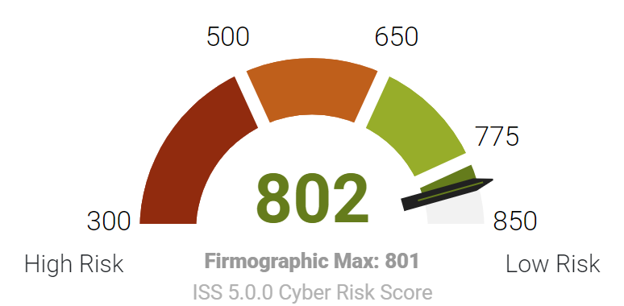
ISS Cyber Risk Score: Up One Point
Predicts the likelihood that an organization will suffer a material cyber incident (breach) within the next 12 months
Expressed on a scale of 300 (high risk) – 850 (lower risk),
Calculated based on the behavior of an organization, as well as firmographic information that includes company size and the industry in which the firm operates.
Good News!
LTC holds the highest and best score we can achieve (for now)
We will continue to monitor and adjust accordingly

Slide 12


Appendix
12

Slide 13
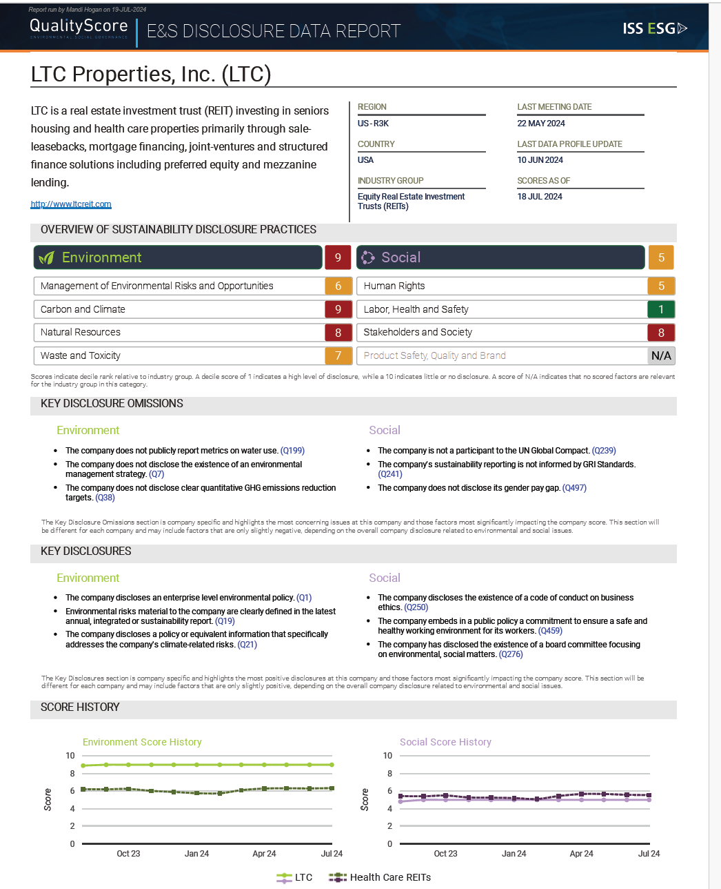
Additional Documents
ISS Data Report (attached)

Slide 14
ISS Example of Challenged Question:
    Question: “Does the company embed in a public policy an acknowledgement of the human right to water?”
    Process: I requested they change the answer from no to yes and pointed them to our Human Capital Policy disclosure.
    ISS Response: Upon checking LTC’s Human Capital Policy (pg. 4), it appears that the excerpt “A safe and healthy environment includes access to clean sanitary facilities and drinking water as a fundamental human right” only referred to the company’s operations (i.e. employees) and did not express a commitment to respecting the human right to water of third parties. The company needs to state a commitment to respecting the human right to water of third parties (and not its employees, suppliers or clients).
    Solution: Include this exact language in the ESG Report update. It will also be included in the next round of updated disclosures. Unfortunately, this takes time so sometimes the score suffers.

Slide 15
Thank You
15

