Slide 1







Start New
Launch New Tool
Open Existing
Optimize existing

Slide 2


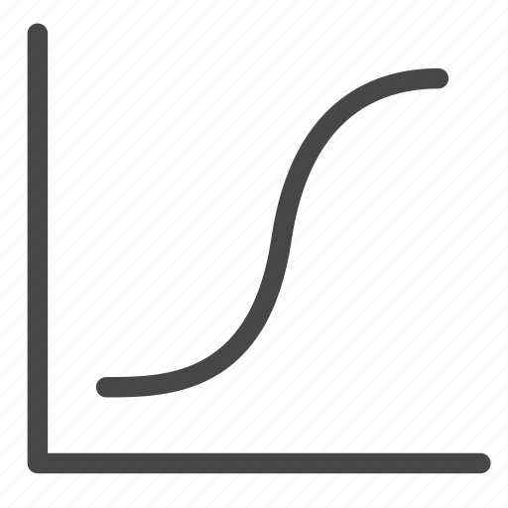
Change Press
Convert To
Create Starter Curve
Press
Manage Presses

Slide 3


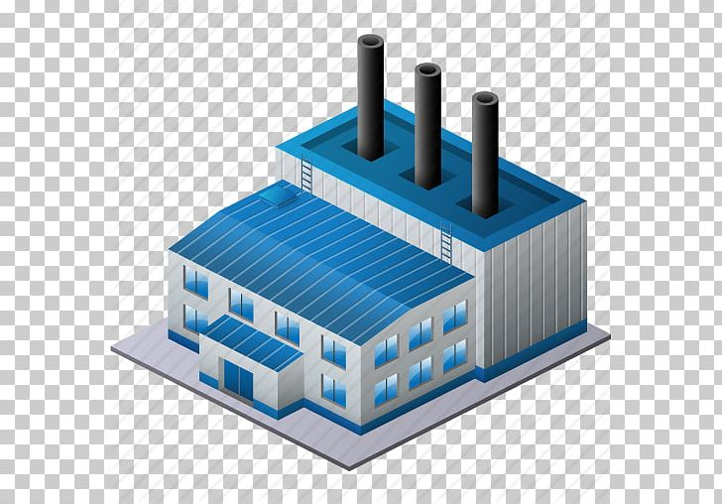
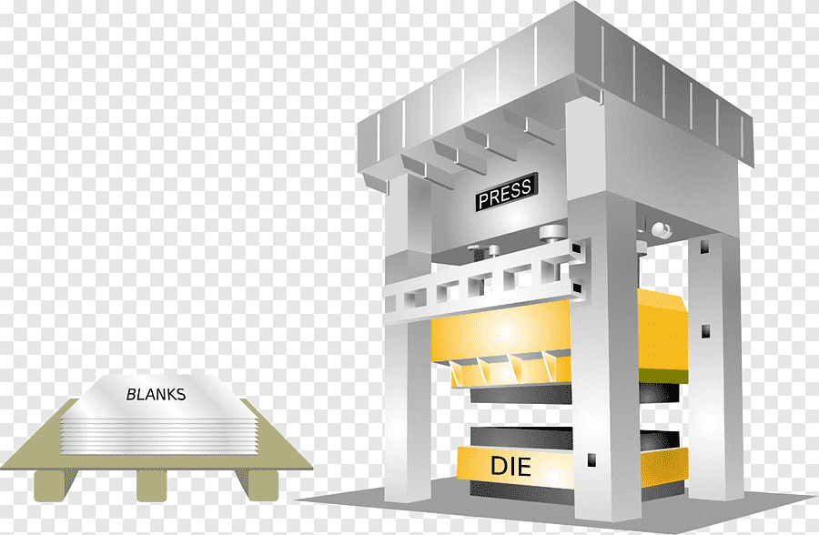



Start New
Customer
Optimize Existing
Launch New Tool
Facility
Press
Facility
UI will have both a side nav bar with small versions of the icons and larger , easier to pick icons in the main UI area. This is so it is easier use with tablets and more of a visual interpretations rather than reading words, This is why we want the icons more modern and visually recognizable.

