Slide 1

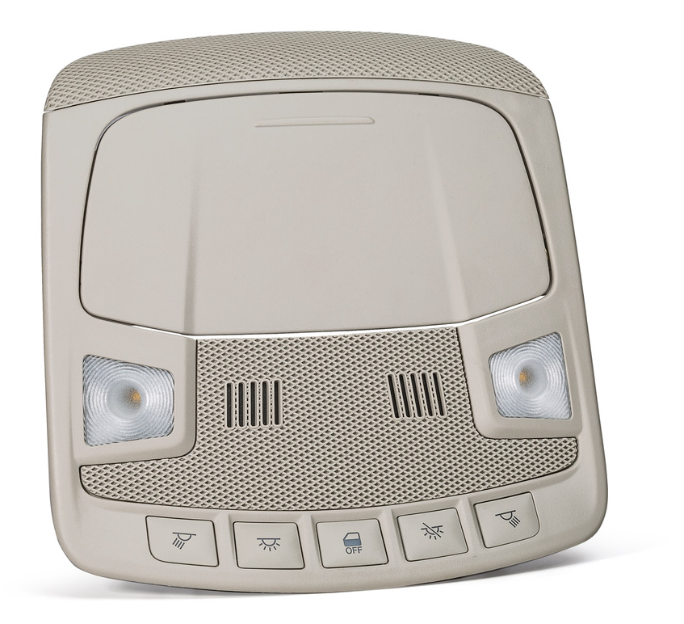
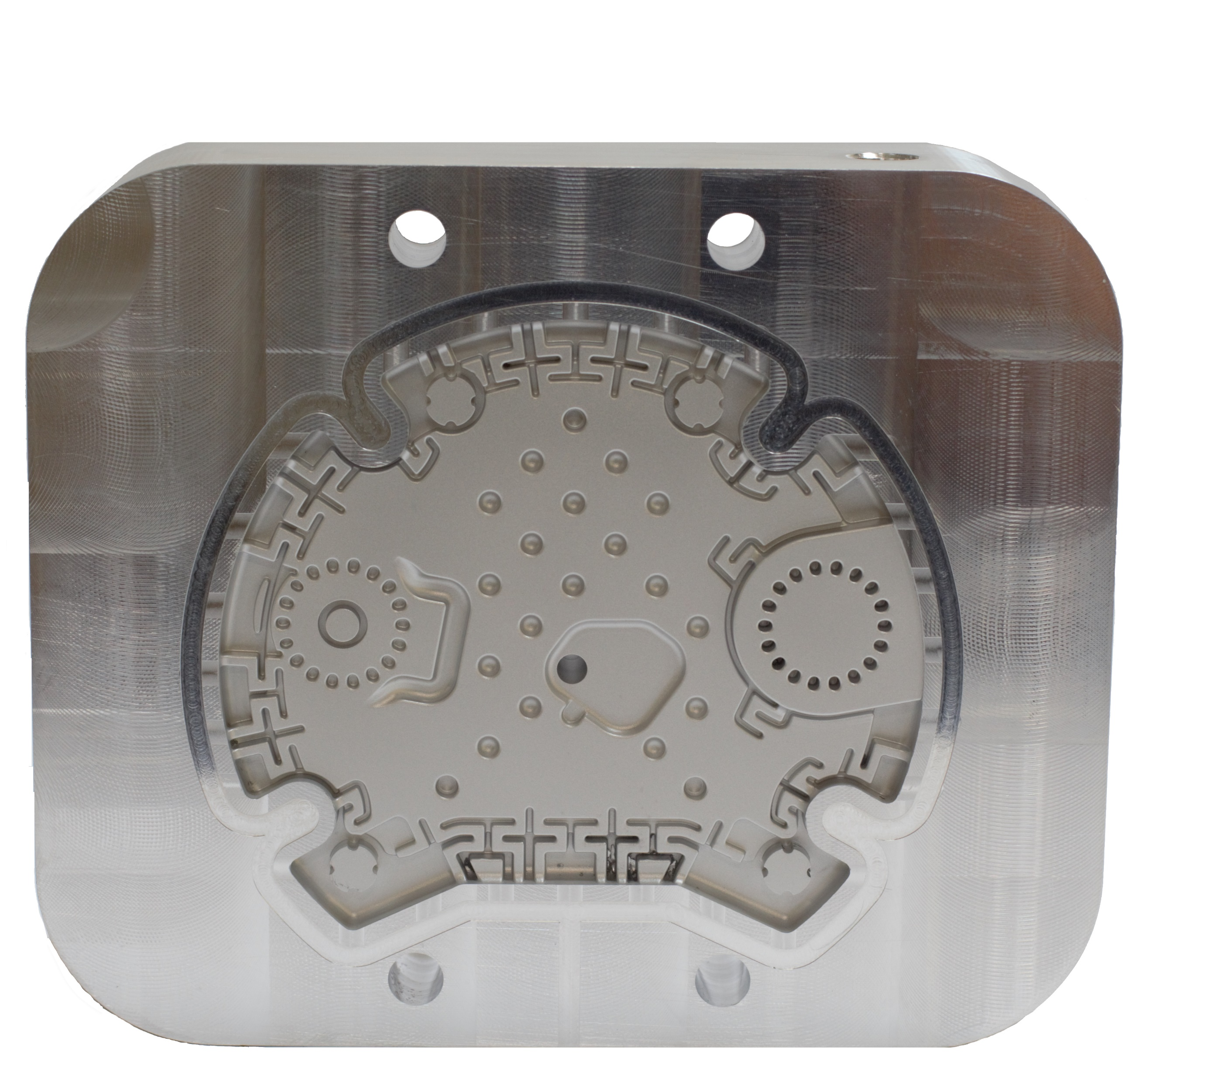
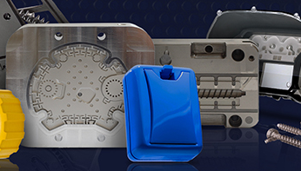
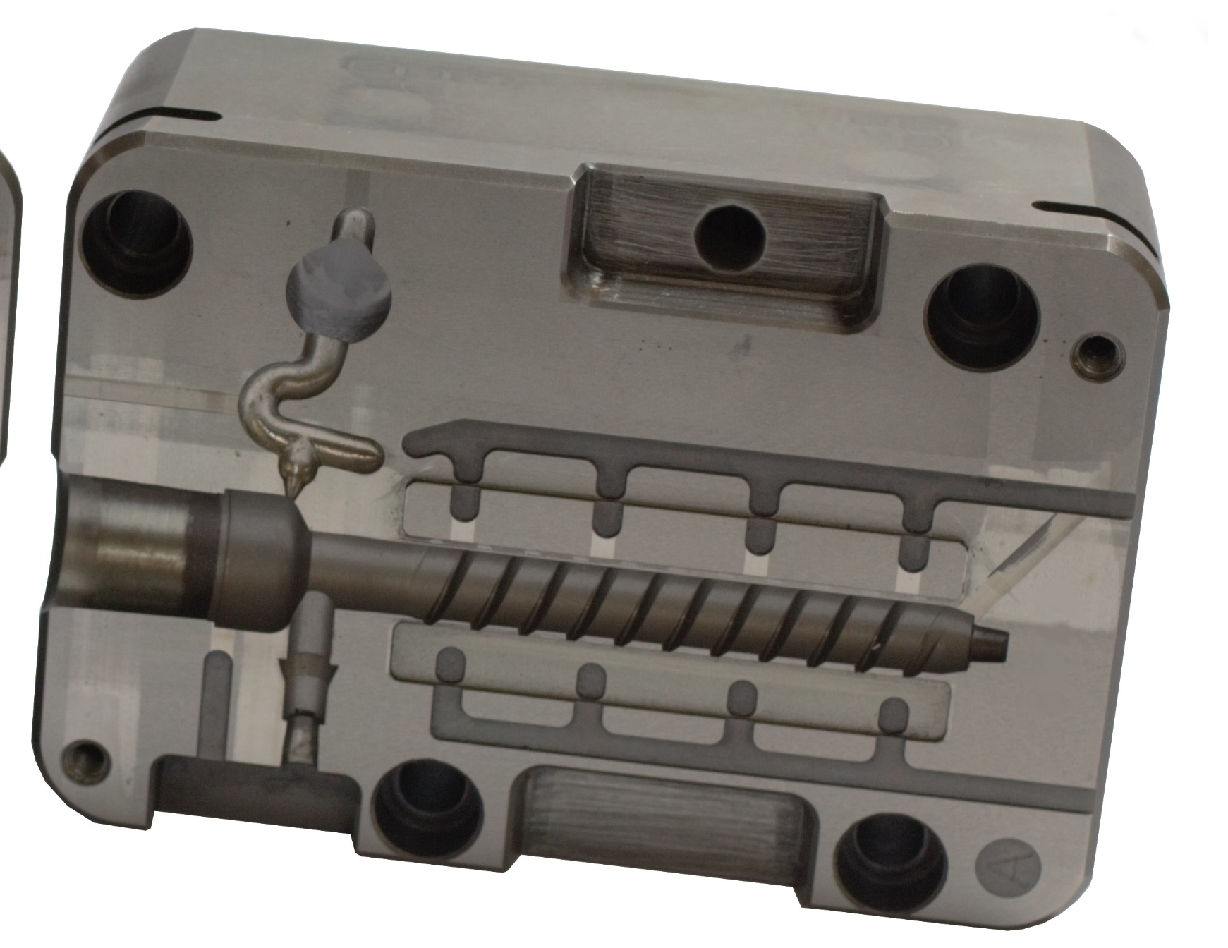
Make smaller
Remove and replace with overhead console image.
Remove and replace with tool cavity detail images,
see below suggested layering suggestion
Make larger
Swap Locations
Make smaller

