Slide 1


Slide 2
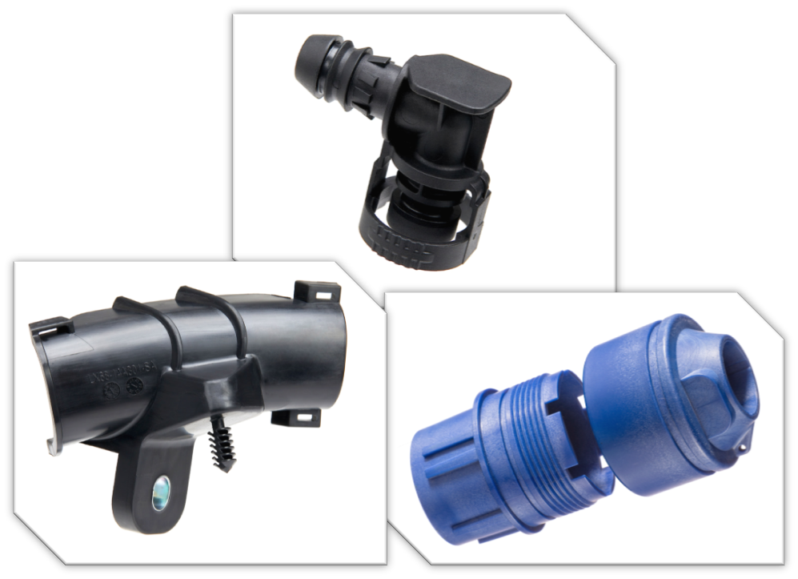
Elite Plastic Products, Inc.
Founded 1995
Headquarters located in Shelby Charter Township, Michigan.
Production Molding
Domestic & Offshore Tooling Capabilities
In-House Tool Qualification and Maintenance
IATF 16949 Certified
Press Tonnage Range: 85-400
Value Added Services: Over-molding, Insert-Molding, light assembly.

Slide 3
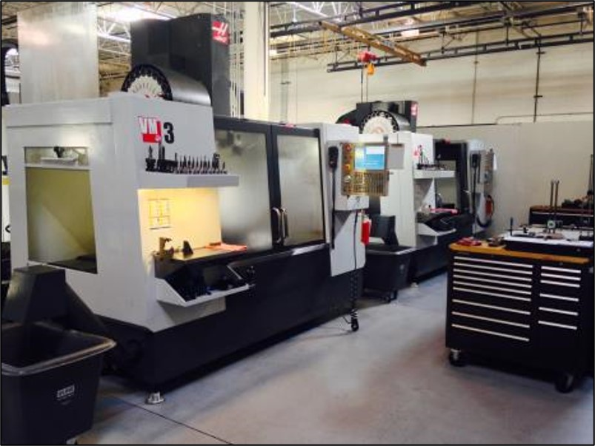
Elite Mold & Engineering, Inc.
Founded 1982
Prototype & Low-Volume Production
In-House Tooling
ISO 9001:2016 Certified
ITAR Registered
Press Tonnage Range: 55-400
Additive Manufacturing Capabilities

Slide 4
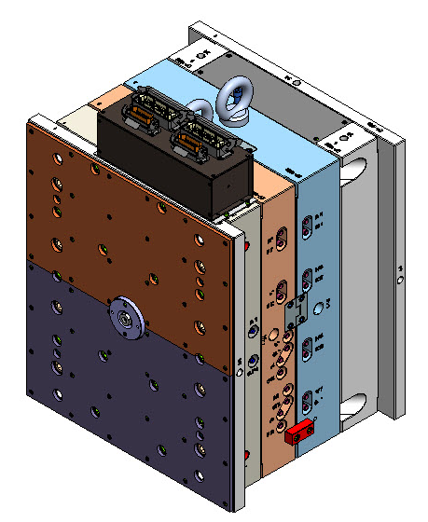
Engineering Services
  Mold Flow Analysis
  Mold 2D & 3D Design
  Molding Process Development and Troubleshooting
  On-Site Customer Support for Tooling and Processing
  Project Management Through Full Lifecycle
  Reverse Engineer Existing Parts
  DFM Analysis
  3D Printing (DLS & SLA)
  In-House and Third-Party Part Testing
  Production Feasibility Reports

Slide 5
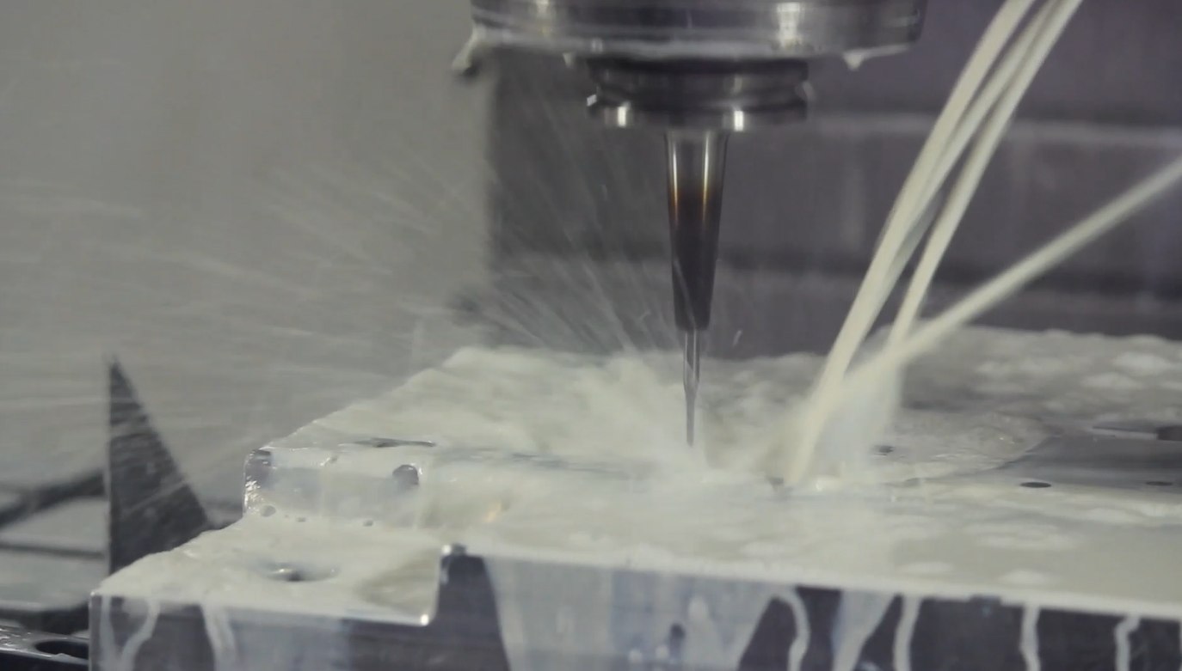
Tooling and Injection Molding Capabilities
USA
Over 150 production molds annually
Over 200 prototype and low volume molds annually
10 CNC machines & 4 EDMs
In-house engineering changes, repairs, and maintenance
Scientific molding
Automated processes
Insert molding and light assembly
38 injection molding machines
(55 – 400 tons)
Overseas Capabilities
Over 300 molds annually
10 CNC machines
4 EDMs
Injection molding capabilities
Main Markets
Automotive
Aerospace & Defense
Consumer Products
Industrial Products
Power Sport
Medical Device

Slide 6
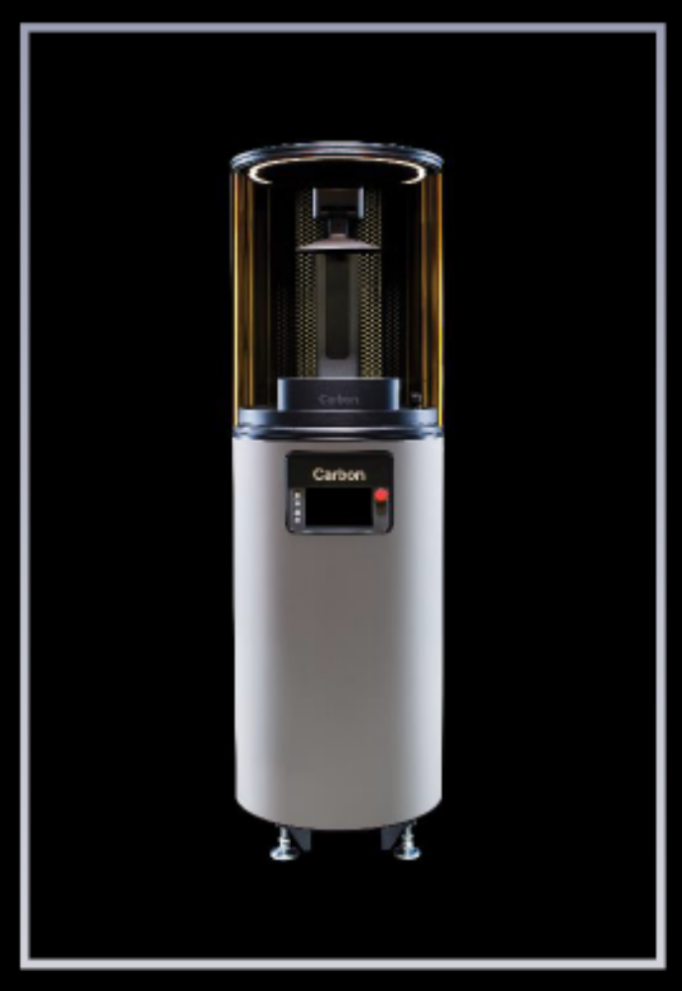
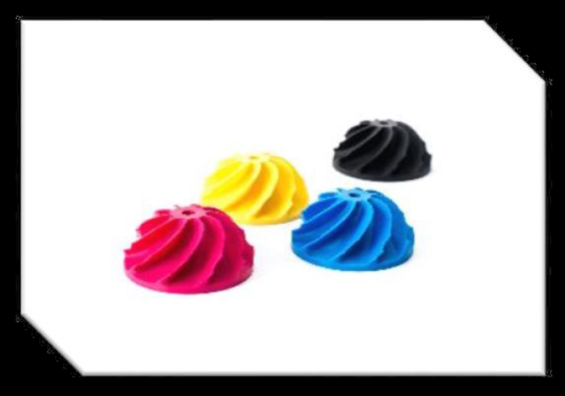
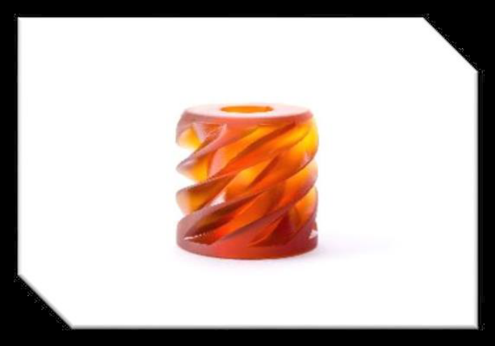
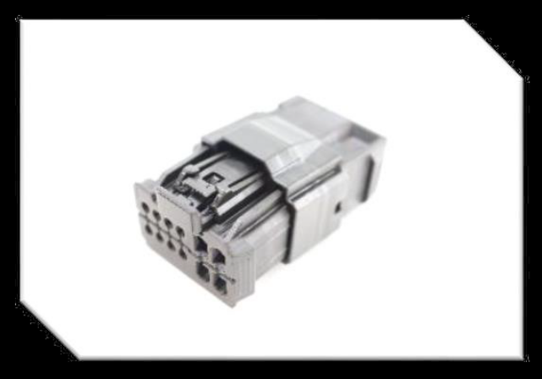
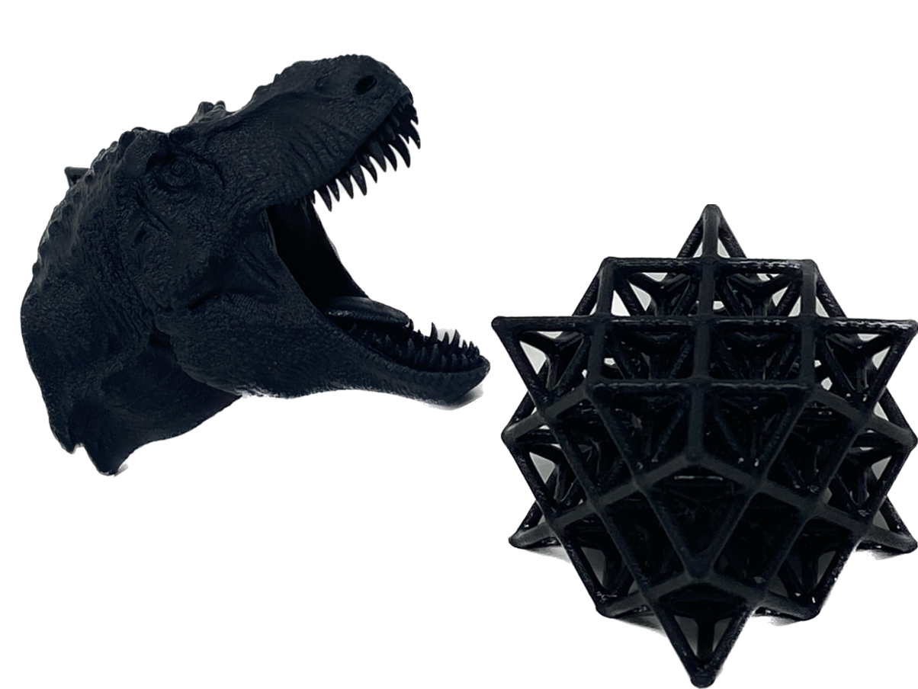
Additive Manufacturing Services
Elite offers Carbon M2 DLS printing services.
Carbon DLS Printing Advantages vs. SLA:
Production quality printed parts with full density.
Quick turnaround and rapid production capabilities
Better surface finish for premium cosmetic parts
Greater Material flexibility
  OEM Spec. Approved grades.

Slide 7

Quality System & Continual Improvement
  Elite is committed to continual improvement in all aspects of our business with a dedicated continual improvement staff
    IATF 16949:2016 certified
  Our System:
    Real-time shop floor communication for quality concerns
    100% product traceability from raw material through shipment
    Thorough APQP process to capture all customer requirements
      fully integrated into manufacturing ERP system
    Monitor key process indicators in all business areas including
      Customer service
      Machine and tooling maintenance
      On-time PPAP submissions
    Investment in automation equipment
    Investment in employee training

Slide 8
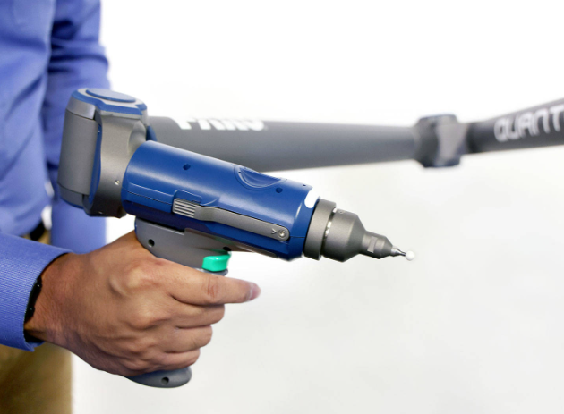
Part Inspection Capabilities
Capabilities
  Measurement and Part Performance Testing
  Part Inspection and Statistical Process Control (SPC)
  Process Capability Studies
  Measurement System Analysis
  Sample Inspection (full dimensional, first/last piece, in-process inspection)
Full-service Metrology Laboratory
  Contact & Non-Contact CMM
  FARO Arm
  Surface Profilometer
  Force Gage
  Spectrophotometer
  Gloss Meter
  Torque Driver
  Calipers, gage pins, height gage, surface plate
  Design and manufacture of gages, check fixtures, assembly fixtures
  100% integration with ERP system

Slide 9

Customer Support
Our team is dedicated to understanding our customers’ needs
  What We can Provide:
    A dedicated program manager
    A project timeline and weekly tool build report
    Support for pre-launch quantities at production pricing
    Competitive pricing
    PPAP qualifications
    CMM layouts
    Just-in-time delivery
    Thorough APQP process to capture all customer requirements with on time delivery
    24-hour contact

Slide 10
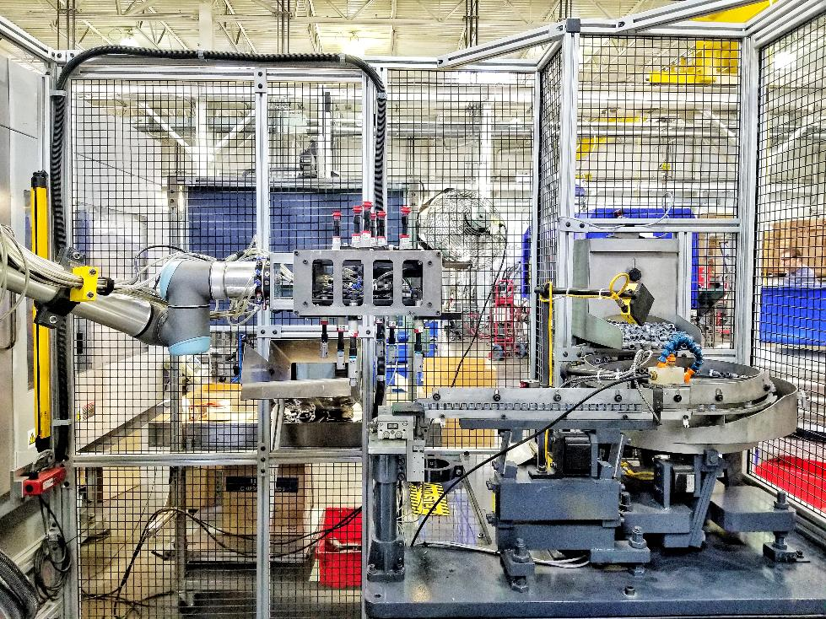
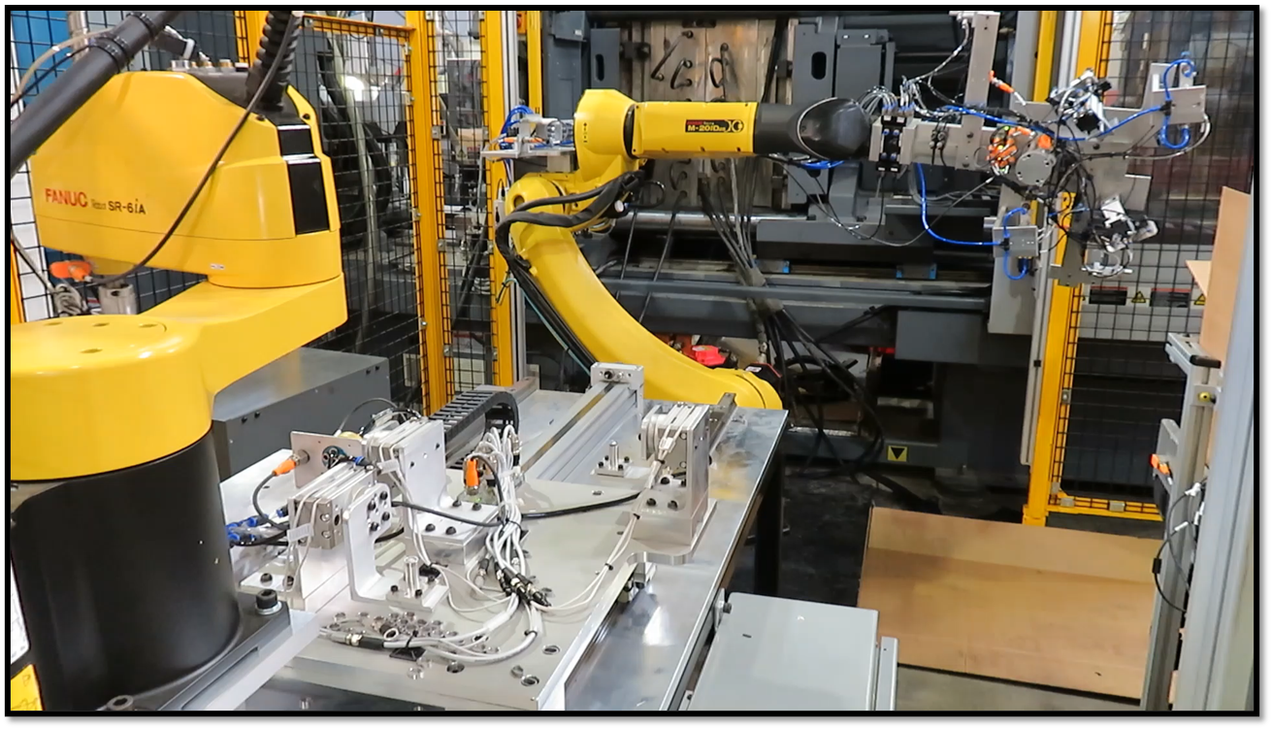
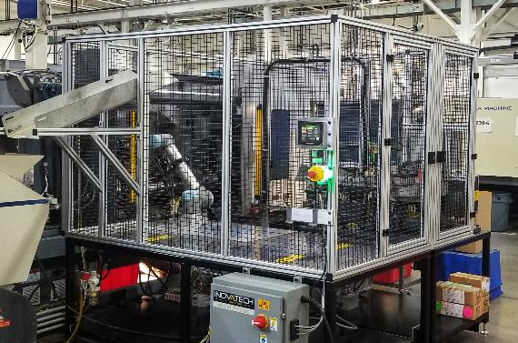
Automated Insert Molding

Slide 11

Why Elite?
Experience
We have been in the molding industry since 1982, and have seen projects of all different types
Full Project Lifecycle Management
We can take your concept from the prototype level with molded prototype samples or even 3D printed parts and turn it into a full production line with a fully automated manufacturing process.
Support
We can provide support from the start with Moldflow and warp analysis. Our friendly staff is also willing to help whenever possible and provide creative solutions for any issues.
Reliability
By going with Elite, you will continue to get the same great service and quality parts throughout the entire program.
Michigan company
Another great reason to go with Elite is because we are a Michigan small business, that proudly supports the Great Lake State as one of the great manufacturing hubs of the world.

Slide 12
Locations
Elite Mold & Engineering
51548 Filomena Drive
Shelby Twp. MI 48315
(17,500 square feet)
(586)314-4000
Shared Building
51476 Filomena Drive
Shelby Twp. MI 48315
(24,000 Square Feet)
*Additive department is located in this office.
Elite Plastic Products
51354 Filomena Drive
Shelby Twp. MI 48315
(36,000 square feet)
(586)247-5800

