Slide 1

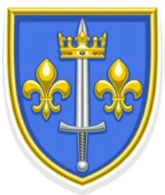




Create gold crown with red highlights similar or same as below
Create blue shield with gold beveled edge like below using a blue closer to color surrounding helmets to right)
Make helmets gold to match bevel with red plumes
Use golden lions with this shape on sides facing shield
Use old world font like this for Kennedy in scroll angled up from left to right to match scroll; make banner gold tone that goes with, but stands out from other golds

