Slide 1
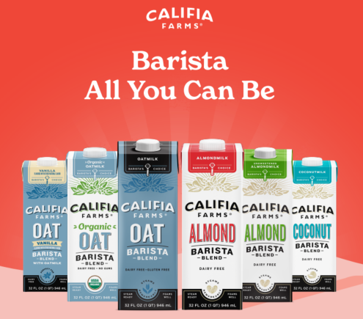

Ad Size: 300 x 250 pixels (file size less than 80K) –
Barista Product Line
Source File: 07A_EXP_0069_SCE_2024_ONE_PAGER
Need to resize and pull graphics and copy from attached POS
Copy as follows:
  Barista’s choice for plant-based milk
  Froth and steam perfect lattes
  Made with simple plant-based ingredients

Slide 2
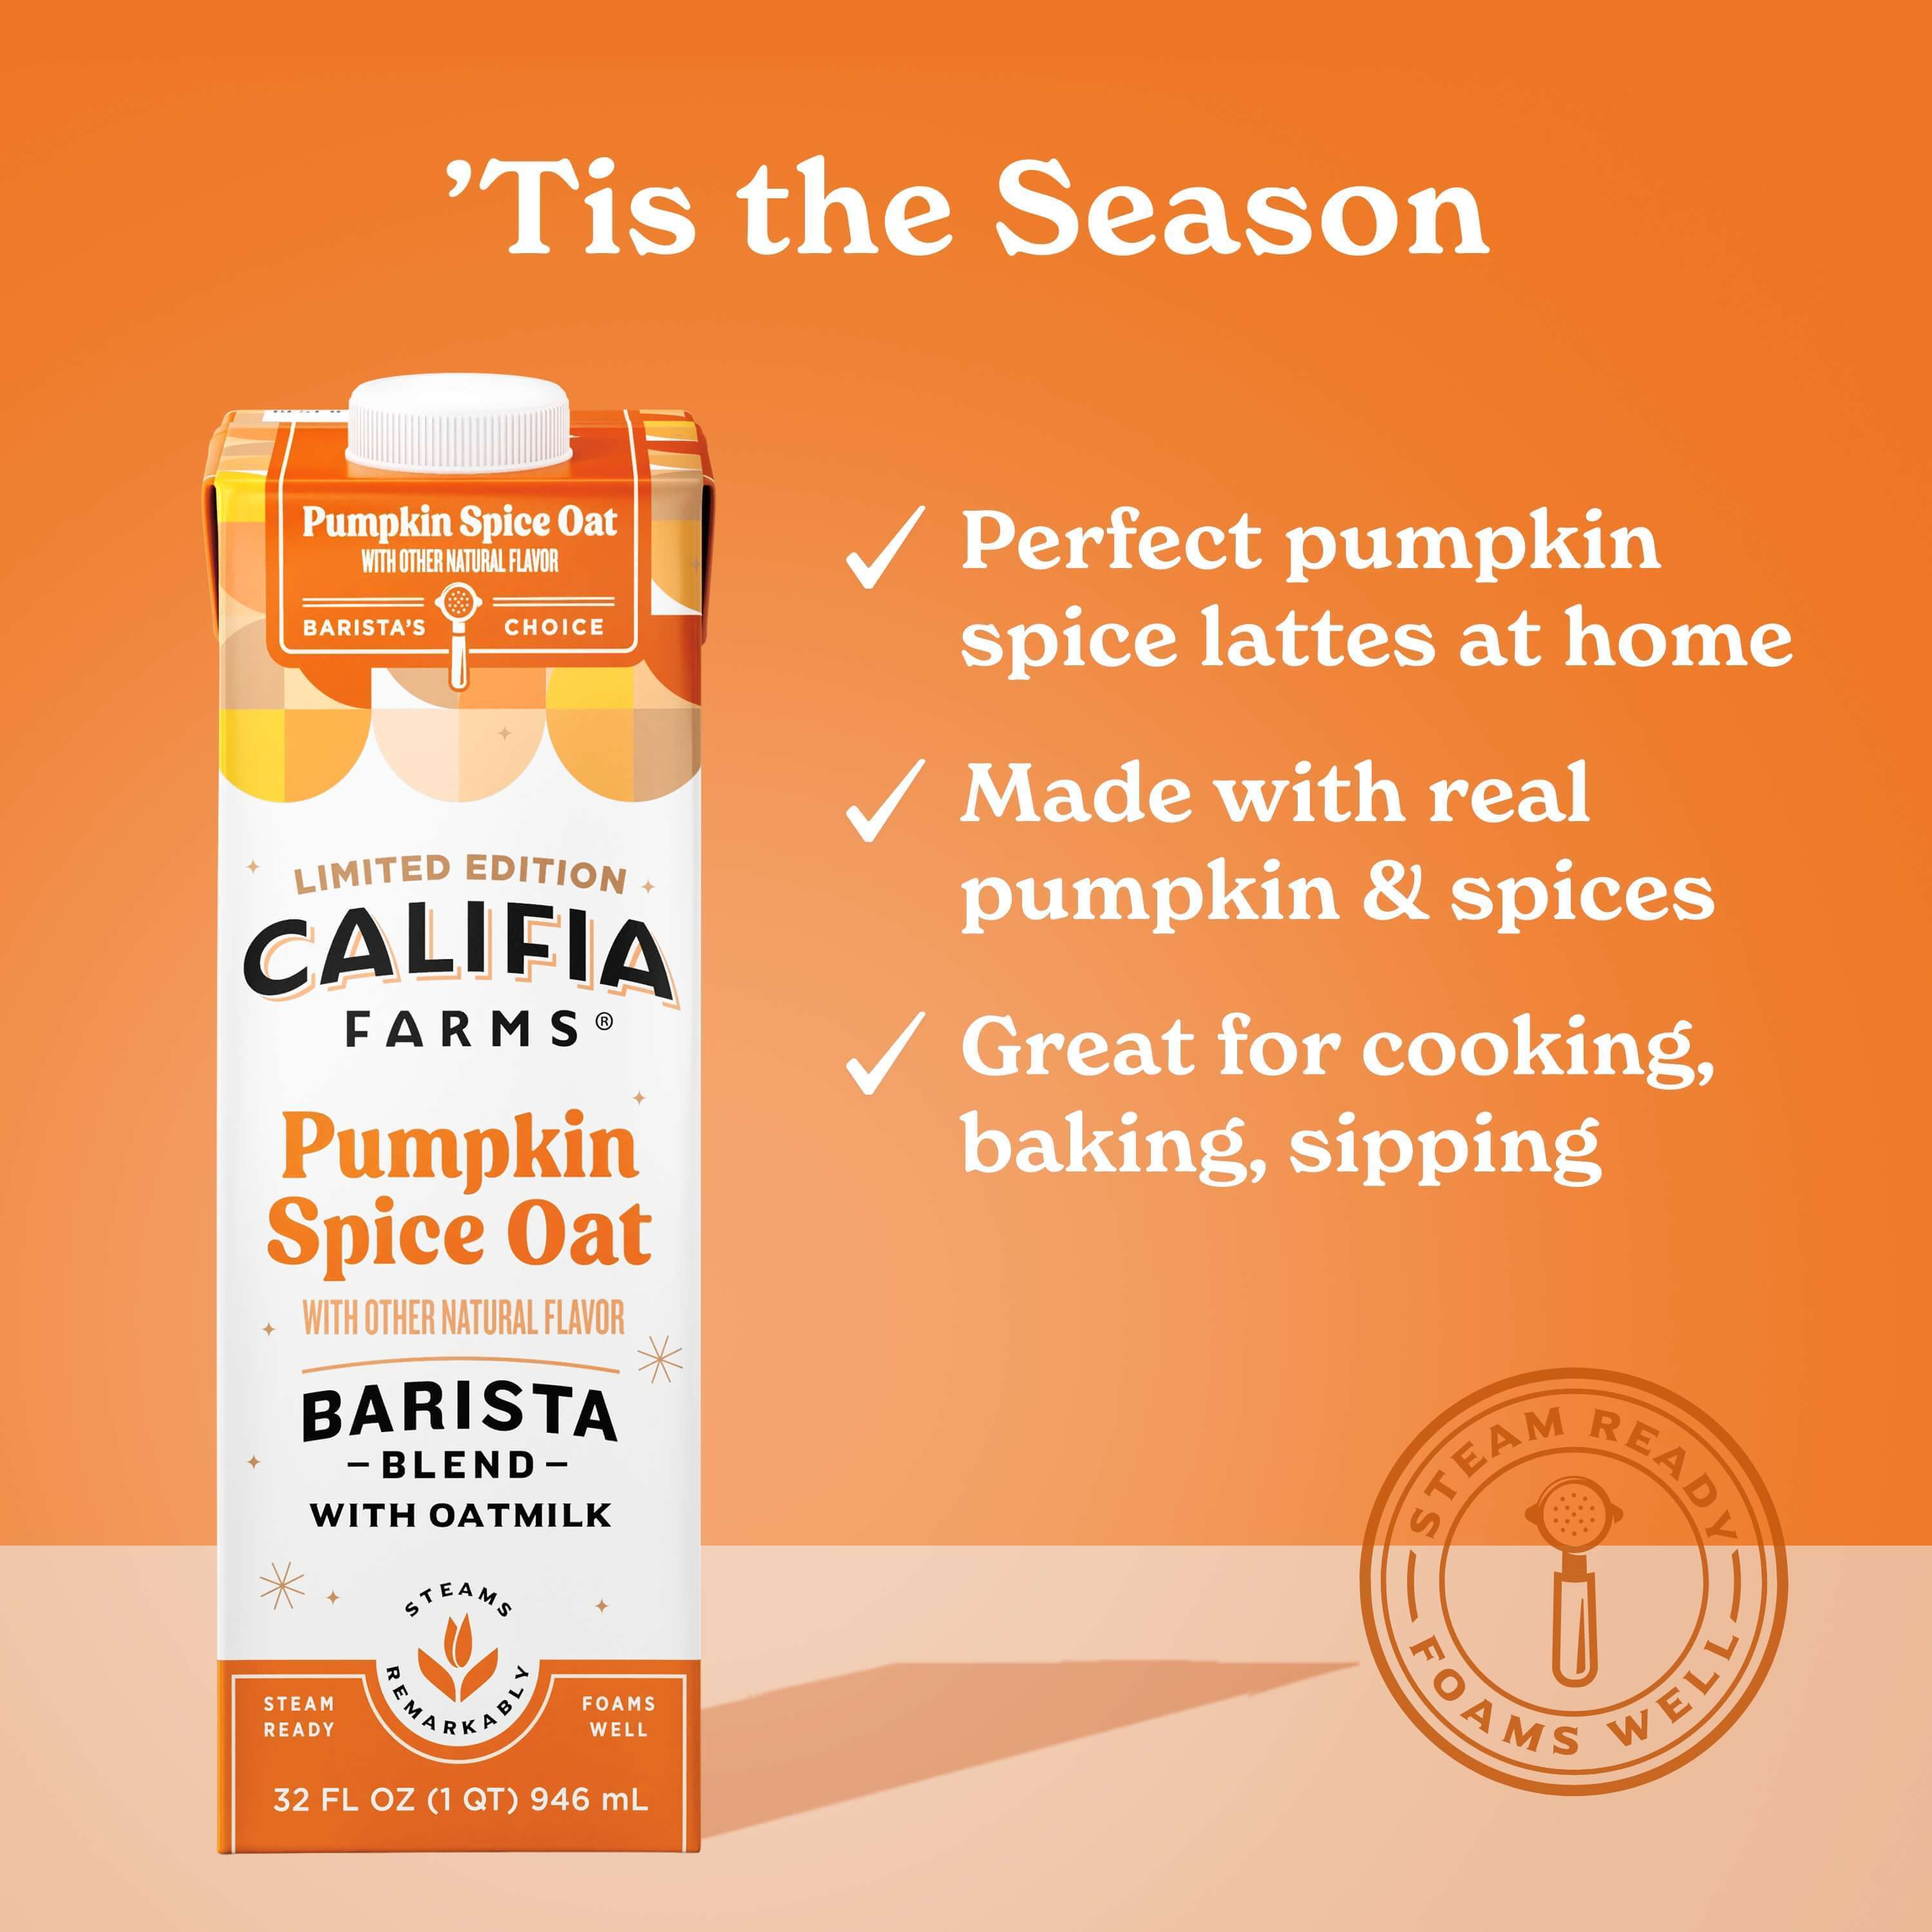
Ad Size: 300 x 250 pixels (file size less than 80K) –
Pumpkin Spice Oat Barista
Source File: Pump Sp Oat Barista Banner
Need to resize
Copy as follows:
  Make perfect Pumpkin Spice Lattes
  Made with real pumpkin & spices
  Great for cooking, baking, sipping

Slide 3
Ad Size: 970 x 250 pixels -
Barista Product Line
Source File: 07A_EXP_0069_SCE_2024_ONE_PAGER
Need to resize and pull graphics and copy from attached POS
Copy as follows:
  Barista’s choice for plant-based milk
  Froth and steam perfect lattes
  Made with simple plant-based ingredients

Slide 4
Ad Size: 535 x 260 pixels –
Pumpkin Spice Oat Barista
Source File: Pump Sp Oat Barista Banner
Need to resize
Copy as follows:
  Make perfect Pumpkin Spice Lattes
  Made with real pumpkin & spices
  Great for cooking, baking, sipping

