Slide 1
PROPSPOT
BRAND
GUIDELINES

Slide 2
01
MISSION & VISION
Brand Guidelines
Propspot

Slide 3
Our Mission
At Propspot, we believe every real estate transaction should be a purposeful step toward realizing your dreams. Our mission is to turn this vision into reality by ensuring each match is not just a process, but a personal journey towards achieving your ideal home. Your dream is our mission.
MISSION
&
VISION
Our Vision
Our vision is to make property wealth accessible to all. We offer a unique approach by simplifying property investment with our proprietary technology, breaking down barriers to provide a seamless path to financial freedom. By partnering with you, we turn real estate transactions into personalized steps toward financial independence.
Our Strategy
a customer-centric experience with our personalized strategy matching formula. Using proprietary technology, we tailor investment strategies to each user's personalised strategy, identifying ideal suburbs and properties. We prioritize transparency and excellence, empowering users to achieve financial independence.

Slide 4
02
COLORS
Brand Guidelines
Propspot

Slide 5


Gradient Colours
Hex Code:
#5E25FD
Hex Code:
#3A65F3
Hex Code:
#23CDDE

Slide 6
Primary Colours
Hex Code:
#3A65F3
Hex Code:
#5E25FD
Hex Code:
#23CDDE
Hex Code:
#5E25FD
Hex Code:
#3A65F3
Hex Code:
#5E25FD
Hex Code:
#23CDDE
Hex Code:
#FFFFFF

Slide 7
Accent Colours
Hex Code:
#F9384C
Hex Code:
#FCBF46

Slide 8
Overlays
80% Opacity
80% Opacity
80% Opacity
Hex Code:
#FFFFFF
Hex Code:
#5E25FD
Hex Code:
#5E25FD
Hex Code:
#3A65F3
Hex Code:
#23CDDE

Slide 9

80% Opacity
80% Opacity
80% Opacity
Hex Code:
#5E25FD
Hex Code:
#FFFFFF
Gradient
Overlays

Slide 10
03
TYPOGRAPHY
Brand Guidelines
Propspot

Slide 11
Primary Font
Proxima Nova
Aa
Light
Regular
Medium
Bold
Brand Guidelines
Propspot

Slide 12
Primary Font
Proxima Nova
Weight
Bold for headlines, semibold for subheadlines, and regular for body copy.
Spacing
Headlines, slightly tighter tracking is suitable, while body text should have more open tracking to improve readability.
Color
Use color strategically with typography to enhance legibility and hierarchy. For example, darker colors for headlines and lighter shades for body copy.
Size
Headlines can range from 24px to 32px for impact.
Subheadlines at 18px to 22px.
Body copy at 14px to 16px.
Captions around 12px.
Brand Guidelines
Propspot

Slide 13
Secondary Font
Breathing
Aa
Regular
Brand Guidelines
Propspot

Slide 14
04
ICONS
Brand Guidelines
Propspot

Slide 15













Slide 16













Slide 17
05
PHOTOGRAPHY
Brand Guidelines
Propspot

Slide 18






Slide 19
06
LOGO
Brand Guidelines
Propspot

Slide 20
Propspot
PRIMARY
LOGO
Propspot

Slide 21

Propspot
SECONDARY
LOGO

Slide 22


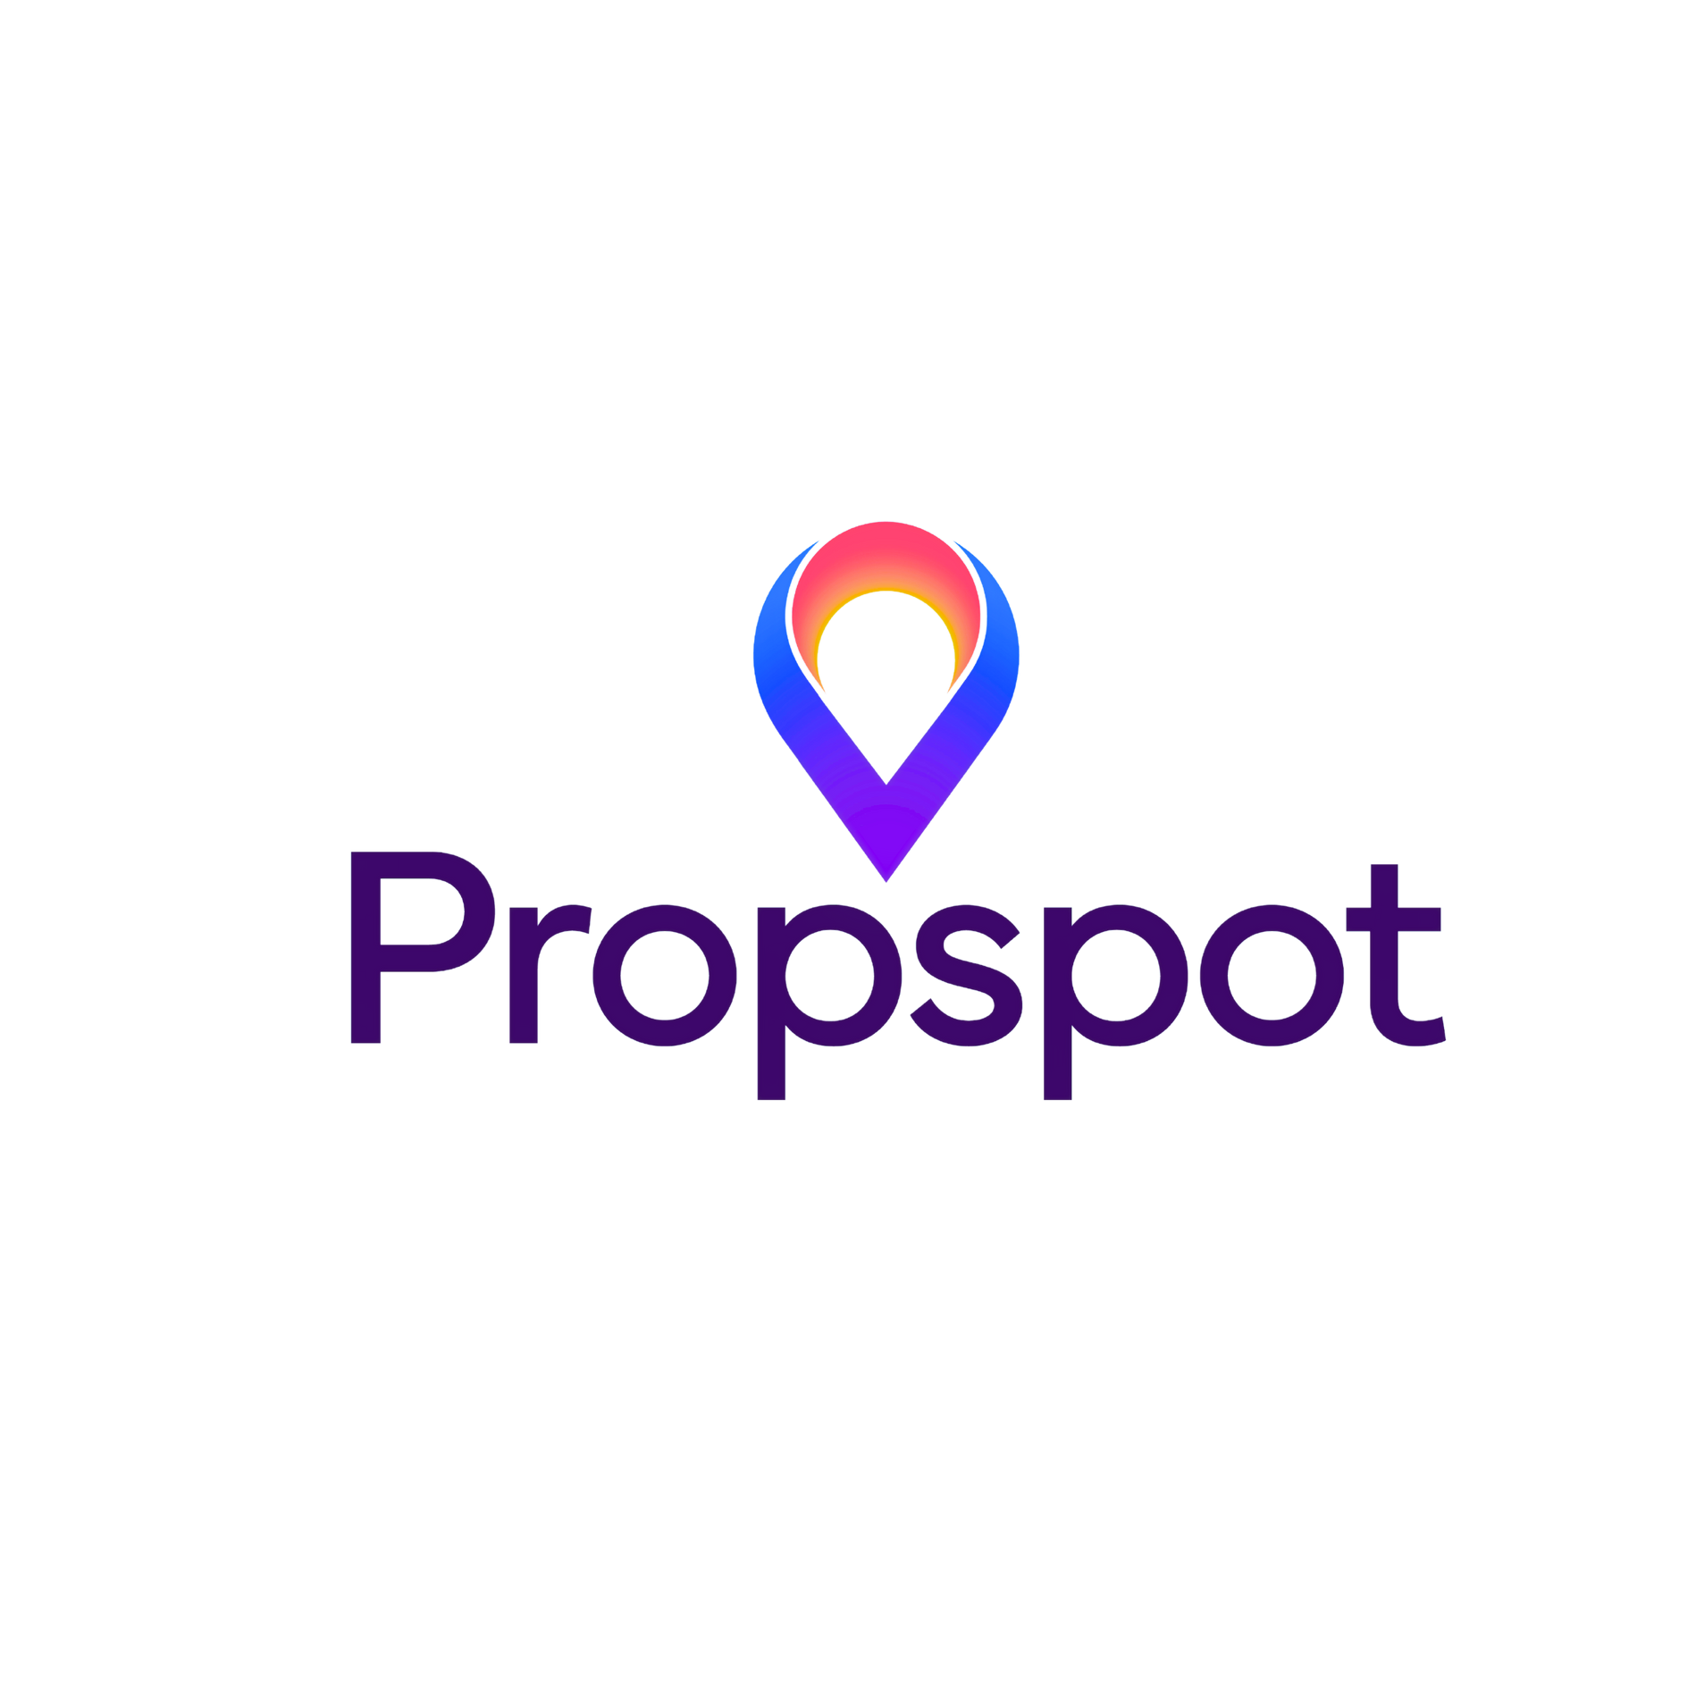
Primary
LOGO
MARK
White
Secondary

Slide 23
Element Guidelines
Do not stretch or distort the logo
Do not alter the logo colors
Do not place the logo on visually busy or contrasting backgrounds
Use the designated brand colors for the logo, and ensure high contrast for legibility.
Logo should be positioned at the top-left corner on websites, and centrally on print media.
The full-color logo should be placed on a white or light background. Use monochrome logo versions on dark or busy backgrounds.
LOGO
MARK

Slide 24
07
SOCIAL MEDIA
Brand Guidelines
Propspot

Slide 25





Slide 27
PROPSPOT
BRAND
STRATEGY

Slide 28
08
CORE VALUES
Brand Strategy
Propspot

Slide 29
Simplicity
Empathy
We design every step to be intuitive and straightforward, making property investment easy and accessible for everyone.
We prioritize your journey, ensuring our technology supports and enhances your experience every step of the way.
Excellence
Innovation
We strive for excellence in every interaction, delivering remarkable experiences that make property transactions smooth and stress-free.
We continuously innovate to simplify the investment process, creating seamless and efficient experiences.

Slide 30
09
BRAND STATEMENTS
Brand Strategy
Propspot

Slide 31
Tagline
“Making Property Simple”
Customer Commitment
"We're With You Every Step of the Way."
Brand Promise
"Every interaction with Propspot brings you closer to the doorstep of your future, with clarity, confidence, and ease."

Slide 32
10
BRAND ARCHETYPE
Brand Strategy
Propspot

Slide 33

The Magician
Goal
Transform the complex real estate process into a simple, magical experience that empowers users and fulfills their dreams.
Fear
Being perceived as ordinary or unable to deliver transformative experiences.
Strategy
Use knowledge and innovation to deliver remarkable solutions that revolutionize the real estate industry.
Gift
Ability to see and actualize potential in the real estate market, bringing visions to reality.

Slide 34
How Propspot Embodies the Magician Archetype
Creating Wonder
Just as a magician creates a sense of wonder and excitement, Propspot creates a sense of awe and satisfaction by making the complex and often stressful process of buying property feel effortless and magical.
Empowering Customers
Like a magician empowers his audience to dream of the impossible, Propspot empowers its users with tools and insights that enable them to make confident, informed decisions.
Visionary Solutions
The Magician archetype is visionary, seeing possibilities where others see obstacles. Propspot embodies this trait by envisioning and implementing new ways to interact with real estate markets, transforming and leading the industry.
Transformational Technology
Propspot uses cutting-edge AI and machine learning to demystify and simplify the property buying and investment process, much like a magician uses his tools to perform astonishing feats.
Inspiring Change
Like the Magician who inspires change and new perspectives in his audience, Propspot inspires a new approach to real estate, changing perceptions and expectations about what a real estate service can be.

Slide 35
11
TARGET AUDIENCE
Brand Strategy
Propspot

Slide 36



Real Estate Investors
Aspiring Homeowners
Established Investors

Slide 37
12
PRIMARY AUDIENCE
Brand Strategy
Propspot

Slide 38
Personality
Aspiring property investors and homeowners are average everyday Australians with a strong desire to secure their financial future through property investment. They are practical, hardworking individuals who value simplicity and clarity in the investment process. Balancing family, work, and their investment ambitions, they seek practical solutions that fit their busy lifestyles.
Values
  Simplicity and Efficiency: Appreciate straightforward processes and clear, concise information to aid their investment decisions.
  Financial Security: Prioritize investments that promise long-term financial stability and growth.
  Practicality: Value practical and reliable solutions that make the investment process easier and more manageable.
  Community and Family: Value strong community ties and aim to improve their living conditions for the benefit of their families.
Interests and Lifestyle: These individuals are often engaged in activities that enhance their knowledge of real estate and financial planning. They participate in local community events, enjoy family activities, and are keen on home improvement projects. They balance their professional commitments with their aspirations to invest in property and build a secure future.
Challenges
  Navigating Market Uncertainty: Concerned about fluctuating property markets and economic conditions.
  Financial Barriers: Struggle with securing financing and managing the costs associated with property investment.
  Complexity of the Process: Find the property investment process complex and overwhelming.
  Time Constraints: Juggle investment activities with busy professional and personal lives.
Purchase Drivers
  Financial Growth: Seeking opportunities to grow their wealth through property investment.
  Ease of Use: Preferring platforms that simplify the investment process, making it easy to understand and execute.
  Trusted Guidance: Valuing expert advice and insights that help them make confident investment decisions.
  Community Impact: Interested in investments that positively affect their community and lifestyle.
  Practical Solutions: Looking for practical and reliable solutions that fit into their busy lifestyles.
Propspot's Point of Difference
  Personalized Strategy: Offering tailored property investment strategies through user-friendly technology.
  Simplicity: Providing a seamless, straightforward platform that makes property investment accessible and efficient.
  Comprehensive Support: Delivering expert guidance and detailed market insights to empower informed decision-making.
  Community Focus: Highlighting properties in supportive, family-friendly neighborhoods that enhance quality of life.
  Practical Innovation: Continuously innovating to offer practical solutions that make property investment easier for everyday Australians.
Aspiring Homeowners/Investors
  Age: 20-50
  Gender: All genders
  Location: Urban and suburban areas across Australia
  Income Level: Middle to upper-middle class
  Occupation: Professionals, tradespeople, and everyday workers

Slide 39
13
SECONDARY AUDIENCE
Brand Strategy
Propspot

Slide 40
Personality
Real estate investors are ambitious and goal-oriented individuals who have experience in the property market. They are strategic thinkers who value data-driven decisions and innovative solutions. Balancing multiple investments and market trends, they seek advanced tools and insights to optimize their portfolios.
Values
  Data-Driven Decision Making: Rely on accurate, comprehensive data to guide their investment choices.
  Financial Growth: Focus on maximizing returns and building long-term wealth through diversified investments.
  Innovation: Appreciate cutting-edge technology and tools that provide a competitive edge in the market.
  Efficiency and Scalability: Value solutions that streamline investment processes and enable scalable portfolio growth.
Interests and Lifestyle: These individuals stay updated on real estate trends, market analytics, and investment strategies. They often attend industry conferences, participate in investment groups, and use advanced financial planning tools. Their lifestyle includes managing multiple properties, networking with other investors, and continuously seeking new investment opportunities.
Challenges
  Market Volatility: Navigating the uncertainties of fluctuating property markets and economic conditions.
  Complex Portfolio Management: Managing diverse property portfolios and the complexities involved.
  Access to Reliable Data: Finding accurate and timely market insights to inform investment decisions.
  Risk Management: Balancing risk and reward across different investment properties and strategies.
Purchase Drivers
  Comprehensive Insights: Seeking platforms that offer detailed market analytics and property insights.
  Advanced Tools: Preferring advanced financial tools and technologies that enhance investment strategies.
  Efficiency: Valuing platforms that streamline investment processes and save time.
  Portfolio Optimization: Looking for solutions that help optimize their property portfolios for maximum returns.
  Reliable Support: Valuing expert advice and support to guide their investment decisions.
Propspot's Point of Difference
  Advanced Analytics: Providing detailed market insights and property analytics to inform data-driven decisions.
  Innovative Technology: Offering cutting-edge tools that streamline investment processes and enhance portfolio management.
  Efficiency and Scalability: Delivering solutions that enable efficient and scalable property investment.
  Expert Guidance: Providing reliable support and expert advice to help investors make informed decisions.
  Comprehensive Support: Offering a robust platform that simplifies complex portfolio management and optimizes returns.
Real Estate Investors
  Age: 25-55
  Gender: All genders
  Location: Nationwide, with a focus on major cities and growth areas
  Income Level: Upper-middle class to high net worth individuals
  Occupation: Experienced property investors, real estate professionals, and high-net-worth individuals

Slide 41
14
TERTIARY AUDIENCE
Brand Strategy
Propspot

Slide 42
Personality
Established investors are seasoned professionals with a substantial track record in property investment. They are analytical, strategic, and always on the lookout for opportunities to diversify and expand their portfolios. They value efficiency, precision, and comprehensive insights to maintain and grow their investments.
Values
  Precision and Detail: Demand accurate and detailed information to support their sophisticated investment strategies.
  Long-Term Growth: Focus on sustainable growth and long-term financial stability through diversified investments.
  Innovation: Embrace new technologies and methodologies that can give them an edge in the market.
  Trust and Reliability: Prioritize reliable data sources and trustworthy platforms to make informed decisions.
  Interests and Lifestyle: These investors stay deeply engaged with market trends, financial news, and real estate developments. They often participate in high-level industry events, network with other top investors, and use advanced investment tools. Their lifestyle includes managing multiple high-value properties, consulting with financial advisors, and exploring new markets for potential investments.
Challenges
  Market Dynamics: Dealing with the complexities of changing market conditions and economic factors.
  Portfolio Management: Efficiently managing a large and diverse portfolio of properties.
  Data Overload: Sifting through vast amounts of data to find relevant and actionable insights.
  Risk Management: Balancing high rewards with potential risks across various investments.
Purchase Drivers
  Advanced Insights: Seeking platforms that provide in-depth market analysis and investment insights.
  Efficiency Tools: Preferring advanced tools that enhance efficiency in managing and expanding portfolios.
  Strategic Support: Valuing platforms that offer strategic advice and expert support tailored to their sophisticated needs.
  Comprehensive Solutions: Looking for comprehensive solutions that address the full spectrum of their investment activities.
  Reliable Data: Prioritizing accurate and timely data to make well-informed decisions.
Propspot's Point of Difference
  In-Depth Analytics: Delivering advanced market analysis and property insights to inform strategic investment decisions.
  Innovative Technology: Offering state-of-the-art tools that enhance efficiency and effectiveness in portfolio management.
  Expert Support: Providing tailored strategic advice and expert support to meet the sophisticated needs of established investors.
  Comprehensive Platform: Offering a robust, all-encompassing platform that addresses every aspect of property investment.
  Reliable Data: Ensuring access to accurate, timely, and reliable data for well-informed decision-making.
Established Investors
  Age: 30-55
  Gender: All genders
  Location: Nationwide, with a focus on major urban centers and high-growth areas
  Income Level: High net worth individuals
  Occupation: Experienced property investors, real estate moguls, and high-income professionals

Slide 43
15
UNIQUE SELLING PROPISITION
Brand Strategy
Propspot

Slide 44
01
02
03
Intelligent Matching
Precision Insights
Seamless Experience
Our proprietary technology utilizes deep learning to match users with a tailored property investment strategy, pinpoint the perfect suburb, and ultimately identify the ideal property.
Delivering precise market insights to empower informed decisions, helping investors build a robust property portfolio with confidence.
An all-encompassing platform that guides users effortlessly from browsing to buying, simplifying every step of the property investment journey.

Slide 45
16
BRAND PERSONALITY
Brand Strategy
Propspot

Slide 46
Simplified
Clear: Making complex real estate concepts easy to understand and navigate.
Effortless: Ensuring a smooth, hassle-free experience from browsing to buying.
User-Centric
Empathetic: Understanding and prioritizing the unique needs and journeys of each user.
Supportive: Offering guidance and assistance at every step of the investment process.
Dynamic
Adaptable: Quickly responding to market changes and user needs.
Energetic: Bringing enthusiasm and vigor to the real estate investment journey.
Trustworthy
Reliable: Providing dependable and accurate insights to build trust with our users.
Transparent: Maintaining openness in our processes, ensuring users feel secure in their investment decisions.
Professional
Expertise: Demonstrating deep knowledge and proficiency in real estate and investment.
Excellence: Striving for high standards in every aspect of our service, creating remarkable experiences.
Empowering
Knowledgeable: Equipping users with the insights and tools needed to make informed investment decisions.
Inspirational: Motivating users to achieve their financial goals and dreams through property investment.
Visionary
Innovative: Constantly pushing the boundaries of what's possible in real estate investment.
Forward-Thinking: Always looking ahead to anticipate and shape the future of property investment.

Slide 47
17
BRAND VOICE
Brand Strategy
Propspot

Slide 48
Clear and Concise
Trustworthy and Reliable
Empathetic and Supportive
Language
Use straightforward and easy-to-understand language.
Tone
Direct and to the point, avoiding jargon and unnecessary complexity.
Language
Use empathetic and understanding language that prioritizes the user’s needs.
Tone
Warm and approachable, making users feel supported and valued.
Language
Use empathetic and understanding language that prioritizes the user’s needs.
Tone
Warm and approachable, making users feel supported and valued.
Inspirational and Empowering
Innovative and Forward-Thinking
Simple and Accessible
Language
Use motivational and encouraging language that inspires confidence.
Tone
Positive and uplifting, motivating users to achieve their financial goals.
Language
Use dynamic and progressive language that highlights innovation.
Tone
Energetic and forward-looking, emphasizing cutting-edge solutions and future possibilities.
Language
Use clear and simple language that ensures accessibility for all users.
Tone
Friendly and approachable, making complex processes easy to understand.

Slide 49
18
THEME
Brand Strategy
Propspot

Slide 50

Simplified Journey
Innovative Matchmaking
Empowered Decisions
Human-Centric Technology
Aspirational Living
Community Building
Sustainable Investments
Accessible Expertise
New Age
Approach
Transparent Transactions

Slide 51
19
WHO WE ARE
WHO WE ARE NOT
Brand Strategy
Propspot

Slide 52
Who we “are”
We are architects of change, building a future where home ownership is a reality for all.
We are community creators, connecting individuals with spaces where they can thrive.
We are a beacon of trust, consistently reliable in an industry that demands certainty.
We are innovators, redefining the real estate journey with cutting-edge technology.
We are a testament to what's possible, opening doors to potential and prosperity.
We are advocates for clarity, ensuring transparency in all our interactions.
We are enablers, empowering our users with knowledge and power.
We are partners, walking alongside our users every step of the way.
We are visionaries, seeing beyond transactions to life's milestones.
We are simplifiers, turning the complex into the accessible.
Brand Strategy
Propspot

Slide 53
Who we are “not”
We are not obscure, hiding details in fine print.
We are not distant, leaving users to navigate alone.
We are not traditionalists, content with the status quo.
We are not complicators, muddling what should be clear.
We are not just a service, but a transformative experience.
We are not skeptics of change, but champions for progress.
We are not followers, reacting to trends instead of setting them.
We are not brick-and-mortar bound, limited by physical constraints.
We are not indifferent, but deeply invested in each customer's journey.
We are not just about homes, but about the dreams and lives that fill them.
Brand Strategy
Propspot

Slide 54
20
PERSONALITY REFERENCES
Brand Strategy
Propspot

Slide 55



Visual Inspiration
If we were a location
If we were a car
If we were a phone
Silicon Valley
Cybertruck
iPhone
The Heartbeat of Innovation
Uniquely Iconic
A Symbol of Simplicity
Imagine Propspot as Silicon Valley, synonymous with cutting-edge technology, groundbreaking ideas, and relentless excellence, Propspot embodies this spirit of innovation in real estate investment. Propspot thrives on creating revolutionary solutions that simplify complex processes, making property investment accessible and efficient.
A vehicle that defies expectations with its distinctive design and groundbreaking technology. Just as the Cybertruck stands out with its futuristic features, Propspot revolutionizes real estate investment with innovative technology and a personalized, seamless experience for customers, setting new industry standards.
The iPhone is celebrated for making advanced technology accessible and simple to use, much like Propspot simplifies property investment. With a focus on delivering a seamless, efficient, and personalized user experience, Propspot ensures that complex investment processes are straightforward and easy to navigate.

