Slide 1





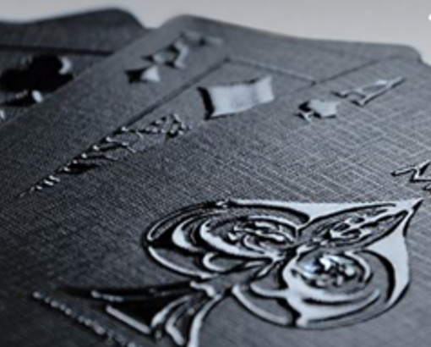


Slide 2


Big
&
Pawsome

Slide 3



Big
&
Pawsome

