Slide 1








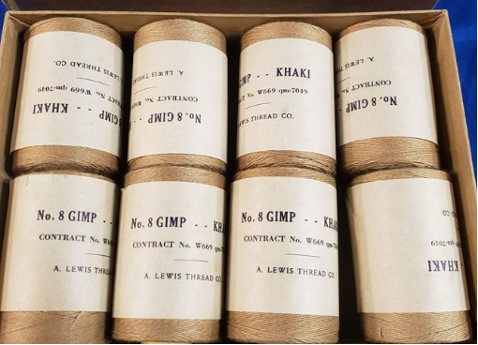





Flag here
#1 pick
Do not use “est.” in any design, color scheme to be khaki, greens and dark brown. Possible some white, not too many colors

