Slide 1
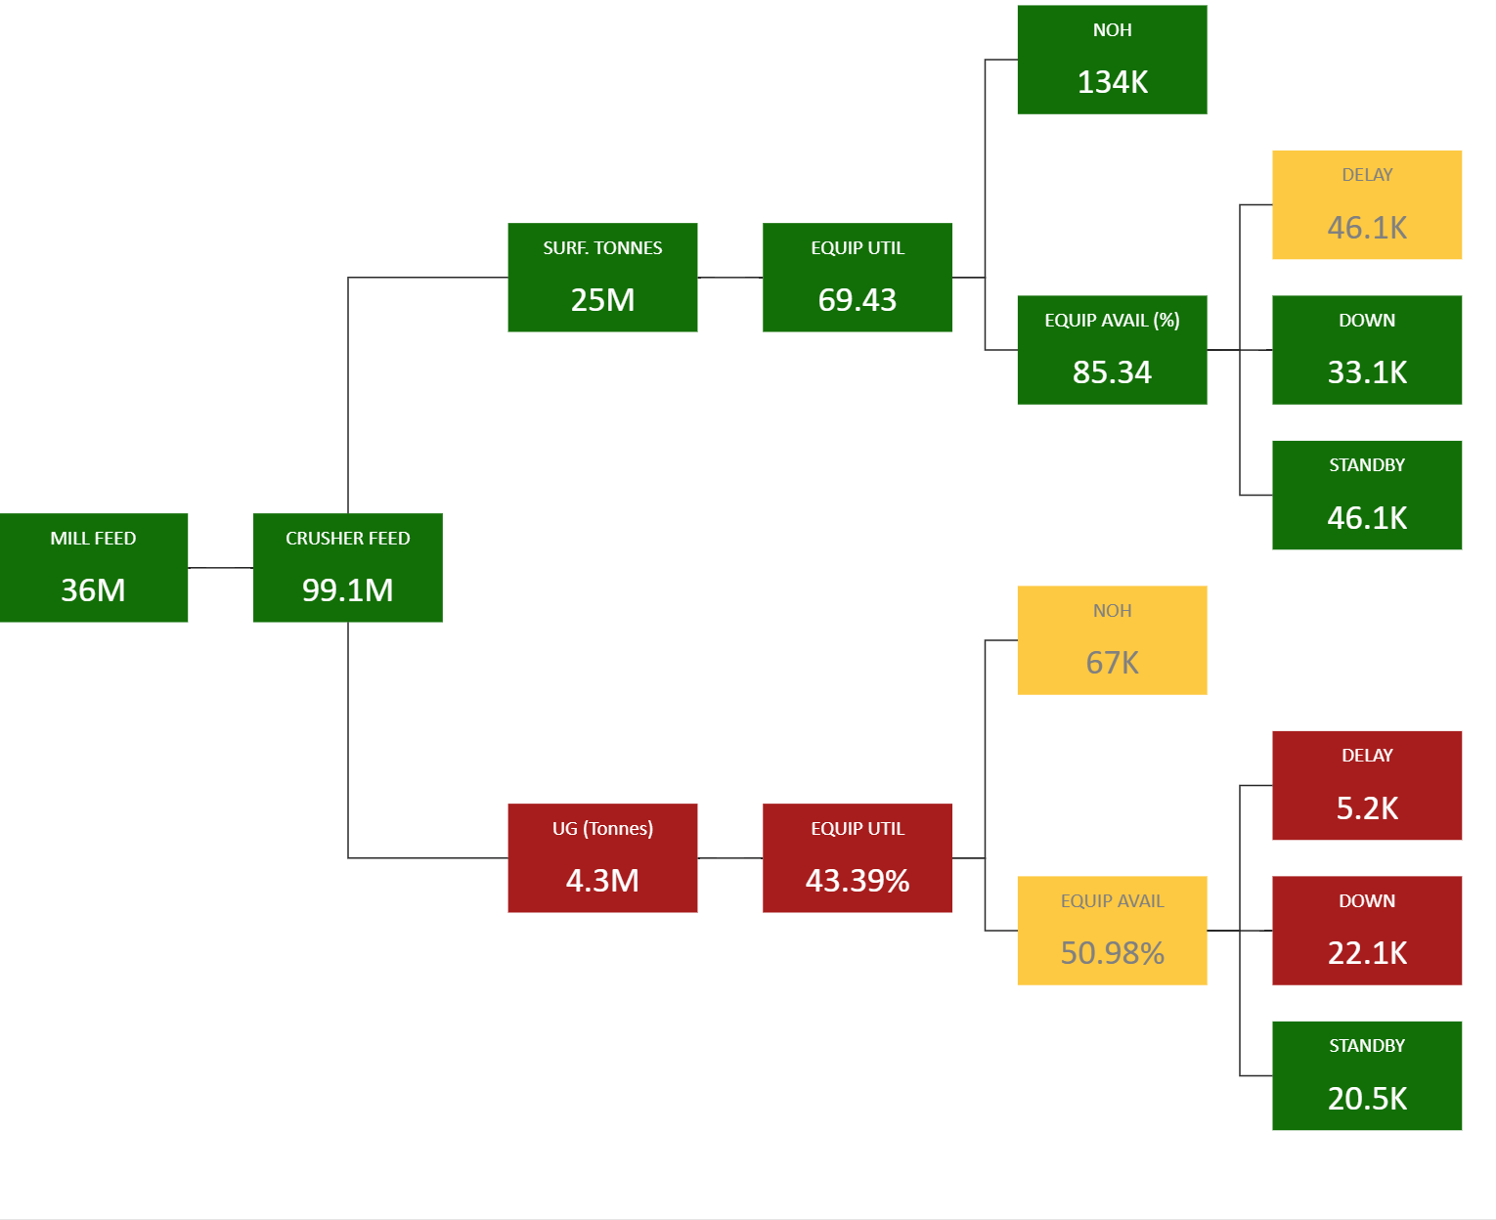
Data Sources
Data Management and Simulation
Visualization and Analytics
Ore Accounting
Centric Enterprise
Centric Analytics
Mobile Asset
Fixed Asset
Plant Operations
Metals Production
Simulation
Financial

