Slide 1




(For Sole traderand small businesses)
Here to serve our customers
As your local, trusted wholesaler

Slide 2
Who we are:
Started in 1995 with just a (large) mobile phone and a few desks, the company has grown into a respected wholesaler with branches across Kent, Middlesex, Essex and Sussex. In addition to the 6 Regent branches, the company also owns and operates Gemini Electrical Supplies (Teddington) and Select Electrical Supplies Ltd (Worthing)
We are straight, honest and down to earth – we would rather turn down an order if we cannot meet your delivery needs, rather than leave you waiting on site
We take pride in our work, our company and the job we do for our customers
Branch network image - with circle to highlight the delivery radius
(Can this be created ?)
“Our experienced, helpful and dedicated colleagues offer a personalised service to every customer. We’re here to help business grow so that you can deliver top quality service to your customers”

Slide 3
First things first - What won’t we do?
Make promises we can’t keep – we won’t promise you the world and then let you down.
Keep you waiting on the trade counter, or on site waiting for a delivery
We won’t entice you with cheap prices, only to increase them as you become comfortable in dealing with us
Deliberately misquote items to win an order. We’ll make sure everything's covered to save time and money later.
Courier goods to site without telling you.
Part dispatch orders when you are expecting a complete order, and invoice you for goods you haven’t yet received.
Bombard you with pointless marketing.
We won’t place the account on stop on the first day of the new month
We won’t ignore your business if a “larger” customer comes along
“We’re a family owned and run business helping you, our local customers, get quality prices with a personalised service”

Slide 4
What do we do?
All of our customers are “Key Accounts” - Whether you spend £500 or £50,000 per month, you will be treated as a key account, with quick response time, deliveries, good credit terms
We are a “One-stop-shop” – We keep a comprehensive range of items, meaning you won’t have to go elsewhere for odds and sods.
Same day deliveries – regardless of size, if you need something urgently, we understand that you need it! We will always do our best to cater for those urgent last few items to complete a job.
Show you new products to keep you up-to-date with the latest release.
Provide access to all our branches with invoicing from your local branch.
Invoice goods same day so that you aren’t waiting around.
Be flexible on returns, not withholding credit notes.
Flexible and fast delivery service – all across the Uk including late afternoon/evening deliveries - ensuring you get the products when you need them at a time that suits you, & if we haven’t got something, we’ll arrange it via our branch network on a next day service.
Customer rewards, including *Personal incentives?
“Our 3 core tenets are:
“We. operate in small teams of motivated, experienced and talented people who share the belief that we are nothing without our customers”
“We tailor our stockholding to suit and support our customers”
“We help our customers grow their businesses with flexible credit terms, and full project design, support and delivery”

Slide 5
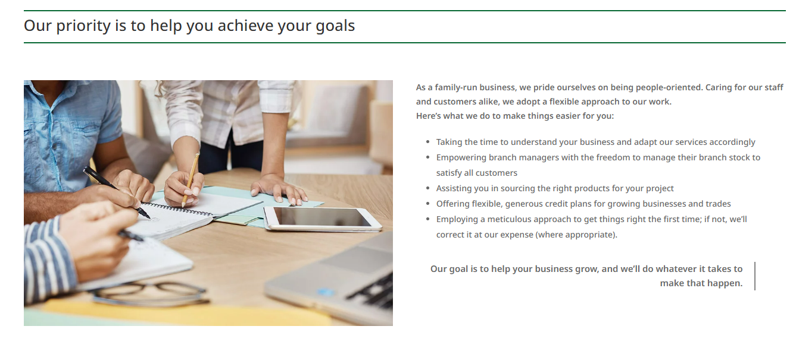
How do we help you?

Slide 6
Our goals
To be the go-to wholesaler for accurate, competitive quotations, supplying the best quality products at the fairest price
To support our people to grow accounts not profit.
To become a partner - not a just a supplier, but the easiest supplier to deal with, so your business can grow
To be the most highly respected Wholesaler in the areas in which we operate
To support our colleagues with training, support and incentives
To become a valued partner to our suppliers
“Throughout the years, the business model has evolved to embrace new technologies and products, but the core philosophy remains the same: Going the extra mile to ensure your job runs as smoothly and successfully as possible”

Slide 7
Last thoughts:
When you deal with us you can enjoy:
A personalised service, helping you find the right project for your jobs
Same day local delivery and nationwide next day delivery
First class customer support and honest advice
Flexible credit terms to support your business
Consistent pricing with no surprises on your invoices
“We can’t always promise the lowest prices, but we guarantee fair competitive pricing with unparalleled customer service and support”

Slide 8


Partner brands

