Slide 1


Has 1Q24 Suppl information-
This Investor Presentation has 1Q24 info. Tied out by Marilee on 5/xx/24.
Used 5/xx/24 date to update SNL and Dividend Yield. Stock price was $xx33.61.
NAREIT REITWeek
June 2024

Slide 2
About ltc
LTC Properties, Inc. (NYSE: LTC) is a real estate investment trust (REIT) investing in seniors housing and care properties primarily through sale-leasebacks, mortgage financing, joint ventures and structured finance solutions including preferred equity and mezzanine lending.
MONTHLY DIVIDENDS
AS OF MARCH 31, 2024
Established 1992
NYSE: LTC
Investment Grade ¹
NAIC 2C rating
Total Liquidity
$197M
Debt to Annualized Adjusted EBITDAre
5.5x
Dividend Yield ²
6.8%
Market Value ²
$1.5B
Enterprise Value ²
$2.3B
Debt to Enterprise Value ²
36.7%
Insurance industry’s rating agency for debt investments
Closing stock price of $33.61 on May 2, 2024
2

Slide 3







Ltc is a compelling Investment
LTC maintained monthly dividends throughout the pandemic when most health care REITs cut theirs
  Longstanding executive leadership team with DECADES OF EXPERIENCE IN HEALTH CARE REAL ESTATE
  228 consecutive payments of MONTHLY dividends
  Creative financing structures offering variety of products to meet operators’ needs
  conservative and strong balance sheet
  Laddered debt maturities matched to CASH FLOW and portfolio maturities
3

Slide 4
Demographics drive demand <Moved up>
U.S. Senior Population Growth Projections by Age Bracket
United States | 2022 - 2060
11,200 people turn 65 each day. 4.1 million will turn 65 in 2024.
85+ population is expected to grow by x% through 2040
Another stat
Another stat
Millions
Source: U.S. Census
Notes:
5/3/24 - SOURCE: https://www.census.gov/data/tables/2023/demo/popproj/2023-summary-tables.html

Slide 5
Portfolio overview
(as of MARCH 31, 2024)
26
STATES
195
PROPERTIES
31
OPERATORS
Gross Investment by Property Type
AL (117)
SNF (77)
OTH* (1)
* Behavioral health care hospital
5

Slide 6
NEW SLIDE: INVESTMENTS: $700 MILLION INVESTED PAST 5 YEARS
INVESTMENTS: 2019-2023
$
32,515
YTD 2024
*Weighted average maturity @ 3/31/24 – 11.3 years
See pg. xx for detailed portfolio overview

Slide 7
Maturities

Slide 8
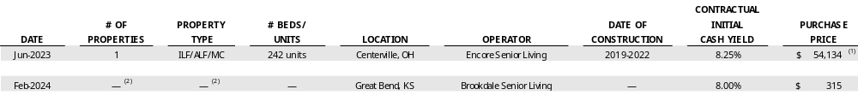
Real Estate Activities – INVESTMENTS - 2023-2024 ytd
(dollar amounts in thousands)
Acquisitions
Encore Centerville
Great Bend (Land parcel)
We contributed $45,000 to a $54,134 joint venture (“JV”) for the purchase of an independent living, assisted living and memory care campus in Ohio. The seller, LTC’s JV partner, has the option to purchase the campus during the third and fourth lease years, with an exit IRR of 9.75%. The campus was leased to an affiliate of Encore Senior Living (“Encore”) under a 10-year term at an initial yield of 8.25% on LTC’s allocation of the JV investment. We committed to fund $2,100 of lease incentives under the new lease. See Consolidated Joint Ventures on page 11 for further discussion.
We purchased a land parcel adjacent to an existing assisted living community.
Acquisitions accounted for as Financing receivables⁽¹⁾
ALG NC-11
Financing receivables represent acquisitions through sale-leaseback transactions, subject to lease agreements that contain purchase options. In accordance with GAAP, the purchased assets are required to be presented as a financing receivable on our Consolidated Balance Sheets and the rental income received is required to be presented as interest income from financing receivables on our Consolidated Statements of Income.
We entered into a JV with an affiliate of ALG Senior and contributed $117,490 into the JV that purchased 11 assisted living and memory care communities. The JV leased the communities to an affiliate of ALG Senior under a 10-year master lease, with two five-year renewal options. The initial annual rent is at a rate of 7.25%, increasing to 7.50% in year three, then escalating thereafter based on CPI, subject to a floor of 2% and ceiling of 4%. The master lease provides the operator with the option to buy up to 50% of the properties at the beginning of the third lease year, and the remaining properties at the beginning of the fourth lease year through the end of the sixth lease year, with an exit IRR of 9.00% on any portion of the properties being purchased. See Consolidated Joint Ventures on page 11 for further discussion.

Slide 9
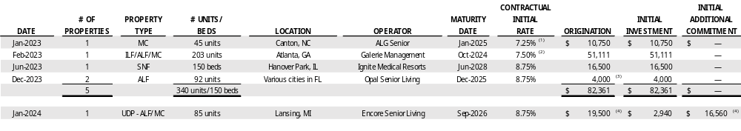
Real Estate Activities – INVESTMENTS – 2023-2024 ytd
(dollar amounts in thousands)
MORTGAGE LOANS
100-1281 ALG12(Haywood)
100-1282 Corso ATL Village Pk
100-1283 Hanover Park
100-1286 Opal (OSL)
100-1285 Delta Township
The initial rate is 7.25% with a 9.00% IRR.
Invested in an existing mortgage loan refinancing certain existing banks and our outstanding $7,461 mezzanine loan originated in 4Q18. The initial rate is 7.5% yield with a 7.75% IRR.
The mortgage loan provides a one-year extension.
Began funding in 1Q24 under this construction loan commitment which was originated in July 2023. The borrower contributed $12,100 of equity at commencement, which was used to initially fund the construction. The interest only loan term is approximately three years, and includes two, one-year extensions, each of which is contingent to certain coverage thresholds.
MEZZANINE LOANS
Village Park -Milton
The initial cash rate is 8.75% with a 12.00% IRR. Our investment represents approximately 12% of the estimated project cost. The loan will also be utilized for the construction of 89 additional units.

Slide 10
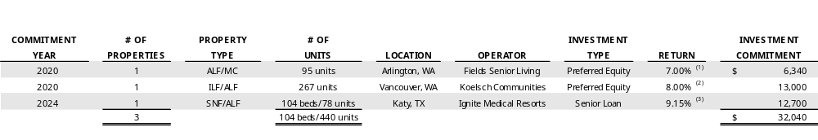
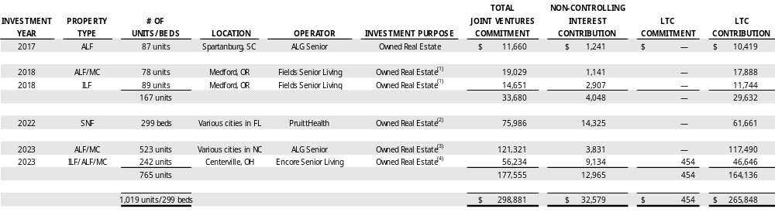
Real Estate Activities – Joint Ventures –CURRENT INVESTMENT HELD
(dollar amounts in thousands)
UNCONSOLIDATED JOINT VENTURES
8/17/20 Magnolia Arlington Pref Equity
9/4/20 Univ. Village @ Salmon Creek Pref Eq
4/1/24 Ignite Katy TX
The initial cash rate is 7.00% increasing to 9.00% in year-four until the IRR is 8.00%. After achieving an 8.00% IRR, the cash rate drops to 8.00% with an IRR ranging between of 12.00% and 14.00% depending upon timing of redemption. Our investment represents 15.50% of the total investment. We have the option to require the JV partner to purchase our preferred equity interest at any time between August 17, 2031 and December 31, 2036.
The initial cash rate is 8.00% with an IRR of 14.00%. Our investment represents 11.00% of the total project cost. The JV provides the JV partner the option to buy out our investment at any time after August 31, 2023 at the IRR rate. Also, we have the option to require the JV partner to purchase our preferred equity interest at any time between August 31, 2027 and prior to the end of the first renewal term of the lease. The project was completed in 4Q23.
Represents a mortgage loan accounted for as an unconsolidated JV in accordance with GAAP. The five-year mortgage loan is interest only. The investment is expected to generate approximately $884 of revenue in 2024.
CONSOLIDATED JOINT VENTURES
Inverness
Weatherly Court
Weatherly Inn
Pruitt
ALG11(no Haywood)-1/5/23
Encore Centerville
Represents a single joint venture with ownership in two properties.
We entered into a JV with an affiliate of PruittHealth and the JV purchased three skilled nursing centers. In accordance with GAAP, the purchased assets are presented as a financing receivable on our Consolidated Balance Sheets.
We entered into a JV with an affiliate of ALG Senior to purchase 11 assisted living/memory care communities. In accordance with GAAP, the purchased assets are presented as a financing receivable on our Consolidated Balance Sheets. See Financing Receivables on page 9 for further discussion.
See Acquisitions on page 9 for further discussion.
Notes:
Unconsolidated JV – Footnote (2) Salmon Creek estimated completion mid-Aug or 03Q23 per Hope’s email on 4/17/23

Slide 11
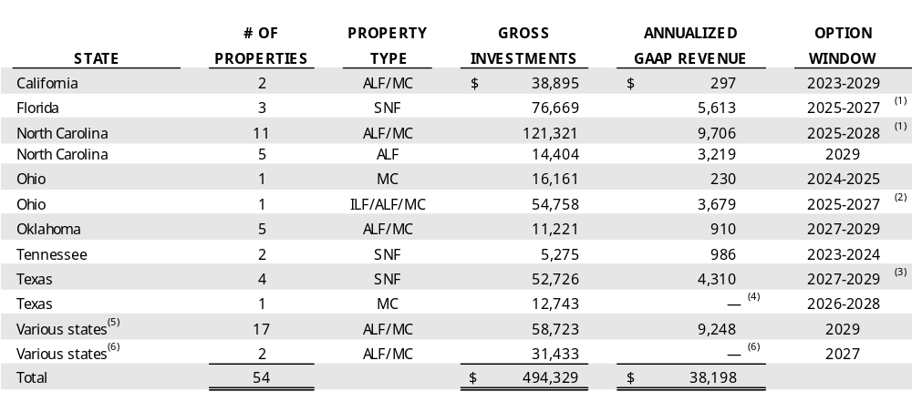
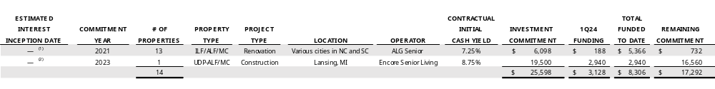
Real Estate Activities – PURCHASE OPTIONS AND rENOVATION & construction loans
(dollar amounts in thousands)
Purchase options
1 | Generations Clovis-CA
2 | Pruitt (Financing Rec)-FL 236-1279
3 | ALG NC-11 (Financing Rec)-NC 237-1280
4 | Navion (as of 1/1/24)
5 | Anthem-WestChester (fka Trilogy)-OH
6 | Encore-Centerville (JV)-OH
7 | Oxford-OK (New 4Q23)
8 | Community Living Ctrs -TN
9 | Ignite TX - JV (Bridgemoor4)-TX
10 | Priority Life Care-Corpus Christi -4/1/24
11 | Brookdale (as of 1/1/24)
12 | Legacy (as of 1/1/24)
These properties were acquired through a sale-leaseback transaction, subject to a lease agreement that contains a purchase option. In accordance with GAAP, the purchased properties are required to be presented as a financing receivable on our Consolidated Balance Sheets.
See Acquisitions on page 9 for further discussion.
The master lease allows the operator to elect either an earn-out payment or purchase option. If neither option is elected within the timeframe defined in the lease, both elections are terminated.
Subsequent to March 31, 2024, this property was transitioned to a new operator. The initial rent for the first six months is zero, after which rent will be based on mutually agreed upon fair market rent.
Properties are in Colorado, Kansas, Ohio and Texas.
In 1Q24, two properties in Georgia and South Carolina were transitioned to a new operator. The initial rent for the first six months is zero, after which rent will be based on mutually agreed upon fair market rent.
RENOVATION & Construction LOANS
ALG 13 (100.1275)
100-1285 Delta Township
This commitment is part of a $59,250 loan commitment secured by 13 properties, (12) North Carolina and (1) South Carolina. Interest payment increases upon each funding.
The interest only loan term is approximately three years at a rate of 8.75%, and includes two, one-year extensions, each of which is contingent to certain coverage thresholds. See Mortgage Loans on page 10 for further discussion.

Slide 12
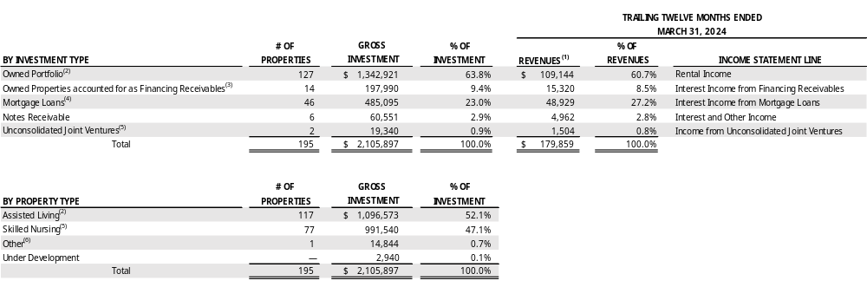
PORTFOLIO overview
(AS OF MARCH 31, 2024, dollar amounts in thousands)
See Trailing Twelve Months Revenues definition in the Glossary.
Subsequent to March 31, 2024, we sold two assisted living communities in Texas for $500. We received proceeds of approximately $400, net of transaction costs, and anticipate recording a minimal gain on sale in 2Q24. See page 16 for further discussion.
Financing receivables represent acquisitions through sale-leaseback transactions, subject to lease agreements that contain purchase options. In accordance with GAAP, the purchased assets are required to be presented as a financing receivable on our Consolidated Balance Sheets and the rental income received is required to be presented as interest income from financing receivables on our Consolidated Statements of Income.
If the Prestige mortgage loans of $258,341 were excluded, then our percentage of mortgage loan investment would be 10.8%.
Subsequent to March 31, 2024, we originated a mortgage loan to Ignite Medical Resorts (“Ignite”), secured by a skilled nursing and assisted living campus. In accordance with GAAP, the mortgage loan is accounted as an unconsolidated joint venture. See Unconsolidated Joint Ventures on page 11 for further discussion.
Includes one behavioral health care hospital and three parcels for land held-for-use, a parcel of land securing a first mortgage held for future development of a post-acute skilled nursing center and a parcel of land securing a first mortgage held for future development of a seniors housing community.
(2) ALG TX 2
(4) Katy
Notes:
198 (Properties) = does not include Bridgemoor/Ignite (TX)

Slide 13
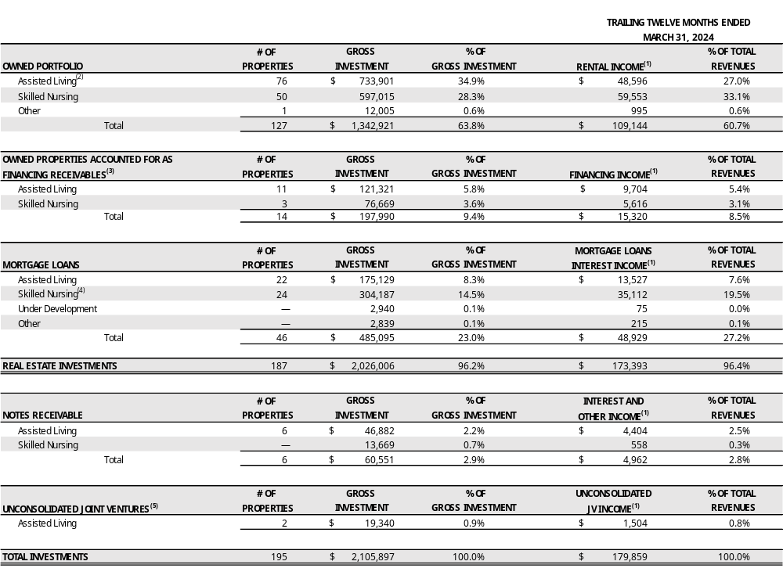
PORTFOLIO overview ⁻ DETAIL
(AS OF MARCH 31, 2024, dollar amounts in thousands)
rental income
(as % of Total Revenues)
OWNED PROPERTIES ACCOUNTED FOR AS FINANCING RECEIVABLES
(as % of Total Revenues)
MORTGAGE LOANS interest income
(as % of Total Revenues)
interest & other income
(as % of Total Revenues)
See Trailing Twelve Months Revenues definition in the Glossary.
Subsequent to March 31, 2024, we sold two assisted living communities in Texas for $500. We received proceeds of approximately $400, net of transaction costs, and anticipate recording a minimal gain on sale in 2Q24. See page 16 for further discussion.
Financing receivables represent acquisitions through sale-leaseback transactions, subject to lease agreements that contain purchase options. In accordance with GAAP, the purchased assets are required to be presented as a financing receivable on our Consolidated Balance Sheets and the rental income received is required to be presented as interest income from financing receivables on our Consolidated Statements of Income.
If the Prestige mortgage loans of $258,341 were excluded, then our percentage of mortgage loan investment would be 2.2%.
Subsequent to March 31, 2024, we originated a mortgage loan to Ignite, secured by a skilled nursing and assisted living campus. In accordance with GAAP, the mortgage loan is accounted as an unconsolidated joint venture. See Unconsolidated Joint Ventures on page 11 for further discussion.
Unconsolidated JV income
(as % of Total Revenues)
(2) ALG TX 2
(5) Katy
Notes:
Mortgage Loan SNF 304,187 – 258,341 (Prestige) = 45,846. 45,846/2,105,897 (Total Investments) = 0.02177 or 2.2%

Slide 14
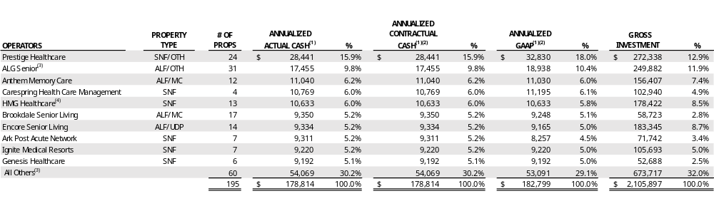
Top 10 operators PORTFOLIO DIVERSIFICATION - 31 OPERATORS
(as of MARCH 31, 2024, dollar amounts in thousands)
See Glossary for definition of Annualized Actual Cash Income, Annualized Contractual Cash Income and Annualized GAAP Income.
The difference between Annualized Contractual Cash and Annualized GAAP at March 2024 is due to straight-line rent, lease incentives amortization and effective interest. See Non-Cash Revenue Components on page 24.
See Operator Update on page 16 for further discussion.
Subsequent to March 31, 2024, a term sheet was executed with HMG, whereby an agreement has been reached, in principle, to amend the master lease covering 11 skilled nursing centers in Texas to extend the term through December 2028. Annual rent will increase by $1,000 to $9,000 for 2024. Rent will increase to $9,500 in 2025, to $10,000 in 2026 and then escalating 3.3% annually thereafter through 2028. The amended master lease provides HMG with two five-year renewal options, with rent in the initial year of the first renewal term adjusting to fair market rent subject to a collar between 2.5% and 12.5%. As a condition of the amendment, HMG will repay $11,900 on its $13,500 working capital note during 2Q24. Upon the repayment, the remaining balance of the working capital note will be interest-free, and will be repaid in installments through 2028.
PRESTIGE | Privately Held | SNF/ILF/ALF Other Rehab | 79 Properties | 5 States
ALG | Privately Held | ILF/ALF/MC | 130 Properties | 6 States
ANTHEM | Privately Held | Exclusively MC | 19 Properties | 9 States
CARESPRING | Privately Held | SNF/ILF/ALF Transitional Care | 17 Properties | 2 States
HMG | Privately Held | SNF/ILF/ALF | 37 Properties | 2 States
BROOKDALE | NYSE: BKD | ILF/ALF/MC Continuing Care | 652 Properties | 41 States
ENCORE | Privately Held | ALF | 42 Properties | 5 States
ARK | Privately Held | SNF/ILF/ALF | 14 Properties | 4 States
IGNITE | Privately Held | SNF/ALF Transitional Care | 21 Properties | 7 States
GENESIS | OTC PINK: GENN | SNF/ Senior Living | More than 250 Properties | 22 States

Slide 15
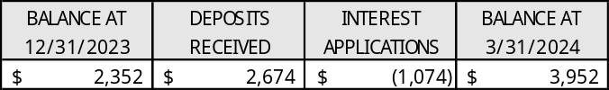
pORTFOLIO DIVERSIFICATION – OPERATOR UPDATE
(dollar amounts in thousands)
TEALWOOD HAMILTON FROM PR
During 1Q24, we collected 106.0% or $42,115 of contractual rent and mortgage interest income as a result of receiving $2,377 of rent credit repayment in connection with the sale of a 110-unit assisted living community in Wisconsin.
During 4Q23, a mortgage loan with Prestige Healthcare (“Prestige”), secured by 15 skilled nursing centers, was amended to set the minimum mortgage interest payment due to us based on an annual current pay rate of 8.5% on the outstanding loan balance of $183,338. The current contractual interest rate on the loan of 10.8% remains unchanged. The amendment also provides us the right to draw on Prestige’s security to pay the difference between the contractual rate and current pay rate. During 1Q24, we received full contractual cash interest of $4,969 from Prestige related to this mortgage loan through $3,896 of cash receipts and application of $1,074 of Prestige’s security. The following table summarizes the activity of Prestige’s security:
Completed the sale and re-lease process for 10 assisted living communities under the ALG Senior (“ALG”) master lease. These properties, seven of which were built in the 90s, are primarily located in small rural towns, are non-revenue generating, and were temporarily transitioned to ALG following the COVID pandemic in July 2022, allowing us time to find a more permanent solution for the portfolio, as follows:
    Transitioned two of the properties located in Georgia and South Carolina to an operator new to us. The lease term is two years with two one-year extension options. The initial rent for the first six months is zero, after which rent will be based on mutually agreed upon fair market rent. The master lease includes a purchase option that can be exercised in 2027, if the two one-year lease extensions are exercised. Additionally, we agreed to fund up to $906 for capital improvements for the first year, and up to $240 for a working capital note, at a rate of 8.25%, maturing on December 31, 2025.
    Sold five of the properties located in Texas for $1,600. We received $925 of proceeds, net of transaction costs, and recorded a loss on sale of $356.
    In April 2024, transitioned one of the properties located in Texas to an operator new to us. The lease term is for two years with two one-year extension options, each of which is contingent on certain coverage thresholds. The initial rent for the first six months is zero, after which rent will be based on mutually agreed upon fair market rent. The master lease includes a purchase option that can be exercised beginning in 2026, if the one-year lease extension is exercised. Additionally, we agreed to fund up to $570 for capital improvements for the first year of the lease, and up to $290 for a working capital note, at a rate of 9.0%, maturing concurrently with the master lease maturity.
    In April 2024, two of the properties located in Texas, that were closed in 2023 and 2024, were sold for $500. We received proceeds of approximately $400, net of transaction costs, and anticipate recording a minimal gain on sale in 2Q24.
Subsequent to March 31, 2024, an operator exercised its renewal option of the master lease for another five years, from March 2025 through February 2030. Annual cash and GAAP rent for 2024 are $8,004 and $7,049, respectively, escalating 2.5% annually. The master lease covers 666 beds across four skilled nursing centers, three in Texas and one in Wisconsin, and a behavioral health care hospital in Nevada.
Subsequent to March 31, 2024, a term sheet was executed with HMG, whereby an agreement has been reached, in principle, to amend the master lease covering 11 skilled nursing centers in Texas to extend the term through December 2028. Annual rent will increase by $1,000 to $9,000 for 2024. Rent will increase to $9,500 in 2025, to $10,000 in 2026 and then escalating 3.3% annually thereafter through 2028. The amended master lease provides HMG with two five-year renewal options, with rent in the initial year of the first renewal term adjusting to fair market rent subject to a collar between 2.5% and 12.5%. As a condition of the amendment, HMG will repay $11,900 on its $13,500 working capital note during 2Q24. Upon the repayment, the remaining balance of the working capital note will be interest-free, and will be repaid in installments through 2028.
Prestige FROM CC -4/18/24
$4969 from amort minus $1073 = $3896
ALG
LEGACY
ALG TX 7 (FKA VERITAS)
CORPUS CRISTI
ALPINE & OAKWOOD
FUNDAMENTAL
HMG FROM PR

Slide 16
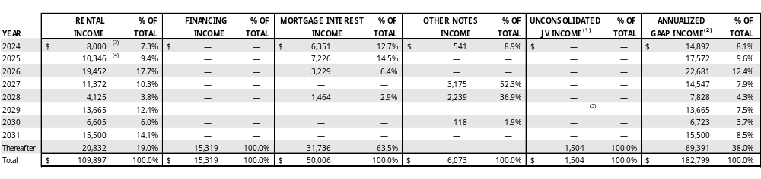
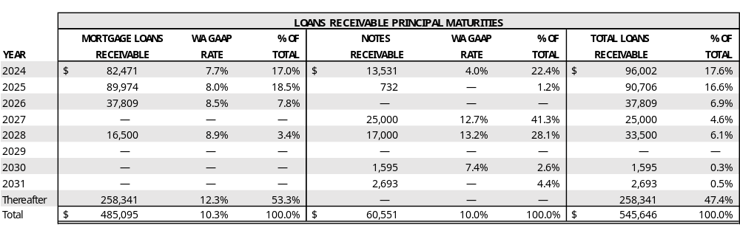
PORTFOLIO DIVERSIFICATION - LEASE Maturities
(as of MARCH 31, 2024, dollar amounts in thousands)
Represents income from two preferred equity investments accounted for as unconsolidated joint ventures. These preferred equity investments do not have scheduled maturities but provide the entity an option to redeem our investment at a future date.
See Annualized GAAP income definition in the Glossary and (1) above.
Subsequent to March 31, 2024, a term sheet was executed with HMG, whereby an agreement has been reached, in principle, to amend the master lease covering 11 skilled nursing centers in Texas to extend the term through December 2028. Annual rent will increase by $1,000 to $9,000 for 2024. Rent will increase to $9,500 in 2025, to $10,000 in 2026 and then escalating 3.3% annually thereafter through 2028. The amended master lease provides HMG with two five-year renewal options, with rent in the initial year of the first renewal term adjusting to fair market rent subject to a collar between 2.5% and 12.5%. As a condition of the amendment, HMG will repay $11,900 on its $13,500 working capital note during 2Q24. Upon the repayment, the remaining balance of the working capital note will be interest-free, and will be repaid in installments through 2028.
Subsequent to March 31, 2024, an operator exercised its renewal option of the master lease for another five years, from March 2025 through February 2030. Annual cash and GAAP rent for 2024 are $8,004 and $7,049, respectively, escalating 2.5% annually. The master lease covers 666 beds across four skilled nursing centers, three in Texas and one in Wisconsin, and a behavioral health care hospital in Nevada.
Subsequent to March 31, 2024, we originated a mortgage loan to Ignite, secured by a skilled nursing and assisted living campus. In accordance with GAAP, the mortgage loan is accounted as an unconsolidated joint venture. See Unconsolidated Joint Ventures on page 11 for further discussion.
(3) HMG FROM PR
(4) Fundamental
(5) Katy
Near Term Lease and Loan Maturities:
Two leases and four loans in 2024 with an annualized GAAP income totaling $14.9 million
Seven leases and five loans in 2025 with an annualized GAAP income totaling $17.6 million
Four leases and three loans in 2026 with an annualized GAAP income totaling $22.7 million
As of March 31, 2024, approximately 93% of owned properties are covered under master leases and approximately 93% of rental revenues come from master leases or cross-default leases.

Slide 17
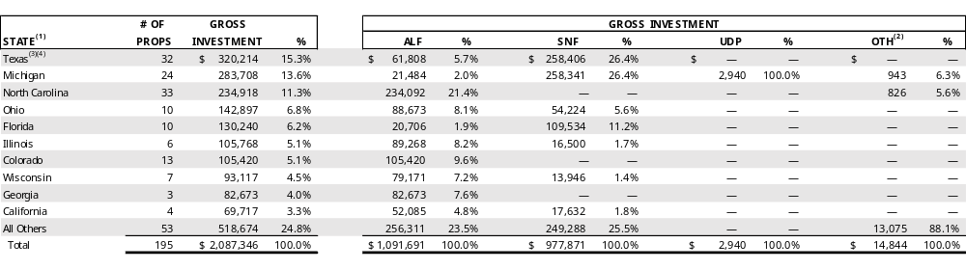
PORTFOLIO DIVERSIFICATION – Geographic diversification
(as of MARCH 31, 2024, DOLLAR AMOUNTS IN THOUSANDS)
Due to master leases with properties in various states, revenue by state is not available. Also, working capital notes are provided to certain operators under their master leases covering properties in various states. Therefore, the working capital notes outstanding balance totaling $18,551 is also not available by state.
Includes one behavioral health care hospital and three parcels for land held-for-use, one parcel of land securing a first mortgage held for future development of a post-acute skilled nursing center and one parcel of land securing a first mortgage held for future development of a seniors housing community.
Subsequent to March 31, 2024, we sold two assisted living communities in Texas for $500. We received proceeds of approximately $400, net of transaction costs, and anticipate recording a minimal gain on sale in 2Q24. See page 16 for further discussion.
Subsequent to March 31, 2024, we originated a mortgage loan to Ignite, secured by a skilled nursing and assisted living campus. In accordance with GAAP, the mortgage loan is accounted as an unconsolidated joint venture. See Unconsolidated Joint Ventures on page 11 for further discussion.
(3) ALG TX 2
(4) Katy
Gross Portfolio by MSA ⁽¹⁾
Average Portfolio Age ⁽¹⁾
Years
The MSA rank by population as of July 1, 2023, as estimated by the United States Census Bureau. Approximately 66% of our properties are in the top 100 MSAs. Includes only our real estate investments.
As calculated from construction date or major renovation/expansion date. Includes only our real estate investments.

Slide 18
REAL ESTATE INVESTMENTS METRICS
(TRAILING TWELVE months through DECEMBER 31, 2024 AND SEPTEMBER 30, 2023
Same Property Portfolio (“SPP”) Coverage Statistics ⁽¹⁾
Assisted living
Skilled nursing
ALF metrics include Coronavirus Stimulus Funds (“CSF”) as allocated/reported by operators. Excluding CSF, the 4Q23 normalized EBITDAR and EBITDARM coverages were 1.03x and 1.28x, respectively, and 0.92x and 1.16x, respectively, for 3Q23. See definition of Coronavirus Stimulus Funds in the Glossary. Occupancy represents the average TTM occupancy. For the 66% of the reported SPP ALF, spot occupancy was 88% at March 31, 2024, 87% at January 31, 2024 and 87% at September 30, 2023.
SNF metrics include CSF, as allocated/reported by operators. Excluding CSF, the 4Q23 normalized EBITDAR and EBITDARM coverages were 1.21x and 1.71x, respectively, and 1.18x and 1.67x, respectively, for 3Q23. Occupancy represents the average TTM occupancy. For the 87% of the reported SPP SNF, average monthly occupancy was 75% in March 2024, 74% in January 2024 and 72% in September 2023.
Information is from property level operator financial statements which are unaudited and have not been independently verified by LTC. The same store portfolio excludes properties transitioned on or after October 1, 2022 and properties sold.

Slide 19

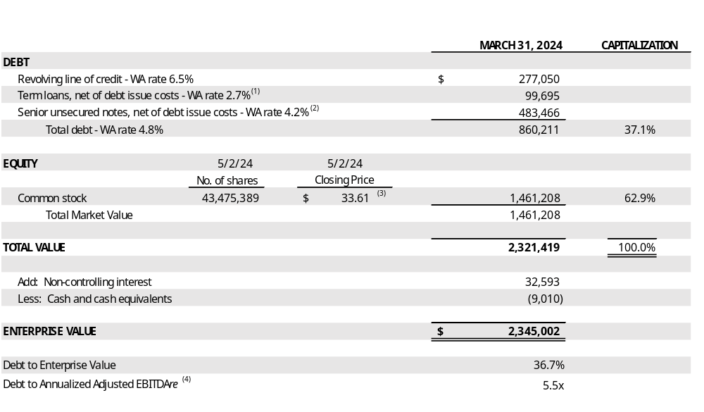
ENTERPRISE VALUE
(amounts in thousands, except per share amounts and number of shares)
Represents outstanding balance of $100,000, net of debt issue costs of $305.
Represents outstanding balance of $484,660 net of debt issue costs of $1,194.
Closing price of our common stock as reported by the NYSE on May 2, 2024.
See page 29 for Reconciliation of Annualized Adjusted EBITDAre.

Slide 20
DEBT METRICS
(dollar amounts in thousands)
LINE OF CREDIT LIQUIDITY
Leverage Ratios – found in
Fin Data Summary Tab
LEVERAGE RATIOS
Coverage Ratios – found in
Annlzd EBITDAre Tab
COVERAGE RATIOS

Slide 21
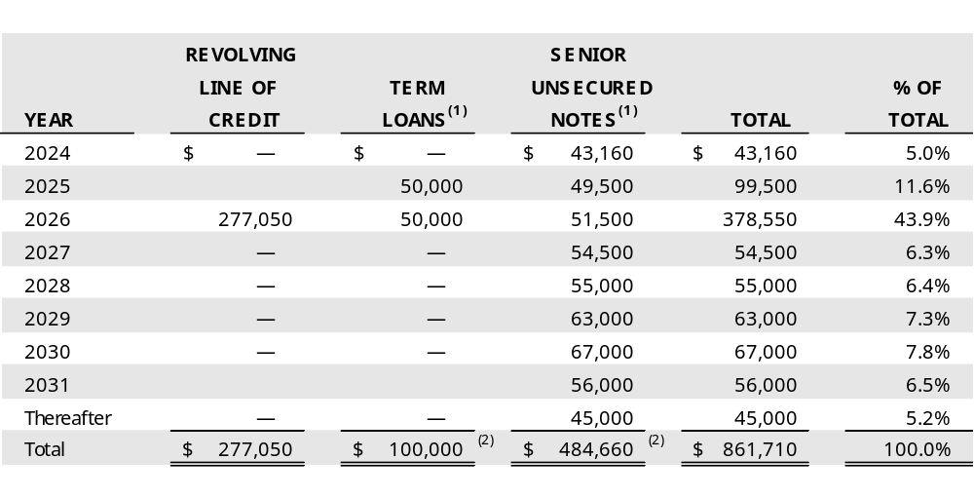
DEBT SUMMARY MATURITY
(as of MARCH 31, 2024, dollar amounts in thousands)
DEBT STRUCTURE ⁽²⁾
Reflects scheduled principal payments.
Excludes debt issue costs which are netted against the principal outstanding in the term loans and senior unsecured notes balance on our Consolidated Balance Sheets shown on page 27.

Slide 22
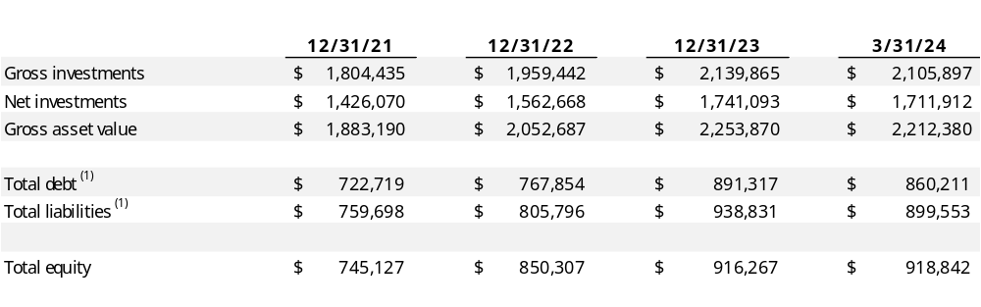
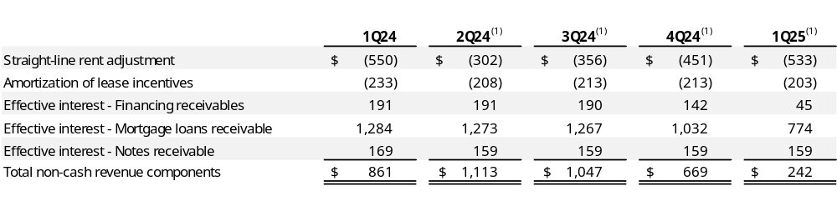
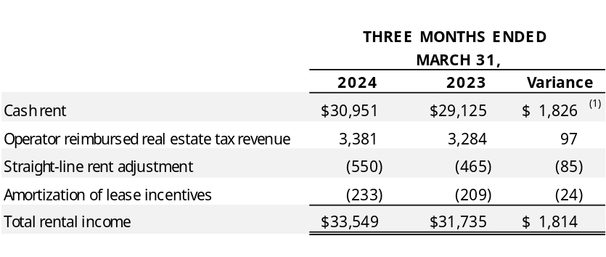
Financial data summary
(dollar amounts in thousands)
Includes outstanding gross revolving line of credit, term loans, net of debt issue costs, and senior unsecured notes, net of debt issue costs.
NON-CASH REVENUE COMPONENTS
For leases and loans in place at March 31, 2024 assuming no other renewals or modifications.
COMPONENTS OF RENTAL INCOME
Increase primarily due to the $2,377 repayment of rent credit in connection with the sale of a 110-unit assisted living community, 2023 acquisitions and rent escalations offset by portfolio transitions and property sales.

Slide 23
Dividend HISTORY
Consistent dividend payment for over a decade, even through the Covid pandemic when the majority of the health care REITs cut their dividends. LTC currently pays a monthly dividend of $0.19 per share. The 1Q 2024 FAD payout ratio was 85.1%.⁽¹⁾
1Q 2024 dividends of $0.57 per share and 1Q 2024 diluted FAD excluding non-recurring items of $0.67 per share.

Slide 24
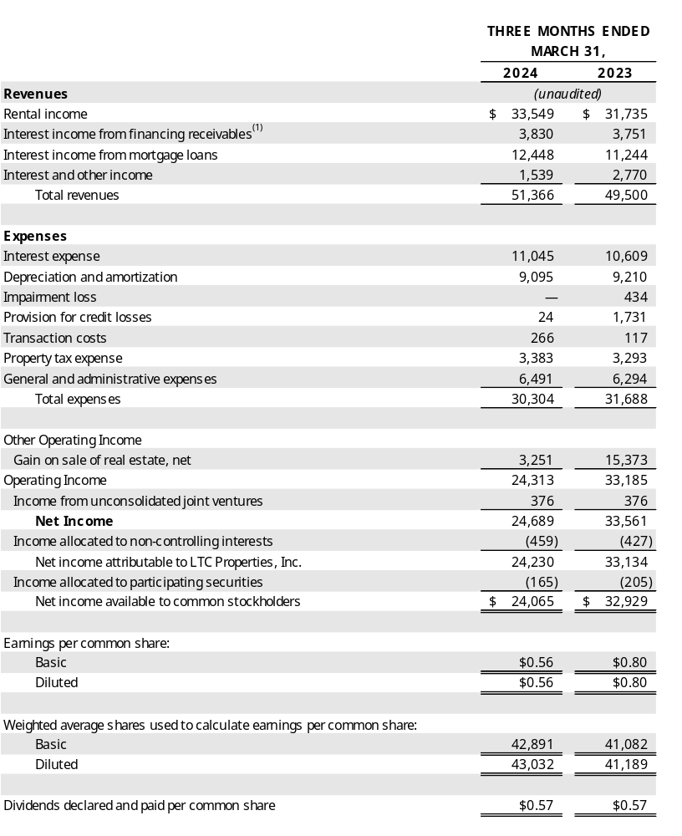
CONSOLIDATED INCOME STATEMENTs STATEMENTS OF Income
(amounts in thousands, except per share amounts)
Represents rental income from acquisitions through sale-leaseback transactions, subject to leases which contain purchase options. In accordance with GAAP, the properties are required to be presented as financing receivables on our Consolidated Balance Sheets and the rental income to be presented as Interest income from financing receivables on our Consolidated Statements of Income.

Slide 25
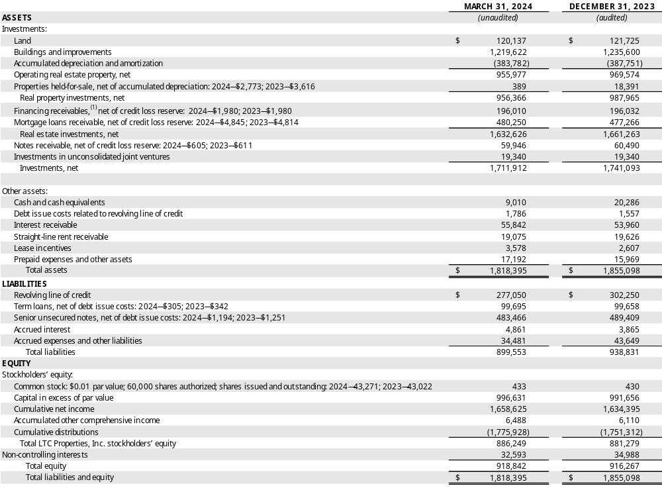
Consolidated Balance sheets
(amounts in thousands, except per share amounts)
Represents acquisitions through sale-leaseback transactions, subject to leases which contain purchase options. In accordance with GAAP, the properties are required to be presented as financing receivables on our Consolidated Balance Sheets.

Slide 26
Appendix A:
SEC Reg. G Compliance

Slide 27
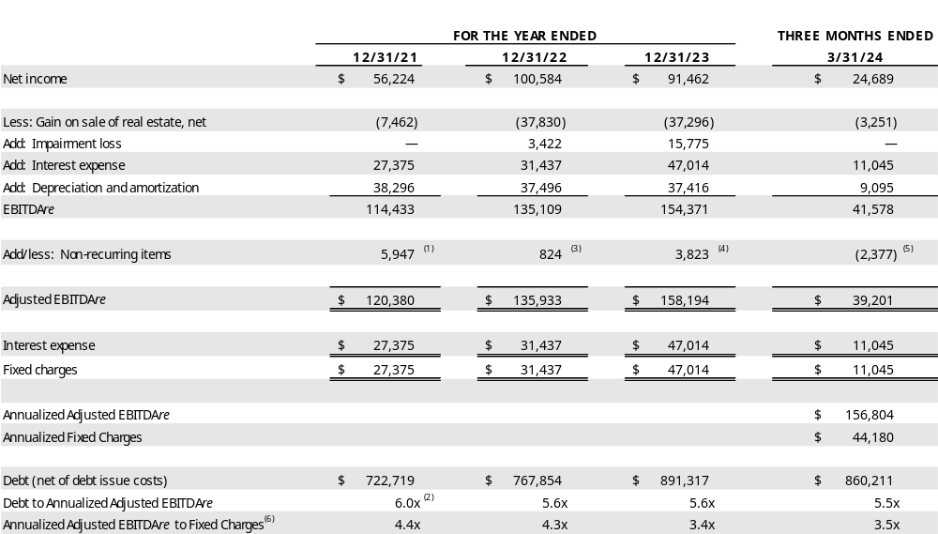
Appendix a: sec reg. g compliance
(dollar amounts in thousands)
Reconciliation of Annualized adjusted EBITDAre and Fixed Charges
Represents the Senior Care settlement payment ($3,895), a straight-line rent receivable write-off ($758), a provision for credit losses on mortgage loan originations ($869), and the 50% reduction of 2021 rent and interest escalations ($425).
Increase due to additional borrowings for investments.
Represents a lease incentive balance write-off of $173 related to a closed property, a $1,332 provision for credit losses reserve related to the acquisition of three skilled nursing centers accounted for as a financing receivable, two mortgage loans and a mezzanine loan, and a lease termination fee of $500 paid to a former operator of 12 assisted living communities, partially offset by lease termination fee income of $1,181 received in connection with the sale of an assisted living community.
Includes the $3,561 note receivable write-off related to the sale and transition of 10 assisted living communities and $1,832 of provision for credit losses related to the acquisition of 11 assisted living communities accounted for as a financing receivable and two mortgage loan originations, partially offset by the $1,570 exit IRR and prepayment fee received in 2023 in connection to the payoff of two mezzanine loans.
Represents the $2,377 repayment of rent credit received in connection with the sale of a 110-unit assisted living community in 1Q24.
Given we do not have preferred stock, our fixed charge coverage ratio and interest coverage ratio are the same.

Slide 28
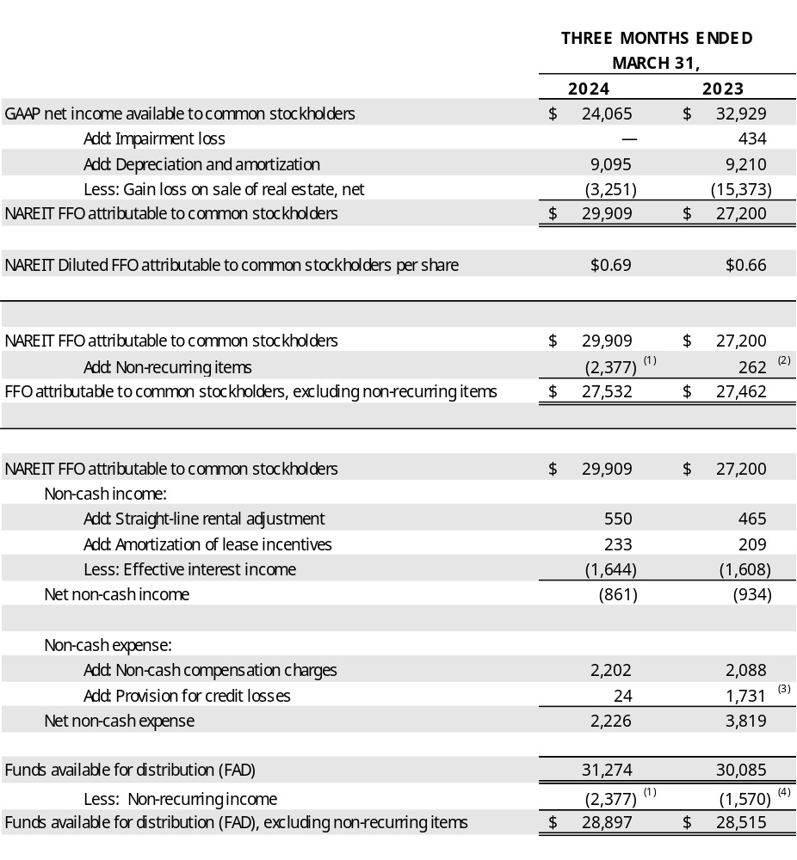
Appendix a: sec reg. g compliance - Reconciliation of FFO and FAD
(UNaudited, amounts in thousands, except per share amounts)
Represents the repayment of rent credit received in connection with the sale of a 110-unit assisted living community in Wisconsin. The rent credit was provided to the operator during new construction lease-up.
Represents the net of (3) and (4) below.
Includes $1,832 of provision for credit losses related to the $121,321 acquisition accounted for as a financing receivable and $61,900 of mortgage loan originations.
Represents the exit IRR and prepayment fee received in 2023 in connection to the payoff of two mezzanine loans.

Slide 29
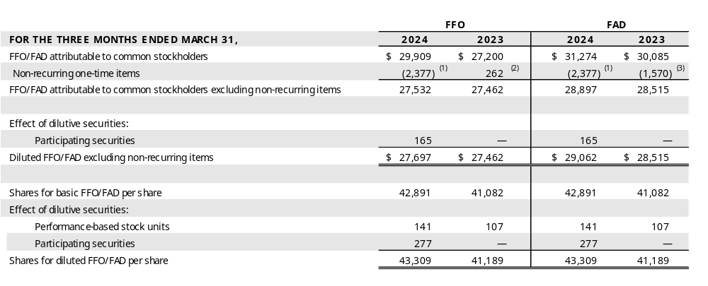
Appendix a: sec reg. g compliance - Reconciliation of FFO Per Share
(UNaudited, amounts in thousands, except per share amounts)
Represents the repayment of rent credit received in connection with the sale of a 110-unit assisted living community in Wisconsin. The rent credit was provided to the operator during new construction lease-up.
Represents $1,832 of provision for credit losses related to the $121,321 acquisition accounted for as a financing receivable and $61,900 of mortgage loan originations, offset by (3) below.
Represents the exit IRR and prepayment fee received in 2023 in connection to the payoff of two mezzanine loans.

Slide 30

Visit our website to learn more about our ESG initiatives. www.LTCreit.com/ESG
30

Slide 31
GLOSSARY
Annualized Actual Cash Income: Represents annualized cash rental income includes cash rent (excluding real estate tax reimbursement), interest income from financing receivables, mortgage loans, mezzanine loans and working capital notes, and income from unconsolidated joint ventures received for the month of March 2024 for investments as of March 31, 2024.
Annualized Contractual Cash Income: Represents annualized contractual cash rental income prior to abatements & deferred rent repayment (excluding real estate tax reimbursement), interest income from financing receivables, mortgage loans, mezzanine loans and working capital notes, and income from unconsolidated joint ventures for the month of March 2024 for investments as of March 31, 2024.
Annualized GAAP Income: Represents annualized GAAP rent which includes contractual cash rent, straight-line rent and amortization of lease incentives (excluding real estate tax reimbursement), GAAP interest income from financing receivables, mortgage loans, mezzanine loans and working capital notes, and income from unconsolidated joint ventures for the month of March 2024 for investments as of March 31, 2024.
Assisted Living Communities (“ALF”): The ALF portfolio consists of assisted living, independent living, and/or memory care properties. (See Independent Living and Memory Care) Assisted living properties are seniors housing properties serving elderly persons who require assistance with activities of daily living, but do not require the constant supervision skilled nursing properties provide. Services are usually available 24 hours a day and include personal supervision and assistance with eating, bathing, grooming and administering medication. The facilities provide a combination of housing, supportive services, personalized assistance and health care designed to respond to individual needs.
Contractual Lease Rent: Rental revenue as defined by the lease agreement between us and the operator for the lease year.
Coronavirus Stimulus Funds (“CSF”): CSF includes funding from various state and federal programs to support healthcare providers in dealing with the challenges of the coronavirus pandemic. Included in CSF are state-specific payments identified by operators as well as federal payments connected to the Paycheck Protection Program and the Provider Relief Fund. CSF is self-reported by operators in unaudited financial statements provided to LTC. Specifically excluded from CSF are the suspension of the Medicare sequestration cut, and increases to the Federal Medical Assistance Percentages (FMAP), both of which are reflected in reported coverage both including and excluding CSF.
Earnings Before Interest, Tax, Depreciation and Amortization for Real Estate (“EBITDAre”): As defined by the National Association of Real Estate Investment Trusts (“NAREIT”), EBITDAre is calculated as net income (computed in accordance with GAAP) excluding (i) interest expense, (ii) income tax expense, (iii) real estate depreciation and amortization, (iv) impairment write-downs of depreciable real estate, (v) gains or losses on the sale of depreciable real estate, and (vi) adjustments for unconsolidated partnerships and joint ventures.
Financing Receivables: Properties acquired through a sale-leaseback transaction with an operating entity being the same before and after the sale-leaseback, subject to a lease contract that contains a purchase option. In accordance with GAAP, the purchased assets are required to be presented as Financing Receivables on our Consolidated Balance Sheets and the rental income to be presented as Interest income from financing receivables on our Consolidated Statements of Income.
Funds Available for Distribution (“FAD”): FFO excluding the effects of straight-line rent, amortization of lease costs, effective interest income, provision for credit losses, non‑cash compensation charges and non-cash interest charges.
Funds From Operations (“FFO”): As defined by NAREIT, net income available to common stockholders (computed in accordance with U.S. GAAP) excluding gains or losses on the sale of real estate and impairment write-downs of depreciable real estate plus real estate depreciation and amortization, and after adjustments for unconsolidated partnerships and joint ventures.
GAAP Lease Yield: GAAP rent divided by the sum of the purchase price and transaction costs.
GAAP Rent: Total rent we will receive as a fixed amount over the initial term of the lease and recognized evenly over that term. GAAP rent recorded in the early years of a lease is higher than the cash rent received and during the later years of the lease, the cash rent received is higher than GAAP rent recognized. GAAP rent is commonly referred to as straight-line rental income.
Gross Asset Value: The carrying amount of total assets after adding back accumulated depreciation and loan loss reserves, as reported in the company’s consolidated financial statements.
Gross Investment: Original price paid for an asset plus capital improvements funded by LTC, without any deductions for depreciation or provision for credit losses. Gross Investment is commonly referred to as undepreciated book value.
Independent Living Communities (“ILF”): Seniors housing properties offering a sense of community and numerous levels of service, such as laundry, housekeeping, dining options/meal plans, exercise and wellness programs, transportation, social, cultural and recreational activities, on-site security and emergency response programs. Many offer on-site conveniences like beauty/barber shops, fitness facilities, game rooms, libraries and activity centers. ILFs are also known as retirement communities or seniors apartments.
Interest Income: Represents interest income from mortgage loans and other notes.
Licensed Beds/Units: The number of beds and/or units that an operator is authorized to operate at seniors housing and long-term care properties. Licensed beds and/or units may differ from the number of beds and/or units in service at any given time.
Memory Care Communities (“MC”): Seniors housing properties offering specialized options for seniors with Alzheimer’s disease and other forms of dementia. These facilities offer dedicated care and specialized programming for various conditions relating to memory loss in a secured environment that is typically smaller in scale and more residential in nature than traditional assisted living facilities. These facilities have staff available 24 hours a day to respond to the unique needs of their residents.
Metropolitan Statistical Areas (“MSA”): Based on the U.S. Census Bureau, MSA is a geographic entity defined by the Office of Management and Budget (OMB) for use by Federal statistical agencies in collecting, tabulating, and publishing Federal statistics. A metro area contains a core urban area of 50,000 or more population. MSAs 1 to 31 have a population of 19.8M – 2.2M. MSAs 32 to 100 have a population of 2.2M – 0.6M. MSAs greater than 100 have a population of 0.6M – 59K. Cities in a Micro-SA have a population of 223K – 12K. Cities not in a MSA has population of less than 100K.

Slide 32
GLOSSARY
Payor Source: LTC revenue by operator underlying payor source for the period presented. LTC is not a Medicaid or a Medicare recipient. Statistics represent LTC's rental revenues times operators' underlying payor source revenue percentage. Underlying payor source revenue percentage is calculated from property level operator financial statements which are unaudited and have not been independently verified by us.
Private Pay: Private pay includes private insurance, HMO, VA, and other payors.
Purchase Price: Represents the fair value price of an asset that is exchanged in an orderly transaction between market participants at the measurement date. An orderly transaction is a transaction that assumes exposure to the market for a period prior to the measurement date to allow for marketing activities that are usual and customary for transactions involving such assets; it is not a forced transaction (for example, a forced liquidation or distress sale).
Real Estate Investments: Represents our investments in real property and mortgage loan receivables.
Rental Income: Represents GAAP rent net of amortized lease inducement cost.
Same Property Portfolio (“SPP”): Same property statistics allow for the comparative evaluation of performance across a consistent population of LTC’s leased property portfolio and the Prestige Healthcare mortgage loan portfolio. Our SPP is comprised of stabilized properties occupied and operated throughout the duration of the quarter-over-quarter comparison periods presented (excluding assets sold and assets held-for-sale). Accordingly, a property must be occupied and stabilized for a minimum of 15 months to be included in our SPP. Each property transitioned to a new operator has been excluded from SPP and will be added back to SPP for the SPP reporting period ending 15 months after the date of the transition.
Skilled Nursing Properties (“SNF”): Seniors housing properties providing restorative, rehabilitative and nursing care for people not requiring the more extensive and sophisticated treatment available at acute care hospitals. Many SNFs provide ancillary services that include occupational, speech, physical, respiratory and IV therapies, as well as sub-acute care services which are paid either by the patient, the patient’s family, private health insurance, or through the federal Medicare or state Medicaid programs.
Stabilized: Properties are generally considered stabilized upon the earlier of achieving certain occupancy thresholds (e.g. 80% for SNFs and 90% for ALFs) and, as applicable, 12 months from the date of acquisition/lease transition or, in the event of a de novo development, redevelopment, major renovations or addition, 24 months from the date the property is first placed in or returned to service, or properties acquired in lease-up.
Trailing Twelve Months Revenues: For the owned portfolio, rental income includes cash rent, straight-line rent and amortization of lease incentives and excludes real estate tax reimbursement and rental income from properties sold during the trailing twelve months. Financing receivables revenue includes cash interest income and effective interest from financing receivables during the trailing twelve months. Mortgage loans revenue includes cash interest income and effective interest from mortgage loans and construction loans during the trailing twelve months. Notes receivables revenue includes cash interest income and effective interest from mezzanine loans and working capital notes and excludes loan payoffs during the trailing twelve months. Unconsolidated JV revenue includes income from our investments in joint ventures during the trailing twelve months.
Under Development Properties (“UDP”): Development projects to construct seniors housing properties.
Mezzanine: In certain circumstances, the Company strategically allocates a portion of its capital deployment toward mezzanine loans to grow relationships with operating companies that have not typically utilized sale-leaseback financing as a component of their capital structure. Mezzanine financing sits between senior debt and common equity in the capital structure, and typically is used to finance development projects, value-add opportunities on existing operational properties, partnership buy-outs and recapitalization of equity. We seek market-based, risk-adjusted rates of return typically between 9% to 14% with the loan term typically between three to 10 years. Security for mezzanine loans can include all or a portion of the following credit enhancements; secured second mortgage, pledge of equity interests and personal/corporate guarantees. Mezzanine loans can be recorded for GAAP purposes as either a loan or joint venture depending upon specifics of the loan terms and related credit enhancements.
Micropolitan Statistical Areas (“Micro-SA”): Based on the U.S. Census Bureau, Micro-SA is a geographic entity defined by the Office of Management and Budget (OMB) for use by Federal statistical agencies in collecting, tabulating, and publishing Federal statistics. A micro area contains an urban core of at least 10,000 population.
Mortgage Loan: Mortgage financing is provided on properties based on our established investment underwriting criteria and secured by a first mortgage. Subject to underwriting, additional credit enhancements may be required including, but not limited to, personal/corporate guarantees and debt service reserves. When possible, LTC attempts to negotiate a purchase option to acquire the property at a future time and lease the property back to the borrower.
Net Real Estate Assets: Gross real estate investment less accumulated depreciation. Net Real Estate Asset is commonly referred to as Net Book Value (“NBV”).
Non-cash Revenue: Straight-line rental income, amortization of lease inducement and effective interest.
Non-cash Compensation Charges: Vesting expense relating to stock options and restricted stock.
Normalized EBITDAR Coverage: The trailing twelve month’s earnings from the operator financial statements adjusted for non-recurring, infrequent, or unusual items and before interest, taxes, depreciation, amortization, and rent divided by the operator’s contractual lease rent. Management fees are imputed at 5% of revenues.
Normalized EBITDARM Coverage: The trailing twelve month’s earnings from the operator financial statements adjusted for non-recurring, infrequent, or unusual items and before interest, taxes, depreciation, amortization, rent, and management fees divided by the operator’s contractual lease rent.
Occupancy: The weighted average percentage of all beds and/or units that are occupied at a given time. The calculation uses the trailing twelve months and is based on licensed beds and/or units which may differ from the number of beds and/or units in service at any given time.
Operator Financial Statements: Property level operator financial statements which are unaudited and have not been independently verified by us.

