Slide 1

The modern recruitment consultant
Success in recruitment today is evolving and changing
  It has never been about being pushy – that hasn’t changed
  And relying on old fashioned relationships alone is not enough
  Today it is about advice, problem solving and value creation
  – not just the services
“My job is to be a resource
for my educators and clients,
to stand out because I help them to be successful.
I realise that developing business is
how I contribute to the a team!”

Slide 2

Let’s practice the Meet and Greet
Break out into groups of 3
- Educator/Client
- Consultant
- Observer
Agree the type of meeting and the opportunity
Practise developing a relationship
- The approach
- The opening
- The quality of the connection
- The dynamics between buyer and consultant
Observer leads the feedback
- What was done well
- Suggestions for improvement
Note: we are only practising the very early stages of the meeting to establish rapport
* Rotate roles after a few minutes

Slide 3
High Performance BD – Day 1
Morning
08.30 | Workshop Introduction Workshop objectives The anzuk BD Way: overview and unpack Your needs & prework review
10.15 | Morning Break
10.30 | BD Planning Market landscape – identify opportunities Efficiency & Effectiveness in coverage Call planning
12.00 | The anzuk P.R.E.S. call sequence Overview our 4 Step Call Sequence The importance of Pre-Call Planning Case Study Skills practice sessions
12.45 | Lunch
Afternoon
1:30 | The anzuk R.E.C.R.U.I.T. BD Process Overview of the 7 Step RECRUIT BD process Helping stakeholders to be successful Positioning ourselves for success Demonstration Case Study Skills Practice in RECRUIT
3.15 | Break
3.30 | Explore Needs via Quality Questioning Questions are the key, Dominate the Listening The Questioning funnel 7 different questioning types 5 levels of listening Skills practice in questioning and active listening
5.00 | Close Day 1

Slide 4
SMART Objective Worksheet – The WHAT
Fluffy Objective:
“___________________________________________”
S.M.A.R.T. Objective
S.M.A.R.T Objective
“ To....
____________________________________________________________________________________________________________________________________________”

Slide 5






The 9 Building Blocks of Line Management
Communicate, Manage, Lead
 | Coaching “WORK WITH” SESSIONS Coaching Process | Motivation CAN do and WANT to do Motivators and Demotivators | Team-building How can WE win? Forming, Storming, Norming and Performing | Behaviour Guardians of the CULTURE Model the Culture
 | Sales Plan VISION INTO ACTION 5 Planning Questions, KRA’s | Organisation RIGHT People, Accounts & Activity Success Profile, Territory Planning, Sales Drivers | Evaluation SUCCESS IS… Performance Dashboard
 | Strategy SHARE THE VISION Strategic Plan | Communicate COACH NOT TELL G.R.O.W. Model

Slide 6
Positioning on The Value Chain
4. Trusted Advisor
3. Solutions Provider
Questions:
Where are you today?
What does it take to move up?
What is your customer looking for?
2. Transactional Trader
1. Order Taker

Slide 7
The Stretch: Balancing Three Competing Demands
TASK
TEAM
INDIVIDUAL

Slide 8
The 4 Essential Coaching Traits
Presence
Logged on
Questioning
Ask, don’t Tell
Measurement & Feedback
5 levels of Listening
Behavioural Flex
From High control
Mindful state
Manage climate
Observations
Use a Variety of Questions
Be an Active Listener
To Low control

Slide 9
The anzuk Call Sequence – P.R.E.S
Plan
RECRUIT
Execute
Sustain
This is how we structure our calls

Slide 10
An integrated approach to learning
Periodic Training
Developing High Performance Consultants
Instalments of training over time:
Externally delivered workshops
and Internally delivered reinforcement
Regular coaching sessions with
your manager
Objective feedback on strengths
and development opportunities
using the Coaching Action Tool
Objective Feedback
(via The Coaching Action Tool)
Regular Coaching

Slide 11
The anzuk development system
PRES
Call Sequence
10 Step Coaching Process
RECRUIT
BD Process
Coaching Action Tool
Supporting your growth as a
high performance consultant

Slide 12
Now plan the HOW
How will you achieve your pre planned BD goal?
Questions to ask?
Solutions to needs?
Objections to overcome?

Slide 13

Build a relationship – 5 considerations
Detection
Get your radar on to read the climate
What can you observe, hear, sense
Connection
Use empathy to build a bridge
Get them talking about themselves
Alignment
Find what you have in common
Maximise similarities and minimise differences
Collaboration
Create a shared experience - get them involved early
Work on an activity together – probing, solving, options, inspecting
Authenticity
Be genuine and keep it real
Don’t overdo your energy or confidence – be your best you!

Slide 14
Features, Advantages & Benefits
Feature
  What it is or has in the product/service itself
  - An indisputable characteristic or attribute
Advantage
  How the feature works
  - what it does, or doesn’t do
Benefit
  Why they should buy it
  - The end result or outcome for people or businesses
Proof
  The evidence to support the claim

Slide 15
Asking questions exercise
We know that clients/educators buy on emotion and justify with logic.
If we can uncover both sides of their needs then we have a distinct advantage.
Add to each side of the worksheet, the potential needs you might uncover
when asking your buyers early discovery questions.
Emotional Needs (Personally orientated) | Financial Needs (Business orientated)
Effort required to juggle rosters | Cost per day for an educator
Hassle involved with change of suppliers | Maximising return per day for being an educator
Personal preference for suppliers or consultants | Attracting new admissions (business growth)
Fear of missing out | Managing to a budget

Slide 16
What is High Performance BD:
High Performance Positioning | The anzuk Value Proposition
Your Distinguishing Capabilities | High Performance Results

Slide 17
Exercise Two: 2. Strategic opportunities
Where are the biggest strategic opportunities for you?
Strategic dimension | Opportunity | How to convert the opportunity

Slide 18
Why Buyers Object
What they say | What this indicates | Objection type
“That's a big claim. Really?” | Don't believe you | Scepticism
“No thanks, I already have a supplier for filling staff roles.” | Not interested enough | Indifference
“I have heard your name mentioned but we feel we are too small to use a recruitment service for our little centre up here.” | Unclear of the positive outcome | Misunderstanding
“No, I’m not that keen. But if you were to sharpen your pencil on rates, we might be more open to talk with you more.” | Testing your willingness to deal | Try on
“You simply cost more than the opposition in cost per head per day, and things are really tight for us right now.” | A deficiency in our offer | Real

Slide 19
SPACER – expressing benefits in single words
All benefits derive from one of these six power words:
Safety | We have the highest screening, interviewing and ongoing educator management systems in the industry giving you added peace of mind for the right fit to role
Performance | Our consultants go the extra distance in contacting, reporting and visiting your site to give you the very best experience when you need to find relief educators
Appearance | The Ready2Book app gives you full transparency to your orders, both past, current and future in an easy to navigate online platform that shows all the information
Convenience | Our consultants are available from 6.30am every day to manage those emergency situations where you need staff cover that day. We make it easy to get help.
Economy | Our real value is that you get the right educator, in the right place, at the right time – all with market competitive rates
Reliability | As the largest player in the market, you can rest assured that you are dealing with the most professional consultants with the largest network to pull from.

Slide 20
Behaviours & Culture
Objective | Practices | On Track
To ensure that our company values and virtues are turning up. We want our people to not just know but to live, embody and model these in both internal and external exchanges. | 1. Lives our values | Has been exposed to our company values and educated in their importance Can state all seven of the BE GREAT values Knows what needs to turn up to demonstrate that each value is being lived Examples of living the values are noted and discussed during each coaching session
 | 2. Embodies our virtues | Can state WHY we have virtues that run beside our values Knows the seven virtues and can list them accurately Can show evidence of the virtues being embodied by the consultant during coaching sessions from real world application
 | 3. Safe Practices and Inclusion | Is aware of the anzuk expectations of operating safely when at work Evidence exists of safe use of motor vehicle Has a clean and safe work environment with respect to electronic equipment, power connections, ergonomics and healthy work habits Is aware of our inclusion policies to other team members Can show evidence of championing our inclusion practices on the job when in a coaching session with their manager

Slide 21
3. Opportunity Matrix – Client example
 | Existing Clients/Educators | New Clients/Educators
 | 2. Client development (Portfolio expansion) | 4. Market development (Infiltration)
Additional Services | Offering additional service ranging to existing customers “Appropriate” service expansion Proactive offers Present new service innovations Minimise competitors | Offering new services/programs to new clients Niche marketing Special service or program development
 | 1. Client service (Protection) | 3. Market expansion (Penetration)
Existing Services | Ensure existing anzuk clients continue to book with us Responsive contact High quality service delivery Frictionless account administration Relationship enhancements | Offering existing services to new clients Targeted new business development Convert inquiries as new business Reinstate lapsed clients Expand within groups or networks

Slide 22
Coaching to GROW
Before coaching session
During Coaching Session: | Possible Questions to Ask:
GOALS Agree purpose/agenda of the session Check understanding of relevant goals, targets or standards | “Let’s remind ourselves what we’re trying to achieve…” What do we want to get out of this session? What would be ideal for you in future?
REALITIES Ask first! – Ask team member how they feel they have performed or what they have experienced and why Share your thoughts and clarify any perception gaps | Ask the person how they think things are now What do you think of your current performance? What did you do well? What worked for you? What didn’t & why? What did you learn?
OPTIONS Ask what can be done differently / reinforce the positives Generate joint ownership of the problem Uncover obstacles and issues Use a systematic approach to problem solving Offer information and assistance | Ask the person what they learned from the experience What would you do differently next time? What could you improve on? Share your observations Things I thought you did well were… Things you could try and do differently are…
WILL TO ACT Check for commitment to improvements Express confidence and offer support Summarise the key action steps mutually agreed upon and ensure they are documented Add any other considerations you can offer Finish on a positive note | Agree actions going forward Let’s agree one or two things you’ll aim to achieve within an agreed timeframe Discuss support mechanism/ assistance, where appropriate
Before Coaching:
Schedule
Prepare & plan
During Coaching: GROW
1. GOALS
2. REALITIES
3. OPTIONS
4. WILL TO ACT
Follow-up:
Measure
Observe
Feedback & encouragement
Further coaching

Slide 23
The anzuk BD Process: R.E.C.R.U.I.T.
This is how we deliver BD
at anzuk
7. Take action to execute
6. Initiate commitment
5. Uncover & overcome objections
4. Review progress
3. Collaborate on Solutions
2. Explore needs
1. Relationship build

Slide 24
The anzuk BD Process: R.E.C.R.U.I.T.
7. Take action to execute
6. Initiate commitment
5. Uncover & overcome objections
4. Review progress
Use questions first to find out..
3. Collaborate on Solutions
2. Explore needs
1. Relationship build

Slide 25
The PERFORM Sales Process
7. Make it happen!
This is how
we sell at
Bunzl
6. Resolve by closing
5. Objections overcome
4. Feedback on progress
3. Respond with Solutions
2. Explore needs
1. Purpose of the call

Slide 26
The PERFORM Sales Process
7. Make it happen!
This is how
we sell at
Bunzl
6. Resolve by closing
5. Objections overcome
4. Feedback on progress
Use questions first to find out..
3. Respond with Solutions
2. Explore needs
1. Purpose of the call

Slide 27
The PERFORM Sales Process
7. Make it happen!
This is how
we sell at
Bunzl
6. Resolve by closing
5. Objections overcome
4. Feedback on progress
Now Respond with a Solution
to their Needs...
3. Respond with Solutions
2. Explore needs
1. Purpose of the call

Slide 28
The PERFORM Sales Process
7. Make it happen!
This is how
we sell at
Bunzl
6. Resolve by closing
5. Objections overcome
Now get feedback on the fit of the solution to their needs
4. Feedback on progress
3. Respond with Solutions
2. Explore needs
1. Purpose of the call

Slide 29
The PERFORM Sales Process
This is how
we sell at
Bunzl
7. Make it happen!
6. Resolve by closing
Time to handle those pesky objections…
5. Objections overcome
4. Feedback on progress
3. Respond with Solutions
2. Explore needs
1. Purpose of the call

Slide 30
The PERFORM Sales Process
7. Make it happen!
Time to get the Big YES!
6. Resolve by closing
5. Objections overcome
This is how
we sell at
Bunzl
4. Feedback on progress
3. Respond with Solutions
2. Explore needs
1. Purpose of the call

Slide 31
The PERFORM Sales Process
What needs to happen after the YES
7. Make it happen!
6. Resolve by closing
5. Objections overcome
This is how
we sell at
Bunzl
4. Feedback on progress
3. Respond with Solutions
2. Explore needs
1. Purpose of the call

Slide 32
The Bunzl Call Sequence - PRIME
How we call on customers
P
PLAN the call
R
RAPPORT build
I
INSPECT the site/store
M
MEET the decision maker
E
EXECUTE the outcomes

Slide 33

P.R.I.M.E. – Starts with Planning
P | PLANNING
R
I
M
E
Before entering a call…….imagine what success looks like.
Set a Primary and a Secondary SMART Goal – the WHAT
S Specific
M Measurable
A Ambitious
R Realistic
T Timed
Plus, consider HOW you will achieve your objectives

Slide 34

P.R.I.M.E. – RAPPORT established
P
R | RAPPORT
I
M
E
On entering a call, don’t be boring like all other salespeople!
Greet the customer, show respect but don’t start selling yet!
Make your presence known
Focus on a strong connection
Differentiate yourself
Gain permission to do your
inspection of their site/store
… but DON’T SELL YET!

Slide 35

P.R.I.M.E. – INSPECT the site/store
Now Inspect the site or store
Eyes open, ears tuned, senses on
Review external, internal, stores,
machinery (if relevant), stock
Look for opportunities
Speak with staff
Watch consumers/end users
Review sales history – opportunities – past notes
Now reconfirm your objectives & sales plan
P | G
R
I | INSPECTION
M
E

Slide 36

P.R.I.M.E. – MEET the customer and start the sell
P
R
I
M | MEET
E
Ready to now meet with the customer to talk business
Re- establish your rapport first then pick up the
PERFORM Sales Process
P – Purpose of the Call
E – Explore needs via questioning
R – Respond with features and benefits – solutions
F – Feedback from the customer as to the fit
O – Overcome objections
R - Resolve by closing
M - Make it happen

Slide 37

P.R.I.M.E. – Execute the outcomes
P
R
I
M
E | Execute
Follow through and update your information
Process orders, credits, requests
Make call notes for achievements,
follow up in CRM/Bunzl Insights
Update customer profile and intelligence
Advise your manager on any big issues
Set a starting objective for next call

Slide 38
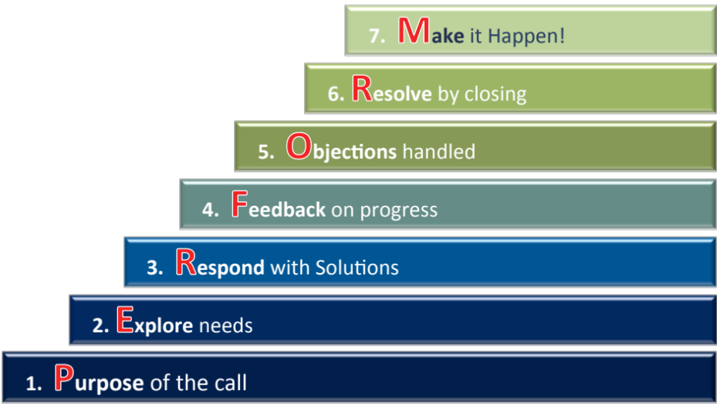
Step 1: Purpose of the call
Aim: Align your objectives with those of the customer
Why?
Clear goals give purpose and direction
Customer feels involved in the call
Free your mind to focus on the customer
How?
Make an opening statement of what you wish to cover in today’s call,
which positions your
Primary and Secondary objectives
  “What I wish to cover today is …”
Invite the customer to add to the agenda so they feel included
and aligned
  “Was there anything else you wanted me to address with you today?”
Use a checking question to confirm alignment
  “So, shall we cover off A+B+C? Great.”

Slide 39
Step 2: Explore Needs
Aim: Find out what they really need
Why?
To identify the strength of
needs/priorities/problems/desires
To design the right solution
How?
Open Questions to probe needs
- Who, What , Where, When, Why, Which and How?
- “Tell me about ….”
Closed Questions to zero in
- To confirm needs
Summary Questions
- “So, what you are looking for is ….”
- To check we have it all right!

Slide 40
Step 3: Respond with Solutions to Needs
Aim: Match a solution to the needs expressed
What?
Demonstrate attractive end results
or payoffs for the customer
Why?
Because they want to know...
“ What’s in it for me?”
How?
Support your recommendations with ….
Benefits that link to their needs
Focus on converting features in to
benefits with the linking phrase
“…which means that …you get ….”
Offer Proof that these benefits will accrue

Slide 41
Step 4: Feedback on the fit
Aim: Check the fit of the solution to the need….
If it is a good match ….stop selling and close it.
If it is not a good match…uncover why not!
Why?
To check understanding and acceptance
To test the strength of commitment
To uncover objections
How?
Importance Check
“Is that what you’re looking for?”
“How does that work for you in your site?”
“That would solve your need, wouldn't it?”
Trial Closes
“If I could organise that solution for you, would you like me to check on stock availability or organise a quote?”

Slide 42
Step 5: Objections overcome
Aim: Deal with the objection genuinely….
and move to a positive conclusion for both of us.
Why?
If we don’t overcome objections,
we could fail to help them to buy
If we do overcome the objection,
we earn the right to seek commitment
How? - Use the ABC Method
Acknowledge and Ask
- Validate their concern first
- Then seek understanding via
asking a series of questions
2. Bundle
- Clarify what needs solving with a summary question
3. Counter and Close
- Outweigh the problem(s) with compelling benefits
- Move to seeking their commitment

Slide 43
Step 6: Resolve the Sale!
Aim: Gain a resolution to act ....today!
Why?
Customers expect you to close!
Help them to decide to act
Resolve issues, challenges, opportunities
How?
Respond to “buying signals” as triggers
  Things they might SAY
  Things they might DO
  Note their body language
Select from a variety of different closing questions to suit the situation (recommendation, direct, assumptive,
risk, immediate gain, summary,
alternate, concession)

Slide 44
Step 7: Make it Happen!
Aim: Execute the agreed action
Why?
Avoid fall downs
Maximise benefits for both of us
Ensure both of us now act
How?
Summarise the positives of the decision to act
Clarify what YOU will now do
Invite the customer to confirm what THEY will commit to doing
Offer your support to help them complete their commitments
Agree what comes next

Slide 45
Coaching Action Tool (CAT Summary)
NAME: |  |  | TERRITORY: |  |  |  |  | DATE:
OBSERVATIONS |  | OFF TRACK |  | ON TRACK |  | OBSERVATIONS |  | GTH | Good | Great | N/O
BEHAVIOURS AND CULTURE |  |  |  |  |  | R | RECRUIT BD Process
1. Lives our Values – BE GREAT |  |  |  |  |  | 6. R Relationship developed
2. Embodies our 7 Virtues |  |  |  |  |  | 7. E Explore Needs
3. Practices Safety and Inclusion |  |  |  |  |  | 8. C Collaborate on Solutions
 |  |  |  |  |  | 9. R Review Progress
P | PLANNING | GTH | Good | Great | N/O | 10. U Uncover & Overcome Objections
4. Macro |  |  |  |  |  | 11. I Initiate Commitment
5. Micro |  |  |  |  |  | 12. T Take action to Execute
 |  |  |  |  |  | E | EXECUTE OUTCOMES
 |  |  |  |  |  | 13. Order processing and administration
 |  |  |  |  |  | S | SUSTAIN
 |  |  |  |  |  | 14. Service excellence follow up
User Instructions:
Consultant becomes familiar with performance standards
Consultant completes self-assessment prior to coaching session
Consultant submits self-assessment prior to coaching session
Coach & Coachee confirm assessment together towards end of session
Three BD Highlights from the session:
1.
2.
3.
Key Coaching Conversations/Directions from the session
Notes:
44

Slide 46
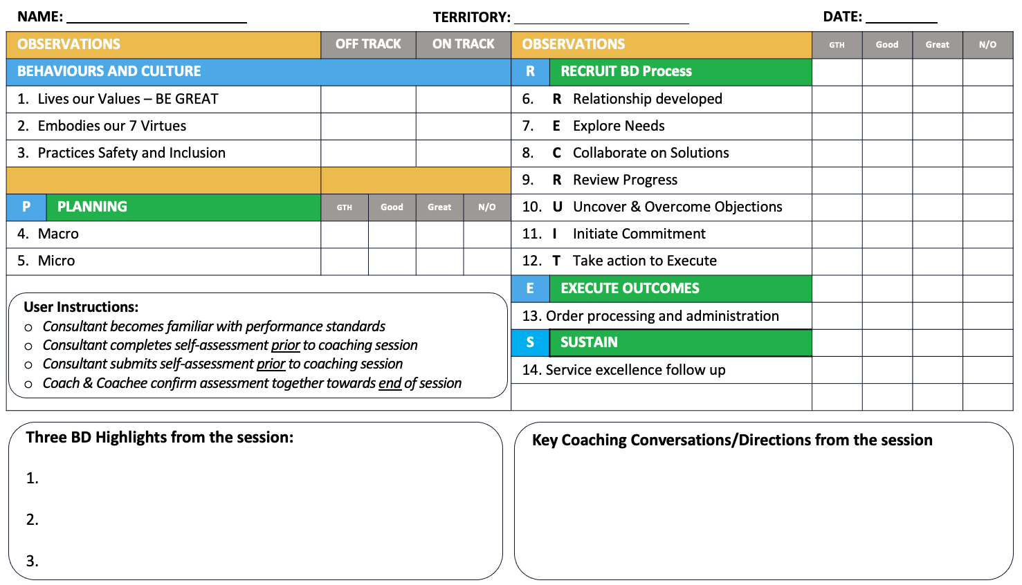
The components of the Coaching Action Tool
Competency Clusters
Specific Behaviours
SIMPLE 2 PAGE TOOL
Front – CAT Assessment
Back – CAT Actions
3-point measurement scale
GT | GREAT | Excelling above standard
GD | GOOD | Achieving the standard
GR | GROWTH | Working towards the standard
N | NOT OBSERVED | No opportunity to observe
BD highlights noted from the session
Coaching highlights noted from the session

Slide 47
5 levels of listening
1. Disconnected listening
4. Attentive listening
5. Empathic listening
2. Insincere listening
3. Selective listening
It’s all about ME
Now it’s about THEM

Slide 48

Active Listening Skills
Attending
Following
Reflecting
Log on with your genuine focus, gestures and
body language
Question, prompt and probe
Summarise back & check understanding
Let’s practise this skill!

Slide 49
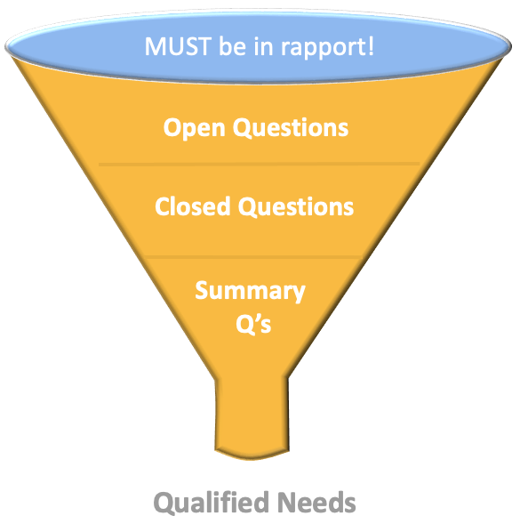

Questioning Techniques Summary
Core Questions Open Closed Summary | Leading Questions Discovery Shortcut Menu Questions Tie Downs | Conditional Questions “If I… would you…” On a Stated Need On a Question On an Objection On a Demand

Slide 50
Passing the “So What?” test
“We offer our educators a range of events, training, info sessions and even social gatherings.”
“Well so what?”
“These are all tailored to your personal goals.”
“Yeah better
..but ...”
“To help you to grow, to find your ideal role more quicky and open up your options
to working across Australia or even overseas.”
“Yes, that’s what I really need!”
Customers buy Benefits not Features!
...you need to talk in THEIR language!
B
A
F

Slide 51
Ten Step Coaching Process
For each call......
1. Review the situation
2. Review call objectives – the WHAT
3. Review the call plan – the HOW
4. Final pre-sale check, confirm roles
5. In the call; listen and observe
6. Congratulate, briefly
7. Review versus objectives
8. Reinforce the positives
9. Agree improvements
10. Objectives for the next call recorded
Your Team Leader has been trained to ask questions and not tell
We want you to think this way for
all calls, not just on coaching days
No intervention in the call by
the Team Leader – it’s your customer/client, your territory,
your development
“We want to teach you
how to fish …
not to feed you for a day!”

Slide 52
The anzuk Feedback Model
Get their feedback first on what worked well.
“What worked well in that last call?”
Then add your view of the strengths observed.
“What I liked was when you …….”
Get their feedback first on what could be improved.
“What would you do differently next time?”
Then add your view of what to consider or change.
“You might like to consider ……..”

Slide 53
Distinguishing Features from Benefits
Features & Advantages
Benefits
For
Clients & their organisation
For Educators
& their careers
For
Learners
& their development
VS
Product/Service Focused
Attributes
Outcomes

Slide 54
Customers buy Benefits more than Features
Remember to highlight the Benefits
Product/Service: Ready2Book
Feature
Characteristics
Advantages
What it does/doesn’t do
Benefits
End Results or Outcomes
We have a purpose-built App for employers called Ready2Book that is downloadable to all
your devices.
It allows you to book, track, view your order, together with all the educators’ compliance documents in one central place.
Which means:
You can know in advance who is coming and their history with you
Have peace of mind that they are right for the job in terms of qualifications and compliance
Save time worrying about and managing your staff
Operate from anywhere that suits you giving you added flexibility
One feature can lead
to multiple benefits!

Slide 55

Handling Objections: ABC
As simple as……..
Acknowledge & Ask
Bundle
Counter & Close

Slide 56
Handling Objections: Technique
Acknowledge
and Ask
Bundle
Bundle together the issues so we can agree
what we need to agree! It’s a summary question.
Counter and Close
Use powerful facts and benefits to
outweigh their concern … then close on it.
Let them express their concern(s). Listen!
Validate their concern early on (but don't agree).
Ask questions to find out more about how they interpret the issue. (This provides valuable information)

Slide 57

Objection: Rates too high example
Bundle
You: “So, what we really need to do here is compare not just the prices you are paying but the value and risk exposure that you are getting from the respective suppliers?”
C: “Well yes, I think you have a point, and I would be open to getting your insights and advice."
You: “Thank you for that. What I will do is to compare the facts and evidence so you can make up your mind as to what is the best choice for your business. Does that sound fair?”
C: ”Yes, I think that is most reasonable.”

