Slide 1
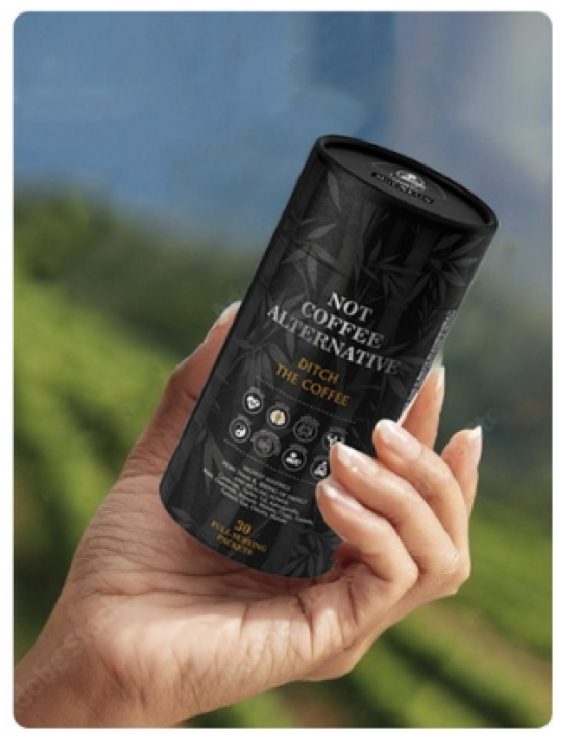

Infor Graphic #1
This picture is meant to be the first image when people come to see the product on Amazon.
The focus here is on the rendering of package, also the sachet with someone drinking it at work.
Ditch the coffee, Better your life
NOT COFFEE ALTERNATIVE

Slide 2

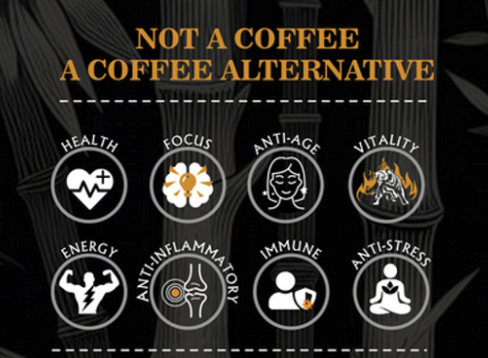
Infor Graphic #2
This infographic is meant to inform the customer of what this does.
Background image will be people drinking in office with a can and sachet nearby.
NOT COFFEE ALTERNATIVE is a Coffee replacement.
No More Morning Jitters OR Afternoon Crashes.
Promotes (show the images from the can)
Brain Focus
Stabilizes and improves gut health
Sustained Energy
Lowers Inflammation
Boosts Immunity
Adaptogenic to help lowering Stress
Promotes Healthy Vitality
Promotes healthy blood sugar level

Slide 3
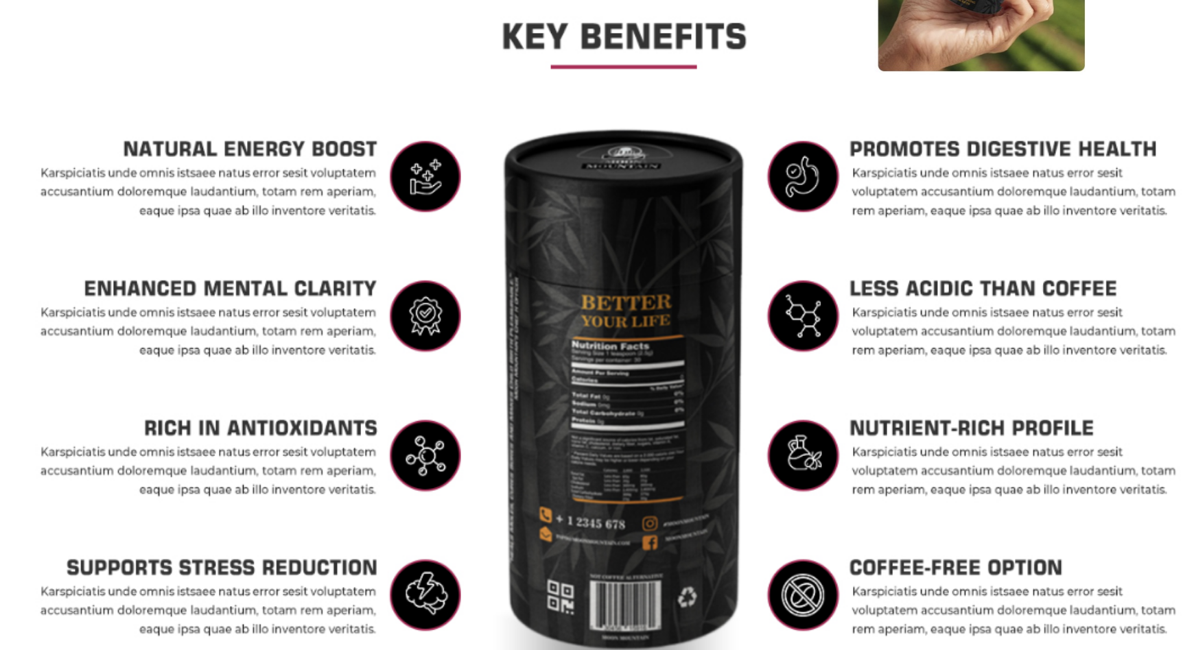

Slide 4
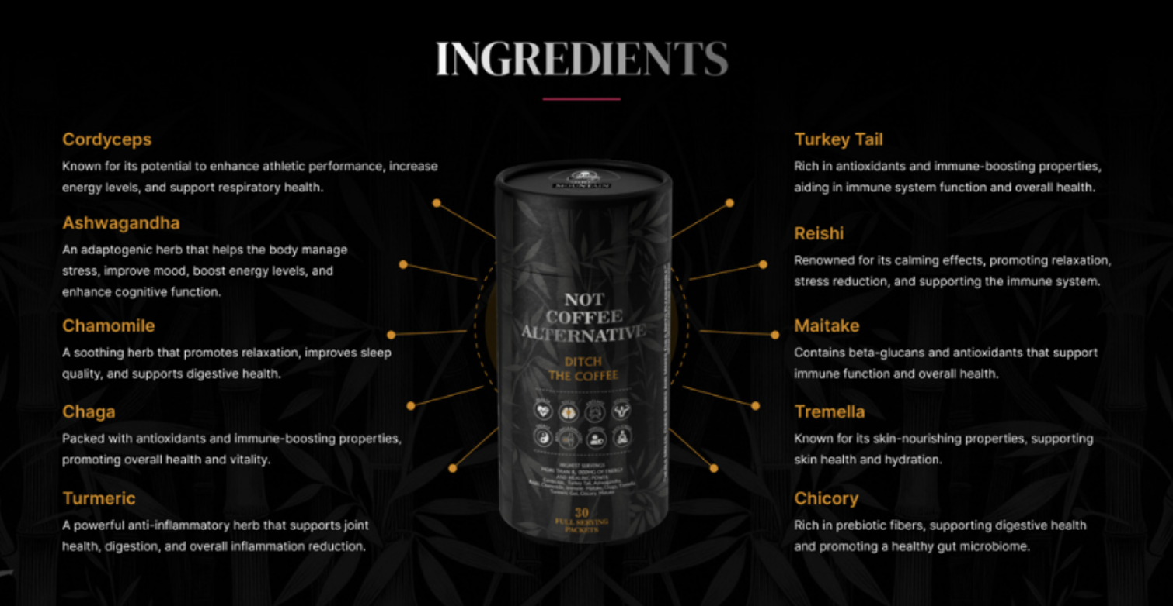

Slide 5
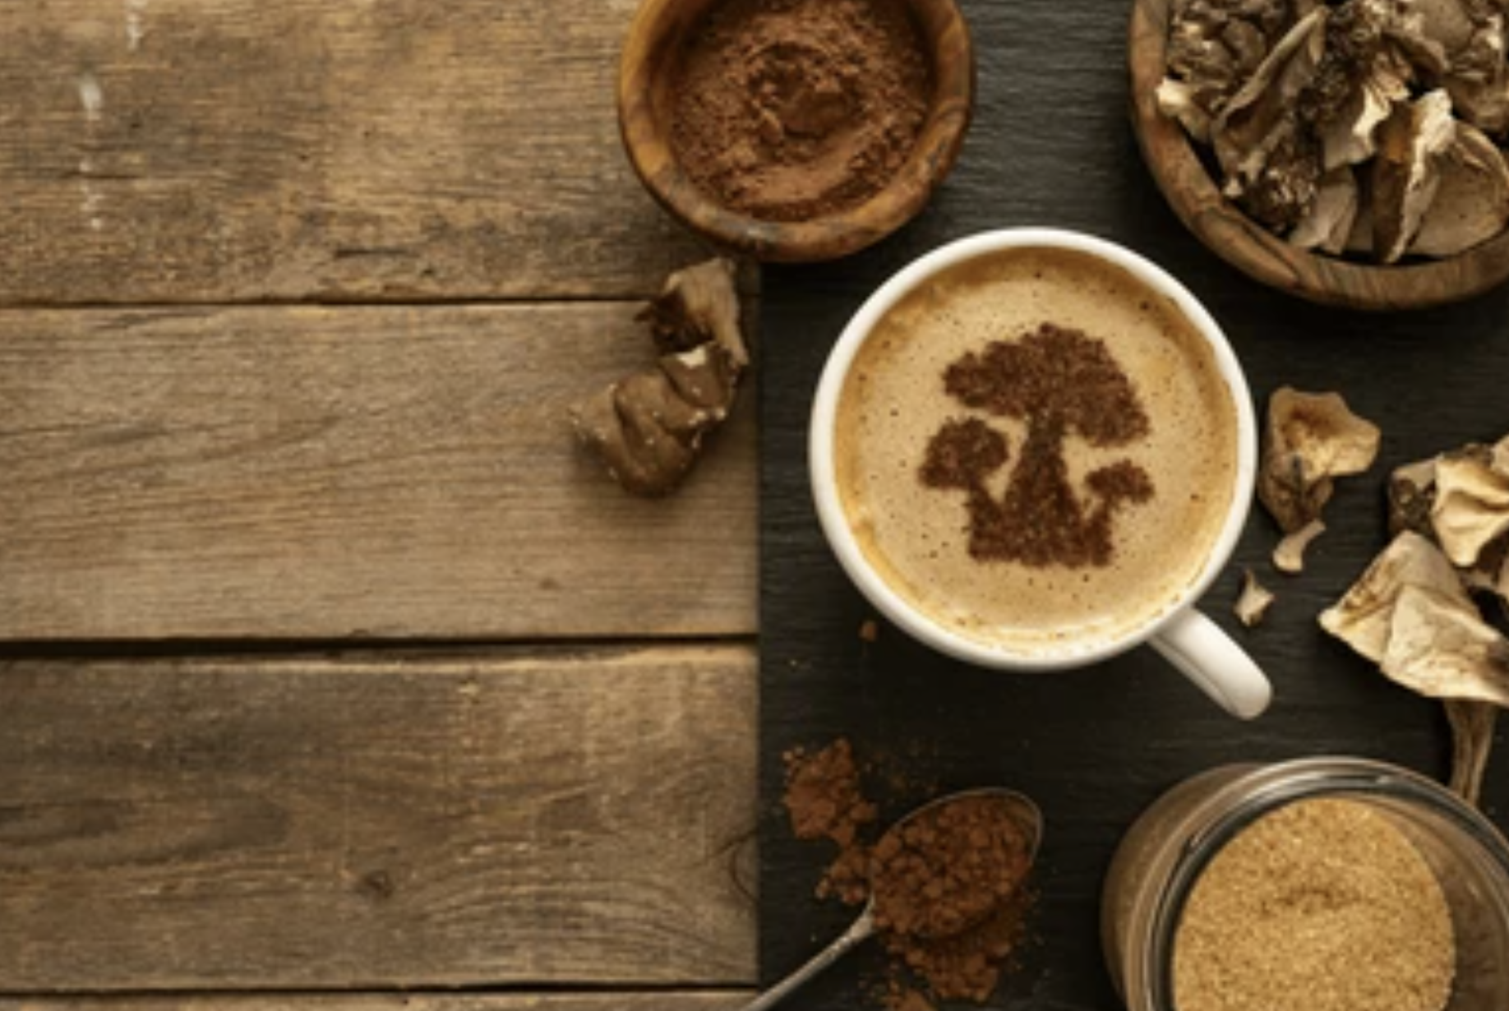
Infor Graphic #3
This infographic is focused on Ingredients.
Show Nutritional label. Then List the ingredients and their effects.
State: Proprietary ingredients to more power that any other product you will find: 9000 mg
Show Vega symbol
Cordyceps
Lions Mane
Reishi
Turkey Tail
Chamomile
Tremella
Chicory Root
Chaga
Cocoa ……
Ashawagandha
Maitake
Green Tea
Turmeric Extract

Slide 6
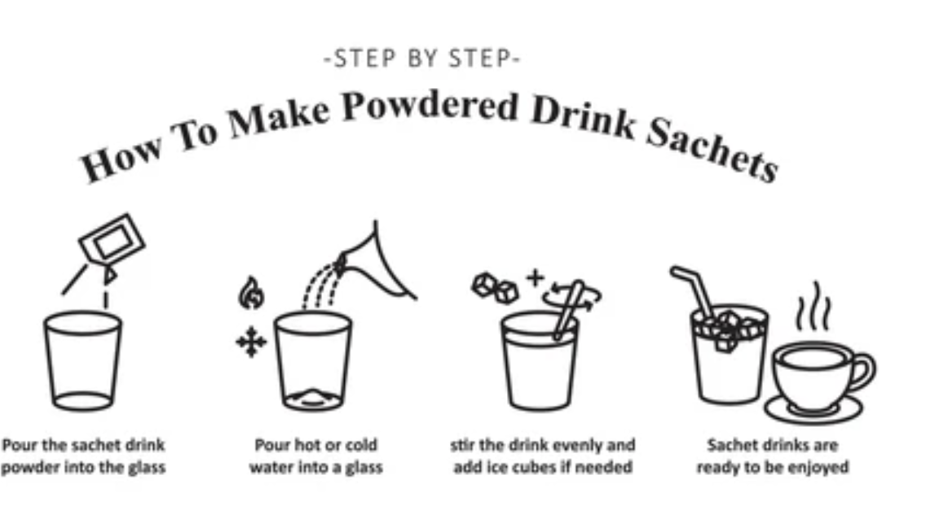
Infor Graphic #4
This info graphic is on how to use the product.
Each packet has 30 packets, add one packet into
Put into 1 cup or 250 ml of water
Add to your favorite hot drink
Even add it to your coffee routine.
Drink at any time
When Drinking on empty stomach 30 minutes after waking supports fast absorption functions.

Slide 7



