Slide 1


Slide 2
Matt Burgess - background
32 years as a finance professional
CFO of an international oil exploration company
Financal Controller of a major building company
Senior Group Accountant at a major NZ bank

Slide 3
Development of Xcel Productivity Tools (XPT)
I’ve worked with many accounting platforms over the years. All of them did a reasonable job of processing transactions, invoicing customers and paying invoices
However, they have been universally underwhelming when it comes to their reporting capabilities
Using a combination of Power BI, Excel, Visual Basic, SQL Server, SSAS, Power Query, and various other software packages, I have consistently delivered my own reporting solutions to the finance teams I am responsible for
My solutions have always outperformed the reporting capabilities native to the accounting packages for speed, flexibility and ease of use
I have taken my skills and learnings from these experiences to develop the XPT

Slide 4
The Goal of the XPT Solution
Our goal is to revolutionise client accounting reporting processes, starting with the two XPT tools and aiming for an end-to-end solution whereby the desired information is delivered to all users at the click of a button

Slide 5
The XPT Solution
Provides superior information and analysis to enable all users, from senior executives to junior accountants, to fully understand their business
Is extremely easy to use for anyone who knows Excel
Is completely customisable to meet client requests
Includes preset and flexible charts to visualise all elements of client organisations
Enables clients to gather and interpret all their accounting information within one application
Is automated to save significant amounts time and money

Slide 6
Automation
  All business-critical information from board reports to detailed charts can be displayed generated by the click of a button
Flexibility
  Design client reports to meet the exact requirements of their organisations
  Focus on any part of client businesses with the infinite options of Excel
Speed
  All client accounting information in one place
  No need to log in to different organisations or accounting systems
  Instant updates for all reports, instant charts, instant drill-downs

Slide 7
XPT Provide:
Reporting Tools
  Financial and management reporting. Profit and loss, balance sheets, cash reports, forecasts
Analysis Tools
  Preset and customised queries to help decision-makers understand and run their businesses
  As detailed on the following slides

Slide 8
Reporting Tools
Financial and Management Reporting
  Any report clients can design in Excel, populated directly from their accounting systems
  Immediate update of parameters such as date, organisation, division
  Report by quarter, month, week or day
Multiple databases, organisations and platforms
  Combines reports for any company, partnership or not-for-profit, from SAP, Dynamics, NetSuite, Xero, QuickBooks, MYOB or Sage
Automated consolidations
  Across all client entities, or any subgroups of client entities
Detailed board packs
  Produce PDF board packs from consolidated reports or multiple entities at the click of a button

Slide 9
Reporting Tools(2)
Drill down to transactions underlying values
  Instantly view the transactions that make up the totals on financial and management reports
  Summarise those transactions by customer, supplier, project or product
Customisable dashboards
  Design dashboards with fully customisable layouts rather than picking from a list
  View the values and drill down to the transactions represented in the dashboards
Customisable ratios and KPI’s
  Identify and analyse the most appropriate ratios and KPI’s for clients’ specific businesses
  View the values and drill down to the transactions that drive the ratios and KPI’s
Export critical information to mobile via Power BI
  The XPT solution is driven by Excel Power Query, which is very similar to Power BI. Power BI is used to deliver XPT data and charts to client mobile devices

Slide 10
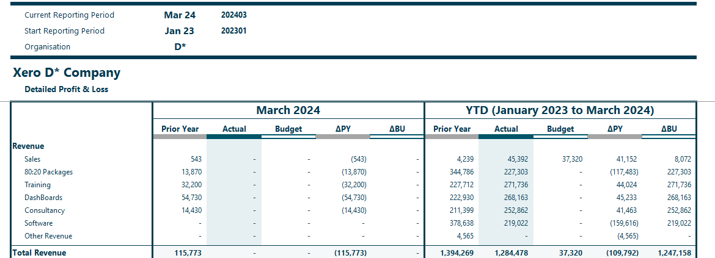
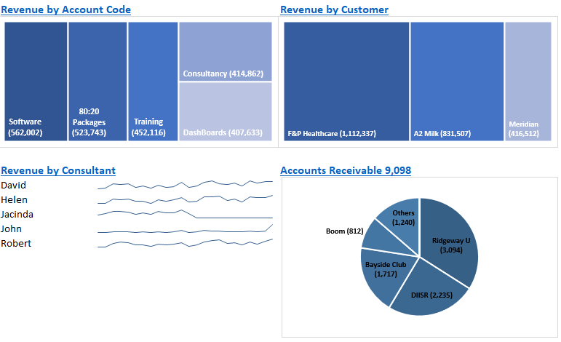
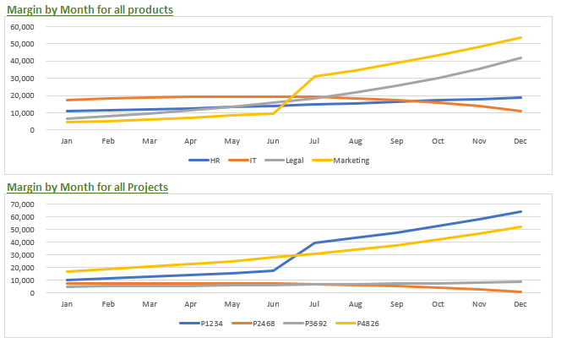
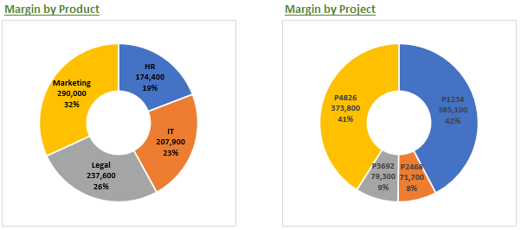
Infinite report flexibility - IBSC anyone?
Reporting Tools(3) - images from the tools
Automated Dashboards
Margin Analysis

Slide 11
Analysis Tools
Relevant information and analysis
  Understand client businesses - revenue, expenditure, assets, liabilities
  For boards, senior executives and accounting teams
  Automate and chart business-critical financials
Multiple databases, organisations and platforms
  Combine reports for any company, partnership or not-for-profit
  Whatever the source of the accounting information
Movement by Month
  Identify transaction totals by account code across all periods
  Filter by any period or combination of databases, account types, or analysis codes
  Drill down to the underlying transactions

Slide 12
Analysis Tools(2)
Customised queries
  Filter the database transactions by any element within those databases
  Visualise the selected transactions using charts
  Drill down on any of the values represented by those charts
  Record the filters so the reports can be rerun instantly at any time
Automated communication
  Highlight issues and send queries / comments via email to the relevant teams directly from the Analysis Tools
Export information to mobile via Power BI
  The XPT solution is driven by Excel Power Query, which is very similar to Power BI. Power BI is used to deliver XPT data and charts to client mobile devices

Slide 13
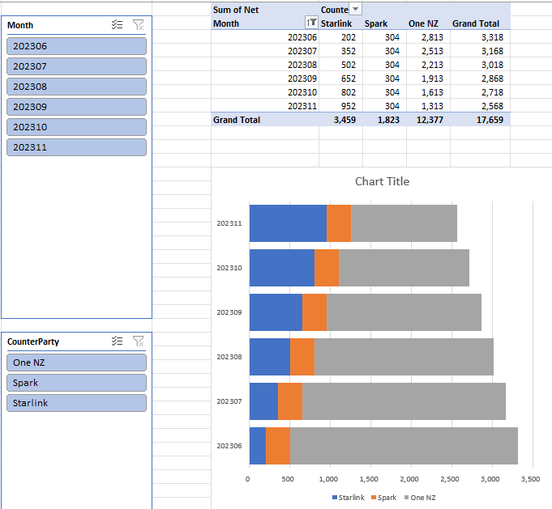
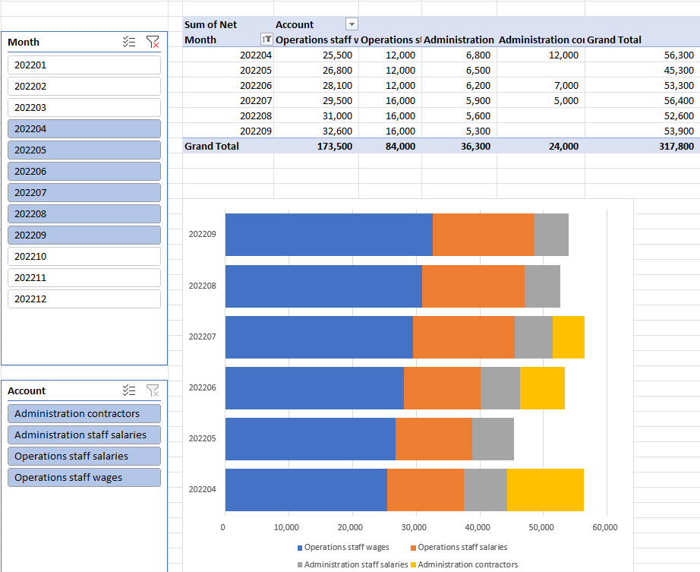
Account code by month
Analysis Tools(3) - images from the tools
CounterParty by month
Automated Communication – please explain the highlighted values

Slide 14
Summary of Customer Benefits
Automated delivery of relevant and accurate information for key decision-makers
From any accounting platform or combination of accounting platforms
Strong focus on automated charts
All your accounting data in Excel and ready for analysis
Easy customisation of all client reports using Excel skills already inherent in all finance teams
Improved productivity leading to time and cost savings

