Slide 1
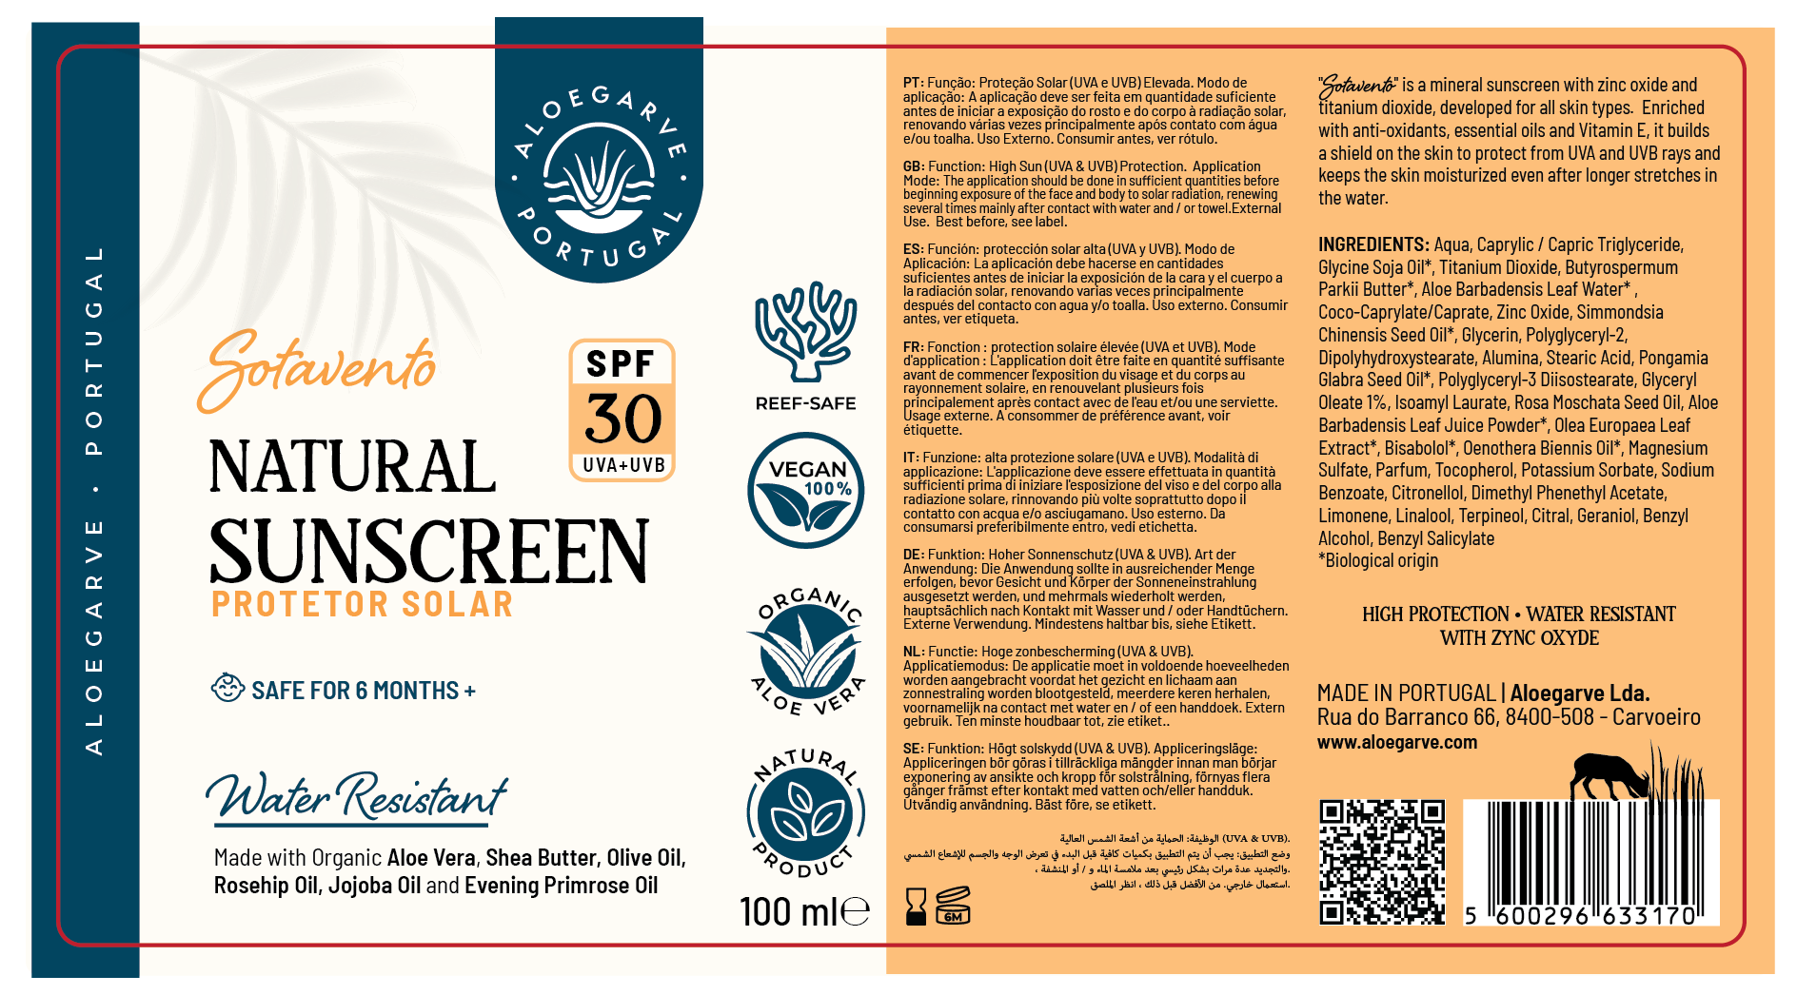
Our current Sunscreen Design
https://aloegarve.com/products/natural-sunscreen-with-spf30-100ml?_pos=4&_sid=7912a08af&_ss=r

Slide 2
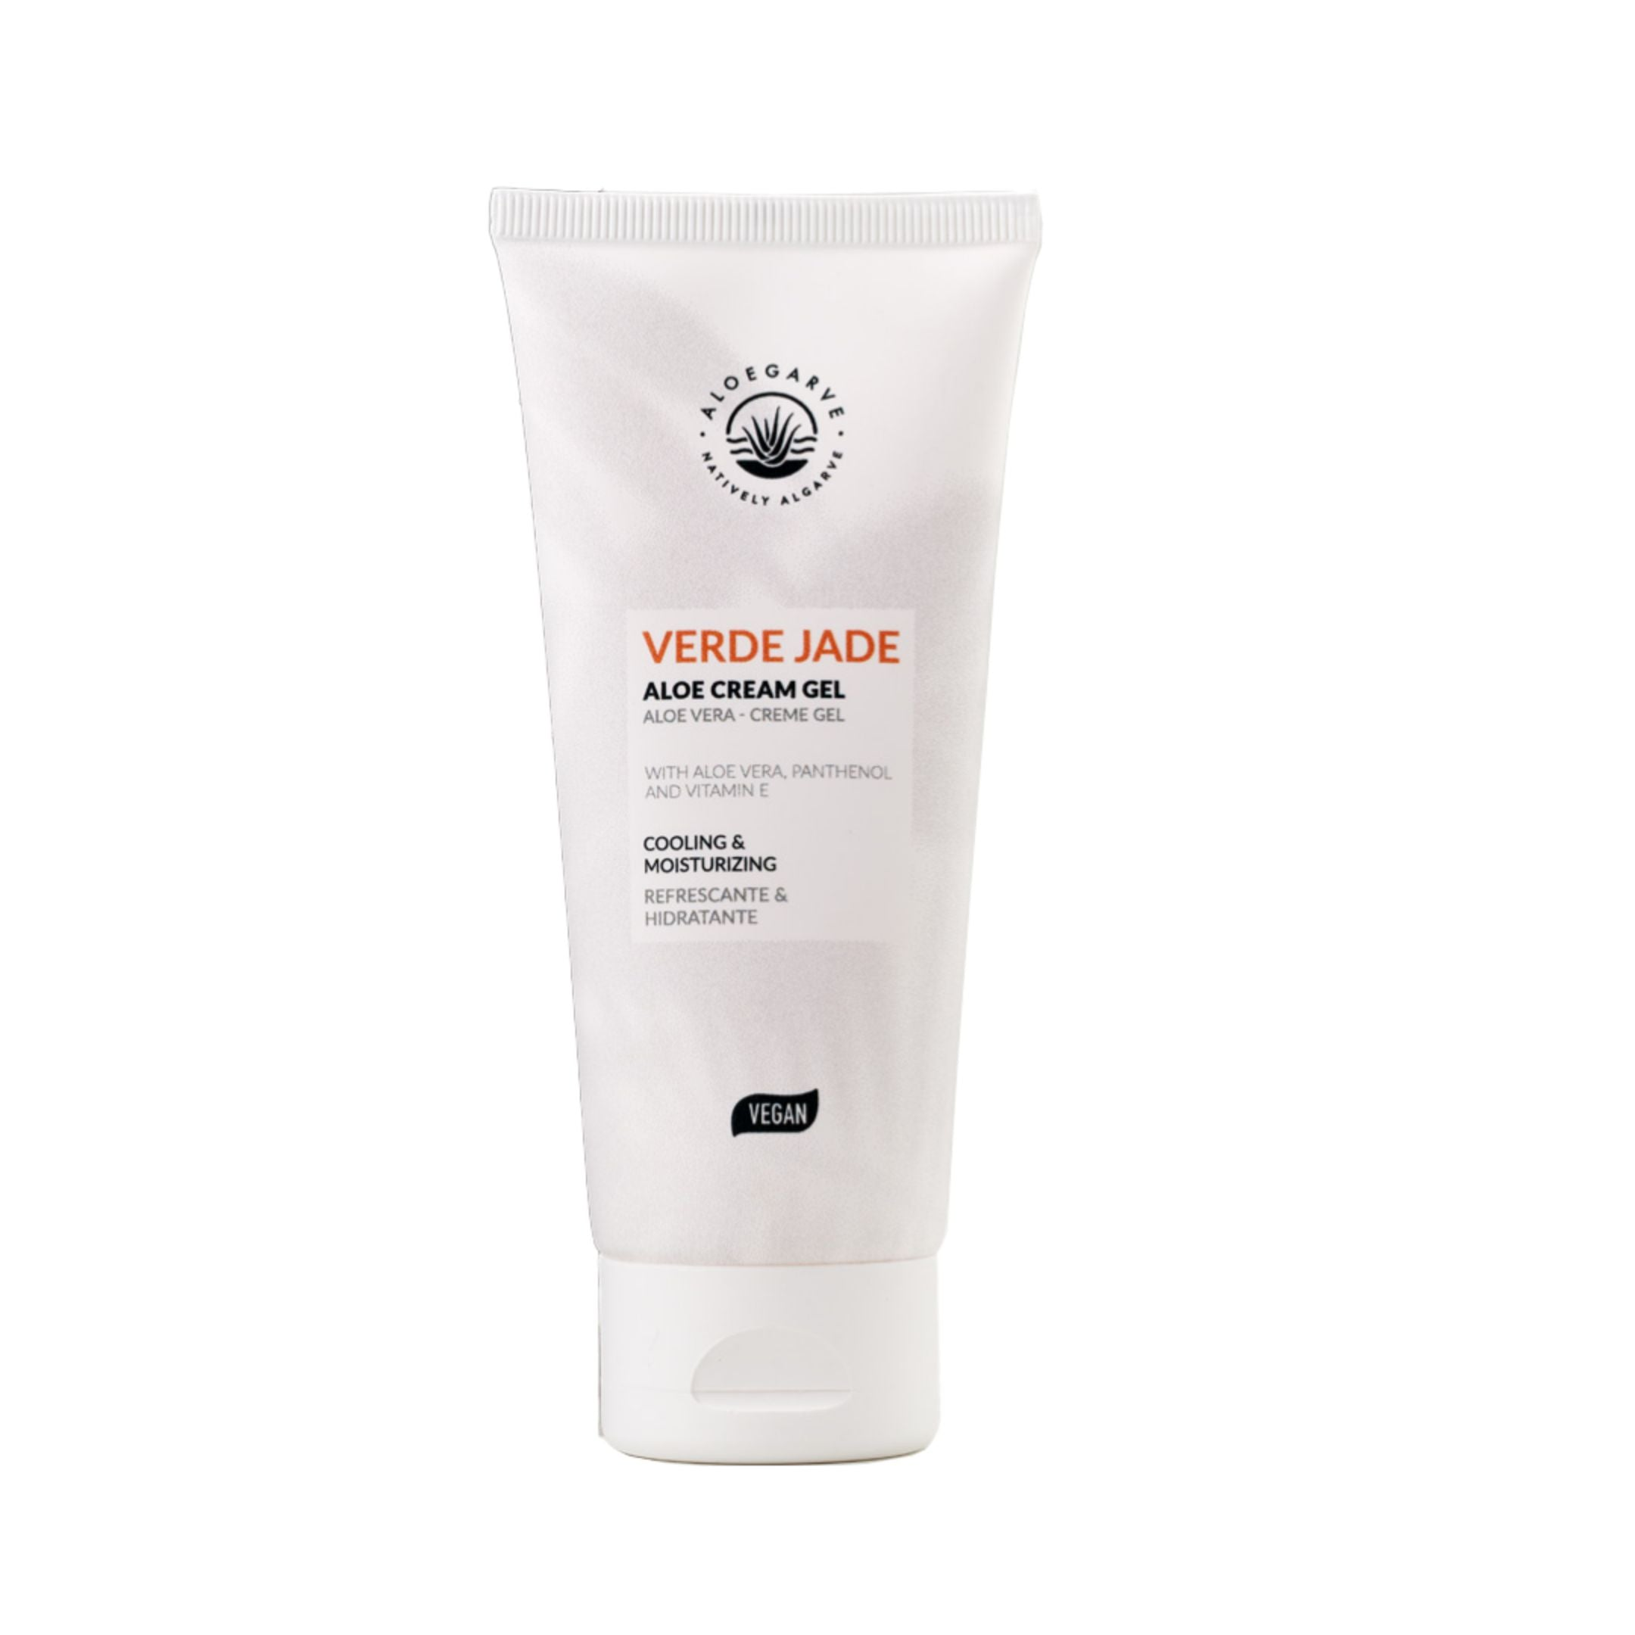
Front
Logo
Sotavento (Name) small
Natural Sun Lotion (Function in 2 languages, English and Portuguese) UVA, UVB
For Body and Face
SPF (large) 30+
With BIO Aloe Vera, Non-greasy, Water Resistant, Safe for kids and adults
Vegan
100ml
This is NOT our current sunscreen design but another reference product for content

Slide 3
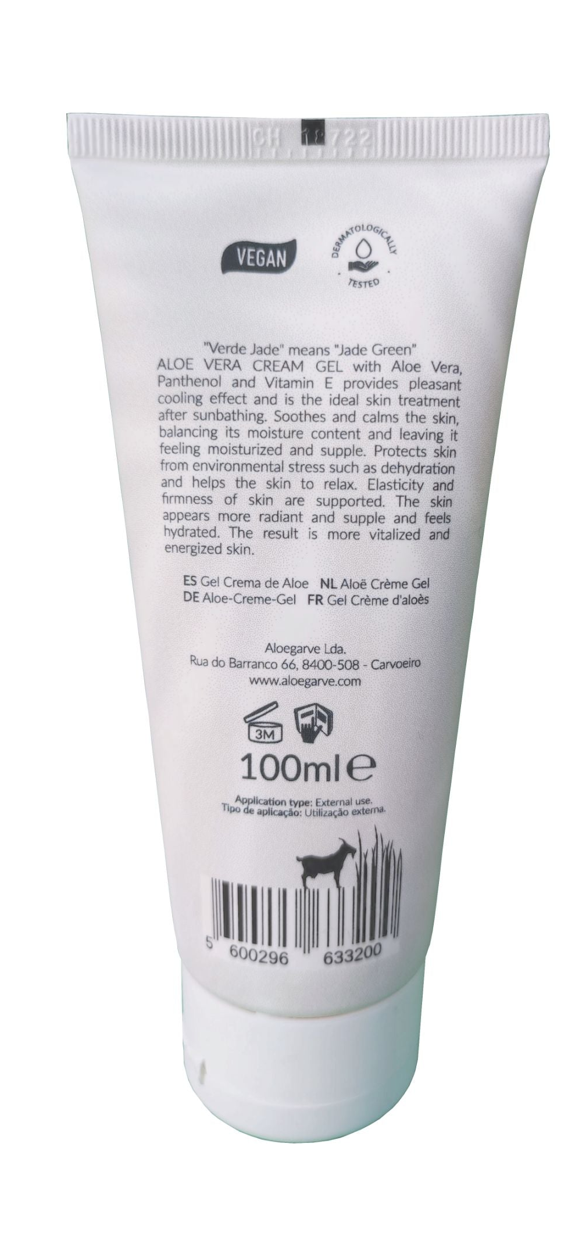
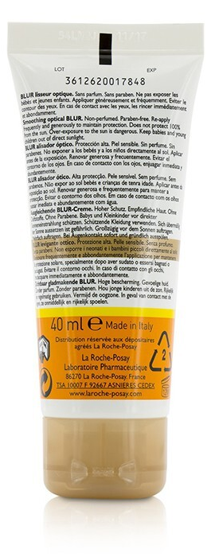
Back
Short text : 1-2 sentences
Functions, instructions and warning in 9 languages (optimize space)
Barcode
Ingredients
Address
Content in ml
Expiration after opening icon
Warnings

Slide 4
