Slide 1

(Your title)
Confidential Information. All non-public, confidential or proprietary information of OTS, including but not limited to specifications, samples, patterns, designs, plans, drawings, documents, data, business operations, customer lists, pricing, discounts or rebates, disclosed by OTS to Company, whether disclosed orally or disclosed or accessed in written, electronic or other form or media, and whether or not marked, designated or otherwise identified as “confidential” in connection with this Agreement is confidential, solely for the use of performing this Agreement and may not be disclosed or copied unless authorized in advance by OTS in writing. Upon OTS’s request, Company shall promptly return all documents and other materials received from OTS. OTS shall be entitled to injunctive relief for any violation of this Section. This Section does not apply to information that is: (a) in the public domain; (b) known to Company at the time of disclosure; or (c) rightfully obtained by Company on a non-confidential basis from a third party.
HULKUSA.com
307.699.3198
(Date)

Slide 2

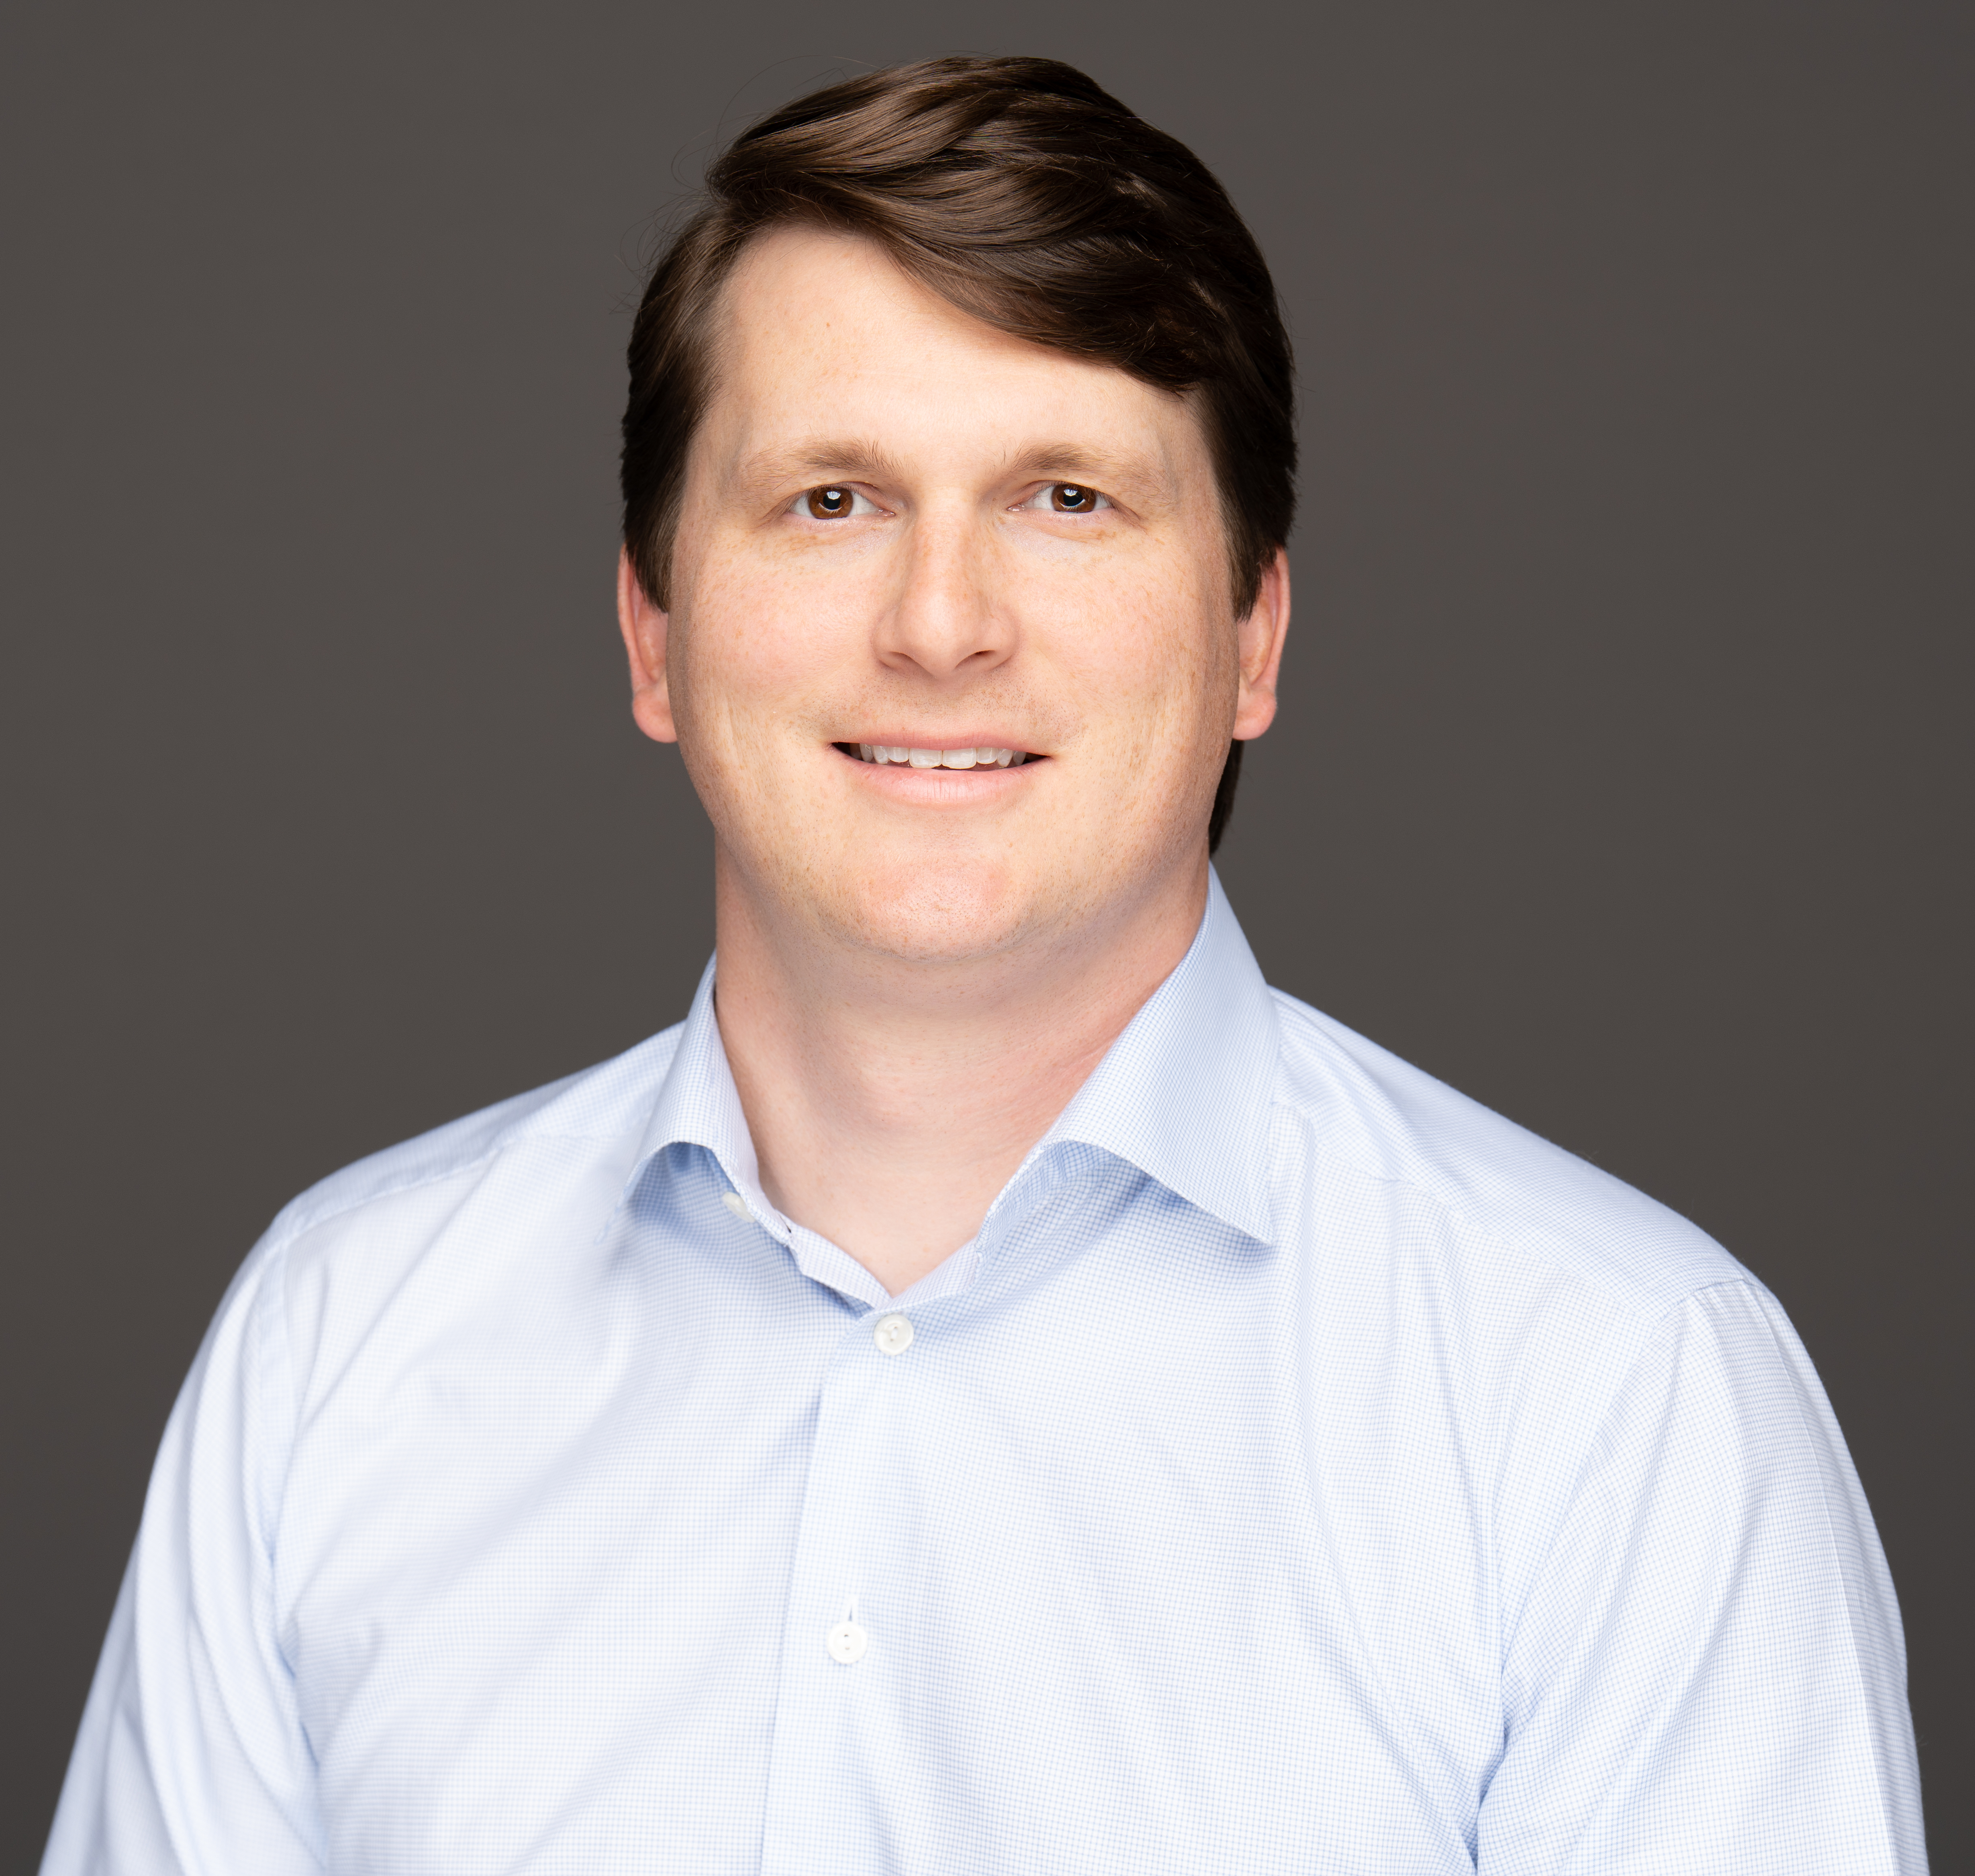
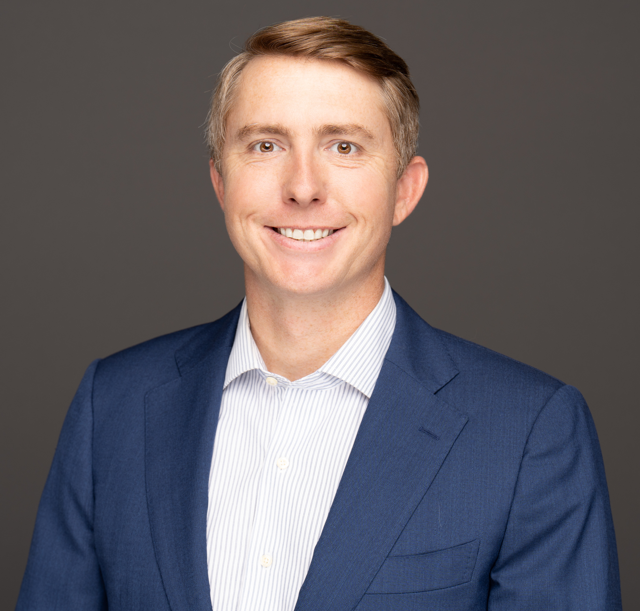
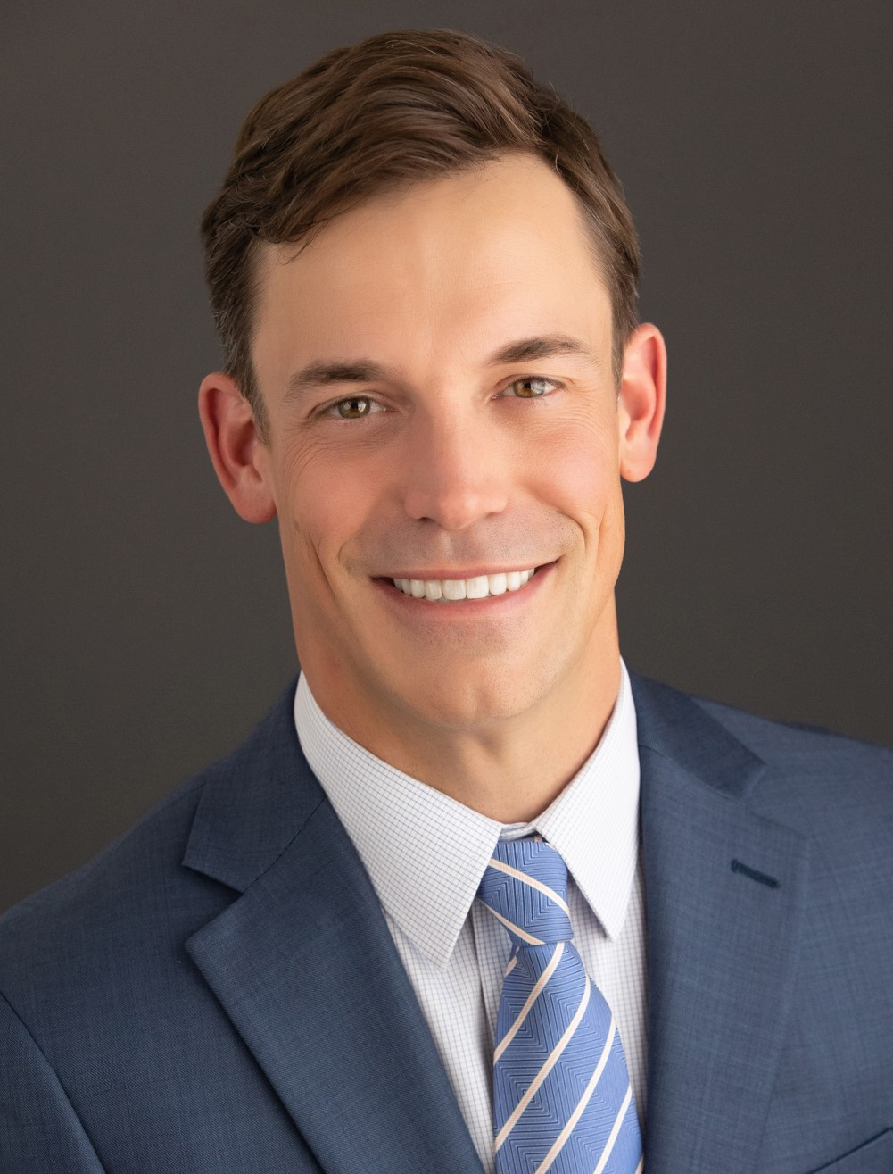
Your HULK Team:
Chandler England Co-Founder, Director of Product Business Development, Finance and Logistics Background | Mark Robinson Co-Founder, Director of Engineering and Information Prior: Field Engineering at Baker Hughes, 5 yrs | Matthew Smart Co-Founder, Director of Operations and Sales Prior: Account Manager at Baker Hughes, 8 yrs | NAME Title – Customer specific relationship manager Experience
Since 2017, HULK is a founder-led, solutions driven company, focused on the development and distribution of HULK products for advanced ESP cable protection in unconventional wells.
HULKUSA.com
307.699.3198
Date

Slide 3
(TITLE)
Titles/captions/names always in Anton font
Body text always in Neue Haas Grotesk Pro font
HULKUSA.com
307.699.3198
1/2/2024

Slide 4
(TITLE)
Titles/captions/names always in Anton font
Body text always in Neue Haas Grotesk Pro font
HULKUSA.com
307.699.3198
1/2/2024

Slide 5
(TITLE)
Titles/captions/names always in Anton font
Body text always in Neue Haas Grotesk Pro font
HULKUSA.com
307.699.3198
1/2/2024

Slide 6
(TITLE)
Titles/captions/names always in Anton font
Body text always in Neue Haas Grotesk Pro font
HULKUSA.com
307.699.3198
1/2/2024

Slide 7
(TITLE)
Titles/captions/names always in Anton font
Body text always in Neue Haas Grotesk Pro font
HULKUSA.com
307.699.3198
1/2/2024

Slide 8
(TITLE)
Titles/captions/names always in Anton font
Body text always in Neue Haas Grotesk Pro font
HULKUSA.com
307.699.3198
1/2/2024

Slide 9
(TITLE)
Titles/captions/names always in Anton font
Body text always in Neue Haas Grotesk Pro font
HULKUSA.com
307.699.3198
1/2/2024

Slide 10
(TITLE)
Titles/captions/names always in Anton font
Body text always in Neue Haas Grotesk Pro font
HULKUSA.com
307.699.3198
1/2/2024

Slide 11
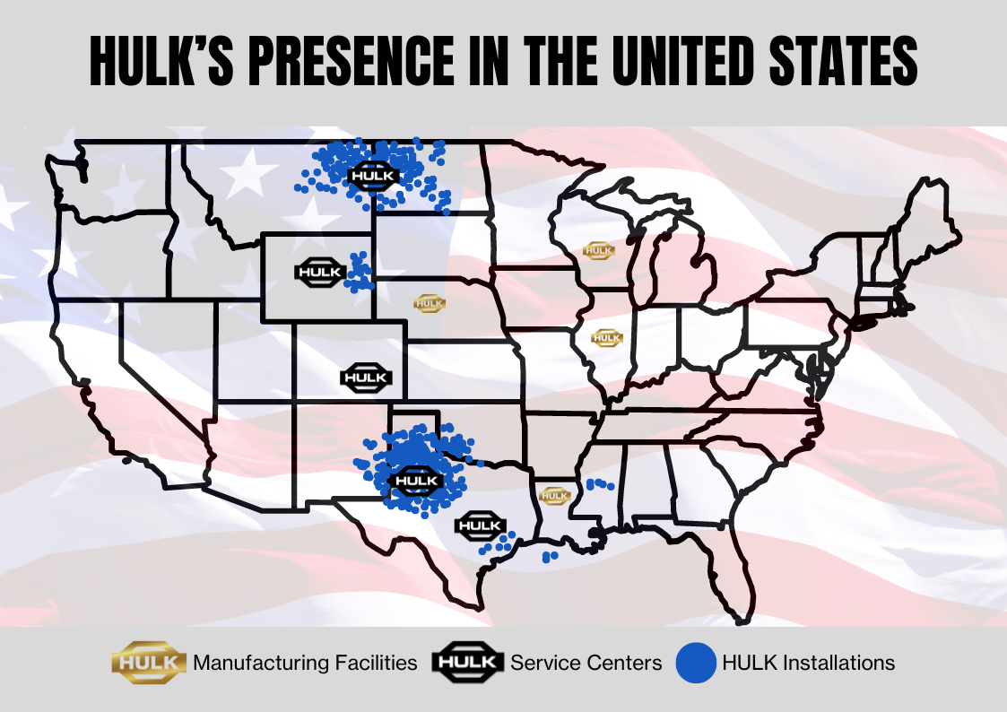
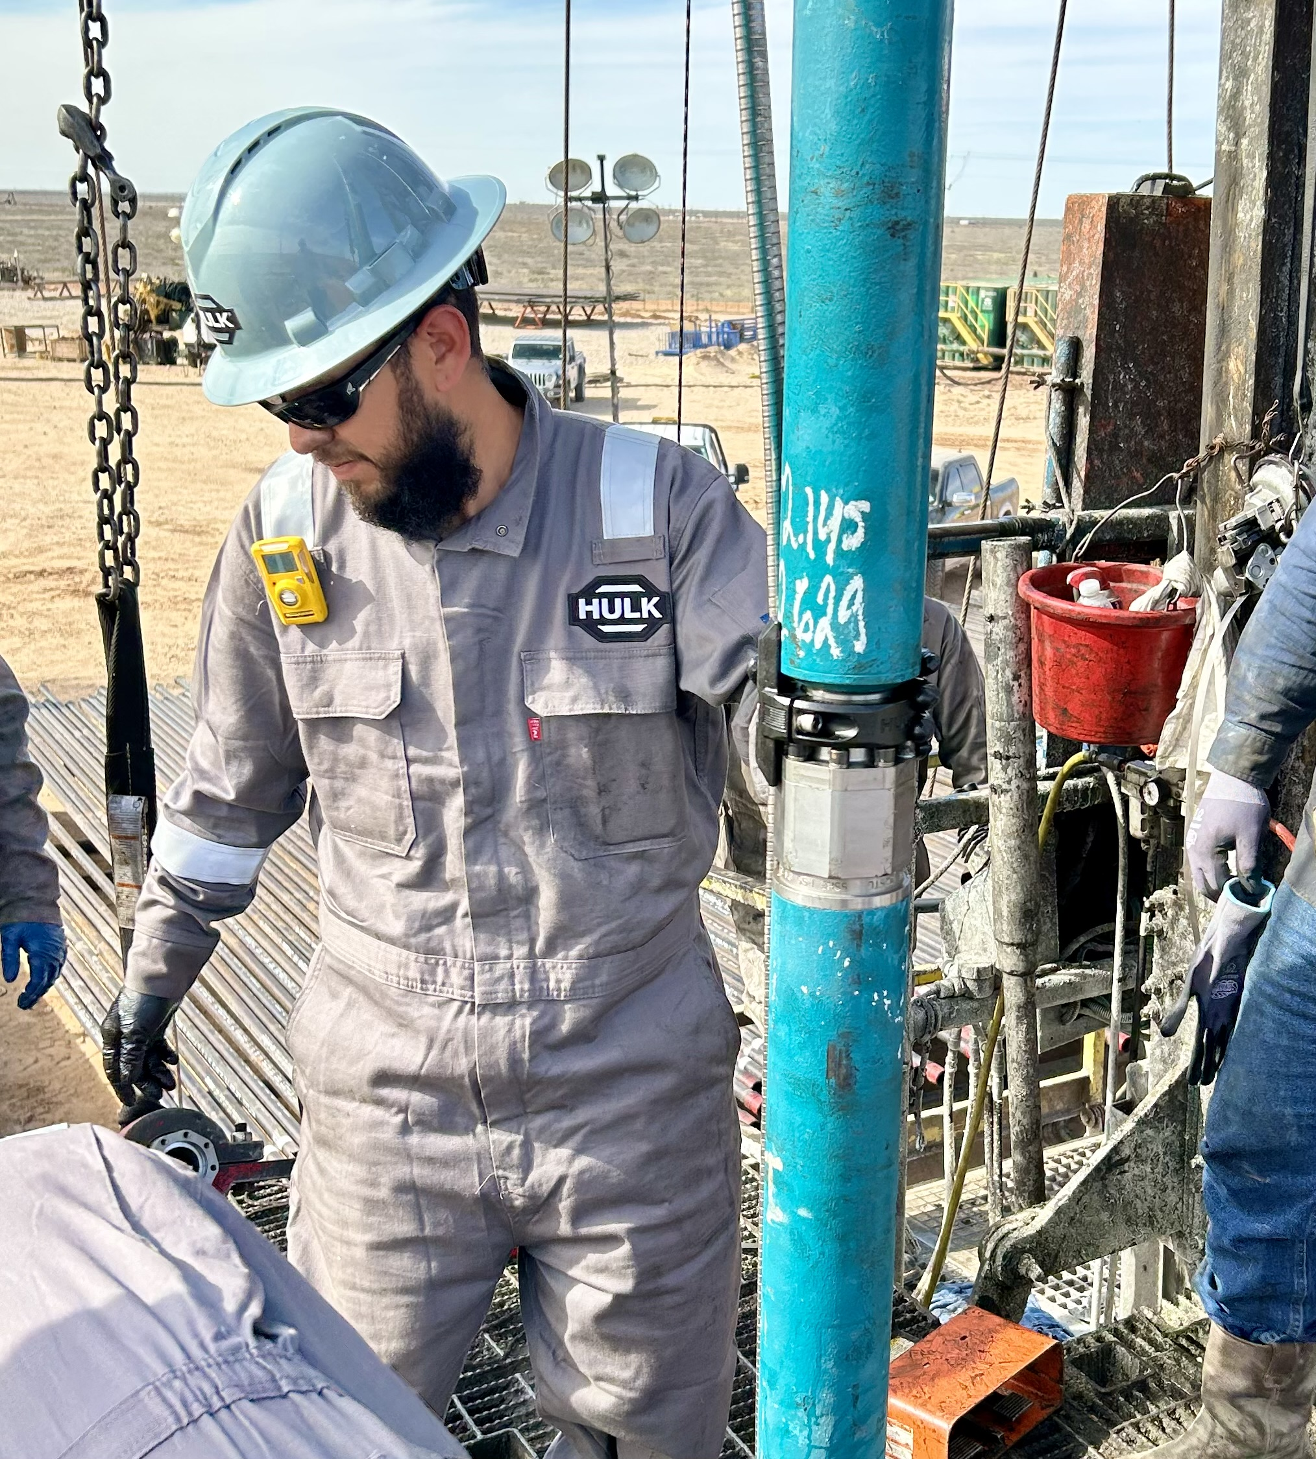
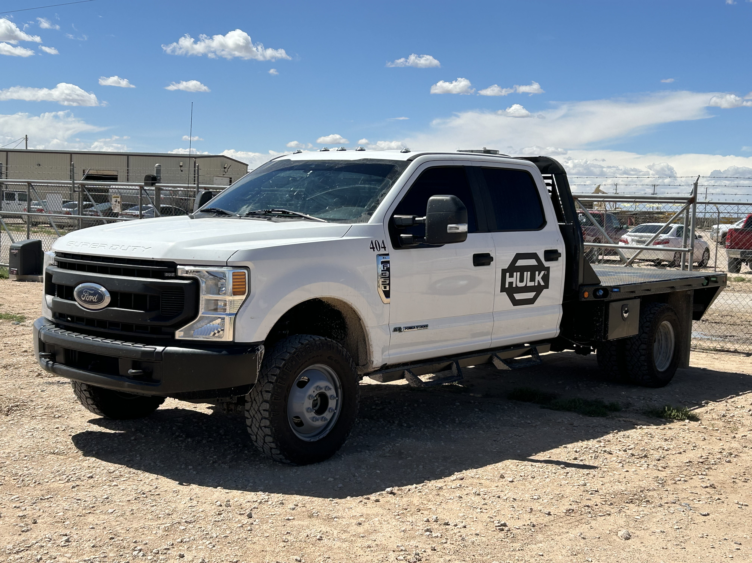
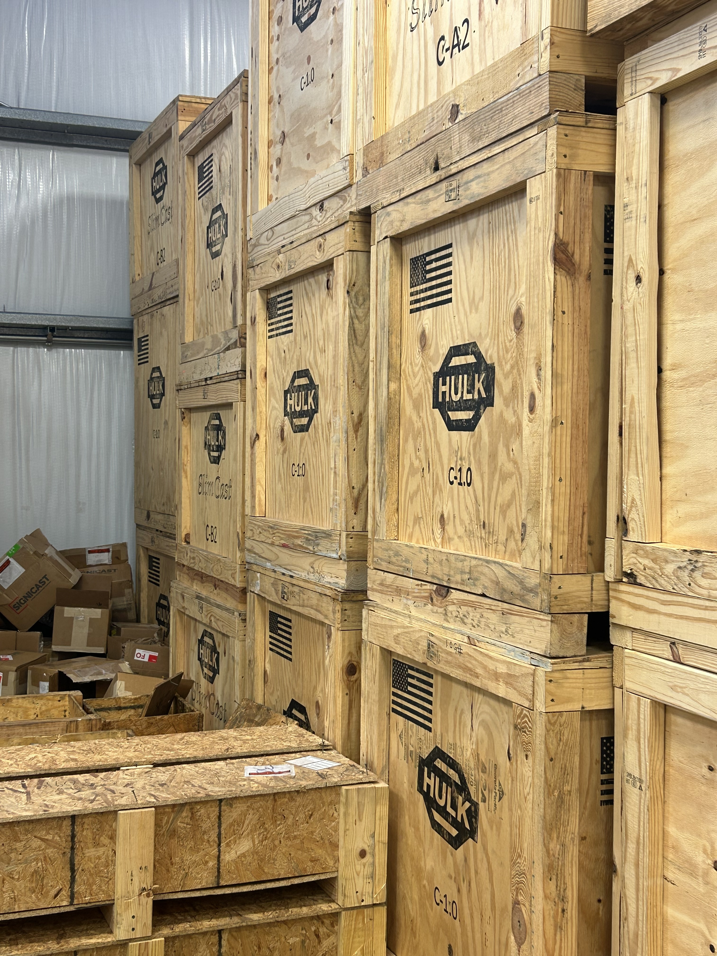
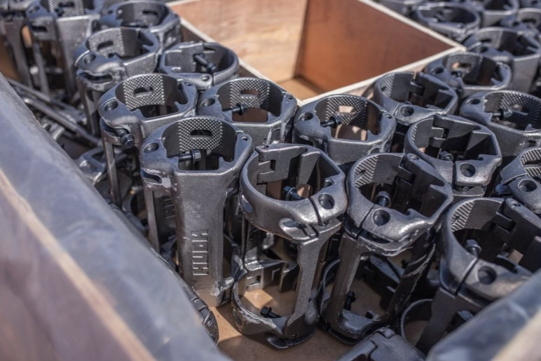
HULK Operational Footprint
HULK Operational Footprint
Oil Tool Solutions (dba HULK)
Refurbishment/Warehouse
Williston, ND
Casper, WY
Midland, TX
Headquarters
Denver, CO
Houston, TX
Company Success
6,000 + installations in Bakken and Permian
~1,000,000 units deployed
97%+ rerun rate including tens of thousands of clamps having been run 3+ times
Cable Compatibility
Apergy
Baker Hughes
Borets
Extract Production
Endurance Lift
Novomet
Schlumberger (Reda)
Summit (Halliburton)
Valiant
HULKUSA.com
307.699.3198
7/29/2023

Slide 12
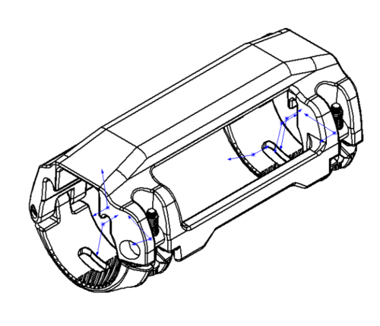
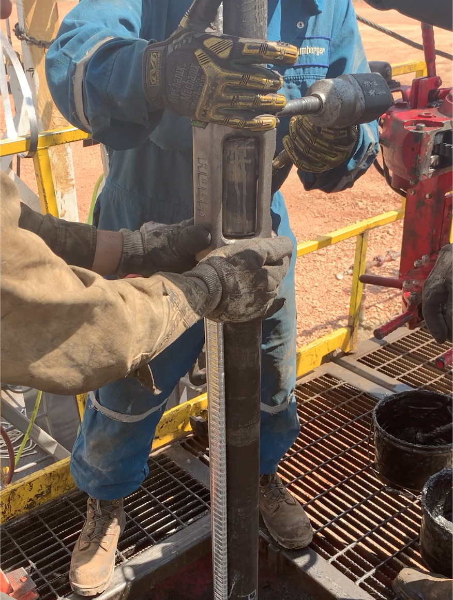
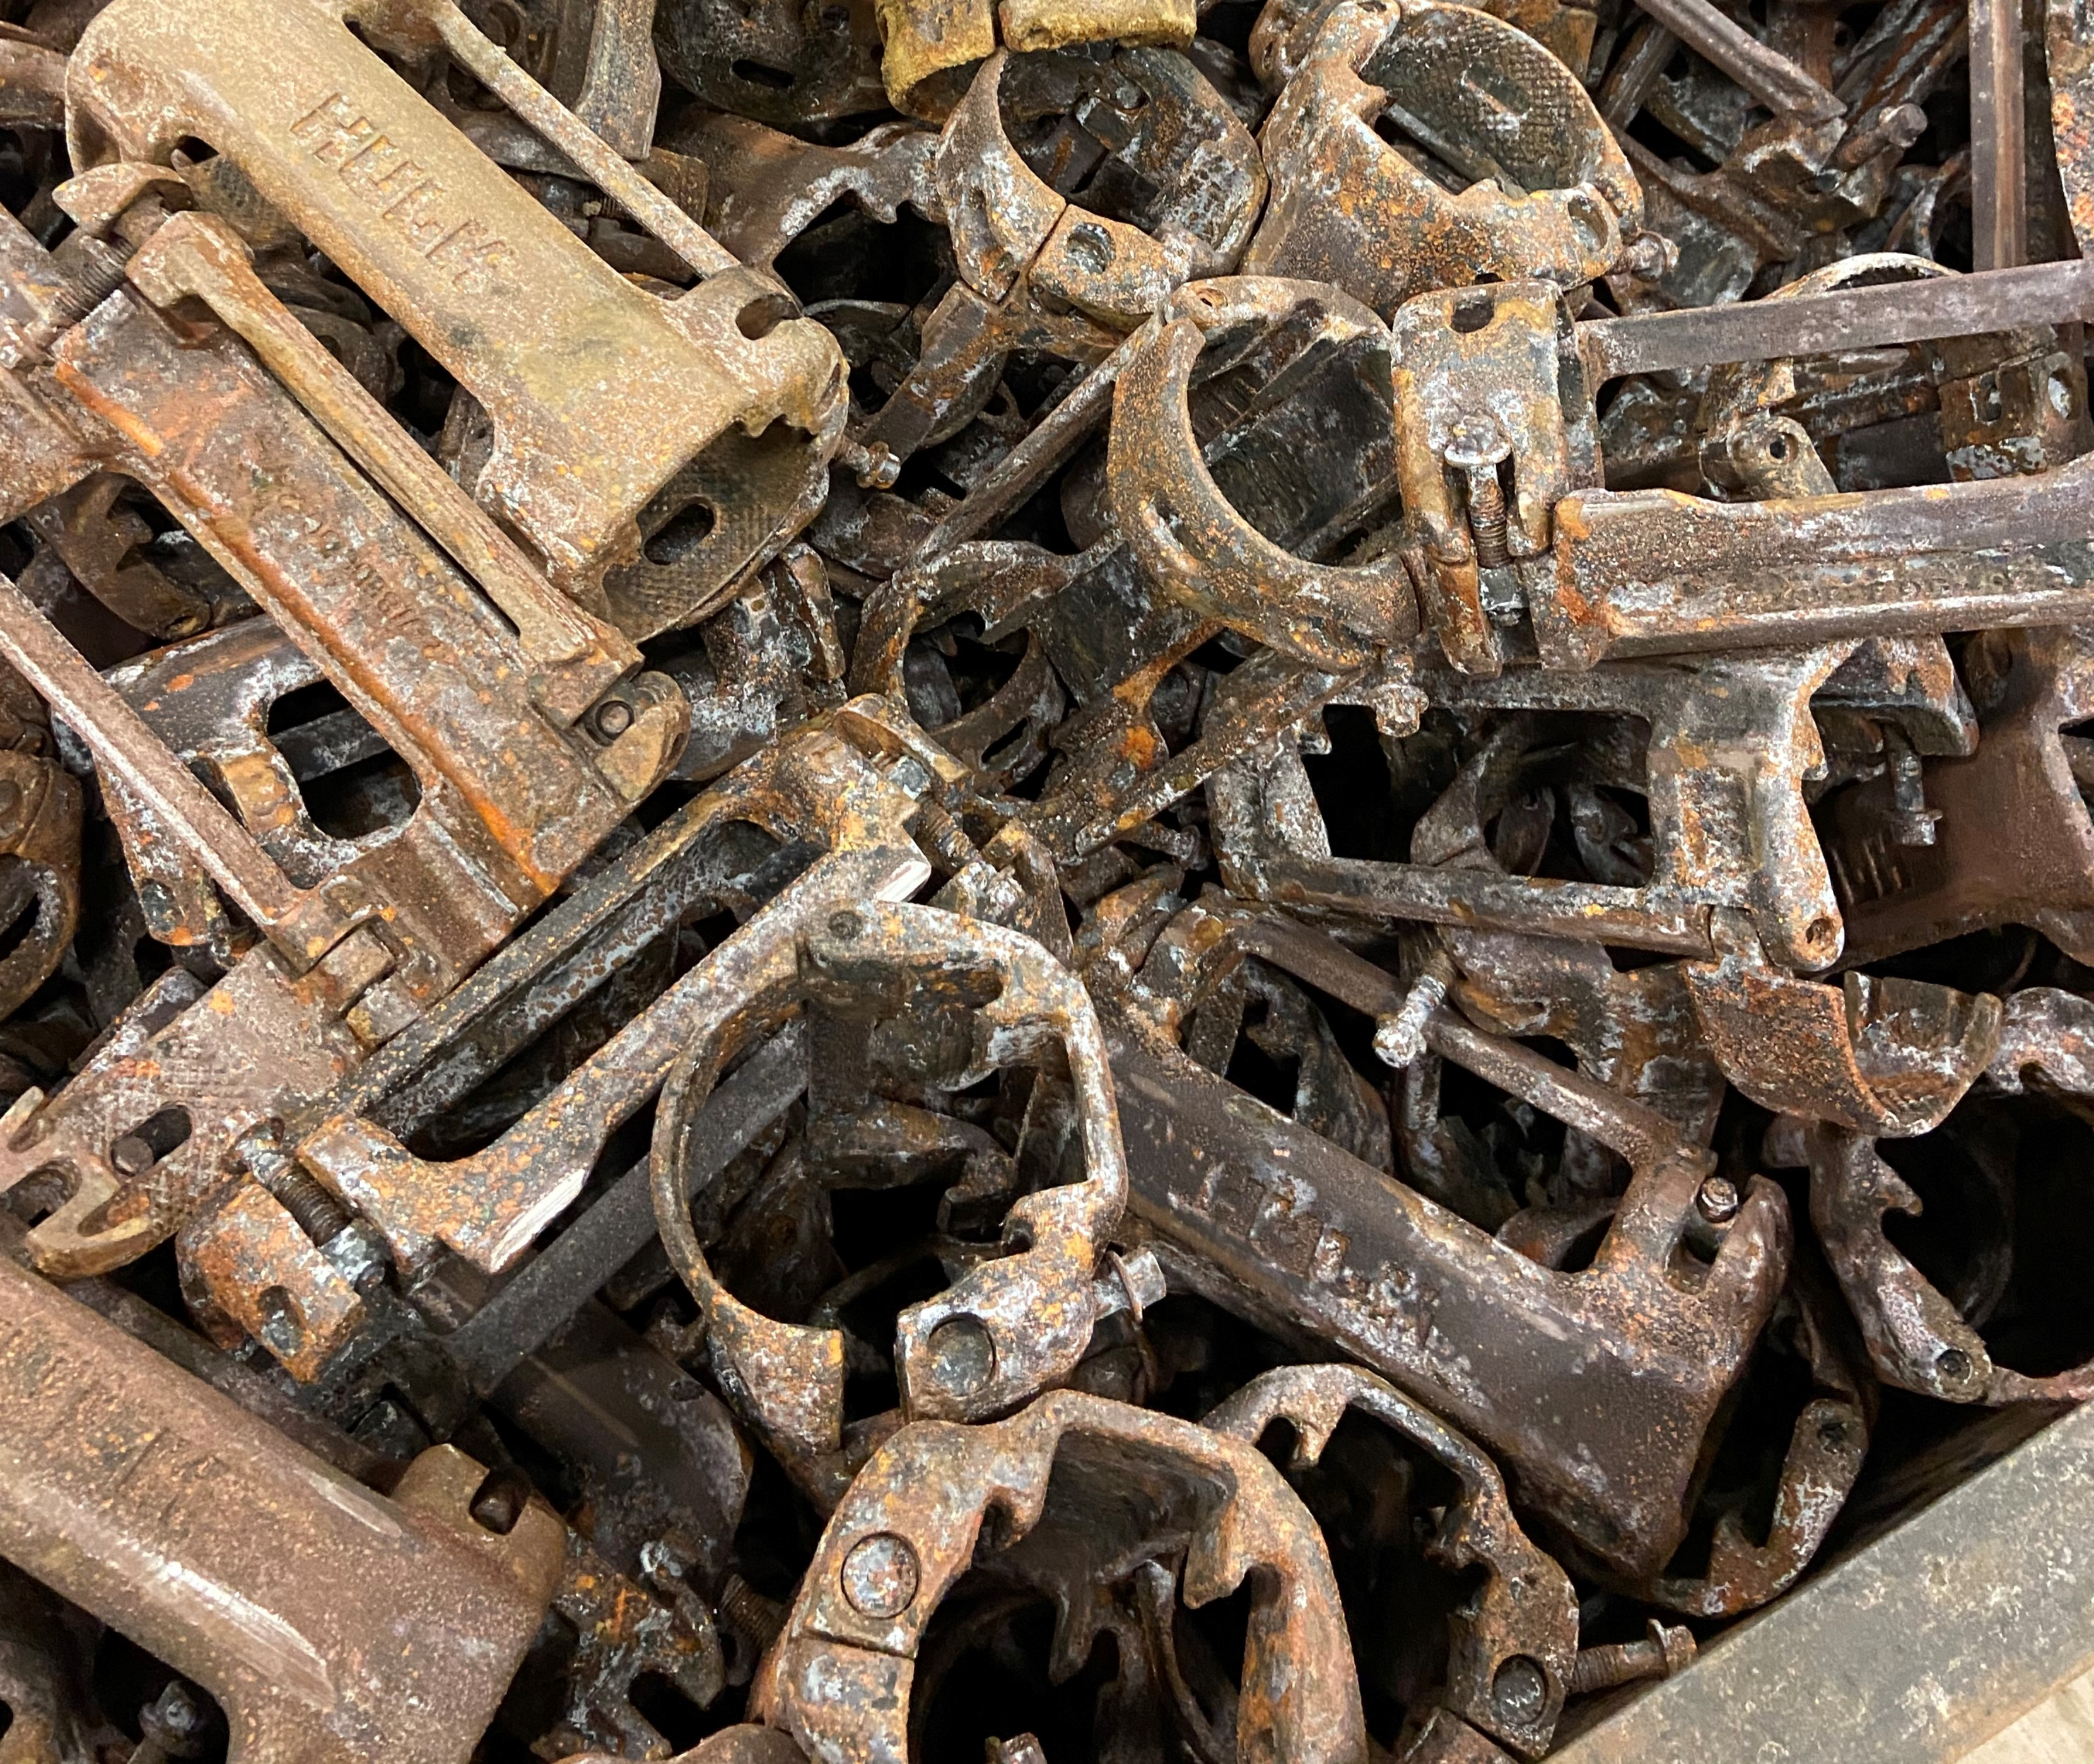
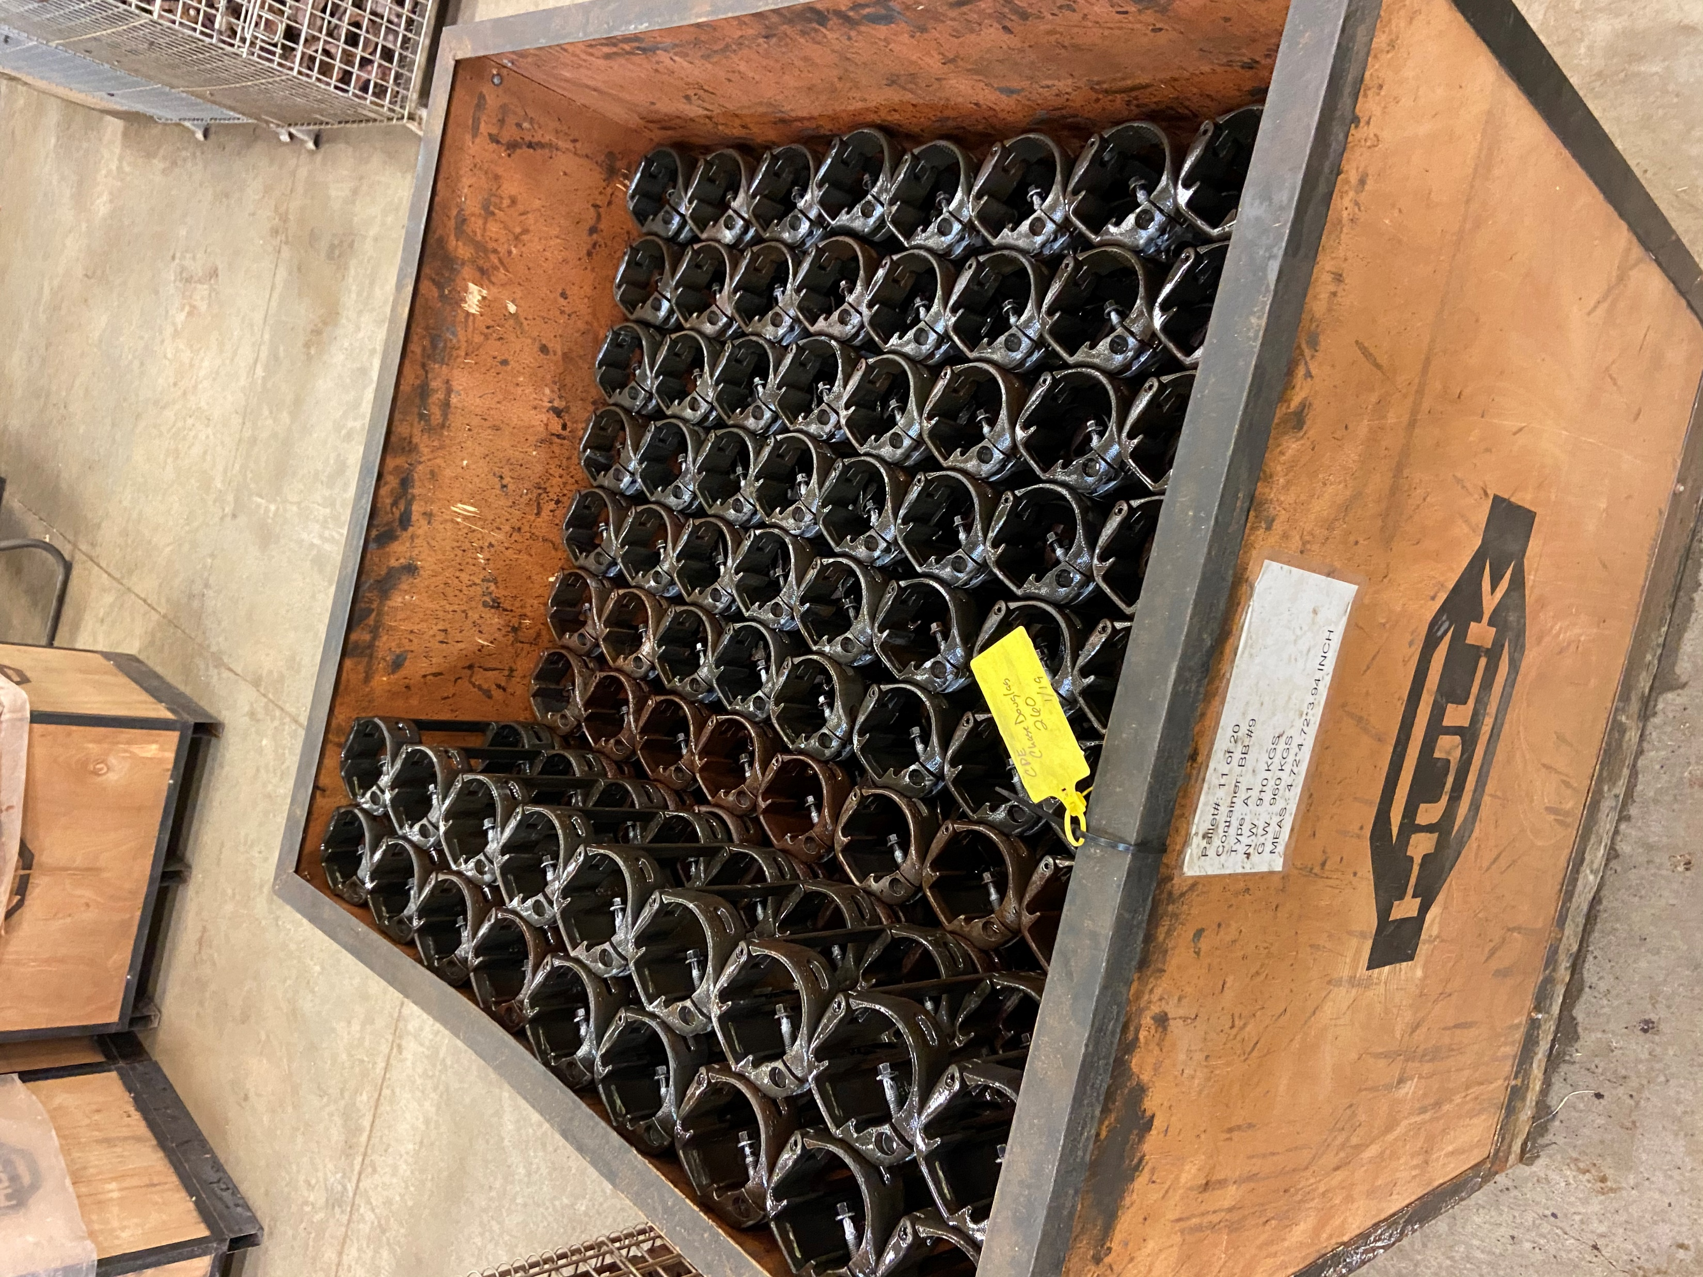
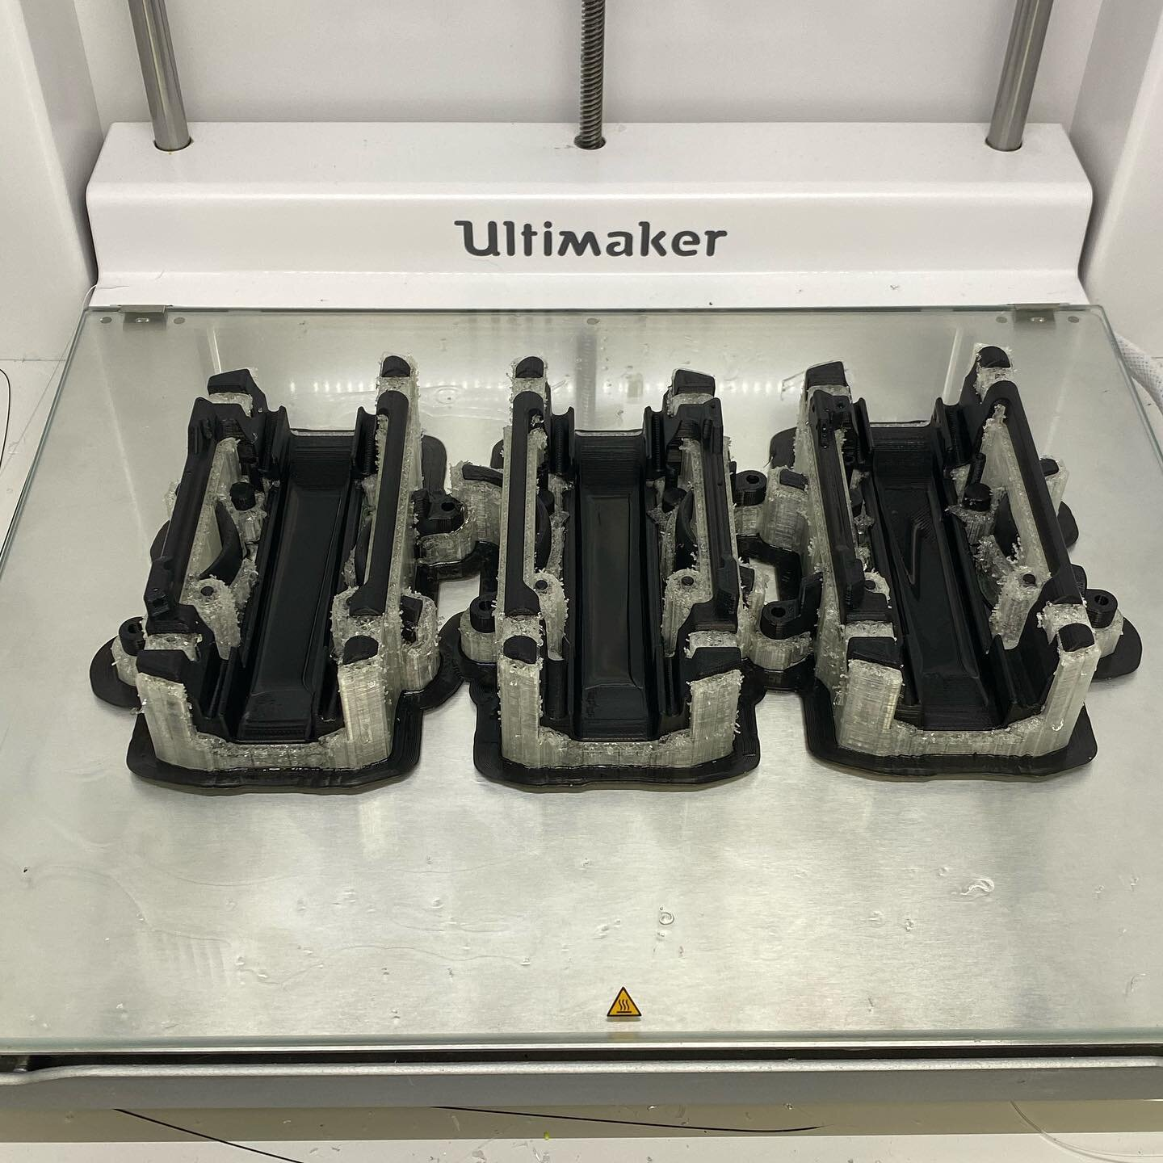
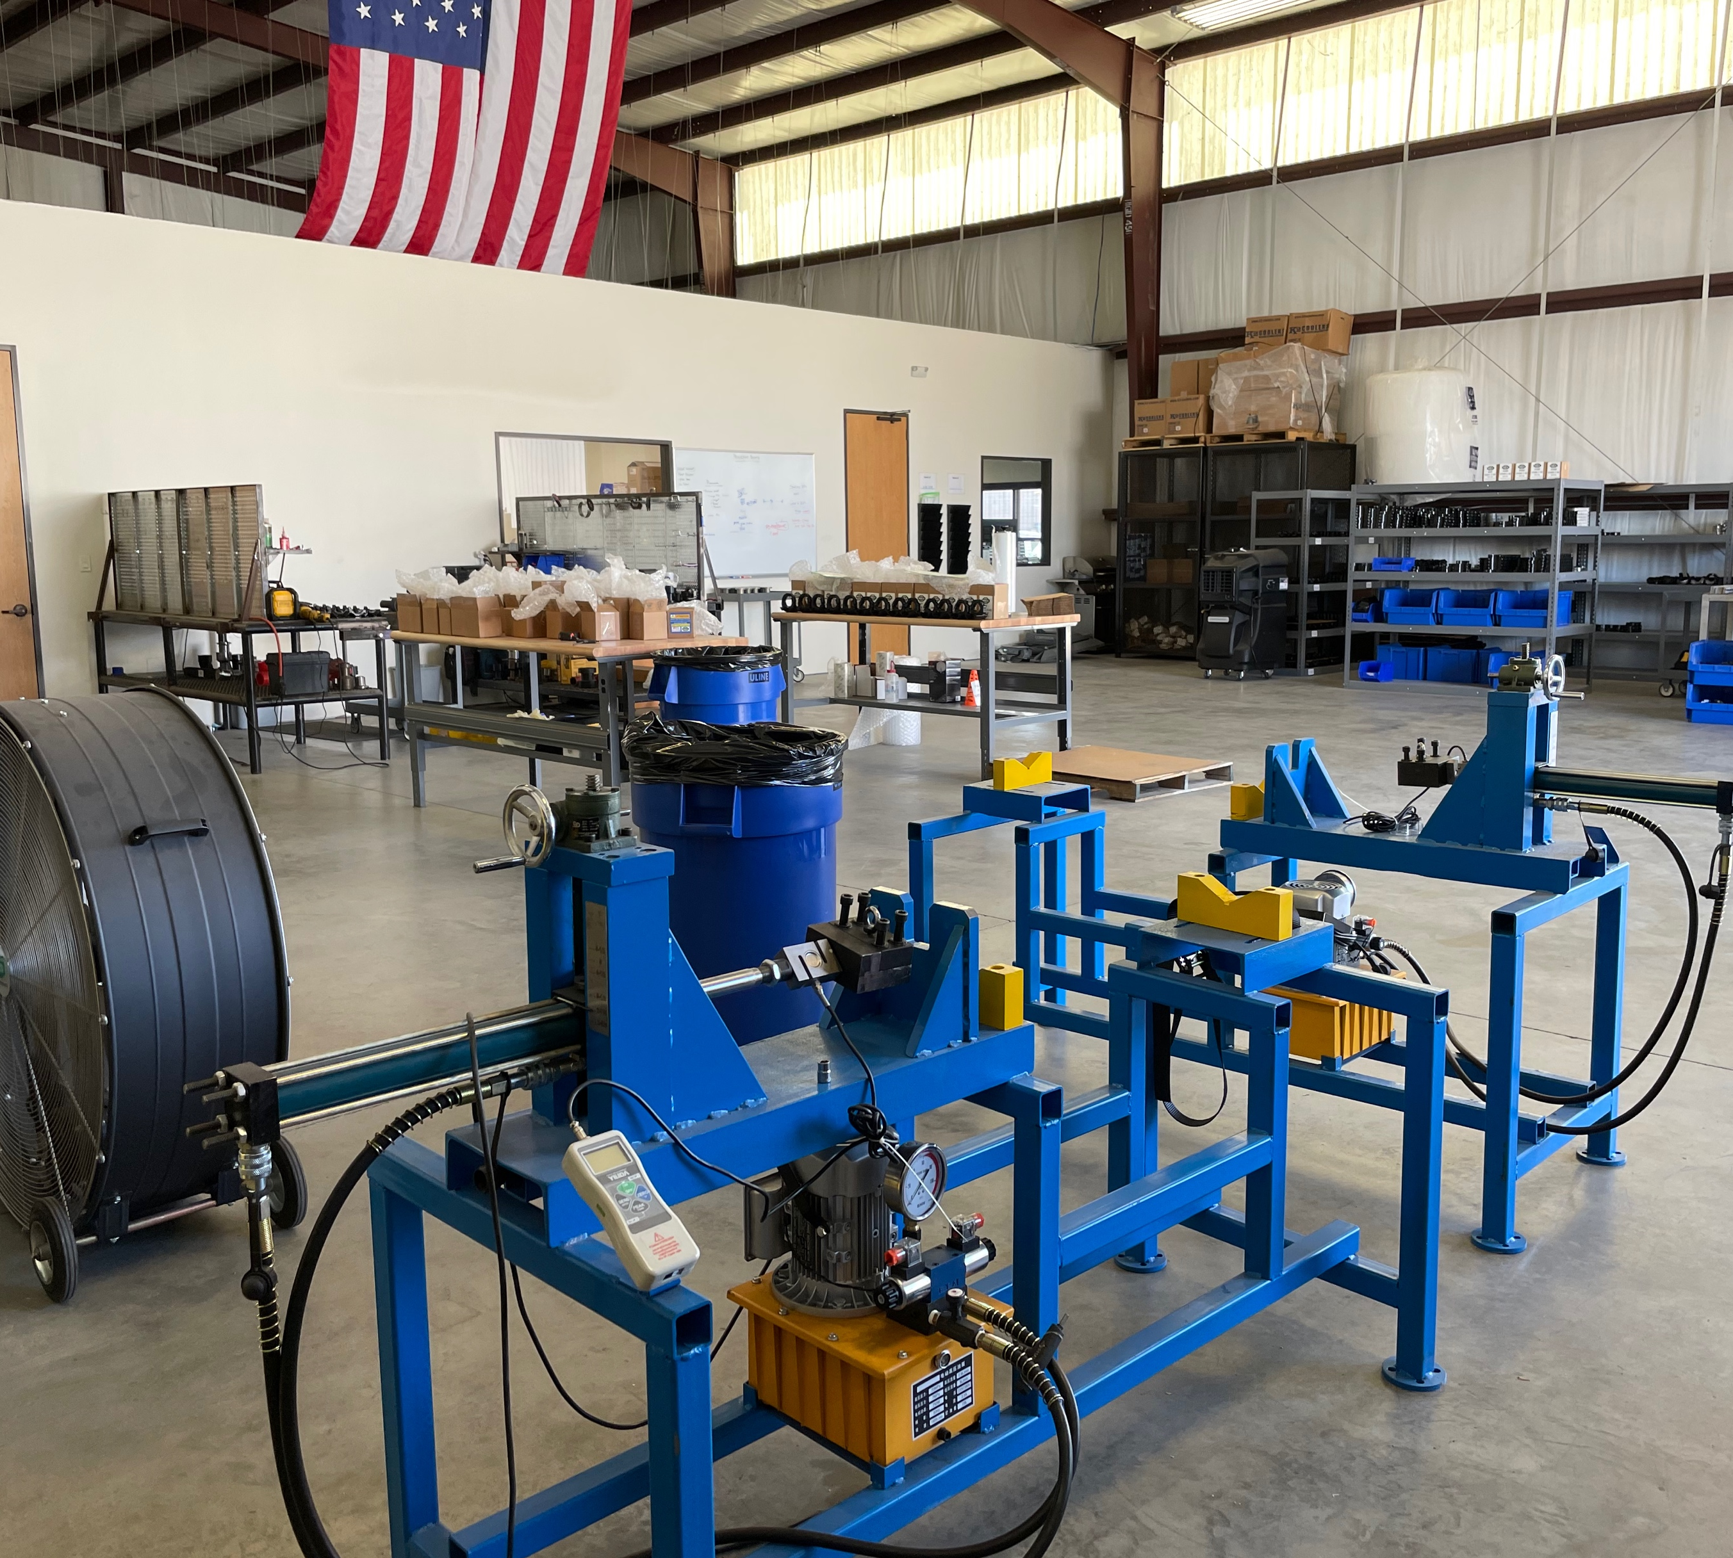
Engineering and Development
In House Engineering
Manufacturing
Refurbishment, Quality Control and Re-Run
In House and 3rd Party Testing
Deployment in the Field incl. Logistics + Hot Shot Service
HULKUSA.com
307.699.3198
End-to-end Ownership of Solution Development,
Product Quality and In-Field Performance
HULK believes in the power of listening to customers' needs to guide product development.
1/2/2024

Slide 13
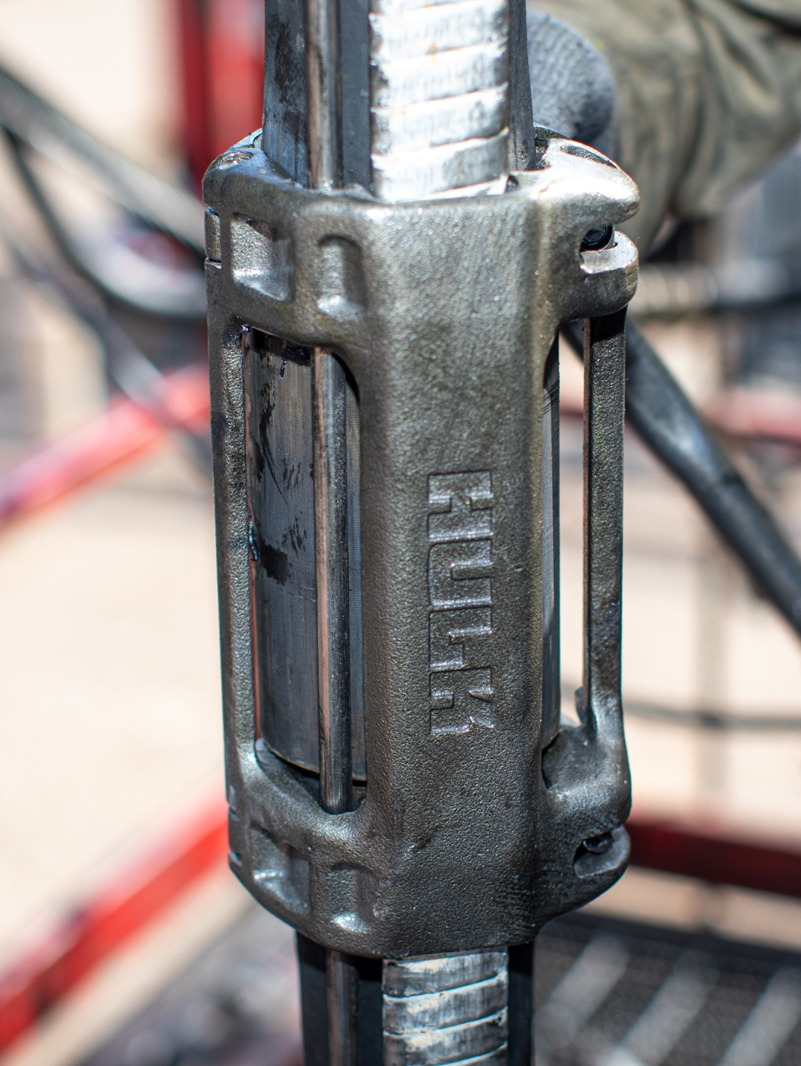
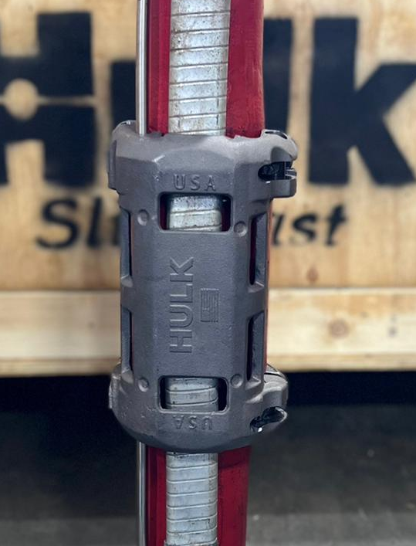
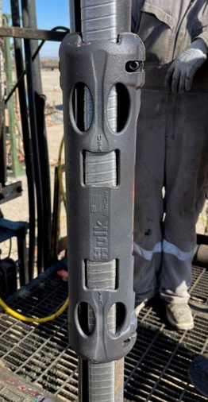
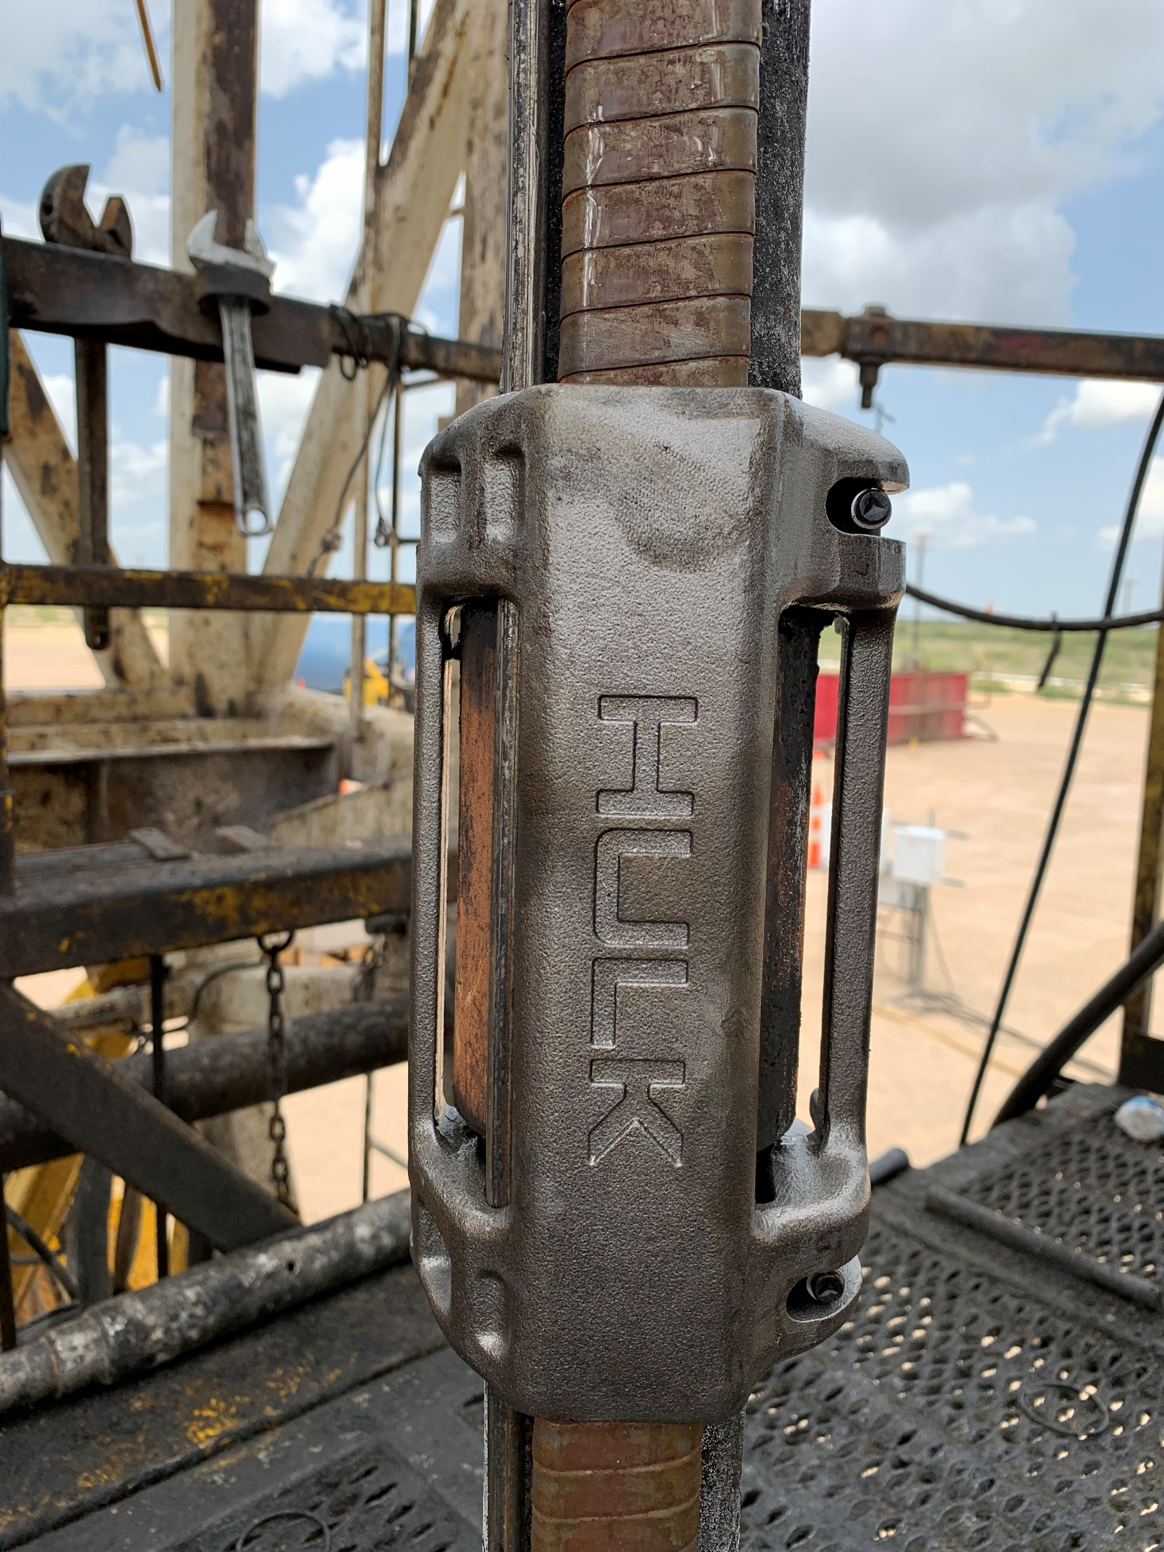
HULK CROSS COLLAR PRODUCTS
HULK product lines include comprehensive cable protection via ESP cross-coupling and motor lead extension guards.
We understand harsh well conditions and deviations.
This why we engineer high-quality products to withstand demanding applications!
HULK SHORT CLAMPS – 7” Casing
HULK SLIMCAST – 5-1/2” Casing
2-3/8”
2-7/8”
3-1/2”
2-7/8”

Slide 14
(Your title)
If HULK can solve a problem for you, please contact us:
Matt Smart, Director of Sales and Operations:
Email: matt.smart@hulkusa.com
Phone: +1-307-699-3198
Or find us online at:
https://www.hulkusa.com
https://www.linkedin.com/company/hulk-usa
HULKUSA.com
307.699.3198
Confidential Information. All non-public, confidential or proprietary information of OTS, including but not limited to specifications, samples, patterns, designs, plans, drawings, documents, data, business operations, customer lists, pricing, discounts or rebates, disclosed by OTS to Company, whether disclosed orally or disclosed or accessed in written, electronic or other form or media, and whether or not marked, designated or otherwise identified as “confidential” in connection with this Agreement is confidential, solely for the use of performing this Agreement and may not be disclosed or copied unless authorized in advance by OTS in writing. Upon OTS’s request, Company shall promptly return all documents and other materials received from OTS. OTS shall be entitled to injunctive relief for any violation of this Section. This Section does not apply to information that is: (a) in the public domain; (b) known to Company at the time of disclosure; or (c) rightfully obtained by Company on a non-confidential basis from a third party.
(Date)

