Slide 1

LOCATION
REVEIW
CRAIG BOULRIS, MD, QME

Slide 2
ORTHOPAEDIC SURGERY
TOTAL PANELS

Slide 3
ORTHOPAEDIC SURGERY
TOTAL DOCTOR LOCATIONS

Slide 4
ORTHOPAEDIC SURGERY
PANEL RATIO

Slide 5
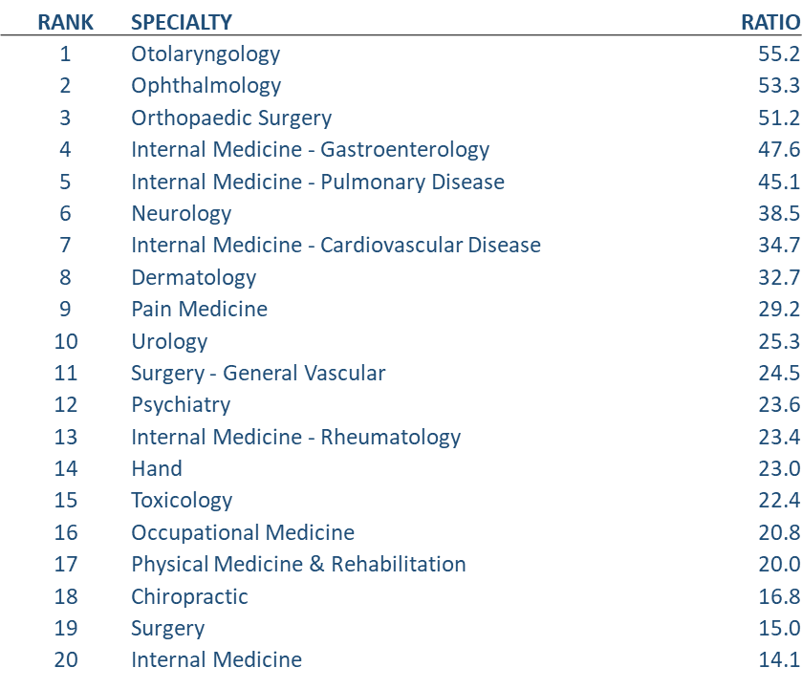
SPECIALTIES RANKED
2023 PANEL RATIO

Slide 6
TOP ORTHOPAEDIC SURGEONS
2023 BY LOCATION
RANK | LAST | FIRST | ADDRESS | CITY | TOTAL
1 | MINOR | FRANK | 1500 STANDIFORD AVE BLDG B | MODESTO | 172
2 | KLASSEN | MICHAEL | 1400 FLORIDA AVE STE 108 | MODESTO | 170
3 | BRODERICK | DAVID | 1500 STANDIFORD AVE BLDG B | MODESTO | 167
4 | BELLOMO | ANTHONY | 3555 DEER PARK DR STE 150 | STOCKTON | 167
5 | CAPUTO | JOHN | 1803 WEST MARCH LN STE E | STOCKTON | 165
6 | WOLL | JOHN | 1400 FLORIDA AVE STE 108 | MODESTO | 163
7 | KLASSEN | MICHAEL | 3555 DEER PARK DR STE 150 | STOCKTON | 163
8 | HEYRANI | NASSER | 729 SUNRISE AVE STE 606 | ROSEVILLE | 162
9 | SAADAT | EHSAN | 1500 STANDIFORD AVE BLDG B | MODESTO | 160
10 | TONTZ | WILLIAM | 1671 W MAIN ST STE A | EL CENTRO | 159
11 | ABELES | DOUGLAS | 5250 CLAREMONT AVE | STOCKTON | 159
12 | D'AMICO | DANIEL | 1400 FLORIDA AVE STE 108 | MODESTO | 158
13 | CAPUTO | JOHN | 1650 LEAD HILL BLVD STE 100 | ROSEVILLE | 158
14 | VAN DOLSON | LEO | 700 LOUGHBOROUGH DR STE C | MERCED | 157
15 | PEDTKE | ANDREW | 1500 STANDIFORD AVE BLDG B | MODESTO | 157
16 | CIEPIELA | MICHAEL | 1400 FLORIDA AVE STE 108 | MODESTO | 157
17 | SAADAT | EHSAN | 700 LOUGHBOROUGH DR STE C | MERCED | 154
18 | ROBINSON | SEAN | 5250 CLAREMONT AVE STE 102 | STOCKTON | 154
19 | BRODERICK | DAVID | 333 SAN CARLOS WAY STE B | STOCKTON | 153
20 | SAADAT | EHSAN | 2900 FRESNO ST STE 105 | FRESNO | 151

Slide 7
TOP ORTHOPAEDIC SURGEONS
2023 PANEL DATA
RANK | DOCTOR | PANELS
1 | BRODERICK DAVID | 1177
2 | KLASSEN MICHAEL | 1126
3 | XELLER CHARLES | 1117
4 | D'AMICO DANIEL | 1104
5 | MAC ARTHUR ROBERT | 1100
6 | MOAZZAZ PAYAM | 1098
7 | BELLOMO ANTHONY | 1067
8 | SAADAT EHSAN | 1054
9 | ABELES DOUGLAS | 1034
10 | PEDTKE ANDREW | 986
11 | FONSECA ALLEN | 964
12 | CIEPIELA MICHAEL | 962
13 | AKMAKJIAN JACK | 906
14 | CHIU JASON | 899
15 | WELBORN JOHN | 883
16 | DUNLAP JANET | 882
17 | HARWAY ELANA | 864
18 | MOLDAVSKIY PAVEL | 862
19 | OMID REZA | 855
20 | KIM DONALD | 850

Slide 8
TOP ORTHOPAEDIC LOCATIONS
RANK | ZIP CODE | CITY | PANELS | CURRENT DOCTORS | CURRENT RATIO
1 | 95219 | STOCKTON | 1174 | 9 | 117.4
2 | 92243 | EL CENTRO | 1446 | 12 | 111.2
3 | 95340 | MERCED | 775 | 6 | 110.7
4 | 92201 | INDIO | 1764 | 15 | 110.3
5 | 95350 | MODESTO | 2754 | 24 | 110.2
6 | 93277 | VISALIA | 1163 | 10 | 105.7
7 | 95823 | SACRAMENTO | 1148 | 10 | 104.4
8 | 93721 | FRESNO | 1723 | 16 | 101.4
9 | 95661 | ROSEVILLE | 1096 | 11 | 91.3
10 | 93291 | VISALIA | 812 | 8 | 90.2
11 | 93550 | PALMDALE | 1695 | 18 | 89.2
12 | 92395 | VICTORVILLE | 2912 | 32 | 88.2
13 | 93901 | SALINAS | 1847 | 20 | 88.0
14 | 90305 | INGLEWOOD | 2625 | 29 | 87.5
15 | 93301 | BAKERSFIELD | 2990 | 34 | 85.4
16 | 95687 | VACAVILLE | 424 | 4 | 84.8
17 | 95207 | STOCKTON | 2004 | 23 | 83.5
18 | 95403 | SANTA ROSA | 746 | 8 | 82.9
19 | 95404 | SANTA ROSA | 663 | 7 | 82.9
20 | 95126 | SAN JOSE | 1072 | 12 | 82.5
21 | 95341 | MERCED | 246 | 2 | 82.0
22 | 96002 | REDDING | 1115 | 13 | 79.6
23 | 93612 | CLOVIS | 788 | 9 | 78.8
24 | 93454 | SANTA MARIA | 1339 | 16 | 78.8
25 | 93704 | FRESNO | 466 | 5 | 77.7

Slide 9
TOP ORTHO LOCATIONS: DANVILLE
RANK | ZIP CODE | CITY | PANELS | CURRENT DOCTORS | CURRENT RATIO
1 | 95219 | STOCKTON | 1174 | 9 | 117.4
3 | 95340 | MERCED | 775 | 6 | 110.7
5 | 95350 | MODESTO | 2754 | 24 | 110.2
6 | 93277 | VISALIA | 1163 | 10 | 105.7
7 | 95823 | SACRAMENTO | 1148 | 10 | 104.4
8 | 93721 | FRESNO | 1723 | 16 | 101.4
9 | 95661 | ROSEVILLE | 1096 | 11 | 91.3
10 | 93291 | VISALIA | 812 | 8 | 90.2
13 | 93901 | SALINAS | 1847 | 20 | 88.0
15 | 93301 | BAKERSFIELD | 2990 | 34 | 85.4
16 | 95687 | VACAVILLE | 424 | 4 | 84.8
17 | 95207 | STOCKTON | 2004 | 23 | 83.5
18 | 95403 | SANTA ROSA | 746 | 8 | 82.9
19 | 95404 | SANTA ROSA | 663 | 7 | 82.9
20 | 95126 | SAN JOSE | 1072 | 12 | 82.5
21 | 95341 | MERCED | 246 | 2 | 82.0
22 | 96002 | REDDING | 1115 | 13 | 79.6
23 | 93612 | CLOVIS | 788 | 9 | 78.8
25 | 93704 | FRESNO | 466 | 5 | 77.7
26 | 93274 | TULARE | 2091 | 26 | 77.4
27 | 95816 | SACRAMENTO | 927 | 11 | 77.3
28 | 94589 | VALLEJO | 386 | 4 | 77.2
29 | 95348 | MERCED | 764 | 9 | 76.4
30 | 95603 | AUBURN | 227 | 2 | 75.7
31 | 95076 | WATSONVILLE | 813 | 10 | 73.9
32 | 94606 | OAKLAND | 809 | 10 | 73.5

Slide 10
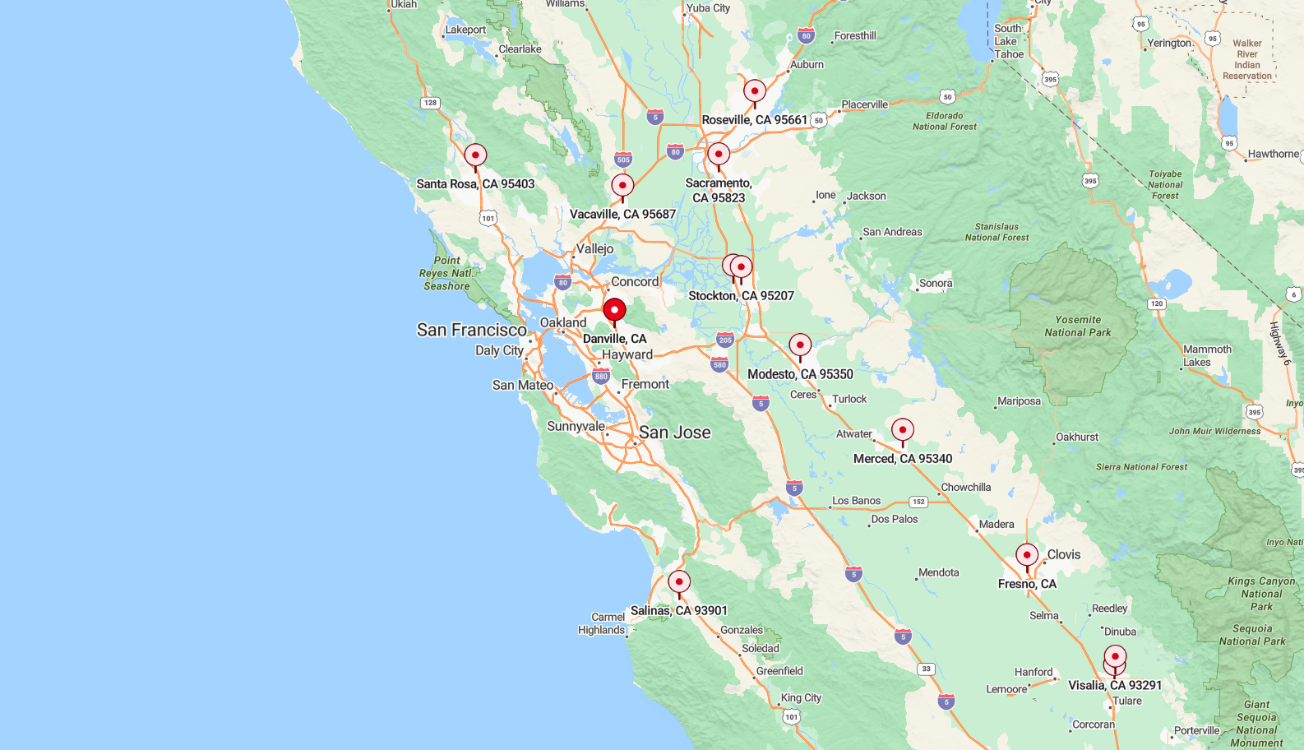
PROPOSED LOCATIONS

