Slide 1

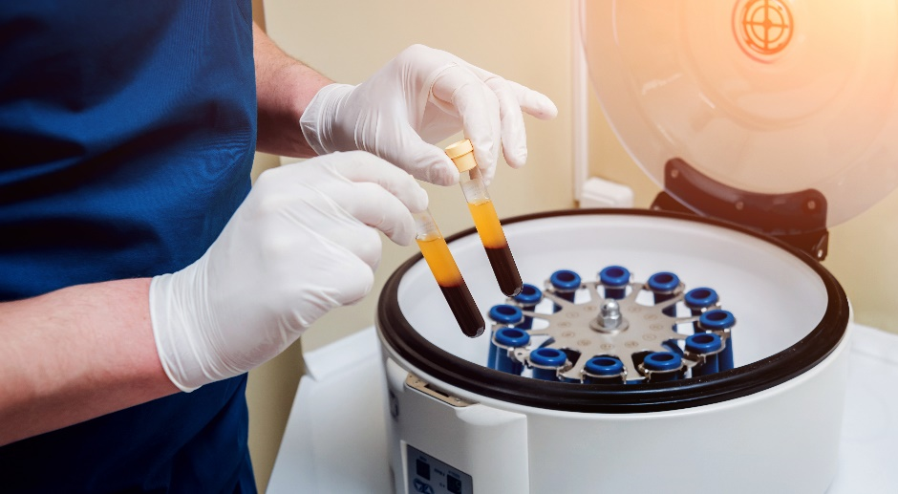
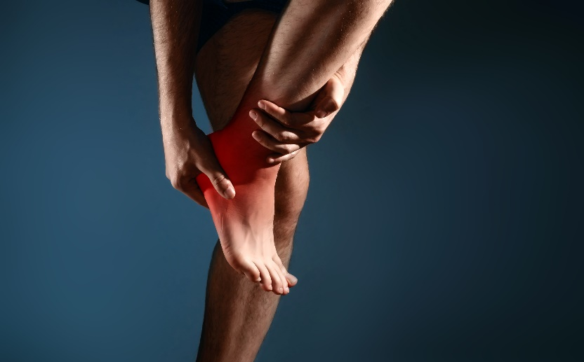
Podiatry | Foot & Ankle Surgery
Sports Medicine | Wound Care
(877) 668 - 0008
Platelet Rich Plasma Therapy (PRP)
Platelet-rich plasma, or PRP is a substance that helps promote healing when injected. The platelets are the component of your own blood that contains special “factors,” or proteins, that help accelerate tissue repair and regeneration. It also contains proteins that support cell growth.
Injecting the PRP into damaged tissues will stimulate your body to produce new, healthy cells and promote healing. A consultation is required to make sure you qualify.
Treating: Plantar Fasciitis | Achilles Tendonitis | Tendon & Ligament Injuries
Self pay price: $199 per treatment
Same Day | Emergency | Saturday Appointments
Our Doctors are on call at the FHH ER 24/7
Frederick Office
141 Thomas Johnson Dr. Ste. 170
Frederick, MD 21702
Urbana Office
3430 Worthington Blvd. Ste. 201
Urbana, MD 21704
Martinsburg Office
123 Healthcare Lane
Martinsburg, WV 25401

