Slide 1
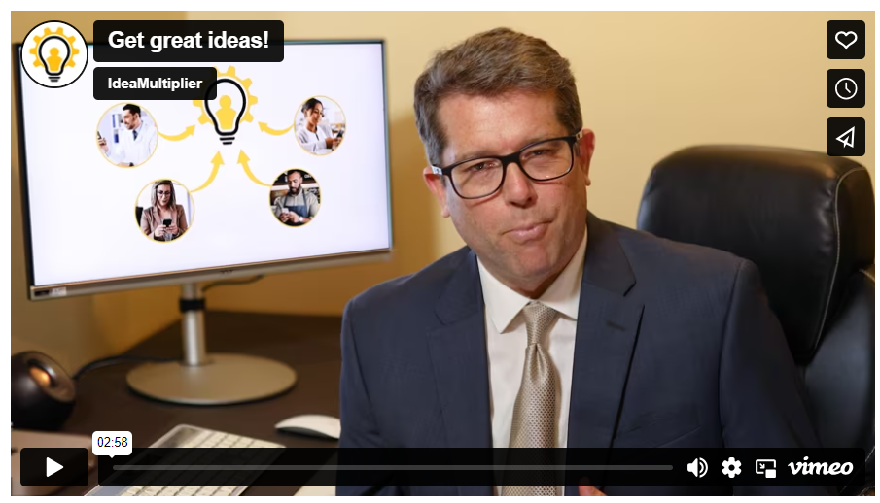
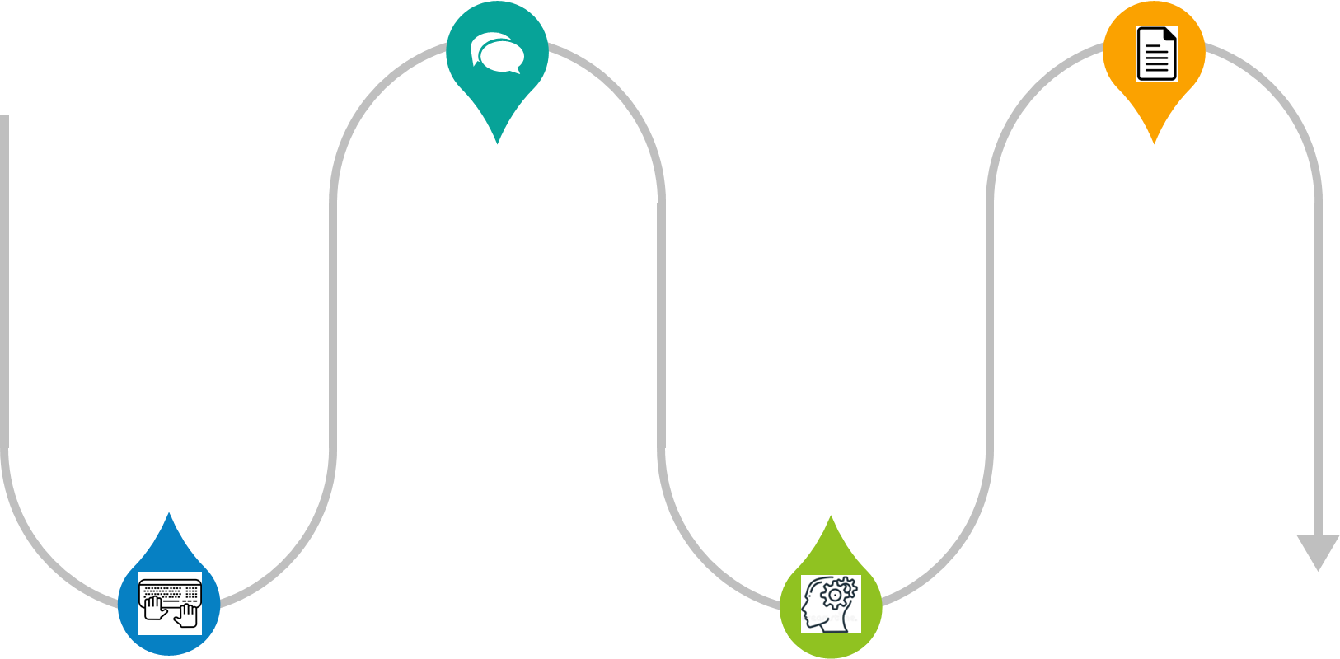

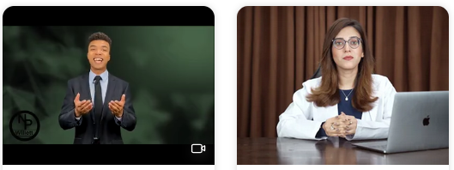
Managers constantly solve problems.
The best managers always ask employees for ideas to help solve those problems.
We help managers ask employees for ideas.
IdeaMultiplier is simply the best way a manager can get more -- and better -- ideas from employees.
The results speak for themselves: More+Creative ideas. Guaranteed: One will generate a 1,000% ROI!
By using IdeaMultiplier, managers also build a team culture that encourages ideas and creative thinking.
How IdeaMultiplier works:
Sign-Up
Use our suggested idea prompts or write your own to ask employees for ideas to solve problems.
We text employees one monthly question. Texting makes that question stand-out.
Idea creativity starts! Employees share their ideas via a brief, well written message.
The next morning you get a report with their ideas. Mix and match ideas or pick the best ideas to Implement!
1x a Month
Customer Success Stories
This Fortune 500 manager uses IdeaMultiplier to engage remote employees to gather ideas to achieve business goals.
This retail store manager uses IdeaMultiplier to out-compete other local stores and engage her entire team.
This small business owner views employees’ ideas as the single best way he can grow and keep customers happy.
This non-profit director uses IdeaMultiplier to ask her employees, donors, and volunteers for their ideas to “do more with less.”

Slide 2
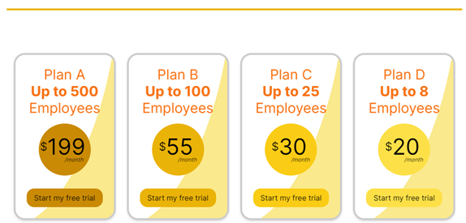
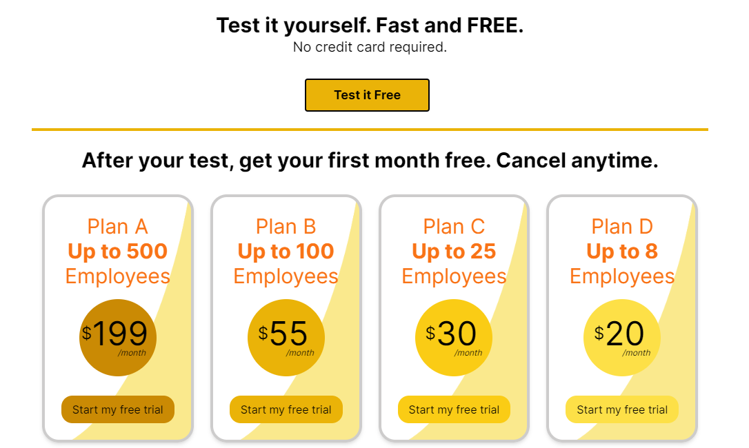
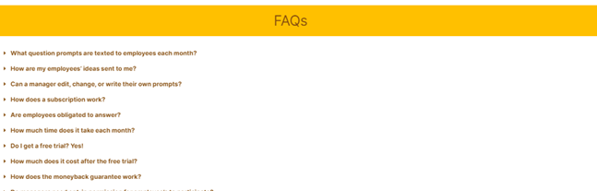

Try it free.
It’s simple to use and you get a free month trial.
Employee ideas are incredibly valuable!
Get 1 idea with a 1,000% ROI. Guaranteed!
“Nothing is more expensive than missing out on a great idea.”
If you use IdeaMultiplier for a year,
we guarantee you’ll get at least one employee idea that will generate a 1,000% ROI for you, or we give you back up to 12 months of what you paid for IdeaMultiplier.
-Jack Welch
General Electric’s CEO 1981-2001

