Slide 1

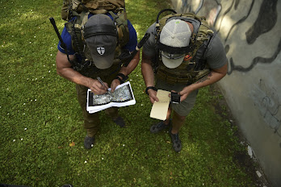
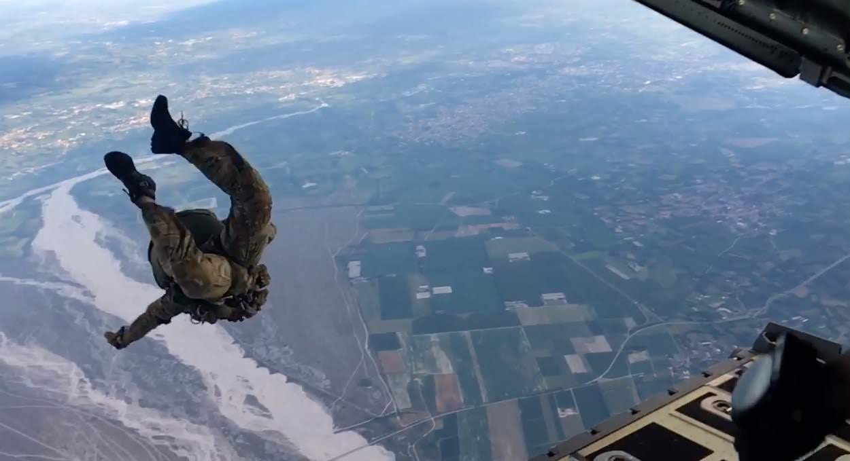
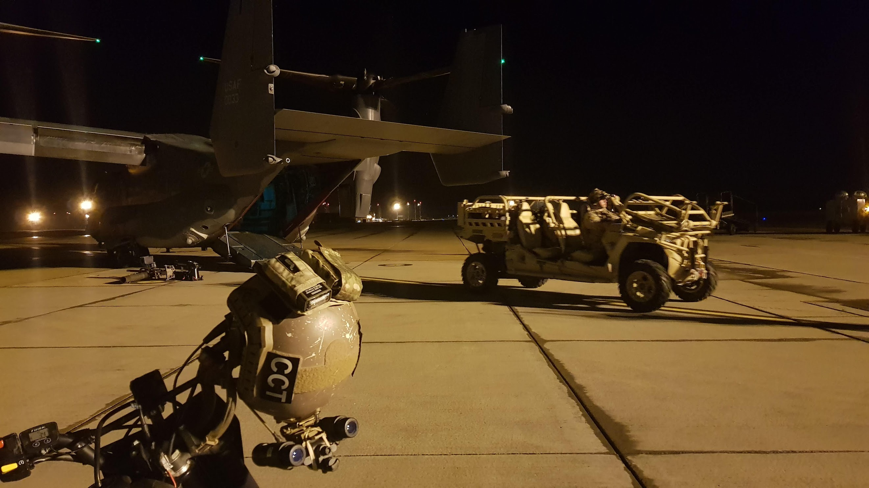
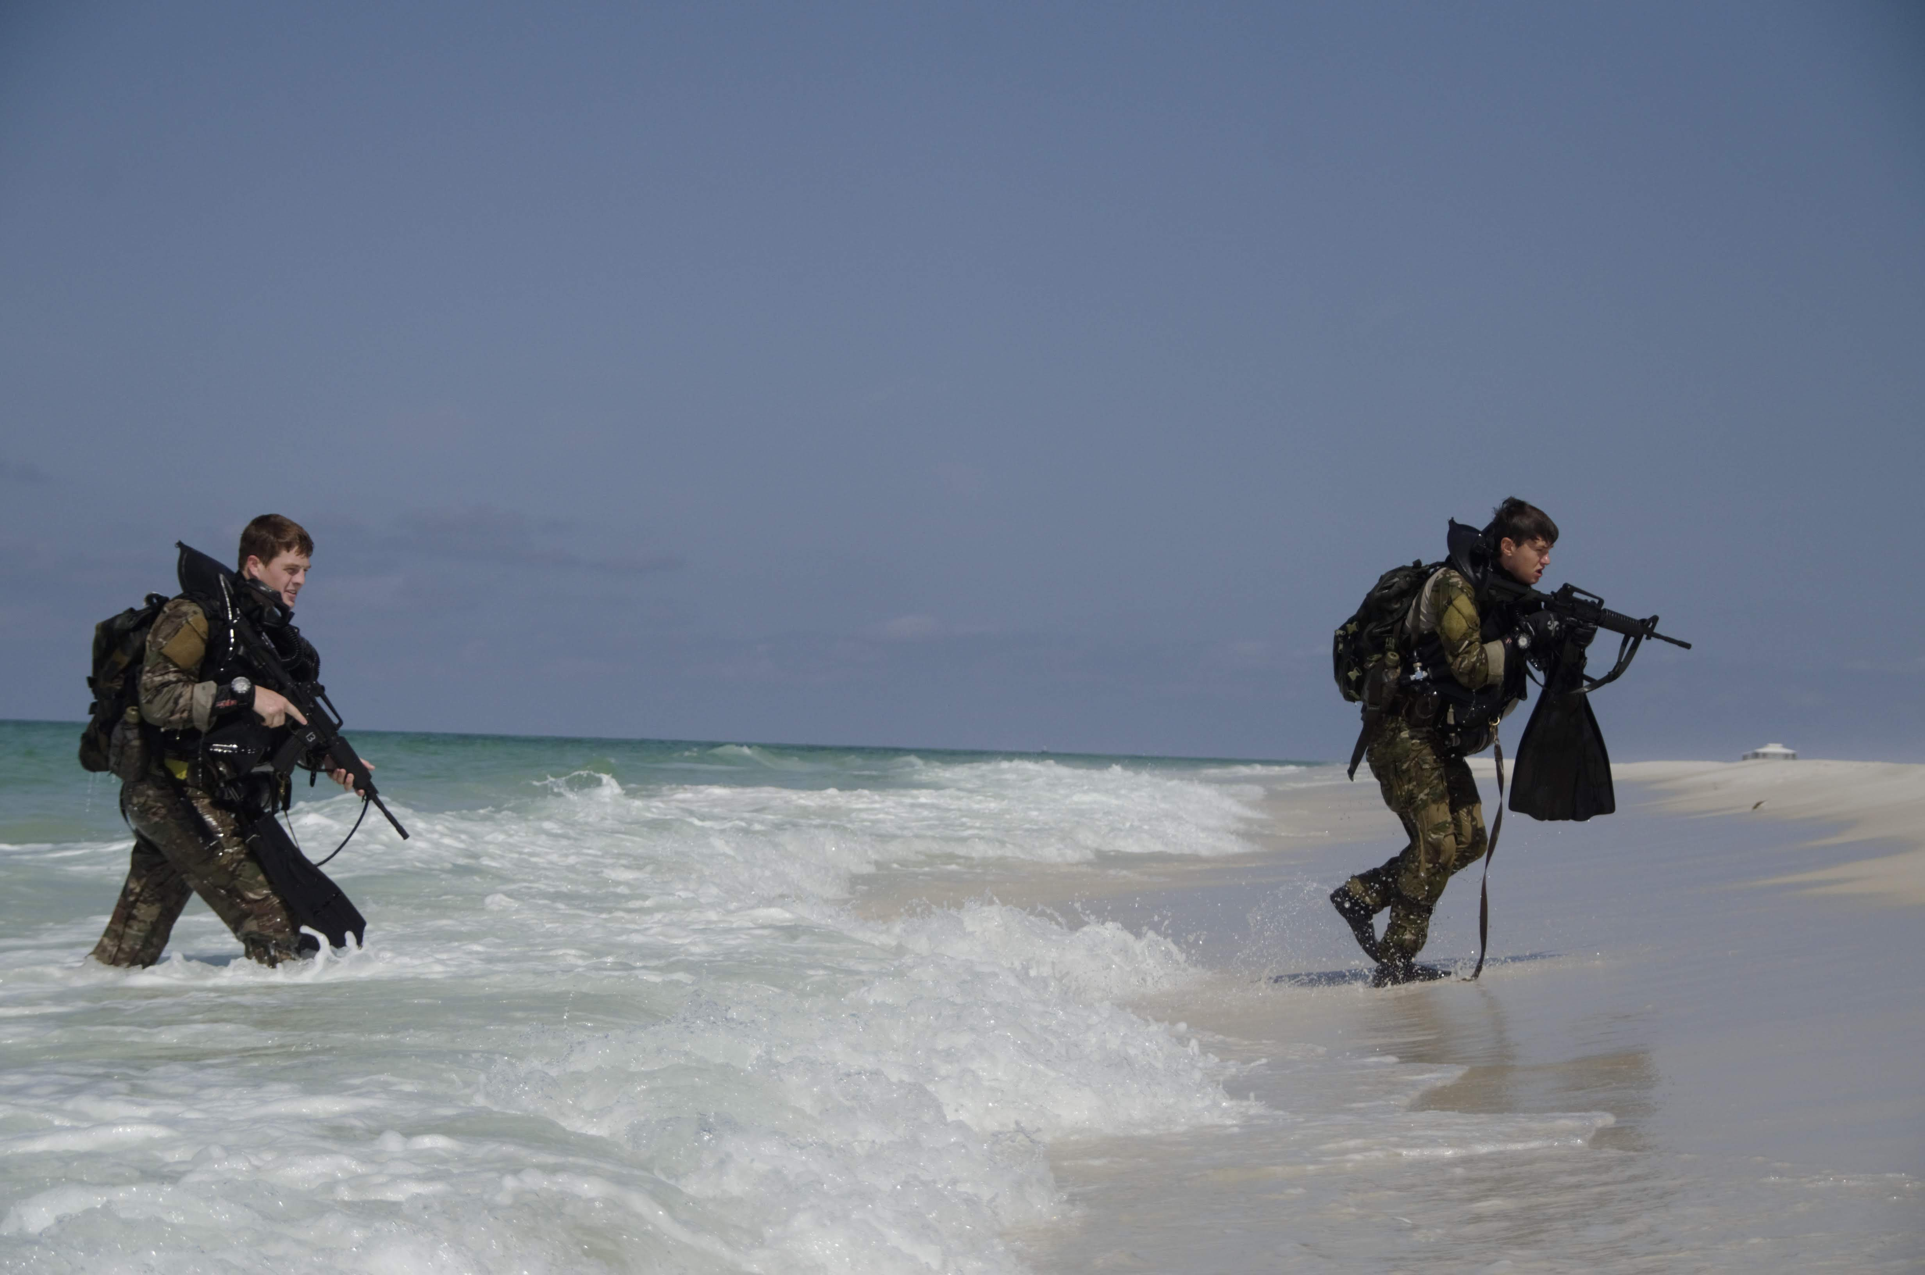
SITE-1
VILLAGE COMPLEX
TUNNEL SYSTEM
MFF
HLZ
OPFOR
LODGING
SITE-2
7,000FT RUNWY
MFF/SL/HLZ
SITE-3
MULTIPLE SHOOTING LANES
TACTICAL VEHICLE AREA
SITE-4
INACTIVE RUNWAY
MULTIPLE SHOOTING LANES
1000M SNIPER RANGE
TRENCH WARFARE TRAINING
NEAR THE SEA FOR OTB ASSAULTS

