Slide 1

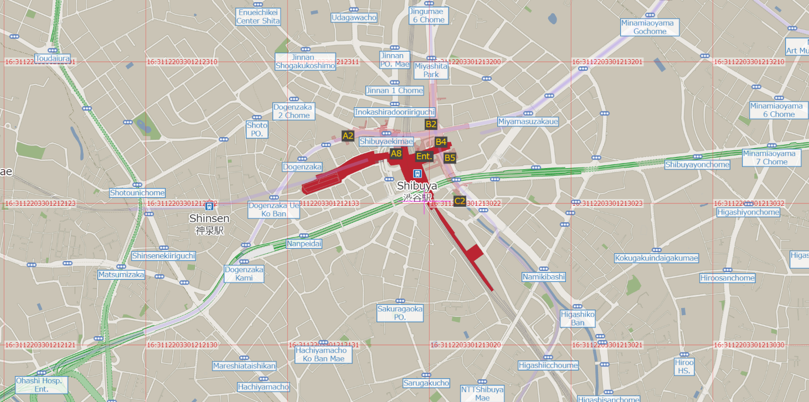
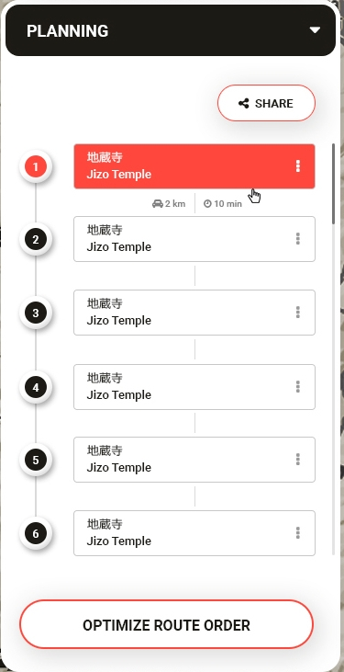


Shrine Align
We would like to place a shrine or temple icon here.
⛩
大山稲荷神社
Oyama Inari Shrine
⛩
宮益御嶽神社
Miyamasu Mitake Shrine
⛩
千代田稲荷神社
Chiyoda Inari Shrine
⛩
豊榮稲荷神社
Toyosaka Inari Shrine
This is a current state of the slider bar.
We would like to have a dropdown where users can select popularity or stylish kanji.
⛩
妙法寺
Myohouji Temple
⛩
商和稲荷神社
Showa Inari Shrine

Slide 2
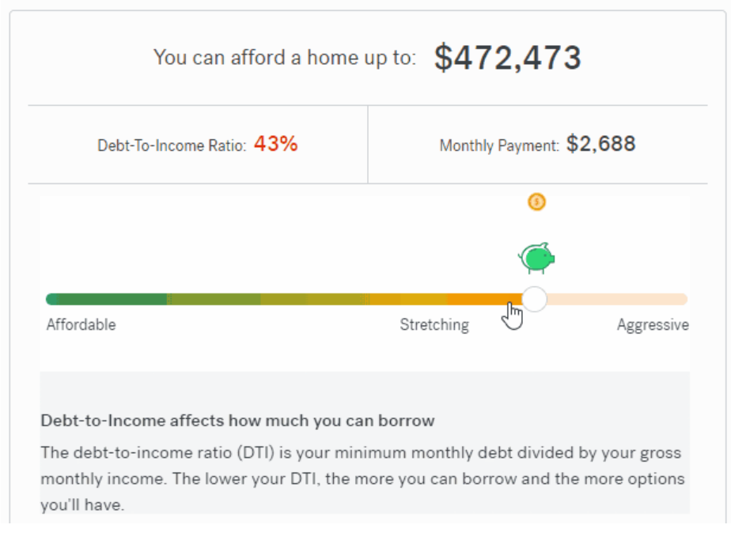
Reference
I would like a slider bar with clear, understandable colors and icons like this.

