Slide 1


TagDataTrust
Tagging Data You Can Trust
Proposal Created for {Company} by Mihai Milea & Chris Knight {Date}
{IMAGE OF PROSPECT BRAND}

Slide 2
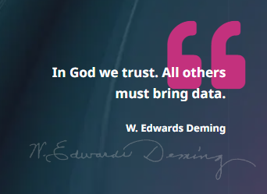
Our Vision
We understand the importance of data-driven decisions in organisations of all sizes. If the data collected from your website / app is incorrect, or incomplete, then the outcome of your decisions is invariably a reflection of that.
This is why our analytics implementation work is not only carefully vetted on multiple layers, but the implementation itself is engineered to include multiple fail-safes designed with data quality in mind.
We thrive by making our customers understand the value of trusted data, fueling them with confidence to make bold business decisions.

Slide 3








Clients We Work With

Slide 4














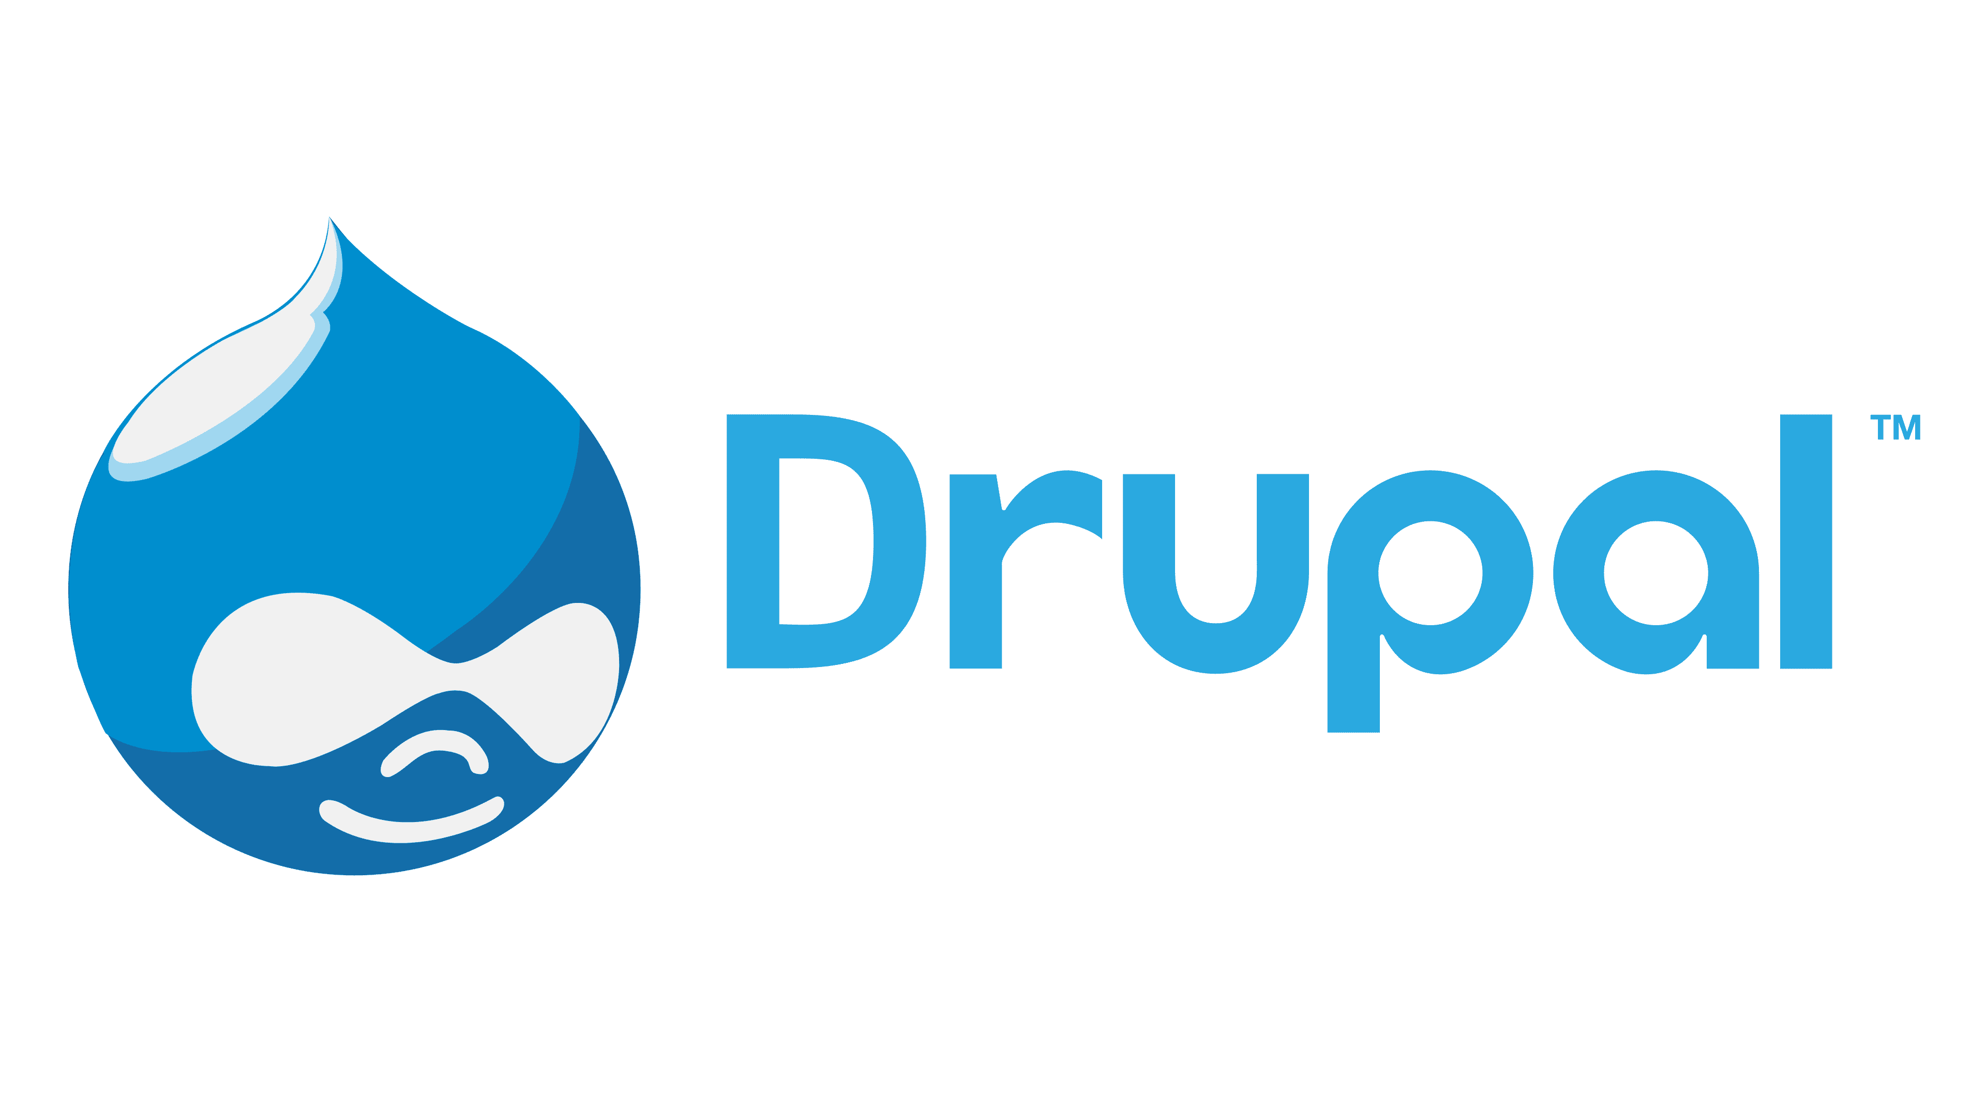


CMS we work with

Slide 5
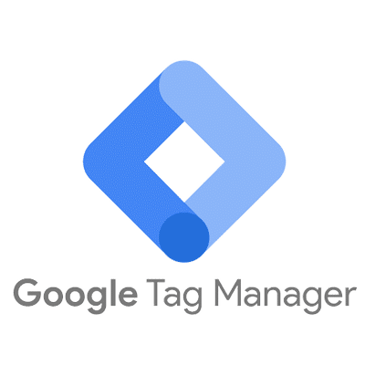




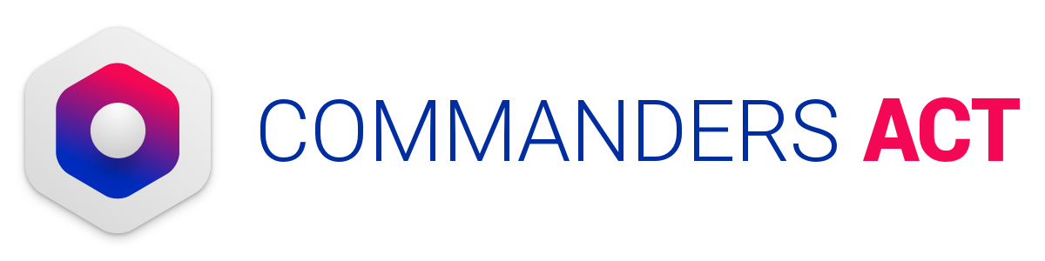
Tag Management Systems we use

Slide 6

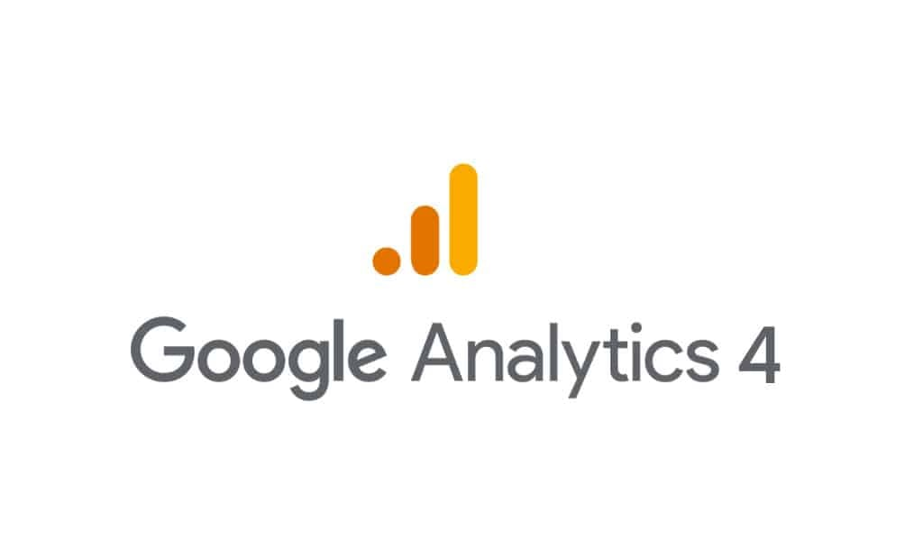



Analytics Implementation (Web & Mobile)

Slide 7



Customer Data Platforms Implementation

Slide 8



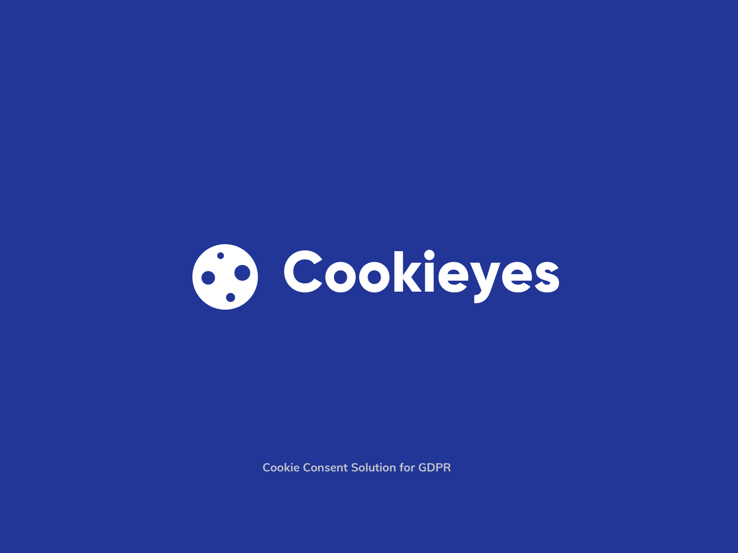


CMPs we use

Slide 9
Our Services
Analytics Implementation
Data Strategy
Advanced
Technologies
Continuous Improvement
We help you deploy analytics and measurement capabilities. Providing you with data and tagging expertise to create an effective reporting framework. We are specialists in data compliance, data privacy and consent management
Starting from requirements gathering & auditing your current set-up, to solution architecture & continuous development plans, our team has the capability to take your project from its idea stages, to a fully-fledged business solution that can be used to expand your business.
We partner with visionary customers who want to transform and grow their organization by building their business using modern digital marketing technologies. We develop custom data models to help you track revenue against marketing spend.
All our solutions are designed to include multiple fail-safes. Our code & configurations are engineered to be robust and to allow future development. We include automated testing tools that can help our clients maintain high Data Quality standards at all times.

Slide 10









Key Deliverables
Data strategy
Tracking implementation
Analytics compliance
Gather requirements to obtain clear objectives
Technology-agnostic Tag Management System setup
Consent Management Platform integrations
Deep dives on key analytics platforms
Analytics solution implementation
Align cookie and other tracking tech with local laws
Recommended roadmap
Customer Data Platforms Implementation
Navigate evolving data privacy requirements
Implementations are tested both manually & with automated tools to make sure your data can always be trusted

Slide 11
Data Related Problems:
Companies are struggling with data tagging, consent, privacy compliance and the ability to measure return on marketing spend
85%
76%
74%
of business are not fully confident in their consent management and privacy compliance strategy
of businesses don’t understand traffic sources or unable to visualize revenue against marketing sources
of businesses don’t have a universal data tagging governance in place

Slide 12
Our Approach
Set up a tag management with a universal data layer
Set up consent management and privacy monitoring tools
Set up Analytics and Advertising platform data streaming
Setup an effective reporting and measurement framework
Visualize Revenue vs Advertising Spend (ROAS)
Experiment and improve with multi-touch attribution modelling

Slide 13
Benefits of good tag management
Quantifiable benefits*
Unquantifiable benefits
$1.1M
Profit
Improved customer experience using personalisation
Increased executive trust in data
Improved data security from control of rogue tags
$839k saving
Improved productivity = cost savings
Analysts able to make decisions and make confident recommendations
$503K
Reduction
Reduced ineffective advertising spend
Increased Data-driven Decision-making
*Source: https://resources.observepoint.com/reports/forrester-total-economic-impact-observepoint/

Slide 14

What Makes us different
Highly experienced consultants
Obsession for delivering flawless data
Elastic team tailored by project
Platform & technology agnostic
Experts in delivering Automated QA solutions
Data discrepancy investigation maestros
Deep expertise in Data Privacy compliance & technology

Slide 15



Next Steps to proceed
Decision: let us know when you would like to start, or if you require any further clarifications
Contract: discussion over commercial terms to seal the deal officially
Start: sort out access & begin the project

Slide 16
Project Proposal Timeline
Month 1
Month 2
Month 3
GTM Audit
GTM Cleanup & Consolidation
GA4 Audit
Set Up GTM Serverside
GA4 Cleanup & Consolidation
QA Testing
Cookie Compliance
Call with developers
GA4 Training
GTM Training
KPI Workshop
Adhoc Support

Slide 17
Custom Conversion Attribution
Visualize the entire Sales Funnel by Channel
Get an overview of baseline metrics
Accurately measure ROAS
Enhance Technology,
Skill People and Firm up Processes
Analyze all
Conversion Metrics and Revenue
Understand the impact of both paid and non-paid media channels
Get a clear picture of data you trust with better visualization
Glean insights by trying different attribution models and comparing results

Slide 18
Testimonials 1
{Client LinkedIn profile Photo:}
(Client Name)
{Client Job Title}
{Client Testimonial:}

Slide 19
Testimonials 2
{Client LinkedIn profile Photo:}
(Client Name)
{Client Job Title}
{Client Testimonial:}

Slide 20
Testimonials 3
{Client LinkedIn profile Photo:}
(Client Name)
{Client Job Title}
{Client Testimonial:}

Slide 21












Thank you
Our partners and clients
Contact information
Tagdatatrust.com
+44 7990 245773
contact@tagdatatrust.com

