Slide 1
Creative Direction
NewCo

Slide 2


Colour Options

Slide 3

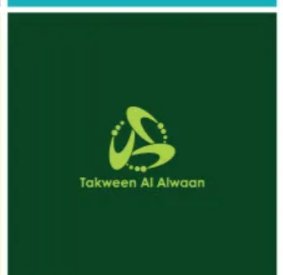
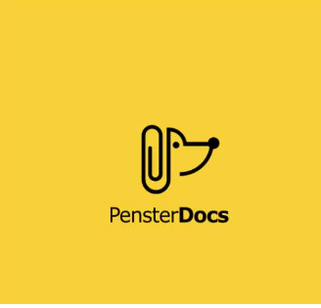
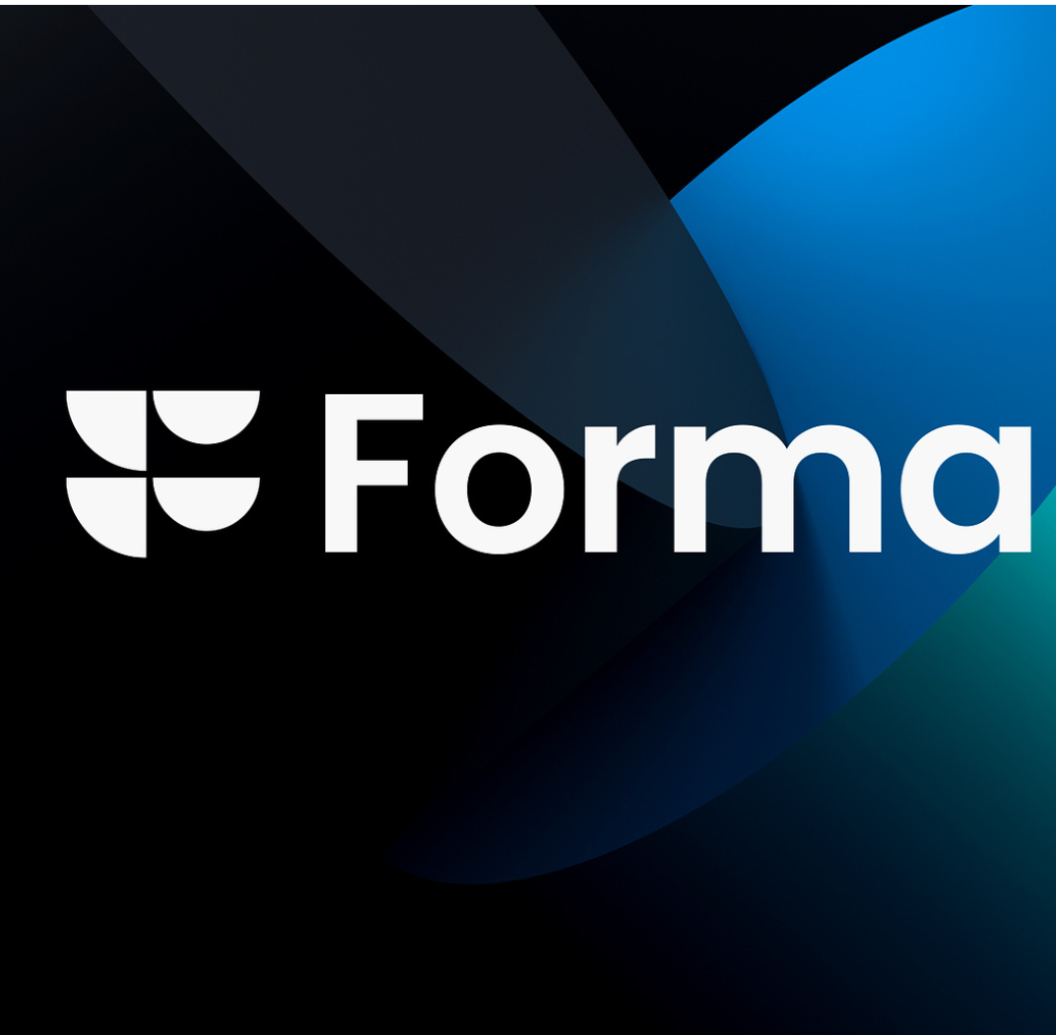
Logos we like and why
We like the simplicity and modernity of this logo and the easy connection between the name and the icon
We like the icon in this logo and how it suggests multiple dimensions and a circular intent
We like the clever and fun way the icon presents the brand and the use of bold and normal font in the name
We like the strength of this logo placed on a well-designed background of brand colours

