Slide 1
Notes:
Thank you for taking the time to speak with us today. Stay At Home Nursing has been looking at the state of healthcare in Canada for the past year and feel that there are a lot of challenges ahead for the industry, but a great many opportunities for the industry to redefine itself, and more broadly impact on healthcare in a foundational way.

Slide 2
Delivering Comprehensive Health
@Home
Notes:
We have been around since March 2017, evolving and growing during the recent COVID years, and feel like we’ve done a great job as a team - but over the next few years we think we can play an instrumental role and be the leaders in delivering Comprehensive Healthcare @ Home.

Slide 3
Is the Home Healthcare model broken?
No, because the model has never been accurately defined, or described.
Notes:
Over the past few months we have worked with a strategic consulting firm reviewing the healthcare industry and the role home care plays within the overall system today, and we feel strongly that there is a great opportunity for all of us to have a major impact on how healthcare is delivered.

Slide 4
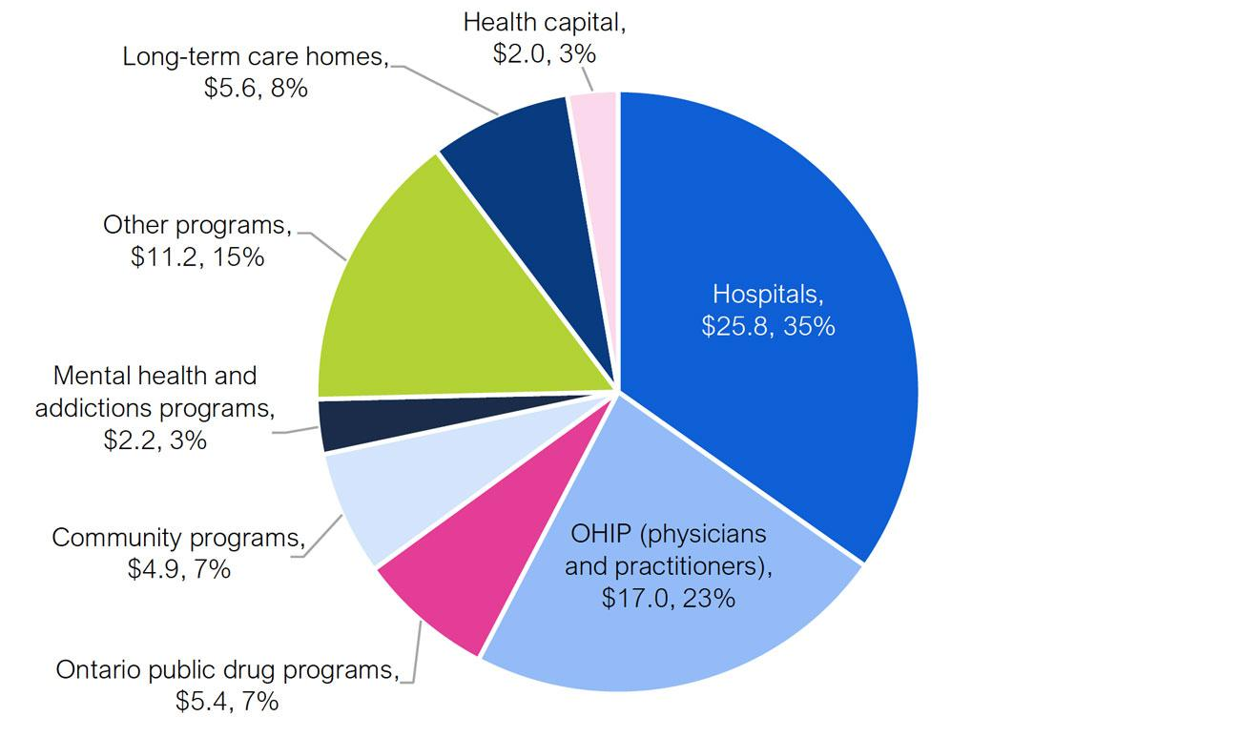
Source: FAO analysis of information provided by the Ministry of Health.
2021-2022 data
Notes:
Let’s start by trying to understand the state of the home health care industry in Canada, in the broader context of overall healthcare.
Canada spends most of its healthcare budget ($331bn) on institutional care - getting people into hospitals or long term care, or funding retirement homes. Home care has always been an afterthought to government ministries and agencies. Last year about 0.2% of government spending ($12.5bn) was spent on home healthcare. That money is managed by agencies like Home and Community Care and they decide who gets what - with services delivered in home by agencies like ours to provide task based care - come in, do the tasks, rush off to the next client. In large part home care is not about helping people stay at home in a healthy way - but rather as a stop gap before we shuffle them off to Hospital, Long term care or Hospice care. We are not given time or space to really help set goals and strategies with the families and clients to help them thrive.
In the above budget breakdown for Ontario there isn’t even a slice representing Home Care

Slide 5



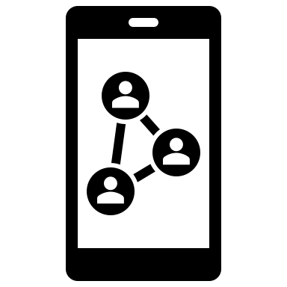
Key Industry Drivers
Rising Geriatric Population
Increasing Chronic
Conditions
Covid Reverberations and Change
Digital Inflection Point
Covid impact still being felt.
Much change is permanent.
6.2 mill CDN’s 65 and over will rise to 10.4 mill by 2037.
7 out of 10 will need long-term care support.
Notably dementia and Alzheimer's.
13.7% of CDN’s have a disability.
HealthTech / Mobile
Back-end efficiencies
Behavioral:
- Less than 40% of CDN’s have accessed HC records online. But 4 out 5 CDN’s want to use online HC resources.
Notes:
This situation has been amplified by many factors - Covid showed how bad it is to cram people into crowded institutions that some people liken to being “jails” for being old. And the baby boomer generation that we will be in for the next 8 years or so will mean there are simply not going to be enough beds in hospitals and LTC to care for people. We MUST help keep people at home.

Slide 6
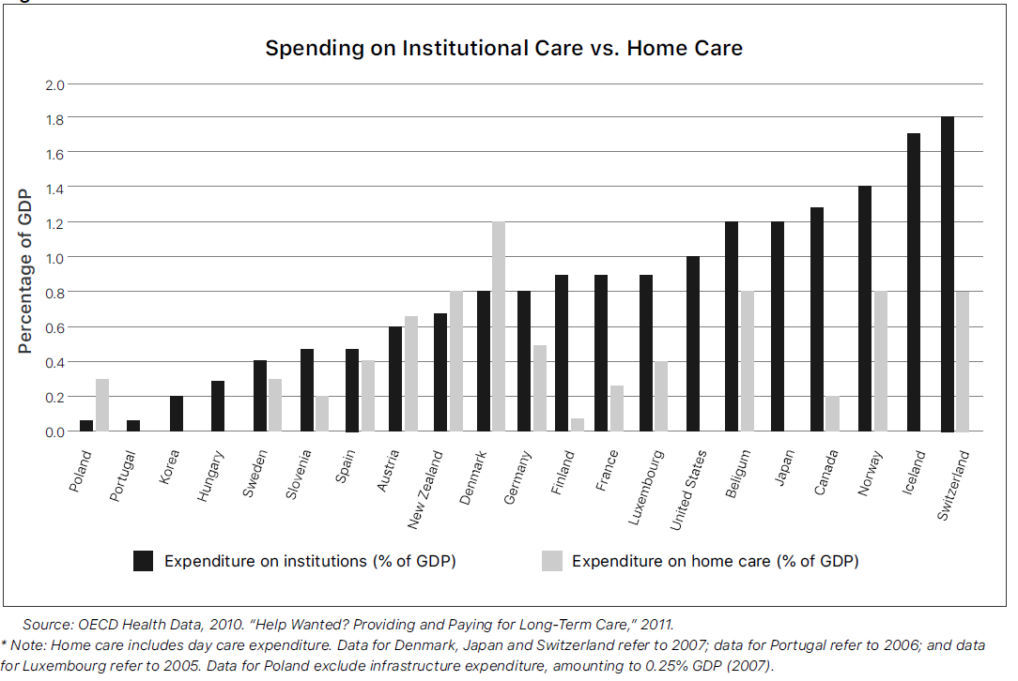
Notes:
There are many examples in the world of better ways to do it. Across developed countries, Canada spends the most amount per person on government funded health care - but has far from the best outcomes. The average spent on home care in these countries is 0.8% of government spending - meaning that if Canada increased spending on homecare tomorrow by 400% and spent $48 bn per year it would just put us up to the average of these other countries. This is unlikely to happen, but it’s not unreasonable to think about it…. It doesn’t mean spending more in fact! What other countries have found is that better in-home care actually reduces costs in hospitals and emergency rooms - a dollar spent on home care can actually save more than a dollar in other areas. So we could as a nation quadruple what we spend on home care, and actually reduce our $331 bn annual spend.

Slide 7
Key Industry Drivers
Health Care in Canada (public) was $331bn in 2022. Only 3.8% of that, ($12.5bn) was for home and community care
Private care represents about 25% of the total, suggesting that home care provider industry in 2022 was about $16bn
There were 4,295 businesses in this category, with the vast majority doing $1-3m in annual revenue (owner operated)
Paramed was the top company by revenue with about $440.3m in this area (home health care), representing about 2.6% of the total
Notes:
The current investment of about $16bn last year in home care was fragmented with 4,295 companies (in the NAICS database) providing care across Canada. The vast majority of these companies are at the $1-3m level. The largest player in the industry, Paramed did $440.3m last year - just about 2.75% of the total. There are maybe 5-6 other companies that are $100m+, a handful (like Stay at Home Nursing) at the $8-$20m level - but most are small owner operated businesses.

Slide 8
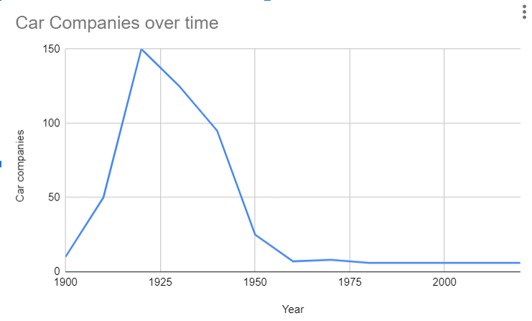
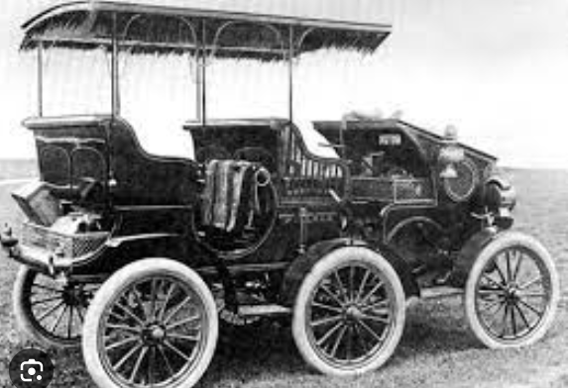




Category consolidation is coming to Home Care
8.3% CAGR next 7 years
Increased Regulation
4,295 companies will collapse to 200-300
By 2030, the $32bn Home Health Care sector will have 3 players delivering 75 % of the care – a dominant player with about 50%, a second with 20% and a third with 5%
Hundreds of others will split the remaining and be $10-20m companies
Notes:
Against this fragmented backdrop, analysts are predicting that homecare will grow faster than any other aspect of healthcare spending in the next several years, with a cumulative annual growth rate of 8.3% - meaning that by 2030 we can expect at least $32bn to be spent in homecare - although I think this could be a lot more if we want to “catch up” to the average level of other developed countries.
This increased spending will coincide with quite a bit more regulation and oversight in the category. Those smaller companies with 2-3 managers trying to be chief technology officers, chief medical officers, chief hr officers, chief compliance officers, general counsel, and quality assurance officers - they won’t survive.
This is very predictable. It happens continually in different categories - did you know in the early 1900’s there were 100’s of automotive companies in North America alone? There was a need for cars, and tremendous innovation, with 3 wheel cars, 6 wheel cars, electric cars, steam cars. But when Ford got his factories going, this quickly collapsed to the Big 3 Auto makers. It’s called a dominant design, and happens across every category. We believe this is coming to Home care.
We expect that in the next 7-8 years the industry will move to that $32billion - with one player taking about 50% of the revenue ($16bn), a second at $6.5billion, a third (5%) at $1.6bn - and then 200-300 others at $20-50m each splitting the last 25%. Our goal at Stay at Home Nursing is to be one of those top 3 - and in so aiming,(its not for us to make lots of money) - but rather to transform healthcare in Canada to recognize that comprehensive healthcare must start at home.

Slide 9

Around the World: Denmark
Senior Friendly system with principles of self-reliance, dignity and self-respect, integrated into the community
National strategy to maintain people in their homes. In the 1980’s legislated against the building of any new LTC homes
Patient outcomes tracked, with funded nursing and caregiving under universal health insurance
Best outcomes and satisfaction levels of any OECD country
Source: Ageing Well Report Queens University 2020
Notes:
Consider Denmark, by every measure the very best place to grow old in. Home care there is offered early, and in coordination with all other healthcare provision. There are many 92 year olds living in their own homes and biking about Copenhagen. A key philosophy in Denmark is recognizing that these citizens (both old and young) dealing with additional medical needs are still part of society. Care is focused on support and empowerment, helping people stay in their homes as long as possible. Denmark spends 1.2% of government spending on home care - 6 times more than Canada does, and it’s the highest in developed countries. And more importantly, this spend correlates to better health outcomes for seniors than any other country.
And from a cost perspective – yes they spend more than 6x per capita on home care than Canada – but they have built no new long term care beds since 1987, and despite population growth and the baby boomers now, they have seen a 30% reduction in absolute numbers of long term care beds utilization.

Slide 10
Show us a problem
we didn’t know we had.
Notes:
In contrast Canada treats its seniors like infants, and locks them up in crowded institutions. This is not right. No one thinks it’s right. So why do we keep doing it?

Slide 11


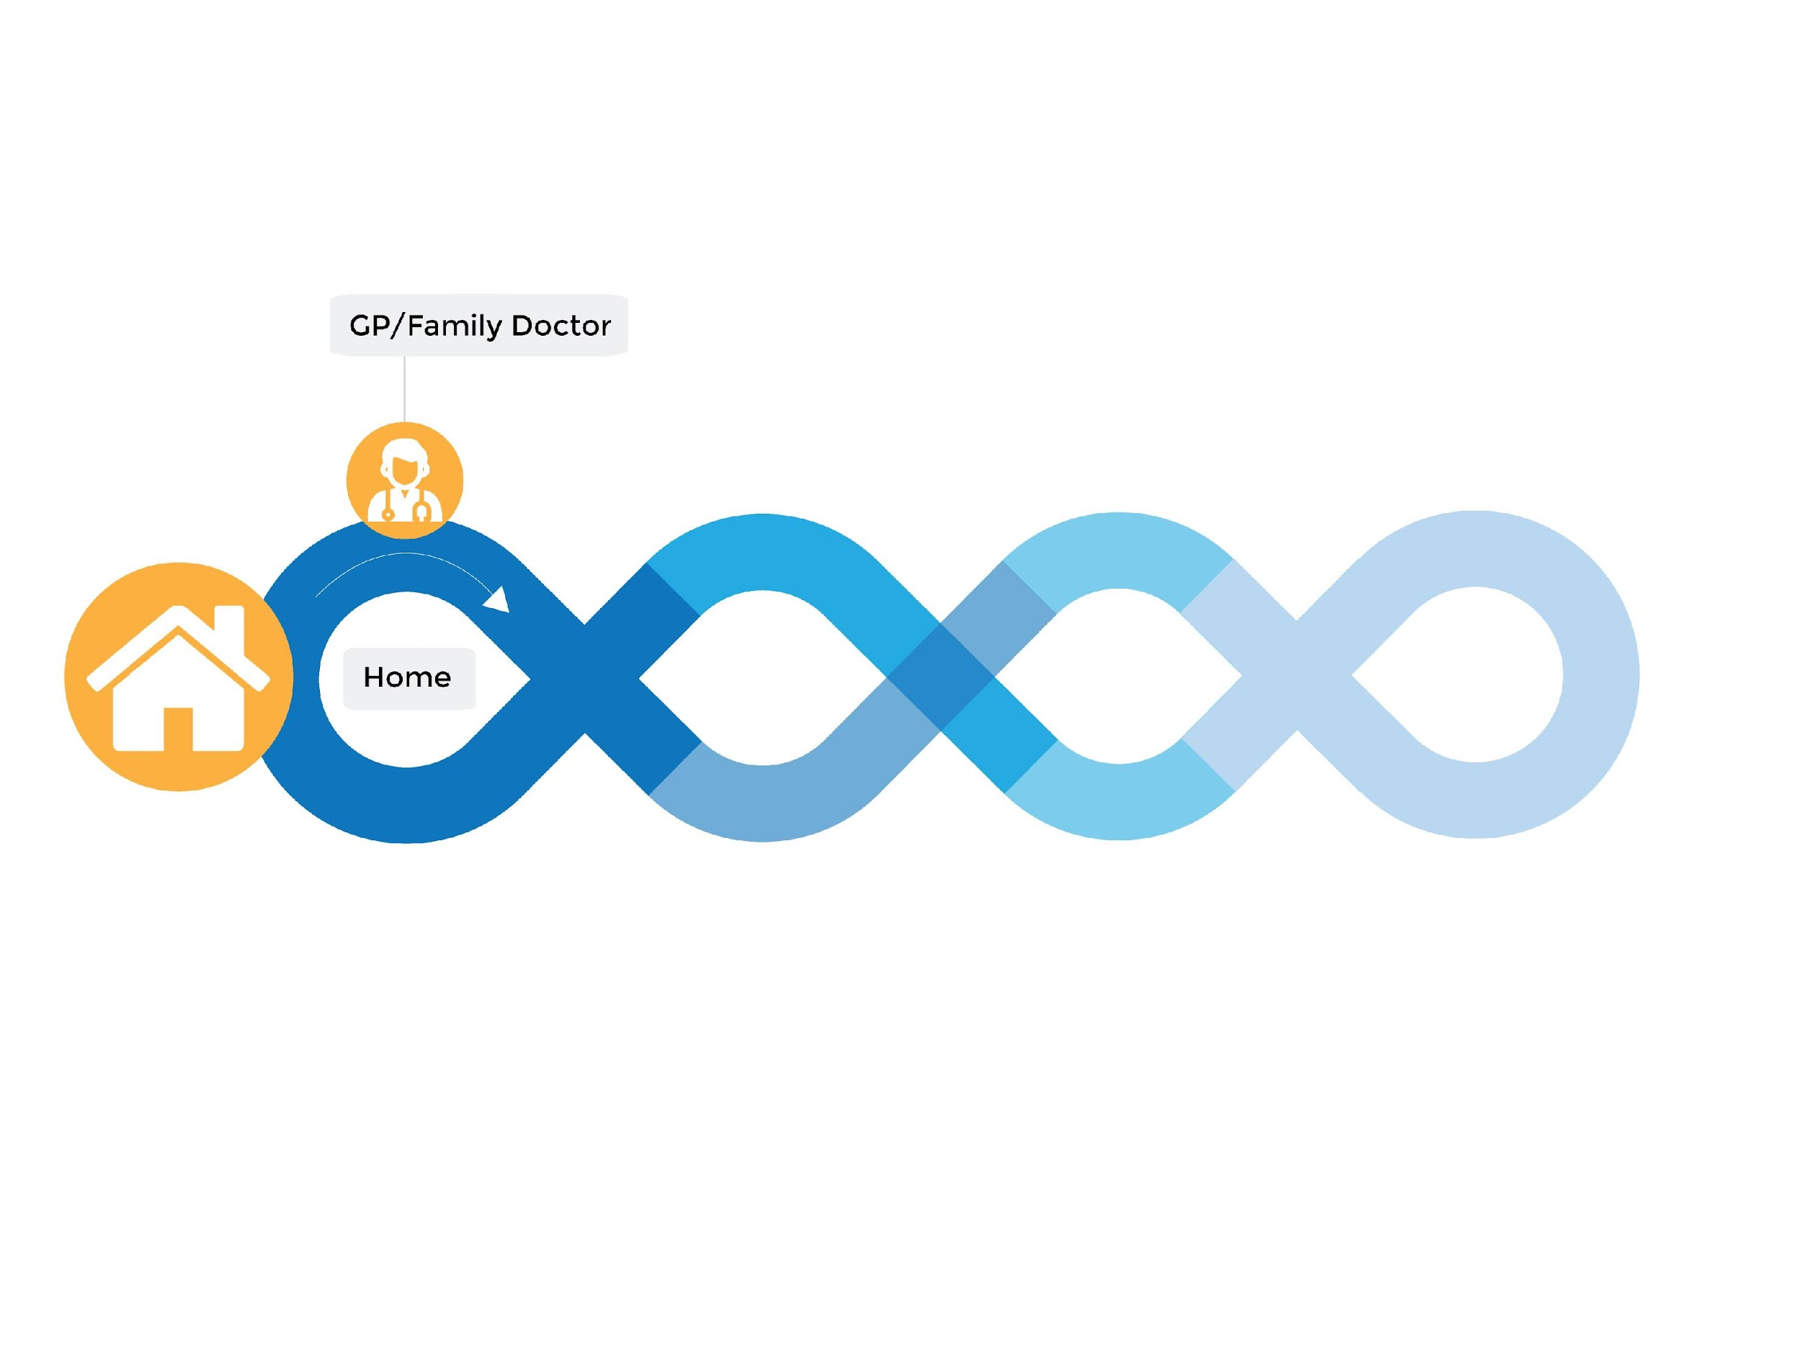
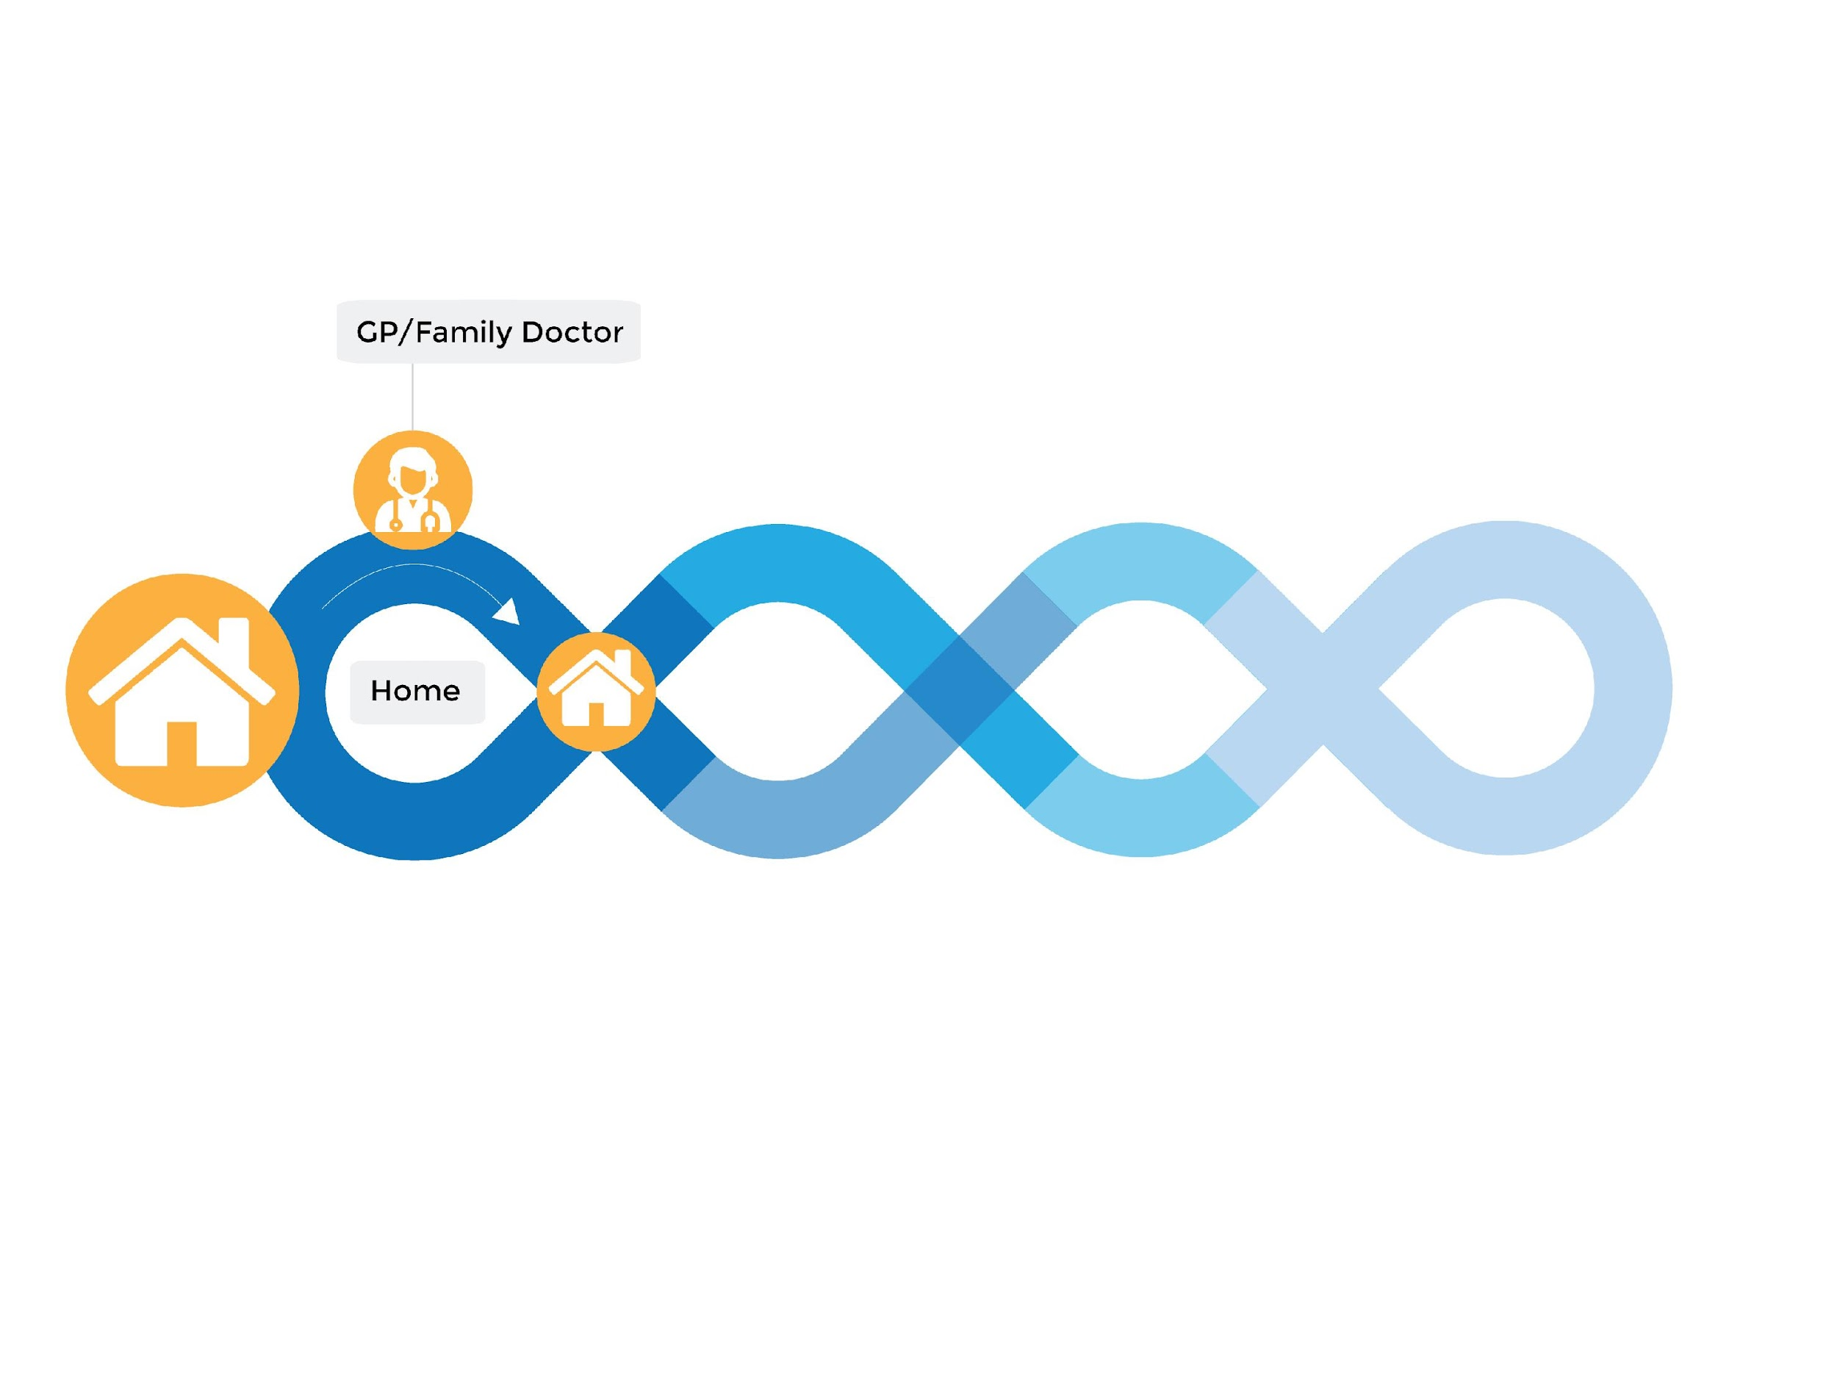
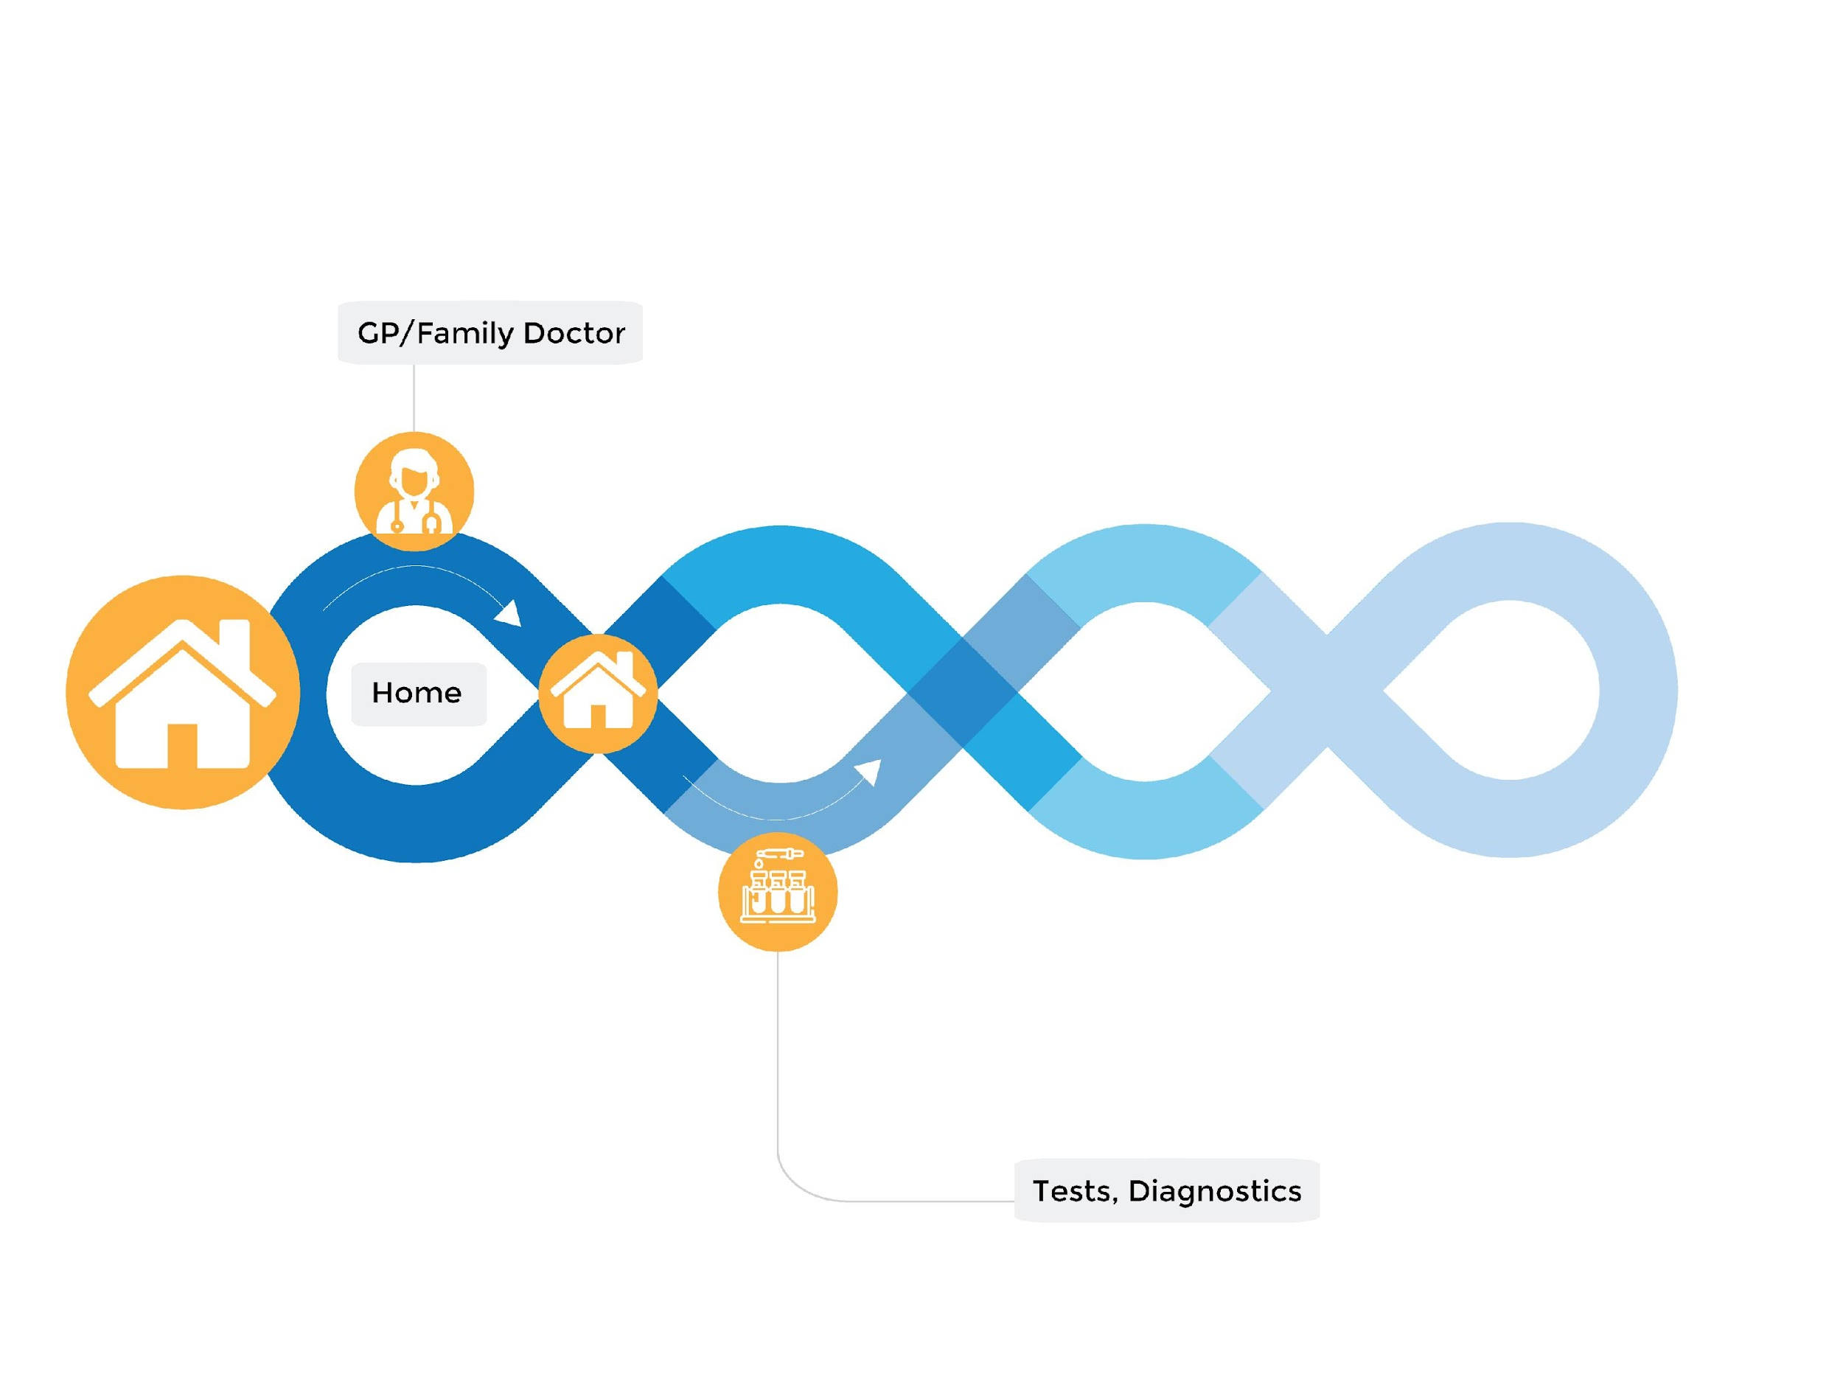
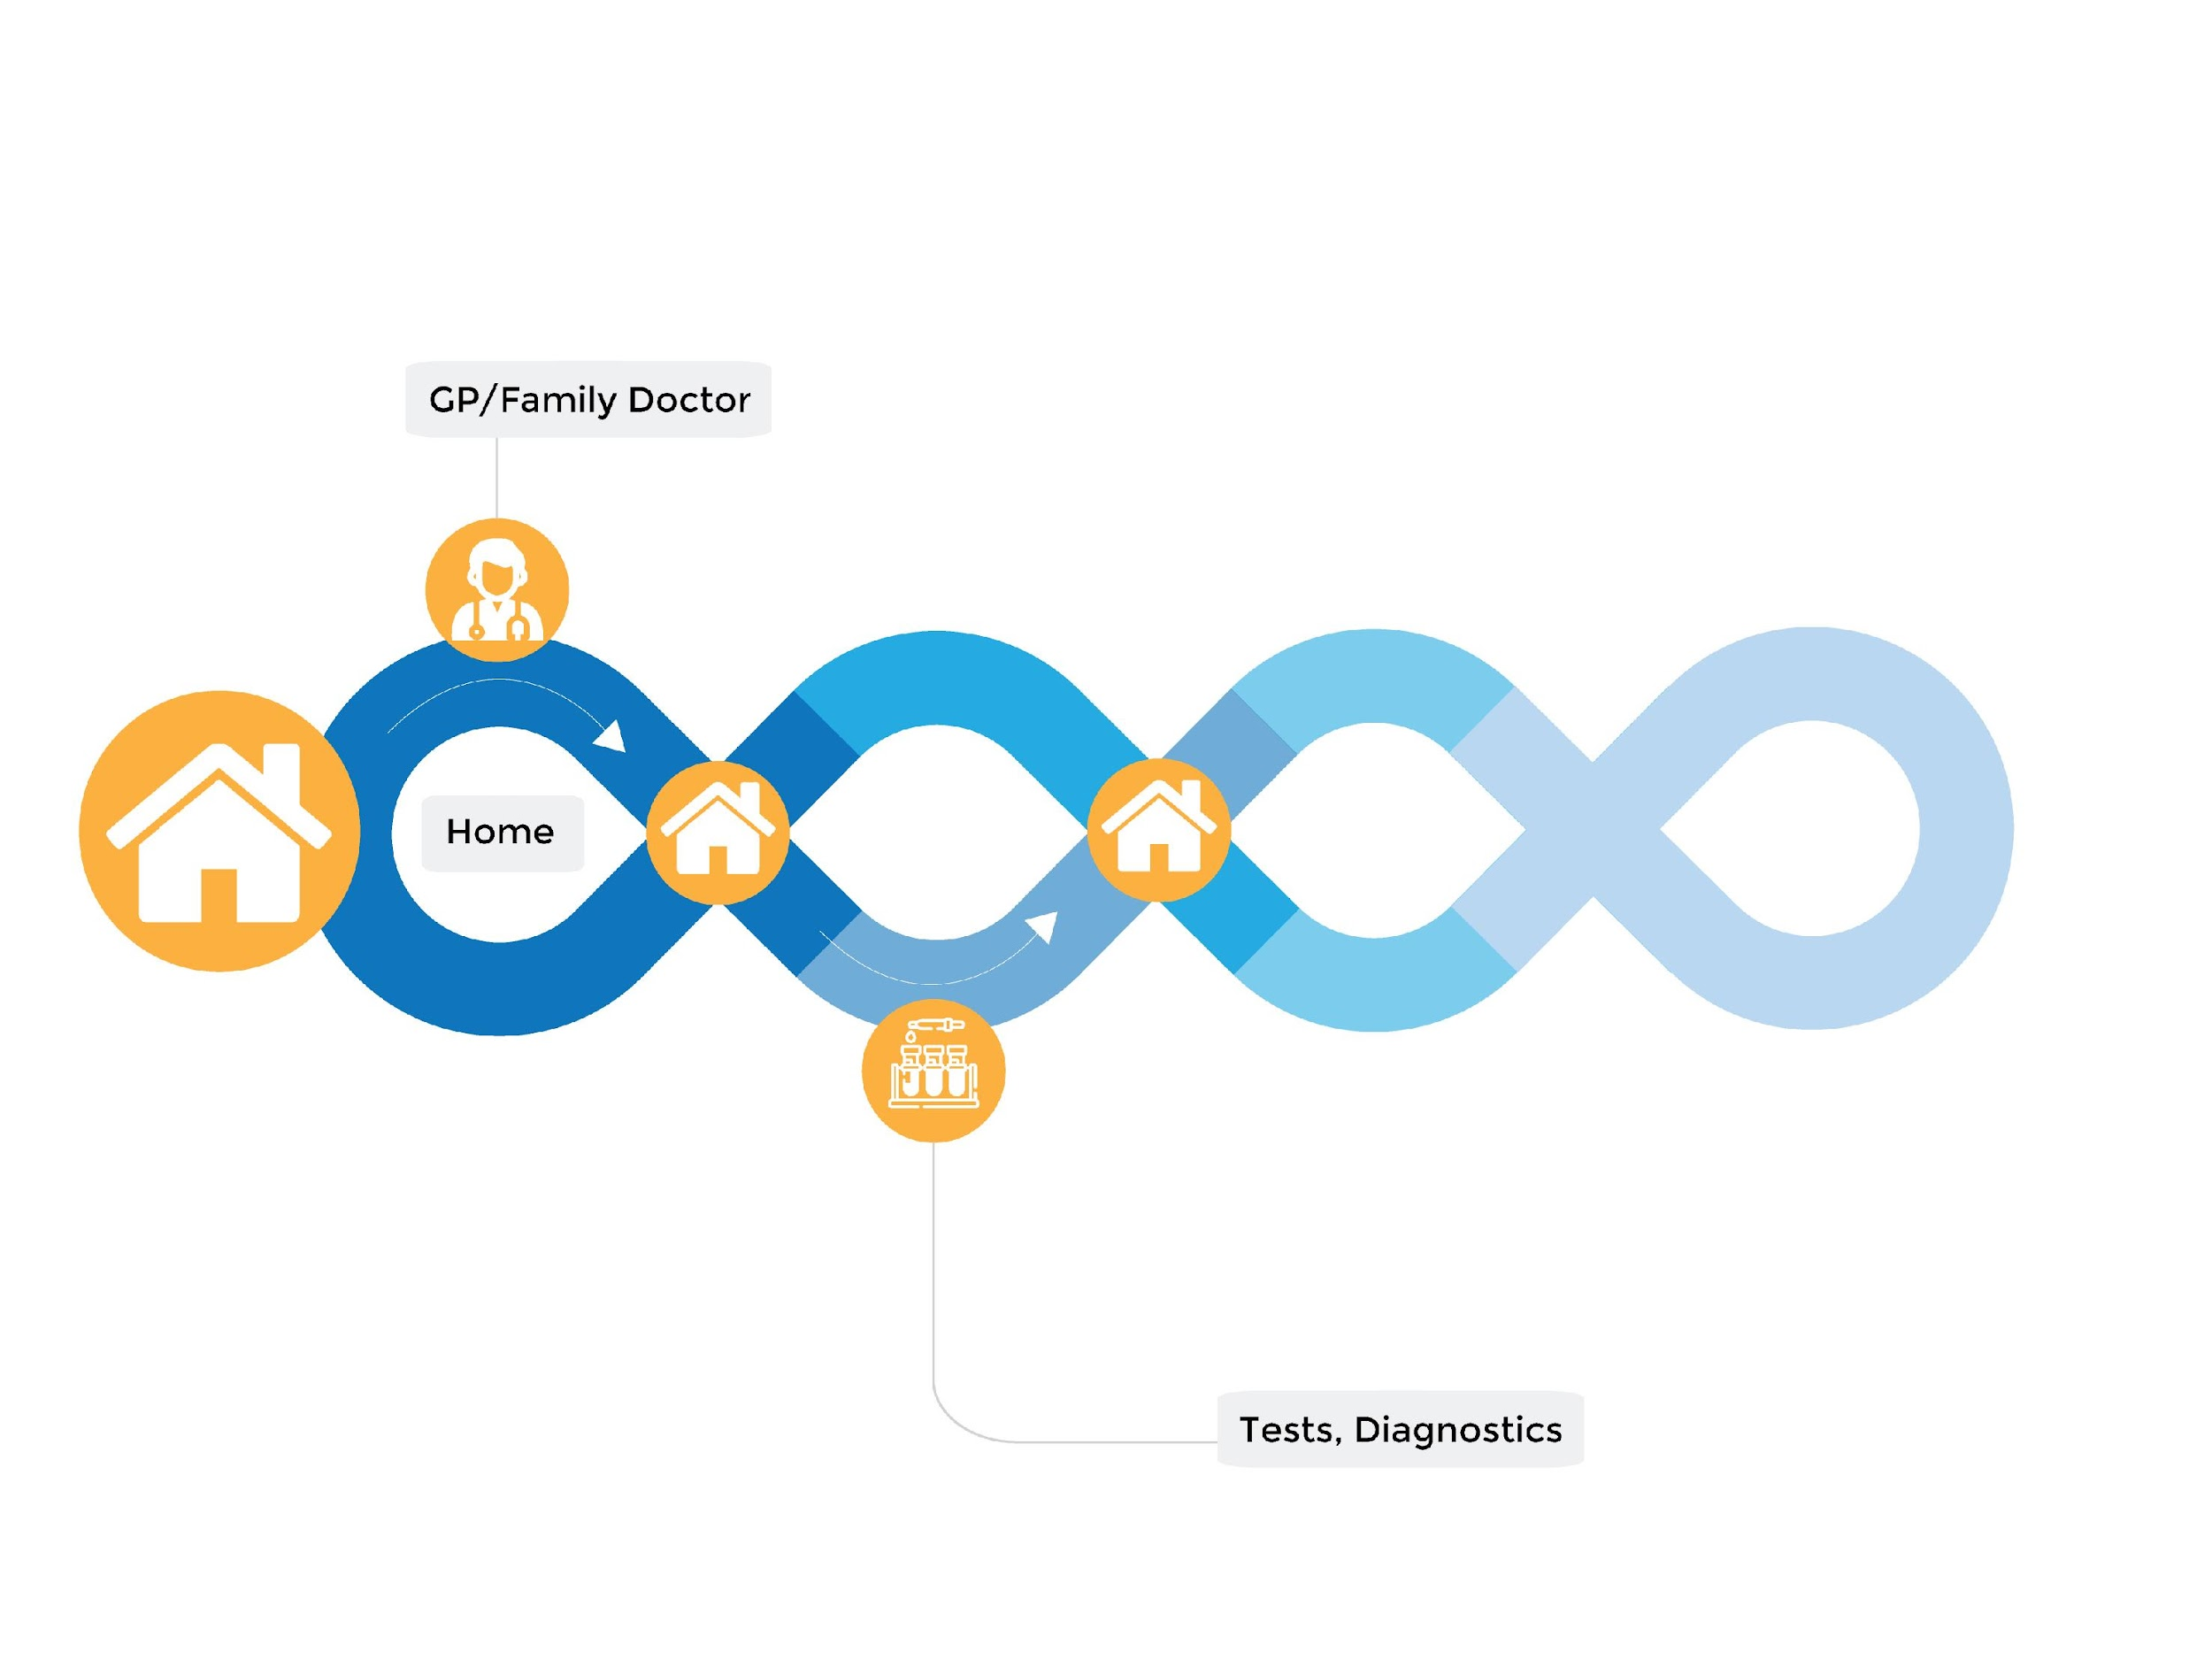
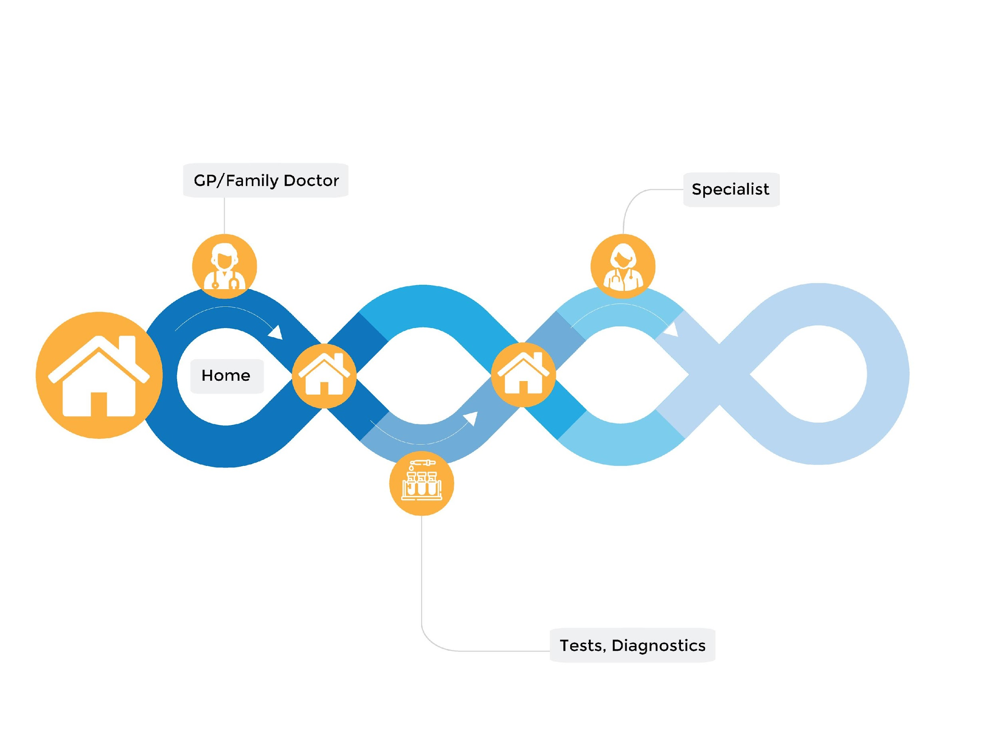

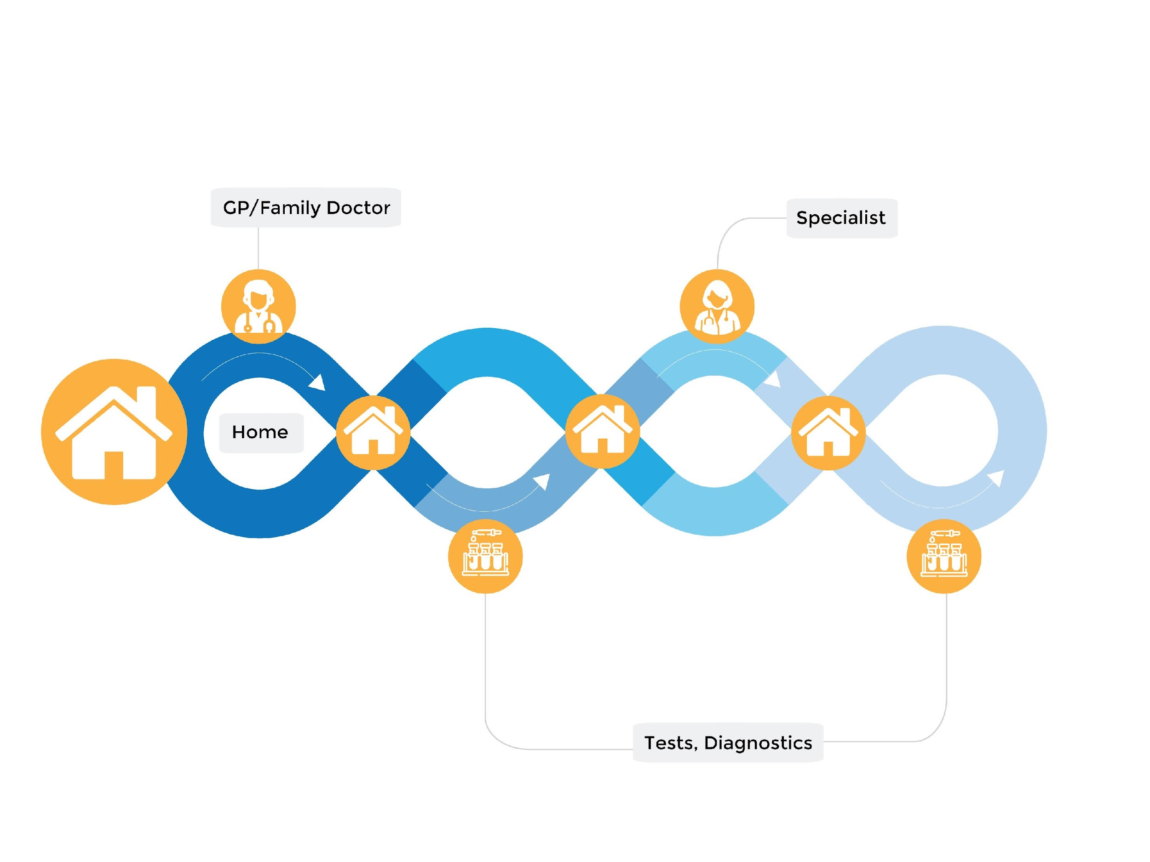
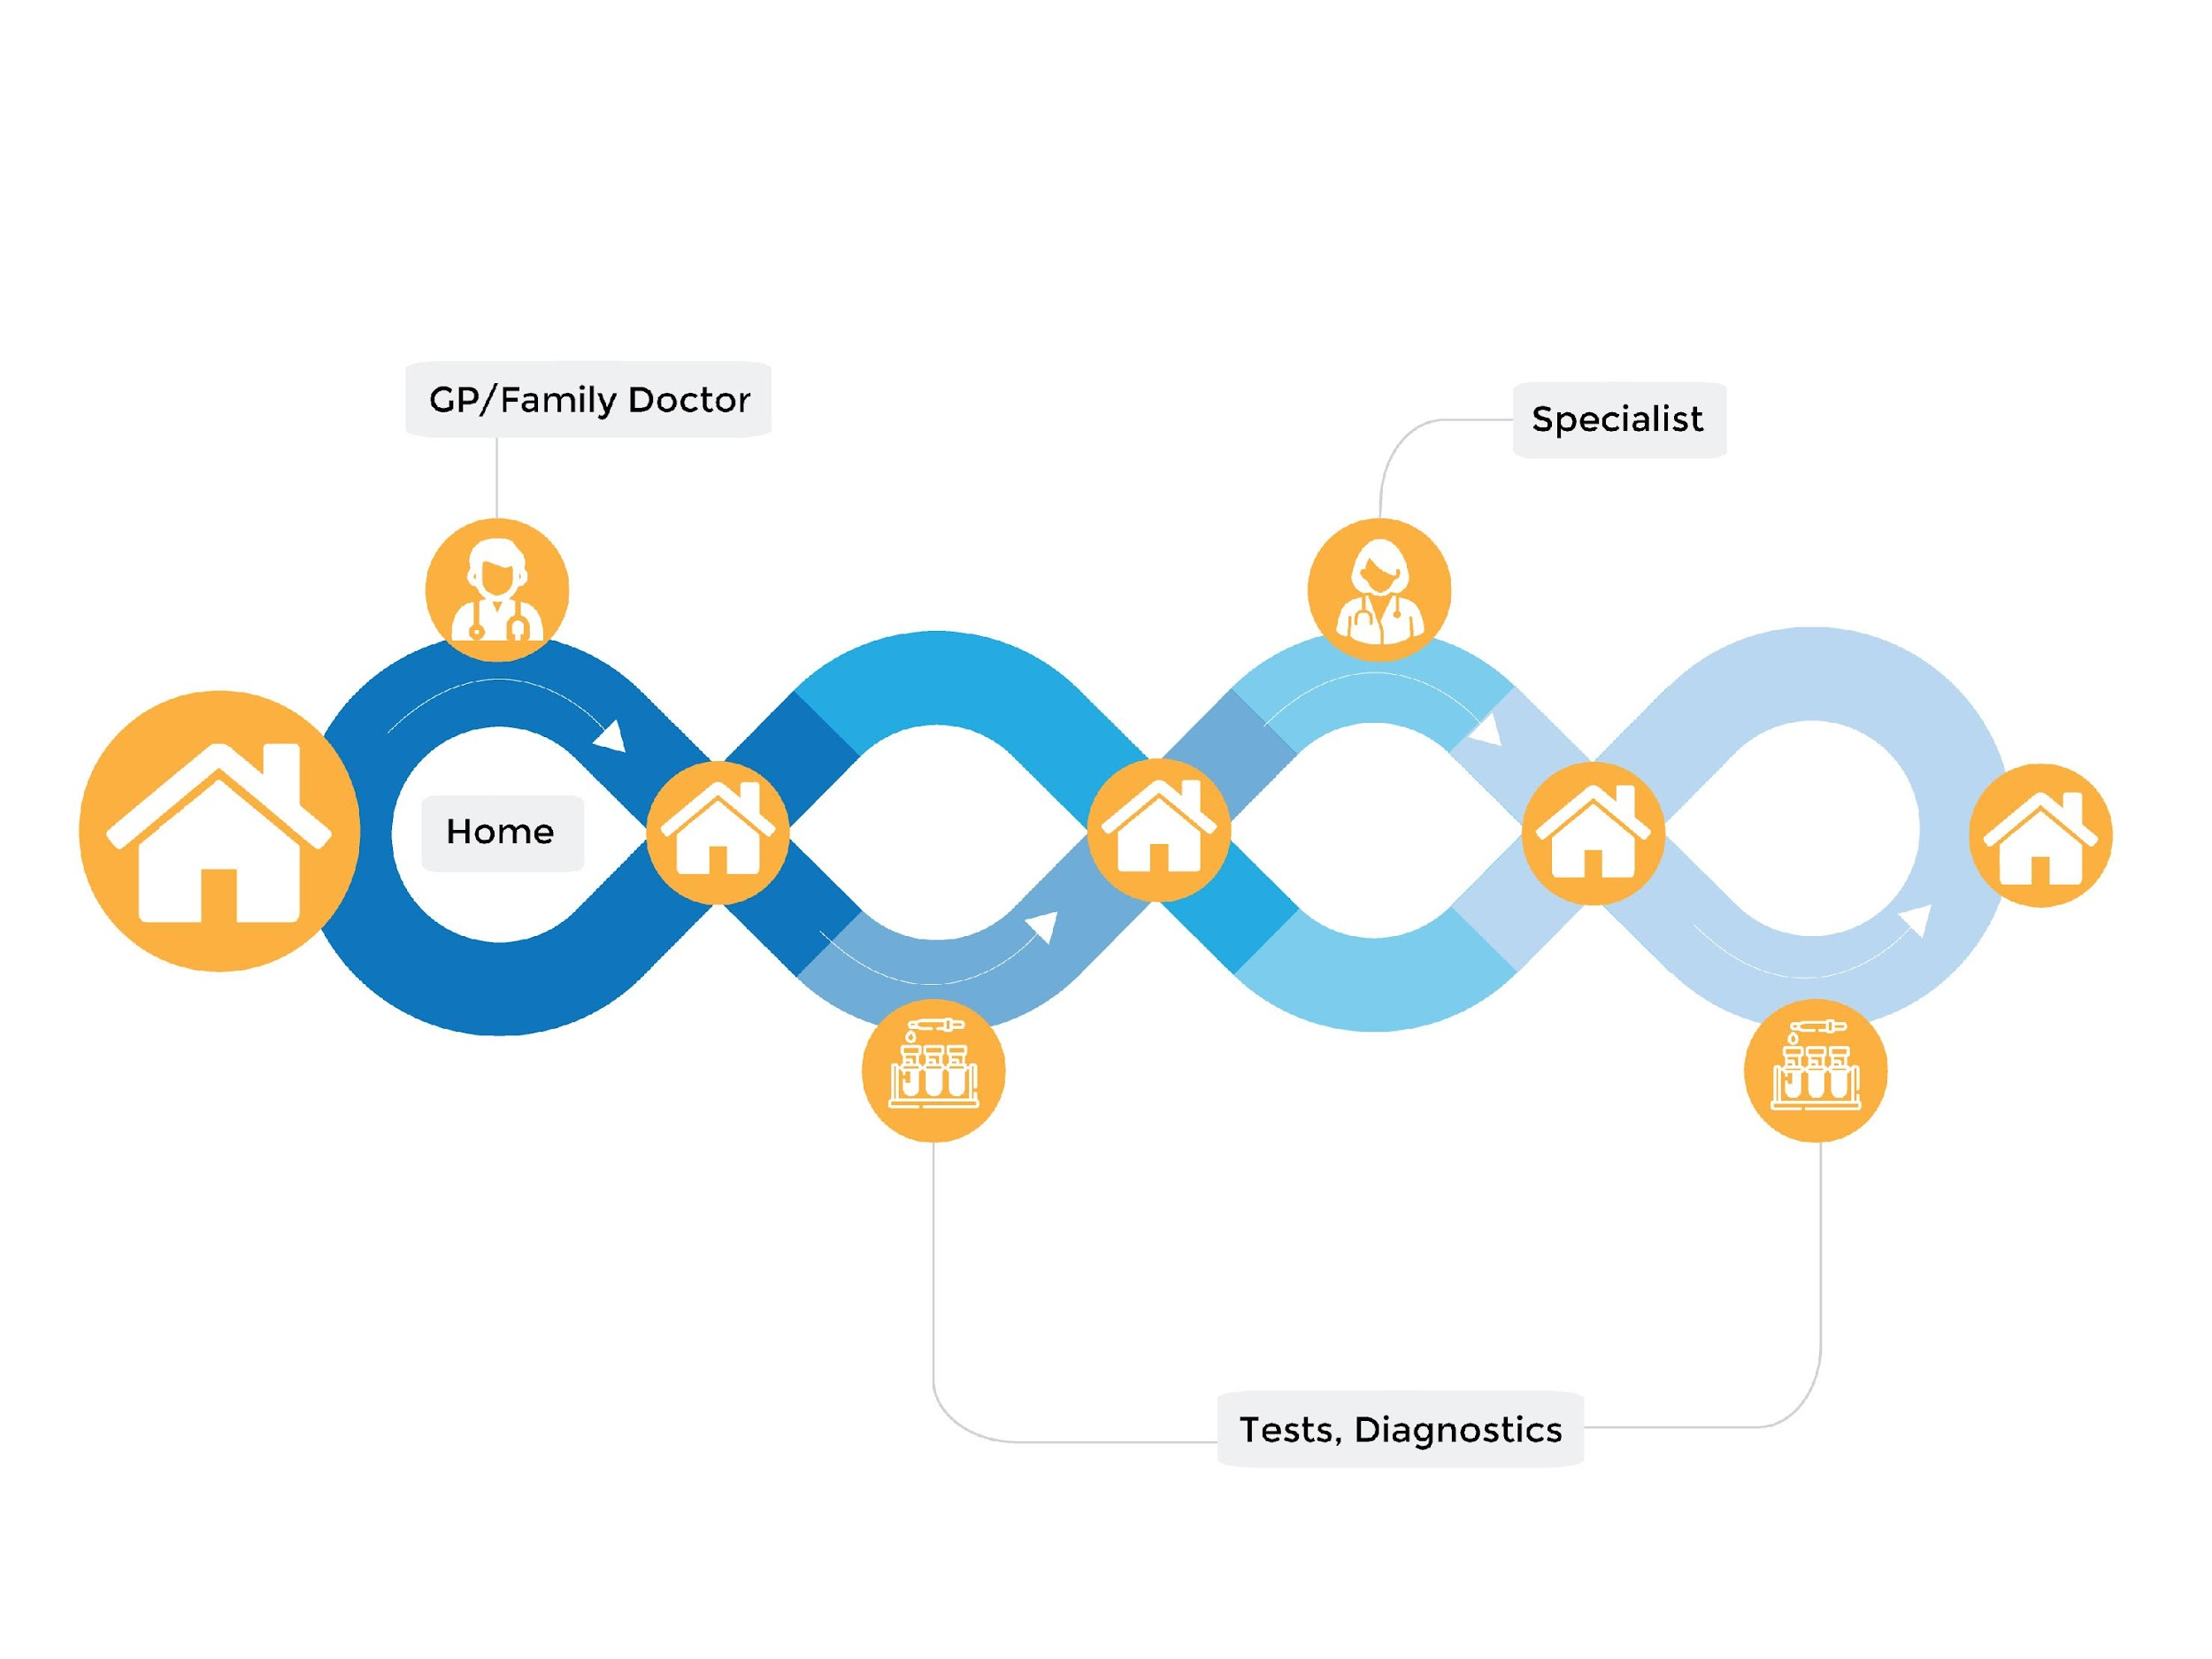
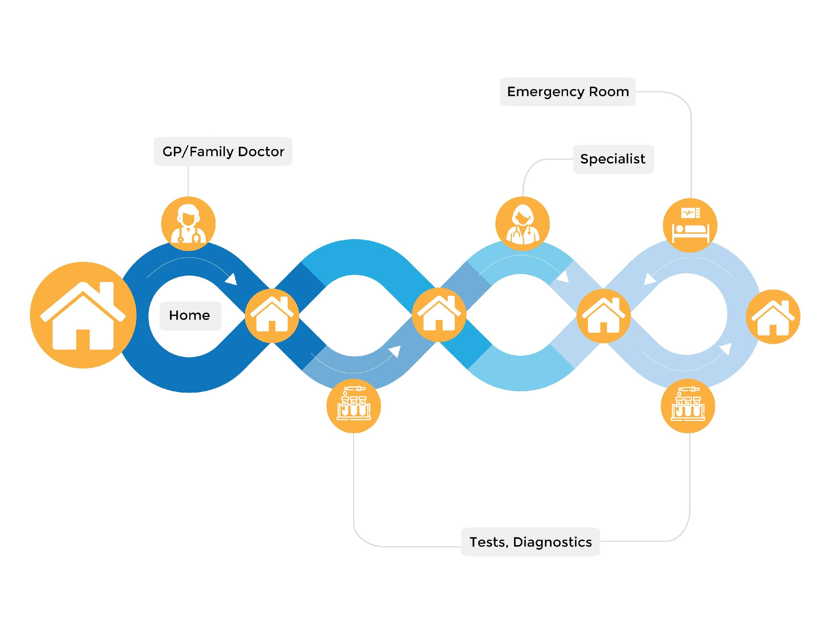

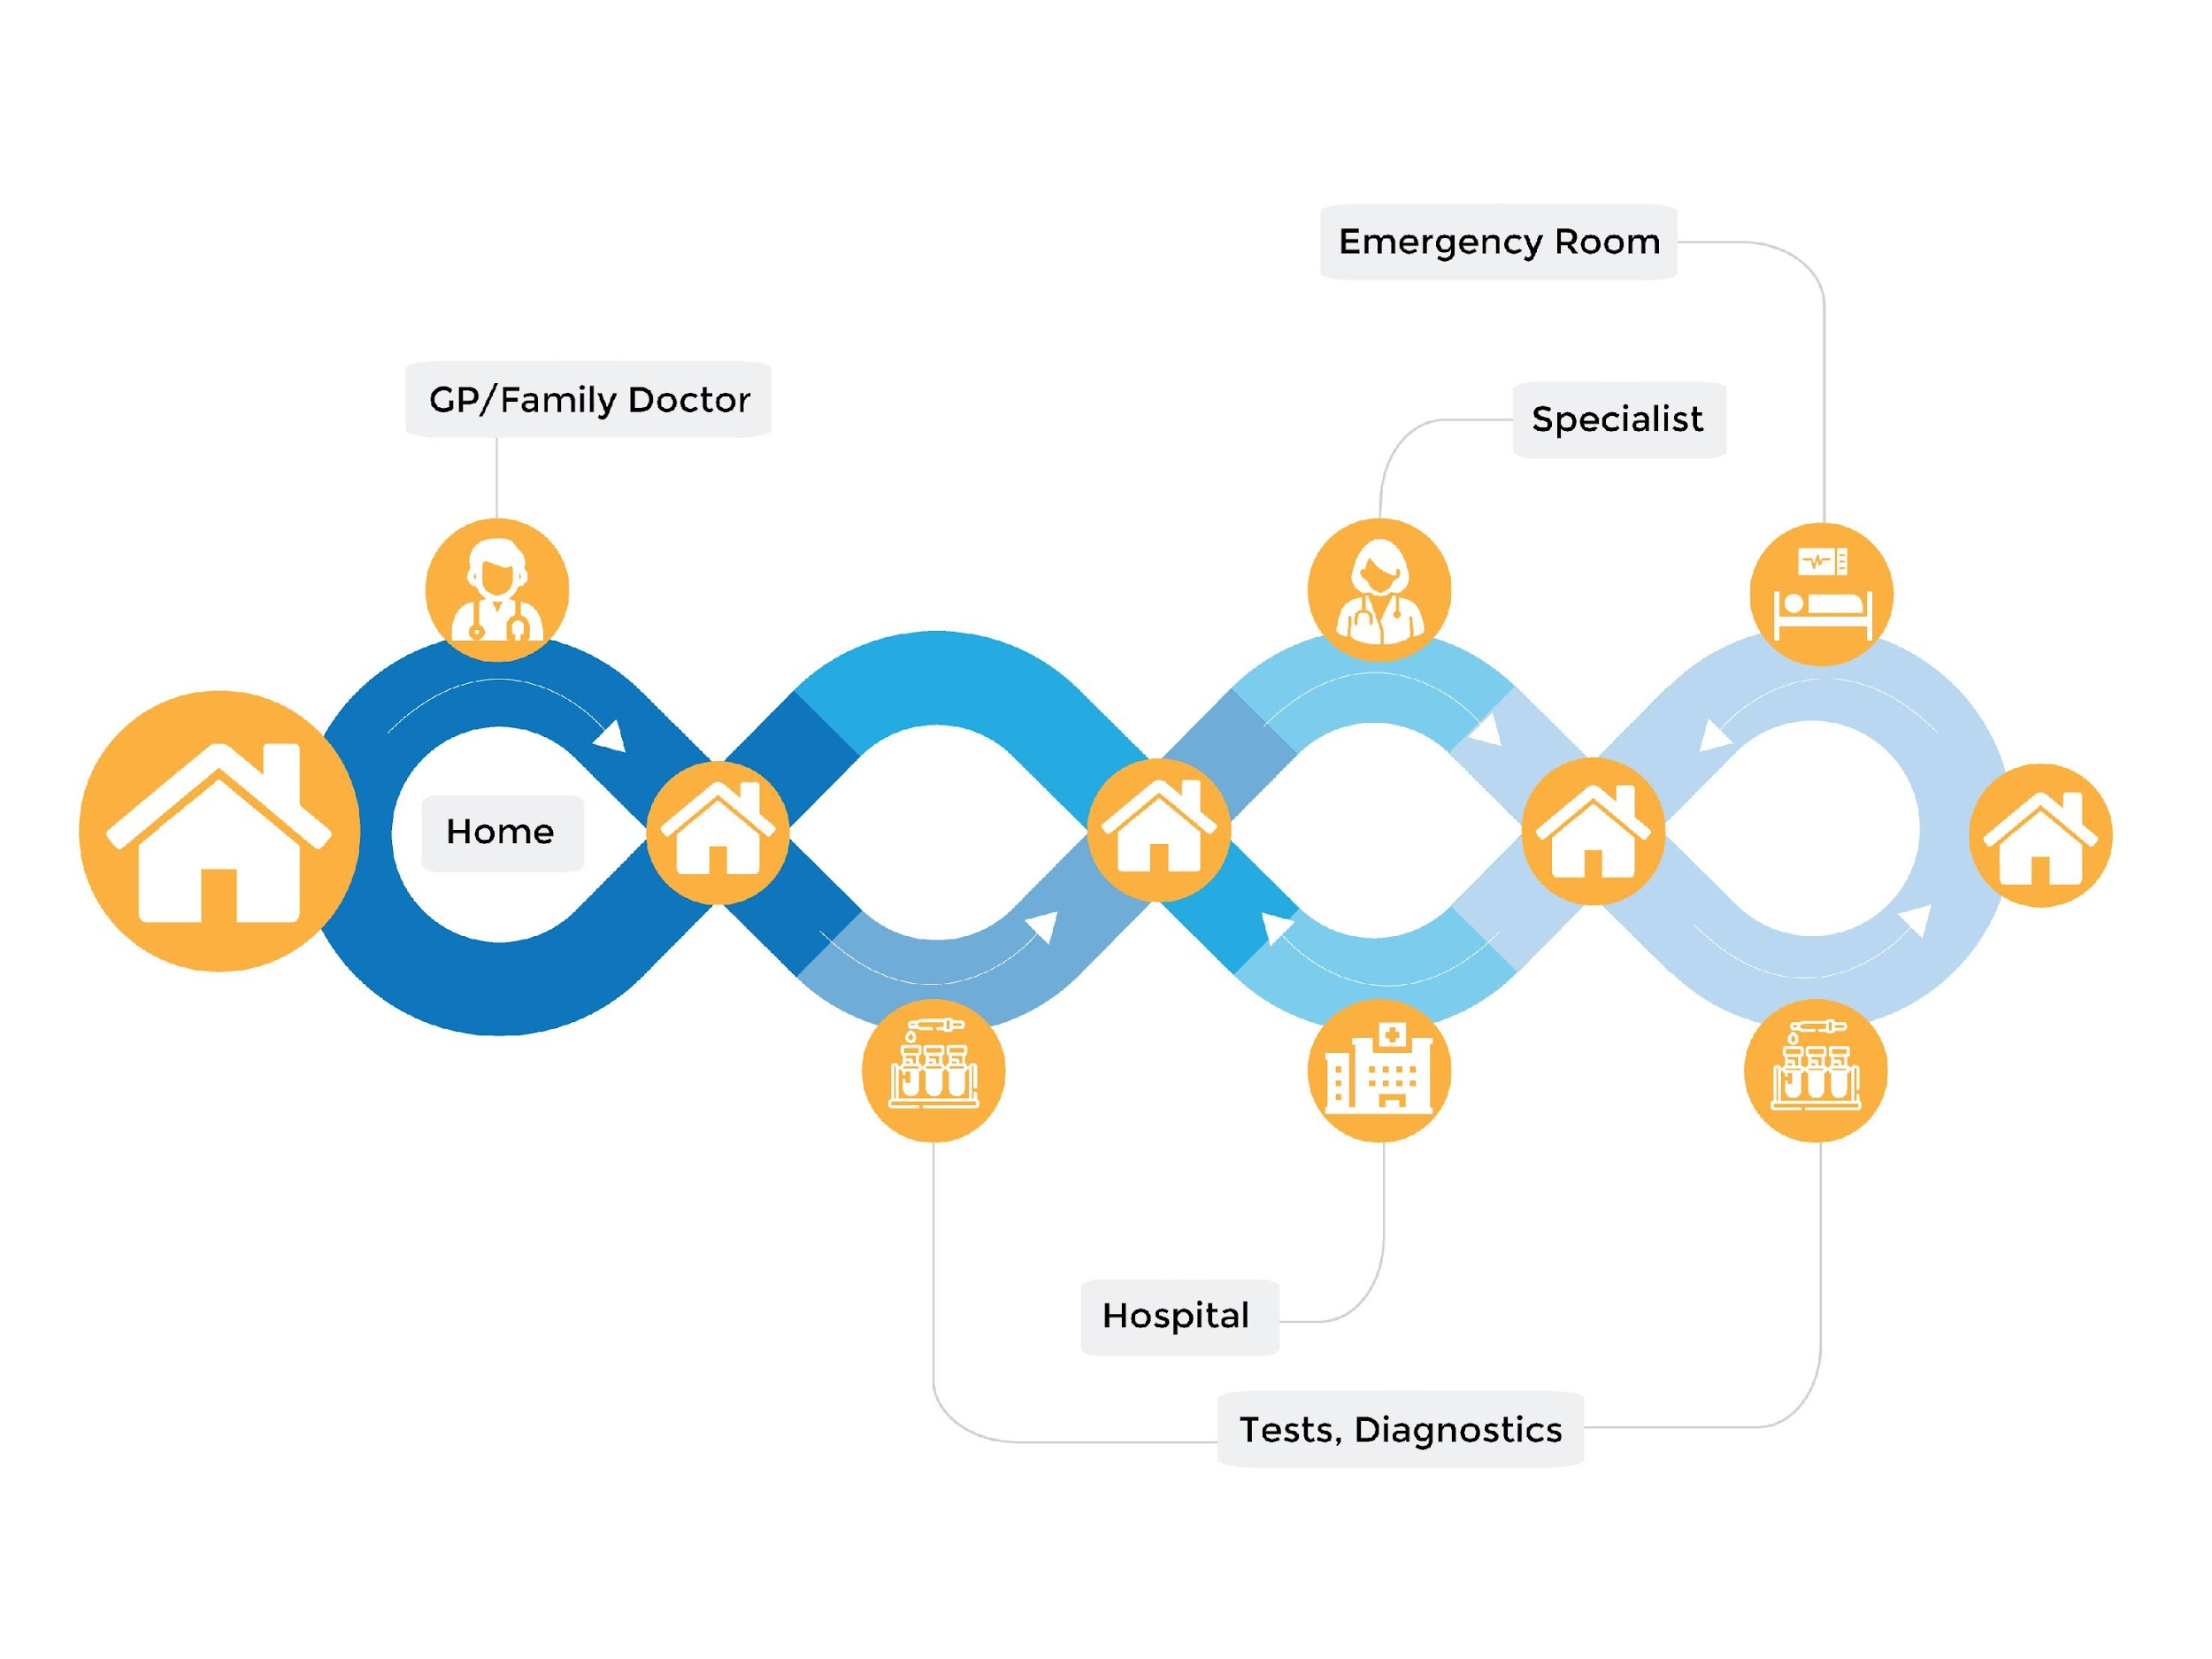

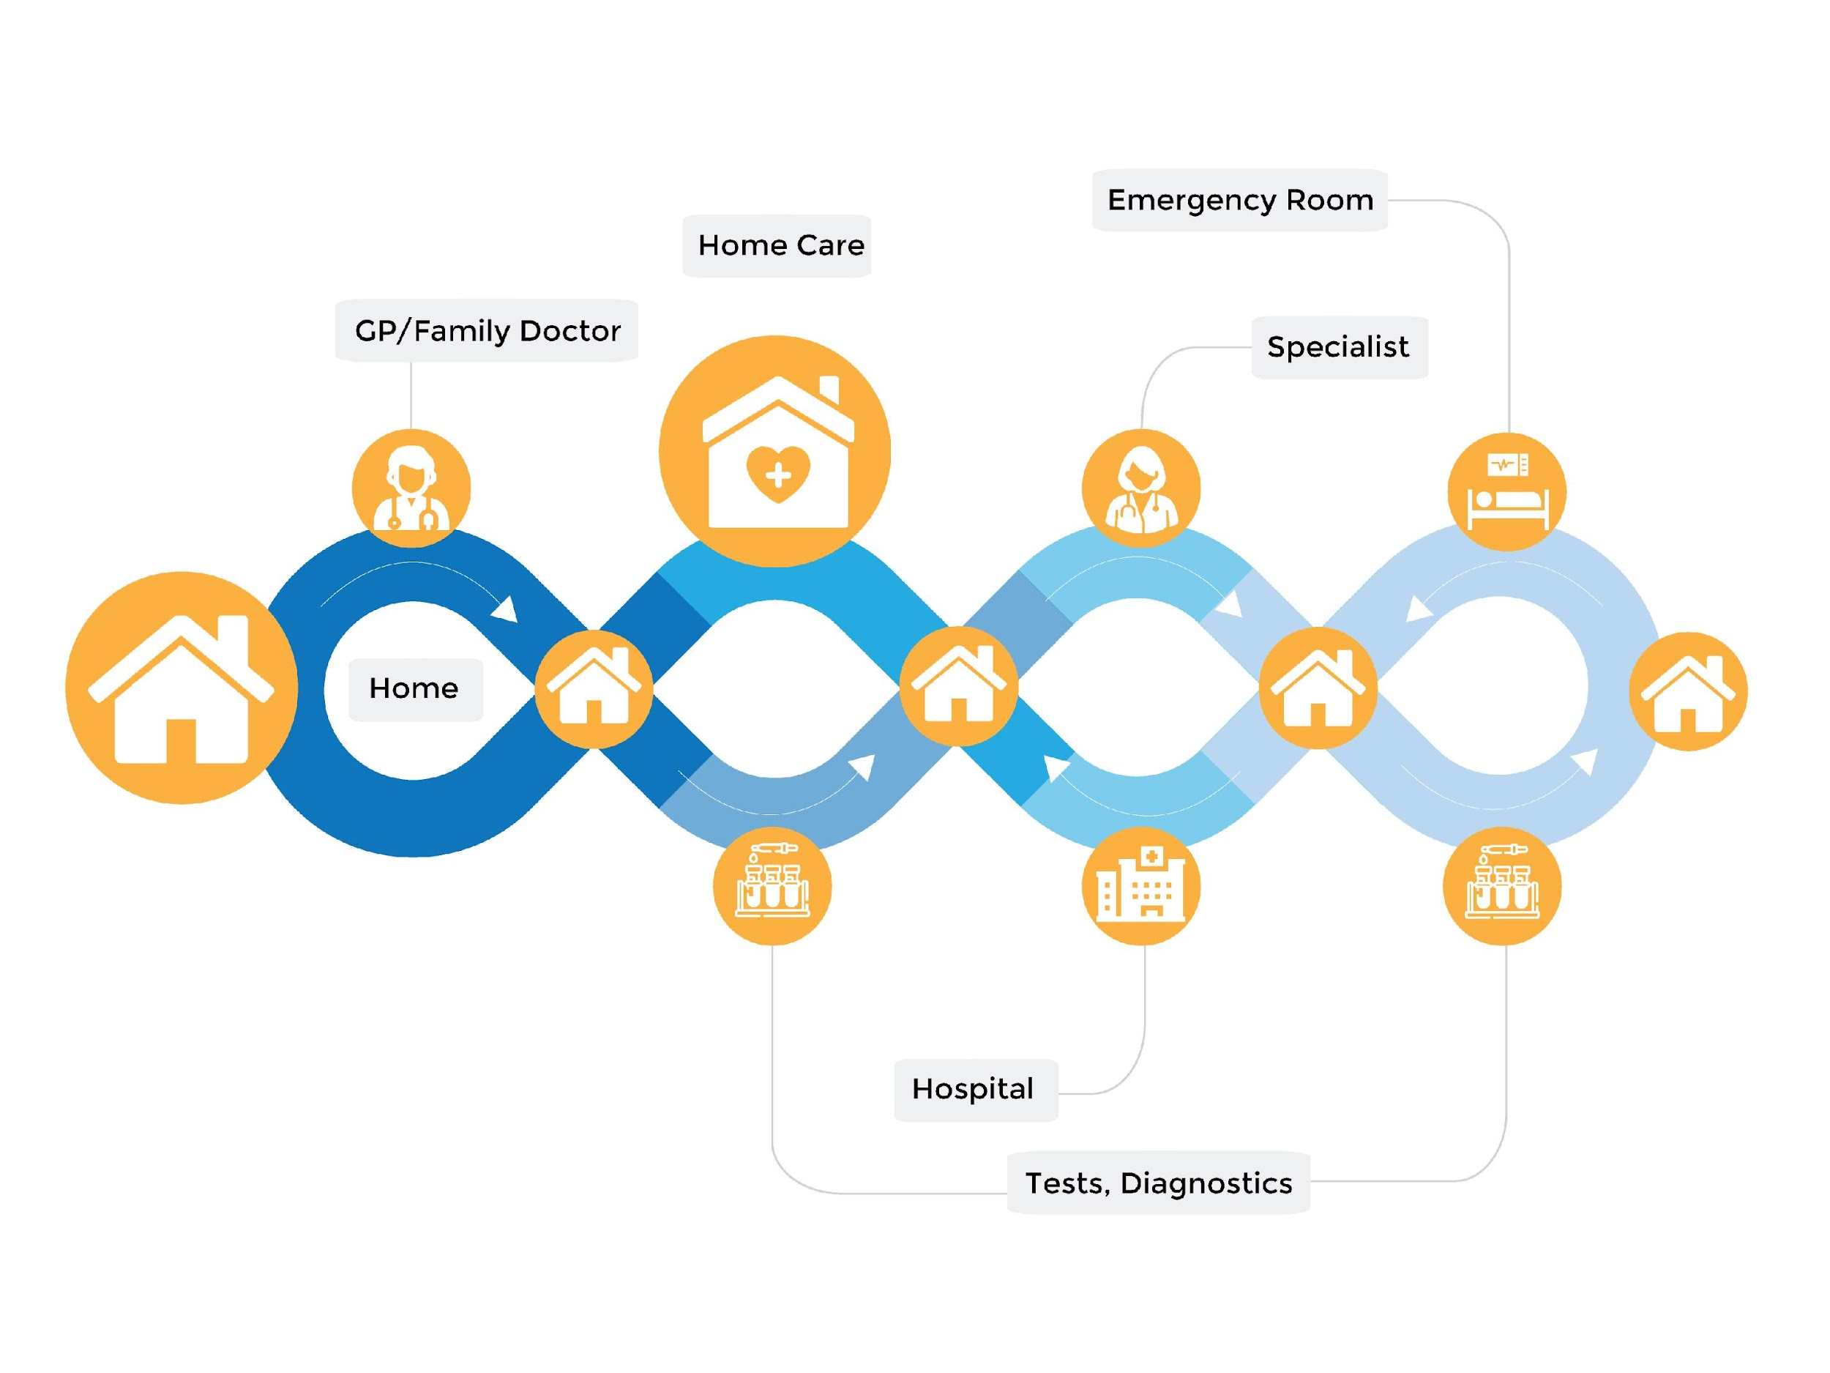
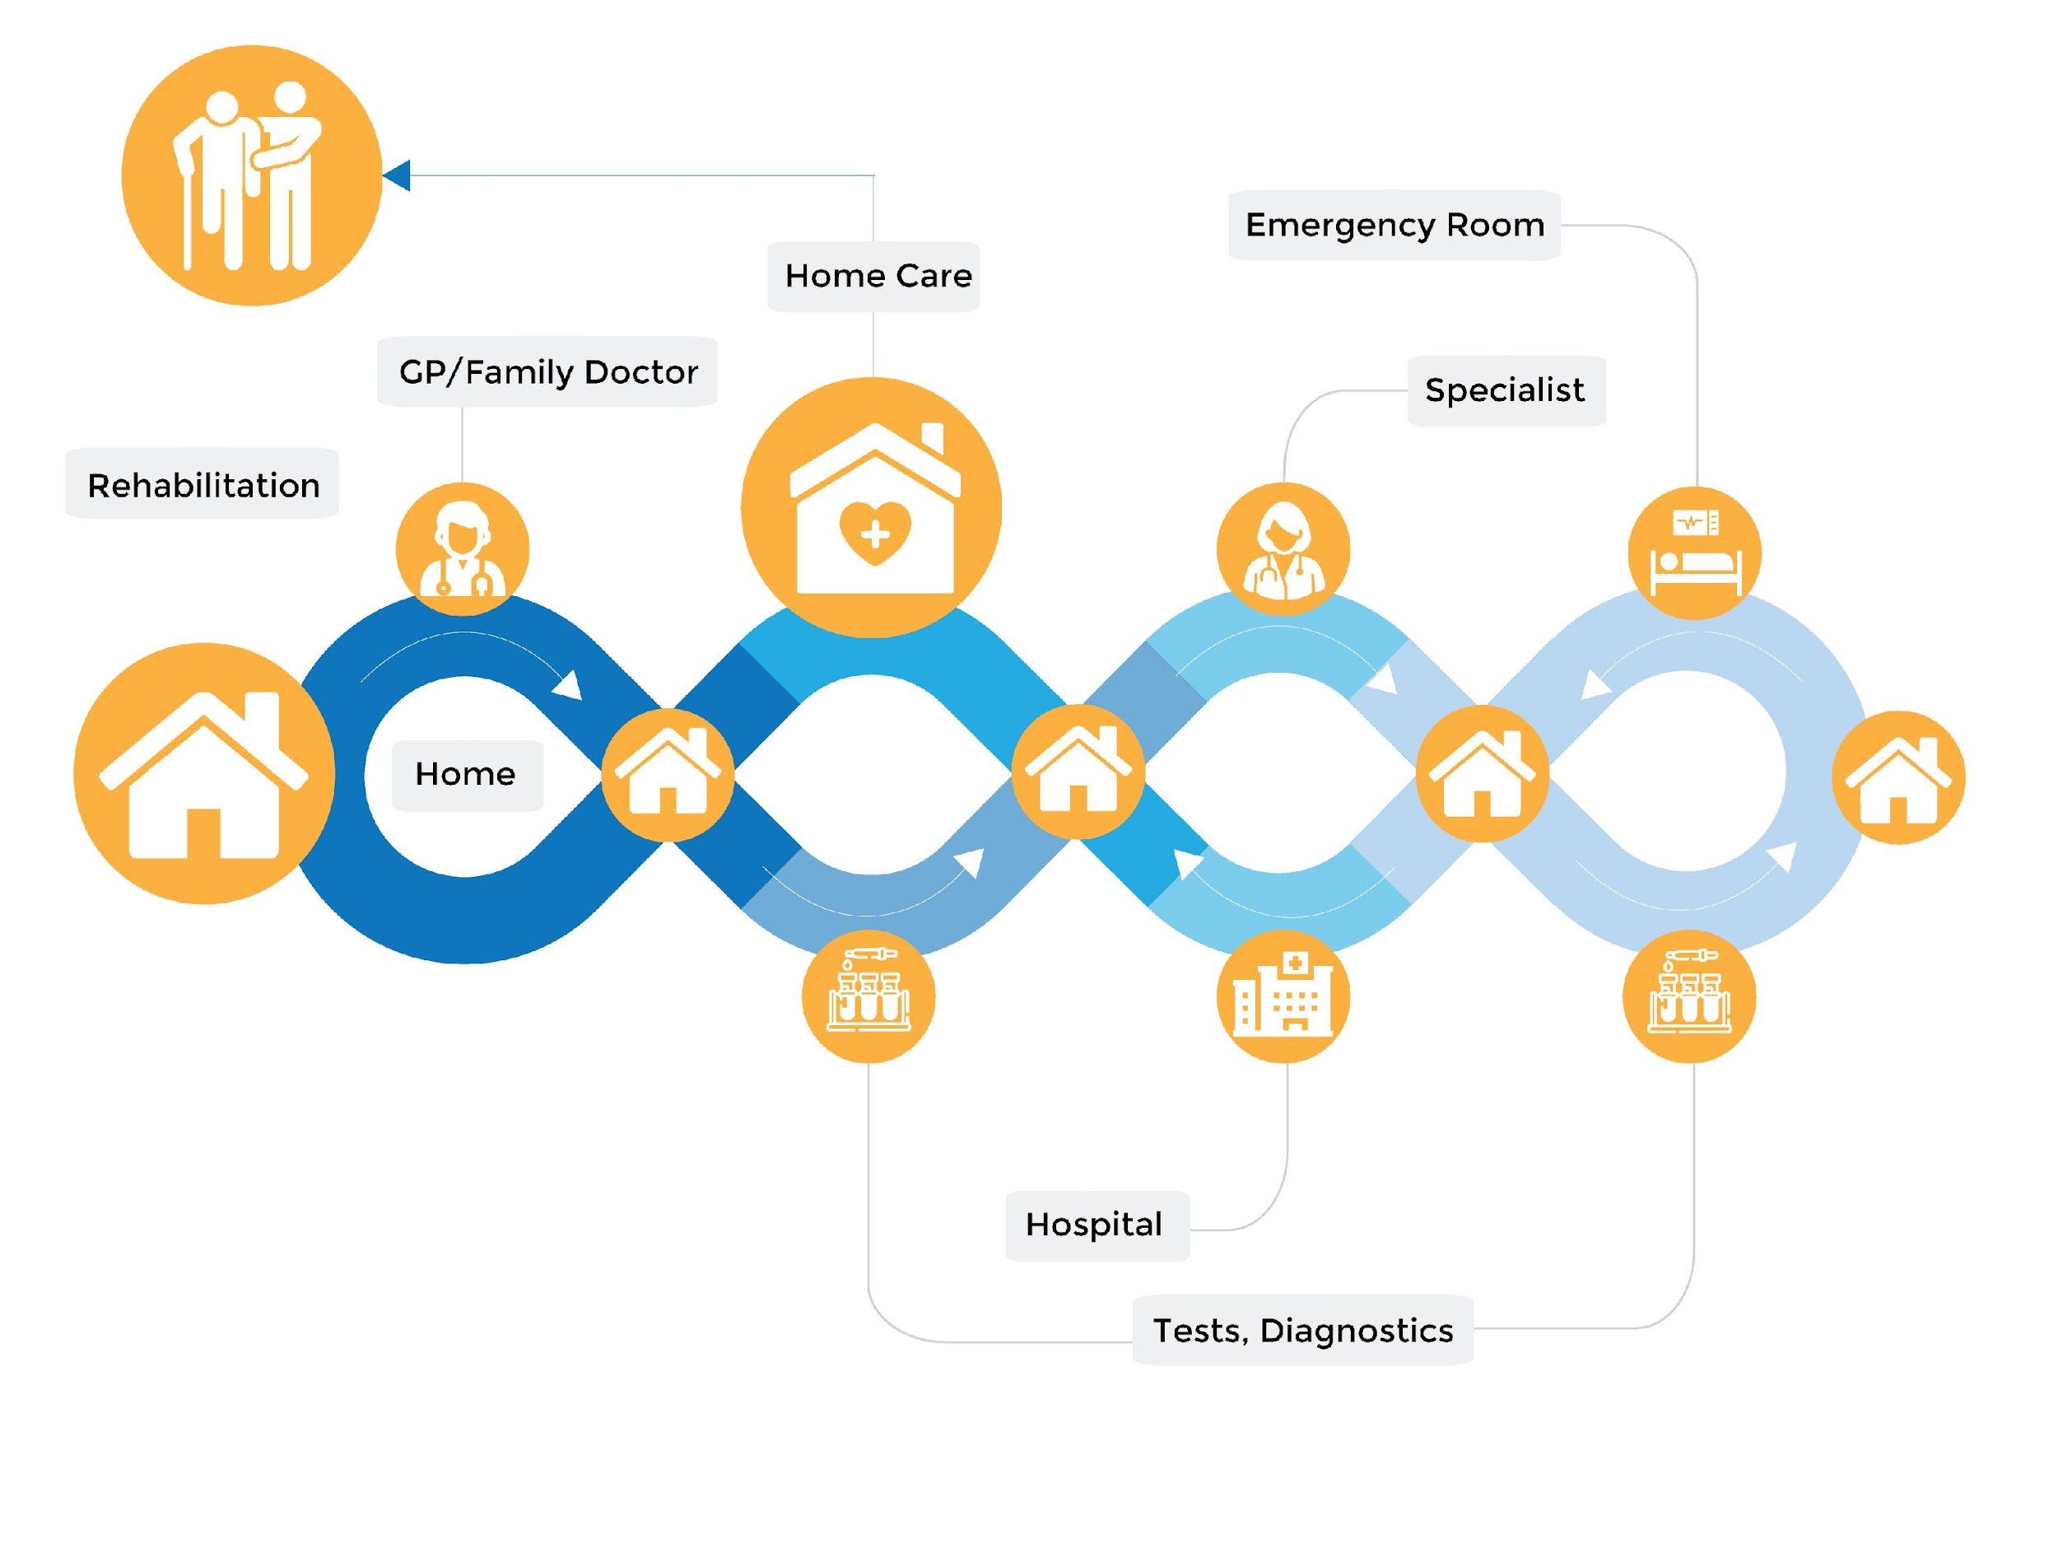

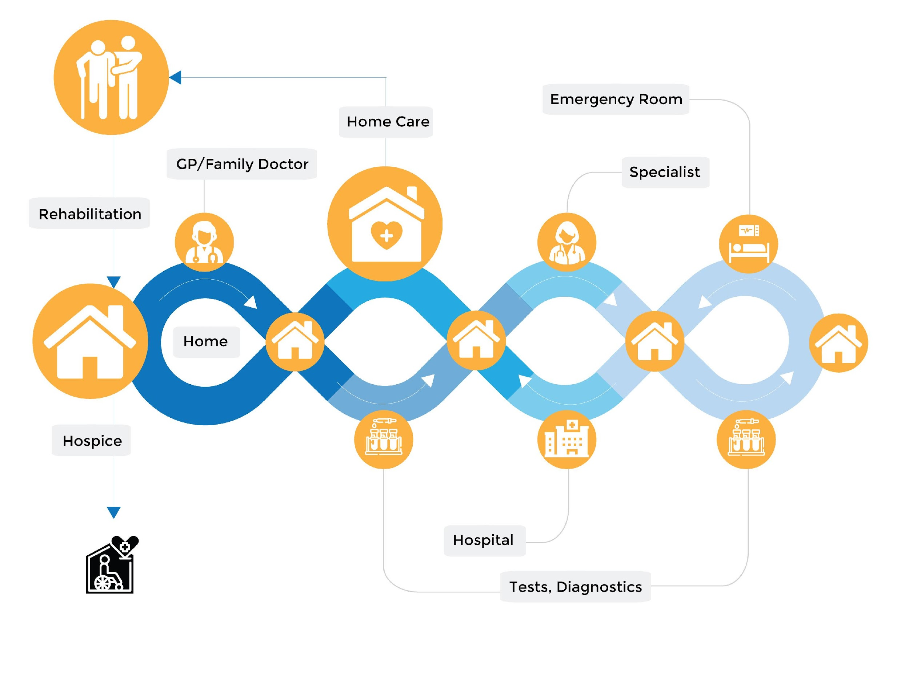
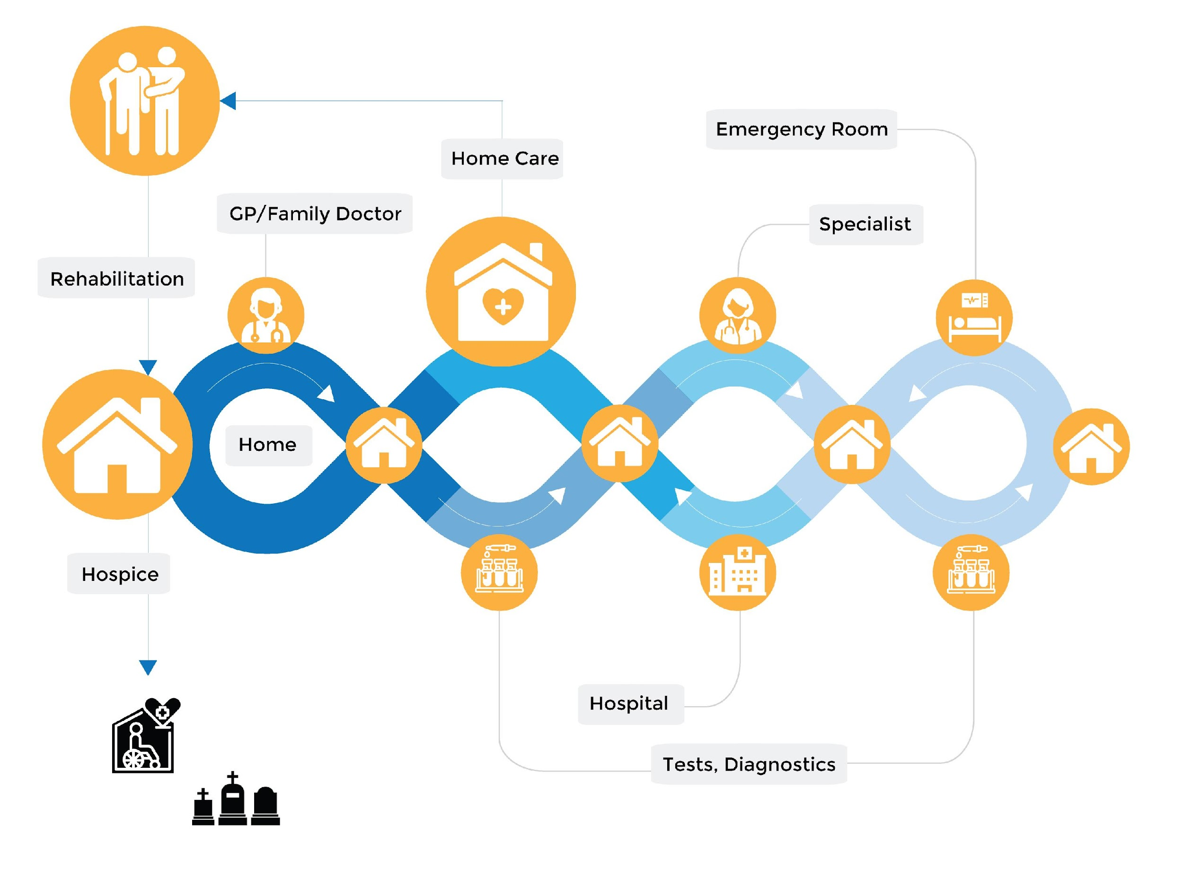
Notes:
Consider what happens for people dealing with a serious illness. When we get sick we are at home, and wait until it is too bad for us before visiting our family doctor. They give us some medicine, advice, and send us home.
Maybe they order a blood test or other lab work. And we go back home
And if it doesn’t get better, they send us to specialists - maybe having to wait 6-9 months for that (but that's a different problem)
And back home
Repeated visits to doctors, specialists, labs and pharmacies may cure us, but if it doesn’t the next step is usually the emergency room - a terrible experience for anyone who has had to endure it. We might be sitting on a gurney in a hall (or a closet in some cases) for days - and then shuffled into hospitals.
Our hospitals are pretty good - don’t get me wrong, it is not all bad here. But the hospitals are overcrowded and like us, understaffed. It is a stressful place for everyone there, employees and patients alike. The hospital may perform surgery or other interventions on the patient - but as soon as they can they want to get you out of there - and back home.
At some point on this journey you may qualify for home care - but all of us know how fragmented that is for clients and families. Home and Community Care may allocate a few hours a day for clients, with specific tasks. This is often not enough for the client, and even if it is, it is rarely enjoyable. The caregivers are not given enough time to connect with their clients in a meaningful way. And because everyone is short staffed at these agencies, clients may often have 2 or 3 agencies coming in. Think about that for a moment from their perspective. That client now has a Care coordinator at Home and Community Care. And maybe they have a care manager at Bayshore, Saint Elizabeth, and Stay at Home. They have different caregivers from each agency. They have 3 separate, uncoordinated care plans. They have 3 family room portals. They have 4 or more phone numbers to call their Care coordinator, Care Managers, 3 separate Scheduling teams, multiple email addresses to reach out to when they need help. But who should the tak to
If we are lucky, we get to go to rehab, and our long journey allows us to go home for more healthy years. But as we get older, we cycle through this endless journey, over and over again with increasing speed. And eventually we are not allowed to go back home, shuffled off to Long term care. Quite sadly the average length of stay in LTC is 13.7 months, before we pass.
It’s a mess. All of us do our best - but the system itself is not set up to be successful.
This has to change.

Slide 12
Caregivers
Industry
Clients
Notes:
As part of our strategic consulting, we have created a vision for how this could change. We have a plan, but we cannot do it alone.
To make it work we have to recognize that Caregivers are the central pillar to this. They are the core of the care that is being delivered. .
Clients also have a role to play - they need to be supported with education, advocacy and empowerment.
Finally significant industry changes are required - regulations, accreditation, and oversight to ensure high quality care with the proper respect for clients and caregivers.

Slide 13
We envision a home healthcare ecosystem that is not just interconnected but empowers clients and inspires transformative industry change, a future where every individual plays a crucial role in reshaping healthcare.
Pillars of Excellence: Elevating caregivers to professionals ensures a stable, supportive, and ambitious workforce.
Empowering Clients: Our commitment to empowerment replaces institutionalization, offering a personalized and dignified health journey at home.
Industry Collaboration: Join hands with us in building a framework that sets new standards, ensuring quality care and a living wage for all.

Slide 14

Primary Care Manager
Remote Monitoring Feeds
Unified Care Teams
Clinic (owned)
Hospital engagement / hand-off mgmt
Mobile Clinic
Caregiver Appreciation
Educational Portal
Unified Family Portal
Super user recog’n
CG Community Launch
Matching 2.0
Compass For All
Socio-Economic Determinants
Caregiver Persona
Unified Health Portal
Client Persona
Scheduling Optimization
Financial Incentives Model
Navigator Certif’n
AI Navigator
High-Risk Predictive
Private Care Buildout
Core Training & Certific’n
Feb Strike
Sept. Strike
March Strike
Journey
9 Months
Navigation
18 Months
Comprehensive
27 Months
Notes:
For our caregivers - let’s consider. They are asked to do one of the toughest jobs out there, both physically and mentally stressful. They are expected to do this without job security, without reasonable financial stability, with little or no community support, and without recognition of the professionalism in their role, or a career path for them to grow and succeed. Churn is high, and maintaining quality of care difficult.
We have created a blueprint for the next few years of technology and other initiatives we believe will change this.
Some key elements here that we think could make a difference:
Training and certification to help care teams build new skills, linked with financial rewards
A robust and independent caregiver community - think about Sephora Beauty Insiders but for caregiving and nursing, providing the caregiver both practical advice on doing the job, but moral and psychological support for this tough career.
A unified family room portal for clients to see at a glance their health data, and their healthcare team - across the full breadth of health services.
And finally a new role for a health care navigator - an experienced, certified advocate for the client.

Slide 15
Blueprint for home healthcare Transformation
At Stay at Home Nursing, we have crafted a strategic blueprint for the future, leveraging technology and initiatives for a brighter tomorrow:
Training and Certification: Empowering care teams with new skills, offering financial incentives for growth.
Caregiver Community: providing practical advice, moral support, and a sense of belonging for caregivers and nurses in this demanding profession.
Unified Family Room Portal: A revolutionary portal offering clients a comprehensive view of their health data and healthcare team, spanning the entire spectrum of health services.
Healthcare Navigator: Introducing a dedicated role—an experienced, certified advocate for the client, ensuring personalized support throughout their health journey.

Slide 16

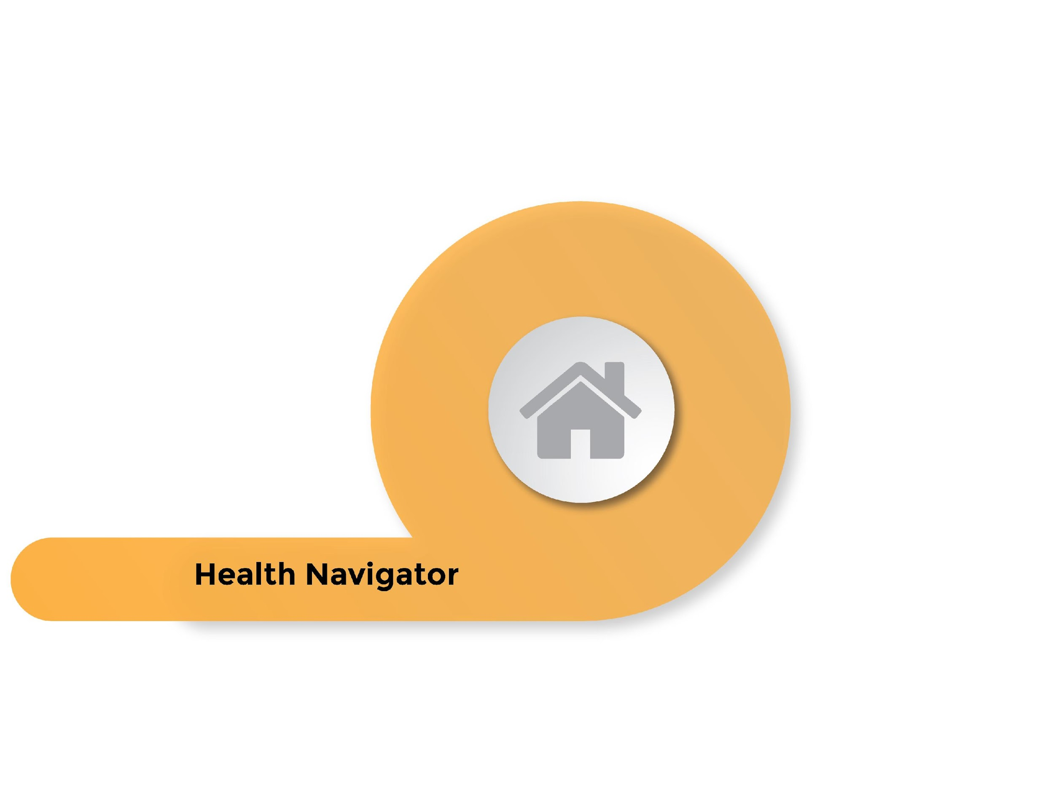
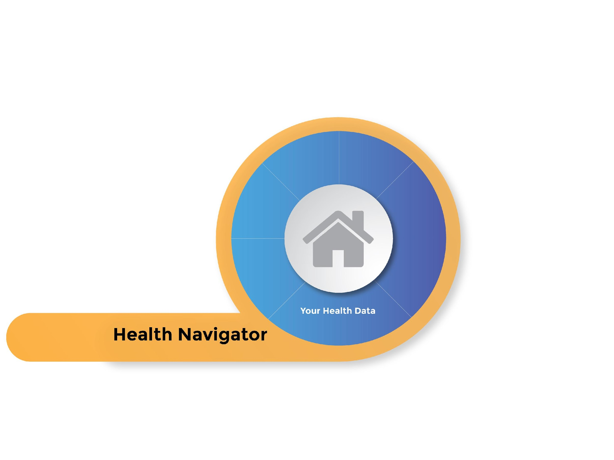
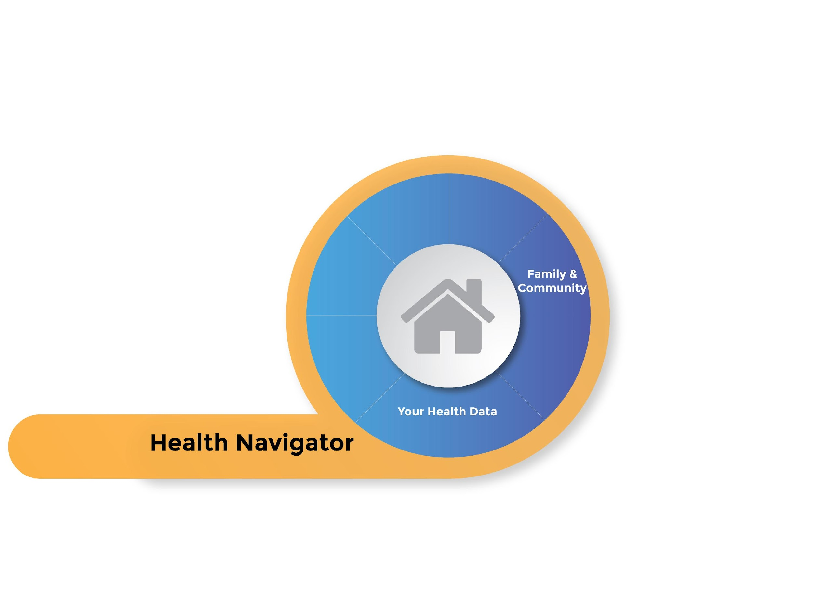





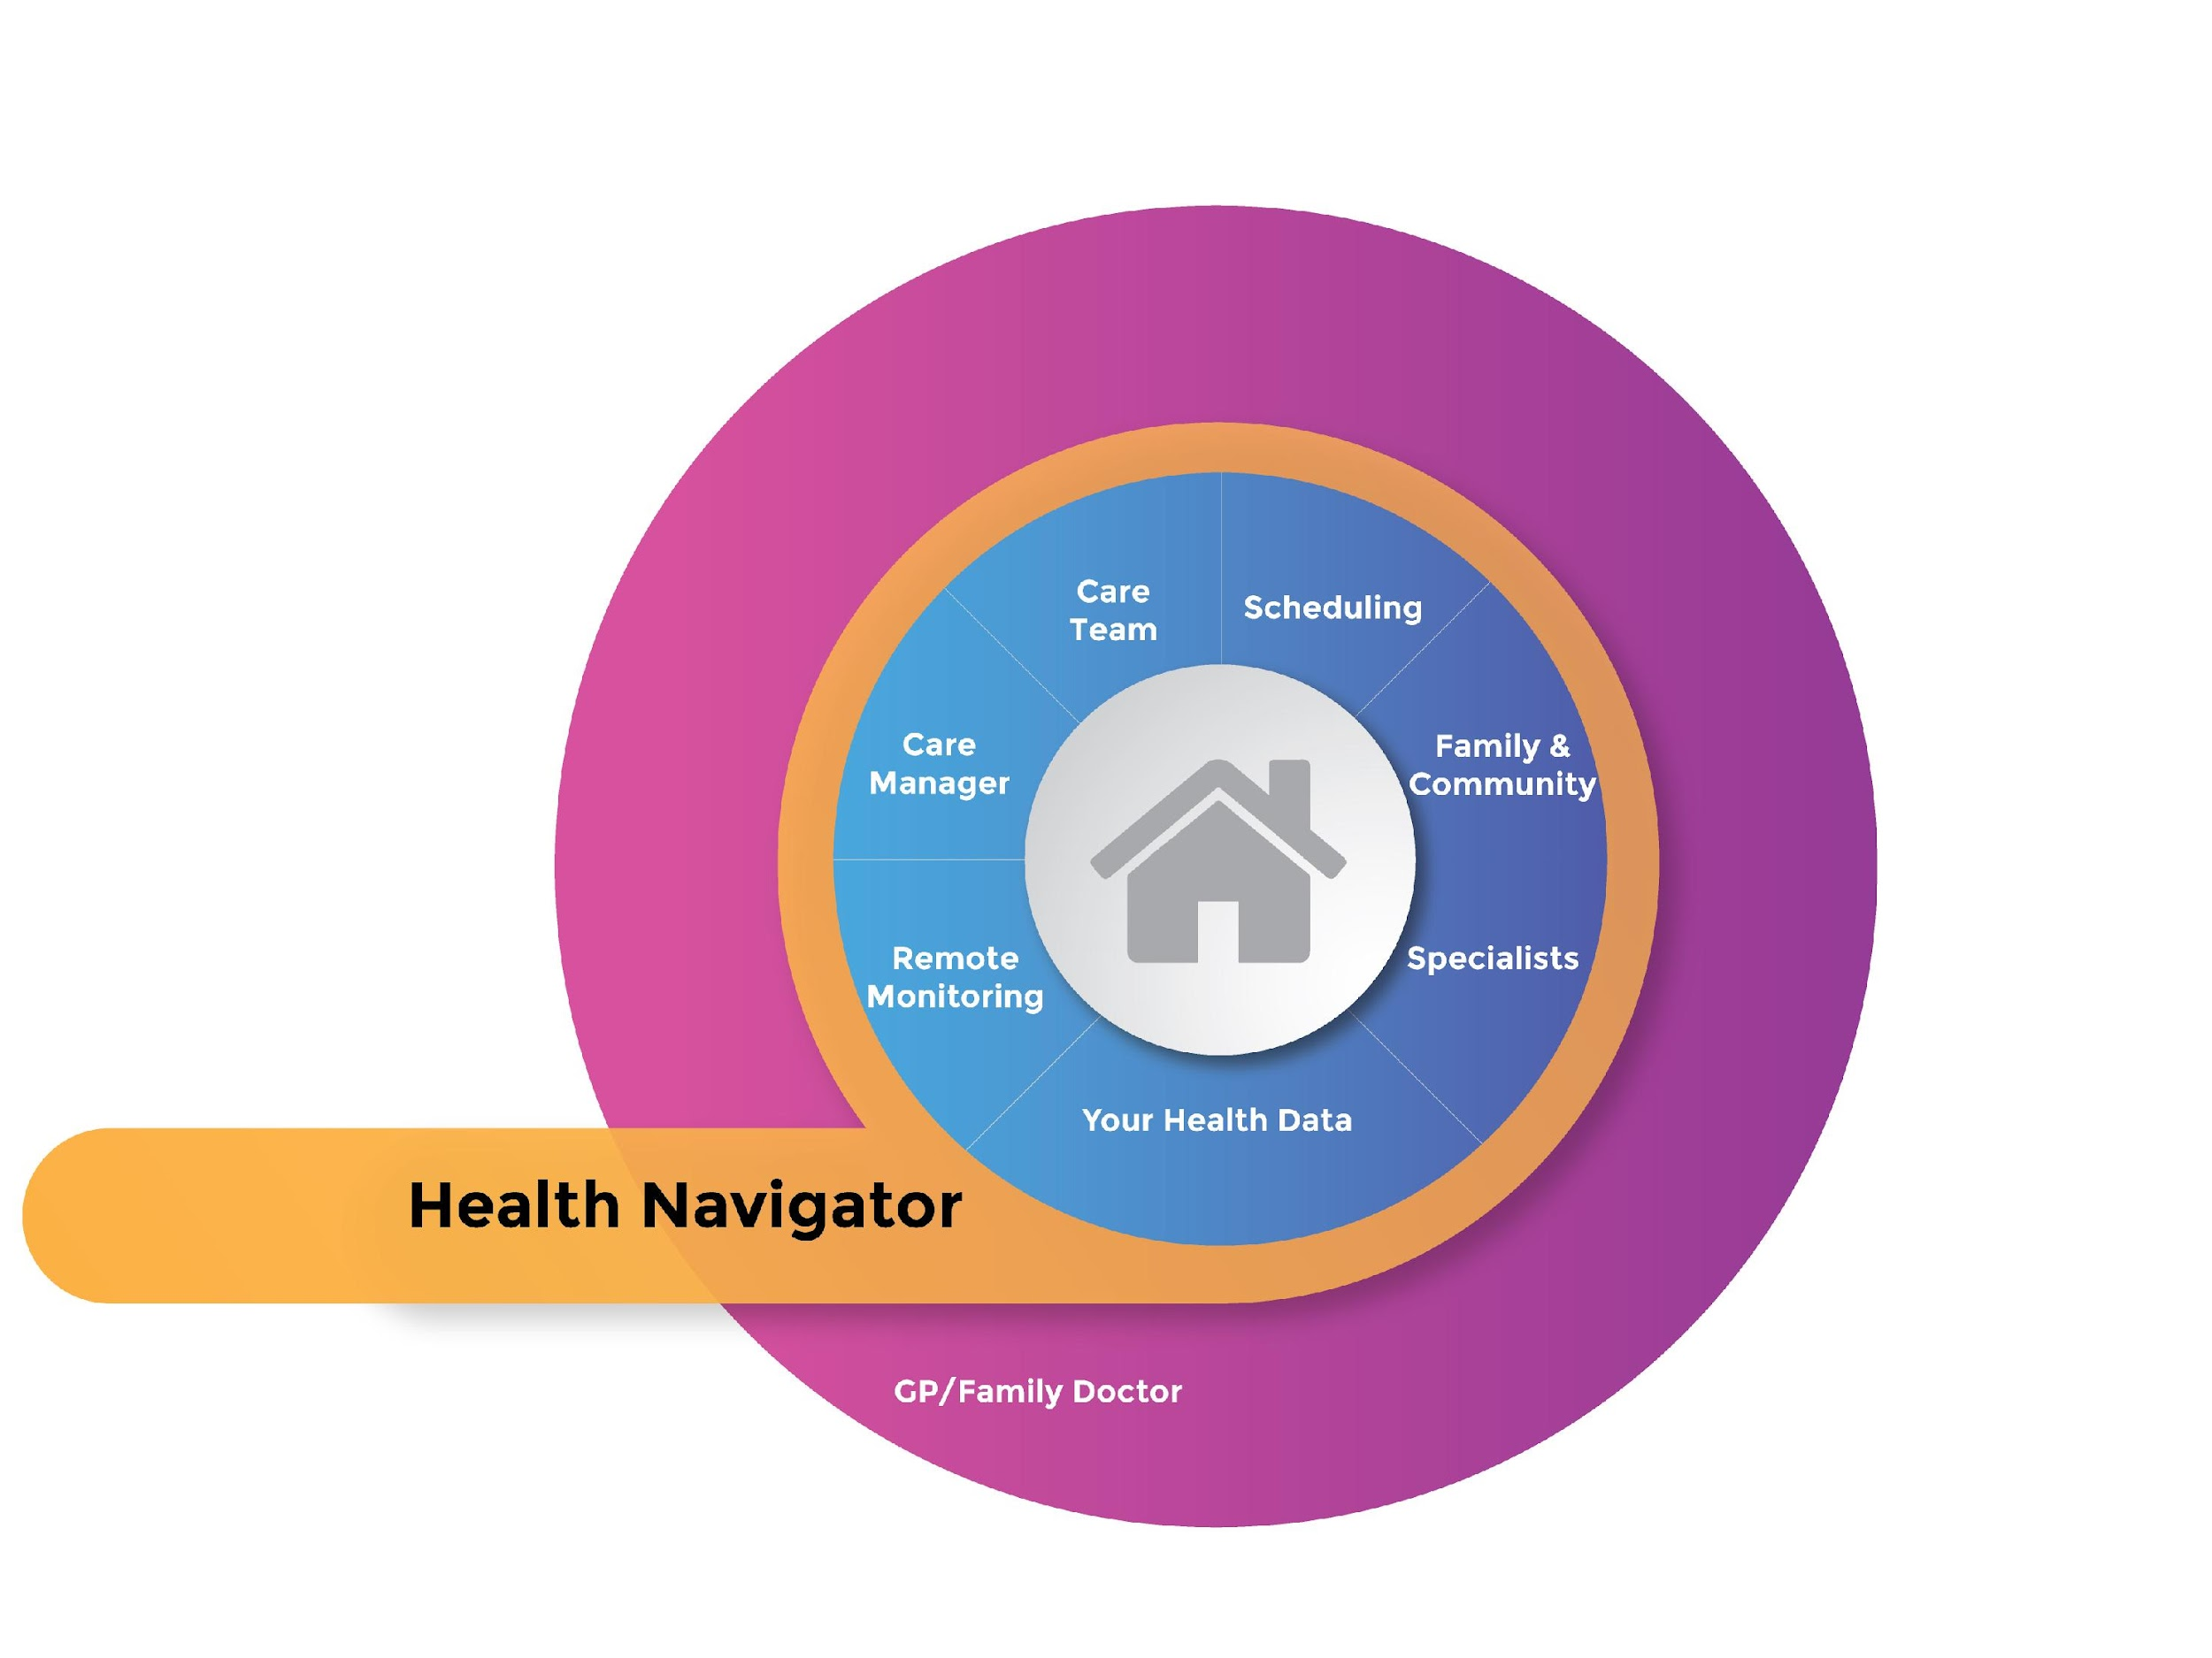



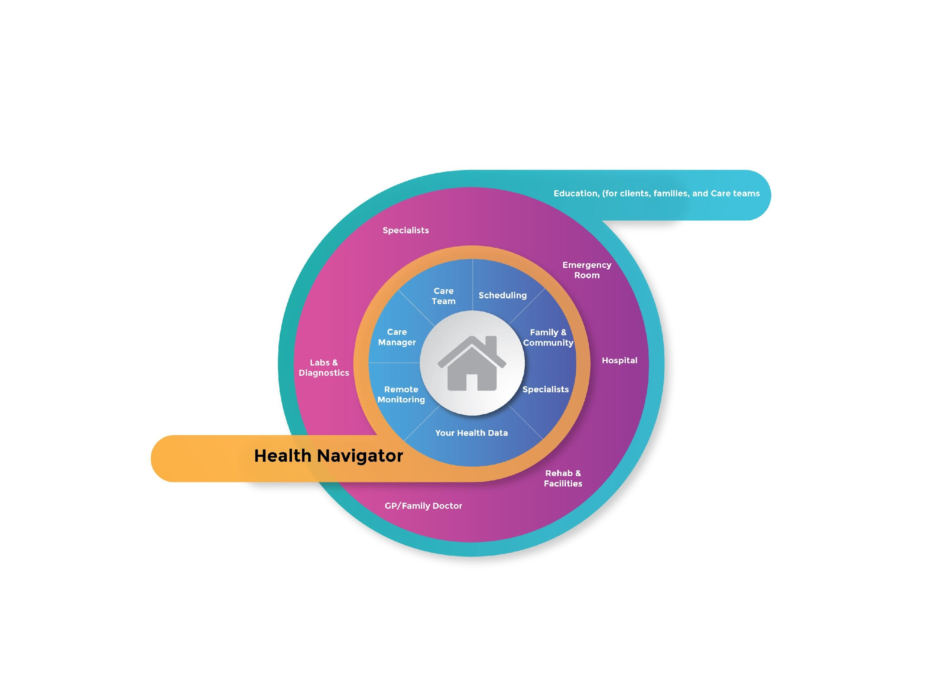
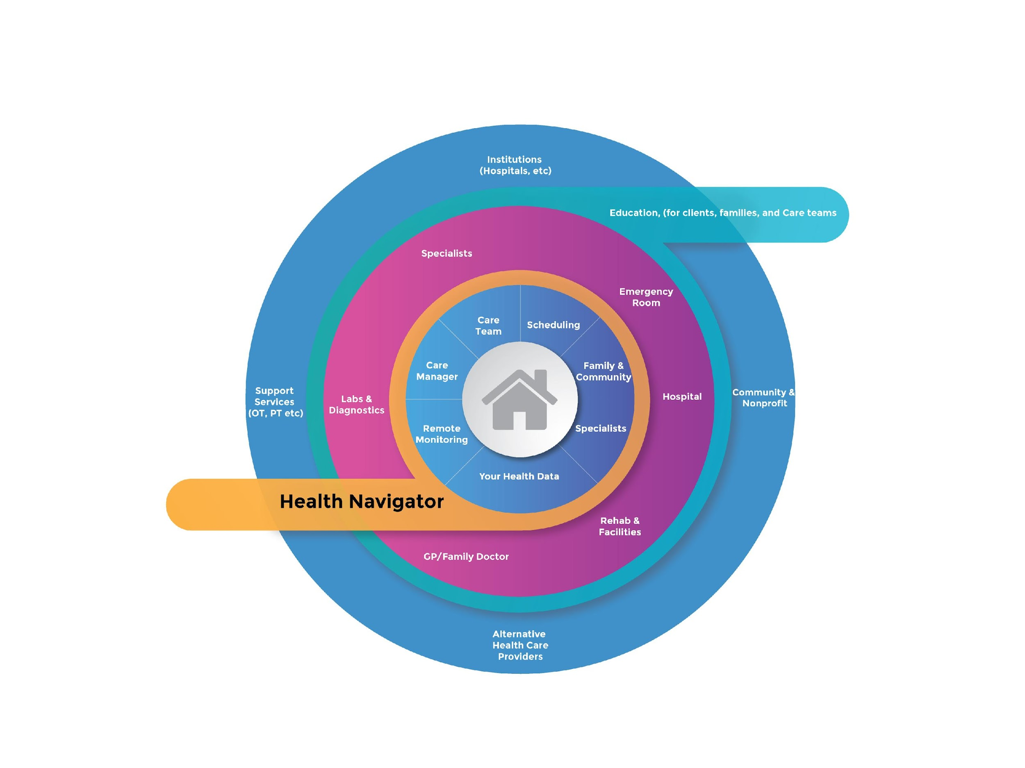
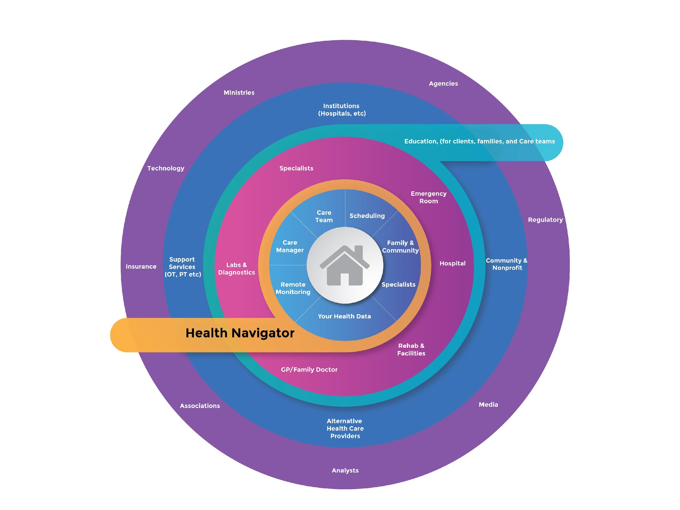
Notes:
The navigator role we see as crucial. When we get sick, for many of us we have no idea what to do, who to talk to, how to manage. Imagine a trained individual who knows the system inside out, who has supported 100’s or maybe 1000’s of clients over the years on finding the care they need when they need it, and acting as a guide and advocate for the client at every stage of this journey.
They will get to know their clients and their conditions - helping them to set up a unified view of their health data so that everyone on the team is working with the same information and not missing things. This will be data controlled by the client - their personal health information, and they can control who gets to see it - but it is comprehensive. Family and friends that are helping the client will be brought in and can have full or restricted access to this portal so that extended care can be provided seamlessly.
The Navigator will help get the client get set up with a unified team of home health care support (even if it involves multiple agencies), directed by a primary care manager. A first step might be to get some tools in for remote monitoring - maybe as simple as a fitbit, maybe more complex with BP, temperature, HR, Blood Glucose monitoring, etc. all going into that central data, and an AI Navigator supporting the Human Navigator - watching for warning signs of possible issues - infections or illness progression that we might be able to manage better with earlier intervention and avoid the ER.
The Care team would evolve over time and with needs, and carefully coordinate with a smart scheduling team - to make a “meaningful match” with the right caregiving team for the clients needs - skills, personality and home situation. The Care Manager will bring in specialists for treatment at home - OT, PT, etc, nurses for infusion therapy or maybe dialysis at home.
Already we have a better solution for home care. But as we need to take those visits out to the doctor, or lab, or specialists, we will be getting more data, new prescriptions. This Comprehensive Health at Home will mean all that information is shared with everyone that needs it. If or when we have to go to ER or hospitals, we will have a plan in place long before they come back home to support them. The same holds with going out for Rehab or specialty services - all of it is communicated to the team providing comprehensive health at home.
All of this nestles within an infrastructure of continuous education for care teams, clients, and families. We are supported - both for specific visits, but also more broadly in community by Hospitals, care facilities, community and non profit client advocacy groups, specialty medical services like physio or OT, and alternative care providers.
On the broader areas, many other players would play a role in shaping the industry, budgets, strategies, technology, oversights and quality of care.
Now - I want you all, with everything I have said to just pause a moment. We have written a manifesto - a bible - for what we want to see change. Stay At Home Nursing cannot do this alone, and so we hope to find allies to help us on this journey.

Slide 17
Elevating Healthcare at home Ecosystem through Comprehensive Health Navigation
Our Health Navigator transcends traditional models, fostering expert guidance, client empowerment, and collaborative care teams.
Expert Health Navigator: adept at navigating the healthcare landscape, guiding clients, ensuring optimal care and streamlined experiences.
Client-Centric Data Control:
  Secured Health Information
  Unified Health Data View
Integrated Family Support: facilitate inclusive family participation, providing restricted yet meaningful access to the client's health portal.
Adaptive Caregivers Teams:
  Smart Scheduling Solutions
  Expert Integration
Comprehensive Health Information Sharing:
  Revolutionizing Data Exchange
  Proactive Transition Planning
Empowering Stakeholders: Continuous education initiatives for care teams, clients, and families, supported by key healthcare players and institutions.
Inspiring Transformative Change.
We envision a healthcare at home ecosystem that is not just interconnected but empowers clients and inspires transformative change.

Slide 18
This Is Our Point of View
Notes:
Please take these next 4 minutes. Put your phones down. Tune out all distractions. Listen to this manifesto - and at the end I want you to ask yourself. Is this something you want to be part of?
[POV Manifesto]
It’s good to be home.
It’s our center. We know it. It’s our safe place.
So when we are met with a health challenge we naturally want to deal with it at home. It’s less stressful. It avoids an additional layer of unfamiliarity and tension. And it drives better health outcomes. There’s plenty of research validating homecare throughout a health issue not only improves health outcomes, but also lowers costs. It’s a better experience for the patient, and it lowers impact on the healthcare system.
But this critical role of homecare in the healthcare ecosystem has never been as defined or recognized as it needs to be. And in fact its role and criticality is only growing and intensifying as our population ages, rising rates of chronic diseases persist, and post-pandemic ripples are still being felt.
If we truly want to have a comprehensive health system and capability, then homecare necessarily plays the core, foundational role within it.
And at the heart of homecare it is, and always will be, about people. It’s about getting a meaningful match between the client and the in-home caregiver. Over time, as the client’s situation evolves this matching needs to be adaptive, predictive and to also have the capability for judgement calls by the care-manager. This combines into a trusted health navigator, who has a comprehensive understanding of healthcare steps and players, and helps the client across the health journey, guiding and supporting where needed.
It also demands ongoing education of the client around their condition and its management. Clients including families must become their own advocates for communicating their issues and needs. This rises above defaulting to an institutionalized or infantilized environment for our elders or those in medical recovery. It enables ageing gracefully in the community for longer, while also providing support and respite for family members.
On the Caregiver side, the homecare model only really works if there is personal growth and learning. Continual education, development and certification means that it is a career opportunity, and not a transient gig. So whether it is infection management, or dealing with dementia or a host of other key certifications, it is an ongoing journey and progression.
Linked to this is the financial incentive and rewards of having this skill and certification. It means a dynamic, not stagnant roadmap for a fair and equitable compensation for a very challenging profession.
And when it is needed, there needs to be community and support for caregivers, helping avoid burnout, and maintaining the passion to make a difference in clients’ lives.
This symbiotic relationship between client and caregiver doesn’t operate in a vacuum. There is a large, complex ecosystem and industry that interacts and impacts on comprehensive health at home.
Consider medical records and its timely exchange and access to help client outcomes. This is still far too complex and slow, with clinics, specialists, hospitals and homecare often working with only fragmented, isolated segments of information. It needs to evolve to more a centralized and personalized infrastructure across healthcare players to support homecare and client health outcomes.
Industry also needs to step up and recognize that caregivers or “PSW’s” are a massive, critical sector that lack formalized recognition as a trade and service. Being a hairdresser or barber has more structure and accreditation than homecare professionals providing critical support. This formalization and structure needs to encourage, and not restrict growth in the PSW profession. It needs to encourage professionalism, consistency, and continuity of homecare professionals. And in turn compensation, work environment and recognition must continually advance.
This new era recognizing the opportunity for Comprehensive Health at Home has never been more pronounced. The pandemic and its after-effects accelerated this, but understanding and formalizing homecare and its foundational role will drive improved health outcomes. It takes pressure off hospitals and primary care. It frees up beds. It lowers cost across the healthcare ecosystem.
It is integral to our health management and experience because there is nothing more personal than our health, and there is nowhere as safe, dignified, personalized and comfortable as our home.
And so we know this to be true: It’s good to be home.
At SAHN we understand this deep connection to our home, as well as its crucial role in a truly comprehensive healthcare experience. We’re not only building a team and company to deliver on this promise but are passionate about being part of the bigger change…about making a difference in individuals’ lives, but also helping drive change at scale, to make comprehensive health at home a reality. Come join us. Make a difference. Be part of the home team.
Pause….
.. so - I’ll pause here and see what kind of feedback you have on our vision and manifesto. And whether you think this is a worthy goal for us to pursue, and more importantly if we can work with you to achieve it.

Slide 19
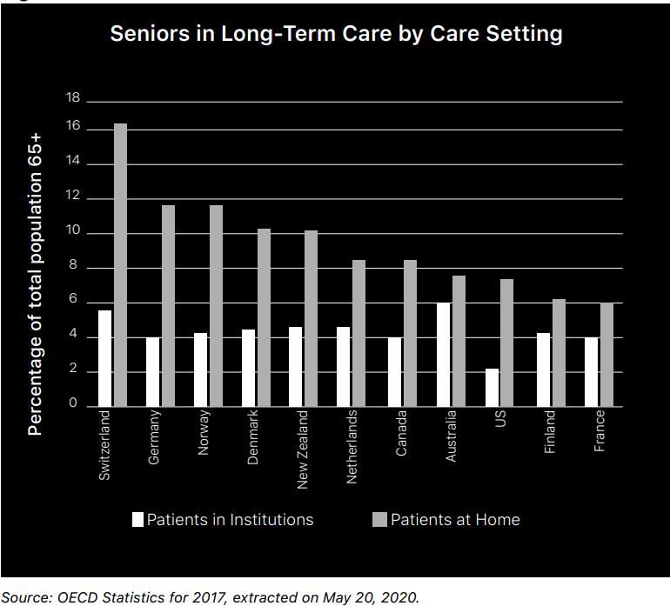

Slide 20
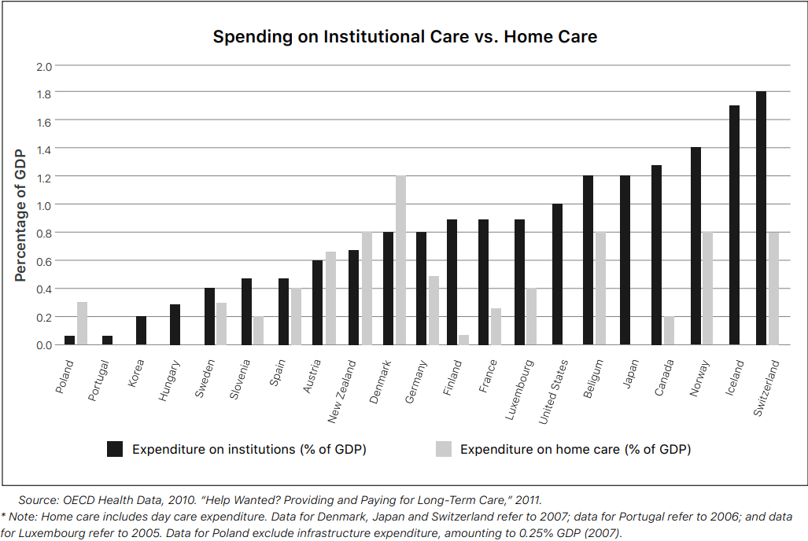

Slide 21
