Slide 2
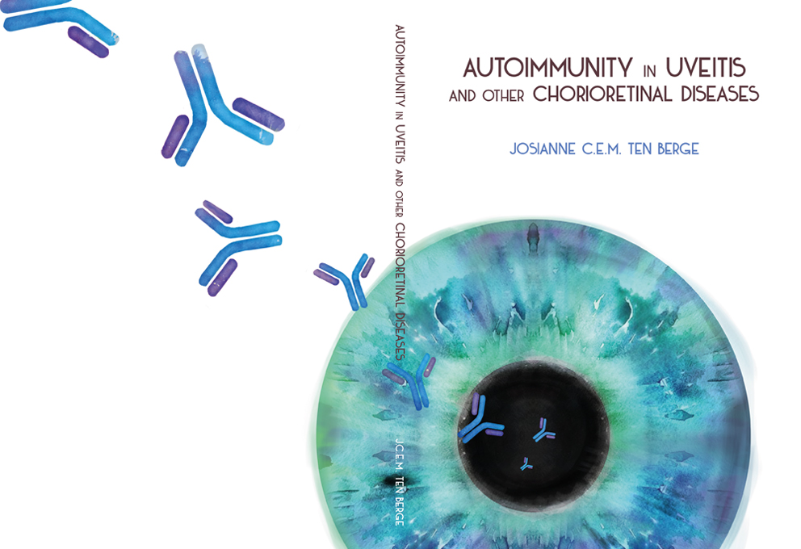

Antibody Based Treatment for
SARS-CoV-2
Arvind Gharbharan

