Slide 1
Instructions
Create an infographic called "Generative AI Opportunity Radar for Bid Response". (see slide 3).
I want to use it on social media (LinkedIn and Website).
I want the file to be scalable without loss of qualify
I added 2 inspiration graphics in my brief (see slide 2).
I want to use blue and grey as the main color. The blue colors I use in my logo are:
  0a93b7 for light blue
  092e40 for dark blue.
You can use other colors as you see fit; you don’t have to use the logo colors only.
I want to add my logo on the infographic. (I also uploaded my company logos)
My logo fonts are Trojan Pro Bold and Gotham Medium font. You don’t have to use the same fonts as the logo, you can use other fonts as you see appropriate.

Slide 2
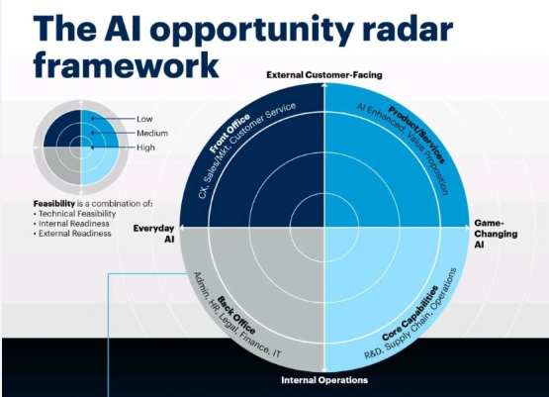
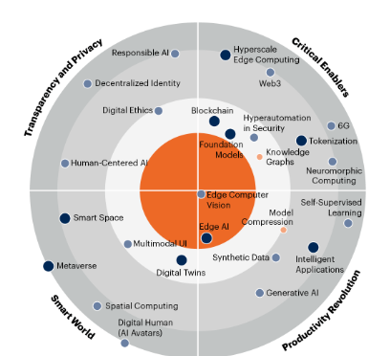
Inspirations

Slide 3
Generative AI Opportunity radar for Bid Response
Process enhancement
Company profile
Decision Support
CV and Resumes
Bid/No Bid Analysis
Proposal Development
Past Performance
Bid Qualification
Opportunity assessment
Technical solution
Compliance Matrix
Win Probability modeling
Statement of Work
Strategic Pricing optimization
Executive Summary
Security Questionnaires
Insights generation
(Transformative application)
Compliance assessment
Due Diligence Questionnaires
Task Automation
(foundational use)
Capture Plan
SWOT Analysis
Customer Hot Buttons
Customer Intelligence
Competitive Intelligence
Value Proposition
Proposal plan
Proposal outline
Differentiators
Win Theme extraction
Key messages extraction
Capture Strategy
Proposal Strategy
Strategy Enablement
Notes:
Generative AI Opportunity radar for Bid Response

