Slide 1
ICXI LOGOS
www.icxi.com

Slide 2








ICXI
Typeface
Microsoft Yi Baiti ????
Works as a cypher
On white or colour
Works as a logo
Works as a cypher BW
Works as a logo BW
Works as a distinctive header/footer/badge
Type Face
Dubai ????
Does NOT Work as a cypher
On white or colour
Works as a logo
Works as a cypher BW
Works as a logo BW
Does NOT work as a distinctive header/footer/badge

Slide 3

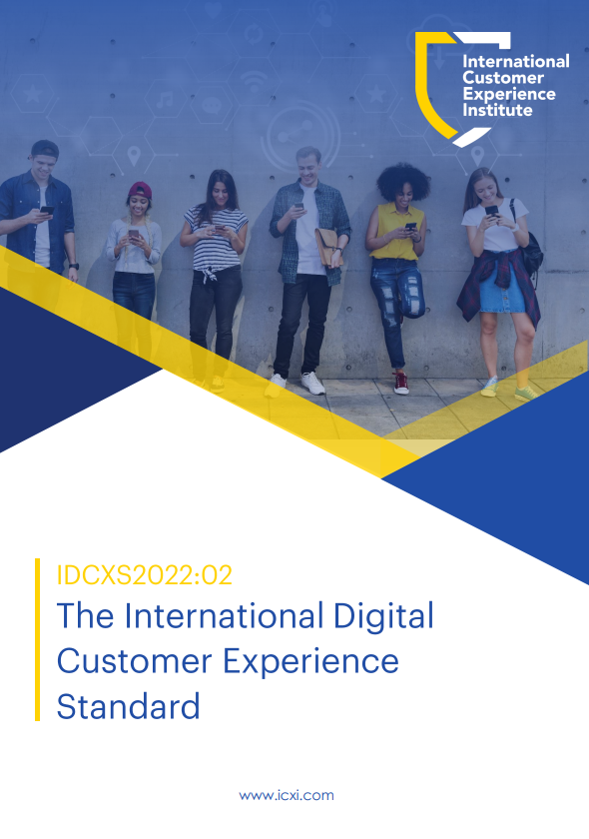

Where We are at - Standards
PRETTY GOOD!

Slide 4











Works as solid
Works sometimes as
transparent image
Does not work as
transparent image
on Light Backround

Slide 5

Works as solid
Works as
transparent image
Works as
transparent image
on Light Backround

