Slide 1
Introduction
This document contains detailed design requirements.
While the document describes it on a PC screen, please make it responsive design so that it can also be displayed on smartphones.

Slide 2
Task Description 1/2
Project Overview
  Site Name: Shrine Align
  Target Audience: Visitors to Japan
  Usage Scenario: Trip planning before and during the visit to Japan
Functionalities
  Plotting the names and locations of shrines and temples across Japan
  Enabling users to select multiple shrines and temples and proposing optimal touring routes
  Intuitive user interface without relying heavily on language explanations
Deliverables
  Source code (HTML, CSS, JavaScript, etc.)
  Site name logo
  Icons
  Favicon

Slide 3
Task Description 2/2
Deadline
  May 1, 2024
Design Requirements
  Responsive design for both PC and mobile devices
Design Preferences
  Catchy design suitable for coverage in domestic and international news media
  Unique design not typically created by Japanese designers
  Incorporation of Japanese traditions while maintaining a modern aesthetic
  Inclusion of motifs representing shrines and temples, such as bells and omikuji

Slide 4
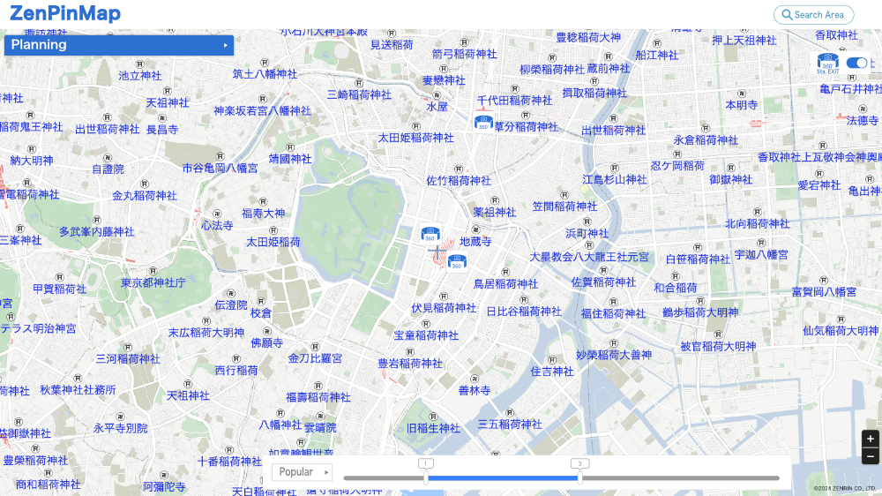

Image 1/4
Request
When clicked, please display the map of Japan as shown on the fifth page. Please create the design of the button and its behavior after being clicked.
Shrine Align
The website name will be stated here.
Request
Please design the font for the website name.
I'm thinking of storing links such as terms of use inside the hamburger menu.
Request
Please create a hamburger menu icon.
Make it so that when the icon is clicked, a menu with terms of use and others appears.
Please make it possible to close the menu.
360-degree image
show/hide toggle
Request
When you click the toggle button, please make the 360-degree image icons appear on the map.
This icon represents the presence of a 360-degree image at the station entrance.
Request
Please design this icon.
Please set up the icon to open in a new tab when clicked.
This slider bar allows users to narrow down the popularity of shrines and temples.
Request
Please design the slider bar.
Allow users to move the bar from both left to right and right to left, narrowing down the range of popularity.
The background map and the zoom in/out buttons will be integrated by our company.

Slide 5
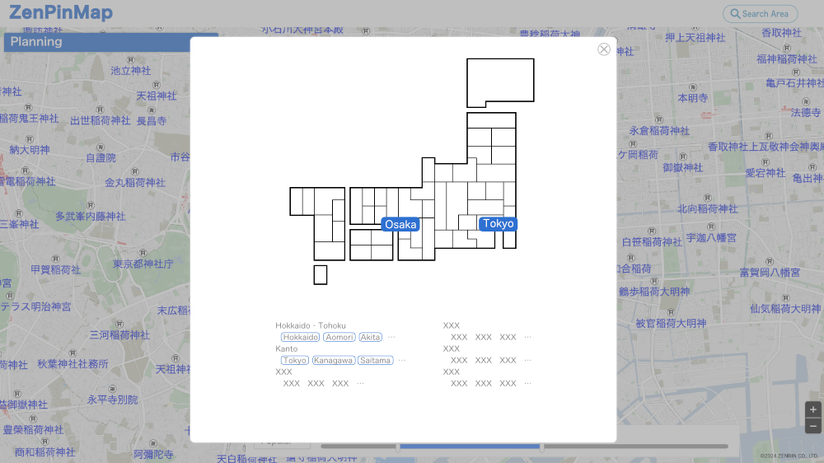
Image 2/4
Shrine Align
This is a map of Japan.
Request
1. Please make it possible to close the screen.
2. Design the interface for easy selection of one of the 47 prefectures.
3. Implement a design or animation that clearly indicates when one of the 47 prefectures has been clicked.
4. Upon clicking one of the 47 prefectures, please ensure it returns to the initial screen (slide 1).
I would like to place buttons for each of the 47 prefectures here. Please design buttons for each of the 47 prefectures.

Slide 6
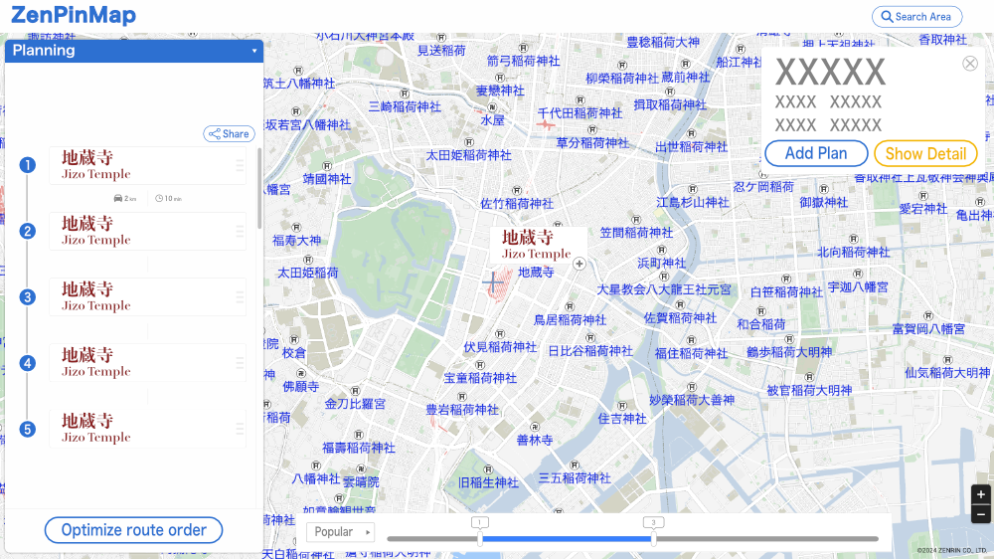
Image 3/4
This is the screen that displays detailed information about shrines and temples (such as name and address).
Request
When clicking on the stylishly written name of the shrine or temple(A), please make it show a detailed screen.
Create a button that adds the clicked shrine or temple to the "planning" section on the left side of the screen. Here, it's expressed as "add plan," but feel free to design it. Also, make the animation for the addition impressive.
Create a button that, when clicked, transitions to the detailed display page. Here, it's expressed as "show detail," but feel free to design it.
Make sure the screen can be closed with the "X" button.
Shrine Align
A
When you click on the blue text, it will display the names of shrines and temples in a stylish font (both in Japanese and English)(A).
Request
Please create a div to display the names of shrines and temples in a stylish font.
Enable dragging the div created in 1. so that it can be added to the "planning" section on the left side of the screen.
When dragging to add to 'planning,' please ensure that the trajectory looks visually appealing.
When you press the plus button at the bottom right, please ensure that it is added to the "planning" on the left side of the screen.

Slide 7
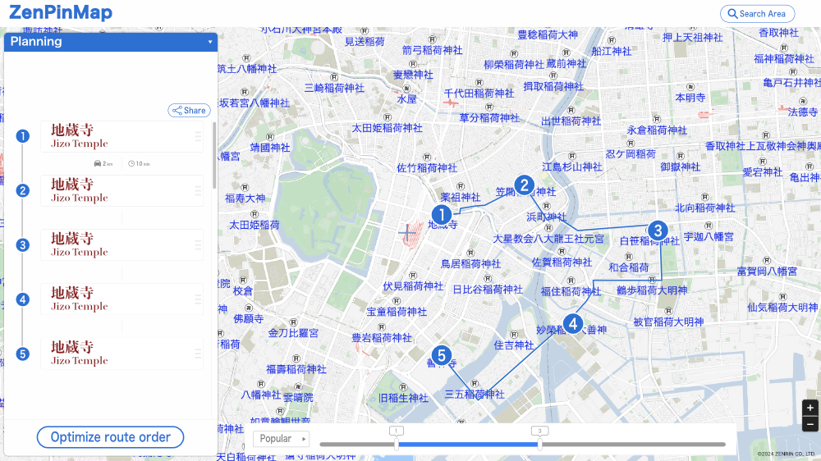
Image 4/4
Shrine Align
This represents the route around shrines and temples.
Request
Please create a pop-up to represent the route around shrines and temples as shown in the left figure.
Enable the pop-up to expand and collapse.
Display the order of shrines and temples. Also, enable dragging the elements to rearrange the order.
Allow deletion of elements.
Create a button to calculate the optimal route when clicked (expressed as "Optimize route order" in the figure). Also, create an animation for rearranging the order.
When the content exceeds the screen size, please make it scrollable

