Slide 1






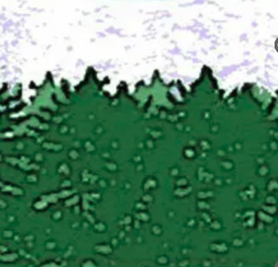
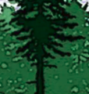
My T-shirt Mock-up:

Slide 2
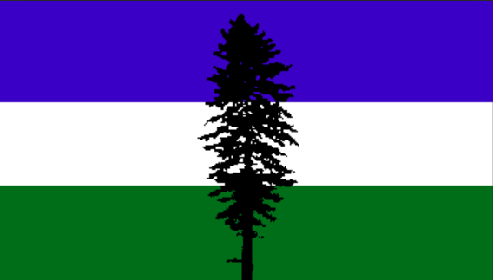

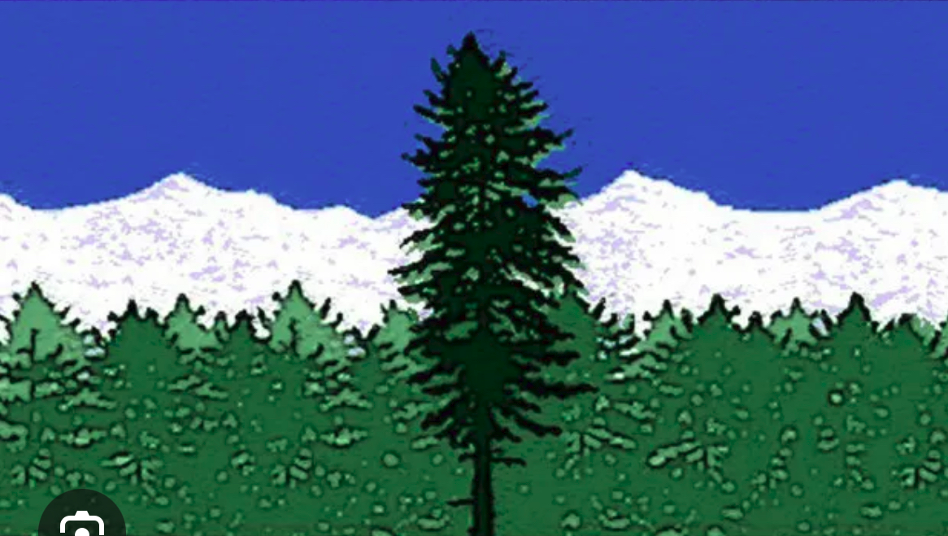
What I am trying to combine:
+
+
Some of the “natural mountain and forest effects” of this one

Slide 3

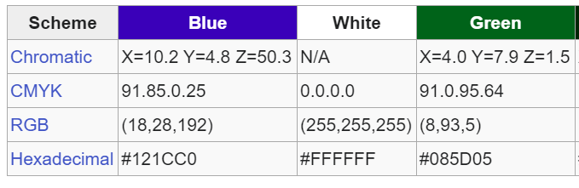
Colors: Limit it to 4 colors - The 3 colors below plus the black tree.

