Slide 1
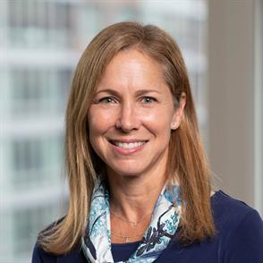
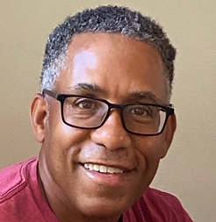
Who We Are
Lisa Freudenheim
Chris Foster
Lisa Freudenheim is an Associate Professor and Director of the Academic Enrichment Program at Boston University School of Law. She has devoted her career in legal education to teaching and counseling students and attorneys, with a focus on developing the fundamental skills to promote success and wellbeing in law school and in the legal profession. Previously, she served as a Professor and Director of Academic Excellence, and most recently as Dean and Associate Dean at New England Law | Boston. She is a former member of the faculty at Suffolk University Law School, a Visiting Professor at Boston College Law School, and a Teaching Fellow at Brandeis University. She earned a Bachelor of Arts from Tufts University and a Juris Doctor from New York University Law School. After graduation, she practiced employment law in Connecticut, New York, and Massachusetts. For the past twenty years, she has served as a consultant and advisor to major law firms and corporations nationwide in designing and presenting professional development training focusing on legal writing and analysis.
Chris Foster provides legal and business writing consulting services to businesses, business professionals, law firms, and attorneys. He earned a Bachelor of Arts, cum laude, in English from Duke University, a Master of Fine Arts in creative writing from the University of Iowa Writers’ Workshop, and a Juris Doctor, cum laude, from Harvard Law School. At the University of Iowa, Chris served as the poetry editor of The Iowa Review. At Harvard Law School, he served as treasurer and as an editor of the Harvard Law Review. Following graduation from Harvard, Chris practiced law at Hogan & Hartson L.L.P. (now Hogan Lovells) in Washington, D.C., then at Shook, Hardy & Bacon, L.L.P. in his hometown of Kansas City, MO. After private practice, he worked in the general counsel’s office of GE Insurance Solutions and Honeywell International. Chris was also dedicated to launching and managing with his sister and mother an ophthalmology practice in North Carolina that provides eye care services to patients at senior living facilities.
Notes:
Lisa, then Chris introduces himself

