Slide 1

<header>
Insert suitable pictures - ideally several changing or video background
<Tagline:>
Affordable IT Solutions That Revolutionize Tomorrow‘s Air Cargo Today

Slide 2
Web Map https://goldensupport.eu
INDUSTRIES
SOLUTIONS
OPERATIONAL SUPPORT
CASE STUDIES
TESTIMONIALS
NEWS
ABOUT US
Skyline Airline
ABOUT GOLDEN SUPPORT
Skyline GHA
OUR STORY
AWBline
HOME PAGE
OUR ETHOS
SKYTrucks
SUSTAINABILITY
Bee-Online
CONTACT
HOEM PAGE / NAVIGATION BAR / SUBPAGES

Slide 3

See notes below for instructions
HOME PAGE
Seamlessly connecting the air cargo industry from Manila to Tahiti
Blending decades of air cargo knowledge with end-to-end IT solutions.
Whether you are an Airline, GSA, GHA, Forwarder or E-commerce Operator,
our expertise can elevate your daily workflows, cutting down on expenses, time, and errors.
LEARN MORE
(link to INDUSTRIES)
We are not IT tech experts attempting to do cargo! We are cargo experts with programming skills!
FACTS:
Established: 2014 Countries covered: 18
Employees: 22 Connected Clients: 20+
Nr. of Annual Electronic Exchanges: 11,500,000 + Nr. of Annual AWBs: 350,000 +
Notes:
Create an animated graphic:
An icon of an airplane flying over a globe from Manila to Tahiti.
Highlight the following countries as it flies over them, without stating the names:
Country
Czech Republic
Slovakia
Poland
Serbia
Croatia
French Polynesia
India
Guatemala
Ecuador
Mexico
Suriname
Panama
Chile
Costa Rica
Ecuador
Canada
Philippines
Spain
Norway
France

Slide 4
Navigation bar: SOLUTIONS - SKYLINE FAMILY
VOICE YOUR ISSUES, WE WILL CRAFT THE SOLUTION
We cover the entire air cargo chain and can provide you with a tailored system for anything.
Data - Cloud - Connecting - Predicting - Analysing - Sharing
All Skyline solutions were crafted to enhance operational efficiency, ease, and automation in every aspect of air cargo value chain to drive digital transformation. These suite of solutions were developed with the expertise of airlines, general sales agents, handling agents, and forwarders.
The Skyline Family facilitates a distinctive link and interaction among the various components of the systems, while also enabling communication with the internal or external systems of different clients.
Additionally, Skyline solutions are designed in a contemporary setting, allowing for potential future advancements.

Slide 5
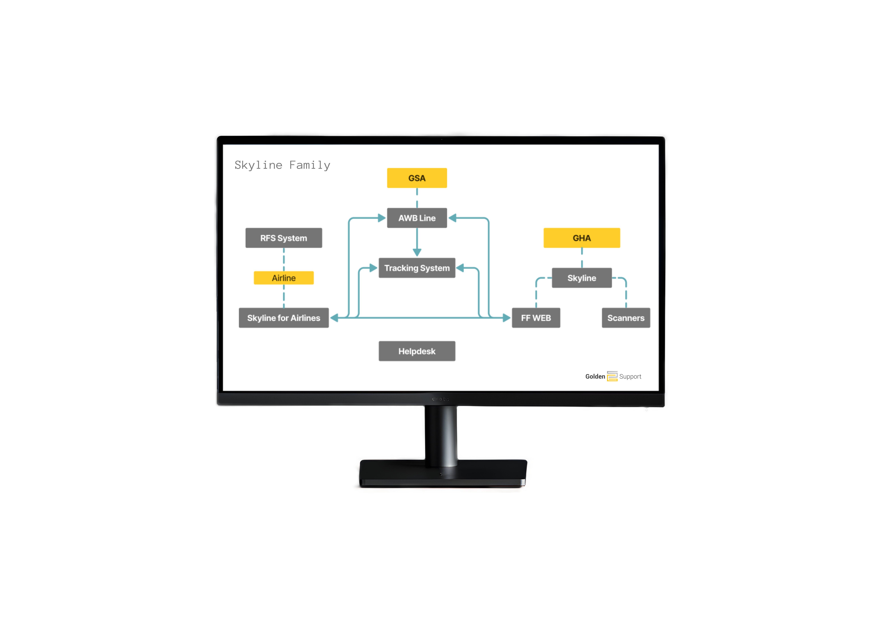





SOLUTIONS - SKYLINE FAMILY (continued)
CREATE CASCADING LAYERS:
Skyline Airline
Skyline GHA
AWBline
SKYTrucks
Bee-online

