Slide 1

Loose guide/proposal/inspiration for this project:
Logo is for a team “Spooky Slow Speed” running together in a road race. Looking for a logo to make T Shirts. T shirts will likely be white base. Must include “The World Famous” in this font at top – it is a connection to a logo we have used for others events (see next page). I would like the main feature to potentially a ghost (ideally the one pictured here, but not mandatory) “running slowly”. Open to ideas. Bricks for feet? Out of breath? An alternate idea would be a “spooky” tortoise? Or a cross-over between this white ghost and a “slow tortoise”? Our team held our own event 2 years ago and logo is on the next page. Keeping similarities – with a new twist would be great. No black fill background needed this time
*Color are welcome if appropriate – not bound to black and white*
The World Famous
Spooky Slow Speed
Team

Slide 2
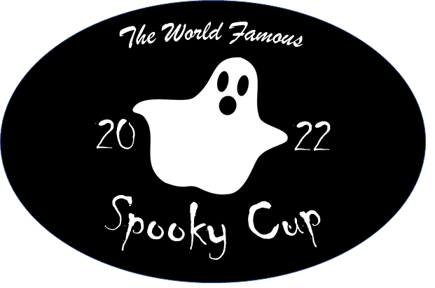
Previous logo (just for reference)

