Slide 1
Mastering Challenging Conversations

Slide 3
I like the look of this circle on the left – would be great if that could be shaped into a subtle speech bubble.

Slide 5

I like the look of this design where the thought bubble is somewhat hidden in the margin. I would want the colors to be more neutral. Shades of blue and white – teal or lime green for accent colors

Slide 6
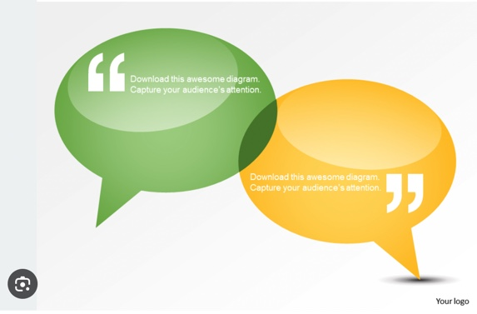
Something ike this would be good to see in shades of blue and white or dark blue and teal without the quote marks

Slide 7
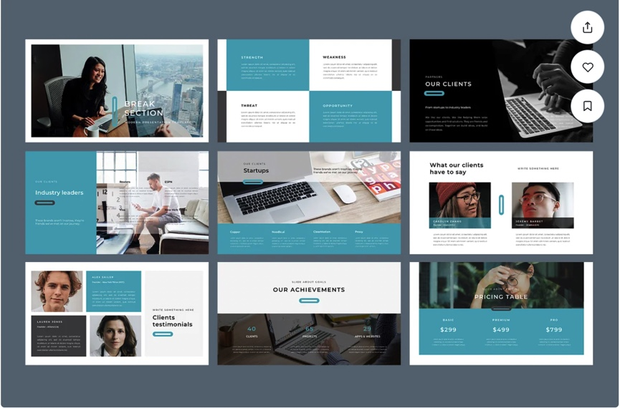
I like the bold clean look of this template. I don’t have photos in my presentation but will have graphic images to add.

Slide 8
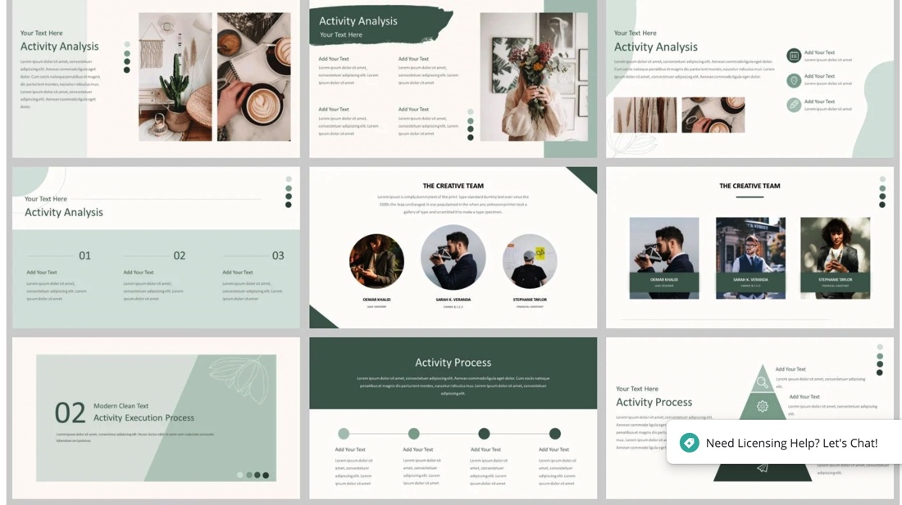
I like the backgrounds used in these slides and the way the content shapes are laid out – would be good to see this in shades of blue.

