Slide 1
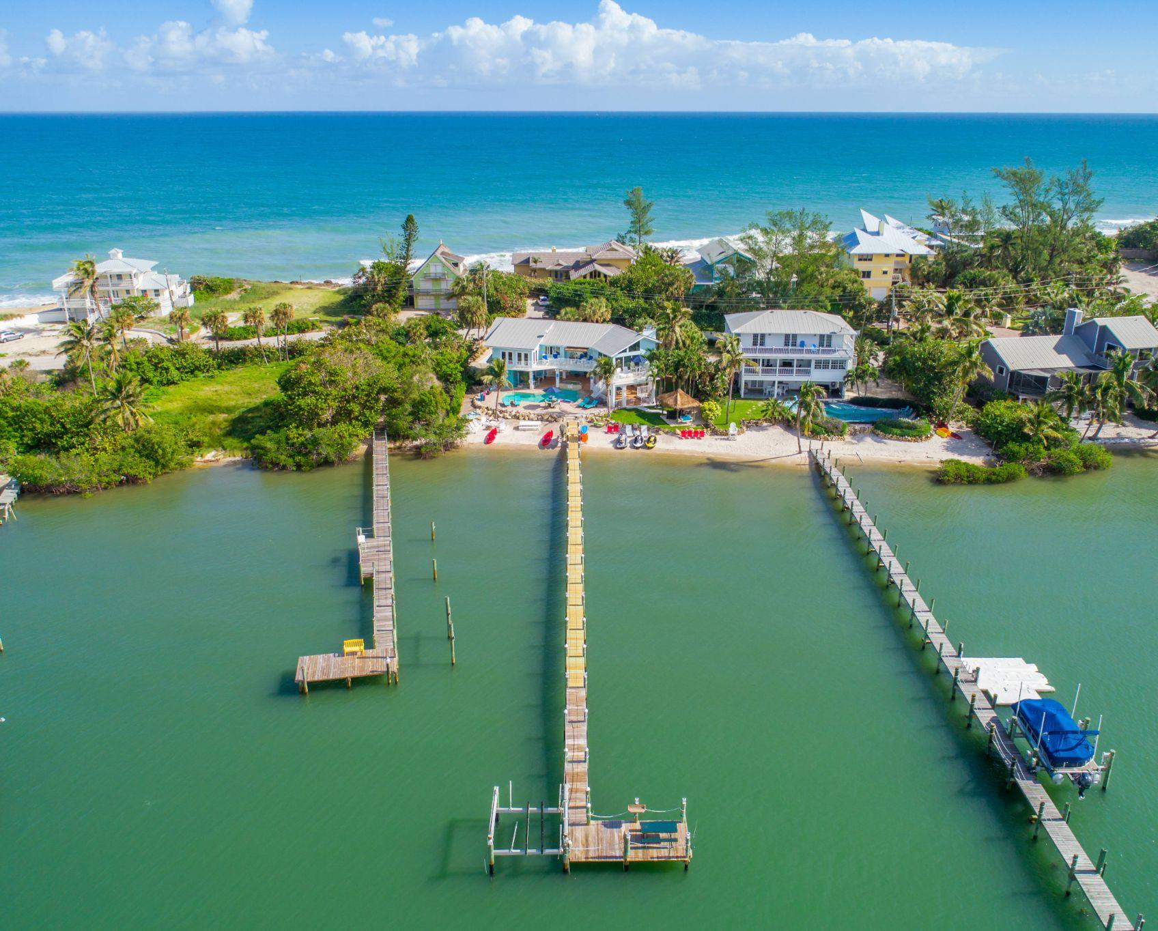

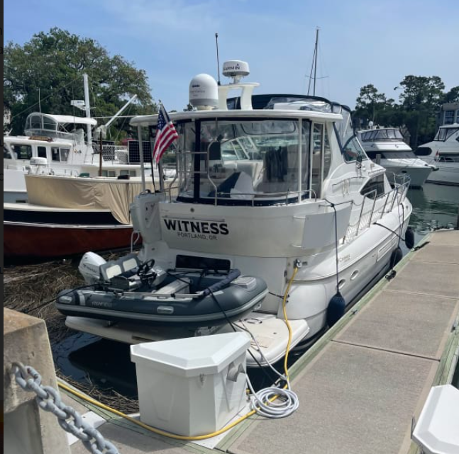
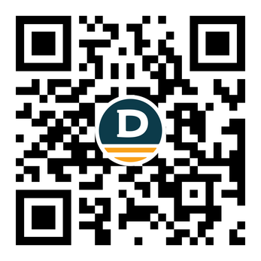

DOCKSHARE
Peer to Peer Boat Dock and Slip Rentals
Nate Young
nate@dockshare.app
dockshare.app

Slide 2
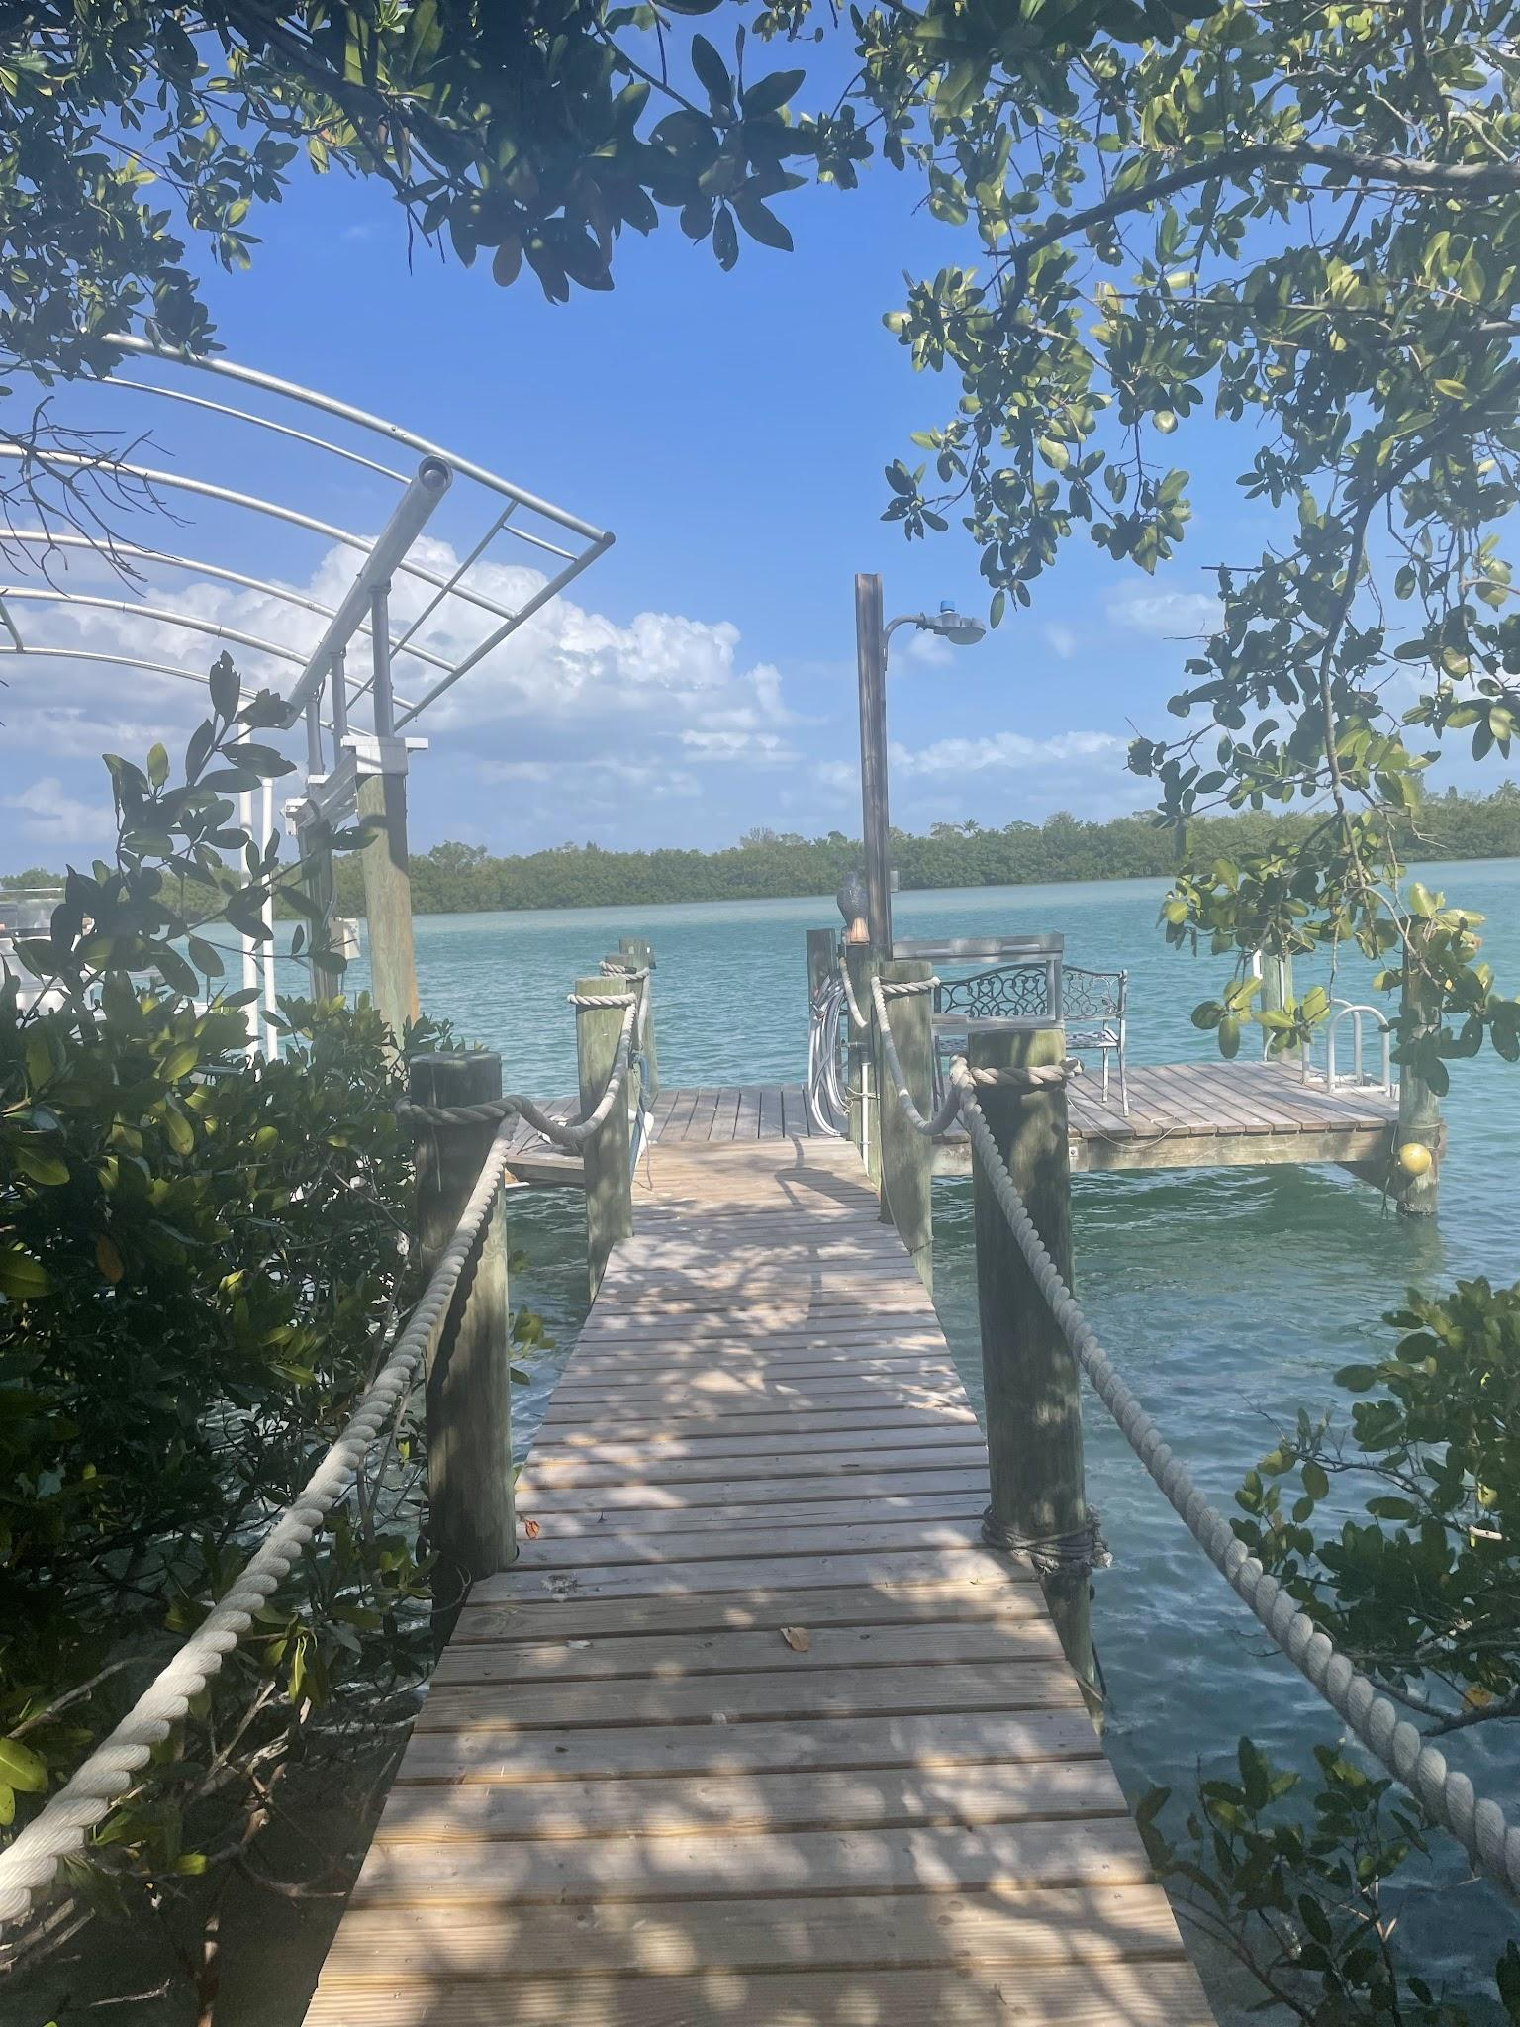
THE PROBLEM

Slide 3


OUR MISSION
Dockshare facilitates safe and hassle-free boating experiences by connecting boat owners with private docks and marina slips. Our platform ensures secure transactions for owners renting to fellow boaters, offering opportunities for spontaneous adventures and long-term docking solutions.

Slide 4
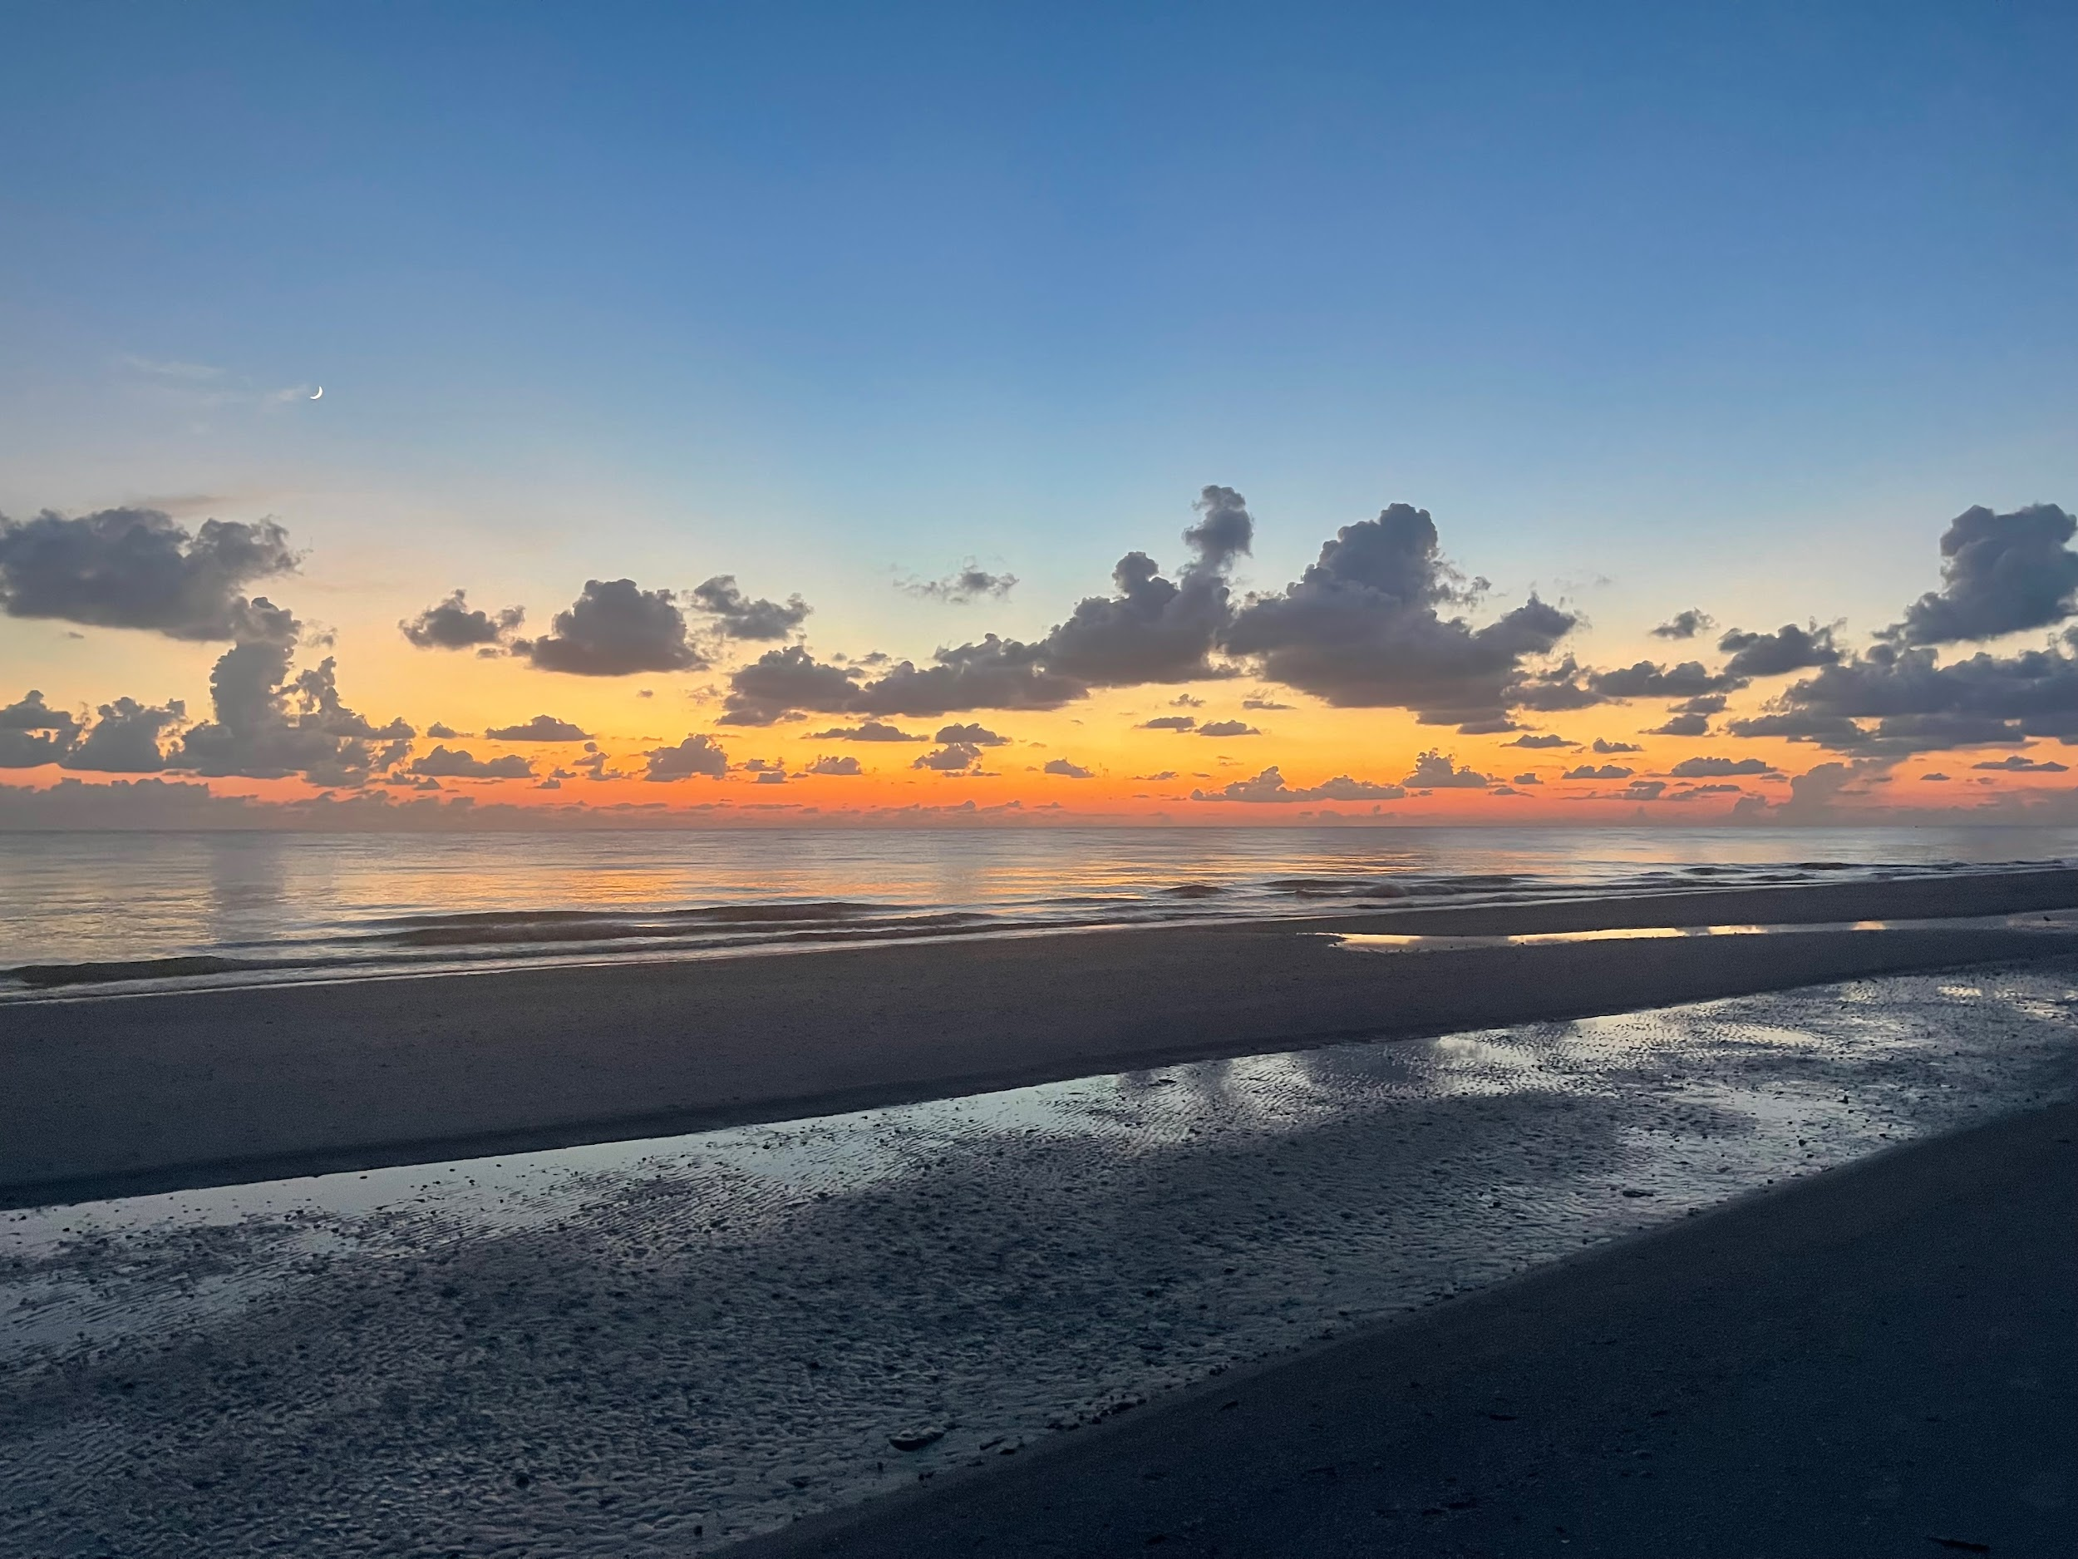

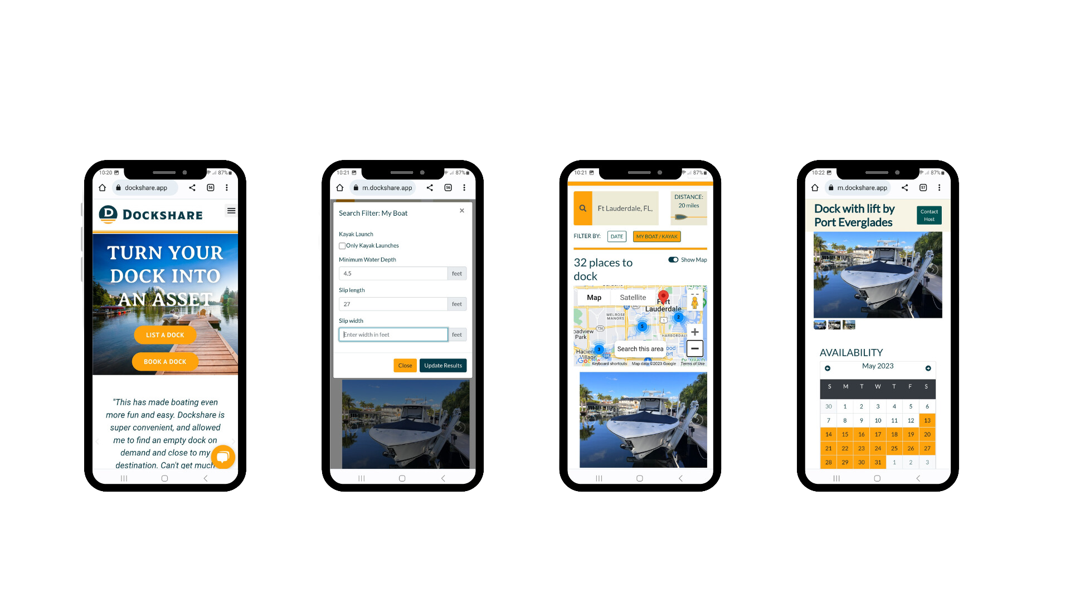


OUR SOLUTION
Access to the largest listing of private docks and slips
Flexible On-Demand Bookings
Online Platform Connection
Convenience and Cost Savings
Insurance for Damage Protection
Income Opportunities for Dock Owners

Slide 5
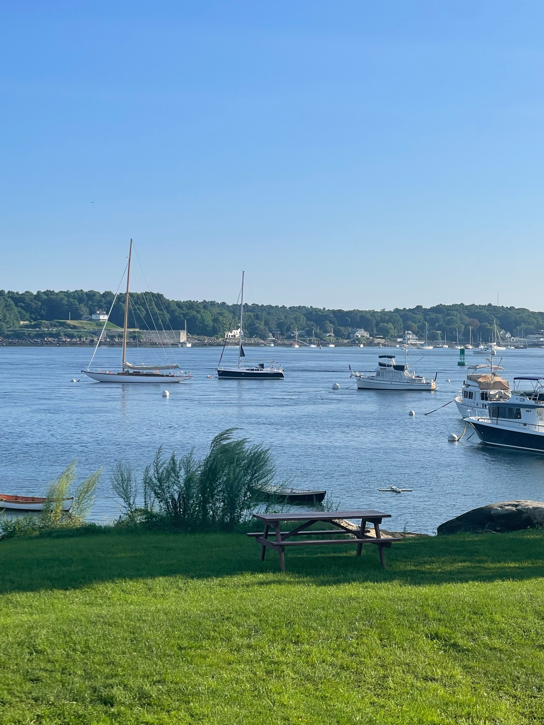
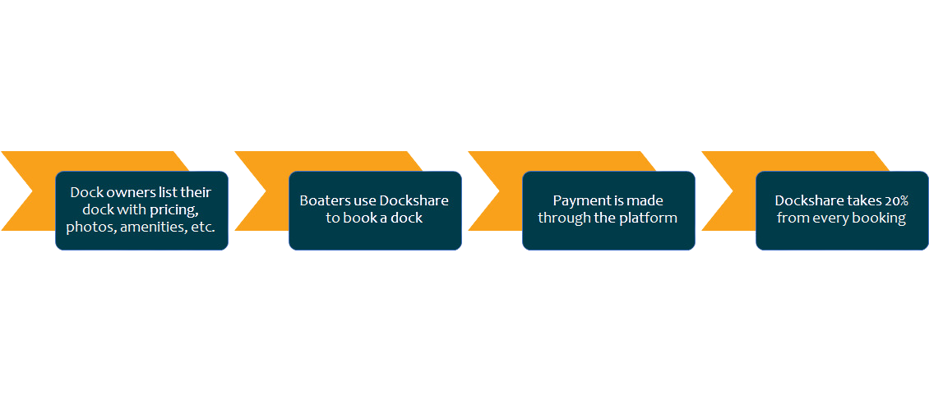

BUSINESS MODEL

Slide 6

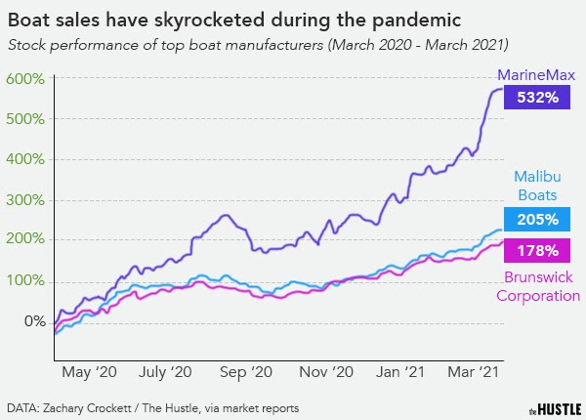
THE MARKET

Slide 7

COMPETITION
Facebook
Marketplace
Dock Booking
Pier Share
Dock Skipper
Connecthedocks
Dockspot
Snag A Slip
Dockwa
Craigslist

Slide 8
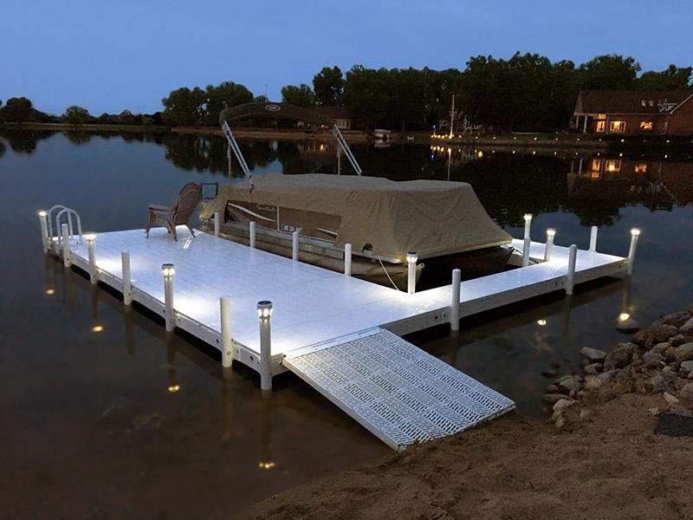
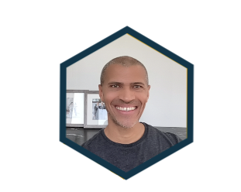
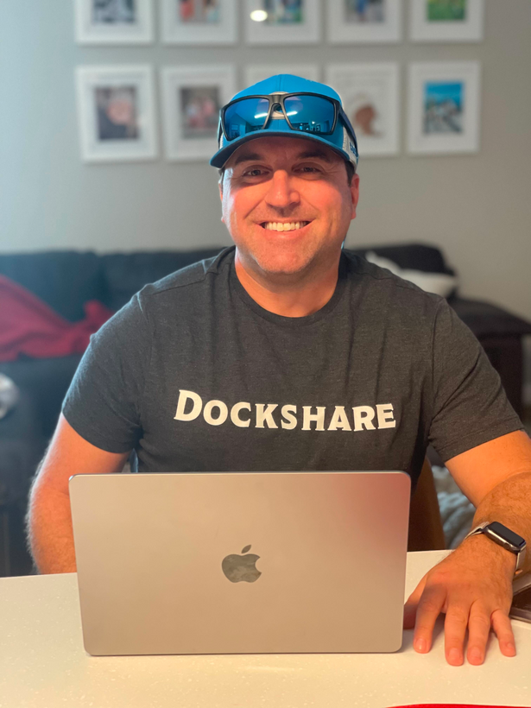

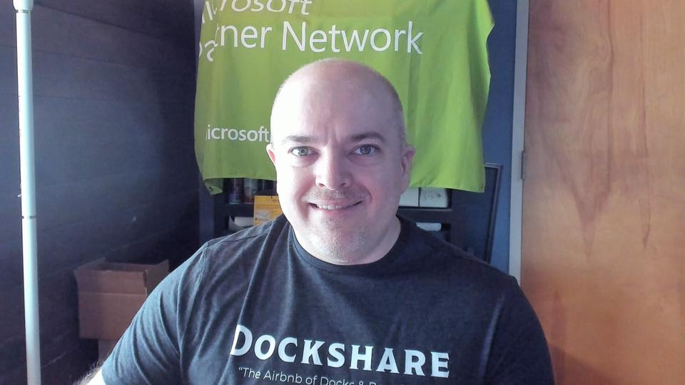
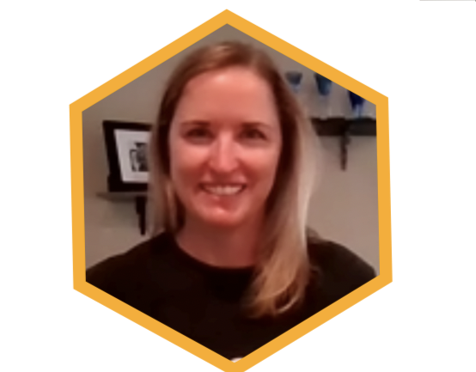

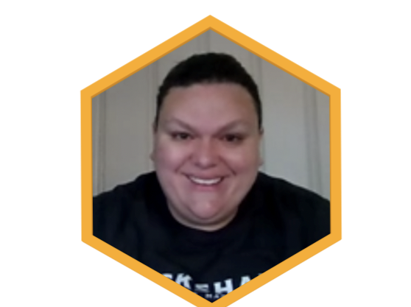
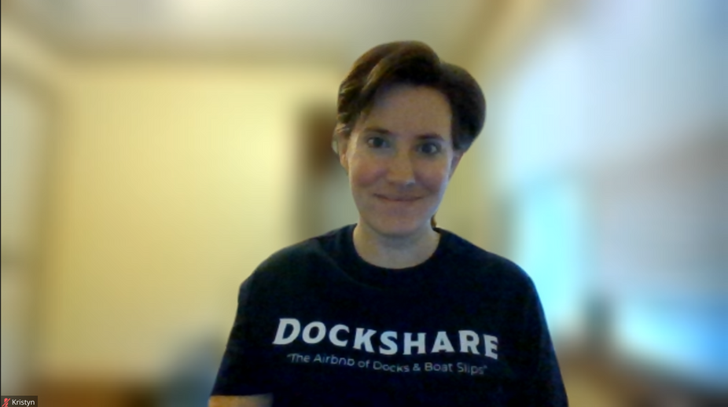
THE TEAM
Nate, CEO
Matt, Growth
Cofounder,
Gina, Marketing
Adam, Technology
Lauren, Product
Kristyn, Marketing
Laura, Customer Exp.

Slide 9
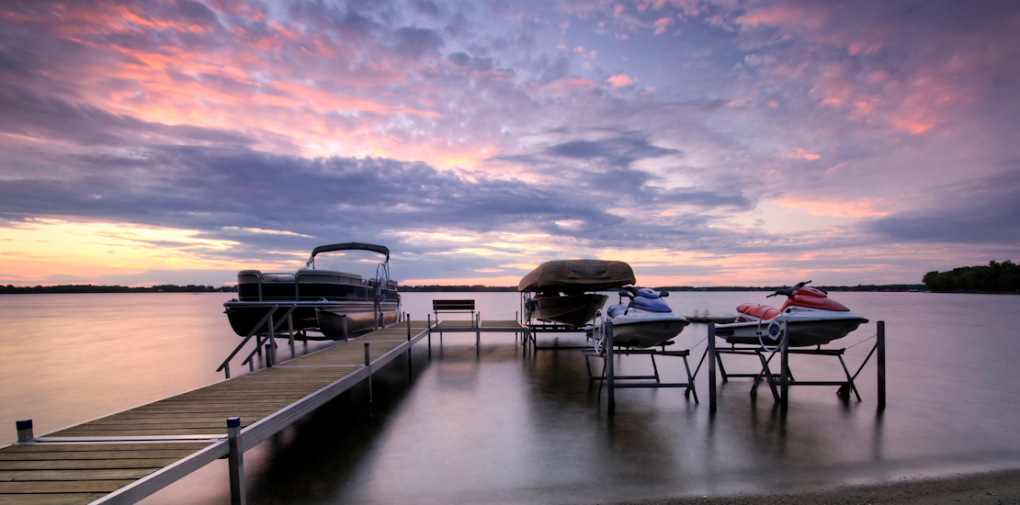
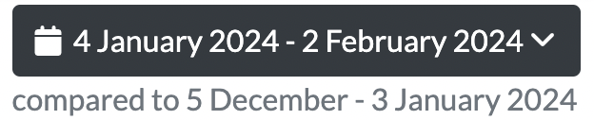
KPI’S
Notes:
Through our team’s efforts, we have achieved some impressive milestones including earning our first revenue in under 2 years. We are on a steady growth path and are confident that the world needs Dockshare!

Slide 10
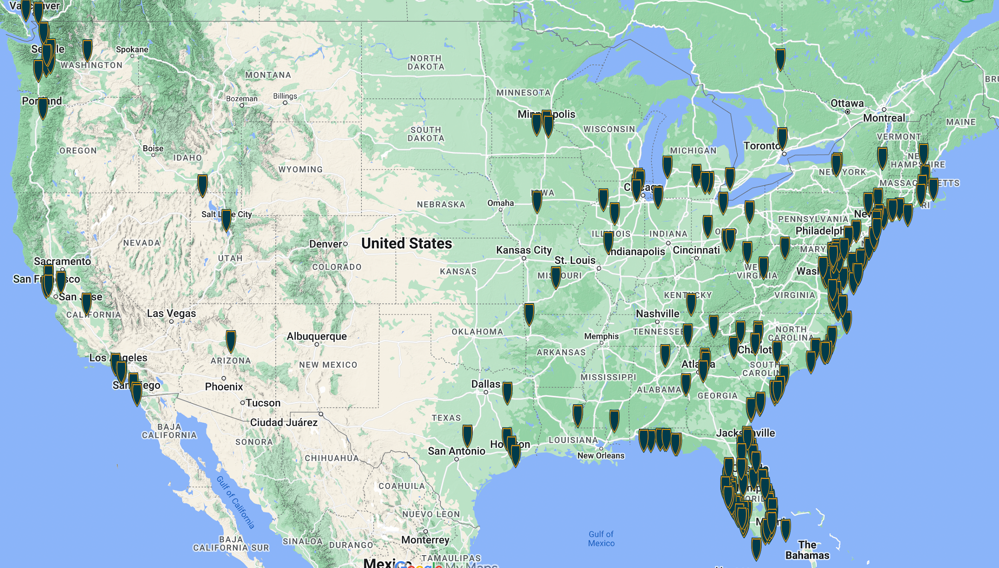
DOCKS AND SLIPS Listed on Dockshare
Notes:
Through our team’s efforts, we have achieved some impressive milestones including earning our first revenue in under 2 years. We are on a steady growth path and are confident that the world needs Dockshare!

Slide 11
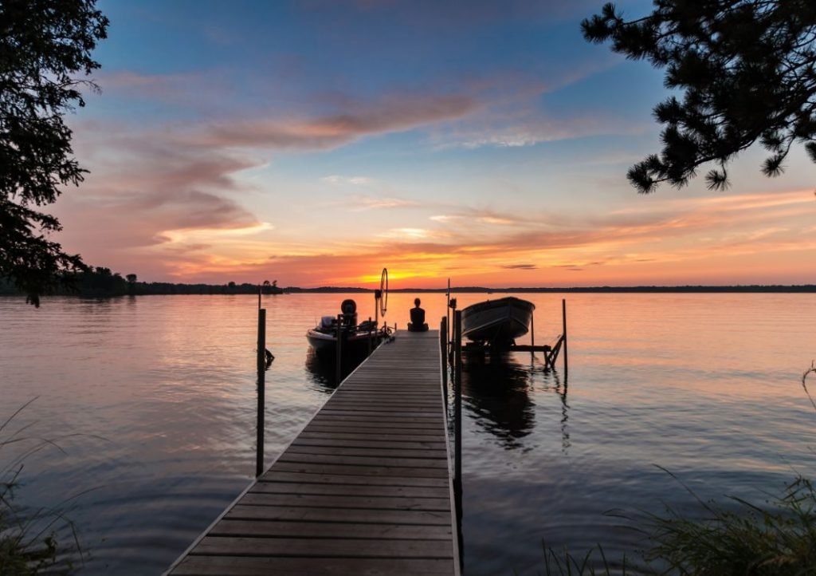





THE ASK
WE’RE RAISING!

