Slide 1



Building Automation Demo
February 6th, 2024

Slide 2

Agenda
Introduction
Control Resource Overview
Benefits of an Open System
What is Tridium
Site Demo
Closing

Slide 3

Introduction
  Control Resource is a division of Hurst Mechanical, West Michigan’s largest full service mechanical contractors for over 40 years. We focus on building long term relationships with our customers by providing a next level building automation experience. Our fulltime team of engineers and electricians are trained on mechanical and controls systems to make sure your building management system is performing at its full potential.
  Our focus is growth through commitment to service and sustainability.

Slide 4

What Does Control Resource Offer?
Let’s dive in

Slide 5
Services We Offer
Building Automation
Electrical
Tridium Base Building Automation Systems
Open Unitary Controllers
HVAC & Process Controls
Lighting Control
Card Access
Commercial & Industrial Installation with 24/7 Service
Generator Installations
Lighting Upgrades
Service Upgrades
Variable Frequency Drives
Commercial and Industrial Installation with 24/7 Service

Slide 6

What is the benefit of an open protocol system over a proprietary system?
Concerned customer

Slide 7






Benefits of an Open System
Interoperability
Devices and systems from different manufacturers to communicate and work together.
Flexibility
Allows for more customization and fine-tuning of system behavior.
Vendor Neutrality
You're not tied to a single vendor for all your components.
Ease of Integration
Easier to integrate with other building systems, such as lighting and security.
Scalability
More adaptable to changes in building size or functionality.
Reduced Costs
The competition among vendors and the ability to mix and match components can lead to cost savings.

Slide 8

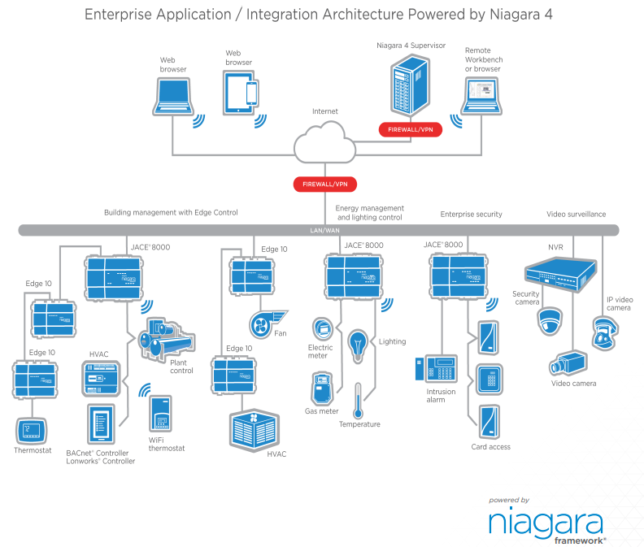
System Architecture

Slide 9
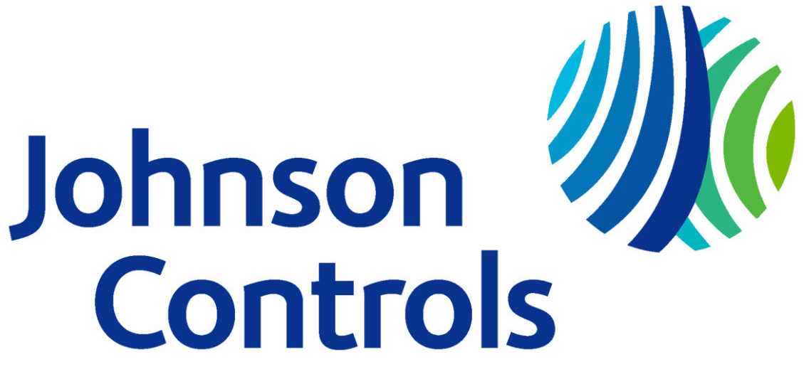


Brands we Support

Slide 10



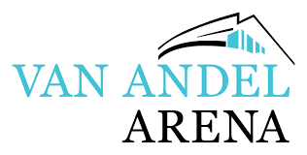




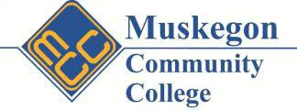



Some of Our Key Customers

Slide 11

Conclusion
Thank you for your time today.
We look forward to working together.

