Slide 1
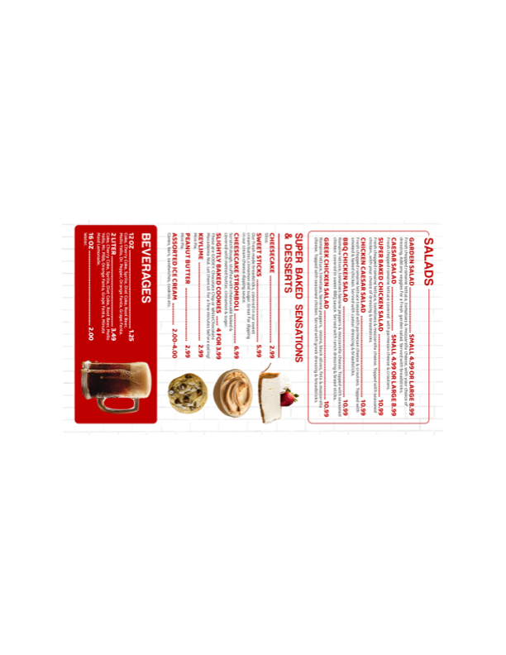


ORDER ONLINE AT
WWW.SUPERBAKEDPIZZA.COM
Hilton Head Island
70 Pope Ave, Suite B
Circle Center
843-715-4880
CARRY OUT OR SUPER FAST DELIVERY!
Minimum
$10

Slide 2
