Slide 1
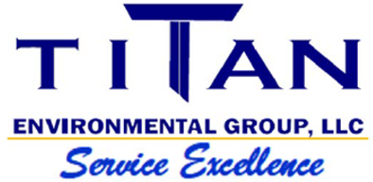

A FULL SERVICE ENVIRONMENTAL COMPANY
VACUUM TRUCK SERVICES
REMEDIATION
AST & UST TANK REMOVALS
BULK TRANSPORTATION
TANK CLEANING
WASTE SAMPLING & PROFILING
WASTE MANAGEMENT
Safety and compliance is our key focus at Titan Environmental Group. All of our employees are OSHA, Hazwoper and DOT certified. We operate with integrity, pride and professionalism each and every day.
(984) 200-6525

Slide 2
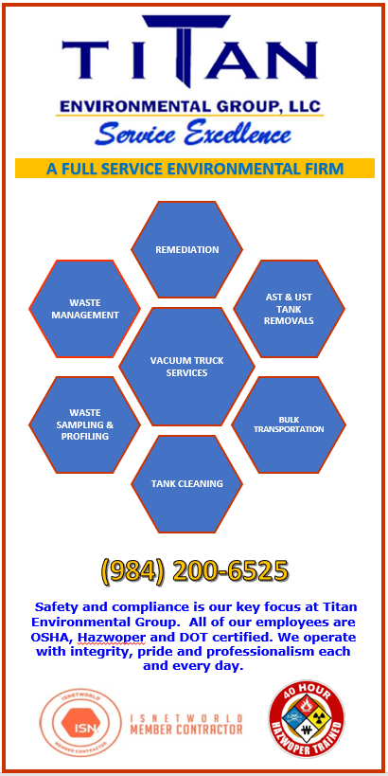
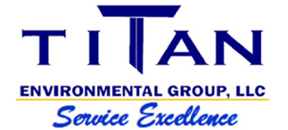
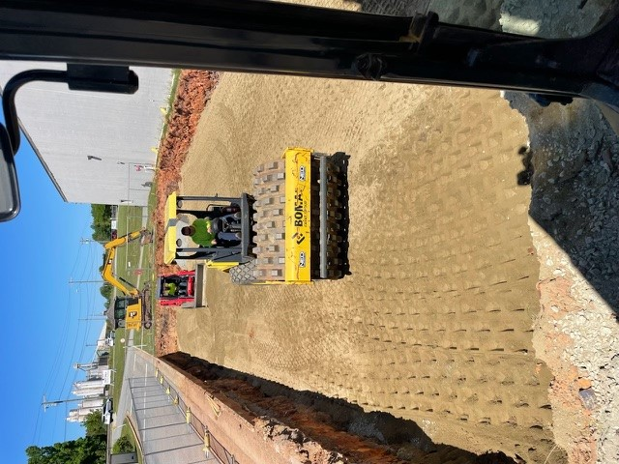
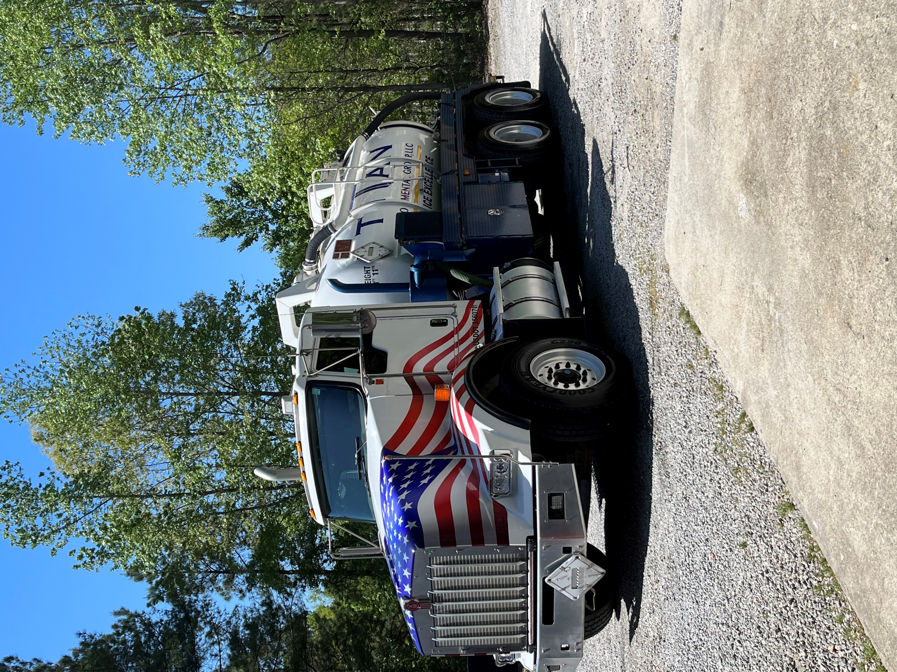

Vacuum truck services
Tank pumping
AFVR services
Oil water separators, grit chambers, tanks
and clarifier cleaning
Waste water transportation
Straight truck and tractor trailer service
Waste management
Solid waste transportation and disposal
Drum and tote management
Waste sampling, profiling and manifesting
Non hazardous, hazardous and e-waste recycling
Fuel recycling
Remediation
Soil and ground water contamination excavating
and disposal
AST & UST removal
Facility demolition, excavation and site work
Lagoon cleaning and closure
Landfill remediation and RAP implementation

