Slide 1



Automated Quality Assurance A.I.
Automate your Quality Assurance and
improve your insight by 50x

Slide 2


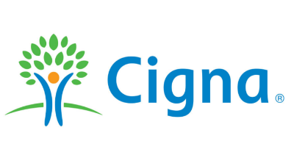




A bit about us…
Trusted by companies across the globe to transform their customer service
Founded by contact centre leaders in 2015
Salesforce AppExchange Partner
  5 Star-rated listing
100m+
AI predictions provided
so far by
I-VIE
Our AI Assistant!
We take Complexity and bring Clarity

Slide 3
Why You Need AI-Powered Quality Assurance

Slide 4

Manual QA Lacks Insight & Wastes Resources
On average, only 2% of all cases will be audited
QA tools are not integrated, or worse... on spreadsheets!
Cases are randomly selected, meaning issues can be missed
Reporting is delayed, with no key reporting/dashboards
Compliance and soft skill risks are only found on randomly selected cases, not the other 98%
Feedback training cycles are slow and lack impact

Slide 5

Resulting in a Lower NPS Score, Wasted Time & Risk
98%
of service cases missed every day
3 Months+
delay in QA training for agents
£46k+
of wasted spend due to manual effort*
*Based on the Average FTE Salary of Contact Centre Agents

Slide 6

We’re Supercharging Quality Assurance for Salesforce Users

Slide 7
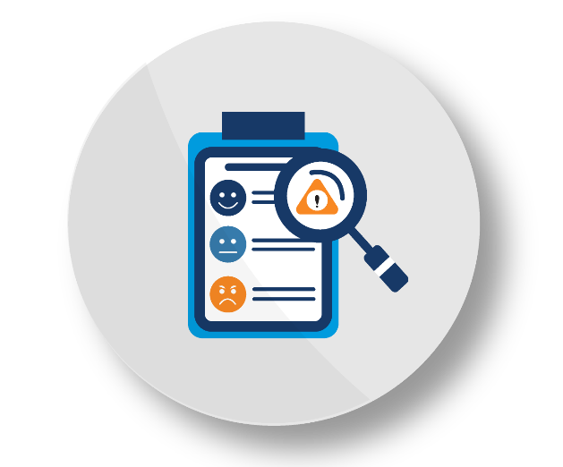
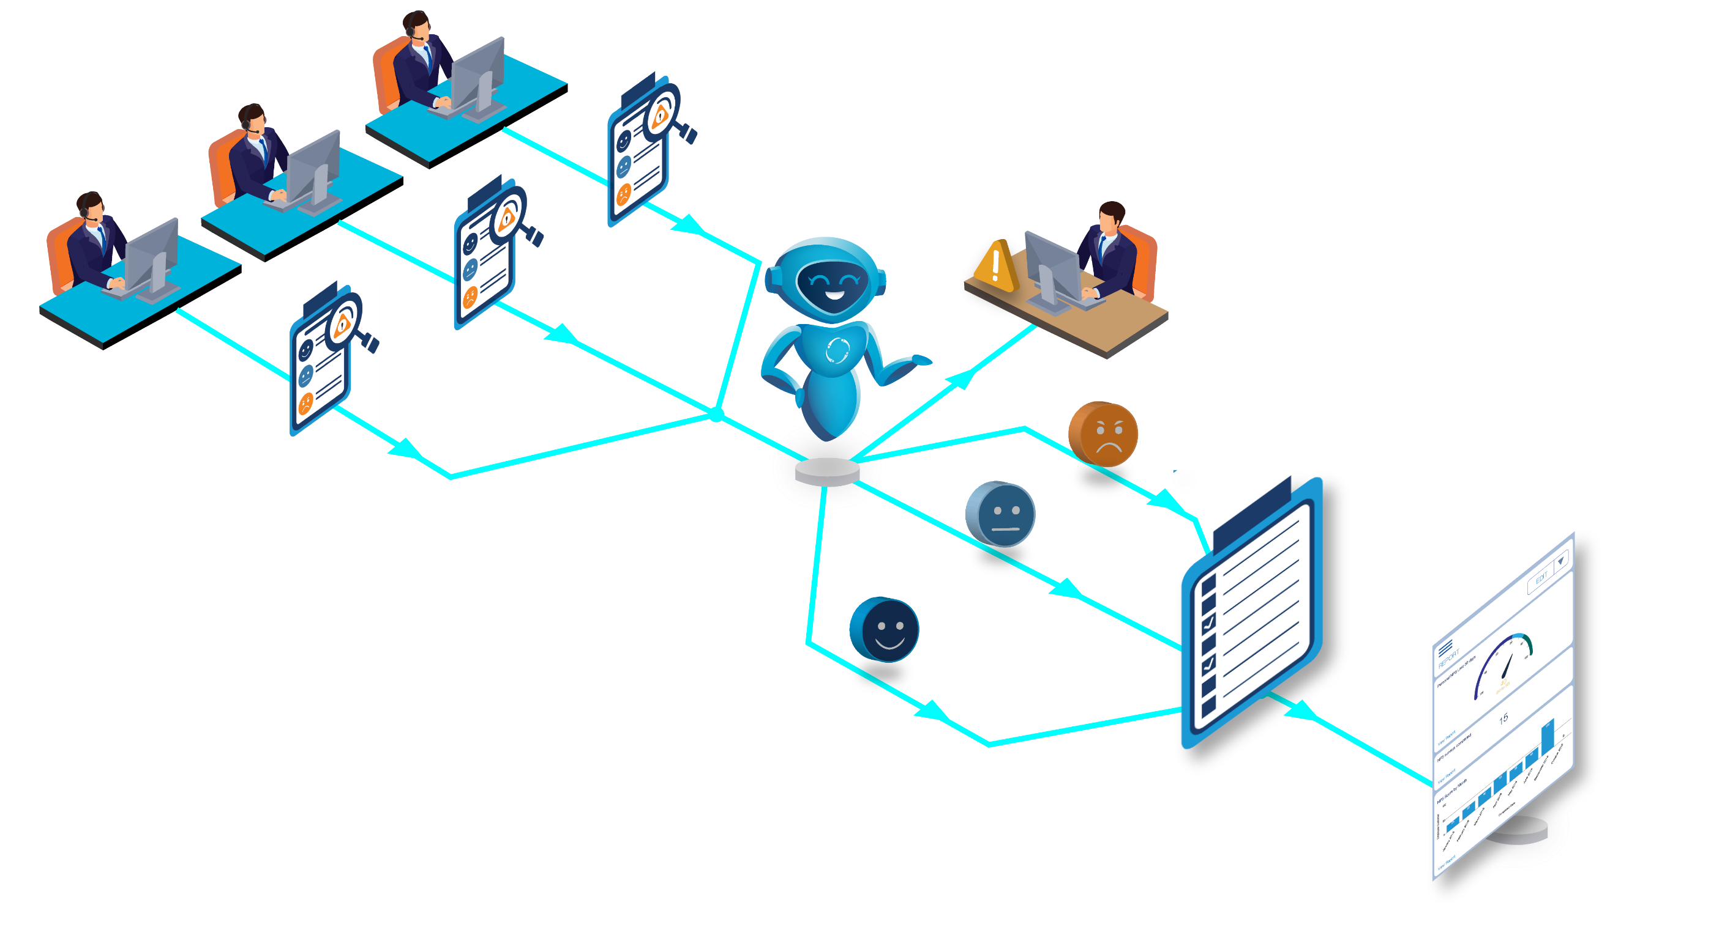
AI-Powered Compliance and Emotion Scoring
Compliance risks highlighted
immediately
Agent handle
cases
Manual QA in
Salesforce
Score emotion
automatically
Notes:
Explain how different this is from their own process

Slide 8
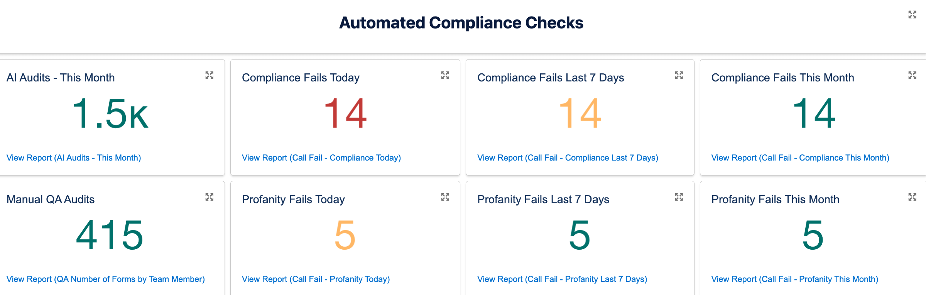
Immediate Compliance Checks
Rest easy knowing 100% of your cases are being audited
Tailor-made checks based on your business requirements
Instant insights for real-time risk mitigation
Improved training insights for service and process excellence

Slide 9
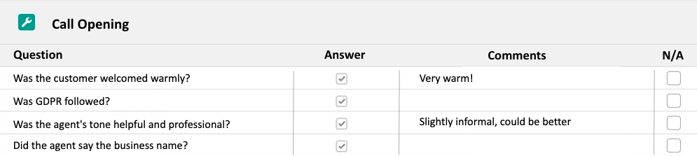
Manual scorecards inside Salesforce
Select and audit cases that are most relevant to your risks
Built-in appeals process
Provide actionable and transparent feedback to individuals
Fully Customisable Forms
Linked to QA AI records, cases, users, accounts, contacts, etc.
Weighted Scoring

Slide 10
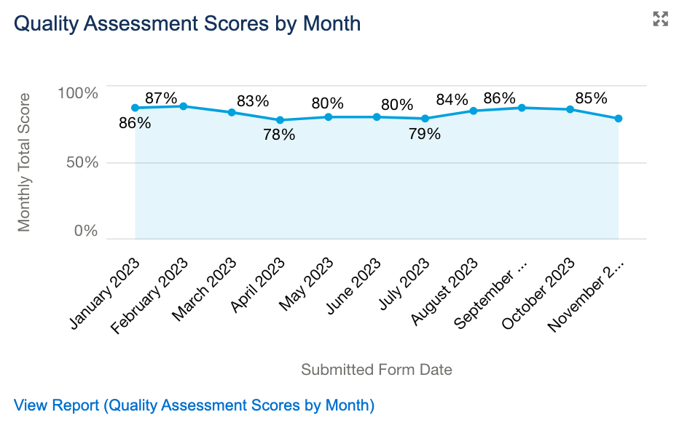
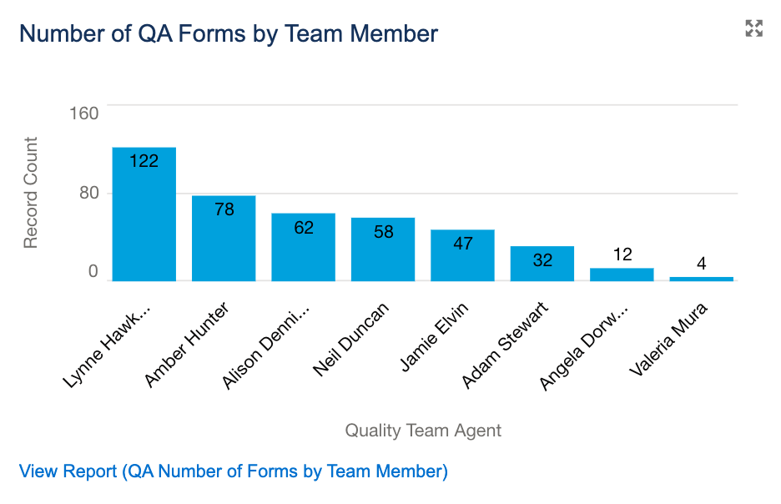
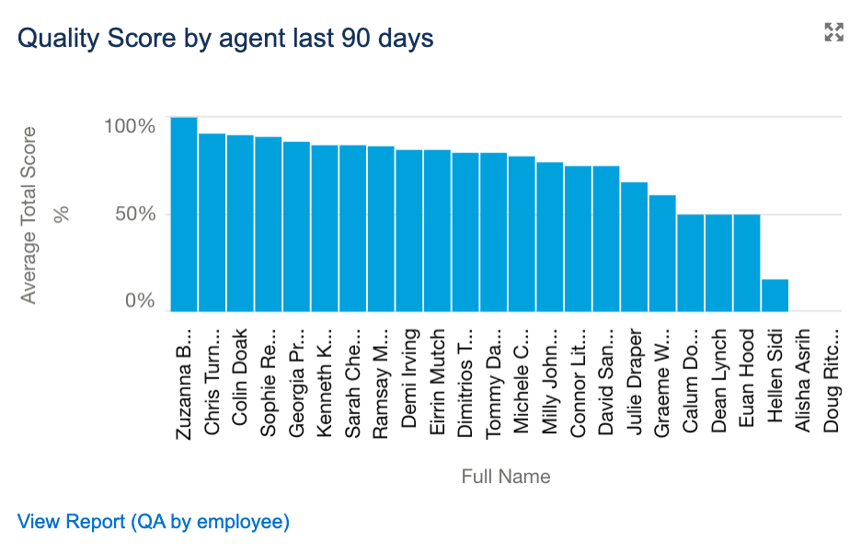
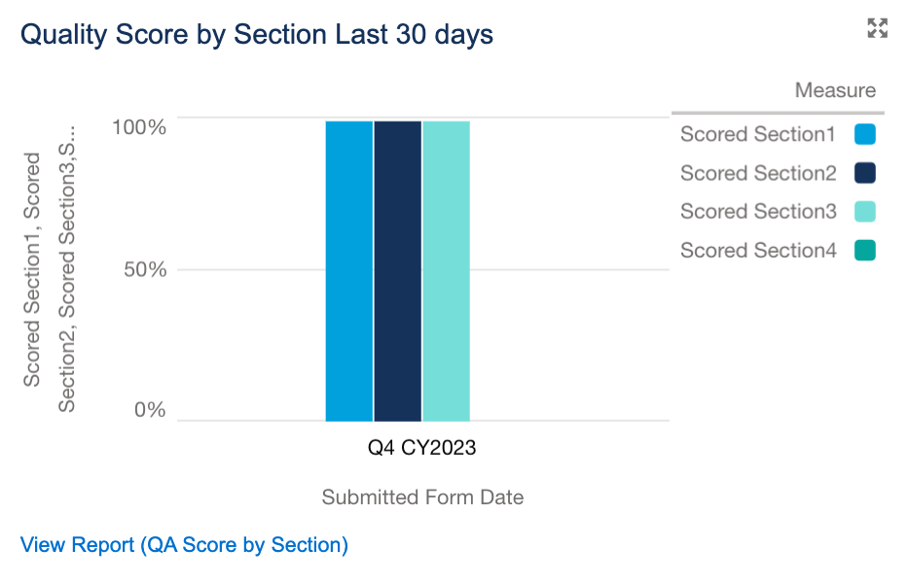
Real-time Quality Reporting
At-a-glance reporting for leadership and QA teams
Track key KPIs for quality teams
Easily identify areas for improvement
Track appeals process

Slide 11
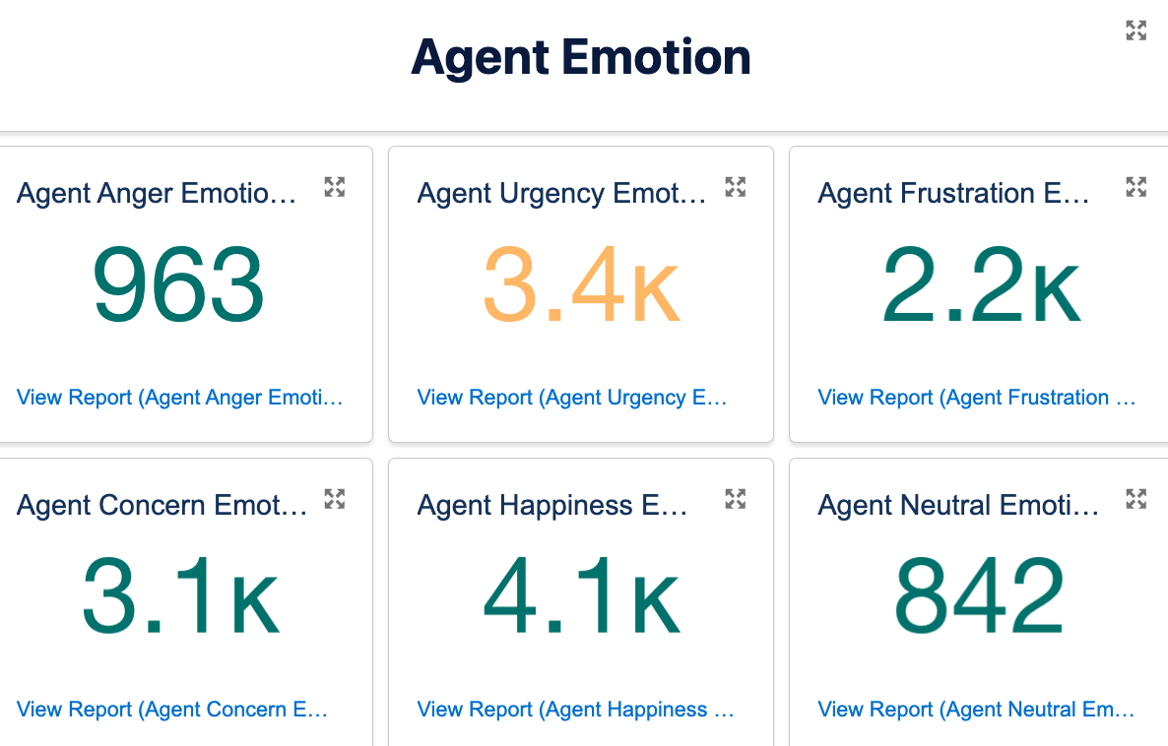
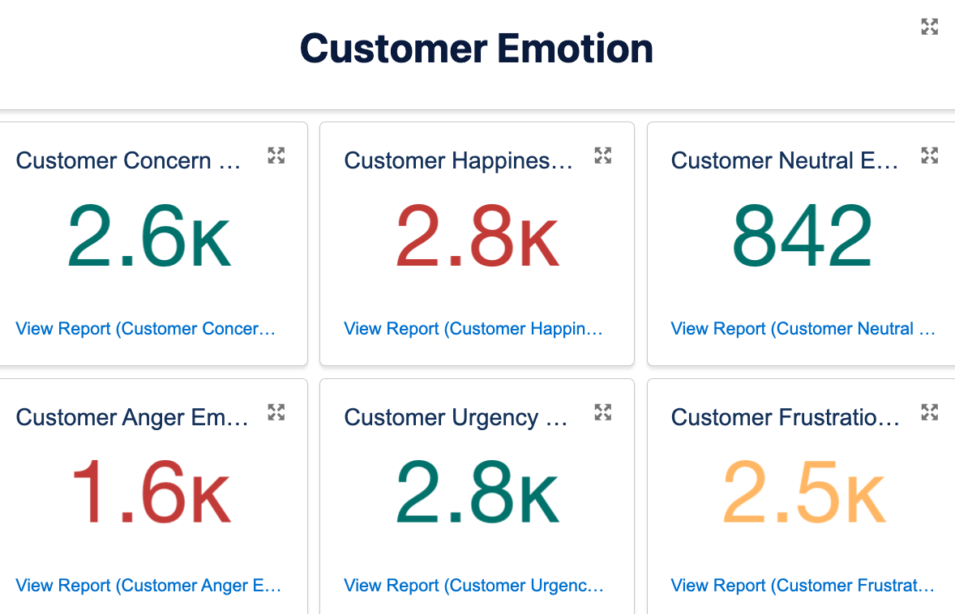
Emotion Scoring
Flag angry customers and prioritise cases accordingly
Immediate insight to agent and customer emotions
Informed case insight – no more random selection!
Easily identify issues for process and training improvements
Chatbot impact on customer emotion

Slide 12
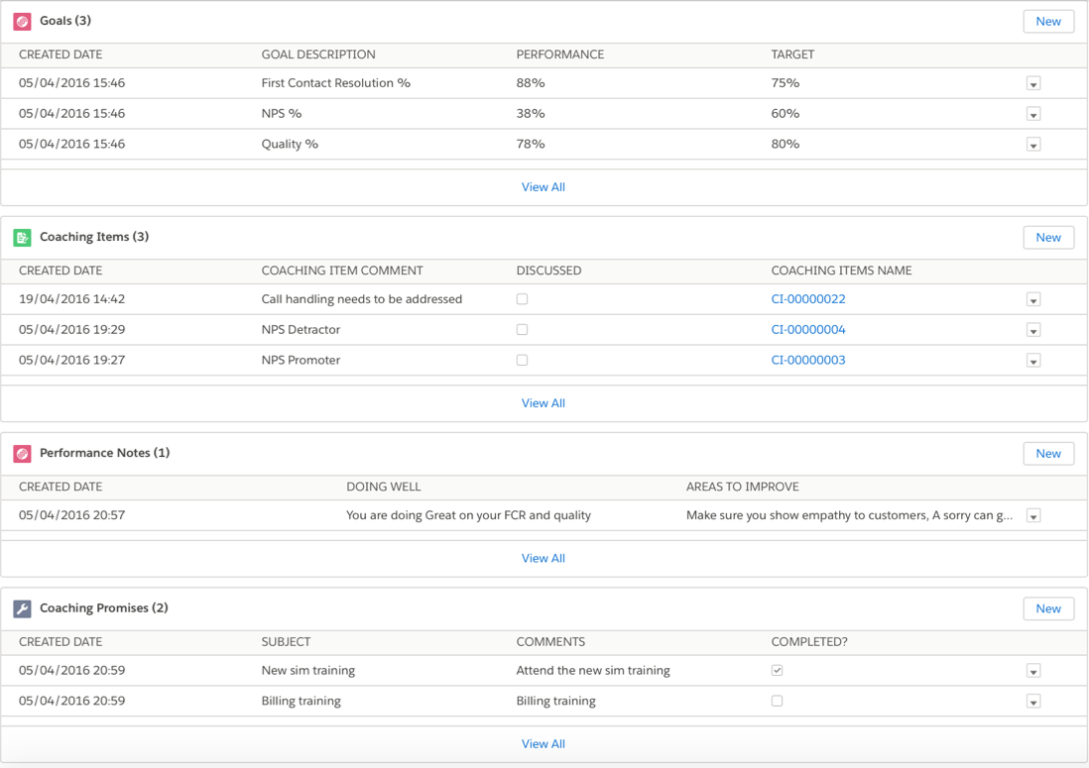
Coaching made simple
Quickly see individual’s real-time performance against their targets
Auto-created coaching suggestions to help reduce time spent searching for relevant coaching opportunities
Highlight where an agent is performing well and areas to improve
Bring outcome tracking to Salesforce

Slide 13
Employees, Managers and Quality Teams love simplicity
Employees
Managers
Quality
Employees
Managers
Quality
Individual reporting & dashboards
Real-time performance
Limited access to their audits
Team reporting & dashboards
Real-time performance
Access to team performance
Coaching form creation
Company-wide reporting/dashboards
Appeals process
Quality team KPI trackers
Coaching form creation

Slide 14
Real results with real savings
0 Compliance risks missed
Direct impact on CSAT and NPS scores
Up to 100% of cases audited
Doubled manual auditing efficiency
24% increase in Service Consistency
Faster & more efficient coaching cycles

Slide 15
Grow with In-gage
We’re Scalable
We’re Simple
We’re Here to Help
Get more auditing done with low effort and maximum results.
We make it easy to onboard and enable users to supercharge their quality assurance.
Our dedicated support teams are here when you need a hand.

Slide 16
Join the QA Revolution!
1. Demo
2. Stakeholder Demo
3. Technical Call
4. Proposal & Agreement
5. Kick-off Call
6. 2-Day Implementation
Feedback
Efficiency
Measure
App Enhancements
1, 3 & 6 Month
Accelerator Sessions
Speed of Evolution
Loyalty
Change
Tech Support
Impact
Advocacy

Slide 17




Audit 100% of cases for AI Risk & Compliance checks
Quality Assurance scorecards
AI Emotion Flagging for prioritisation and chat-bot checking
Keep agents in process with next best action AI suggestions

Slide 19
Powerful service-specific AI Auditing
80%
65%
92%
23%
57%
Emotion
Empathy
Tone
Compliance
Spelling &
Grammar
Automatic auditing of 100% of your cases
Inside Salesforce for easy, low effort access
Real-time insights of customer and agent comms
Highlight conversations worth reviewing
Catch compliance risks as they occur
Conversation summaries for at-a-glance reviews

Slide 20
In-gage Quality AI
Employee AI
Audit 100% of your support cases, catch business risks, survey your customers, and provide tailor-made training.
Process AI
Provide employees with all the answers, automate your processes, and track how they perform

Slide 21
Employee AI
Audit 100% of Cases
Customer Feedback Surveys
Identify Training Opportunities
Automated Compliance Risk Monitoring - Track and manage compliance risks based on bespoke requirements for instant remediation
Comprehensive Interaction Scoring - Evaluate interactions based on spelling, grammar, and tone for consistent service quality.
Efficient Case Handling Reporting - Track and optimise case efficiency by agent for streamlined customer support.
Automatic Emotion Analysis - Gain insights into the emotions of your employees and customers during service interactions
Robust Reporting on Response Times - Monitor and analyse response times to ensure timely customer engagement.
Enhanced Customer Feedback Analysis - Leverage AI to categorize and analyse customer feedback effectively.
Bespoke Quality Scorecards - Take your QA insights further with easy-to-use manual scorecards

Slide 22
Process AI
Bespoke Chatbots
AI-Assisted
Case Handling
Measure your
Impact on Service
Automated Case Categorisation - Get cases to the right team the first time, reducing human error & cost-to-serve
Intelligent Knowledge Base Recommendations - Provide customers with relevant recommendations based on their requests.
Proactive Next Best Action Identification - Determine the most suitable next steps for agents to enhance customer experiences.
Emotion Analysis for Chatbot Interactions - Analyse customer emotions in response to your chatbot interactions
Streamlined Case Efficiency Tracking - Monitor and optimise case handling efficiency by process for improved customer experience
Chatbot Impact Analysis - Understand how your chatbot influences overall customer satisfaction.

Slide 23
Knowledge Base Assistance
Leverage your existing knowledge base to provide agents with automated suggestions, ensuring customers receive efficient support that solves their issues first time
Trained on your knowledge base
Direct impact on CSAT and NPS scores
Agents can focus on service excellence
Service consistency
improvements
Increased customer satisfaction
Reduced cost-to-serve
Expected H1 2024

Slide 24
Bespoke AI Chatbot
On average, live chat and chatbots handle 69% of all contact centre conversations. On top of this, 31% of customer service organizations plan to start using chatbots within the next 18 months.
Stay ahead of the curve with chatbots that understand your products/services and customers’ requests.
Trained on your knowledge base for accurate support
Elevate your self-serve offering
Reduce wait times & cost-to-serve
Agents can focus on complex cases
Integrate with Salesforce and sites/portals
Increase CSAT & NPS scores
Expected H1 2024
Source: Salesforce & Comm100

Slide 25
Quality AI Beta Program
Working with our existing clients to improve product offering and sharing the experience to grow the In-gage Family:
1-year of free access to upgraded Quality AI
Premium Support included
Early access to:
  Knowledge Base Assistance
  Bespoke AI Chatbot
Additional costs may apply to extra AI products

