Slide 1
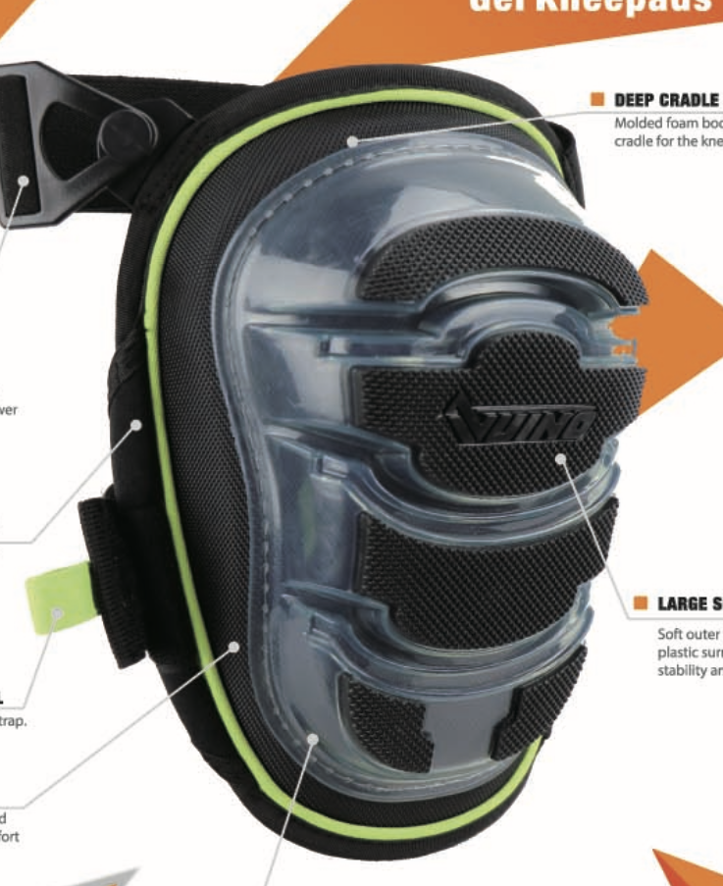
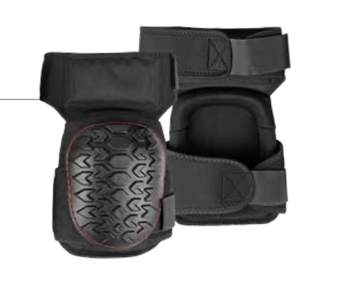
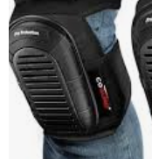
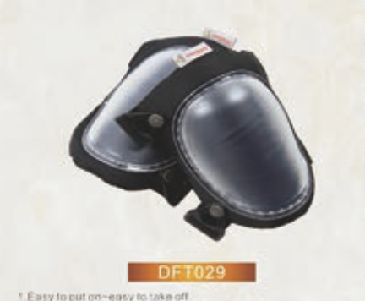
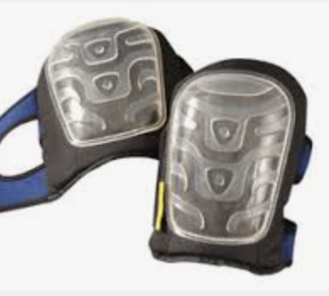
Safety Knee Pad
Design Brief
Goal: Unique design of the front of the product. The design should be simple and sleek.
About the Brand: More masculine leaning, simple designs preferred. Not too busy.
Examples of designs we like:
Examples we don’t like:
Too similar to other products on the market
Too plain

