Slide 1
Developing oral Taxanes with fewer severe side effects to improve cancer patient’s lives
Introduction to Modra – January 2024
Non confidential Overview

Slide 2
Modra Snapshot
What we have developed
Boosted oral taxanes for administration at-home
Lead program, ModraDoc006/r, a boosted oral formulation of docetaxel
  Phase IIb study completed in metastatic Castration-Resistant Prostate Cancer (mCRPC) patients
  Same efficacy with dramatically improved safety in mCRPC
  Phase III mCRPC strategy outlined and discussed with FDA
  Phase IIa study completed in patients with metastatic Breast Cancer (mBC)
Second program with ModraCab/r, a boosted oral formulation of cabazitaxel
Strong IP protection
Large Opportunity
Replace IV taxanes
  >7M new patients in taxane-relevant tumors p.a.
  Lead program, ModraDoc006/r
  Implement superiority and maximized speed-to-market strategy for advanced ModraDoc006/r prostate cancer lead indication
  Drive adoption in other tumor indications and novel all-oral combinations; including in breast, ovarian, lung and gastric
  Access an open playing field based on established product strengths in positive tolerability
Market potential exceeds $1B
Notes:
VF reformatted and GS made wording edits

Slide 3
Introduction
Re-inventing Taxanes: Some of the Most Broadly Used Chemotherapies for Treating Cancer

Slide 4
The Challenges of Intravenous Taxanes
Expensive and burdensome infusion administration
Serious toxicities
Tumors develop resistance to therapy
Costly to both patients and healthcare systems
Dose reductions, premature cessation of treatment
Tumors start to grow again
Notes:
VF changed pics/spacing/formatting

Slide 5
Physicians are Very Receptive to the Potential of Oral Taxanes
Oncologist enthusiasm for oral chemotherapy
Prostate cancer experts have high opinions of oral taxanes
“I think the oral taxanes are real, I think they will have real activity, and for a lot of patients they are a very appealing treatment option… Globally there’s a demand for oral medicines. If your choice was to get an oral taxane vs. IV, I’d be hard pressed to say IV based on these data…” KOL
“Patients want oral drugs and providers like oral drugs too... It would depend on if you were giving [in combination] with something else. As long as the patient would just have oral docetaxel and wouldn’t have to go into the office to get it, that would be great. I think patients would like that a lot.” KOL
Average = 7.1
Source: Analyst reports 2020

Slide 6
Modra’s Oral Taxanes Aim to Replace Intravenous Taxanes
Expensive and unpleasant infusion administration
      Toxic excipients eliminated
      One day/week dosing
      Low pill burden & manageable tablet size
      Differentiated PK
Oral at home
delivery
oral taxane tablet
Best-in-class tox
Neutropenia
Neuropathy
Alopecia
Serious toxicities
      Boosts oral taxane bioavailability to ensure therapeutic exposure levels
      Inhibits P-gp and CYP3A4
      Concept, used widely in HIV/HCV, now applied to oncology
ritonavir - booster
Tumors develop resistance to therapy
Reverse resistance

Slide 7
The Opportunity
Epidemiology
  In taxane-relevant tumors in 2018, 7M people diagnosed p.a., of which 4M treated with a chemotherapy1
Overall taxane market dynamics
  Taxane sales in 2021$4B, growing at 6% p.a.2
  Address limitations of intravenous drug administration
  Improved health and QoL during treatment and safe chronic treatment
  Decreased healthcare costs, and improved access in low and middle income countries
Estimates of global chemotherapy demands and corresponding physician workforce requirements for 2018 and 2040: a population-based study, Wilson et al, Lancet
Global Taxane Market report 2022, Data Bridge Market Research
Notes:
VF reformatted and GS made wording edits

Slide 8
Modra’s Focus on Developing Oral Taxanes
Program | Indication | Pre-clinical | Phase 1 | Phase II | Phase III
ModraDoc006/r (oral docetaxel + ritonavir) | mCRPC
 | MBC
 | high risk prostate cancer, +radiotherapy
ModraPac005/r* (oral paclitaxel + ritonavir) | Solid tumors
ModraCab/r (oral cabazitaxel + ritonavir) | Solid tumors
* Tool compound

Slide 9
ModraDoc006/r
Oral Docetaxel

Slide 10
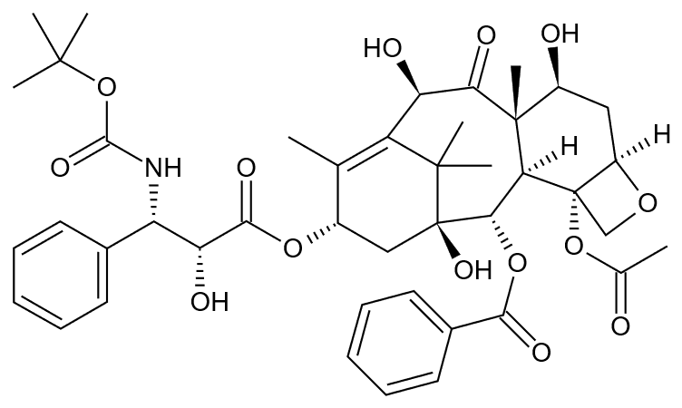
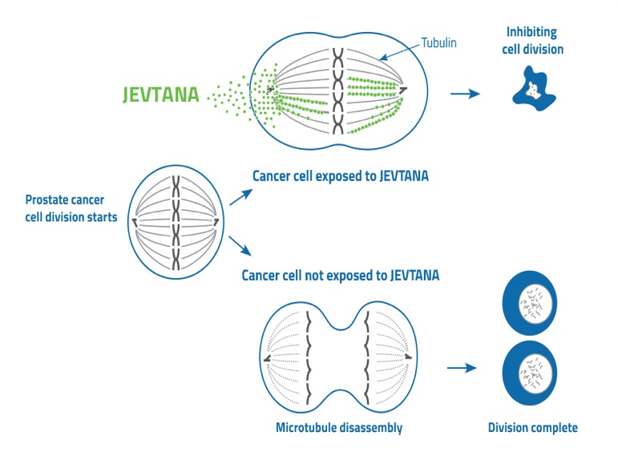
Docetaxel
Molecular Target | Reversibly binds tubulin, used in construction of cell cytoskeletons
Mechanism of Action | Cytotoxic - inhibits cell division by inhibition of mitotic spindle assembly
Regulatory Status | First approved in US in 1995 Approved indications: NSCLC, HRPC (CRPC), breast cancer, gastric adenocarcinoma, SCCHN
Administration | Usually once every 3 weeks, IV infusion
Inhibiting cell division
docetaxel
Cancer cells exposed to docetaxel
Cancer cells not exposed to docetaxel

Slide 11
Oral Docetaxel (ModraDoc006/r) - Preclinical Development
Role of CYP3A4 in reducing docetaxel exposure in multiple models
Ability of ritonavir to increase docetaxel systemic exposure by inhibiting CYP3A4
  Co-administration of ritonavir increases systemic exposure to oral docetaxel over 50-fold in wild-type and P-gp deficient mice
Addition of ritonavir to docetaxel also increases docetaxel concentrations intratumorally
Co-administration of ritonavir and docetaxel shown to reverse resistance to docetaxel in in-vitro prostate cancer models
Patients
Status
10mg/kg docetaxel p.o.
12.5mg/kg RTV
N=3-7 per group
Doc +RTV, wild-type
Doc +RTV, P-gp deficientª
Doc, wildtype
Doc, P-gp deficientª
Bardelmeijer HA et al. Cancer Res. 2002, “Low systemic exposure of oral docetaxel in mice resulting from extensive first-pass metabolism is boosted by ritonavir”

Slide 12
Oral Docetaxel (ModraDoc006/r) - Clinical Development
Clinical Development
Pilot PK oral docetaxel booster study | n/a | Complete
Phase I – PK/dose-finding, weekly dosing | 19 | Complete
Phase I – PK/dose-finding, bi-daily weekly dosing | 28 | Complete
Phase I - Food effect study | 17 | Complete
Phase Ib – PK/dose-finding in mCRPC | 23 | Complete
Phase IIa – HER2- breast cancer | 12 | Complete
Phase 1/II with RT and ADT in early prostate cancer | 19 | Ongoing
Phase IIb in mCRPC (vs IV docetaxel) | 102¹ | Complete
Key Findings
Comparable systemic taxane exposure levels to IV docetaxel
Improved PK compared to IV docetaxel (similar AUCs at much lower cMax)
ModraDoc006/r effective with unique and improved safety profile (decreased neutropenia and neuropathy)
Patients
Status
Randomized 1:1 ModraDoc006/r vs IV docetaxel

Slide 13
PK Differences vs. IV Docetaxel Drive Improved Safety Profile of ModraDoc006/r
Similar exposure levels → drives efficacy
 | AUC 0-inf (ng/ml*h) 3 weeks | Cmax (ng/ml) | Ratio Cmax/AUC
ModraDoc006/r (BIDW)¹
30-20/100-100 | 4254 | 102 | 0.02
20-20/100-100 | 2343 | 84 | 0.04
30-20/100-100 (mCRPC)² | 1383 | 40 | 0.03
30-20/200-100 (mCRPC)² | 4551 | 167 | 0.04
20-20/200-100 (mCRPC)² | 1674 | 49 | 0.03
iv docetaxel¹
35mg/m2 qw | 3960 | 1850 | 1.40
75mg/m2 q3w | 3050 | 2180 | 0.71
100mg/m2 q3w | 5620 | 4150 | 0.74
75mg/m² q3w (mCRPC) | ~1820³ | n/a | n/a
Lower C_{max} at any given exposure level
→ reduction of some toxicities, esp. heme
AUCs for weekly regimens were multiplied by 3 to achieve 3 weekly AUC estimates (for rationale, see Baker);
mCRPC AUC and Cmax data takes average of cycle 1 and 2
De Vries Schultink et al Cancer Med 8:2019
Source: for ModraDoc006/r - Modra clinical studies; for IV - Baker et al, CCR 2004
ModraDoc006/r dosing nomenclature: X-Y/A-B
ModraDoc006 – X a.m., Y p.m.; ritonavir – A a.m.; B p.m.; All in mg, fixed dose, BIDW

Slide 14
ModraDoc006/r Phase IIb in Patients with Metastatic Castrate Resistant Prostate Cancer (mCRPC), Randomized vs IV Docetaxel
Design | Randomized, multicenter, oral ModraDoc006/r versus IV docetaxel
Dose | ModraDoc006/r 30-20/200-100 BIDW (v2)
Amended dose | ModraDoc006/r 20-20/200-100 BIDW (v3)
Primary endpoint | Radiographic PFS (rPFS) according to the Prostate Cancer Working Group 3 criteria¹
Key secondary objectives | Efficacy: ORR, DCR, DOR, rPFS at 6 months, TTP, PSA response rate, PFS at 6 months, PSA-PFS, time to first skeletal event Safety: AEs and SAEs according to NCI criteria Health-related quality of life assessments
Sites | US, Germany, Poland, Czech Republic, Hungary, Russia
Phase IIb Trial Design
ModraDoc006/r
30-20/200-100
RANDOMIZE
N=21
ModraDoc006/r
BIDW
+ prednisone 5mg qd
PV2²
ModraDoc006/r
20-20/200-100
Patients with mCRPC suitable for treatment with a taxane
PV3
N=31
IV docetaxel q3w
75 mg/m²
+ prednisone 5mg qd
+ dexamethasone
N=49
Initially ORR, amended to radiographic PFS
Protocol version 2
Notes:
Can make color changes
20-20 vs. 30-20

Slide 15
Positive Phase IIb Results for ModraDoc006/r in Patients with mCRPC
Results support ModraDoc006/r as an effective, convenient, and well-tolerated oral docetaxel treatment option for patients with mCRPC
Response rates compare favorably to IV docetaxel
Safety benefits compared to IV docetaxel include reduced hematological toxicities, neuropathy and alopecia
20-20/200-100 (“20-20”) dose will be lead dose moving forward (better combination of efficacy and tolerability)
Pivotal study for ModraDoc006/r in patients with mCRPC in development

Slide 16
Phase IIb: Efficacy – Broad Overlap with IV Docetaxel
 | IV docetaxel 75mg/m² PV3 | ModraDoc006/r 20-20 PV3 | IV docetaxel 75mg/m² PV2 | ModraDoc006/r 30-20 PV2
 | ERR¹ | ERR | ERR | ERR
N | 14 | 18 | 17 | 16
PR+CR¹ | 29% | 39% | 47% | 50%
Stable disease | 71% | 47% | 47% | 38%
Total CR/PR+SD | 100% | 86% | 94% | 88%
 | FAS | FAS | FAS | FAS
N | 28 | 29 | 18 | 17
PSA response | 50% | 48% | 67% | 53%
Evaluable for response rate
Source: M18MDP final data
Notes:
Switched from greyed out to green box around selected dose

Slide 17
Marked Reduction in Key Toxicities vs IV Docetaxel & other Oral Taxanes
Reduction or elimination of neutropenia, major reductions in neuropathy, alopecia & fatigue; predominantly mild GI tox
Key treatment-related toxicities (SAF population) | IV docetaxel 75mg/m² |  | ModraDoc006/r 20-20 |  | IV docetaxel 75mg/m² |  | ModraDoc006/r 30-20
 | N=31 |  | N=31 |  | N=18 |  | N=21
 | All | Gr 3/4 | All | Gr 3/4 | All | Gr 3/4 | All | Gr 3/4
Neutropenia | 26% | 19% | 0% | 0% | 22% | 17% | 14% | 5%
Peripheral neuropathy | 29% |  | 10% |  | 28% |  | 14%
Alopecia | 41% |  | 23% |  | 44% |  | 29%
Fatigue | 16% |  | 13% |  | 22% |  | 24%
Nausea | 13% |  | 29% |  | 17% |  | 38%
Diarrhea | 29% |  | 32% | 3% | 11% |  | 62% | 19%
Stomatitis | 13% | 3% | 3% | 3% | 0% |  | 14% | 4%
Typical IV DLTS
Source: M18MDP final data
Notes:
highlighted 20/20 dose and highlight the tox in 30-20 though not sure if we want to do that necessarily? The red numbers should highlight that on their own?

Slide 18
Planned Registration Pathway Targets Speed to Market in the U.S.
Clinical data in mCRPC showing (at least) comparable activity of ModraDoc006/r vs IV docetaxel
RANDOMIZE
ModraDoc006/r
20-20/200-100
Patients with mCRPC who have undergone cabazitaxel therapy
Pre-clinical data showing clear
ability of docetaxel/ritonavir combination to re-sensitize resistant prostate tumors to taxane therapy (see next slides)
Best alternative therapy
Multiple lines of docetaxel maintain significant activity in prostate cancer (see next slides)
Superiority study
692 patients
Primary endpoint: OS
Incorporated feedback from EOP2 with FDA
Futility analysis after 210 patients

Slide 19
Phase III Design mCRPC
RANDOMIZE
ModraDoc006/r
20-20/200-100
N=105
ModraDoc006/r
20-20/200-100
N=241
Power 90%
2-sided alpha = 0.05
Assumed median OS BAT: 9 months¹
Target HR: 0.75
Assumed timelines:
FPI to database lock: ~40 months
130 sites
Patients with mCRPC who have undergone cabazitaxel therapy
Best alternative therapy²
N=105
Best alternative therapy
N=241
Futility analysis
PSA50
@ 3 months
Primary endpoint
OS
1. Rouyer 2019; De Wit 2019; Eisenberger 2017
2. Best alternative therapy: non-taxane chemotherapy; 2^{nd-line} ARTAs

Slide 20


Peak Sales in US and EU Could Easily Exceed $1B
US
Prostate Cancer
$600M
HER2- Breast Cancer
$300M
EU26 + UK
Prostate Cancer
$200M
HER2- Breast Cancer
$100M
Rapid IV taxane substitution likely, given ModraDoc006/r addresses patient and physician concerns with IV taxanes
Additional upside in other territories, tumor types
Source: Modra analysis based on GlobalData epidemiology & treatment data, IMS pricing research
Breast cancer peak sales assumes phase III study and approval in breast cancer.
Notes:
VF moved box to cover UK

Slide 21
Development/Commercial Approach
4. Targeted development and commercialization
in other high volume taxane-sensitive tumor types
Breast Cancer
Prostate cancer
HSPC
1L mCRPC
2L mCRPC
3L mCRPC
NSCLC
Ovarian
1. Launch indication
Gastric
3. Drive adoption in earlier PC
In combination with ARTAs, RT
Phase I provides POC
2. Drive adoption in earlier mCRPC
Mono or combination Lu-PSMA
Leveraging phase IIb data

Slide 22
ModraCab/r
Oral Cabazitaxel

Slide 23

Cabazitaxel
Molecular Target | Primary cytostatic effect results from binding to β-tubulin
Mechanism of Action | Cabazitaxel prevents depolymerization of microtubules Cabazitaxel shows a greater cell penetration than docetaxel
Regulatory Status | Metastasized castration resistant prostate cancer with progression after docetaxel
Administration | One hour infusion every 3 weeks
Notes:
VF reformatted and GS made wording edits

Slide 24

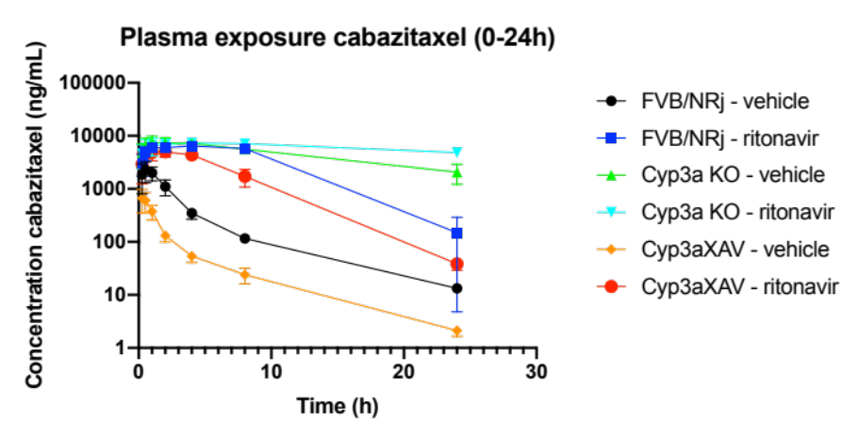
Oral Cabazitaxel (ModraCab/r) - Preclinical Development
Insights into the effect of CYP3A and orally administered ritonavir on the PK and tissue distribution of orally administered cabazitaxel
Ritonavir is able to enhance the plasma exposure of cabazitaxel
  Inhibition of CYP3A metabolism of cabazitaxel will slow down
Species difference between mice and human CYP3A activity human CYP3A more efficient and/or more abundant
FVB/NRj – WT mice
Cyp3a KO
Cyp3aXAV
Patients
Status
Human CYP3A in liver + intestine
Cabazitaxel + Ritonavir / Vehicle
Loos NHC et al. Mol. Pharmaceutics 2023 “Enhancement of the Oral Availability of Cabazitaxel Using the Cytochrome P450 3A (CYP3A) Inhibitor Ritonavir in Mice”

Slide 25
Exclusivity at Least Through Late 2030s
Issued
patent
Formulation & combination with ritonavir
Issued in major markets
Exclusivity through 2028/29
Patent
application
Extended use &
use in solid tumors
New patent allowed in US and Canada thru 12/2039
Exclusivity through early 2040s
Patent
application
Reversing
resistance
Filed Jan 2022
Exclusivity through mid 2040s
Additional data & marketing exclusivity periods from initial approval in US & Europe
Including 8+2 years exclusivity post approval in EU
Notes:
Improved visuals

Slide 26






Key Members of the Modra Team
Colin Freund, CEO
18+ years oncology biotech experience
QUE Oncology, Transgene, GPC Biotech, BCG
Prof. dr. Jan Schellens, MD, CMO
Former head of Clinical Pharmacology at the NKI
20+ years experience in oncology drug research
Co-founder, Modra
Eric van der Putten, Chief Business Officer
30+ years clinical research experience in oncology
Partner, Aglaia Oncology Funds
Prof. dr. Jos Beijnen, CTO
Head of hospital pharmacy at the Netherlands Cancer Institute
20+ years experience in drug formulation
Co-founder Modra
Marianne Keessen, Clinical Operations
15+ years oncology nursing
Project management at Netherlands Cancer Institute
Chris Huiskamp, CFO
20+ years international finance and operations experience
Medpace, Assign, Sourcia

Slide 27




Modra Supervisory Board
Karl Rothweiler, NL
Aglaia Oncology Fund
Klaus Schollmeier, DE
Suppremol
Santhera
Graffinity
Hemanshu Shah, US
Astellas
J&J
BMS
Transgene
Anton Berns, NL
NKI

Slide 28
Additional Images

Slide 29






Slide 30
